Slide 1
Collective Spatial Keyword Queries: A Distance Owner-Driven Approach
Cheng Long, Raymond Chi-Wing Wong: The Hong Kong University of Science and Technology
Ke Wang: Simon Fraser University
Ada Wai-Chee Fu: The Chinese University of Hong Kong
Prepared by Cheng Long
Presented by Cheng Long
1 July, 2013

Slide 2
Outline
Introduction
Contribution
Problem Definition
MaxSum-CoSKQ
Dia-CoSKQ
Experimental Results
Conclusion

Slide 3
Introduction: Spatial-textual data
Spatial + textual
Some examples
  Spatial points of interest
    E.g., restaurants, shopping malls and hotels.
  Geo-tagged web objects
    E.g., Geo-tagged photos at Flicker and geo-tagged docs.
  Geo-social networking data
    E.g., In FourSquare, each user has its checking-in history and profile.
  …

Slide 4
Introduction: Spatial Keyword Queries
Data: A set of spatial-textual objects
Input: a query location and several query keywords
Query goals:
  Spatial Keyword Top-k query / Reverse top-k query
    The score function
  Spatial Keyword kNN query
    Keyword covering constraint.
  Spatial Keyword Range query
    Keyword covering constraint.
  …
Spatially close & textually similar

Slide 5
Introduction: Collective Spatial Keyword Queries
The query keywords are diverse.
The no. of query keywords is large.
Spatial Keyword kNN query / range query
  A single object covers all the keywords.
  Not always possible!
Collective Spatial Keyword Query (CoSKQ)
  By Cao et al. SIGMOD’11
  It finds a set of objects that
    covers the query keywords collectively;
    has the smallest cost.
  Cost Functions
    LinearSum:
    MaxSum:
…
LinearSum-CoSKQ
Adequately solved!
NP-hard!
MaxSum-CoSKQ
Cao-Exact: Scalability issues!

Slide 6










Introduction: Motivation
N₁
The query keywords are t₁, t₂.
Each inner node covers both t₁, t₂.
N₂
N₃
N₂, N₃
Enumeration
Enumeration
N₄, N₇
N₄, N₈
N₅, N₇
N₅, N₈
N₆, N₇
N₆, N₈
o₅, o_{o}
o₅, o₁₀
o₆, o₉
o₆, o₁₀
Cao-Exact.
  Best-first search algorithm based on IR-tree.
  Not scalable!
  8M objects, 6 query keywords: more than 10 days!
IF₂
IF₁
IF₃
t₁: N₂, N₃
t₂: N₃
…
t₁: o₂, o₃
t₂: o₃
…
N₁
N₂
N₃
N₄
N₅
N₆
N₇
N₈
$$o_{1}$$
$$o_{2}$$
$$o_{3}$$
$$o_{4}$$
$$o_{5}$$
$$o_{6}$$
$$o_{7}$$
$$o_{8}$$
$$o_{9}$$
$$o_{10}$$
IF₄
IF₅
IF₆
IF₇
IF₈

Slide 7
Outline
Introduction
Contribution
Problem Definition
MaxSum-CoSKQ
Dia-CoSKQ
Experimental Results
Conclusion

Slide 8
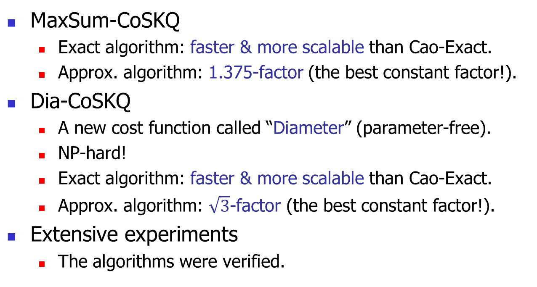
Contributions
MaxSum-CoSKQ
  Exact algorithm: faster & more scalable than Cao-Exact.
  Approx. algorithm: 1.375-factor (the best constant factor!).
Dia-CoSKQ
  A new cost function called “Diameter” (parameter-free).
  NP-hard!
  Exact algorithm: faster & more scalable than Cao-Exact.
  Approx. algorithm: $\sqrt{3}$-factor (the best constant factor!).
Extensive experiments
  The algorithms were verified.

Slide 9
Outline
Introduction
Contribution
Problem Definition
MaxSum-CoSKQ
Dia-CoSKQ
Experimental Results
Conclusion

Slide 10
Problem Definition (1)
q: the query
  A location
  A set of keywords
O: the set of spatial objects, each has
  A location
  A set of keywords
Collective Spatial Keyword Query (CoSKQ): Find a set S of objects such that
  S covers the set of query keywords;
  the cost of S, denoted by cost(S) (defined later), is the smallest.
Relevant object
S is feasible

Slide 11
Problem Definition (2)
MaxSum Cost
  linear combination of two max components
    max(S, q) and max(S, S)
  cost_{MaxSum}(S) = a * max(S, q) + (1-a) * max(S, S)
  Following the convention, we set a = 0.5 by default.
  cost_{MaxSum}(S) = max(S, q) + max(S, S)
Diameter Cost
  max(S, q) vs. max(S, S)
  Use a “max” operation!
  cost_{Dia}(S) = max{max(S, q), max(S, S)}

Slide 12
Outline
Introduction
Contribution
Problem Definition
MaxSum-CoSKQ
  Finding Optimal Solution: MaxSum-Exact
  Finding Approximate solution: MaxSum-Appro
Dia-CoSKQ
Experimental Results
Conclusion

Slide 13





MaxSum-CoSKQ: Finding Optimal Solutions (1)
Cost function: Cost(S) = max(S, q) + max(S, S)
  max(S, q)
  Query distance owner
  max(S, S)
Some basic concepts
  Query distance owner
  Pairwise distance owner
  Distance owner group (o, o₁, o₂)
  (o, o₁, o₂)-consistency
Key observation
  One “distance owner group” usually corresponds to many feasible sets!
$$o$$
$$o_{1}$$
$$q$$
$$o_{2}$$
  Pairwise distance owner
  Pairwise distance owner
$$o$$
$$o$$
$$o$$
$$o_{1}$$
$$o_{1}$$
$$o_{1}$$
Same distance owner group (o, o₁, o₂)
…
$$q$$
$$o_{2}$$
$$q$$
$$o_{2}$$
$$q$$
$$o_{2}$$

Slide 14
MaxSum-CoSKQ: Finding Optimal Solutions (2)
Collective Spatial Keyword Query (CoSKQ):
Find a set S of objects such that
  S is feasible;
  the cost of cost(S) is minimized.
The size is exponential in terms of the number of relevant objects!
Feasible set space
Cao-Exact
S₁
S₂
S₃
…
S_{n}
Distance owner group space
  Search directly!
Distance owner-driven approach
(,,)₁
(,,)₂
…
(,,)_{m}
The size is cubic in terms of the number of relevant objects.

Slide 15
MaxSum-CoSKQ: Finding Optimal Solutions (2)
  A subset of the triplet space
Feasible set space
A distance owner-driven approach
For each triplet (o, o₁, o₂)
  If there exists a feasible set S’ which is (o, o₁, o₂)-consistent then
Return S
S₁
S₂
S₃
…
S_{n}
Issue 1: How to search over the “triplet” space?
  A straightforward one checks cubic candidates!
  Pruning!
Issue 2: How to check for a triplet (o, o₁, o₂) whether there exists a feasible set S’ which is (o, o₁, o₂)-consistent?
  Should be efficient!
Maintain a best-known feasible set S
Issue 1
Issue 2
Distance owner group space
(,,)₁
(,,)₂
…
(,,)_{m}
    S ← S’ if cost(S’) < cost(S)

Slide 16
Issue 1: How to search over the “triplet” space?
A distance owner-driven approach
Maintain a best-known feasible set S
For each triplet (o, o_{1,} o₂)
  If there exists a feasible set S’ which is (o, o₁, o₂)-consistent then
    S ← S’ if cost(S’) < cost(S)
Return S
Issue 1
Not all relevant objects need to be considered as the candidates of the query distance o.
  o cannot be too close to q.
    Lower bound of d(o, q)
    d(o, q) ≥ r_{min} = d(o_{f}, q), o_{f} is the farthest keyword NN from q.
  Objects that are too far away from q can be ignored.
    Upper bound of d(o, q)
    d(o, q) ≤ r_{max} = cost(S)
  A “ring” region, R(S).

Slide 17
Issue 1: How to search over the “triplet” space?
A distance owner-driven approach
Maintain a best-known feasible set S
For each triplet (o, o_{1,} o₂)
  If there exists a feasible set S’ which is (o, o₁, o₂)-consistent then
    S ← S’ if cost(S’) < cost(S)
Return S
Issue 1
Once the candidate of the query distance owner, says o, is fixed, the pairwise distance owners o₁ and o₂ are constrained.
  Restricted in Disk(q, d(o, q))!
  d(o₁, o₂) cannot be too small!
    Lower bound of d(o₁, o₂):
    d(o₁, o₂) ≥ d_{min} = d(o, q) – min{d(o₁, q), d(o₂, q)}
    triangle inequality
  Those with large d(o₁, o₂) can be pruned!
    Upper bound of d(o₁, o₂)
    d(o₁, o₂) ≥ d_{max} = cost(S) – d(o, q)
    Best-known solution S

Slide 18
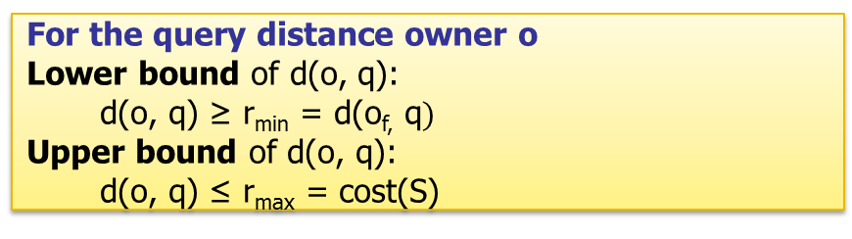
Issue 1: How to search over the “triplet” space?
A distance owner-driven approach
Maintain a best-known feasible set S
For each triplet (o, o_{1,} o₂)
  If there exists a feasible set S’ which is (o, o₁, o₂)-consistent then
    S ← S’ if cost(S’) < cost(S)
Return S
Issue 1
Candidates of o:
  Ring region R(S)
  Ascending order of the distances from q.
For each candidate of o, the candidates of o₁ and o₂:
  Disk(q, d(o, q))
For the query distance owner o
Lower bound of d(o, q):
  d(o, q) ≥ r_{min} = d(o_{f,} q$)$
Upper bound of d(o, q):
  d(o, q) ≤ r_{max} = cost(S)
The ring shrinks progressively!
For the pairwise distance owner o₁, o₂:
Lower bound of d(o₁, o₂)
  d(o₁, o₂) ≥ d_{min} = d(o, q) – min{d(o₁, q), d(o₂, q)}
Upper bound of d(o₁, o₂)
  d(o₁, o₂) ≤ d_{max} = cost(S) – d(o, q)

Slide 19




Issue 2: How to check for a triplet (o, o₁, o₂) whether there exists a feasible set S’ which is (o, o₁, o₂)-consistent?
A distance owner-driven approach
Maintain a best-known feasible set S
For each triplet (o, o_{1,} o₂)
  If there exists a feasible set S’ which is (o, o₁, o₂)-consistent then
    S ← S’ if cost(S’) < cost(S)
Return S
Issue 2
Restrictions on S’ (if it exists)
  d(o₁, o₂) ≥ d(o, o₁)
  d(o₁, o₂) ≥ d(o, o₂)
  S’ is inside Disk(o, d(o, q))
  S’ is inside Disk(o₁, d(o₁, o₂))
  S’ is inside Disk(o₂, d(o₁, o₂))
  S’ covers the query keywords.
Exhaustive search for S’ in the intersection of the three disks with the above restrictions!
  If it succeeds, return S’;
  Otherwise, we know that S’ does not exist!
D(o₁, d(o₁, o₂))
D(o₂, d(o₁, o₂))
$$o$$
$$o_{1}$$
$$o_{2}$$
$$q$$
D(q, d(o, q))
Inverted file could be utilized here.
With the two issues fixed, MaxSum-Exact is complete!

Slide 20
Outline
Introduction
Contribution
Problem Definition
MaxSum-CoSKQ
  Finding Optimal Solution: MaxSum-Exact
  Finding Approximate solution: MaxSum-Appro
Dia-CoSKQ
Experimental Results
Conclusion

Slide 21


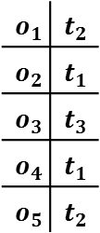
MaxSum-CoSKQ: Finding Approximate Solution (1)
Constrained NN
  - region
  - keyword
o-neighborhood feasible set
  The set containing all Disk(o, d(o, q))-constrained keyword t-NN for each query keyword t.
  E.g., o₃-neighborhood feasible set
    For t₁: Disk(o₃, d(o₃, q))-constrained keyword t₁-NN is o₂.
    For t₂: Disk(o₃, d(o₃, q))-constrained keyword t₂-NN is o₅.
    For t₃: Disk(o₃, d(o₃, q))-constrained keyword t₃-NN is o₃.
$$q$$ | $t_{1}$, $t_{2}$, $t_{3}$
$$o_{1}$$
$$o_{2}$$
$$o_{1}$$ | $$t_{2}$$
$$o_{2}$$ | $$t_{1}$$
$$o_{3}$$ | $$t_{3}$$
$$o_{4}$$ | $$t_{1}$$
$$o_{5}$$ | $$t_{2}$$
$$o_{4}$$
o₃-neighborhood feasible set
is {o₂, o₃, o₅}.
$$o_{3}$$
$$o_{5}$$
$$q$$

Slide 22
MaxSum-CoSKQ: Finding Approximate Solution (1)
Algorithm: MaxSum-Appro
A distance owner-driven approach
Maintain a best-known feasible set S
For each triplet (o, o_{1,} o₂)
  If there exists a feasible set S’ which is (o, o₁, o₂)-consistent then
    S ← S’ if cost(S’) < cost(S)
Return S
The costly part
For each relevant object o in R(S)
S’ ← the o-neighborhood feasible set

Slide 23
MaxSum-CoSKQ: Finding Approximate Solution (2)
Algorithm: MaxSum-Appro
A distance owner-driven approach
Maintain a best-known feasible set S
For each triplet (o, o_{1,} o₂)
  If there exists a feasible set S’ which is (o, o₁, o₂)-consistent then
    S ← S’ if cost(S’) < cost(S)
Return S
For each relevant object o in R(S)
S’ ← the o-neighborhood feasible set
Approximation bound
  MaxSum-Appro is a 1.375-factor approximation.
  Refer to our paper for the proof if you are interested.
Time complexity
  O(n_{r}* |q| * log |O|)
  It has the same as the worst-case time complexity as Cao-Appro2, but a smaller approximation factor (1.375-factor vs. 2-factor).

Slide 24
Outline
Introduction
Contribution
Problem Definition
MaxSum-CoSKQ
Dia-CoSKQ
Experimental Results
Conclusion

Slide 25
Dia-CoSKQ (1): Finding Exact Solutions
cost_{Dia}(S) = max{max(S, q), max(S, S)}
  max(S, q): determined by the query distance owner
  max(S, S): determined by the pairwise distance owners
  Dominated by the “distance owner group” of S
We can apply the distance owner-driven approach to the Dia-CoSKQ problem!
  with several updates.
Pairwise Distance Owner o₁, o₂:
Lower bound of d(o₁, o₂)
  d(o₁, o₂) ≥ d_{min} = d(o, q) – min{d(o₁, q), d(o₂, q)}
Upper bound of d(o₁, o₂)
  d(o₁, o₂) ≤ d_{max} = cost(S) – d(o, q)
d(o, q)
cost(S)

Slide 26

Dia-CoSKQ (2): Finding Approximate Solution
Dia-Appro:
  The MaxSum-Appro algorithm with its cost measurement changed to cost_{Dia}(S).
  It provides a $\sqrt{3}$-factor approximation.
  Same time complexity as MaxSum-Appro.

Slide 27
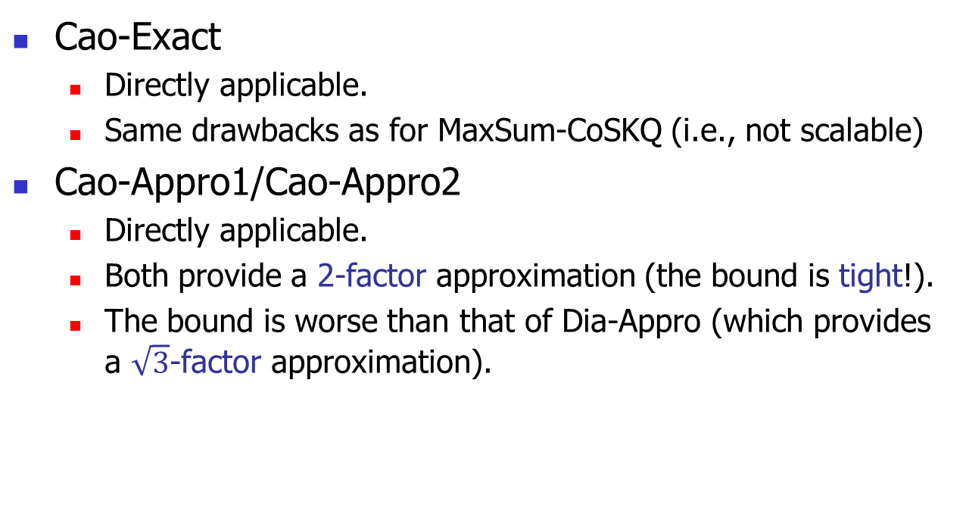
Dia-CoSKQ (3): Adaptions of Existing Solutions
Cao-Exact
  Directly applicable.
  Same drawbacks as for MaxSum-CoSKQ (i.e., not scalable)
Cao-Appro1/Cao-Appro2
  Directly applicable.
  Both provide a 2-factor approximation (the bound is tight!).
  The bound is worse than that of Dia-Appro (which provides a $\sqrt{3}$-factor approximation).

Slide 28
Outline
Introduction
Contribution
Problem Definition
MaxSum-CoSKQ
Dia-CoSKQ
Experimental Results
Conclusion

Slide 29
Experimental Results: Set-Up
 | GN | Web | Hotel
No. of objects | 1,868,821 | 579,727 | 20,790
No. of unique words | 222,409 | 2,899,175 | 602
No. of words | 18,374,228 | 249,132,88 | 80,845
Datasets:
  GN, Web and Hotel (the same datasets as used by Cao et al.)
Query Generation
  Location and query keywords
Algorithms
  MaxSum-CoSKQ: Cao-Exact, Cao-Appro1, Cao-Appro2, MaxSum-Exact, MaxSum-Appro
  Dia-CoSKQ: Cao-Exact, Cao-Appro1, Cao-Appro2, Dia-Exact, Dia-Appro
Factors & Measures
  No. of query keywords and no. of average keywords contained by an object
  Running time and approximation error

Slide 30
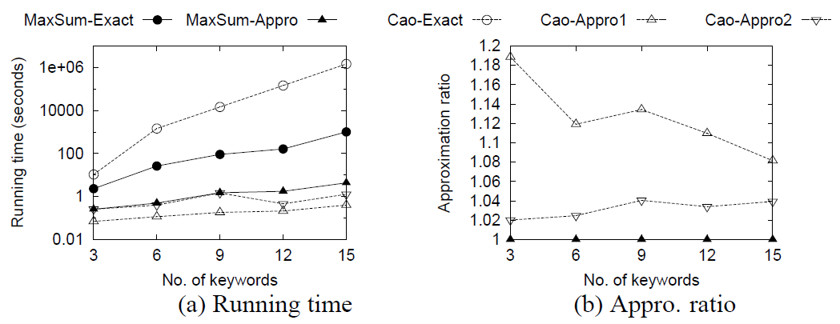
Experimental Results: Performance Study (1)
MaxSum-Exact runs faster than Cao-Exact by up to 3 orders of magnitude.
Problem: MaxSum-CoSKQ
Dataset: Web
Factor: |q.𝜑|
Our MaxSum-Appro runs fast and is comparable with Cao-Appro2.
Our MaxSum-Appro returns near-to-optimal solution.

Slide 31
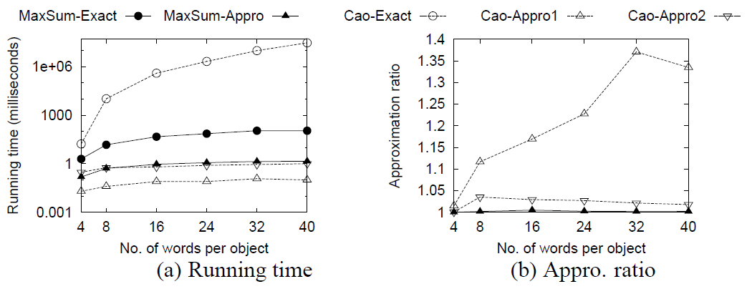
Experimental Results: Performance Study (2)
Problem: MaxSum-CoSKQ
Dataset: Web
Factor: |o.𝜑|
Cao-Exact is not scalable wrt |o.𝜑|.
Our MaxSum-Exact is scalable wrt | o.𝜑|.

Slide 32
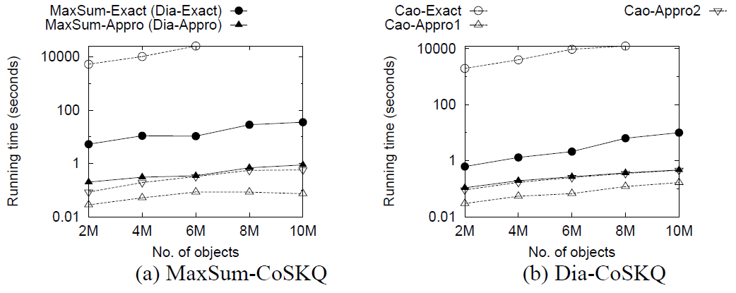
Experimental Results: Performance Study (3)
Cao-Exact runs more than 10 days when the data size is abut 8 millions!
Problem: MaxSum-CoSKQ and Dia-CoSKQ
Dataset: GN
Scalability test.
MaxSum-Exact is still fast (≤100 s) when the data size is millions.
MaxSum-Appro runs in real time (≤1 s).

Slide 33
Outline
Introduction
Contribution
Problem Definition
MaxSum-CoSKQ
Dia-CoSKQ
Experimental Results
Conclusion

Slide 34
Conclusion
Collective Spatial Keyword Query problem
A distance owner-driven approach.
Exact and approximate algorithms.
Extensive experiments.

Slide 35
My research interest
Databases Queries and/or Data Mining on
  Spatial data
    E.g., spatial matching [SIGMOD’13]
  Spatial-textual data
    E.g., spatial keyword query [SIGMOD’13]
  Trajectory data
    E.g., trajectory compression [VLDB’13]
  Social network data
    E.g., viral marketing [ICDM’11]
  Graph
    E.g., shortest path queries etc.

Slide 36
Q & A

