Slide 1
Direction-Preserving Trajectory Simplification
Cheng Long, Raymond Chi-Wing Wong
The Hong Kong University of Science and Technology
H. V. Jagadish:
University of Michigan
29 August, 2013

Slide 2





Trajectory data
Trajectory data is ubiquitous.
  Popularity of GPS-embedded devices, e.g., smart phones, tablets, etc.
Many applications.

Slide 3





A few notions first
Position
  $p_{1}$, $p_{2}$, $p_{3}$, $p_{4}$
Segment
  $\overline{p_{1}p_{2}}$, $\overline{p_{2}p_{3}}$, $\overline{p_{3}p_{4}}$
Size
  Number of positions
$$p_{3}$$
$$p_{4}$$
$$p_{1}$$
$$p_{2}$$

Slide 4
Raw trajectory data is usually of large volume
Illustrating Example
  10,000 taxis
  Sample a position every 5 seconds
  Volume: 5 GB per day!
Issues:
  Storage
  Query processing
trajectory simplification

Slide 5













Trajectory simplification: a rough view
Trajectory simplification
  keep the first and the last positions
  drop some positions in-between.
Error
$$p_{3}$$
$$p_{4}$$
Drop $p_{2}$
$$p_{1}$$
$$p_{3}$$
$$p_{4}$$
$$p_{4}$$
Drop $p_{3}$
$$p_{1}$$
$$p_{2}$$
$$p_{1}$$
$$p_{2}$$
$$p_{4}$$
Drop $p_{2}$, $p_{3}$
$$p_{1}$$

Slide 6
















Existing Trajectory Simplification techniques
Position-Preserving Trajectory Simplification (PPTS)
  Position-based error measurement
  Problem
$$p_{3}$$
($p_{3}′$)
$$p_{3}$$
T
T’
$$p_{2}′$$
$$p_{4}$$
($p_{4}′$)
$$p_{4}$$
Drop $p_{2}$
$$p_{1}$$
($p_{1}′$)
$$p_{2}$$
$$p_{1}$$
$$p_{2}$$
Position error = max{ , , , }
$$dist(p_{1},p_{1}′)$$
$$dist(p_{2},p_{2}′)$$
$$dist(p_{3},p_{3}′)$$
$$dist(p_{4},p_{4}′)$$

Slide 7














Is PPTS always good?
Position-preserving trajectory simplification
Direction-preserving trajectory simplification
Simplified trajectory (via PPTS)
Simplified trajectory
(via DPTS)
Original trajectories
T₁
$$p_{3}$$
T₁’
T₁’’
$$p_{3}$$
$$p_{4}$$
$$p_{4}$$
$$p_{4}$$
$$p_{1}$$
$$p_{2}$$
$$p_{1}$$
$$p_{2}$$
$$p_{1}$$
T₂
$$p_{3}$$
T₂’
$$p_{3}$$
T₂’’
$$p_{3}$$
$$p_{4}$$
$$p_{4}$$
$$p_{4}$$
$$p_{1}$$
$$p_{2}$$
$$p_{1}$$
$$p_{1}$$
T₃
T₃’
T₃’’
$$p_{4}$$
$$p_{4}$$
$$p_{2}$$
$$p_{4}$$
$$p_{2}$$
$$p_{1}$$
$$p_{3}$$
$$p_{1}$$
$$p_{3}$$
$$p_{1}$$
Notes:
This is verified in our empirical studies.

Slide 8




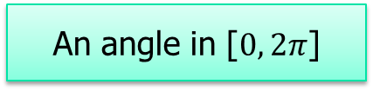




What is “direction information” of a trajectory?
An angle in [$0, 2π$]
$$p_{3}$$
$$π/2$$
$$p_{4}$$
$$π/2$$
$$p_{1}$$
$$p_{2}$$
$$0$$
$$3π/2$$

Slide 9
Why should we preserve the “direction information”?
The “direction information” is heavily used, both directly and indirectly, in a wide range of applications on trajectory data.
Some examples include:
  Map matching:
    Road’s orientations vs. trajectory’s directions.
    [VLDB’05, SSDBM’04]
  Knowledge discovery on trajectory data:
    Clustering [SIGMOD’07, VLDBJ’11], Classification [VLDB’08], Outlier-detection [ICDE’08].
  Direction-based query processing:
    Direction-constrained trajectory search [IDEAS’04], direction-based similarity search [TIME’07].

Slide 10



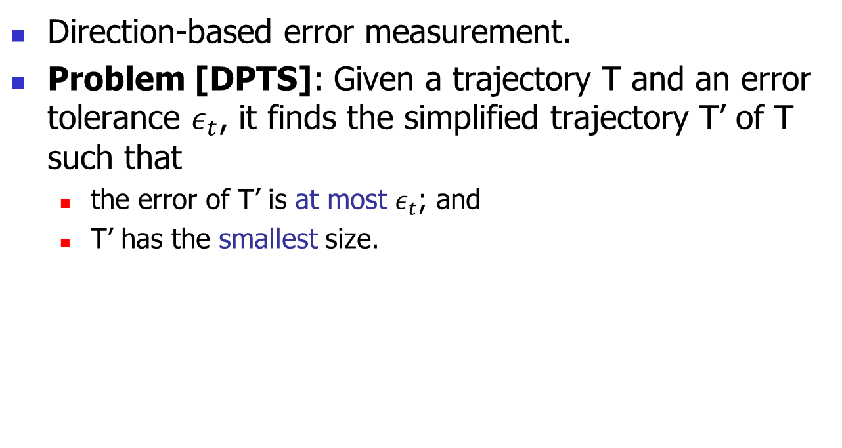












How to preserve the “direction information”?
Direction-based error measurement.
Problem [DPTS]: Given a trajectory T and an error tolerance $ε_{t}$, it finds the simplified trajectory T’ of T such that
  the error of T’ is at most $ε_{t}$; and
  T’ has the smallest size.
$$p_{3}$$
$$p_{3}$$
T
T’
$$p_{4}$$
$$p_{4}$$
Drop $p_{2}$
$$p_{1}$$
$$p_{2}$$
$$p_{1}$$
$$p_{2}$$
$$π/9$$
$$π/6$$
$$0$$
Direction error of T’= max{ , , }
$$π/9$$
$$π/6$$
$$0$$

Slide 11
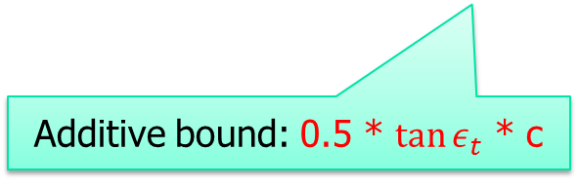

DPTS: A comparison with PPTS
PPTS
DPTS
Length/speed Error
Position-based Error
Direction-based Error
Y
N
N
Y
Y
Y
Additive bound: 0.5 * $\tan{ε_{t}}$ * c
N: un-bounded
Y: bounded
Multiplicative bound: $\cos{ε_{t}}$

Slide 12
DPTS: Our proposed algorithms
Exact algorithms
  DP
    Dynamic programming.
    Time O(n³), space O(n²).
  SP
    Three-step algorithm.
    Basic version: time O(n³), space O(n²).
    Enhanced version: time O(Cn²), space O(n).
Approximate algorithm
  Intersect
    Complexities: time O(n), space O(n).
    Quality guarantee.

Slide 13
DPTS: Experimental study
Datasets:
  Deer, Elk, Hurricane, Geolife and T-Drive
Verification of DPTS
  Theoretical bounds of speed/length error, position error, and direction error of DPTS.
  DPTS is better than PPTS in a clustering application.
Performance study of algorithms
  SP is usually 3 orders of magnitude faster than DP.
  Intersect is scalable and the practical approximation factor is usually smaller than 1.5.

Slide 14
Conclusion
A new notion: DPTS
A rich set of algorithms: DP, SP, Intersect
Extensive experiments

Slide 15
Q & A

