Slide 1
Frequent Item Mining When Obtaining Support is Costly
Joe Wing-Ho Lin and Raymond Chi-Wing Wong
The Hong Kong University of Science and Technology
{whlinaa,raywong}@cse.ust.hk

Slide 2
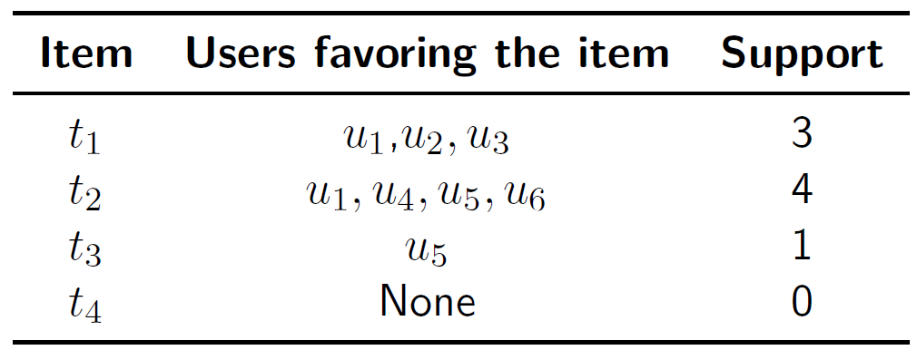
Introduction
Study a new problem:
  Given users and items, find all items favored by at least a given number of users.
  Example:
Remark: users’ preferences are unknown initially.
Aim: ask as few users as possible.
Notes:
we study a new problem that's highly related to the frequent item mining problem in data mining.
Let me begin by defining my problem and then we'll able to see the differences between these two problems.
So in our problem, we're given two sets, a set of users, and a set of items, and our aim is to discover all the items that are favored by at least a given # of users. And we usually this number as the threshold.
By favor, I mean the best choice. So, if a user favors an item, that means this item is the best choice of that user.
And we call each returned item as a frequent item.
So, in this example, if we set the threshold to 2, then we should only return items t_1 and t_2, because their support is larger than the threshold. But we shouldn't return items 3 or 4, because their support is lower than 2.
But the challenge is, in reality, the last two columns are initially hidden to us, because we don't know the preferences of the users initially until we ask them about it, and so these two columns are initially hidden.
And so this is the difference between our problem and the frequent mining problem. In traditional frequent item mining, we assume the whole table is given, but in our new problem, we assume the users’ favorite items are hidden to us.
And so, our aim is to find all frequent items, but at the same time we want to ask as few users about their preferences as possible, because asking about the preferences of a user is typically a costly operation.

Slide 3
Agenda
Related Work
Applications
Problem Definition
Algorithms
Experiments

Slide 4
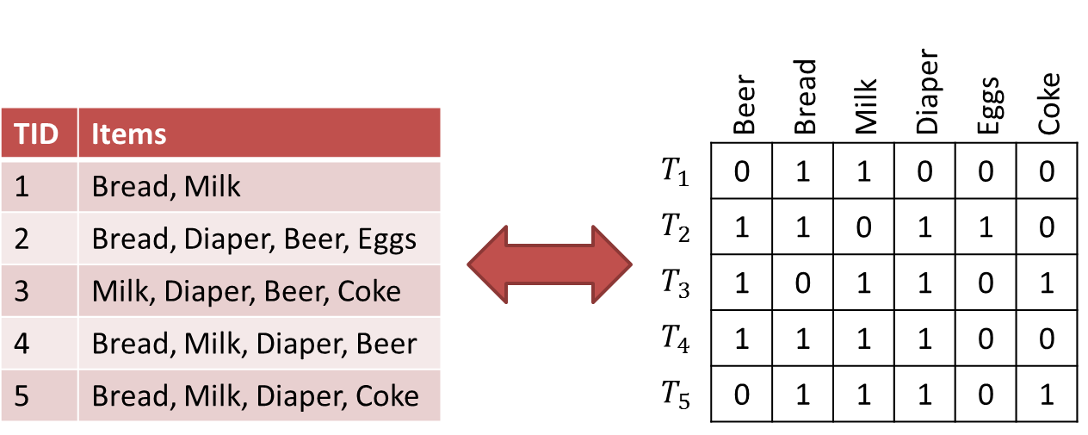
Frequent item mining
Definition: given items and transactions, find all itemsets that appear in at least a predefined number of transactions [1].
Establishing relation: view favorite items of a user as a transaction.
Difference with our problem:
  Transactions known beforehand.
Notes:
To see the correspondence between our problem and FIM, we can view the favorite items of a particular user in our problem as a transaction in the traditional FIM problem. But as we said, what distinguishes our problem is that we don’t assume the favorite items are known in advance.

Slide 5
Heavy hitter finding
Definition: essentially frequent item mining, but transactions come as a data stream [2].
Difference with our problem:
  Also assumes transactions are known.
Notes:
So, another problem that's related to ours is Heavy hitter finding. This problem is basically frequent item mining, but the transactions in this problem come as a data stream. This is the major difference. This problem is different from our problem because it also assumes that the transactions are given when they arrive.

Slide 6
Estimating population proportions
Definition: given users and categories. Each user belongs to ONE category only. Estimate the proportion of each category [3].
Differences with our problem:
  assumes each user favors one item only.
  existing solutions make extra statistical assumptions.
Can solve a special case of our problem.
Notes:
Another problem that's highly related to our problem is the estimating population proportion problem in statistics, particularly survey sampling.
In this problem, we’re given a set of user and a set of categories (or items in the language of our problem), and each user belongs to exactly one category, the aim is to estimate the proportion of users belonging
to each category.
There are two crucial differences between the two problems:
In our problem, a user is allowed to favor multiple items, but in the survey sampling problem, each user can favor only one item. Therefore, our problem is far more general than its counterpart.
(2) they make quite a few statistical assumptions when they derive their solutions to the survey sampling problem. For example, they assume that the data is normally distributed. And they also assume that a term called the finite population correction factor can be ignored in their derivation. But our solution will not make these kind of assumptions. And so our solution is much more general.
Still, their problem can solve a special case of our problem, when each user favors exactly one item. But even in this special case, our solution requires a much smaller sample than the state-of-the-art solutions. We'll make a comparison shortly.
An intuitive way to understand why we can do better is that in their problem, they want to know the exact proportion of each category, but our problem aims only to discover which categories have a proportion exceeding a predetermined value.

Slide 7
Agenda
Related Work
Applications
Problem Definition
Algorithms
Experiments

Slide 8

Marketing survey
Helps various industries discover most popular products.
  E.g., identify popular movie actors to promote their movies.
Notes:
one obvious application of our problem is to help various industries to identify their most popular products. For example, IMDB may want to use our problem to help identify those movie actors (items) who are very popular among visitors (users) and then promote the movies of the popular movie actors.
But you may be aware that there are some movie recommendations in IMDb. For example, this is (CLICK THE PICTURE) a list of 250 most popular movies. But in fact, the movies identified by our problem may not necessarily appear in this list, because some movies of the popular actors may not be well-known, but these movies do have a very high potential to become popular if we promote them, because many people like the movie actors. And so, our problem can identify items that are not yet popular, but they do have high potential to become popular if we do some promotion.

Slide 9

Sponsored search
Helps search engine companies uncover popular ads.
Given search terms (users) and ads (items), identify ads that receive highest score (i.e., Adrank) from many search terms.
  Benefit both engine companies and advertisers.
Notes:
Our problem can also help search engine companies identify popular ads.
Specifically, we identify the ads that receive the highest score (or Adrank, as it is called in the literature) from many search terms. Those ads would therefore be shown frequently to users when they type in keywords appearing in the engine company’s search term set.
Why should we discover popular ads?
1) On the companies’ side, they may want to raise the price they charge for popular ads to increase their revenue.
2) On the advertisers’ side, search engine companies can inform those advertisers that their ads are frequently shown to prospective customers. Given this assurance, those advertisers would more likely to keep advertising in the search engines.
Our problem can also be applied to crowdsourcing, and this is explained in the paper.

Slide 10
Agenda
Related Work
Applications
Problem Definition
Algorithms
Experiments

Slide 11
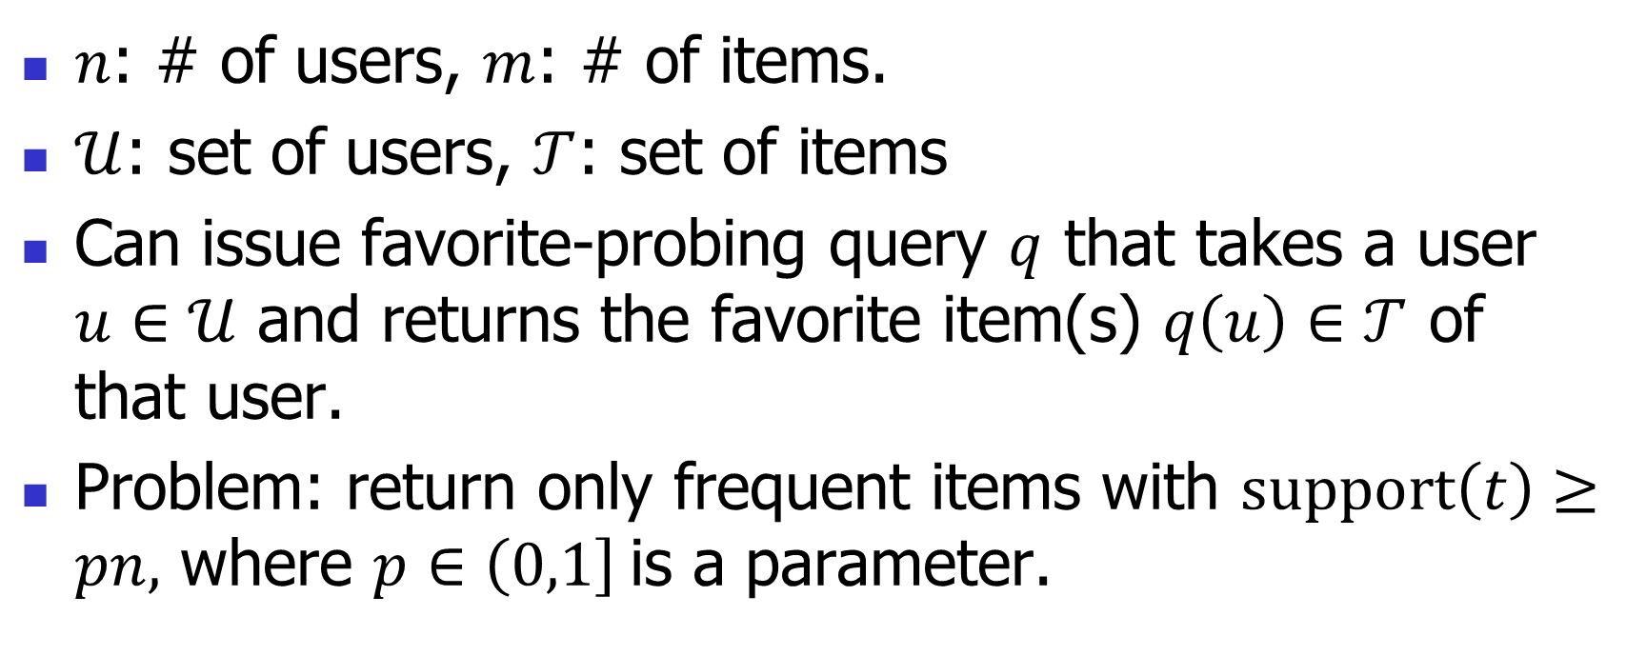
Problem definition
$n$: # of users, $m$: # of items.
$𝒰$: set of users, $𝒯$: set of items
Can issue favorite-probing query $q$ that takes a user $u∈𝒰$ and returns the favorite item(s) $q\left(u\right)∈𝒯$ of that user.
Problem: return only frequent items with $support\left(t\right)≥pn,$ where $p∈\left(0,1\right]$is a parameter.
Notes:
But this problem is challenging in the sense that if we want an exact solution, it can be shown that we need to obtain the preferences of all users. And so our problem actually has a worst-case lower bound of n queries.
And that's why we want an approximation solution, but what performance guarantee do we want achieve? (Next slide)

Slide 12
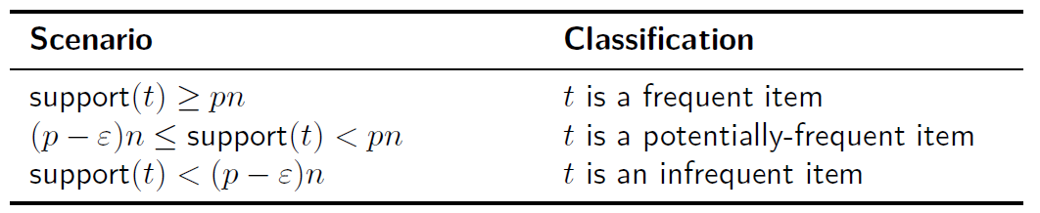
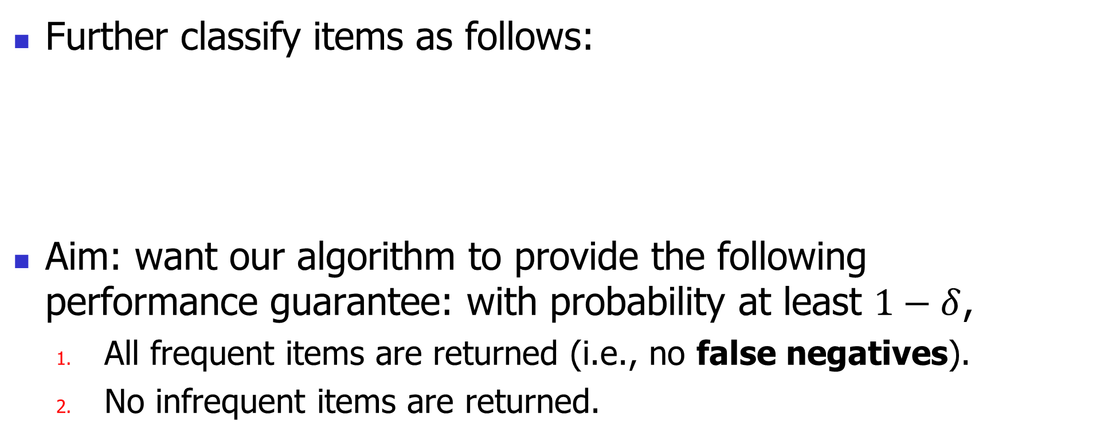
Approximation guarantee
Further classify items as follows:
Aim: want our algorithm to provide the following performance guarantee: with probability at least $1−δ$,
  All frequent items are returned (i.e., no false negatives).
  No infrequent items are returned.
Notes:
First of all, I want to further classify the items into three categories.
The epsilon (error parameter) here is a user-defined parameter
The aim implies that our alg’m may return some items with support close to that of a frequent item.

Slide 13
Agenda
Related Work
Applications
Problem Definition
Algorithms
Experiments

Slide 14
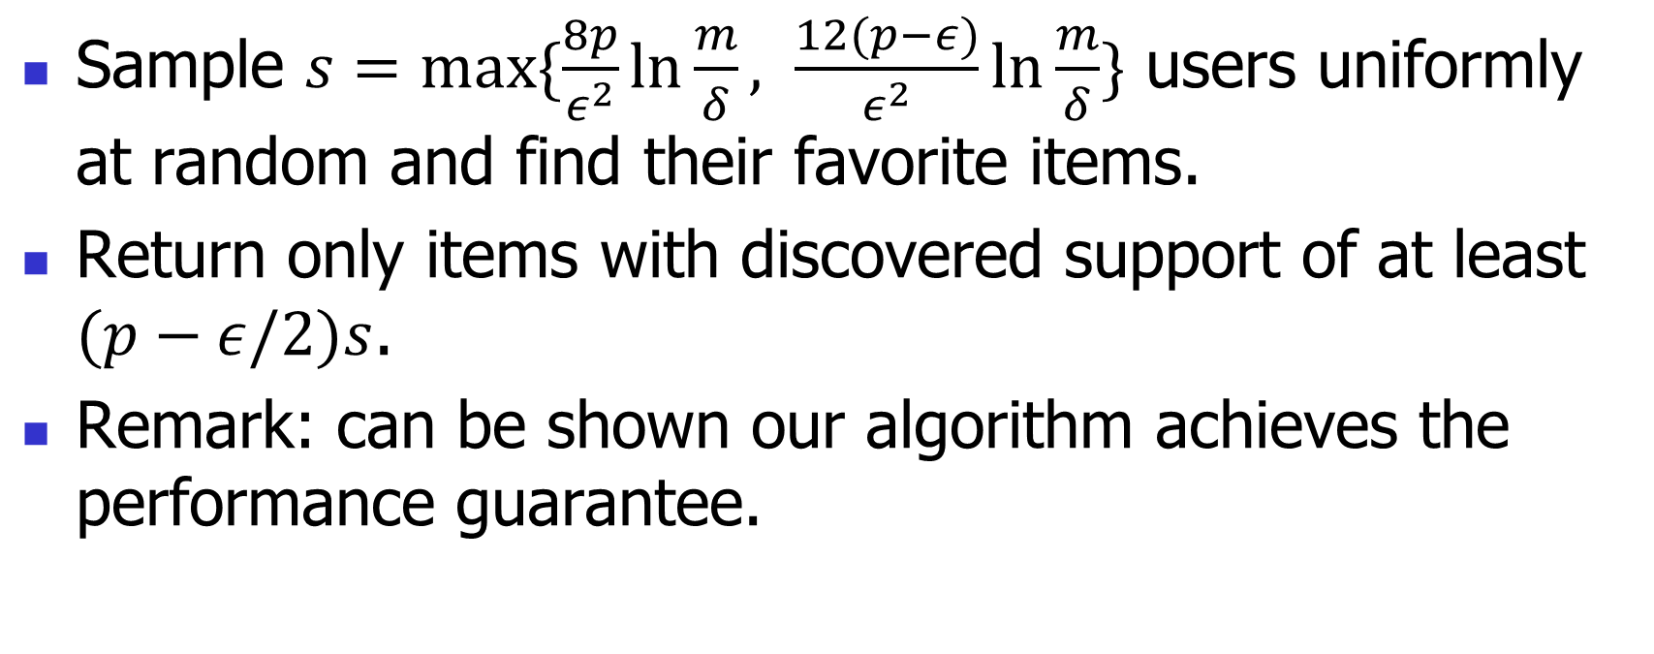
Algorithm: Support sampling
Sample $s=max⁡\{\frac{8p}{ε^{2}}\ln{\frac{m}{δ}}, \frac{12(p−ε)}{ε^{2}}\ln{\frac{m}{δ}}\}$ users uniformly at random and find their favorite items.
Return only items with discovered support of at least $(p−ε/2)s$.
Remark: can be shown our algorithm achieves the performance guarantee.
Notes:
$δ$ in s is the failure parameter, usually set at 1% or 5%.
We will provide ideas for proving that our algorithm achieves the performance guarantee by sampling s users. Full proof can be found in the paper. But first let’s compare our sample size s with that of the survey sampling method.
[ Why not just return items with discovered support >= (p-$ε$)s ? Because some infrequent items will likely be returned this way, making it hard to fulfil the performance guarantee. This can be deduced from the fig on p17 ]

Slide 15
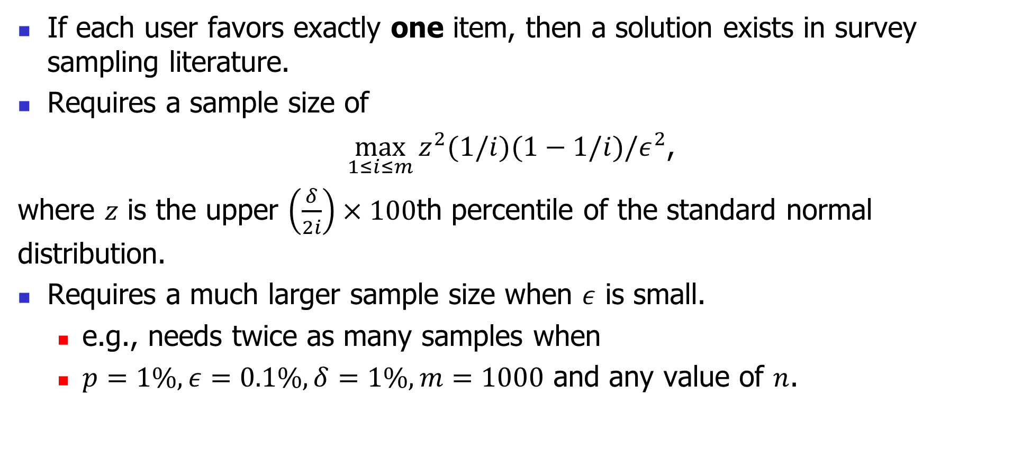
Comparison: Method in survey sampling
If each user favors exactly one item, then a solution exists in survey sampling literature.
Requires a sample size of
$\max_{1≤i≤m}{z^{2}(1/i)(1−1/i)/ε^{2}}$,
where $z$ is the upper $\left(\frac{δ}{2i}\right)×100$th percentile of the standard normal distribution.
Requires a much larger sample size when $ε$ is small.
  e.g., needs twice as many samples when
  $p=1\%, ε=0.1\%, δ=1\%, m=1000$ and any value of $n$.
Notes:
As we said, if each user favors exactly one item, then a solution already exists in survey sampling. Here is the sample size they need.
The sample size is much larger than ours when epsilon is small, which is usually the case.
The existing solution is also derived based on a number of assumptions, eg: normality of the data and the finite population correction can be ignored.
Our result is free of these assumptions.
Also, it is difficult to evaluate the sample size above, because it is a maximization problem.

Slide 16
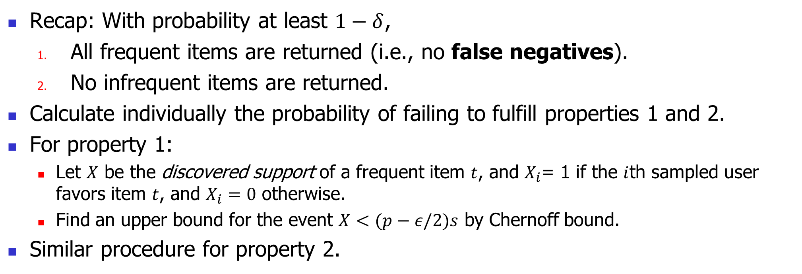
Proof idea
Recap: With probability at least $1−δ$,
  All frequent items are returned (i.e., no false negatives).
  No infrequent items are returned.
Calculate individually the probability of failing to fulfill properties 1 and 2.
For property 1:
  Let $X$ be the discovered support of a frequent item $t$, and $X_{i}$= 1 if the $i$th sampled user favors item $t$, and $X_{i}=0$ otherwise.
  Find an upper bound for the event $X<(p−ε/2)s$ by Chernoff bound.
Similar procedure for property 2.
Notes:
Finally, we use union bound to find an upper bound for the probability that our algorithm fails (i.e., either property 1 or property is violated)

Slide 17
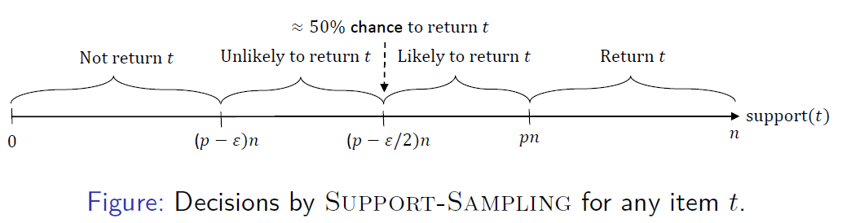
Further results
Notes:
In our paper we have some further results to determine how likely an item will be returned, and it is summarized it the figure above.
This figure is derived with the assumption that our algorithm succeeds in providing the performance guarantee ( remark: success with probability = 1-delta, and delta can be set extremely small, with little effect on the sample size)
The takeaway: if a potentially-frequent item is returned, then it is likely that it has a support >= (p-epsilon/2)n. This is a good attribute of your algorithm because of course we want those potentially-frequent with higher support.

Slide 18
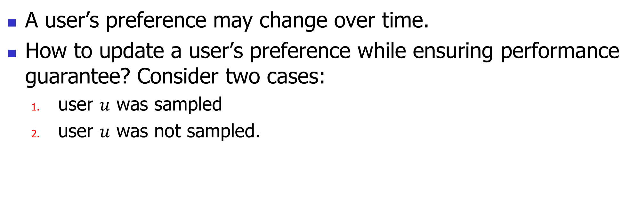
Update of user preferences
A user’s preference may change over time.
How to update a user’s preference while ensuring performance guarantee? Consider two cases:
  user $u$ was sampled
  user $u$ was not sampled.
Notes:
In the sponsored search application, the score that a search term assigns to an ad will change accordingly whenever an advertiser concerned adjusts the bid price for that ad.
So, in general, we need a fast procedure to update our result when there is a change in user preference because users’ preference do change frequently.
Fortunately, we can handle update very easily because of the simplicity of our algorithm.
Case 1: If turns out the user was actually sampled, we just issue a new query to identify the new favorite items of that user. We don’t need to issue any other queries because the preference update of that user will be affect the selection probability of other users. That is, the selection probability depends only on the number of users, and nothing else.
Case 2: If the user was not sampled, then we do nothing, because the preference of that user will not be considered with or without a score function update, since selection probability is independent of a user’s preference.

Slide 19
Agenda
Related Work
Applications
Problem Definition
Algorithms
Experiments

Slide 20
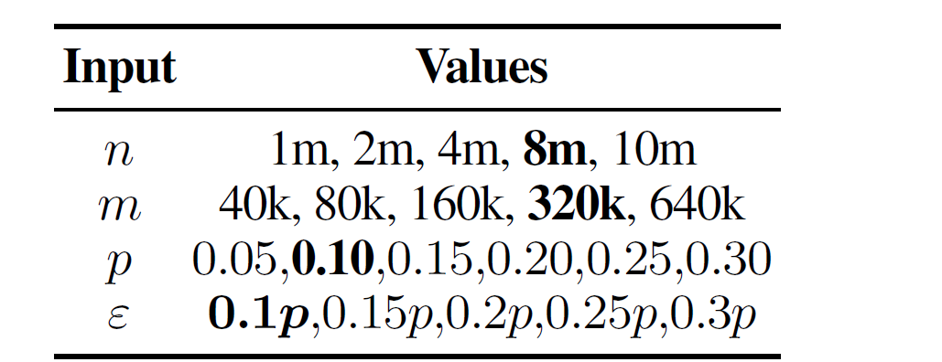
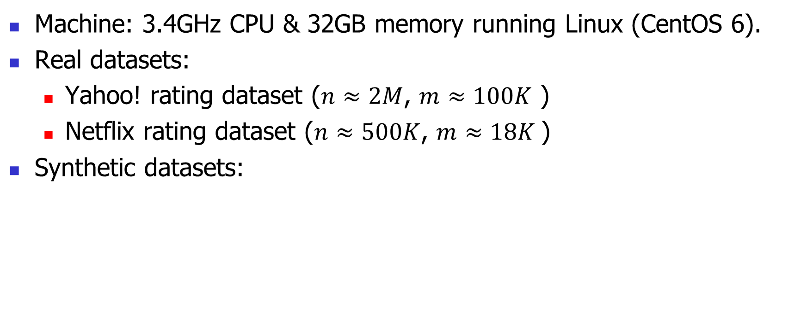
Setup
Machine: 3.4GHz CPU & 32GB memory running Linux (CentOS 6).
Real datasets:
  Yahoo! rating dataset ($n≈2M$, $m≈100K$ )
  Netflix rating dataset ($n≈500K$, $m≈18K$)
Synthetic datasets:
Notes:
Experiments are conducted on both real and synthetic datasets.
Two real datasets are used.
The info of the synthetic datasets are shown in the table; default values shown in bold.

Slide 21
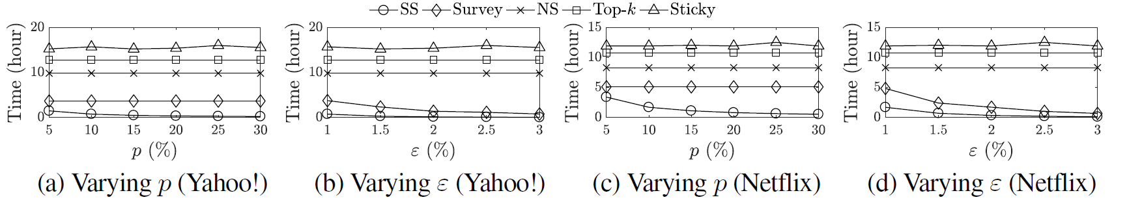
Experiment results (real datasets)
Figure: Performance of SS versus other competitors on real datasets
Notes:
SS: our algo
Survey: Survey sampling
NS: native solution (sample all users)
Top-k: top-k algo
Sticky: Sticky sampling
Why top-k and Sticky fare worse than NS? Because in order to adapt these two alg’m, it is necessary to first of all issue a query to identify users’ preferences first---this is exactly what NS is doing.

Slide 22
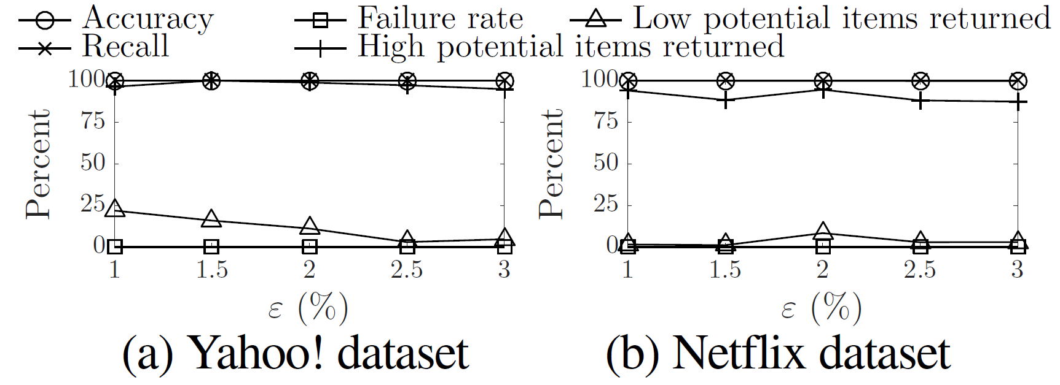
Experiment results (real datasets)
Figure: Statistics of SS on real datasets
Notes:
True +ve = a true frequent item is returned
True –ve = a non-frequent item is not returned
false –ve= a frequent item not returned
false +ve= a non-frequent item returned
Accuracy: always higher than 99.7%; not 100% because some potentially-frequent items are returned
Failure rate = proportion of times our alg’m fails to achieve performance guarantee (in fact, always = 0 in all experiments, although failure parameter delta = 5%)
Low potential items = potential-frequent items with support in [ (p-𝜖)n , (p-$ε$/2)n)
High potential items = potential-frequent items with support in [ (p-$ε$/2)n, pn)
Recall: always 100%, because failure rate=0 => no false –ve => recall=100%
Key takeaway: high-potential items are often returned, while low-potential items are seldom returned, consistent with our analysis .

Slide 23
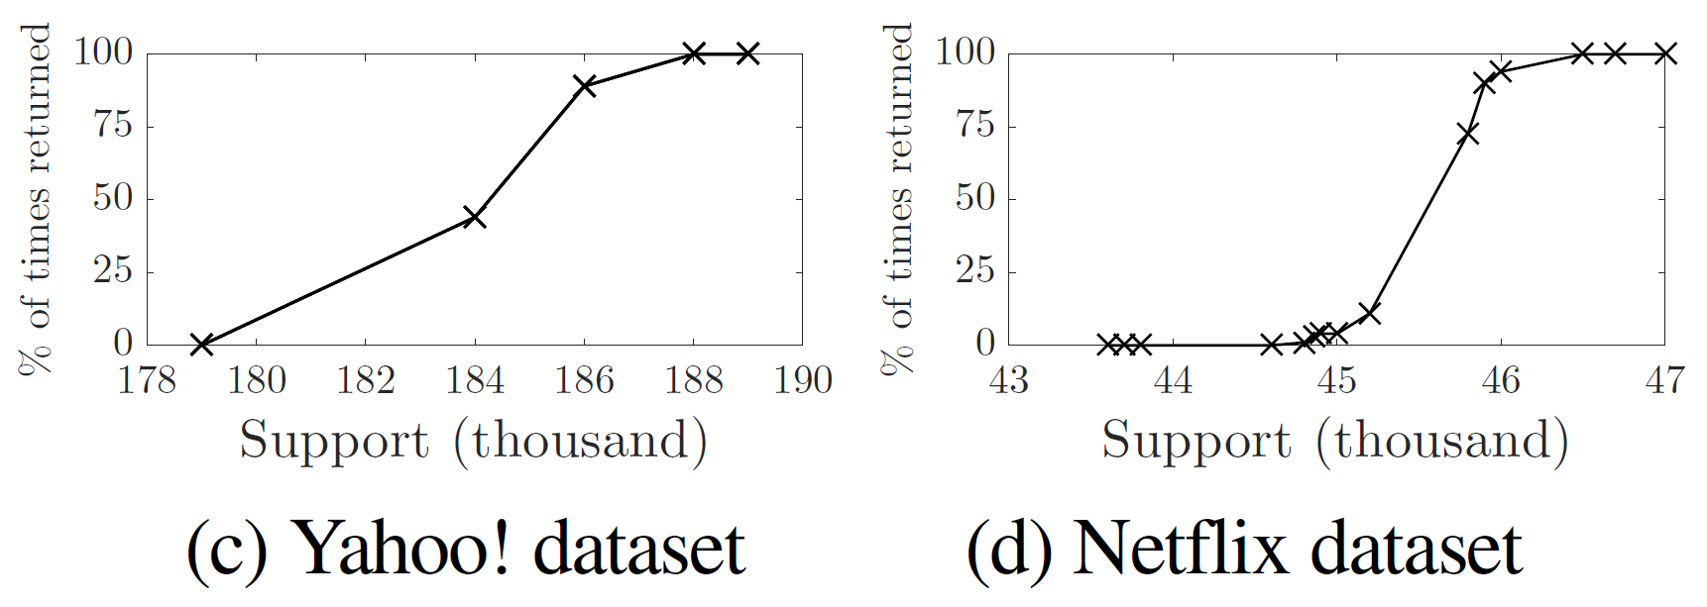
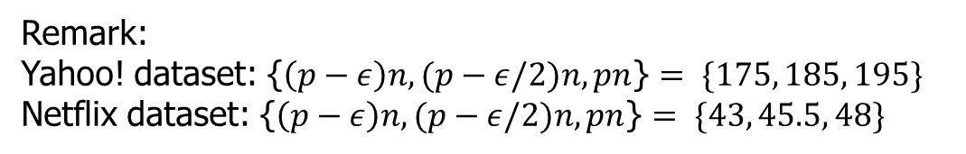
Experiment results (real datasets)
Figure: Return distribution of potentially-frequent items by SS.
Remark:
Yahoo! dataset: {$\left(p−ε\right)n,(p−ε/2)n,pn$} $= \{175, 185, 195\}$
Netflix dataset: {$\left(p−ε\right)n,(p−ε/2)n,pn$} $= \{43, 45.5, 48\}$
Notes:
Figures (c) and (d) show the fraction of times over 100 runs that each potentially-frequent item is returned, when parameters p and epsilon are at their default values. (p=10%, epsilon=1%)
The crosses represent the potentially-frequent items in the datasets.
Takeaway: Once the support of an item is below $(p−ε/2)n$, it is hardly returned in the 100 runs.

Slide 24
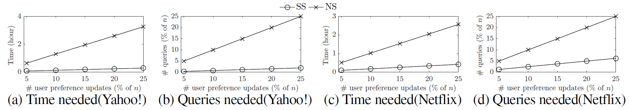
Experiment results (real datasets)
Figure: SS vs. NS on updating users’ preferences on real datasets
Notes:
As we said, our alg’m can handle updates very efficiently.
Note: NS needs to issue a query for every user’s preference update.

Slide 25
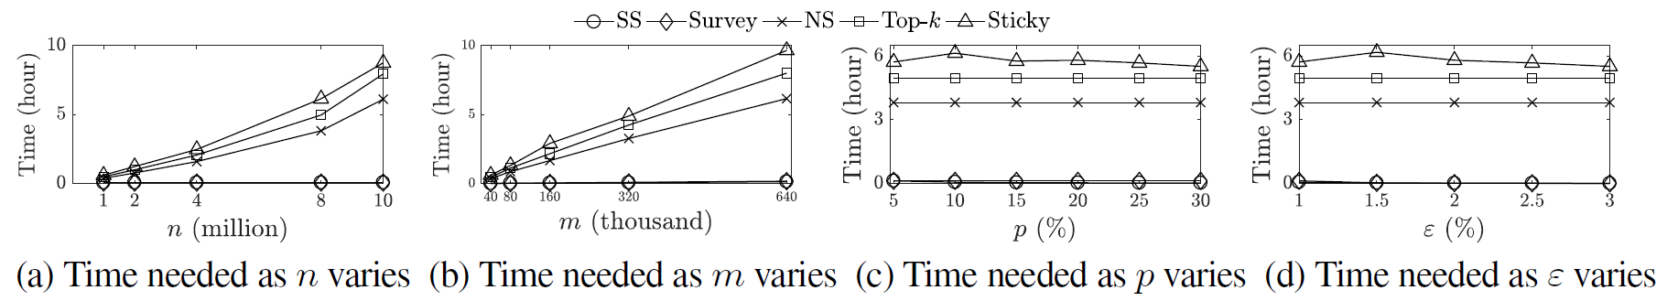
Experiment results (synthetic datasets)
Figure: Performance of SS versus other competitors on synthetic datasets.
Notes:
The results on synthetic datasets are similar to that of real datasets.

Slide 26
Response to reviewers’ comments
Review #1: In abstract, what does m stand for?
  Response: m stands for # items. This was stated in the 1st sentence of abstract, so no change is needed.
Review #2: Is recall guaranteed to be 100% in your algorithm?
  Response: This is true with probability at least 1-delta. This was stated on page 5 of the paper.

Slide 27
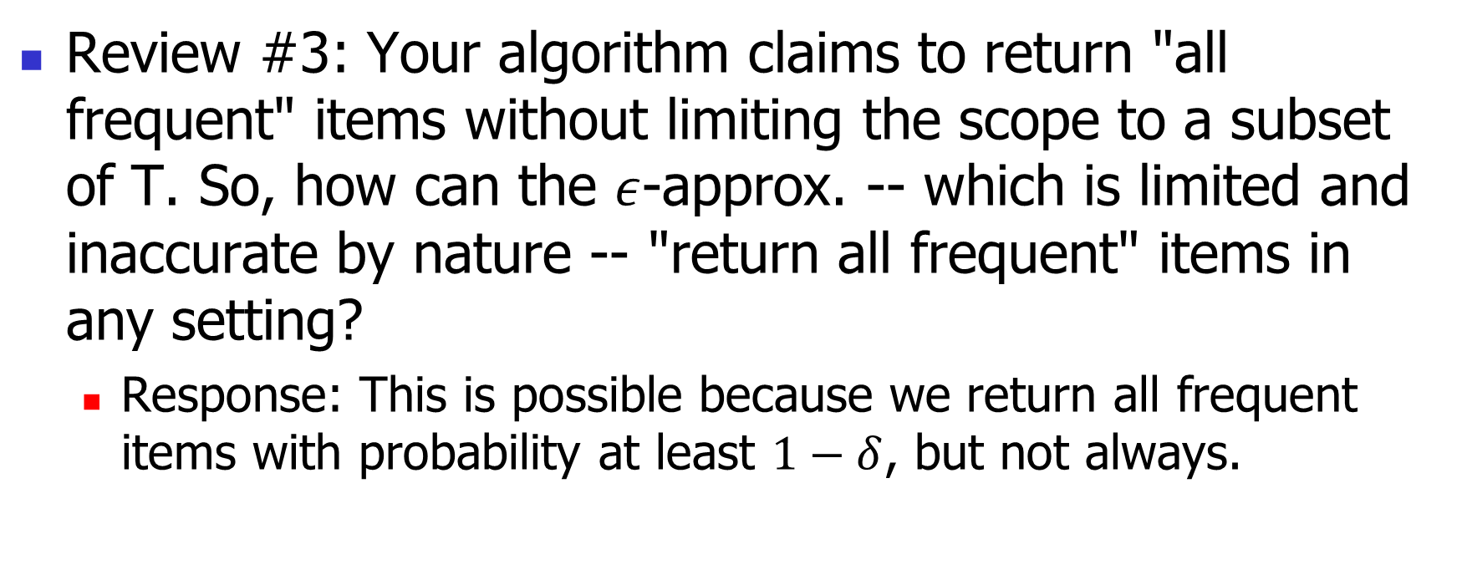
Response to reviewers’ comments
Review #3: Your algorithm claims to return "all frequent" items without limiting the scope to a subset of T. So, how can the $ε$-approx. -- which is limited and inaccurate by nature -- "return all frequent" items in any setting?
  Response: This is possible because we return all frequent items with probability at least $1−δ$, but not always.

Slide 28
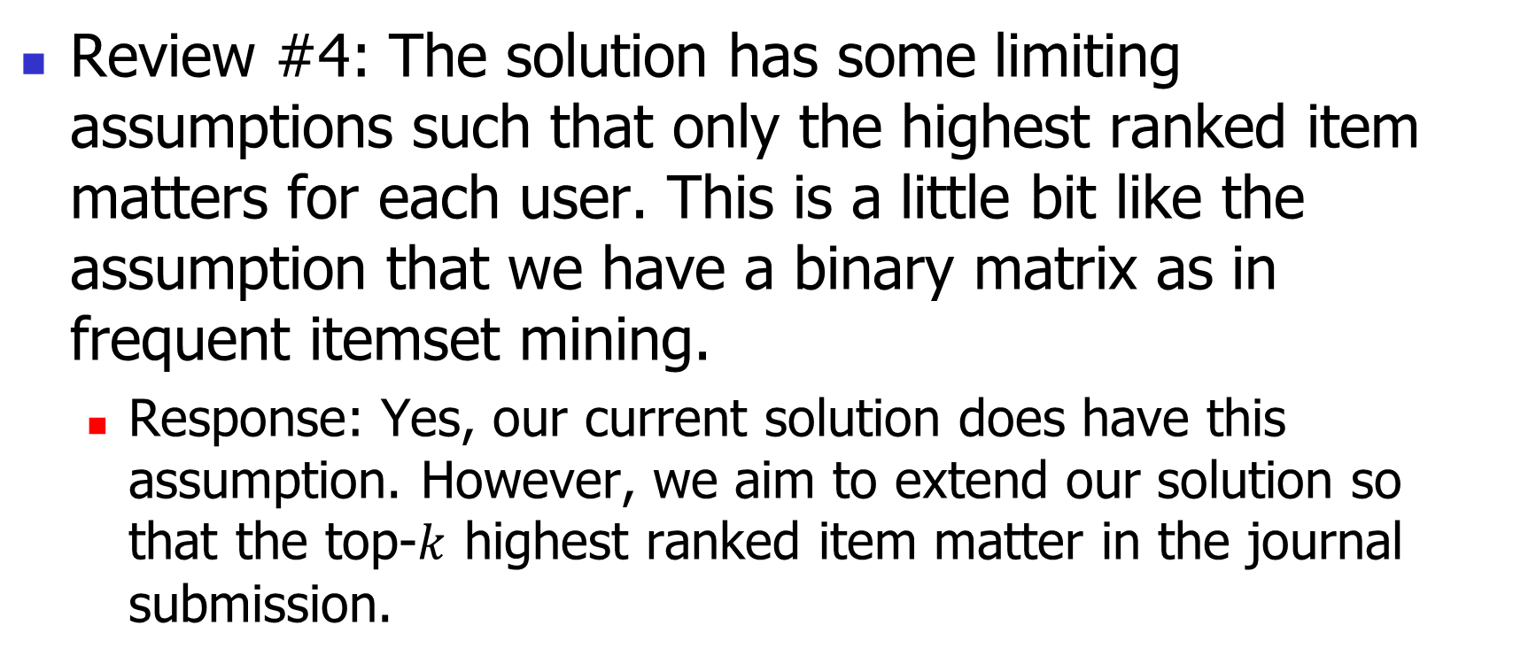
Response to reviewers’ comments
Review #4: The solution has some limiting assumptions such that only the highest ranked item matters for each user. This is a little bit like the assumption that we have a binary matrix as in frequent itemset mining.
  Response: Yes, our current solution does have this assumption. However, we aim to extend our solution so that the top-$k$ highest ranked item matter in the journal submission.

Slide 29
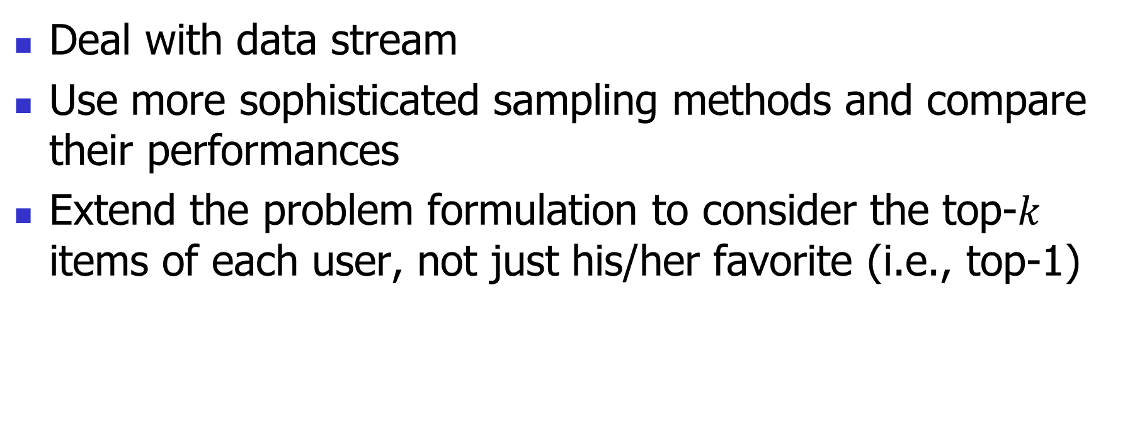
Extensions for journal submission
Deal with data stream
Use more sophisticated sampling methods and compare their performances
Extend the problem formulation to consider the top-$k$ items of each user, not just his/her favorite (i.e., top-1)
Notes:
Deal with data stream: Currently we assume the set of users is fixed before our alg’m is executed. But often users come as a data stream, and we may not have prior knowledge of how many users will arrive.
So, we can extend our problem setting to allow users come as a data stream. In fact, we already did it, but due to the page limit, we had to remove this part and the corresponding experiments. We’ll add this part in our journal submission.
More sophisticated sampling methods: Our solution relies on simple random sampling as its backbone. We’ll explore more sophisticated sampling methods in survey sampling literature to improve our alg’m
Top-k: As suggested by a reviewer, we may consider the the top-$k$ items of each user, not just his/her favorite. This will also be explored in the journal submission.

Slide 30
References
[1] R. Agrawal, R. Srikant, et al. Fast algorithms for mining association rules. In Proc. 20th int. conf. very large data bases, VLDB, volume 1215, pages 487–499, 1994.
[2] G. Cormode and M. Hadjieleftheriou. Finding frequent items in data streams. Proceedings of the VLDB Endowment, 1(2):1530–1541, 2008
[3] S. K. Thompson. Sample size for estimating multinomial proportions. The American Statistician, 41(1):42–46, 1987.

Slide 31
Questions?

