Slide 1
Geometry Approach for k-Regret Query
ICDE 2014
PENG Peng, Raymond Chi-Wing Wong
CSE, HKUST

Slide 2
Outline
1. Introduction
2. Contributions
3. Preliminary
4. Related Work
5. Geometry Property
6. Algorithm
7. Experiment
8. Conclusion

Slide 3
1. Introduction
Multi-criteria Decision Making:
  Design a query for the user which returns a number of “interesting” objects to a user
Traditional queries:
  Top-k queries
  Skyline queries

Slide 4
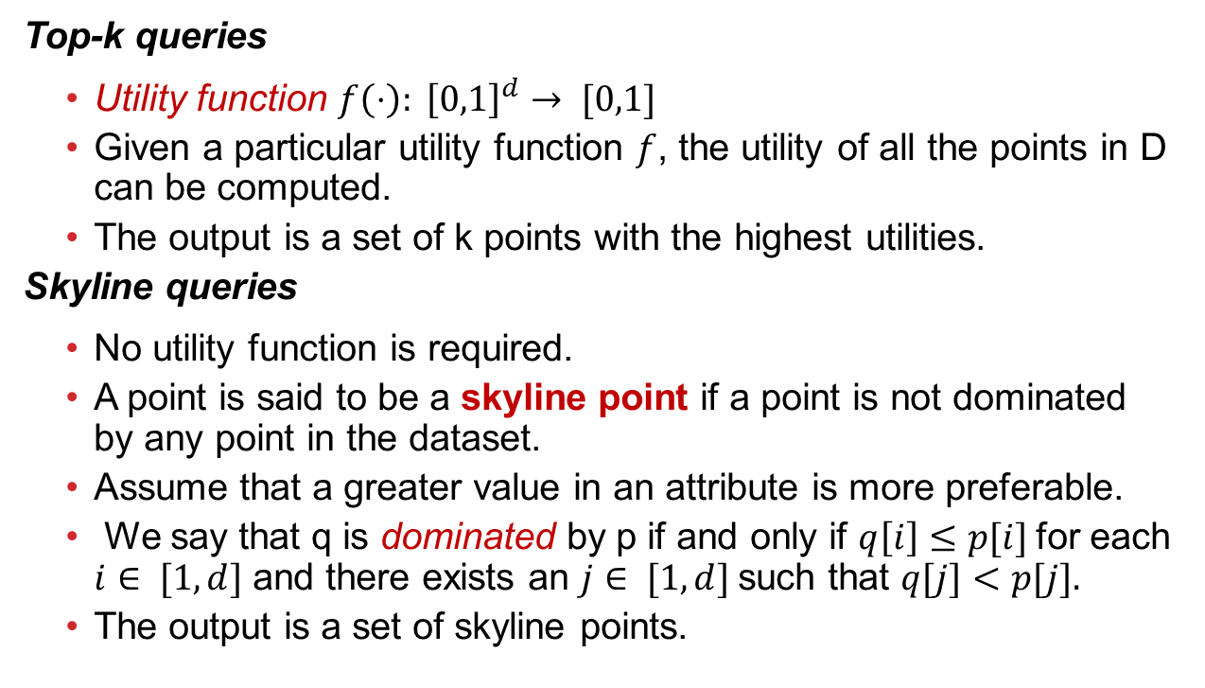
1. Introduction
Top-k queries
  Utility function $f\left(⋅\right): {\left[0,1\right]}^{d}→ [0,1]$
  Given a particular utility function $f$, the utility of all the points in D can be computed.
  The output is a set of k points with the highest utilities.
Skyline queries
  No utility function is required.
  A point is said to be a skyline point if a point is not dominated by any point in the dataset.
  Assume that a greater value in an attribute is more preferable.
  We say that q is dominated by p if and only if $q\left[i\right]≤p[i]$for each $i∈ [1,d]$ and there exists an $j∈ [1,d]$such that $q[j]<p[j].$
  The output is a set of skyline points.

Slide 5
Limitations of traditional queries
Traditional Queries
  Top-k queries
    Advantage: the output size is given by the user and it is controllable.
    Disadvantage: the utility function is assumed to be known.
  Skyline queries
    Advantage: there is no assumption that the utility function is known.
    Disadvantage: the output size cannot be controlled.
Recently proposed Query in VLDB2010
  K-regret queries
    Advantage: There is no assumption that the utility function is known and the output size is given by the user and is controllable.

Slide 6
2. Contributions
We give some theoretical properties of k-regret queries
  We give a geometry explanation of a k-regret query.
  We define happy points, candidate points for the k-regret query.
  Significance: All existing algorithms and new algorithms to be developed for the k-regret query can also use our happy points for finding the solution of the k-regret query more efficiently and more effectively.
We propose two algorithms for answering a k-regret query
  GeoGreedy algorithm
  StoredList algorithm
We conduct comprehensive experimental studies

Slide 7
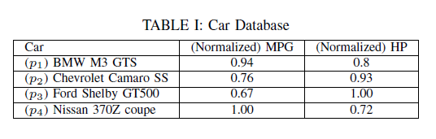
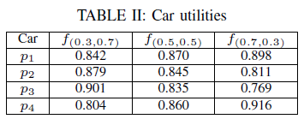
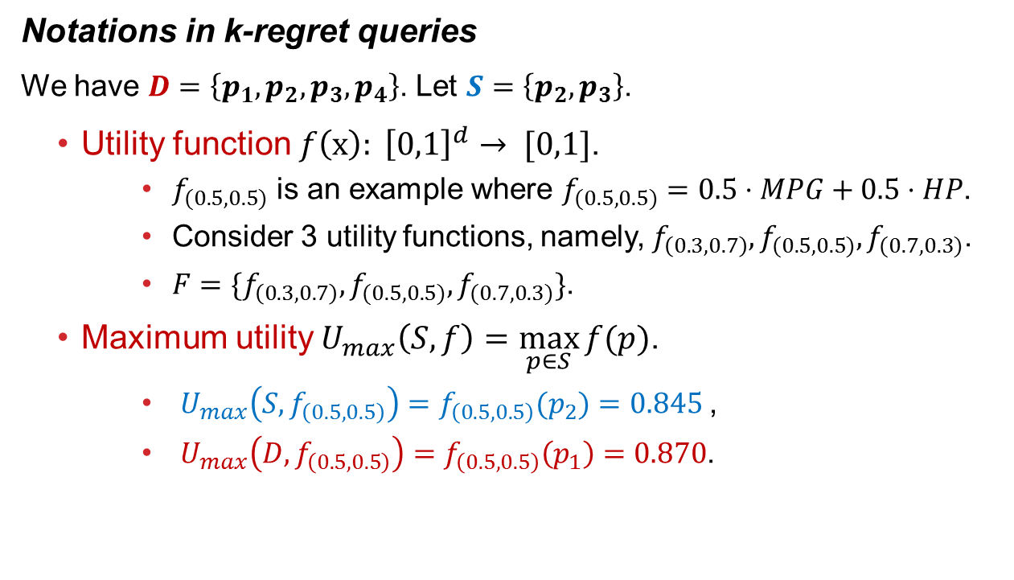
3. Preliminary
Notations in k-regret queries
    We have $D=\left\{p_{1},p_{2}, p_{3},p_{4}\right\}$. Let $S=\left\{p_{2}, p_{3}\right\}$.
  Utility function $f\left(x\right): {\left[0,1\right]}^{d}→ [0,1]$.
    $f_{(0.5,0.5)}$ is an example where $f_{(0.5,0.5)}=0.5⋅MPG+0.5⋅HP$.
    Consider 3 utility functions, namely, $f_{\left(0.3,0.7\right)},f_{(0.5,0.5)},f_{(0.7,0.3)}$.
    $F=\{f_{\left(0.3,0.7\right)},f_{(0.5,0.5)},f_{(0.7,0.3)}\}$.
  Maximum utility $U_{max}\left(S,f\right)=\max_{p∈S}{f(p)}$.
    $U_{max}\left(S,f_{\left(0.5,0.5\right)}\right)=f_{\left(0.5,0.5\right)}(p_{2})=0.845$,
    $U_{max}\left(D,f_{\left(0.5,0.5\right)}\right)=f_{\left(0.5,0.5\right)}\left(p_{1}\right)=0.870$.

Slide 8
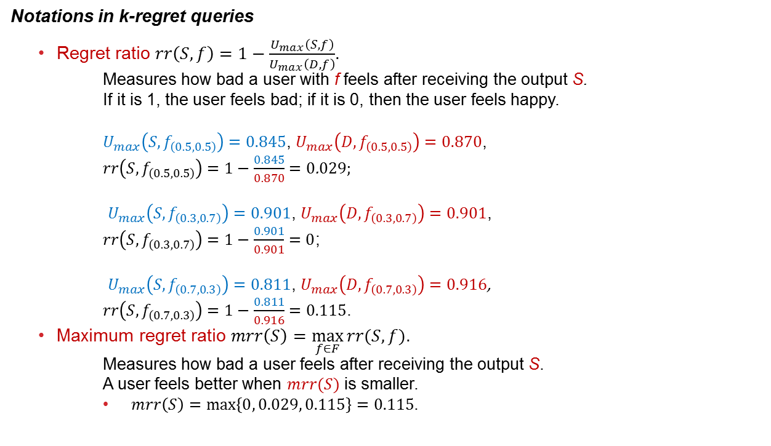
3. Preliminary
Notations in k-regret queries
  Regret ratio $rr\left(S,f\right)=1−\frac{U_{max}\left(S,f\right)}{U_{max}\left(D,f\right)}$.
    Measures how bad a user with f feels after receiving the output S.
    If it is 1, the user feels bad; if it is 0, then the user feels happy.
    $U_{max}\left(S,f_{\left(0.5,0.5\right)}\right)=0.845$, $U_{max}\left(D,f_{\left(0.5,0.5\right)}\right)=0.870$,
    $rr\left(S,f_{\left(0.5,0.5\right)}\right)=1−\frac{0.845}{0.870}=0$.029;
    $U_{max}\left(S,f_{\left(0.3,0.7\right)}\right)=0.901$, $U_{max}\left(D,f_{\left(0.3,0.7\right)}\right)=0.901$,
    $rr\left(S,f_{\left(0.3,0.7\right)}\right)=1−\frac{0.901}{0.901}=0$;
    $U_{max}\left(S,f_{\left(0.7,0.3\right)}\right)=0.811$, $U_{max}\left(D,f_{\left(0.7,0.3\right)}\right)=0.916$,
    $rr\left(S,f_{\left(0.7,0.3\right)}\right)=1−\frac{0.811}{0.916}=0.115$.
  Maximum regret ratio $mrr\left(S\right)=\max_{f∈F}{rr(S,f)}$.
    Measures how bad a user feels after receiving the output S.
    A user feels better when $mrr(S)$ is smaller.
    $mrr\left(S\right)=\max\left\{0, 0.029, 0.115\right\}=0.115$.

Slide 9
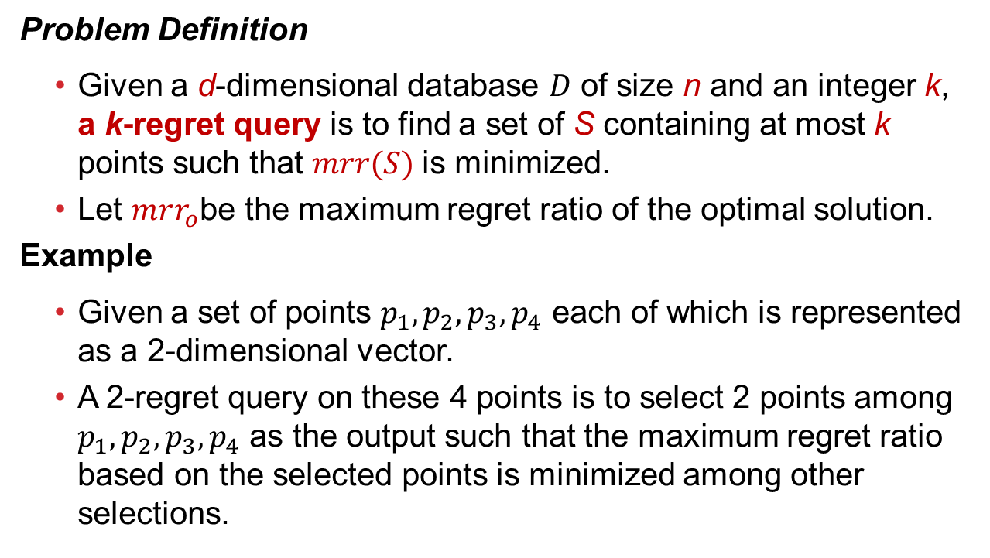
3. Preliminary
Problem Definition
  Given a d-dimensional database $D$ of size n and an integer k, a k-regret query is to find a set of S containing at most k points such that $mrr(S)$is minimized.
  Let $mrr_{o}$be the maximum regret ratio of the optimal solution.
Example
  Given a set of points $p_{1},p_{2},p_{3},p_{4}$ each of which is represented as a 2-dimensional vector.
  A 2-regret query on these 4 points is to select 2 points among $p_{1},p_{2},p_{3},p_{4}$ as the output such that the maximum regret ratio based on the selected points is minimized among other selections.

Slide 10
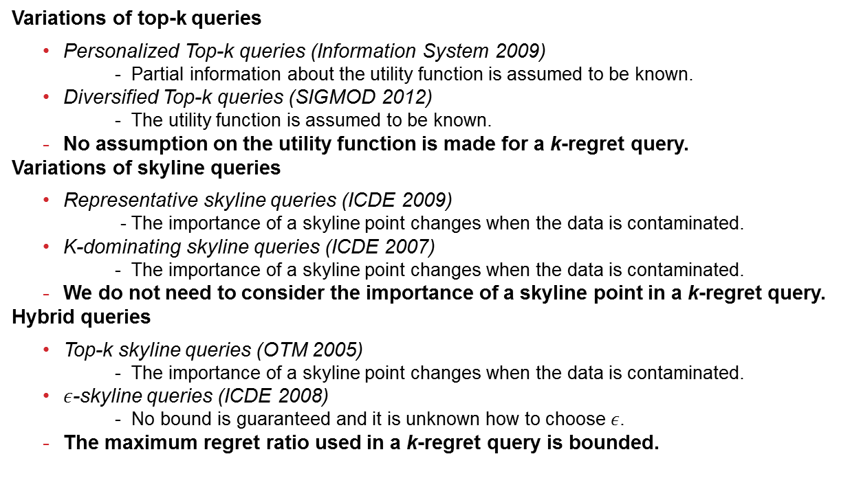
4. Related Work
Variations of top-k queries
  Personalized Top-k queries (Information System 2009)
    - Partial information about the utility function is assumed to be known.
  Diversified Top-k queries (SIGMOD 2012)
    - The utility function is assumed to be known.
  No assumption on the utility function is made for a k-regret query.
Variations of skyline queries
  Representative skyline queries (ICDE 2009)
    - The importance of a skyline point changes when the data is contaminated.
  K-dominating skyline queries (ICDE 2007)
    - The importance of a skyline point changes when the data is contaminated.
  We do not need to consider the importance of a skyline point in a k-regret query.
Hybrid queries
  Top-k skyline queries (OTM 2005)
    - The importance of a skyline point changes when the data is contaminated.
  $ε$-skyline queries (ICDE 2008)
    - No bound is guaranteed and it is unknown how to choose $ε$.
  The maximum regret ratio used in a k-regret query is bounded.

Slide 11
4. Related Work
K-regret queries
  Regret-Minimizing Representative Databases (VLDB 2010)
    Firstly propose the k-regret queries;
    Proves a worst-case upper bound and a lower bound for the maximum regret ratio of the k-regret queries;
    Propose the best-known fastest algorithm for answering a k-regret query.
  Interactive Regret Minimization (SIGMOD 2012)
    Propose an interactive version of k-regret query and an algorithm to answer a k-regret query.
  Computing k-regret Minimizing set (VLDB 2014)
    Prove the NP-completeness of a k-regret query;
    Define a new k-regret minimizing set query and proposed two algorithms to answer this new query.

Slide 12

5. Geometry Property
Geometry explanation of the maximum regret ratio $mrr(S)$given an output set S
Happy point and its properties

Slide 13
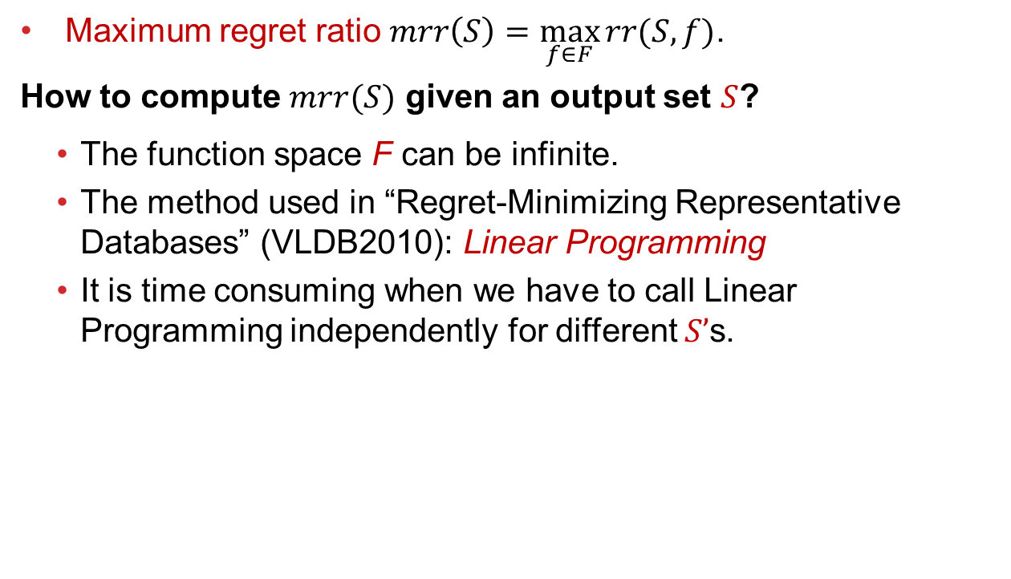
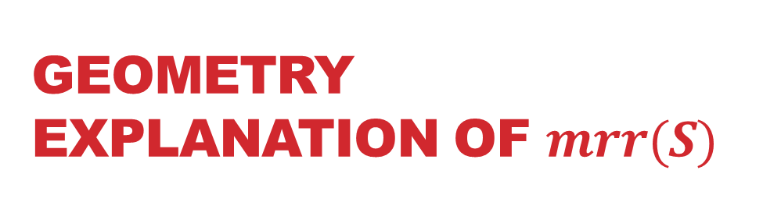
Geometry Explanation of $mrr(S)$
  Maximum regret ratio $mrr\left(S\right)=\max_{f∈F}{rr(S,f)}$.
How to compute $mrr(S)$ given an output set $S$?
  The function space F can be infinite.
  The method used in “Regret-Minimizing Representative Databases” (VLDB2010): Linear Programming
  It is time consuming when we have to call Linear Programming independently for different $S’$s.

Slide 14

Geometry Explanation of $mrr(S)$
  Maximum regret ratio $mrr\left(S\right)=\max_{f∈F}{rr(S,f)}$.
We compute $mrr\left(S\right)$ with Geometry method.
  Straightforward and easily understood;
  Save time for computing $mrr(S)$.

Slide 15







An example in 2-d
$Conv(D)$, where $D=\{p_{1},p_{2},p_{3},p_{4},p_{5},p_{6}\}$.
$$p_{5}$$
1
$$p_{1}$$
$$p_{4}$$
$$p_{2}$$
$$p_{3}$$
$$p_{6}$$
1

Slide 16

An example in 2-d
$Conv(S)$, where S$=\{p_{1},p_{2}\}$.
$$p_{5}$$
1
$$p_{1}$$
$$p_{4}$$
$$p_{2}$$
$$p_{3}$$
$$p_{6}$$
1

Slide 17





Geometry Explanation of $mrr(S)$
Critical ratio
  A $p$-critical point given $S$denoted by $p’$is defined as the intersection between the vector $op$ and the surface of $Conv(S)$.
  Critical ratio $cr\left(p,S\right)=\frac{\left\|p′\right\|}{\left\|p\right\|}$
$$0.8x+0.7y=1$$
$$p=(0.67,0.82)$$
$$p_{}^{′}=(0.6,0.74)$$
$$o$$
Notes:
p’is computed implicitly via Conv(S)
In the r.h.s. example, we have $p=(0.67,0.82)$ and the vector $op$ intersects with the face which is represented by the equation “$0.8x+0.7y=1$”. The $p$-critical point is denoted by $p′$. We compute that $p^{′}=\left(0.6,0.74\right)$ and the critical ratio $cr\left(p,S\right)=\frac{\left\|p′\right\|}{\left\|p\right\|}=0.9$.

Slide 18

Geometry Explanation of $mrr(S)$
Lemma 0:
  $mrr(S) = \max_{p∈D}{(1−cr\left(p,S\right))}$
  According to the lemma shown above, we compute $cr(p,S)$ at first for each $p$ which is outside $Conv\left(S\right)$ and find the greatest value of $1−cr\left(p,S\right)$ which is the maximum regret ratio of $S$.

Slide 19



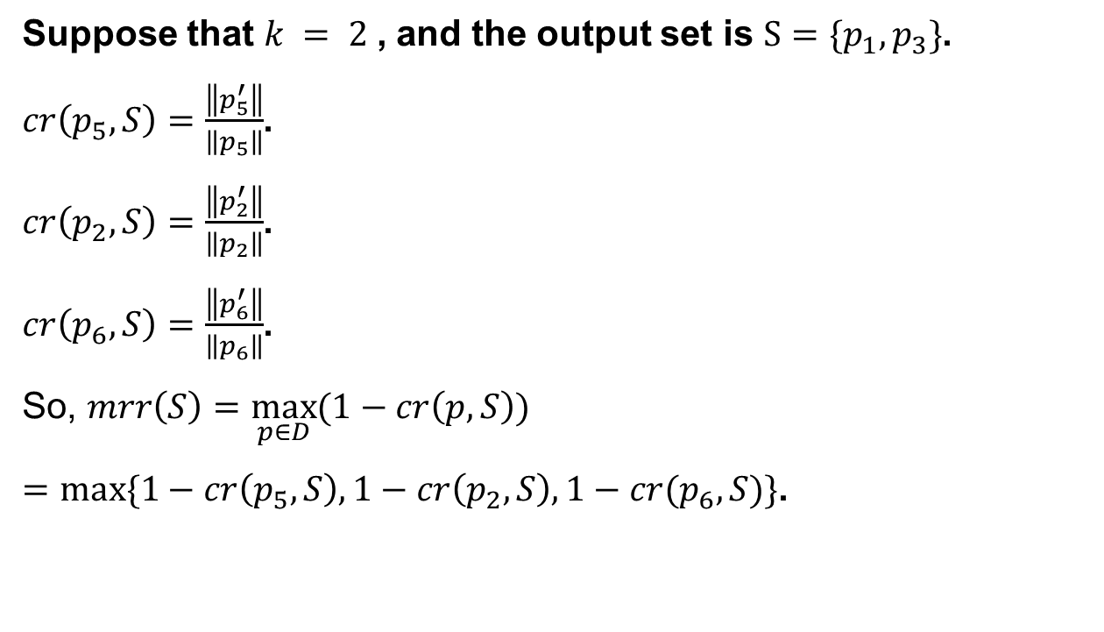






An example in 2-d
Suppose that $k = 2$, and the output set is $S=\{p_{1}, p_{3}\}$.
$cr\left(p_{5},S\right)=\frac{\left\|p_{5}^{′}\right\|}{\left\|p_{5}\right\|}$.
$cr\left(p_{2},S\right)=\frac{\left\|p_{2}^{′}\right\|}{\left\|p_{2}\right\|}$.
$cr\left(p_{6},S\right)=\frac{\left\|p_{6}^{′}\right\|}{\left\|p_{6}\right\|}$.
So, $mrr\left(S\right)=\max_{p∈D}{(1−cr\left(p,S\right))}$
$=max⁡\{1−cr\left(p_{5},S\right),1−cr\left(p_{2},S\right), 1−cr(p_{6},S)\}$.
$$p_{5}$$
$$p_{1}$$
1
$$p_{5}^{′}$$
$$p_{4}$$
$$p_{2}$$
$$p_{2}^{′}$$
$$p_{3}$$
$$p_{6}$$
$$p_{6}^{′}$$
1

Slide 20









Happy point
The set $VC$ is defined as a set of $d$-dimensional points of size $d$, where for each point $vc_{i}$ and $j∈\left[1,d\right]$, we have $vc_{i}[j]=1$ when $j=i$, and $vc_{i}[j]=0$ when $j≠i$.
In a 2-dimensional space, $VC=\{vc_{1}, vc_{2}\}$, where $vc_{1}=\left(0,1\right), vc_{2}=(1,0)$.
$$p_{5}$$
$$vc_{1}$$
$$p_{1}$$
$$p_{4}$$
$$p_{2}$$
$$p_{3}$$
$$p_{6}$$
$$vc_{2}$$

Slide 21




Happy Point
In the following, we give an example of $Conv(\left\{p\right\}∪VC)$ in a 2-dimensonal case.
Example:
$$p_{5}$$
$Conv(\left\{p_{1}\right\}∪VC)$
$$vc_{1}$$
$$p_{1}$$
$Conv(\left\{p_{6}\right\}∪VC)$
$$p_{4}$$
$$p_{2}$$
$$p_{3}$$
$$p_{6}$$
$$vc_{2}$$

Slide 22
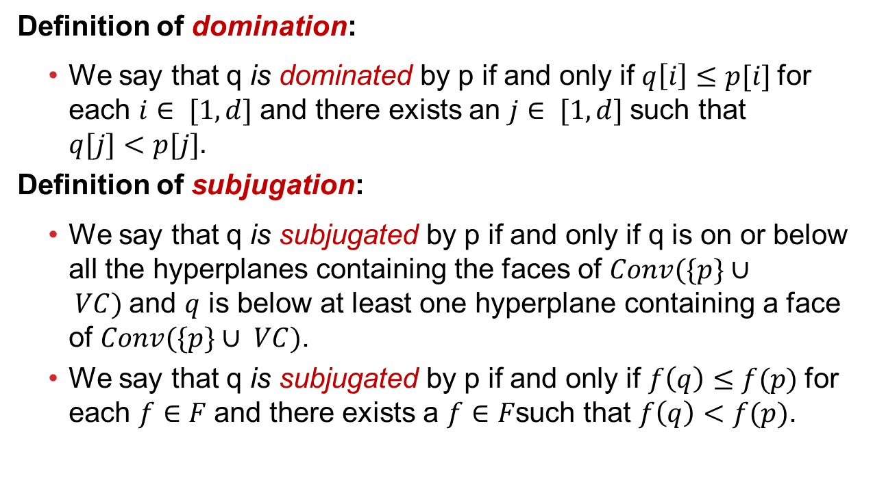
Happy point
Definition of domination:
  We say that q is dominated by p if and only if $q\left[i\right]≤p[i]$for each $i∈ [1,d]$ and there exists an $j∈ [1,d]$such that $q[j]<p[j].$
Definition of subjugation:
  We say that q is subjugated by p if and only if q is on or below all the hyperplanes containing the faces of $Conv(\{p\}∪ VC)$and $q$ is below at least one hyperplane containing a face of $Conv(\{p\}∪ VC)$.
  We say that q is subjugated by p if and only if $f\left(q\right)≤f(p)$for each $f∈F$and there exists a $f∈F$such that $f\left(q\right)<f(p)$.

Slide 23









An example in 2-d
$p_{2}$ subjugates $p_{4}$ because $p_{4}$ is below both the line $p_{2}vc_{1}$ and the line $p_{2}vc_{2}$.
$p_{2}$ does not subjugates $p_{3}$ because $p_{3}$ is above the line $p_{2}vc_{2}$.
$$p_{5}$$
$$vc_{1}$$
$$p_{1}$$
$$p_{4}$$
$$p_{2}$$
$$p_{3}$$
$$p_{6}$$
$$vc_{2}$$

Slide 24

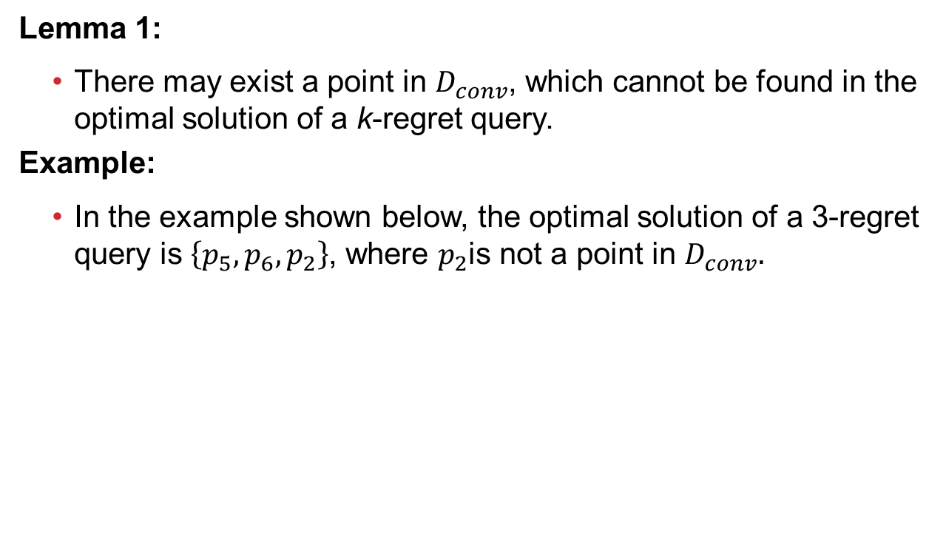






Happy Point
Lemma 1:
  There may exist a point in $D_{conv}$, which cannot be found in the optimal solution of a k-regret query.
Example:
  In the example shown below, the optimal solution of a 3-regret query is $\left\{p_{5},p_{6},p_{2}\right\}$, where $p_{2}$is not a point in $D_{conv}.$
$$p_{5}$$
$$vc_{1}$$
$$p_{1}$$
$$p_{2}$$
$$p_{3}$$
$$p_{6}$$
$$vc_{2}$$
Notes:
Orally define D_{conv},D_{happy} and D_{skyline}.

Slide 25









An example in 2-d
Lemma 2:
  $D_{conv}⊂ D_{happy}⊂ D_{skyline}$
Example:
  $D_{conv}=\left\{p_{1},p_{2},p_{5},p_{6}\right\}$
  $D_{happy}=\left\{p_{1},p_{2},p_{3},p_{5},p_{6}\right\}$
  $D_{skyline}=\left\{p_{1},p_{2}, p_{3},p_{4},p_{5},p_{6}\right\}$
$$p_{5}$$
$$vc_{1}$$
$$p_{1}$$
$$p_{4}$$
$$p_{2}$$
$$p_{3}$$
$$p_{6}$$
$$vc_{2}$$

Slide 26
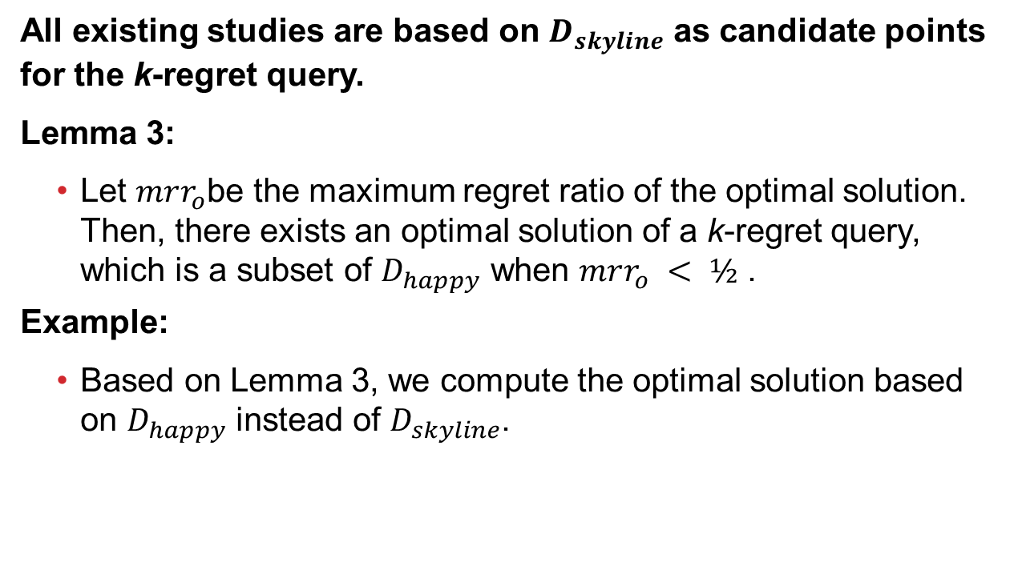
Happy point
All existing studies are based on $D_{skyline}$ as candidate points for the k-regret query.
Lemma 3:
  Let $mrr_{o}$be the maximum regret ratio of the optimal solution. Then, there exists an optimal solution of a k-regret query, which is a subset of $D_{happy}$ when $mrr_{o} < ½$ .
Example:
  Based on Lemma 3, we compute the optimal solution based on $D_{happy}$ instead of $D_{skyline}$.

Slide 27
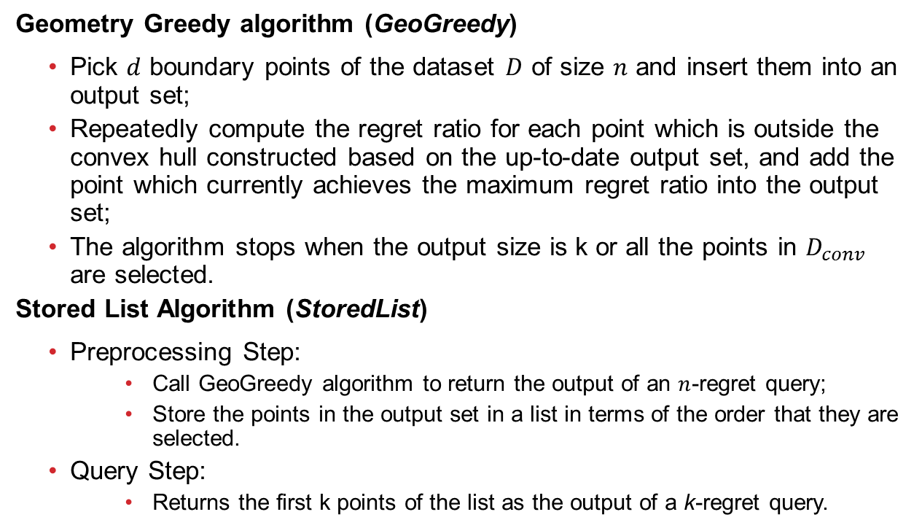
6. Algorithm
Geometry Greedy algorithm (GeoGreedy)
  Pick $d$ boundary points of the dataset $D$ of size $n$ and insert them into an output set;
  Repeatedly compute the regret ratio for each point which is outside the convex hull constructed based on the up-to-date output set, and add the point which currently achieves the maximum regret ratio into the output set;
  The algorithm stops when the output size is k or all the points in $D_{conv}$ are selected.
Stored List Algorithm (StoredList)
  Preprocessing Step:
    Call GeoGreedy algorithm to return the output of an $n$-regret query;
    Store the points in the output set in a list in terms of the order that they are selected.
  Query Step:
    Returns the first k points of the list as the output of a k-regret query.

Slide 28
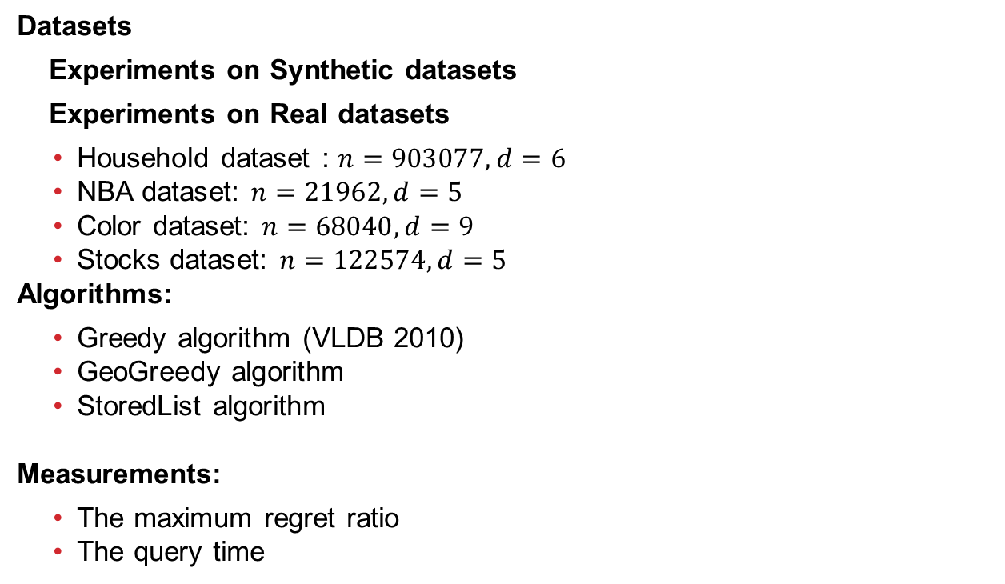
7. Experiment
Datasets
Experiments on Synthetic datasets
Experiments on Real datasets
  Household dataset : $n=903077,d=6$
  NBA dataset: $n=21962,d=5$
  Color dataset: $n=68040,d=9$
  Stocks dataset: $n=122574,d=5$
Algorithms:
  Greedy algorithm (VLDB 2010)
  GeoGreedy algorithm
  StoredList algorithm
Measurements:
  The maximum regret ratio
  The query time

Slide 29

7. Experiment
Experiments
  Relationship Among $D_{conv},D_{happy},D_{skyline}$
  Effect of Happy Points
  Performance of Our Method

Slide 30
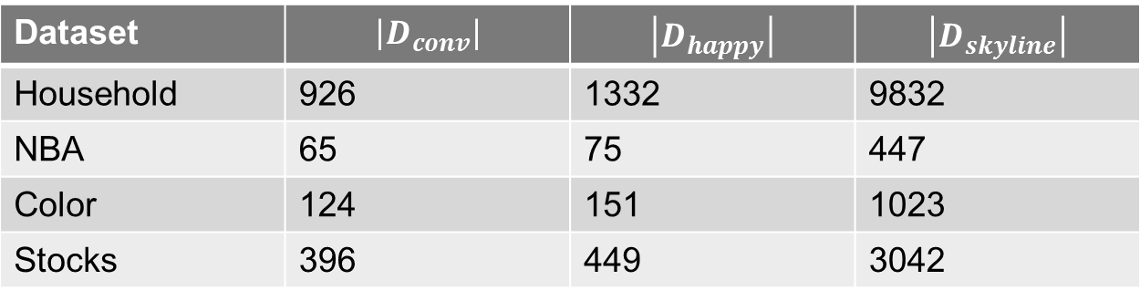

Relationship Among $D_{conv},D_{happy},D_{skyline}$
Dataset | $$\left|D_{conv}\right|$$ | $$\left|D_{happy}\right|$$ | $$\left|D_{skyline}\right|$$
Household | 926 | 1332 | 9832
NBA | 65 | 75 | 447
Color | 124 | 151 | 1023
Stocks | 396 | 449 | 3042

Slide 31
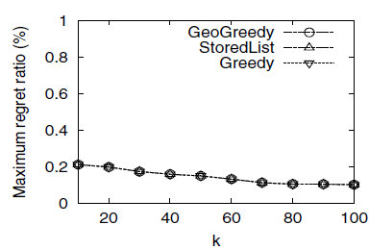
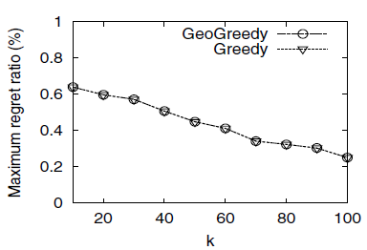


Effect of Happy Points
Household: maximum regret ratio
The result based on $D_{happy}$
The result based on $D_{skyline}$

Slide 32
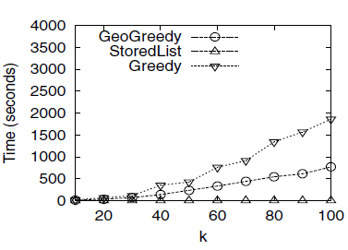
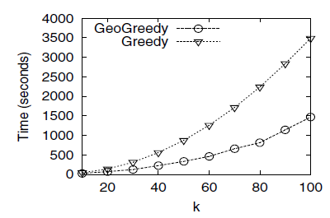
Effect of Happy Points
Household: query time
The result based on $D_{happy}$
The result based on $D_{skyline}$

Slide 33
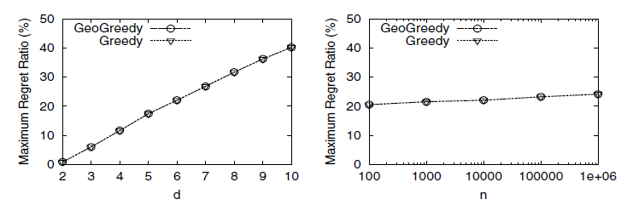
Performance of Our Method
Experiments on Synthetic datasets
  Maximum regret ratio
Effect of d
Effect of n

Slide 34
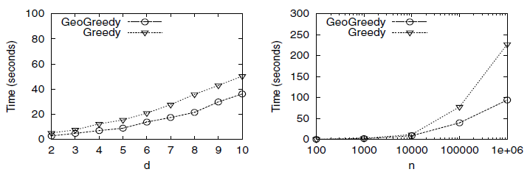
Performance of Our Method
Experiments on Synthetic datasets
  Query time
Effect of d
Effect of n

Slide 35
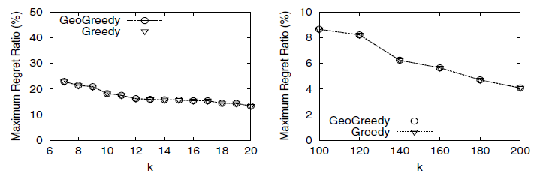
Performance of Our Method
Experiments on Synthetic datasets
  Maximum regret ratio
Effect of k
Effect of large k

Slide 36
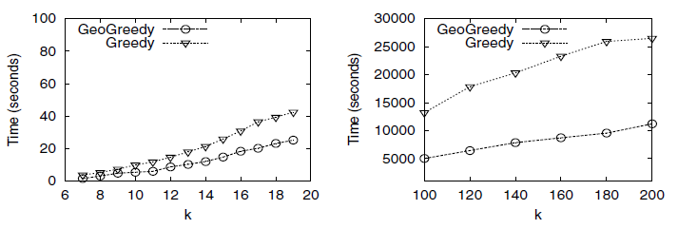
Performance of Our Method
Experiments on Synthetic datasets
  Query time
Effect of k
Effect of large k

Slide 37
8. Conclusion
We studied a k-regret query in this paper.
We proposed a set of happy points, a set of candidate points for the k-regret query, which is much smaller than the number of skyline points for finding the solution of the k-regret query more efficiently and effectively.
We conducted experiments based on both synthetic and real datasets.
Future directions:
  Average regret ratio minimization
  Interactive version of a k-regret query

Slide 38
Thank You!

Slide 39
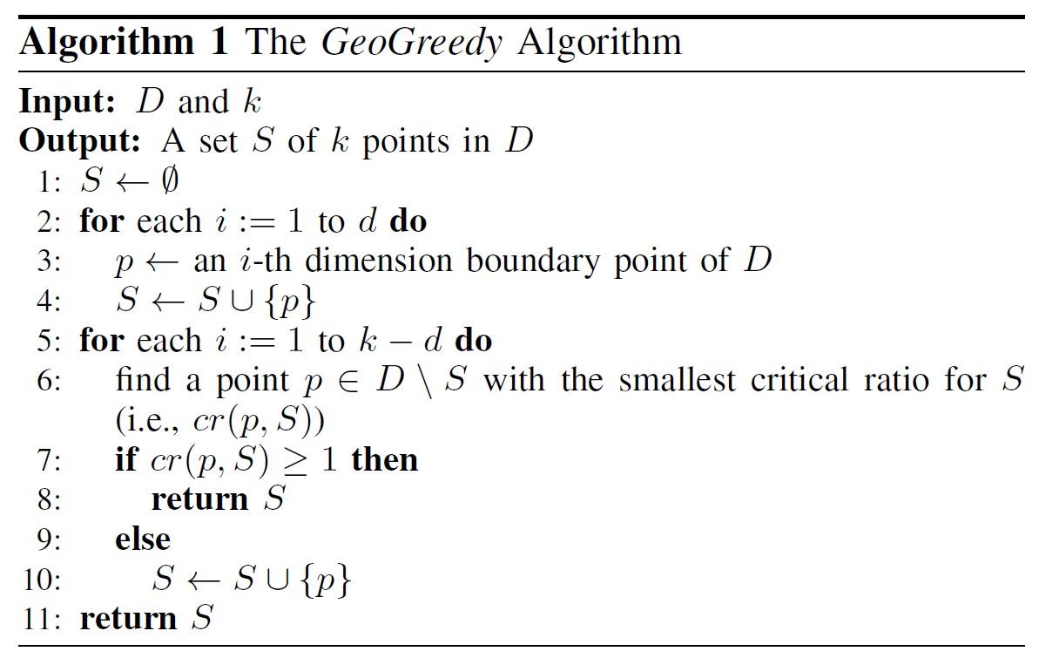
GeoGreedy Algorithm
GeoGreedy Algorithm

Slide 40






GeoGreedy Algorithm
An example in 2-d:
In the following, we compute a 4-regret query using GeoGreedy algorithm.
$$p_{5}$$
1
$$p_{1}$$
$$p_{4}$$
$$p_{2}$$
$$p_{3}$$
$$p_{6}$$
1

Slide 41



GeoGreedy Algorithm
Line 2 – 4:
  $S=\{p_{5}, p_{6}\}$
$$p_{5}$$
1
$$p_{6}$$
1

Slide 42









GeoGreedy Algorithm
Line 2 – 4:
  $S=\{p_{5}, p_{6}\}$.
Line 5 – 10 (Iteration 1):
  Since $cr\left(p_{2},S\right)>cr(p_{1},S)$ and $cr\left(p_{1},S\right)<1$, we add
  $p_{2}$ in $S$.
$$p_{5}$$
1
$$p_{1}$$
$$p_{1}^{′}$$
$$p_{4}$$
$$p_{2}$$
$$p_{2}^{′}$$
$$p_{3}$$
$$p_{6}$$
1

Slide 43


GeoGreedy Algorithm
Line 5 – 10 (Iteration 2):
  After Iteration 1, $S=\{p_{1}, p_{5}, p_{6}\}$.
  We can only compute $cr\left(p_{2},S\right)$ which is less than 1 and we add $p_{1}$in $S$.
$$p_{5}$$
1
$$p_{1}$$
$$p_{4}$$
$$p_{2}$$
$$p_{2}^{′}$$
$$p_{3}$$
$$p_{6}$$
1

Slide 44
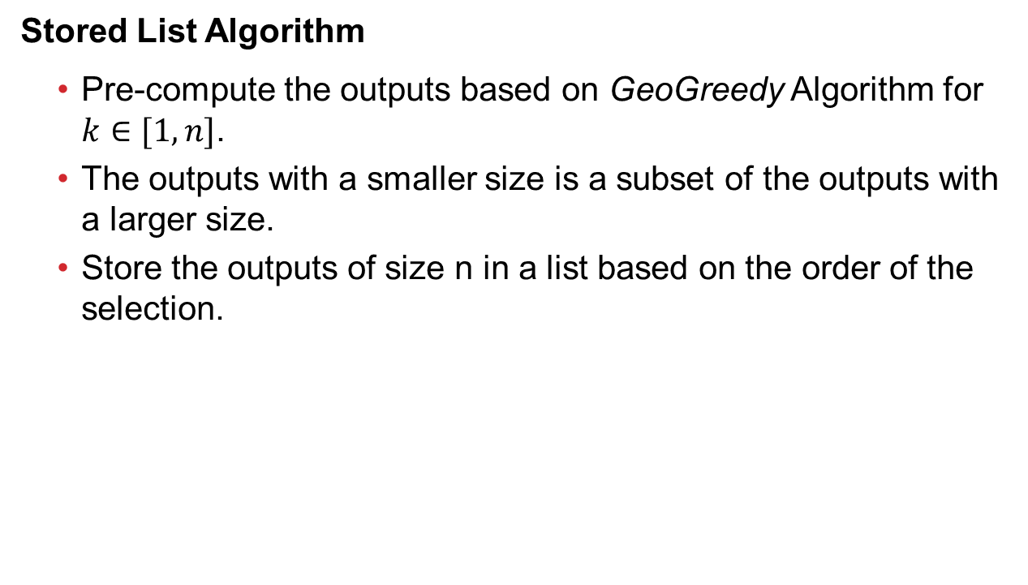
StoredList Algorithm
Stored List Algorithm
  Pre-compute the outputs based on GeoGreedy Algorithm for $k∈[1,n]$.
  The outputs with a smaller size is a subset of the outputs with a larger size.
  Store the outputs of size n in a list based on the order of the selection.

Slide 45
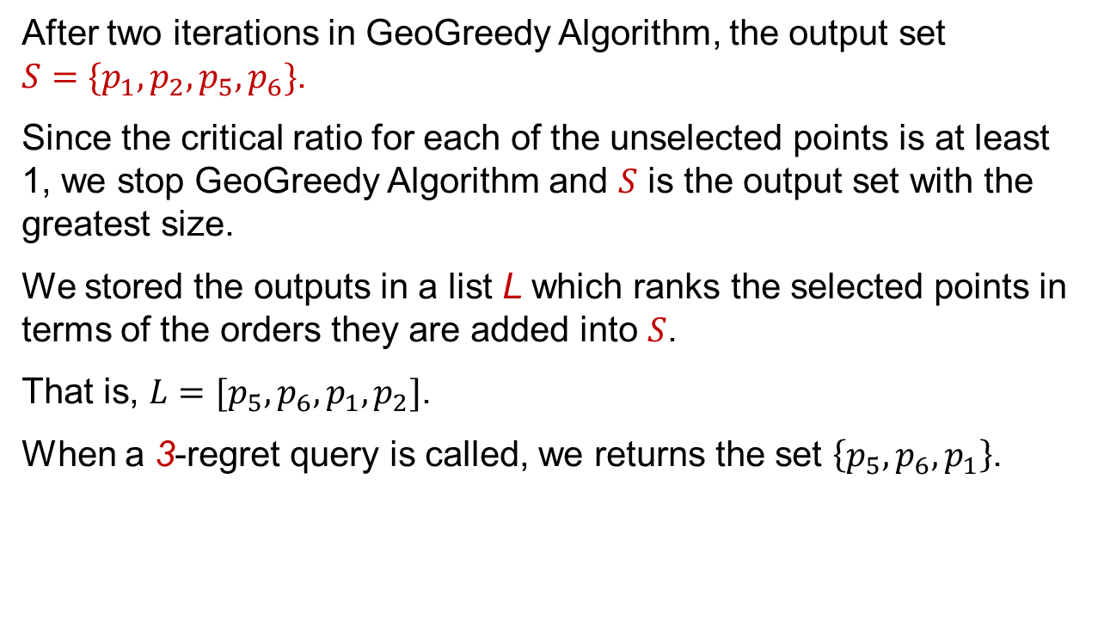
StoredList Algorithm
After two iterations in GeoGreedy Algorithm, the output set $S=\{p_{1},p_{2},p_{5}, p_{6}\}$.
Since the critical ratio for each of the unselected points is at least 1, we stop GeoGreedy Algorithm and $S$ is the output set with the greatest size.
We stored the outputs in a list L which ranks the selected points in terms of the orders they are added into $S$.
That is, $L=[p_{5},p_{6},p_{1},p_{2}]$.
When a 3-regret query is called, we returns the set $\left\{p_{5},p_{6},p_{1}\right\}$.

Slide 46
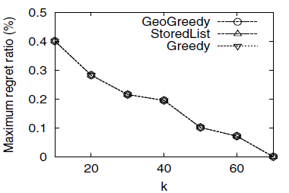
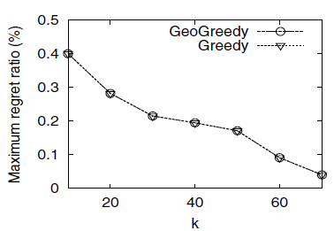
Effect of Happy Points
NBA: maximum regret ratio
The result based on $D_{happy}$
The result based on $D_{skyline}$

Slide 47
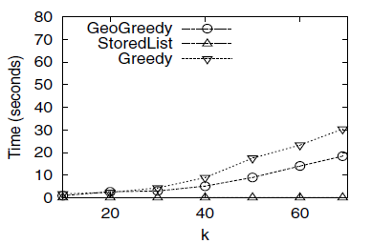
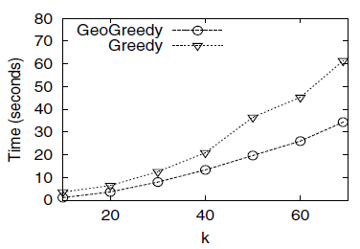
Effect of Happy Points
NBA: query time
The result based on $D_{happy}$
The result based on $D_{skyline}$

Slide 48
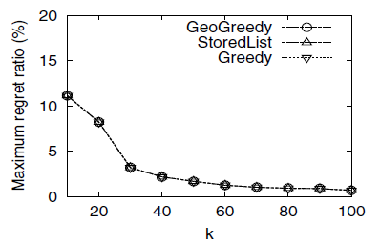
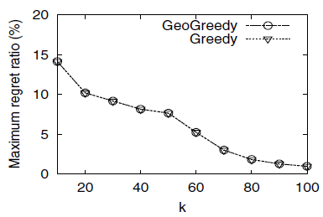
Effect of Happy Points
Color: maximum regret ratio
The result based on $D_{happy}$
The result based on $D_{skyline}$

Slide 49
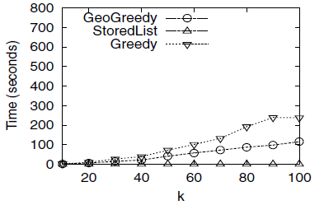
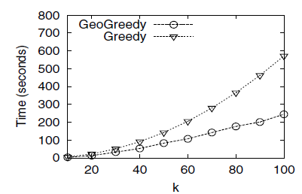
Effect of Happy Points
Color: query time
The result based on $D_{happy}$
The result based on $D_{skyline}$

Slide 50
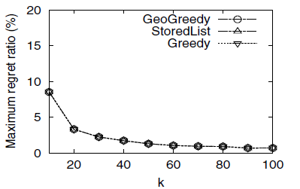

Effect of Happy Points
Stocks: maximum regret ratio
The result based on $D_{happy}$
The result based on $D_{skyline}$

Slide 51


Effect of Happy Points
Stocks: query time
The result based on $D_{happy}$
The result based on $D_{skyline}$

Slide 52

Preliminary
Example:
$F=\{f_{\left(0.3,0.7\right)},f_{(0.5,0.5)},f_{(0.7,0.3)}\}$, where $f_{(a,b)}=a⋅MPG+b⋅HP$.
We have $D=\left\{p_{1},p_{2}, p_{3},p_{4}\right\}$.
Let $S=\left\{p_{2}, p_{3}\right\}$.
Since $U_{max}\left(S,f_{\left(0.3,0.7\right)}\right)=0.901$,
and $U_{max}\left(D,f_{\left(0.3,0.7\right)}\right)=0.901$,
we have $rr\left(S,f_{\left(0.3,0.7\right)}\right)=1−\frac{0.901}{0.901}=0$.
Similarly,
$rr\left(S,f_{\left(0.5,0.5\right)}\right)=1−\frac{0.845}{0.870}=0$,
$rr\left(S,f_{\left(0.7,0.3\right)}\right)=1−\frac{0.811}{0.916}=0.115$.
So, we have $rr\left(S\right)=\max\left\{0,0.029,0.115\right\}=0.115$

Slide 53













An example in 2-d
Points (normalized):
  $p_{1},p_{2},p_{3},p_{4},p_{5},p_{6}$
1
$$p_{5}$$
$$p_{5}$$
$$p_{1}$$
$$vc_{1}$$
$$p_{1}$$
$$p_{4}$$
$$p_{4}$$
$$p_{2}$$
$$p_{2}$$
$$p_{3}$$
$$p_{3}$$
$$p_{6}$$
$$p_{6}$$
$$vc_{2}$$
1

