Slide 1
Hypersphere Dominance: An Optimal Approach
Cheng Long, Raymond Chi-Wing Wong, Bin Zhang, Min Xie
The Hong Kong University of Science and Technology
Prepared by Cheng Long
Presented by Cheng Long
24 June, 2014

Slide 2




Hyperspheres
A hypersphere in a d-dimensional space
  (center, radius)
  the set of all points that have their distances from the center bounded by the radius
$$r$$
$$r$$
$$c$$
$$c$$
2D: a disk
3D: a ball

Slide 3
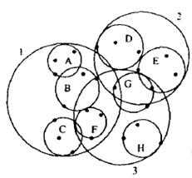
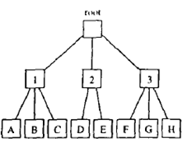
Hyperspheres are commonly used
Uncertain databases
  the location of an uncertain object
Spatial databases
  SS-tree, SS⁺-tree, M-tree, VP-tree and SR-tree
SS-tree: similar to R-tree with hyperrectangles replaced by hyperspheres
layout of 8 objects: A-H
SS-tree based on A-H

Slide 4


Motivating example
Scenario
  Ada has her location uncertain, but constrained in a disk S_{a}.
  Bob has his location uncertain, but constrained in a disk S_{b}.
  Connie has her location uncertain, but constrained in a disk S_{q}.
Question
  Is Ada always closer to Connie than Bob?
$Sa$ (Ada)
$Sa$ (Ada)
S_{q} (Connie)
S_{b} (Bob)
S_{b} (Bob)
S_{q} (Connie)
For this specification of the locations, Ada is closer to Connie than Bob
In fact, for all specifications of the locations, Ada is closer to Connie than Bob
Yes
No

Slide 5
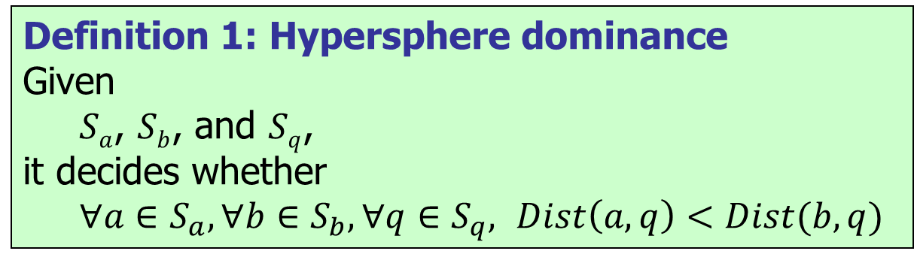
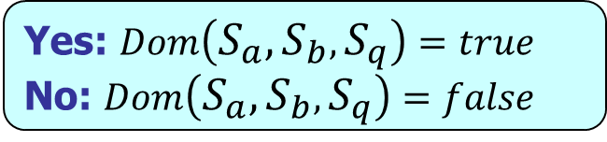
Hypersphere dominance: definition
Definition 1: Hypersphere dominance
Given
  $Sa$, $Sb$, and $Sq$,
it decides whether
  $∀a∈S_{a}, ∀b∈S_{b},∀q∈S_{q},$ $Dist\left(a, q\right)<Dist(b,q)$
Dominance condition
Yes: $Dom\left(S_{a},S_{b},S_{q}\right)=true$
No: $Dom\left(S_{a},S_{b},S_{q}\right)=false$
Basic operator used in many queries
  Probabilistic RkNN query [Lian and Chen, VLDBJ’09]
  AkNN query [Emrich et al., SSDBM’10]
  kNN query [Long et al., SIGMOD’14]

Slide 6
Hypersphere dominance: existing solutions—overview
MinMax [Roussopoulos et al., SIGMOD Record’95; Hjaltason and Samet, TODS’99]
MBR [Emrich et al., SIGMOD’10]
GP [Lian and Chen, VLDBJ’09]
Trigonometric [Emrich et al., SSDBM’10]

Slide 7


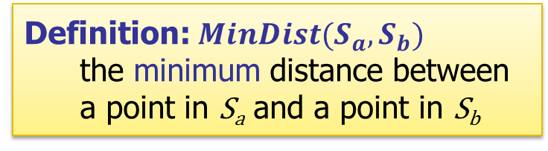





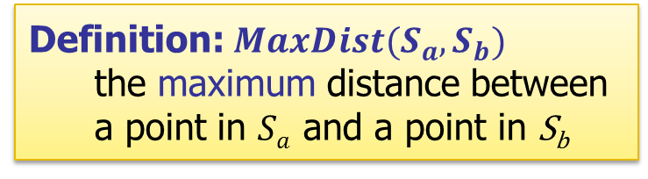










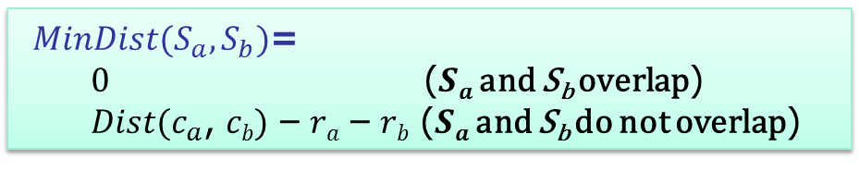





Hypersphere dominance: existing solutions—MinMax (1)
Definition: $MaxDist(S_{a},S_{b})$
  the maximum distance between a point in $Sa$ and a point in S_{b}
Definition: $MinDist(S_{a},S_{b})$
  the minimum distance between a point in S_{a} and a point in S_{b}
$$MaxDist\left(Sa,S_{b}\right)=Dist\left(ca, cb\right)+r_{a}+r_{b}$$
$MinDist(S_{a},S_{b})$=
  $0$ ($Sa$ and S_{b} overlap)
  $Dist(c_{a}$, $cb)$ – $ra$ – $rb$ ($Sa$ and S_{b} do not overlap)
$$Sa$$
$$Sb$$
$$Sb$$
$$Sa$$
$$Sb$$
$$rb$$
$$Sa$$
$$ca$$
$$ra$$
$$cb$$
$$ra$$
$$ca$$
$$cb$$
$$rb$$
$$ca$$
$$cb$$
$$rb$$
$$ra$$
$$MaxDist(S_{a},S_{b})$$
$$MinDist(S_{a},S_{b})$$
$$MinDist(S_{a},S_{b})=0$$

Slide 8

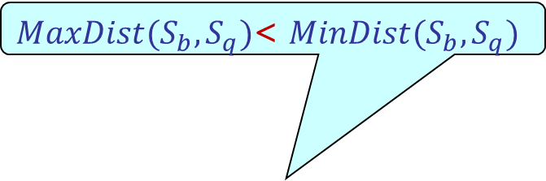
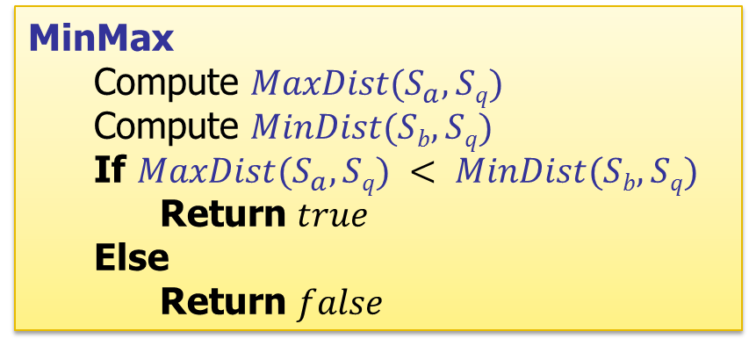

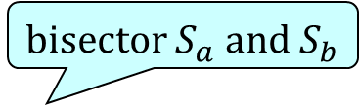


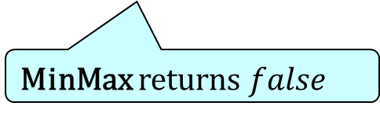

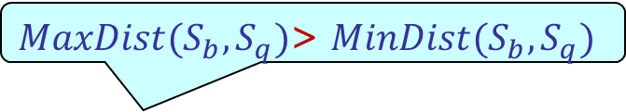



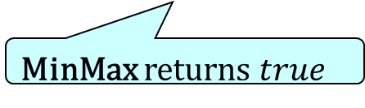
Hypersphere dominance: existing solutions—MinMax (2)
MinMax
  Compute $MaxDist(S_{a}, Sq)$
  Compute $MinDist(Sb, Sq)$
  If $MaxDist(S_{a}, Sq) < MinDist(Sb, Sq)$
    Return $true$
  Else
    Return $false$
$MaxDist(S_{b},S_{q})$> $MinDist(S_{b},S_{q})$
S_{q}
$$MaxDist(S_{a},S_{b})$$
$MaxDist(S_{b},S_{q})$< $MinDist(S_{b},S_{q})$
$$Sa$$
bisector $S_{a}$ and $S_{b}$
$$Sa$$
S_{q}
S_{b}
$$MaxDist(S_{a},S_{q})$$
S_{b}
$$MinDist(S_{b},S_{q})$$
$$MinDist(S_{b},S_{q})$$
MinMax returns $true$
MinMax returns $false$
$$Dom(S_{a}, Sb, Sq) = true$$
$$Dom(S_{a}, Sb, Sq) = true$$
correct
“false negative”

Slide 9
Hypersphere dominance: existing solutions--Insufficiency
Criteria of a method:
  1. Correctness: No false positive
  2. Soundness: No false negative
  3. Efficiency: runs in O(d) where d is the number of dimensionality
Methods | Correct? | Sound? | Efficient?
MinMax | Yes | No | Yes
MBR | Yes | No | Yes
GP | Yes | No | Yes
Trigonometric | No | Yes | Yes
Our approach (Hyperbola) | Yes | Yes | Yes
Our approach is the only one which is correct, sound and efficient!

Slide 10
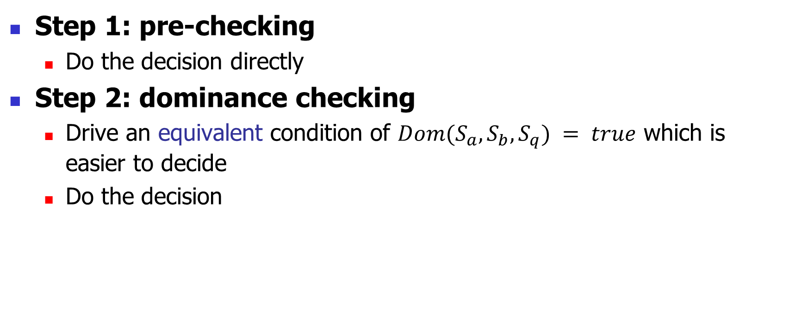
Our approach: major idea
For cases where it is easy to decide whether the dominance condition is true
For cases where it is difficult to decide whether the dominance condition is true directly
Step 1: pre-checking
  Do the decision directly
Step 2: dominance checking
  Drive an equivalent condition of $Dom(S_{a},S_{b},S_{q}) = true$ which is easier to decide
  Do the decision

Slide 11


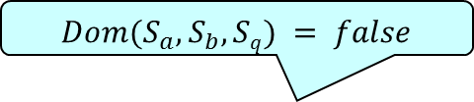

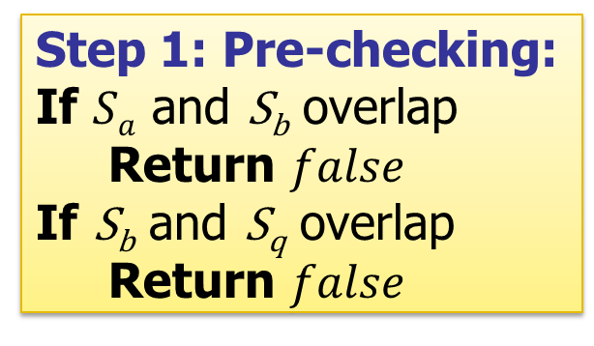

Our approach: pre-checking
Step 1: Pre-checking:
If $Sa$ and S_{b} overlap
  Return $false$
If S_{b} and S_{q} overlap
  Return $false$
$Sa$ and S_{b} overlap
S_{b} and S_{q} overlap
$$Dom(S_{a},S_{b}, Sq) = false$$
$$Dom(S_{a},S_{b}, Sq) = false$$
$$Sa$$
S_{q}
S_{q}
$$Sa$$
S_{b}
S_{b}

Slide 12
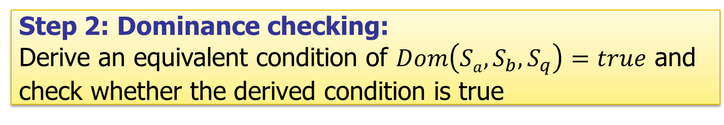
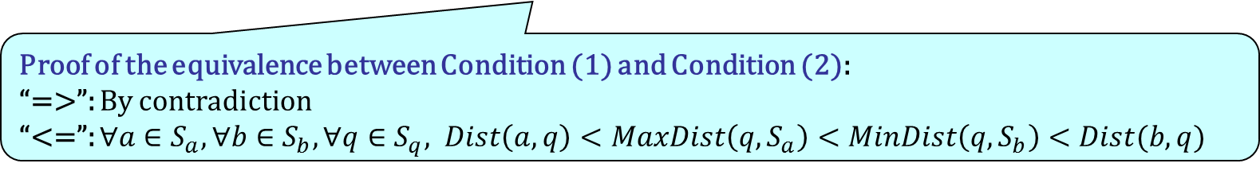
Our approach: dominance checking (1)
Step 2: Dominance checking:
Derive an equivalent condition of $Dom\left(Sa, S_{b},S_{q}\right)=true$ and check whether the derived condition is true
Dominance condition: $∀a∈S_{a}, ∀b∈S_{b},∀q∈S_{q}, Dist\left(a, q\right)<Dist(b,q)$
Equivalent condition (1): $∀q∈S_{q}, MaxDist\left(q,S_{a}\right)<MinDist\left(q,S_{b}\right)$
Proof of the equivalence between Condition (1) and Condition (2):
“=>”: By contradiction
“<=”: $∀a∈S_{a}, ∀b∈S_{b},∀q∈S_{q}, Dist\left(a, q\right)<MaxDist\left(q,S_{a}\right)<MinDist\left(q,S_{b}\right)<Dist(b,q)$

Slide 13
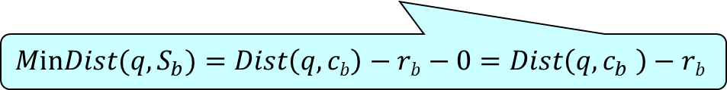
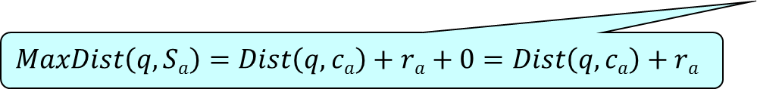
Our approach: dominance checking (5)
Equivalent condition (2): $∀q∈S_{q}, MaxDist\left(q,S_{a}\right)<MinDist\left(q,S_{b}\right)$
$$MaxDist\left(q,Sa\right)=Dist\left(q,ca\right)+ra+0=Dist\left(q,ca\right)+ra$$
$$MinDist(q,S_{b})=Dist\left(q,cb\right)−rb−0=Dist\left(q,c_{b} \right)−rb$$
Equivalent condition (3): $∀q∈S_{q}, Dist\left(q,cb\right)−Dist\left(q,c_{a}\right)>r_{a}+r_{b}$

Slide 14
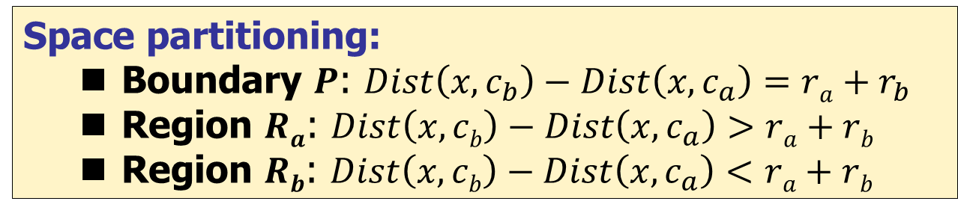

Our approach: dominance checking (3)
Space partitioning:
  Boundary $P$: $Dist\left(x,c_{b}\right)−Dist\left(x, c_{a}\right)=ra+r_{b}$
  Region $Ra$: $Dist\left(x,cb\right)−Dist\left(x,c_{a}\right)>ra+rb$
  Region $Rb$: $Dist\left(x,cb\right)−Dist\left(x,c_{a}\right)<ra+rb$
Equivalent condition (3): $∀q∈S_{q}, Dist\left(q,cb\right)−Dist\left(q,c_{a}\right)>r_{a}+r_{b}$
Equivalent condition (4): $∀q∈S_{q}, q$ is in Region $R_{a}$ ($S_{q}$ is in Region $R_{a}$)
Boundary $P$: $Dist\left(x,cb\right)−Dist\left(x,c_{a}\right)=r_{a}{+r}_{b}$
Region R_{a}
S_{q}
c_{q}
S_{a}
c_{a}
Region R_{b}
S_{b}
c_{b}

Slide 15
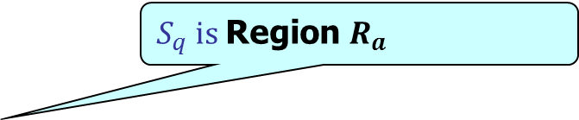



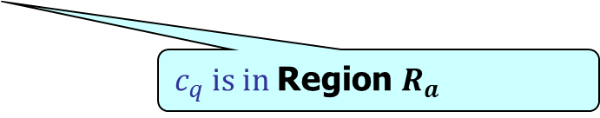
Our approach: dominance checking (4)
Equivalent condition (4): $S_{q}$ is in Region $R_{a}$
Equivalent condition (5): $c_{q}$ is in Region $R_{a}$ and $\min_{x∈P}Dist\left(c_{q},x\right)>r_{q}$
Boundary $P$: $Dist\left(x,cb\right)−Dist\left(x,c_{a}\right)=r_{a}{+r}_{b}$
$S_{q}$ is Region $R_{a}$
Region R_{a}
S_{q}
c_{q}
r_{q}
S_{a}
c_{a}
$c_{q}$ is in Region $R_{a}$
Region R_{b}
$$\min_{x∈P}Dist\left(c_{q},x\right)>r_{q}$$
$$\min_{x∈P}Dist\left(c_{q},x\right)$$
S_{b}
c_{b}

Slide 16
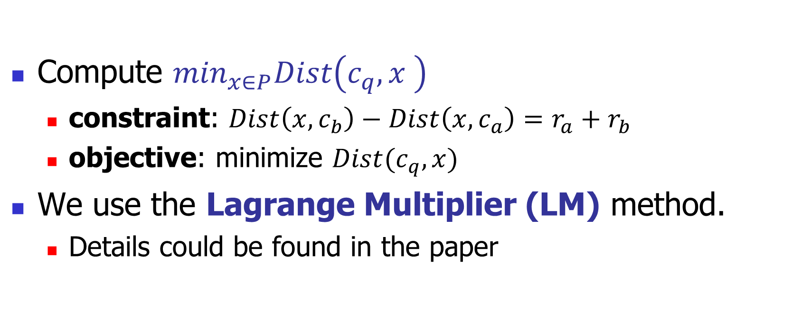
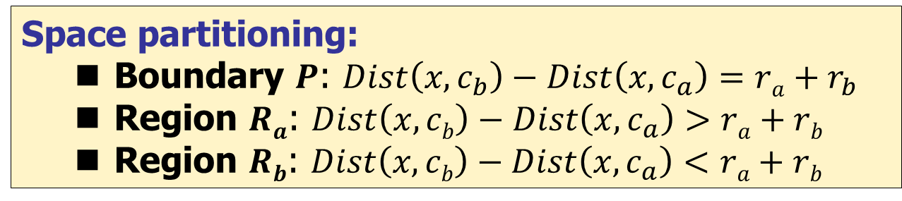
Our approach (2)
Space partitioning:
  Boundary $P$: $Dist\left(x,c_{b}\right)−Dist\left(x, c_{a}\right)=ra+r_{b}$
  Region $Ra$: $Dist\left(x,cb\right)−Dist\left(x,c_{a}\right)>ra+rb$
  Region $Rb$: $Dist\left(x,cb\right)−Dist\left(x,c_{a}\right)<ra+rb$
Equivalent condition (5): $c_{q}$ is in Region $R_{a}$ and $\min_{x∈P}Dist\left(c_{q},x\right)>r_{q}$
Compute $\min_{x∈P}Dist\left(c_{q},x \right)$
  constraint: $Dist\left(x,c_{b}\right)−Dist\left(x,c_{a}\right)=r_{a}+r_{b}$
  objective: minimize $Dist(c_{q},x)$
We use the Lagrange Multiplier (LM) method.
  Details could be found in the paper
correct
sound
efficient
The condition (3) is equivalent to the dominance condition
Each condition transformation takes O(d) time and the cost of LM is also O(d)

Slide 17
Empirical study: set-up
Criteria of a method:
  1. Correctness: No false positive (FP)
  2. Soundness: No false negative (FN)
  3. Efficiency: runs in O(d) where d is the number of dimensionality
Datasets:
  Real datasets: NBA, Color, Texture, and Forest
  Synthetic datasets
Algorithms:
  MinMax, MBR, GP, Trigonometric, Hyperbola (our method)
Measures:
  precision = TP/(TP+FP)
  recall = TP/(TP+FN)
  running time
A correct method has the precision always equal to 1
A sound method has the recall always equal to 1

Slide 18
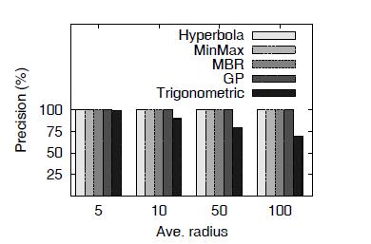
Empirical study: results (precision, NBA)
Methods | Correct? | Sound? | Efficient?
MinMax | Yes | No | Yes
MBR | Yes | No | Yes
GP | Yes | No | Yes
Trigonometric | No | Yes | Yes
Our approach | Yes | Yes | Yes
All algorithms except Trigonometric have precisions = 1.

Slide 19
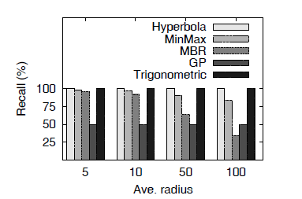
Empirical study: results (recall, NBA)
Methods | Correct? | Sound? | Efficient?
MinMax | Yes | No | Yes
MBR | Yes | No | Yes
GP | Yes | No | Yes
Trigonometric | No | Yes | Yes
Our approach | Yes | Yes | Yes
Only our approach (Hyperbola) and Trigonometirc have recalls = 1.

Slide 20
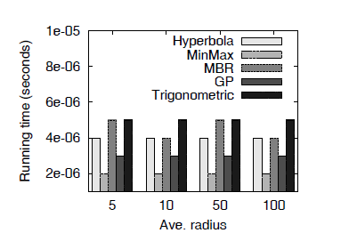
Empirical study: results (running time, NBA)
MinMax < GP < Hyperbola (our method) < MBR < Trigonometric

Slide 21
Conclusion
First solution for the hypersphere dominance problem, which is correct, sound and efficient for any dimension
An application study: kNN
Experiments

Slide 22
Q & A

Slide 23
The following slides are for backup use only

Slide 24
Hyperspheres in uncertain databases
Song and Roussopoulos [SSTD’01]
Cheng et al. [TKDE’04]
Chen and Cheng [ICDE’07]
Beskales et al. [PVLDB’08]

Slide 25
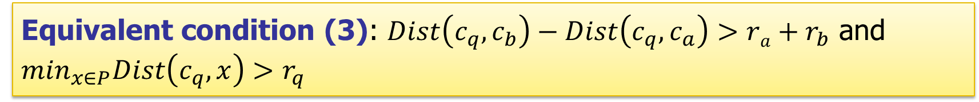
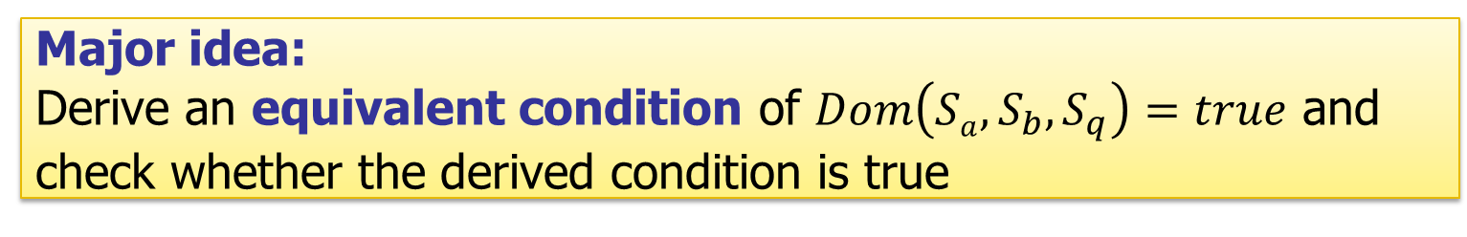
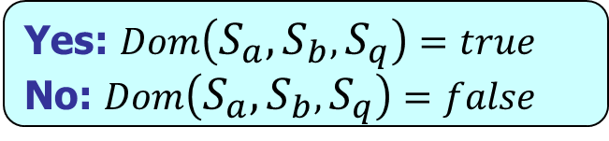
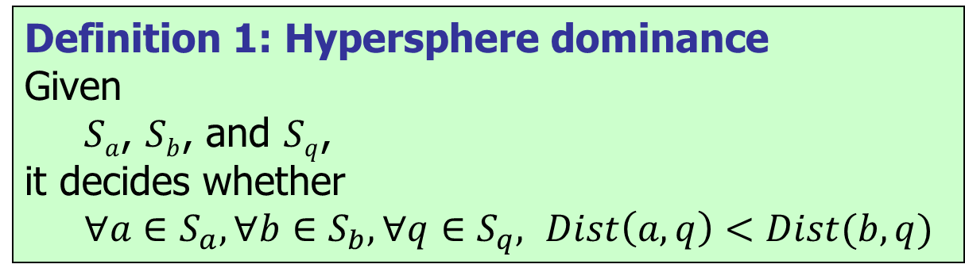
Our approach (1)
Definition 1: Hypersphere dominance
Given
  $Sa$, $Sb$, and $Sq$,
it decides whether
  $∀a∈S_{a}, ∀b∈S_{b},∀q∈S_{q},$ $Dist\left(a, q\right)<Dist(b,q)$
Dominance condition
Yes: $Dom\left(S_{a},S_{b},S_{q}\right)=true$
No: $Dom\left(S_{a},S_{b},S_{q}\right)=false$
Major idea:
Derive an equivalent condition of $Dom\left(Sa, S_{b},S_{q}\right)=true$ and check whether the derived condition is true
Dominance condition: $∀a∈S_{a}, ∀b∈S_{b},∀q∈S_{q}, Dist\left(a, q\right)<Dist(b,q)$
Equivalent condition (1): : $∀q∈S_{q}, MaxDist\left(q,S_{a}\right)<MinDist\left(q,S_{b}\right)$
Equivalent condition (2): $∀q∈S_{q}, Dist\left(q,cb\right)−Dist\left(q,c_{a}\right)>r_{a}+r_{b}$
Equivalent condition (3): $Dist\left(c_{q},c_{b}\right)−Dist\left(c_{q}, c_{a}\right)>ra+r_{b}$ and $\min_{x∈P}Dist\left(c_{q},x\right)>r_{q}$
$x∈P$: $Dist\left(x,c_{b}\right)−Dist\left(x, c_{a}\right)=ra+r_{b}$

Slide 26
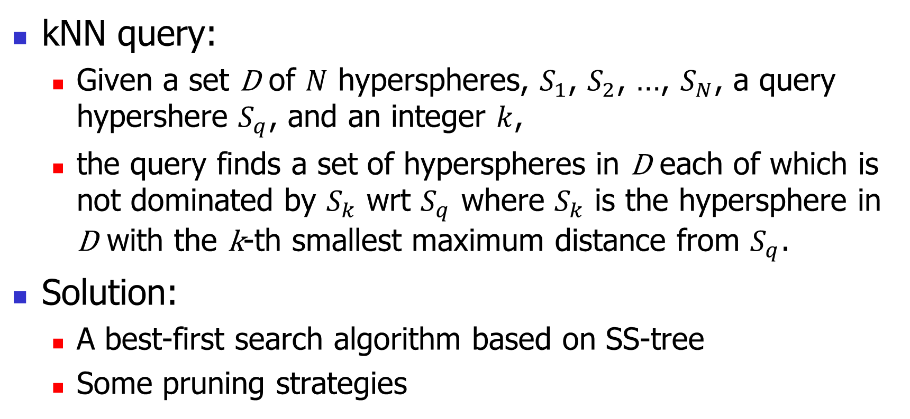
An application study: kNN qeury
kNN query:
  Given a set D of $N$ hyperspheres, $S_{1}$, $S_{2}$, …, $S_{N}$, a query hypershere $S_{q}$, and an integer $k$,
  the query finds a set of hyperspheres in D each of which is not dominated by $S_{k}$ wrt $S_{q}$ where $S_{k}$ is the hypersphere in D with the k-th smallest maximum distance from $S_{q}$.
Solution:
  A best-first search algorithm based on SS-tree
  Some pruning strategies

Slide 27
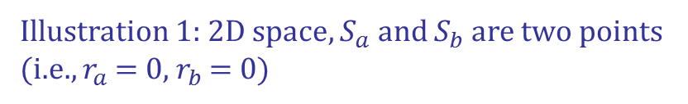



Boundary $P$: $Dist\left(x,cb\right)−Dist\left(x, c_{a}\right)=0$
Region R_{a}
S_{q}
c_{q}
S_{a} ($ca$)
S_{b} ($cb$)
Region R_{b}
Illustration 1: 2D space, $S_{a}$ and $S_{b}$ are two points (i.e., $r_{a}$ = 0, $r_{b}$ = 0)

