Slide 1
Viral Marketing for Dedicated Customers
Presented by: Cheng Long
25 August, 2012

Slide 2
Outline
Introduction
Problems
Solutions
Experimental results
Conclusion

Slide 3
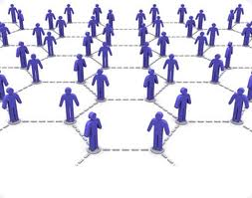
Viral Marketing
seed
Influenced user
Media:
  social network
Process:
  Target some initial users (seeds).
  Propagation.
Question:
  Which seeds in the social network should be targeted at the beginning?

Slide 4
Viral Marketing
A seed: a unit of cost
Scenario 1:
  Condition: at most k seeds.
  Goal: max. the number of influenced users.
Scenario 2:
  Condition: at least J influenced users.
  Goal: min. the number of seeds.
An influenced user: a unit of revenue
K-MAX-Influence
The cost is bounded.
the revenue.
J-MIN-Seed
The revenue requirement is provided.
the cost.
?
It is assumed that all users in the social network are of interest!
A book in Latin
A Chinese

Slide 5
Interest-Specified Viral Marketing
A new paradigm of Viral Marketing
  The company can specify which users in the social network are of interest.
  Interest-Specified Viral Marketing
User
gender, age, addr.
Product’s target
middle-aged, male
male, 30, HK
female, 9, HK
yes
no

Slide 6
Outline
Introduction
Problems
Solutions
Experimental results
Conclusion

Slide 7
Problems
Under the Interest-Specified Viral Marketing paradigm
Scenario 1:
  Condition: at most k seeds.
  Goal: max. the number of influenced users.
Scenario 2:
  Condition: at least J influenced users.
  Goal: min. the number of seeds.
Product’s target
a₁, a₂, …, a_{m}
IS-K-MAX-Influence
Max. the number of influenced users that are of interest.
At least J_{i} influenced users containing attribute value a_{i} for i = 1, 2, …, m.
IS-J-MIN-Seed
 | Stock of clothes
Young | 100
Mid-aged | 200
Old | 50
a₁ = young,
a₂ = mid-aged
a₃= old
J₁ = 100, J₂ = 200, J₃ = 50.

Slide 8
Problems
Traditional Viral Marketing paradigm
Interest-Specified Viral Marketing paradigm
Scenario 1
k-MAX-Influence
IS-k-MAX-Influence
Scenario 2
J-MIN-Seed
IS-J-MIN-Seed
More general, more flexible
NP-hard!

Slide 9
Outline
Introduction
Problem
Solutions
Experimental results
Conclusion

Slide 10
IS-MAX-Influence
Greedy algorithm (MI-Greedy):
  S: seed set.
  Set S to be empty.
  For i=1 to k
    Add the user that incurs the largest gain into S.
  Return S
We prove that MI-Greedy provides a 0.63-factor approximation.
Gain: the increase of the number of influenced users that are of interest

Slide 11
IS-J-MIN-Seed
At least J_{i} influenced users containing attribute value a_{i} for i = 1, 2, …, m
Three approximate algorithms
  MS-Independent
  MS-Incremental
  MS-Greedy
Among these algorithms, MS-Independent and MS-Greedy provide a certain degree of error guarantees.

Slide 12
Outline
Introduction
Problems
Solutions
Experimental results
Conclusion

Slide 13
Experiment set-up
Real datasets:
  HEP-T, Epinions, Amazon, DBLP
Baselines:
  Random
  Degree-heuristic
  Centrality-heuristic

Slide 14
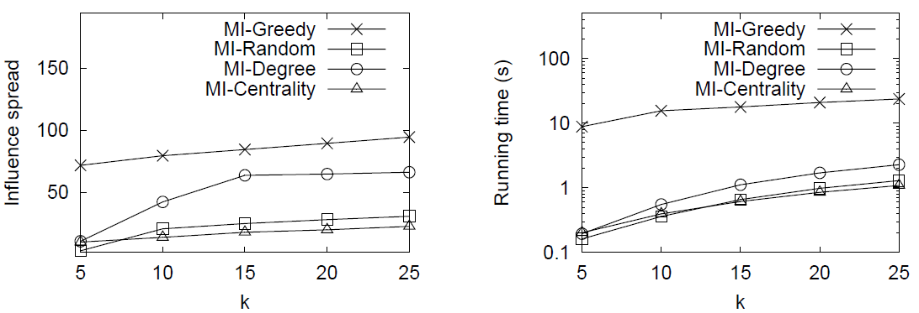
Results for IS-k-MAX-Influence
No. of influenced users that are of interest
Running time
Conclusion: our MI-Greedy beats all the baselines in terms of quality but runs slower.

Slide 15
Outline
Introduction
Problems
Solutions
Experimental results
Conclusion

Slide 16
Conclusion
We propose a new paradigm of Viral Marketing, Interest-Specified Viral Marketing, which is more general and flexible than the traditional one.
Within the new paradigm, We study two typical problems, IS-k-MAX-Influence and IS-J-MIN-Seed.
We conducted extensive experiments which verified the effectiveness of our algorithms.

Slide 17
Q & A
Thank you. ☺

