Slide 1
Learning on Probabilistic Labels
Peng Peng, Raymond Chi-wing Wong, Philip S. Yu
CSE, HKUST

Slide 2
Outline
Introduction
Motivation
Contributions
Related Works
Challenges
Methodologies
Theory Results
Experiments
Conclusion

Slide 3
Introduction
Binary classification:
  Learn a classifier based on a set of labeled instances
  Predict the class of an unobserved instance based on the classifier

Slide 4

Introduction
Deterministic label: $Y$
Probabilistic Label: $P(Y=1|X=x)$.

Slide 5

Introduction
Deterministic label: 0 or 1.
Probabilistic Label: a real number $f∈[0,1]$.
0
0
0.3
0
1
1
0
0.7
0.2
0
0.6
0
0.4
0.1
1
0.8
1
0
0.7
0.4
1
0
0.2
0.6
1
1
1
1
0
0.9
0.6
0.3

Slide 6
Introduction
There are many applications where the instances are labeled with fractional scores.
  An instance is labeled with multiple labelers and there are disagreements among these labelers.
  The domain expert cannot give a deterministic label for an instance.
  The instances themselves are uncertain with a deterministic label.

Slide 7
Introduction
We aims at learning a classifier from a training dataset with probabilistic labels.
0.3
0
0.7
0.2
0.6
0.8
0.4
0.1
0.7
0.4
0.2
0.6
1
0.3
0.9
0.6

Slide 8
Motivation
In many real scenarios, probabilistic labels are available.
  Crowdsourcing
  Medical Diagnosis
  Pattern Recognition
  Natural Language Processing

Slide 9
Motivation
Crowdsourcing:
  The labelers may disagree with each other so a determinant label is not accessible but a probabilistic label is available for an instance.
Medical Diagnosis:
  The labels in a medical diagnosis are normally not deterministic. The domain experts (e.g., a doctor) can give a probability that a patient suffers from some diseases.
Pattern Recognition:
  It is sometimes hard to label an image with low resolution (e.g., an astronomical image) .

Slide 10
Contributions
We propose a way to learn from a dataset with probabilistic labels.
We prove theoretically that compared with learning from deterministic labels, learning from probabilistic labels leads to a faster rate of convergence (i.e., error bound).
We give an extensive experimental studies on our proposed method.
Significance of our work: our result shows that probabilistic datasets can enhance the performance of many existing learning algorithms if used properly. Besides, a lot of recent studies can use our error bound for their error analysis.
  “Proper Losses for Learning from Partial Labels” (NIPS 2012)
  “Estimating Labels from Label Proportions” (JMLR 2009)
  “SVM Classifier Estimation from Group Probabilities” (ICML 2010)

Slide 11
Related Works
Variations of labels in classification:
  Multiple labels
  Partial labels
  Probabilistic labels

Slide 12
Challenges
How to learn from a probabilistic dataset ?
How to theoretically guarantee that learning from probabilistic labels is more efficient than learning from deterministic labels ?

Slide 13
Methodologies
Gaussian Process Regression (GPR)
  We regard the problem of learning from probabilistic labels as a regression problem.
Why GPR ?
  GPR is a hybrid method of statistical learning and Bayesian learning
  We can simultaneously derive an error bound (based on the statistical learning theory) and obtain an efficient solution (based on the Bayesian method).
Notes:
Normally, the algorithms wrt. statistical learning theory are non-tractable

Slide 14
Challenges
How to learn from a probabilistic dataset ?
How to theoretically guarantee that learning from probabilistic labels is more efficient than learning from deterministic labels ?

Slide 15
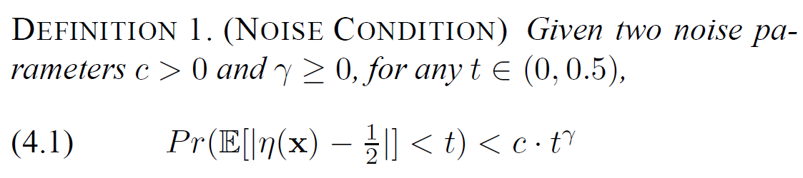

Methodologies
Tsybakov Noise Condition:
  $η\left(x\right)=Pr⁡(Y=1|X=x)$, i.e., the probability that the instance $x$ is labeled with $1$.
  $η\left(x\right)∈[0,1]$.
  This noise condition describes the relationship between the data density and the distance from a sampled data point to the decision boundary.

Slide 16






Methodologies
Tsybakov Noise Condition:
  Let $t =0.3$.
$$Pr⁡(E\left[\left|η\left(x\right)−\frac{1}{2}\right|\right]<0.3)$$
1
$$Volume<c⋅{0.3}^{γ}$$
0.2
0.5
0.8
$$η\left(x\right)$$
0
1

Slide 17




Methodologies
Tsybakov Noise Condition:
  Let $t =0.4$.
$$Pr⁡(E\left[\left|η\left(x\right)−\frac{1}{2}\right|\right]<0.4)$$
1
1
$$Volume<c⋅{0.4}^{γ}$$
0.1
0
0.9
1
$$η\left(x\right)$$
0.5

Slide 18







Methodologies
Tsybakov noise:
  The density of the points becomes smaller when the points are close to the decision boundary (i.e., $η(x)$ is close to $\frac{1}{2}$).
$$Pr⁡(E\left[\left|η\left(x\right)−\frac{1}{2}\right|\right]<0.3)$$
$$Pr⁡(E\left[\left|η\left(x\right)−\frac{1}{2}\right|\right]<0.4)$$
1
1
$$Volume<c⋅{0.3}^{γ}$$
$$Volume<c⋅{0.4}^{γ}$$
0.2
0.5
0.8
$$η\left(x\right)$$
0.1
0
0.9
1
$$η\left(x\right)$$
0
1
0.5

Slide 19

Methodologies
Tsybakov noise:
  Given a random instance $x$, the probability that $E[\left|η\left(x\right)−\frac{1}{2}\right|]$ is less than 0.3 is less than $c⋅{0.3}^{γ}$;
  When $c$ is larger, the probability is higher so the data is more noisy;
  when $γ$ is larger, the probability is smaller so the data is less noisy.

Slide 20

Methodologies
Strategies:
  1. Estimate $\hat{η}(⋅)$ by using the method of Gaussian Process Regression.
  2. Given an instance $x$, the classifier $h\left(x\right)=I_{\hat{η}\left(x\right)≥0.5}$. That is, if $\hat{η}(x)$ is at least 0.5, we predict 1; otherwise, we predict 0.

Slide 21
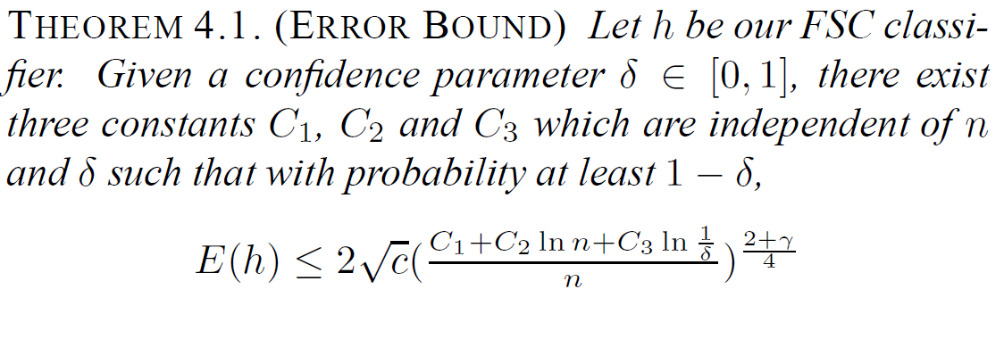

Theoretical Results
Error bound: Let $E(h)$be the excess error of the classifier $h$, which is the difference between the expected error of $h$ and the expected error of $h^{∗}$, where $h^{∗}$ is the optimal classifier achieving the minimum expected error.

Slide 22
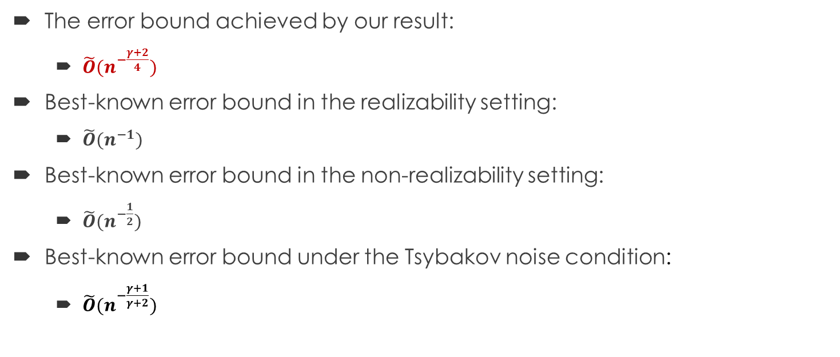
Theoretical Results
The error bound achieved by our result:
  $\tilde{O}(n^{−\frac{γ+2}{4}})$
Best-known error bound in the realizability setting:
  $\tilde{O}(n^{−1})$
Best-known error bound in the non-realizability setting:
  $\tilde{O}(n^{−\frac{1}{2}})$
Best-known error bound under the Tsybakov noise condition:
  $\tilde{O}(n^{−\frac{γ+1}{γ+2}})$
Notes:
Explain Otilde in this slide: We hide the component ln n in the asymptotic results, which can be eliminated by some dedicated techniques.

Slide 23
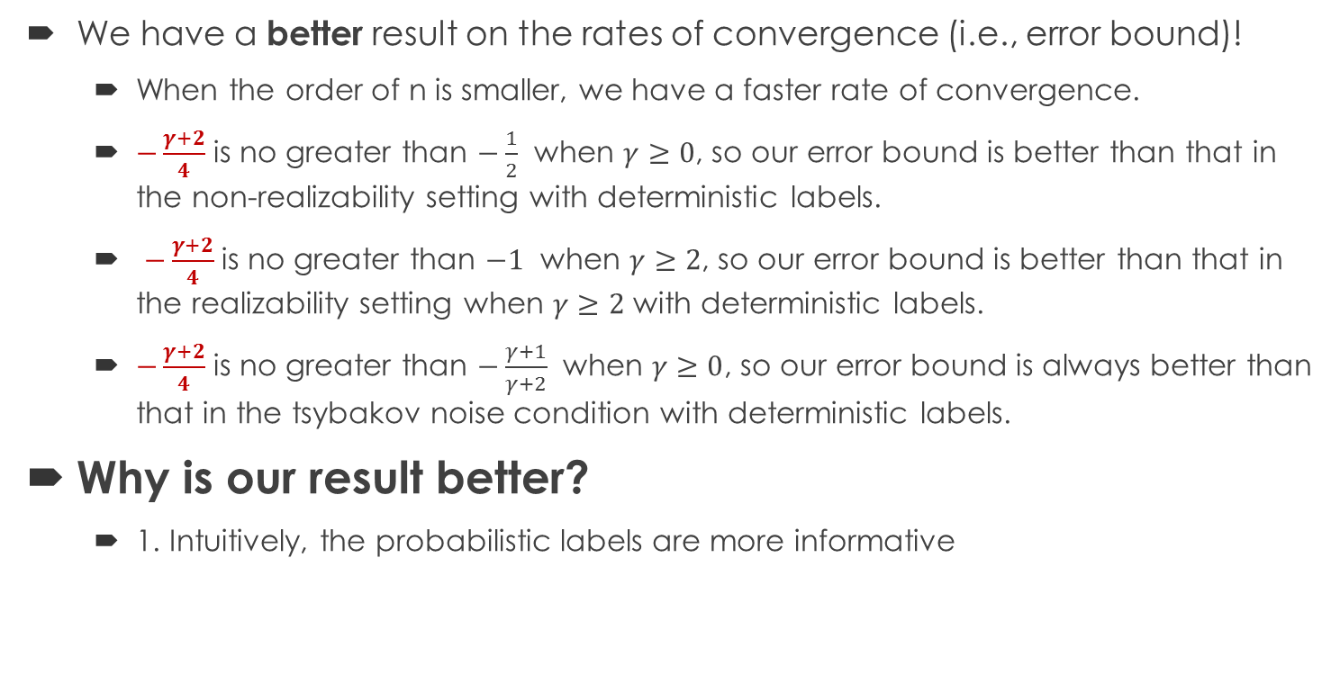
Theoretical Results
We have a better result on the rates of convergence (i.e., error bound)!
  When the order of n is smaller, we have a faster rate of convergence.
  $−\frac{γ+2}{4}$ is no greater than $−\frac{1}{2}$ when $γ≥0$, so our error bound is better than that in the non-realizability setting with deterministic labels.
  $−\frac{γ+2}{4}$ is no greater than $−1$ when $γ≥2$, so our error bound is better than that in the realizability setting when $γ≥2$ with deterministic labels.
  $−\frac{γ+2}{4}$ is no greater than $−\frac{γ+1}{γ+2}$ when $γ≥0$, so our error bound is always better than that in the tsybakov noise condition with deterministic labels.
Why is our result better?
  1. Intuitively, the probabilistic labels are more informative

Slide 24
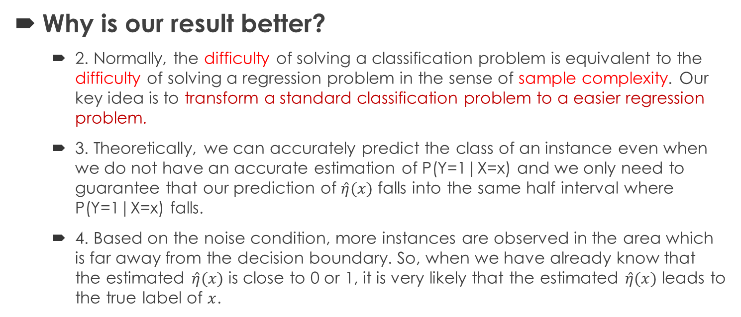
Theoretical Results
Why is our result better?
  2. Normally, the difficulty of solving a classification problem is equivalent to the difficulty of solving a regression problem in the sense of sample complexity. Our key idea is to transform a standard classification problem to a easier regression problem.
  3. Theoretically, we can accurately predict the class of an instance even when we do not have an accurate estimation of P(Y=1|X=x) and we only need to guarantee that our prediction of $\hat{η}(x)$ falls into the same half interval where P(Y=1|X=x) falls.
  4. Based on the noise condition, more instances are observed in the area which is far away from the decision boundary. So, when we have already know that the estimated $\hat{η}(x)$ is close to 0 or 1, it is very likely that the estimated $\hat{η}(x)$ leads to the true label of $x$.

Slide 25
Experiments
Datasets:
  1st type: a crowdsourcing dataset (Yahoo!News)
  2nd type: several real datasets for regression
  3rd type: a movie review dataset (IMDb)
Setup:
  A 10-fold cross-validation
Measurements:
  The average accuracy
  The p-value of paired t-test

Slide 26
Experiments
Algorithms for comparison:
  The traditional method (Trad. Method)
  The order-based method (OM)
  The partial method (Partial)
  The difficult method (Difficult)
  Our algorithm (FSC)
Notes:
Trad. Method: Baseline algorithm
Order-based method: which works on the same problem as ours
Partial method: which works on the partial labels which can be transformed from the probabilistic labels
Difficult method: which the labeler refuses to label instance when he or she is not confident to label it with a deterministic label.

Slide 27
Experiments
The traditional method (Trad. Method):
  We adopt the standard SVM algorithm (with RBF kernel).
  Learn a classifier by the idea of margin maximization.
The order-based method (OM):
  This method is based on the paper “Learning Classification with Auxiliary Probabilistic Information” (ICDM 2011).
  Maintain the partial order between any two instances (based on the probabilistic information) when learning a classifier.
The partial method (Partial):
  This method is based on the paper “Classification with Partial Labels” (KDD 2008).
  Maintain the partial order between any two instances (based on the probabilistic information) when learning a classifier.
The difficult method (Difficult) :
  This method is based on the paper “Who Should Label What? Instance Allocation in Multiple Experts Active Learning” (SDM 2011).
  The labeler refuses to label an instance when he or she considers labeling this instance is difficult.

Slide 28
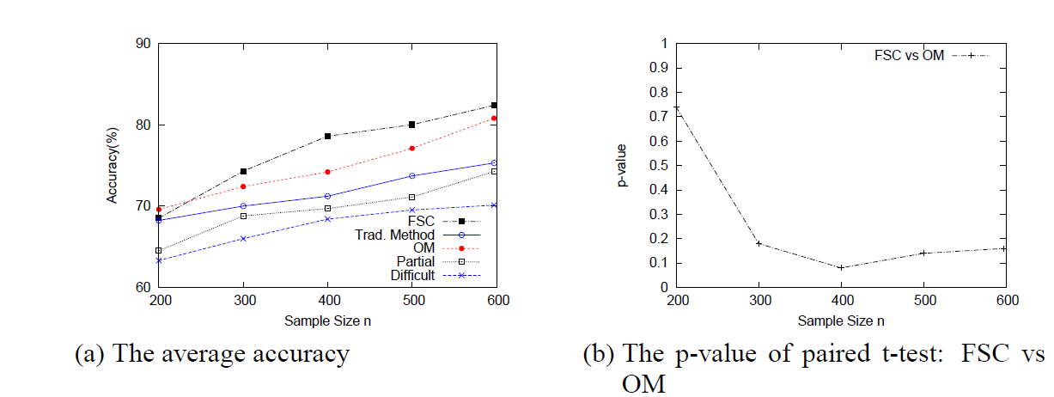
Experiments
Yahoo!News Dataset (Business, Politics and Technique)
Business vs Politics

Slide 29
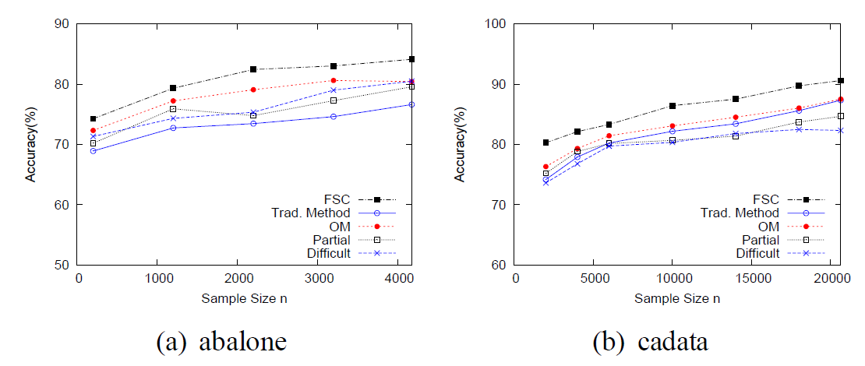
Experiments
Effect of sample size n on the accuracies of classifiers

Slide 30
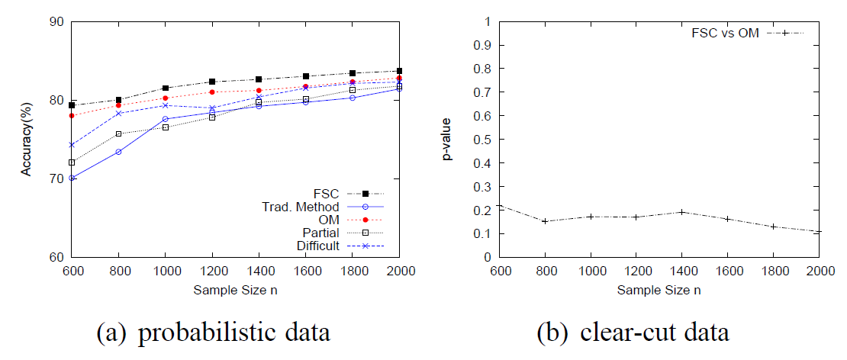
Experiments
IMDb dataset with the paired t-test: FSC vs OM

Slide 31
Conclusion
We propose to learn from probabilistic labels.
We prove that learning from probabilistic labels is more efficient than learning from deterministic labels.
We give an extensive experimental study on our proposed method.

Slide 32
THANK YOU!

Slide 33
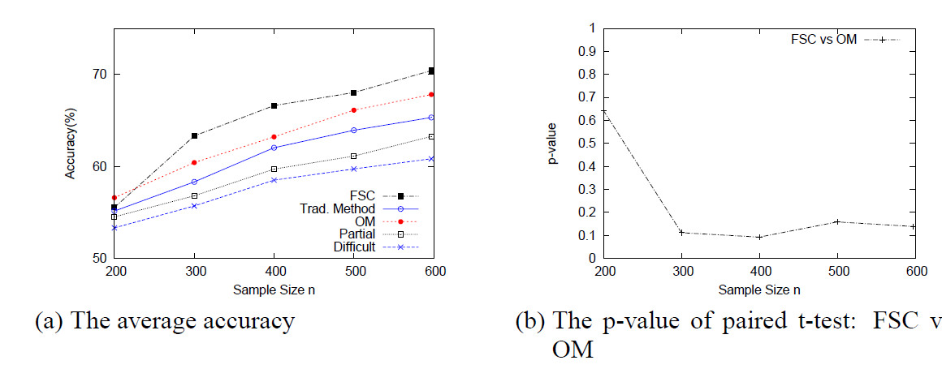
Experiments
Yahoo!News Dataset
Business vs Technique

Slide 34

Experiments
Yahoo!News Dataset
Politics vs Technique

Slide 35
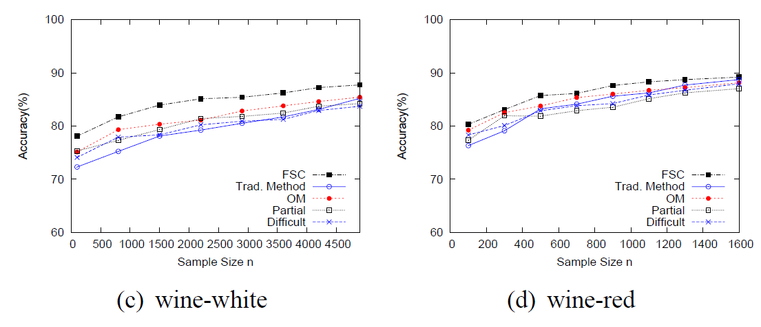
Experiments
Effect of sample size n on the accuracies of classifiers

