Slide 1
Selective Sampling on Probabilistic Labels
Peng Peng, Raymond Chi-Wing Wong
CSE, HKUST

Slide 2
Outline
Introduction
Motivation
Contributions
Methodologies
Theory Results
Experiments
Conclusion

Slide 3
Introduction
Binary Classification
  Learn a classifier based on a set of labeled instances
  Predict the class of an unobserved instance based on the classifier

Slide 4
Introduction
Question: how to obtain such a training dataset?
  Sampling and labeling!
It takes time and effort to label an instance.
Because of the limitation on the labeling budget, we expect to get a high-quality dataset with a dedicated sampling strategy.

Slide 5
Introduction
Random Sampling:
  The unlabeled instances are observed sequentially
  Sample every observed instance for labeling

Slide 6
Introduction
Selective Sampling:
  The data can be observed sequentially
  Sample each instance for labeling with probability

Slide 7
Introduction
What is the advantage of a classification with selective sampling ?
  It saves the budget for labeling instances.
  Compared with random sampling, the label complexity is much lower to achieved the same accuracy based on the selective sampling.

Slide 8

Introduction
Deterministic label: 0 or 1.
Probabilistic Label: a real number $f∈[0,1]$ (which we call Fractional Score).
0
0
0.3
0
1
1
0
0.7
0.2
0
0.6
0
0.4
0.1
1
0.8
1
0
0.7
0.4
1
0
0.2
0.6
1
1
1
1
0
0.9
0.6
0.3

Slide 9
Introduction
We aims at learning a classifier by selectively sampling instances and labeling them with probabilistic labels.
0.3
0
0.7
0.2
0.6
0.8
0.4
0.1
0.7
0.4
0.2
0.6
1
0.3
0.9
0.6

Slide 10
Motivation
In many real scenarios, probabilistic labels are available.
  Crowdsourcing
  Medical Diagnosis
  Pattern Recognition
  Natural Language Processing

Slide 11
Motivation
Crowdsourcing:
  The labelers may disagree with each other so a determinant label is not accessible but a probabilistic label is available for an instance.
Medical Diagnosis:
  The labels in a medical diagnosis are normally not deterministic. The domain experts (e.g., a doctor) can give a probability that a patient suffers from some diseases.
Pattern Recognition:
  It is sometimes hard to label an image with low resolution (e.g., an astronomical image) .

Slide 12
Contributions
We propose a sampling strategy for labeling instances with probabilistic labels selectively
We display and prove an upper bound on the label complexity of our method in the setting probabilistic labels.
We show the prior performance of our proposed method in the experiments.
Significance of our work: It gives an example of how we can theoretically analyze the learning problem with probabilistic labels.

Slide 13
Methodologies
Importance Weight Sampling Strategy (for each single round):
  Compute a weight ([0,1]) of a newly observed unlabeled instance;
  Flip a coin based on the weight value and determine whether to label or not.
  If we determine to label this instance, then add the newly labeled instance into the training dataset and call a passive learner (i.e., a normal classifier) to learn from the updated training dataset.

Slide 14
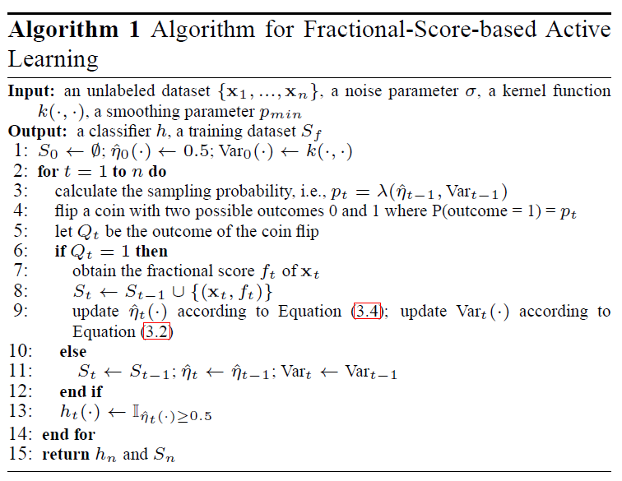
Methodologies

Slide 15


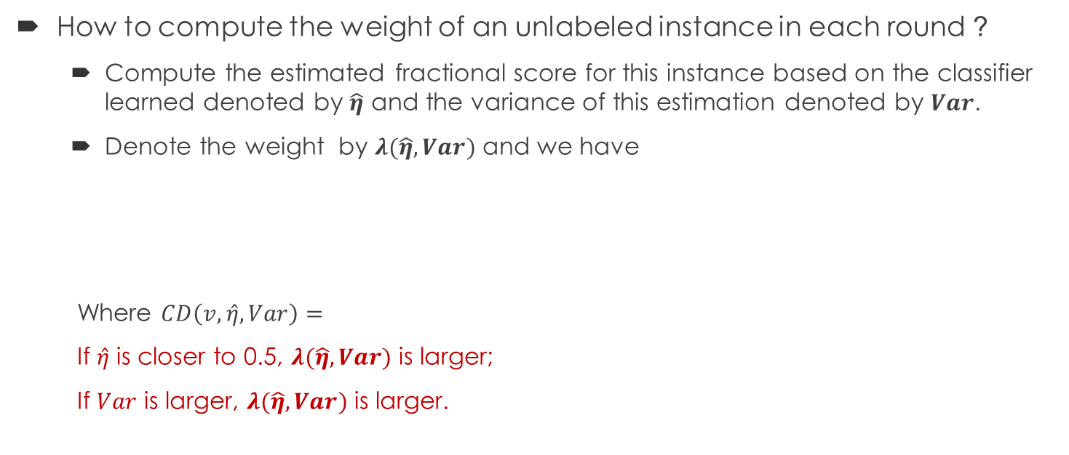
Methodologies
How to compute the weight of an unlabeled instance in each round ?
  Compute the estimated fractional score for this instance based on the classifier learned denoted by $\hat{η}$ and the variance of this estimation denoted by $Var$.
  Denote the weight by $λ(\hat{η},Var)$ and we have
  Where $CD\left(v, \hat{η},Var\right)=$
  If $\hat{η}$ is closer to 0.5, $λ(\hat{η},Var)$ is larger;
  If $Var$ is larger, $λ(\hat{η},Var)$ is larger.

Slide 16
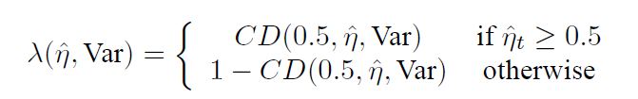
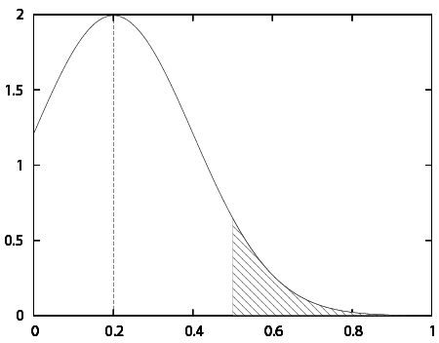
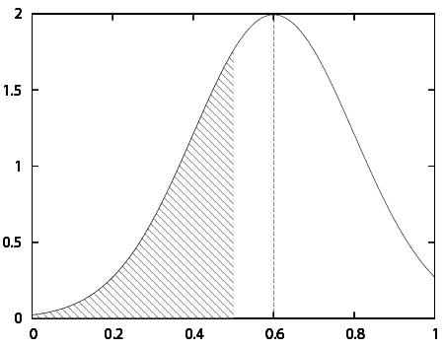

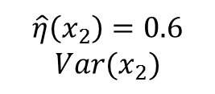
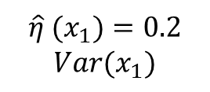

Methodologies
Example:
$$\hat{η} (x_{1})=0.2$$
$$Var(x_{1})$$
$$\hat{η}\left(x_{2}\right)=0.6$$
$$Var(x_{2})$$
$$λ(\hat{η}(x_{2}),Var(x_{2}))$$
$$λ(\hat{η}\left(x_{1}\right),Var\left(x_{1}\right))$$

Slide 17

Methodologies
Tsybakov Noise Condition:
  $η\left(x\right)=Pr⁡(Y=1|X=x)$, i.e., the probability that the instance $x$ is labeled with $1$.
  $η\left(x\right)∈[0,1]$.
  This noise condition describes the relationship between the data density and the distance from a sampled data point to the decision boundary.

Slide 18
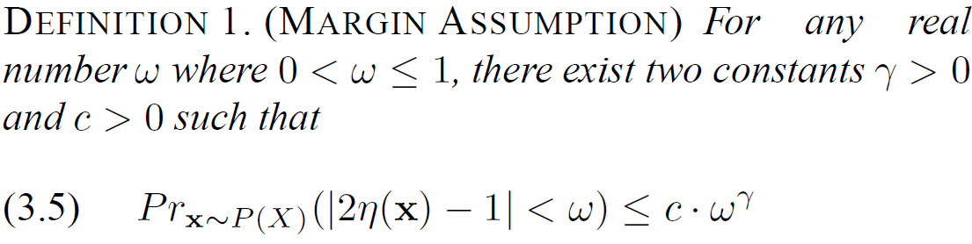

Methodologies
Tsybakov Noise Condition:
  $η\left(x\right)=Pr⁡(Y=1|X=x)$, i.e., the probability that the instance $x$ is labeled with $1$.
  $η\left(x\right)∈[0,1]$.
  This assumption describes the relationship between the data density and the distance from a sampled data point to the decision boundary.

Slide 19






Methodologies
Tsybakov Noise Condition:
  Let $ω =0.6$.
$$Pr⁡(|2η\left(x\right)−1|<0.6)$$
1
$$Volume<c⋅{0.6}^{γ}$$
$$\left|2η\left(x\right)−1\right|$$
0.6
1

Slide 20




Methodologies
Tsybakov Noise Condition:
  Let $ω =0.8$.
$$Pr⁡(|2η\left(x\right)−1|<0.8)$$
1
$$Volume<c⋅{0.8}^{γ}$$
$$|2η\left(x\right)−1|$$
0.8
1

Slide 21



Methodologies
Tsybakov noise:
  The density of the points becomes smaller when the points are close to the decision boundary (i.e., $η(x)$ is close to $\frac{1}{2}$).
1
1
$$Volume<c⋅{0.6}^{γ}$$
$$Volume<c⋅{0.8}^{γ}$$
0.6
1
0.8
1

Slide 22

Methodologies
Tsybakov noise:
  Given a random instance $x$, the probability that $E[\left|η\left(x\right)−\frac{1}{2}\right|]$ is less than 0.3 is less than $c⋅{0.3}^{γ}$;
  When $c$ is larger, the probability is higher so the data is more noisy;
  when $γ$ is larger, the probability is smaller so the data is less noisy.

Slide 23
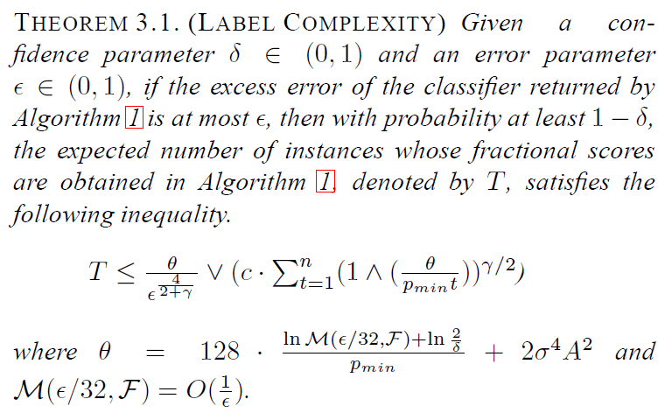
Theoretical Results

Slide 24
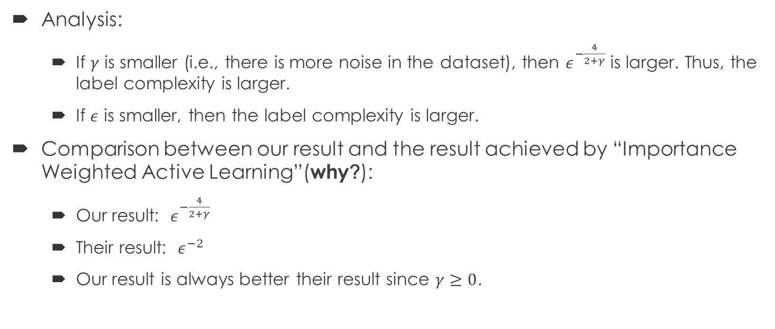
Theoretical Results
Analysis:
  If $γ$ is smaller (i.e., there is more noise in the dataset), then $ε^{−\frac{4}{2+γ}}$ is larger. Thus, the label complexity is larger.
  If $ε$ is smaller, then the label complexity is larger.
Comparison between our result and the result achieved by “Importance Weighted Active Learning”(why?):
  Our result: $ε^{−\frac{4}{2+γ}}$
  Their result: $ε^{−2}$
  Our result is always better their result since $γ≥0$.
Notes:
Reason for comparison between our work and the importance weighted active learning

Slide 25
Experiments
Datasets:
  1st type: several real datasets for regression (breast-cancer, housing, wine-white, wine-red)
  2nd type: a movie review dataset (IMDb)
Setup:
  A 10-fold cross-validation
Measurements:
  The average accuracy
  The p-value of paired t-test
Algorithms (Why?):
  Passive (the passive learner we call in each round)
  Active (the original importance weighted active learning algorithm)
  FSAL (our method)
Notes:
We compare our algorithm with passive to see the effect of our selective sampling strategy
We compare our algorithm with active to see the effect of using probabilistic labels
3. Active is the first efficient/tractable active learning algorithm which achieves a theoretical guarantee on the label complexity.
We also used the importance weighted sampling strategy in our algorithm. But we define a different weight for sampling based on the probabilistic information.

Slide 26
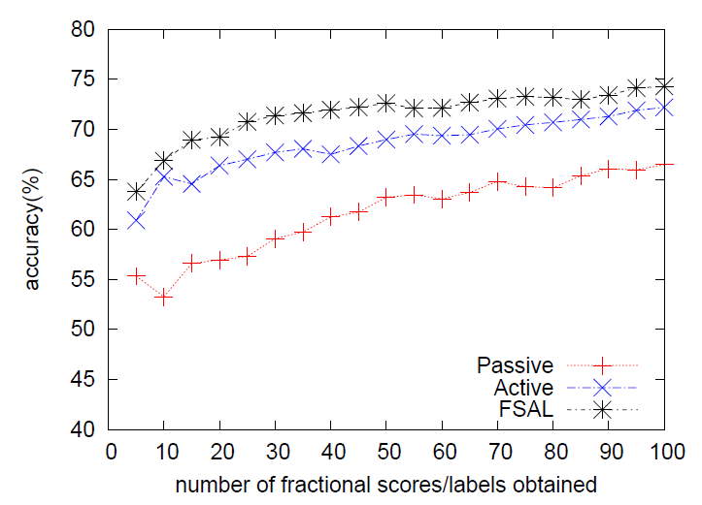
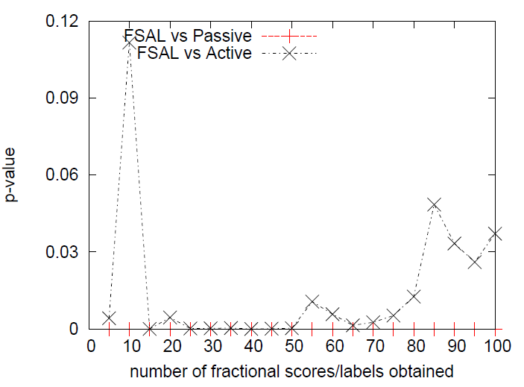
Experiments
The breast-cancer dataset
The average accuracy of Passive, Active and FSAL
The p-value of two paired t-test: “FSAL vs Passive” and “FSAL vs Active”

Slide 27
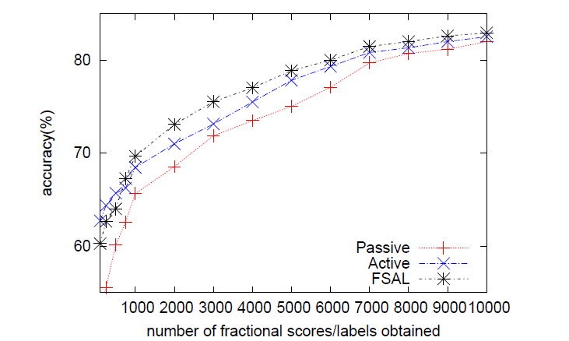
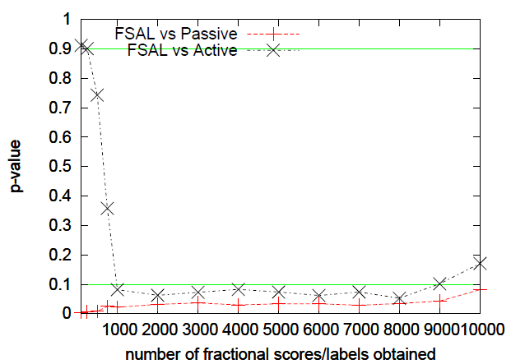
Experiments
The IMDb dataset
The average accuracy of Passive, Active and FSAL
The p-value of two paired t-test: “FSAL vs Passive” and “FSAL vs Active”

Slide 28
Conclusion
We propose a selectively sampling algorithm to learn from probabilistic labels.
We prove that selectively sampling based on the probabilistic labels is more efficient than that based on the deterministic labels.
We give an extensive experimental study on our proposed learning algorithm.

Slide 29
THANK YOU!

Slide 30
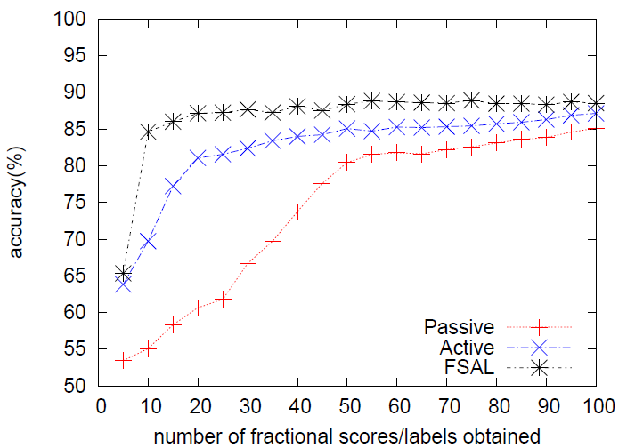
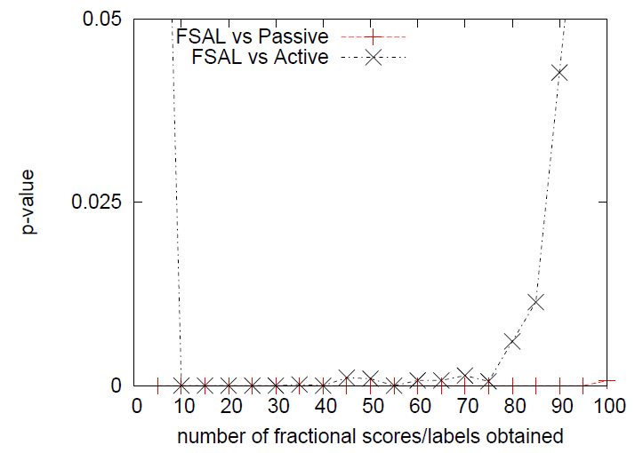
Experiments
The housing dataset
The average accuracy of Passive, Active and FSAL
The p-value of two paired t-test: “FSAL vs Passive” and “FSAL vs Active”

Slide 31
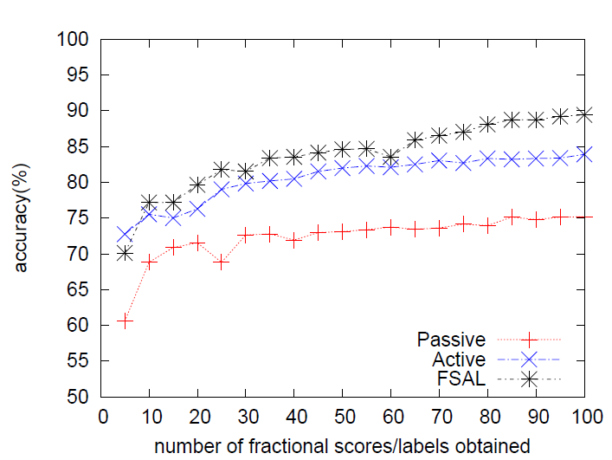
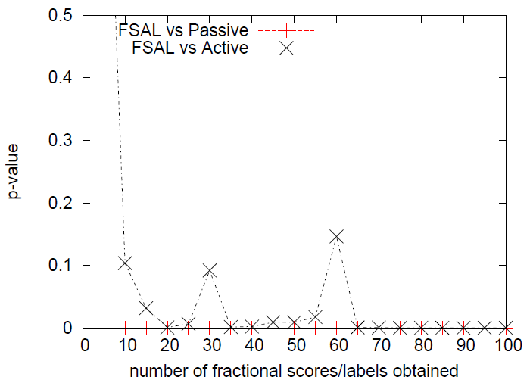
Experiments
The wine-white dataset
The average accuracy of Passive, Active and FSAL
The p-value of two paired t-test: “FSAL vs Passive” and “FSAL vs Active”

Slide 32
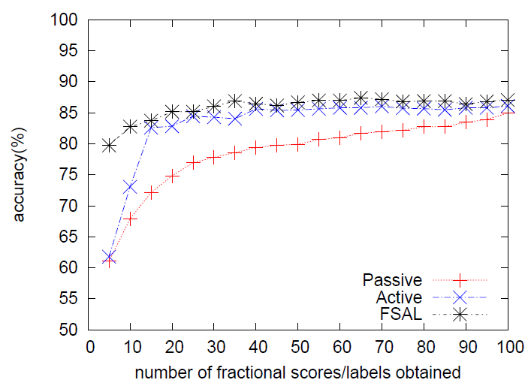
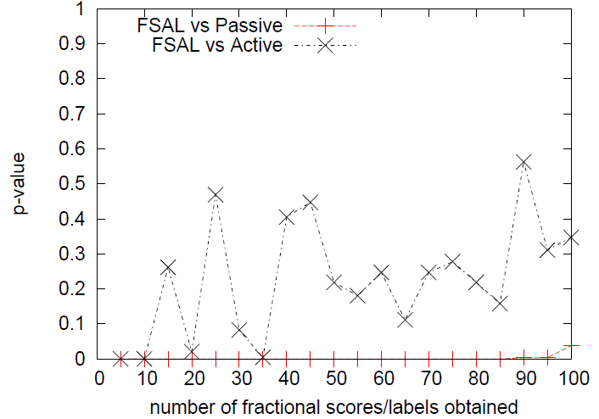
Experiments
The wine-red dataset
The average accuracy of Passive, Active and FSAL
The p-value of two paired t-test: “FSAL vs Passive” and “FSAL vs Active”

