Slide 1
Finding Top-k Profitable Products
Qian Wan, Raymond Chi-Wing Wong, Yu Peng
The Hong Kong University of Science & Technology
Prepared by Yu Peng

Slide 2


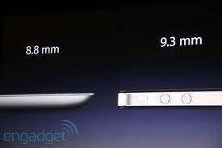



Product Manager’s Dilemma
?
ipad
ipad 2
ipad3

Slide 3

Product Manager’s Dilemma
?

Slide 4

Product Manager’s Dilemma
?
ipad : $ 499
Suit: $600

Slide 5








Product Manager’s Dilemma
?

Slide 6
Product Manager’s Dilemma
 | Weigth (g) | Processor | Camera | Price ($)
ipad | 730/608 | Apple A4 | None | 499->399
ipad 2 | 613/601 | Apple A5 | 2 | 499
ipad 3 | ? | ? | ? | ?
 | Weigth (g) | Processor | Camera | Price ($) | Cost
ipad 3 v1 | 500 | Apple A5 | 2 | ? | 500
ipad 2 v2 | 500 | Apple A6 | 2 | ? | 600
ipad 3 v3 | 100 | Apple A6 | 4 | ? | 2000
Which to produce?

Slide 7
Outline
Problem Definition
Related Work
Proposed Algorithms
Experiments
Conclusion

Slide 8
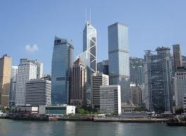

Problem Definition
Background
  Skyline SKY(X)
  $SKY(X)$ contains all the elements in $X$ such that any other elements in $X$ are not better than them.
Products | Distance-to-beach | Price | Cost
p₁ | 7.0 | 200
p₂ | 4.0 | 350
p₃ | 1.0 | 500
p₄ | 3.0 | 600
X={p₁,p₂,p₃,p₄}
SKY(X)={p₁,p₂,p₃}

Slide 9
Problem Definition
Background
Products | Distance-to-beach | Price | Cost
p₁ | 7.0 | 200
p₂ | 4.0 | 350
p₃ | 1.0 | 500
p₄ | 3.0 | 600
q₁ | 5.0 | ? | 100
q₂ | 4.5 | ? | 200
q₃ | 1.5 | ? | 400
X={p₁,p₂,p₃,p₄,q₁,q₂,q₃}
SKY(X)={p₁,p₂,p₃,q₁,q₂,q₃}
What prices of q₁,q₂ and q₃ should we set?

Slide 10
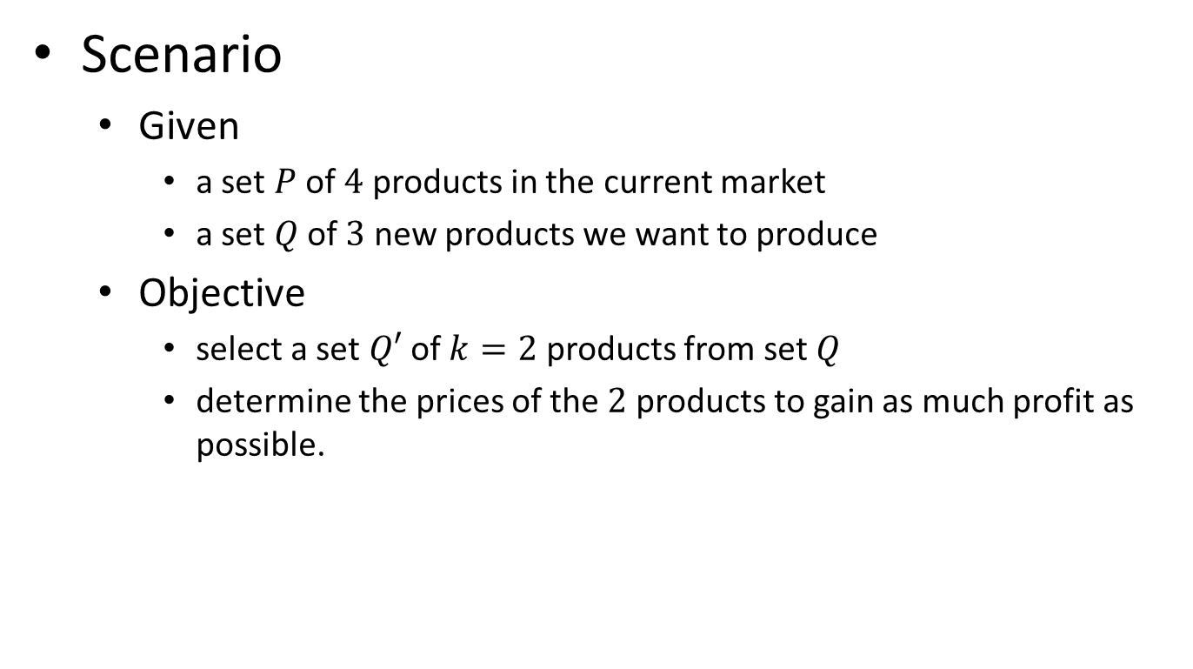
Problem Definition
Scenario
  Given
    a set $P$ of $4$ products in the current market
    a set $Q$ of $3$ new products we want to produce
  Objective
    select a set $Q′$ of $k=2$ products from set $Q$
    determine the prices of the $2$ products to gain as much profit as possible.

Slide 11
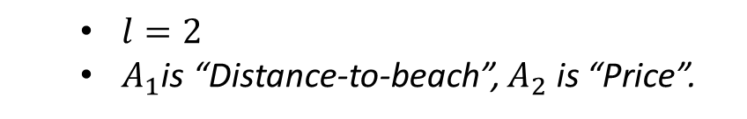
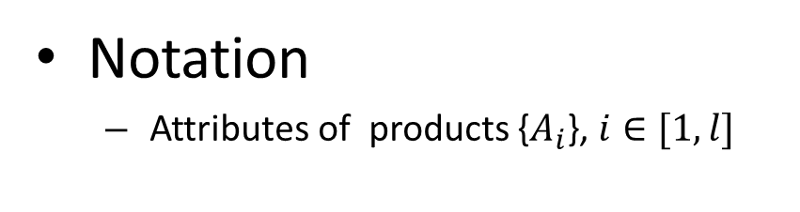
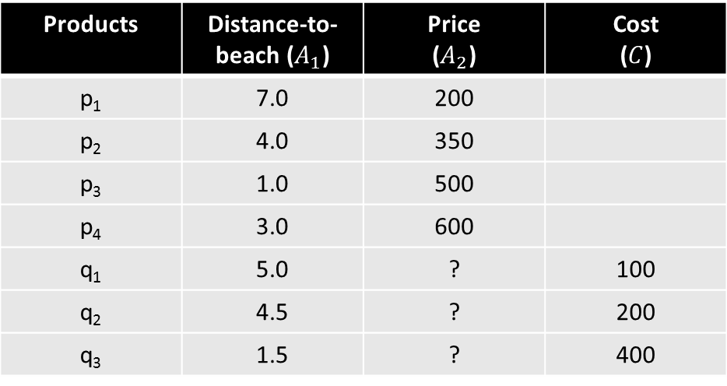
Problem Definition
Notation
  Attributes of products {$A_{i}$}, $i∈[1,l]$
Products | Distance-to-beach ($A_{1}$) | Price ($A_{2}$) | Cost ($C$)
p₁ | 7.0 | 200
p₂ | 4.0 | 350
p₃ | 1.0 | 500
p₄ | 3.0 | 600
q₁ | 5.0 | ? | 100
q₂ | 4.5 | ? | 200
q₃ | 1.5 | ? | 400
  $l=2$
  $A_{1}$is “Distance-to-beach”, $A_{2}$ is “Price”.

Slide 12


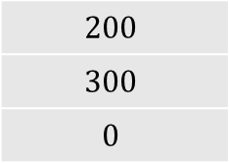
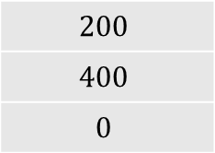
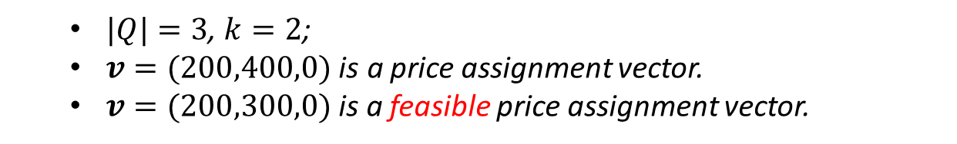
Problem Definition
Notation
  Price Assignment Vector $v$ $=(v_{1},v_{2},v_{3})$
Products | Distance-to-beach ($A_{1}$) | Price ($A_{2}$) | Cost ($C$)
p₁ | 7.0 | 200
p₂ | 4.0 | 350
p₃ | 1.0 | 500
p₄ | 3.0 | 600
q₁ | 5.0 | $$v_{1}$$ | 100
q₂ | 4.5 | $$v_{2}$$ | 200
q₃ | 1.5 | $$v_{3}$$ | 400
$$200$$
$$300$$
$$0$$
$$200$$
$$400$$
$$0$$
  $|Q|=3$, $k=2$;
  $v=(200,400,0)$ is a price assignment vector.
  $v=(200,300,0)$ is a feasible price assignment vector.

Slide 13
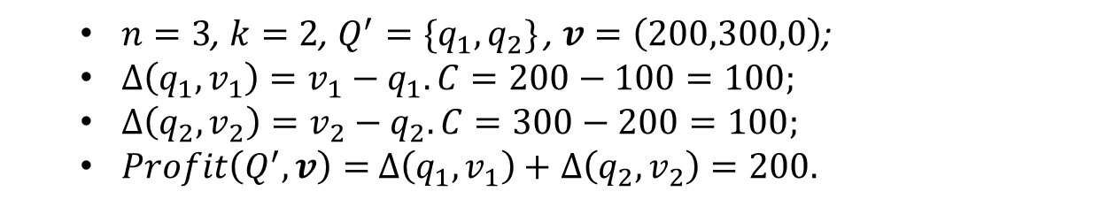

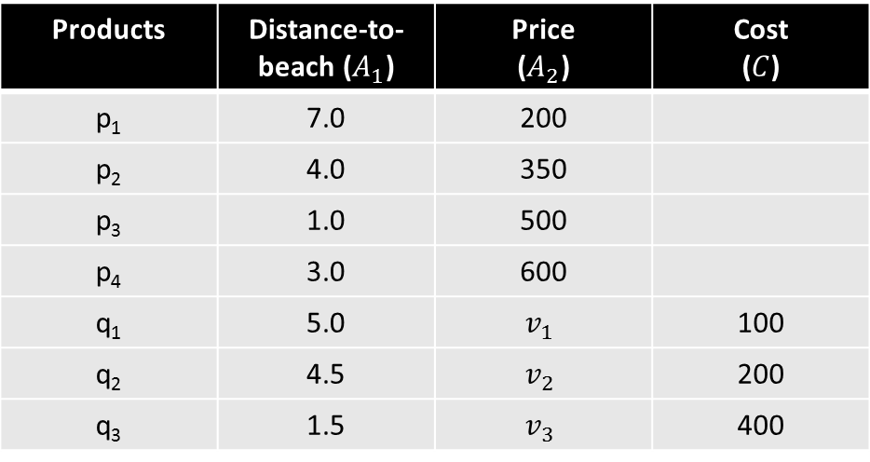
Problem Definition
Notation
  Profit $∆\left(q_{i},v_{i} \right)$ of $q_{i}$: $∆\left(q_{i},v_{i} \right)=v_{i}−q_{i}.C$;
  Profit $Profit\left(Q^{′},v\right)$ of $Q′$: $Profit\left(Q^{′},v\right)=\sum_{q_{i}∈Q′}{∆\left(q_{i},v_{i}\right)}$
Products | Distance-to-beach ($A_{1}$) | Price ($A_{2}$) | Cost ($C$)
p₁ | 7.0 | 200
p₂ | 4.0 | 350
p₃ | 1.0 | 500
p₄ | 3.0 | 600
q₁ | 5.0 | $$v_{1}$$ | 100
q₂ | 4.5 | $$v_{2}$$ | 200
q₃ | 1.5 | $$v_{3}$$ | 400
  $n=3$, $k=2$, $Q^{′}=\{q_{1},q_{2}\}$ , $v=\left(200,300,0\right)$;
  $∆\left(q_{1},v_{1}\right)=v_{1}−q_{1}.C=200−100=100;$
  $∆\left(q_{2},v_{2}\right)=v_{2}−q_{2}.C=300−200=100;$
  $Profit\left(Q^{′},v\right)=$ $∆\left(q_{1},v_{1}\right)+$ $∆\left(q_{2},v_{2}\right)=200.$

Slide 14
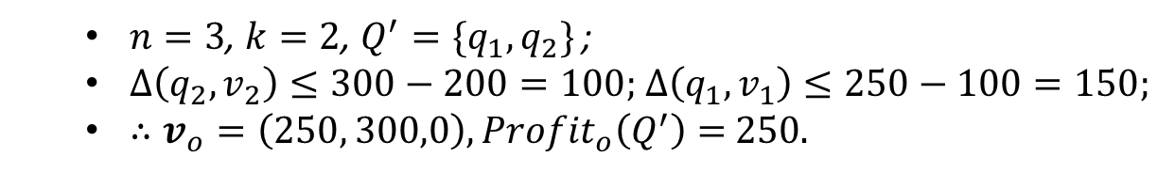


Problem Definition
Notation
  The Optimal Profit ${Profit}_{o}\left(Q^{′}\right)$ of $Q^{′}$
  ${Profit}_{o}\left(Q^{′}\right)=Profit\left(Q^{′},v_{o}\right)=\max_{v′∈V}{Profit\left(Q^{′},v′\right)}$ ;
Products | Distance-to-beach ($A_{1}$) | Price ($A_{2}$) | Cost ($C$)
p₁ | 7.0 | 200
p₂ | 4.0 | 350
p₃ | 1.0 | 500
p₄ | 3.0 | 600
q₁ | 5.0 | $$v_{1}$$ | 100
q₂ | 4.5 | $$v_{2}$$ | 200
q₃ | 1.5 | $$v_{3}$$ | 400
  $n=3$, $k=2$, $Q^{′}=\{q_{1},q_{2}\}$ ;
  $∆\left(q_{2},v_{2}\right)≤300−200=100;$ $∆\left(q_{1},v_{1}\right)≤250−100=150;$
  $∴v_{o}=\left(250, 300,0\right),{Profit}_{o}\left(Q^{′}\right)=$ $250.$

Slide 15
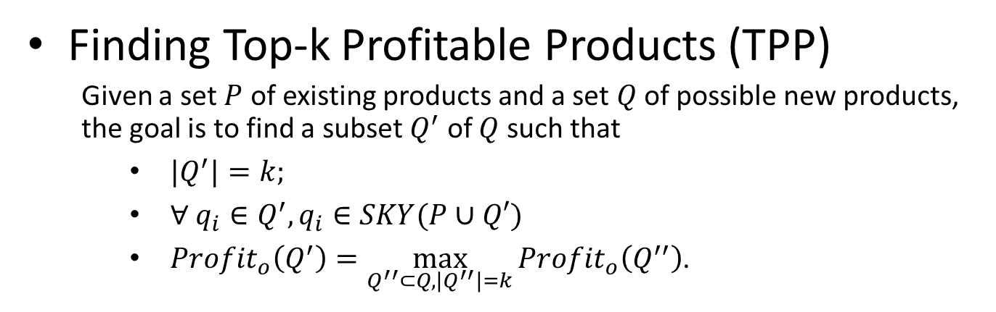
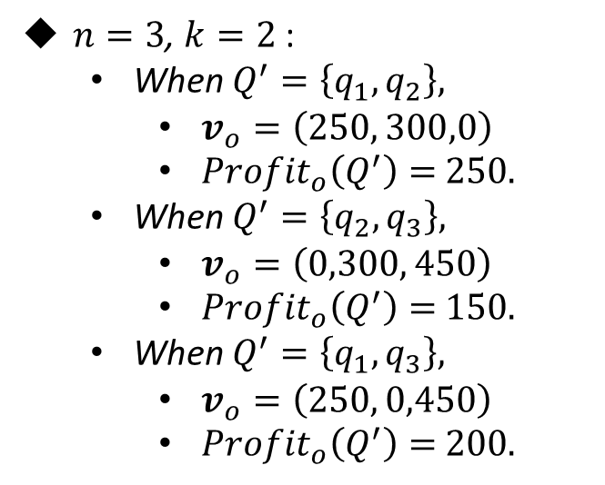
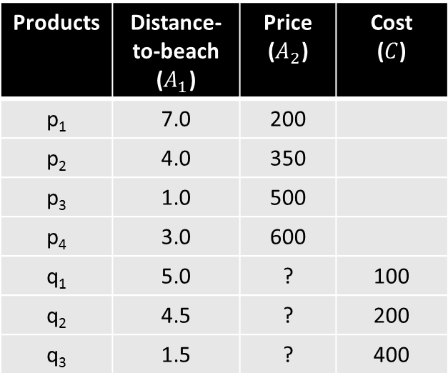
Problem Definition
Finding Top-k Profitable Products (TPP)
  Given a set $P$ of existing products and a set $Q$ of possible new products, the goal is to find a subset $Q^{′}$ of $Q$ such that
    ${|Q}^{′}|=k;$
    $∀ q_{i}∈Q^{′},q_{i}∈SKY(P∪Q′)$
    ${Profit}_{o}\left(Q^{′}\right)=\max_{Q^{′′}⊂Q,{|Q}^{′′}|=k}{{Profit}_{o}\left(Q^{′′}\right)}$.
Products | Distance-to-beach ($A_{1}$) | Price ($A_{2}$) | Cost ($C$)
p₁ | 7.0 | 200
p₂ | 4.0 | 350
p₃ | 1.0 | 500
p₄ | 3.0 | 600
q₁ | 5.0 | ? | 100
q₂ | 4.5 | ? | 200
q₃ | 1.5 | ? | 400
$n=3$, $k=2$ :
  When $Q^{′}=\left\{q_{1},q_{2}\right\},$
    $v_{o}=\left(250, 300,0\right)$
    ${Profit}_{o}\left(Q^{′}\right)=$ $250.$
  When $Q^{′}=\left\{q_{2},q_{3}\right\},$
    $v_{o}=\left(0,300, 450\right)$
    ${Profit}_{o}\left(Q^{′}\right)=$ $150.$
  When $Q^{′}=\left\{q_{1},q_{3}\right\},$
    $v_{o}=\left(250, 0,450\right)$
    ${Profit}_{o}\left(Q^{′}\right)=$ $200.$

Slide 16
Related Work
Skyline Concept
  Admissible points [1]
  Maximal vectors [2]
  Skyline in database [3]
Variations of Skyline
  Computation of Skyline
    Bitmap [4]
    Nearest Neighbor (NN)[5]
    Branch and Bound Skyline (BBS)[6]
  Top-K queries
    Ranked Skyline [6]
    Representative skyline queries [7][8]
    Reverse Skyline queries [9]
  Create “Skyline” queries [10]

Slide 17
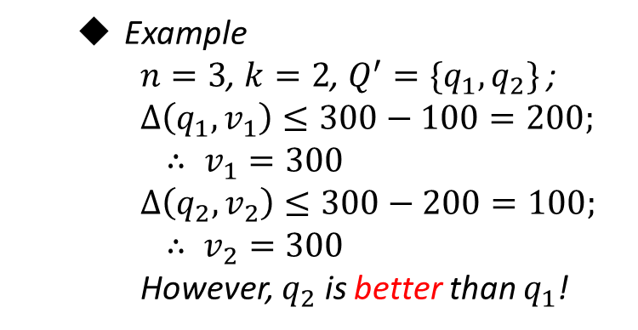
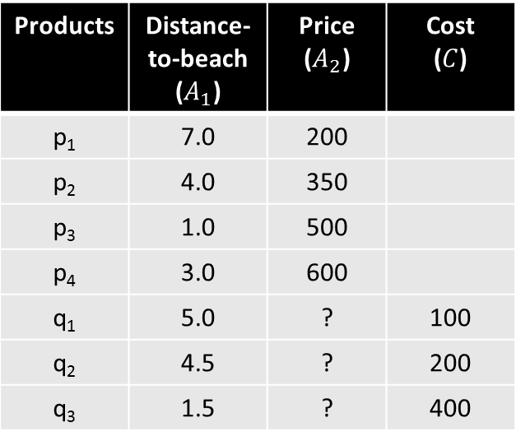
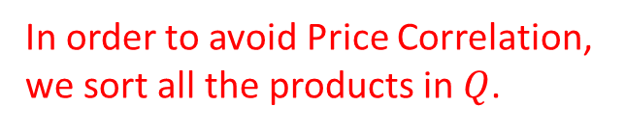
Proposed Algorithms
Analyses
  Price Correlation
Products | Distance-to-beach ($A_{1}$) | Price ($A_{2}$) | Cost ($C$)
p₁ | 7.0 | 200
p₂ | 4.0 | 350
p₃ | 1.0 | 500
p₄ | 3.0 | 600
q₁ | 5.0 | ? | 100
q₂ | 4.5 | ? | 200
q₃ | 1.5 | ? | 400
  Example
    $n=3$, $k=2$, $Q^{′}=\{q_{1},q_{2}\}$ ;
    $$∆\left(q_{1},v_{1}\right)≤300−100=200;$$
    $$∴ v_{1}=300$$
    $$∆\left(q_{2},v_{2}\right)≤300−200=100;$$
    $$∴ v_{2}=300$$
    However, $q_{2}$ is better than $q_{1}$!
300
In order to avoid Price Correlation, we sort all the products in $Q$.

Slide 18















Proposed Algorithms
. . .
$$Q_{1}^{′}$$
Flow
$$Q_{2}^{′}$$
Compare
$$Q$$
$$Q_{3}^{′}$$
$$Q_{n}^{′}$$
. . .
Top-k profitable products
. . .
$$Q_{1}^{′}$$
$$Q_{1}^{}$$
$$Q_{2}^{}$$
$$Q_{3}^{}$$
$$Q_{k}^{}$$
$$Q_{2}^{′}$$
Select $k$ products into $Q’$
Find Optimal Price of $Q_{i}^{′}$
$$Q_{3}^{′}$$
$$Q_{n}^{′}$$

Slide 19


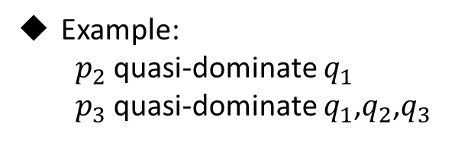
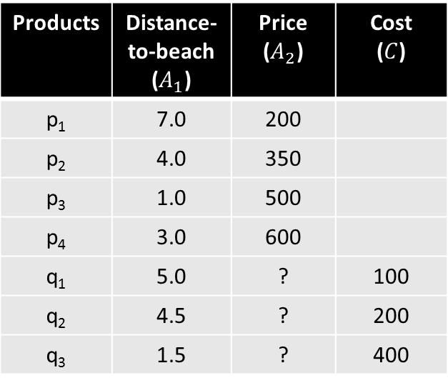
Proposed Algorithms
Find optimal price assignment of a given $Q′$
  Quasi-dominate
    $p$ quasi-dominates $p′$ if and only if one of the following holds:
      $p$ dominates $p′$ with respect to the first $l−1$ attributes;
      $p$ has the same $l−1$ attribute values as $p′$.
Products | Distance-to-beach ($A_{1}$) | Price ($A_{2}$) | Cost ($C$)
p₁ | 7.0 | 200
p₂ | 4.0 | 350
p₃ | 1.0 | 500
p₄ | 3.0 | 600
q₁ | 5.0 | ? | 100
q₂ | 4.5 | ? | 200
q₃ | 1.5 | ? | 400
Example:
  $p_{2}$ quasi-dominate $q_{1}$
  $p_{3}$ quasi-dominate $q_{1}$,$q_{2}$,$q_{3}$
Find Optimal Price of $Q_{i}^{′}$

Slide 20

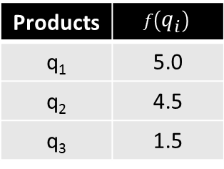
Proposed Algorithms
Find optimal price assignment vector of $Q′$
  Quasi-dominate
  Order Function $f$
    $∀ q_{i}∈Q$, $f\left(q_{i}\right)=q.A_{1}+⋯+q.A_{l−1}$
Products | Distance-to-beach ($A_{1}$) | Price ($A_{2}$) | Cost ($C$)
p₁ | 7.0 | 200
p₂ | 4.0 | 350
p₃ | 1.0 | 500
p₄ | 3.0 | 600
q₁ | 5.0 | ? | 100
q₂ | 4.5 | ? | 200
q₃ | 1.5 | ? | 400
Products | $$f\left(q_{i}\right)$$
q₁ | 5.0
q₂ | 4.5
q₃ | 1.5

Slide 21
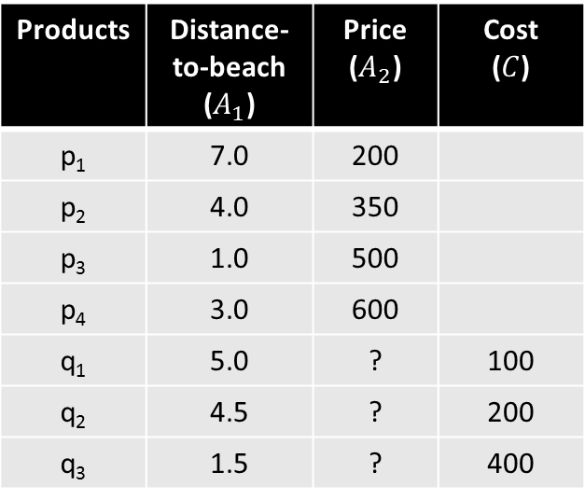

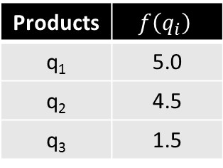
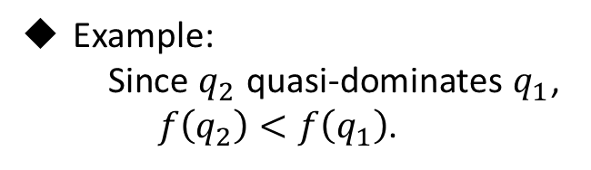
Proposed Algorithms
Find optimal price assignment of a given $Q′$
  Quasi-dominate
  Order Function
  Lemma
    Suppose $p$ and $p′$ are in $X$. If $p$ quasi-dominates $p′$, then $f(p)$ is smaller than or equal to $f(p^{′})$.
Products | Distance-to-beach ($A_{1}$) | Price ($A_{2}$) | Cost ($C$)
p₁ | 7.0 | 200
p₂ | 4.0 | 350
p₃ | 1.0 | 500
p₄ | 3.0 | 600
q₁ | 5.0 | ? | 100
q₂ | 4.5 | ? | 200
q₃ | 1.5 | ? | 400
Products | $$f\left(q_{i}\right)$$
q₁ | 5.0
q₂ | 4.5
q₃ | 1.5
Example:
Since $q_{2}$ quasi-dominates $q_{1}$, $f\left(q_{2}\right)<f\left(q_{1}\right)$.

Slide 22
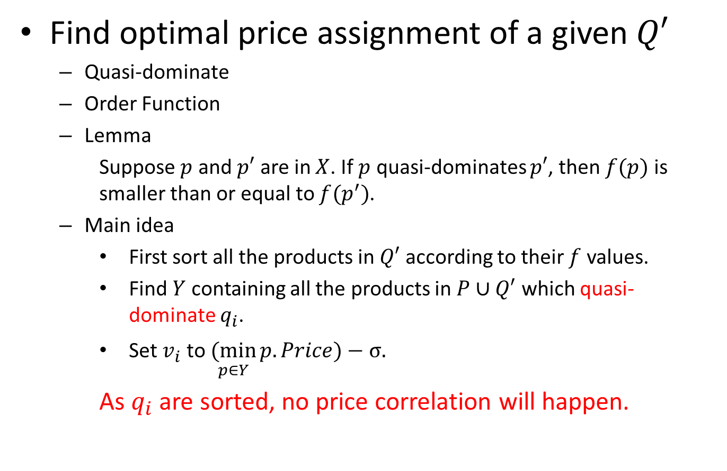
Proposed Algorithms
Find optimal price assignment of a given $Q′$
  Quasi-dominate
  Order Function
  Lemma
    Suppose $p$ and $p′$ are in $X$. If $p$ quasi-dominates $p′$, then $f(p)$ is smaller than or equal to $f(p^{′})$.
  Main idea
    First sort all the products in $Q′$ according to their $f$ values.
    Find $Y$ containing all the products in $P∪Q′$ which quasi-dominate $q_{i}$.
    Set $v_{i}$ to $\underset{p∈Y}{(min}{p.Price)}−σ.$
    As $q_{i}$ are sorted, no price correlation will happen.

Slide 23
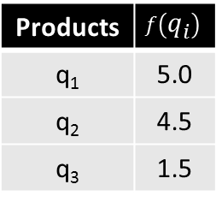
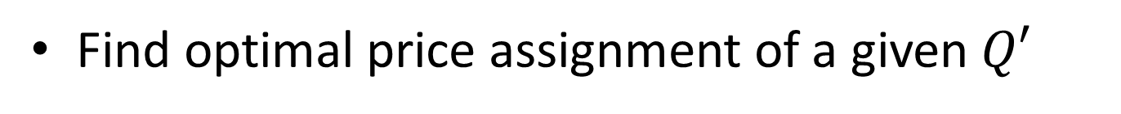
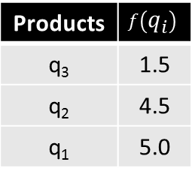
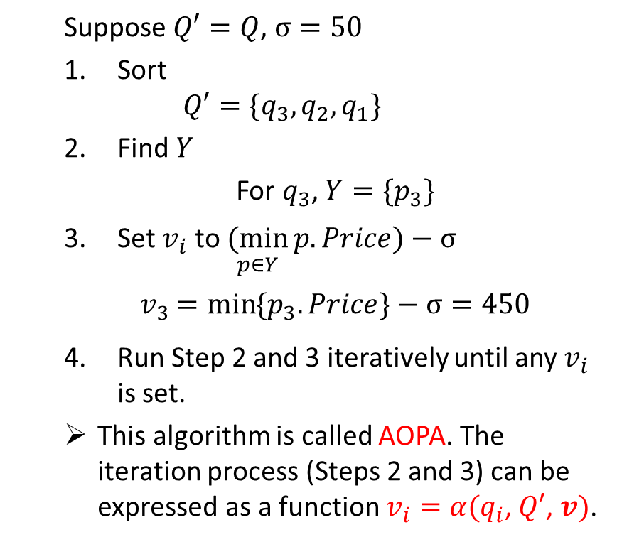

Proposed Algorithms
Find optimal price assignment of a given $Q′$
Products | Distance-to-beach ($A_{1}$) | Price ($A_{2}$) | Cost ($C$)
p₁ | 7.0 | 200
p₂ | 4.0 | 350
p₃ | 1.0 | 500
p₄ | 3.0 | 600
q₁ | 5.0 | ? | 100
q₂ | 4.5 | ? | 200
q₃ | 1.5 | ? | 400
  Suppose $Q′=Q$, $σ=50$
  Sort
  $$Q′=\{q_{3},q_{2},q_{1}\}$$
  Find $Y$
  For $q_{3}$, $Y=\{p_{3}\}$
  Set $v_{i}$ to $\underset{p∈Y}{(min}{p.Price)}−σ$
  $v_{3}$ $=\min_{}{\{p_{3}.Price\}}−σ=450$
  Run Step 2 and 3 iteratively until any $v_{i}$ is set.
  This algorithm is called AOPA. The iteration process (Steps 2 and 3) can be expressed as a function $v_{i}=$ ${α(q}_{i}$, $Q′$, $v)$.
Products | $$f\left(q_{i}\right)$$
q₁ | 5.0
q₂ | 4.5
q₃ | 1.5
Products | $$f\left(q_{i}\right)$$
q₃ | 1.5
q₂ | 4.5
q₁ | 5.0

Slide 24
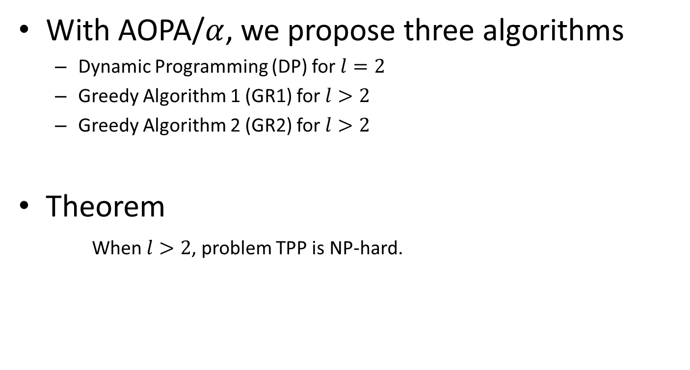
Proposed Algorithms
With AOPA/$α$, we propose three algorithms
  Dynamic Programming (DP) for $l=2$
  Greedy Algorithm 1 (GR1) for $l>2$
  Greedy Algorithm 2 (GR2) for $l>2$
Theorem
  When $l>2$, problem TPP is NP-hard.

Slide 25
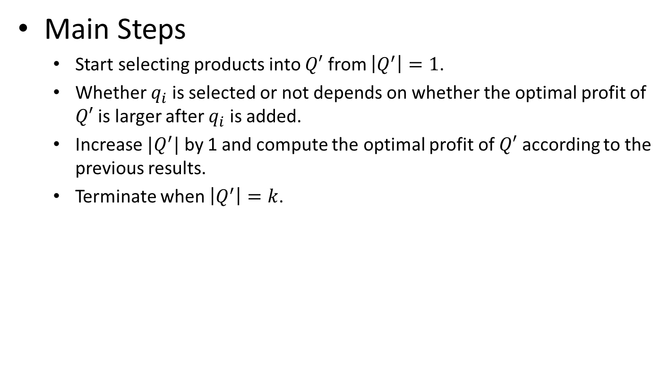
Dynamic Programming (DP)
Main Steps
  Start selecting products into $Q′$ from $\left|Q^{′}\right|=1$.
  Whether $q_{i}$ is selected or not depends on whether the optimal profit of $Q′$ is larger after $q_{i}$ is added.
  Increase $|Q^{′}|$ by 1 and compute the optimal profit of $Q′$ according to the previous results.
  Terminate when $\left|Q^{′}\right|=k$.

Slide 26
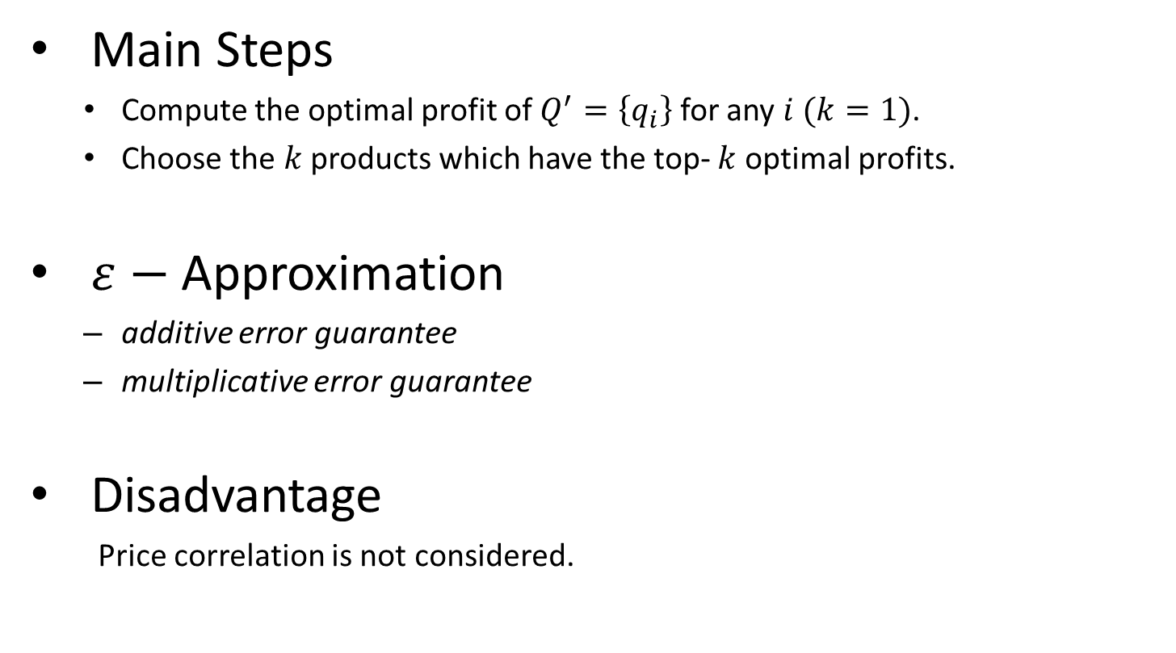
Greedy Algorithm 1 (GR1)
Main Steps
  Compute the optimal profit of $Q^{′}=\left\{q_{i}\right\}$ for any $i (k=1)$.
  Choose the $k$ products which have the top- $k$ optimal profits.
$ε−$ Approximation
  additive error guarantee
  multiplicative error guarantee
Disadvantage
Price correlation is not considered.

Slide 27
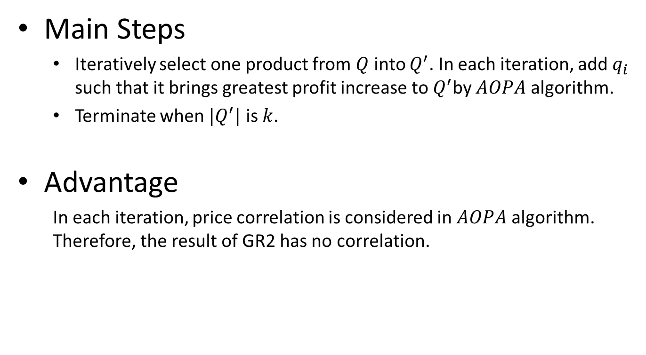
Greedy Algorithm 2 (GR2)
Main Steps
  Iteratively select one product from $Q$ into $Q^{′}$. In each iteration, add$q_{i}$ such that it brings greatest profit increase to $Q^{′}$by $AOPA$ algorithm.
  Terminate when ${|Q}^{′}|$ is $k$.
Advantage
  In each iteration, price correlation is considered in $AOPA$ algorithm. Therefore, the result of GR2 has no correlation.

Slide 28
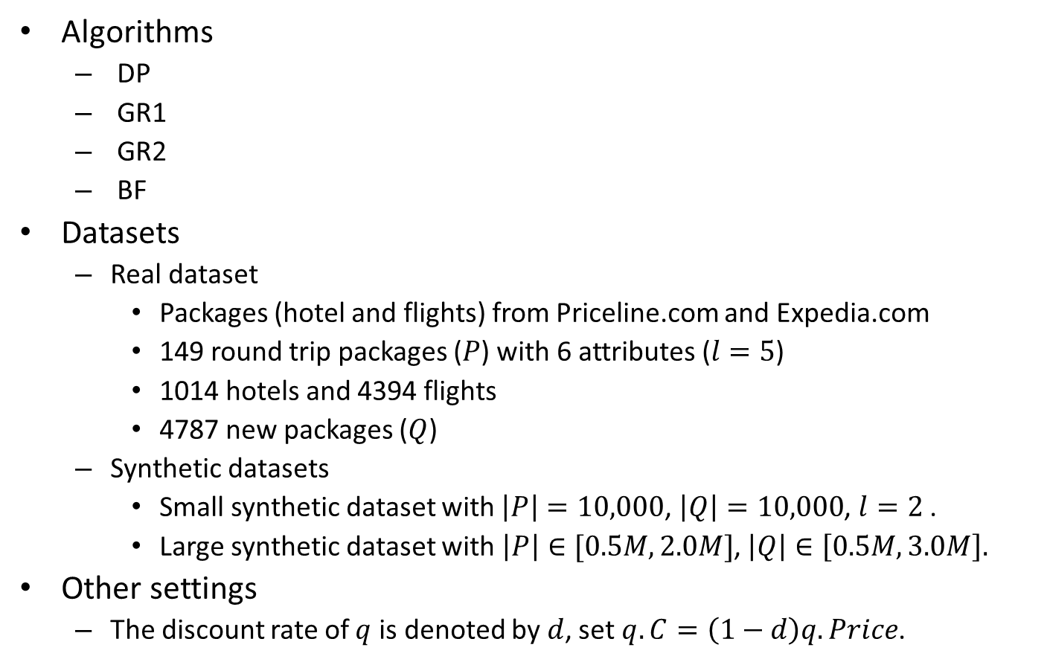
Experiments
Algorithms
  DP
  GR1
  GR2
  BF
Datasets
  Real dataset
    Packages (hotel and flights) from Priceline.com and Expedia.com
    149 round trip packages ($P$) with 6 attributes ($l=5$)
    1014 hotels and 4394 flights
    4787 new packages ($Q$)
  Synthetic datasets
    Small synthetic dataset with $\left|P\right|=10,000$, $\left|Q\right|=10,000$, $l=2$ .
    Large synthetic dataset with $\left|P\right|∈[0.5M, 2.0M]$, $\left|Q\right|∈\left[0.5M, 3.0M\right].$
Other settings
  The discount rate of $q$ is denoted by $d$, set $q.C=\left(1−d\right)q.Price$.

Slide 29
Experiments (cont.)
Real Dataset

Slide 30
Experiments (cont.)
Small synthetic dataset

Slide 31
Experiments (cont.)
Small synthetic dataset

Slide 32
Experiments (cont.)
Large synthetic dataset

Slide 33
Experiments (cont.)
Large synthetic dataset

Slide 34
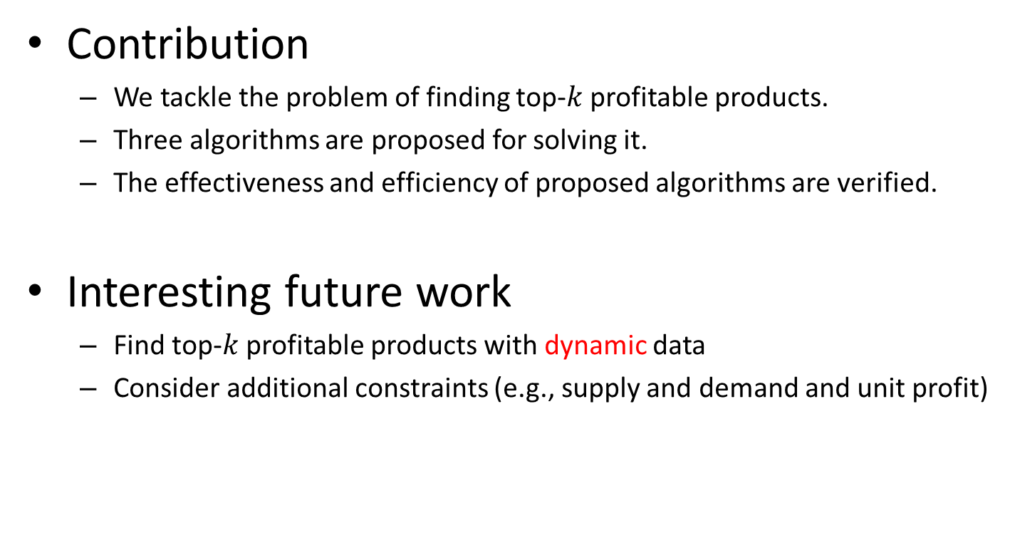
Conclusion
Contribution
  We tackle the problem of finding top-$k$ profitable products.
  Three algorithms are proposed for solving it.
  The effectiveness and efficiency of proposed algorithms are verified.
Interesting future work
  Find top-$k$ profitable products with dynamic data
  Consider additional constraints (e.g., supply and demand and unit profit)

Slide 35
Reference
[1] O. B.-N. et al. On the distribution of the number of admissable points in a vector random sample. In Theory of Probability and its Application, 11(2), 1966.
[2] J. L. B. et al. On the average number of maxima in a set of vectors and applications. In Journal of ACM, 25(4), 1978.
[3] S. Borzsonyi, D. Kossmann, and K. Stocker. The skyline operator. In ICDE, 2001.
[4] K.-L. Tan, P. Eng, and B. Ooi. Efficient progressive skyline computation. In VLDB, 2001.
[5] D. Kossmann, F. Ramsak, and S. Rost. Shooting stars in the sky: An online algorithm for skyline queries. In VLDB, 2002.
[6] D. Papadias, Y. Tao, G. Fu, and B. Seeger. Progressive skyline computation in database systems. In ACM Transactions on Database Systems, Vol. 30, No. 1, 2005.
[7] X. Lin, Y. Yuan, Q. Zhang, and Y. Zhang. Selecting stars: the k most representative skyline operator. In in ICDE, 2007.
[8] Y. Tao, L. Ding, X. Lin, and J. Pei. Distance-based representative skyline. In ICDE ’09: Proceedings of the 2009 IEEE International Conference on Data Engineering, pages 892–903, Washington, DC, USA, 2009. IEEE Computer Society.
[9] E. Dellis , B. Seeger, Efficient computation of reverse skyline queries, Proceedings of the 33rd international conference on Very large data bases, September 23-27, 2007, Vienna, Austria
[10] Q. Wan, R. C.-W. Wong, I. F. Ilyas, M. T. Ozsu, and Y. Peng. Creating competitive products. In VLDB, 2009.

Slide 36
Thank you!
Q&A

Slide 37
Backup Slides

Slide 38
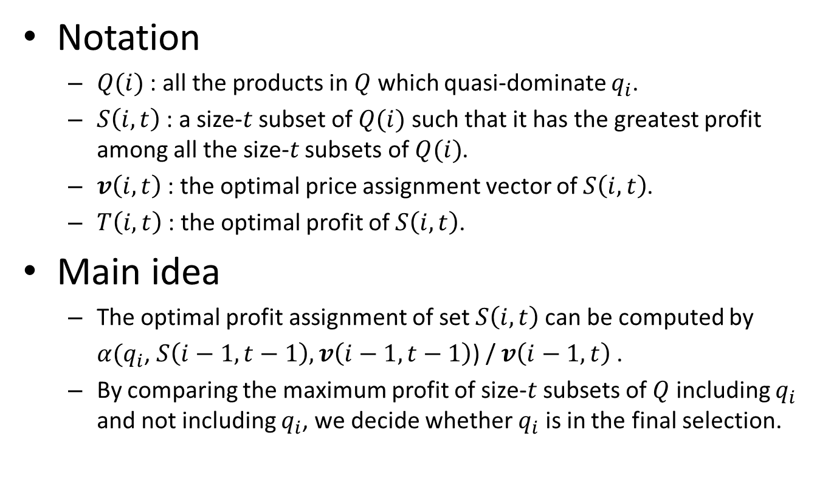
Dynamic Programming
Notation
  $Q(i)$ : all the products in $Q$ which quasi-dominate $q_{i}$.
  $S\left(i, t\right)$ : a size-$t$ subset of $Q(i)$ such that it has the greatest profit among all the size-$t$ subsets of $Q(i)$.
  $v\left(i, t\right)$ : the optimal price assignment vector of $S\left(i, t\right)$.
  $T\left(i, t\right)$ : the optimal profit of $S\left(i, t\right)$.
Main idea
  The optimal profit assignment of set $S\left(i, t\right)$can be computed by
  $α(q_{i}$, $S\left(i−1,t−1\right),v\left(i−1, t−1\right)$) / $v\left(i−1, t\right)$ .
  By comparing the maximum profit of size-$t$ subsets of $Q$ including $q_{i}$ and not including $q_{i}$, we decide whether $q_{i}$ is in the final selection.

Slide 39
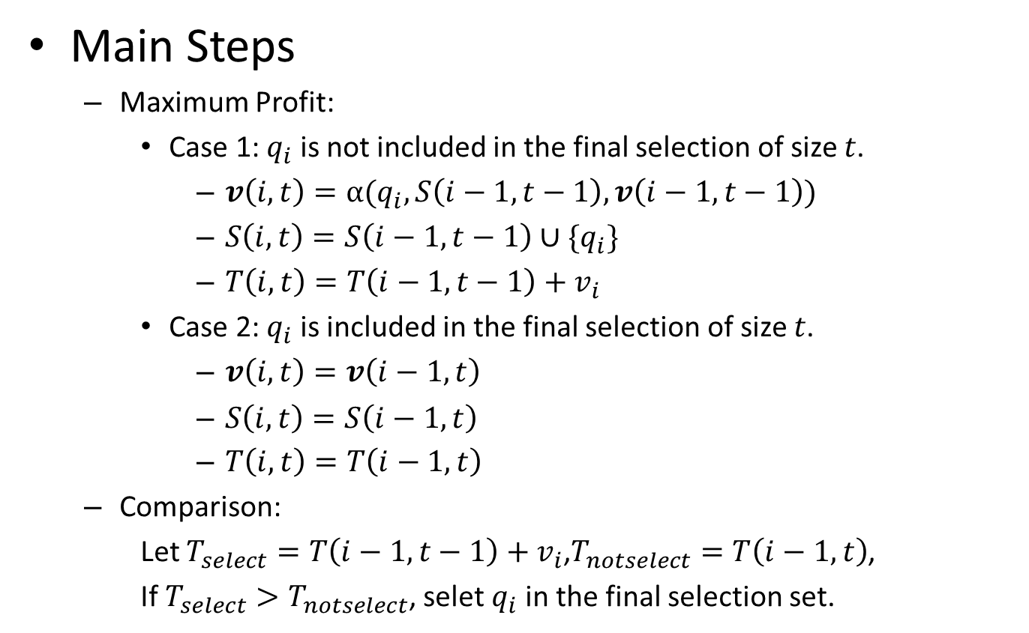
Dynamic Programming (cont.)
Main Steps
  Maximum Profit:
    Case 1: $q_{i}$ is not included in the final selection of size $t$.
      $v\left(i, t\right)=α(q_{i},S\left(i−1, t−1\right),v\left(i−1, t−1\right))$
      $S\left(i, t\right)=S\left(i−1, t−1\right)∪\{q_{i}\}$
      $T\left(i, t\right)=T\left(i−1, t−1\right)+v_{i}$
    Case 2: $q_{i}$ is included in the final selection of size $t$.
      $v\left(i, t\right)=v\left(i−1, t\right)$
      $S\left(i, t\right)=S\left(i−1, t\right)$
      $T\left(i, t\right)=T\left(i−1, t\right)$
  Comparison:
    Let $T_{select}=T\left(i−1, t−1\right)+v_{i}$,$T_{notselect}=T\left(i−1, t\right)$,
    If $T_{select}>T_{notselect}$, selet $q_{i}$ in the final selection set.

