Slide 1
Fraction-Score: A New Support Measure for Co-location Pattern Mining
Harry Kai-Ho Chan, The Hong Kong University of Science and Technology
Cheng Long, Nanyang Technological University
Da Yan, The University of Alabama at Birmingham
Raymond Chi-Wing Wong, The Hong Kong University of Science and Technology
Prepared by Harry
Presented by Harry

Slide 2
Outline
Introduction
Fraction-Score
Algorithm
Experimental Results
Conclusion

Slide 3
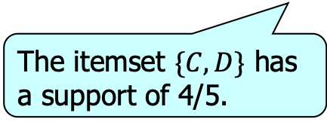
Introduction
Frequent itemset mining in transaction data
 | A | B | C | D
T1 | 1 | 1 | 1 | 1
T2 | 1 | 1 | 0 | 0
T3 | 1 | 0 | 1 | 1
T4 | 0 | 0 | 1 | 1
T5 | 1 | 0 | 1 | 1
The itemset $\{C, D\}$ has a support of 4/5.

Slide 4
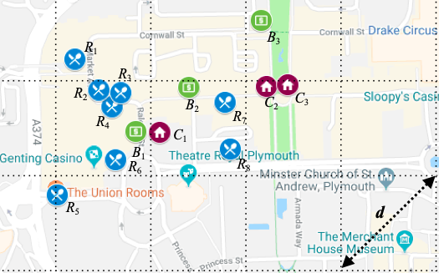
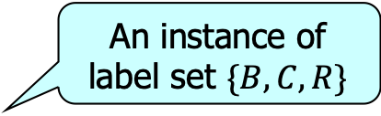
Introduction
Co-location pattern mining in spatial databases
An instance of label set $\{B, C, R\}$
Objects are located within distance d from each other

Slide 5
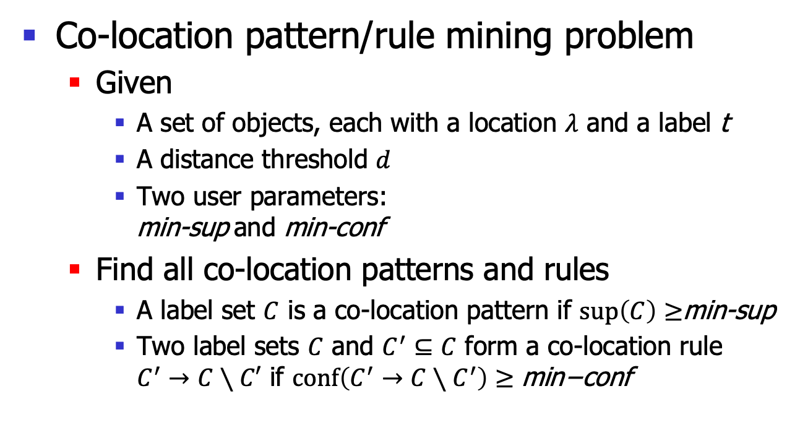
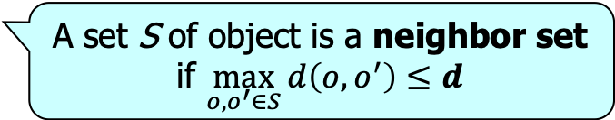
Problem Definition
Co-location pattern/rule mining problem
  Given
    A set of objects, each with a location $λ$ and a label t
    A distance threshold $d$
    Two user parameters:
    min-sup and min-conf
  Find all co-location patterns and rules
    A label set $C$ is a co-location pattern if $\sup\left(C\right)≥$min-sup
    Two label sets $C$ and $C^{′}⊆C$ form a co-location rule
    $C^{′}→C∖C′$ if $conf\left(C^{′}→C∖C^{′}\right)≥\text{min}\text{−}\text{conf}$
A set S of object is a neighbor set if $\max_{o,o^{′}∈S}{d\left(o,o^{′}\right)}≤d$
defined later
In this presentation, we focus on
co-location patterns only

Slide 6
Applications of co-location pattern mining
Ecology
  Animals and plants have not only their labels (e.g., species), but also location information about their habitats
Epidemiology
  Patients are recorded with not only demographic information (e.g., ages and races), but also location information
Urban areas
  POIs (e.g., restaurants, shops) have both some labels (e.g., business types and brands) and locations

Slide 7

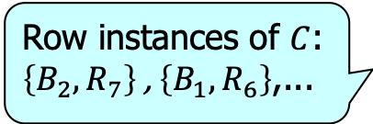

Notations
Given a label set $C$, an instance of $C$ is an object
set $S$ that
  Covers all labels in $C$
  Is a neighbor set
An instance of $C$ is a row instance of $C$
if none of its proper subsets is an instance of $C$
Consider the label set $C=\{B, R\}$
Row instances of $C$:
$\left\{B_{2}, R_{7}\right\}$ , $\left\{B_{1}, R_{6}\right\}$,...

Slide 8
Existing Support Measures
Participation-based approach
[SSTD 2001, TKDE 2004, ICDM 2005, TKDE 2006]
  The most commonly used support measures
    Captures all possible instances
    Satisfies the anti-monotonicity property
  It puts row instances into different groups and counts the number of groups

Slide 9
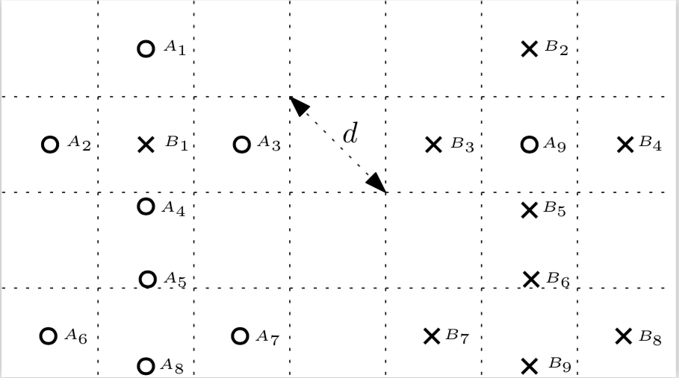
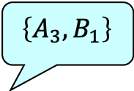
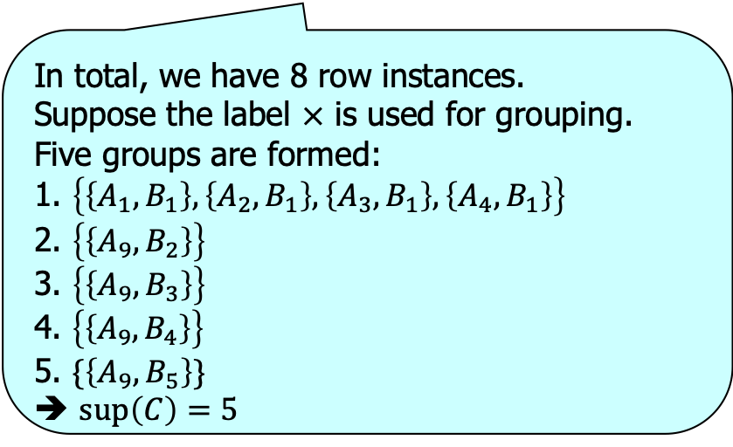
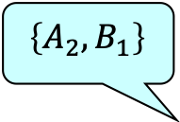

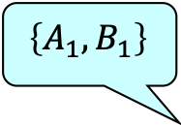



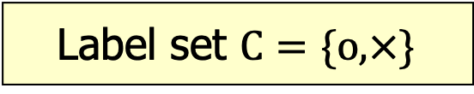

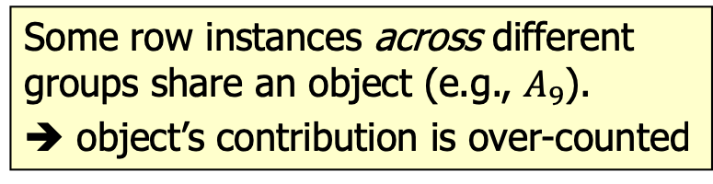
Example
Label set $C=\{o, ×\}$
$$\left\{A_{1}, B_{1}\right\}$$
$$\left\{A_{9}, B_{2}\right\}$$
$$\left\{A_{2}, B_{1}\right\}$$
$$\left\{A_{3}, B_{1}\right\}$$
$$\left\{A_{9}, B_{4}\right\}$$
$$\left\{A_{9}, B_{3}\right\}$$
In total, we have 8 row instances.
Suppose the label $×$ is used for grouping.
Five groups are formed:
1. $\left\{\left\{A_{1}, B_{1}\right\},\left\{A_{2}, B_{1}\right\}, \left\{A_{3}, B_{1}\right\}, \left\{A_{4}, B_{1}\right\}\right\}$
2. $\left\{\left\{A_{9}, B_{2}\right\}\right\}$
3. $\left\{\left\{A_{9}, B_{3}\right\}\right\}$
4. $\left\{\left\{A_{9}, B_{4}\right\}\right\}$
5. $\{\left\{A_{9}, B_{5}\right\}\}$
➔ $\sup\left(C\right)=5$
$$\left\{A_{4}, B_{1}\right\}$$
$$\left\{A_{9}, B_{5}\right\}$$
Some row instances across different groups share an object (e.g., $A_{9}$).
➔ object’s contribution is over-counted

Slide 10
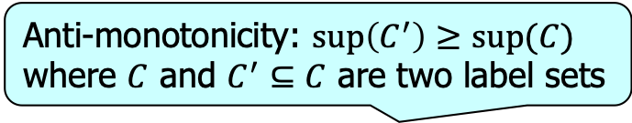
Existing Support Measures
Anti-monotonicity: $\sup\left(C^{′}\right)≥sup⁡(C)$
where $C$ and $C^{′}⊆C$ are two label sets
Approach | Miss/over-count | Anti-monotonicity
Participation-based | overcount | yes
Partitioning-based | miss | yes
Construction-based | miss | no
Enumeration-based | no | no
Other existing support measures
Fraction-Score | no | yes

Slide 11
Our Contributions
We show the weaknesses of existing support measures and propose a new and better one called Fraction-Score
For a fundamental operation involved in mining the co-location patterns and rules, we provide hardness results and design an efficient algorithm which is significantly faster than a baseline adapted from the state-of-the-art

Slide 12
Outline
Introduction
Fraction-Score
Algorithm
Experimental Results
Conclusion

Slide 13
Fraction-Score – High Level Idea
We also group the row instances of C
  To solve the over-counting problem when multiple row instances across groups share objects,
    Fraction-Score counts each group as a fractional unit of prevalence (instead of an entire one as in the participation-based approach)
    The fraction value is calculated by amortizing the contribution of an object among all row instances that the object is involved in

Slide 14
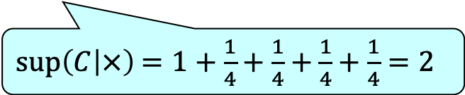
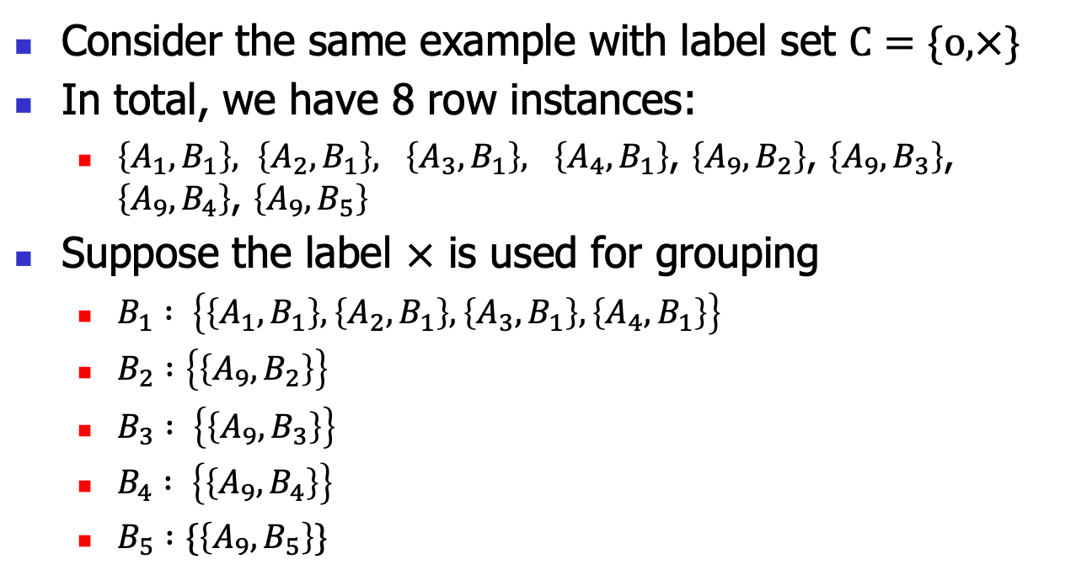
Fraction-Score – Example
Consider the same example with label set $C=\{o, ×\}$
In total, we have 8 row instances:
  $\left\{A_{1}, B_{1}\right\}, \left\{A_{2}, B_{1}\right\}, \left\{A_{3}, B_{1}\right\}, \left\{A_{4}, B_{1}\right\}$, $\left\{A_{9}, B_{2}\right\}$, $\left\{A_{9}, B_{3}\right\}$, $\left\{A_{9}, B_{4}\right\}$, $\left\{A_{9}, B_{5}\right\}$
Suppose the label $×$ is used for grouping
  $B_{1} : \left\{\left\{A_{1}, B_{1}\right\},\left\{A_{2}, B_{1}\right\}, \left\{A_{3}, B_{1}\right\}, \left\{A_{4}, B_{1}\right\}\right\}$
  $B_{2} :\left\{\left\{A_{9}, B_{2}\right\}\right\}$
  $B_{3} : \left\{\left\{A_{9}, B_{3}\right\}\right\}$
  $B_{4} : \left\{\left\{A_{9}, B_{4}\right\}\right\}$
  $B_{5} :\{\left\{A_{9}, B_{5}\right\}\}$
1
¼
¼
¼
$\sup\left(C | ×\right)$ $=1+\frac{1}{4}+\frac{1}{4}+\frac{1}{4}+\frac{1}{4}=2$
¼

Slide 15


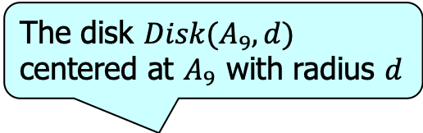
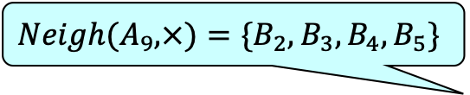
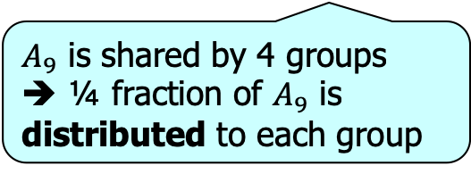
Fraction-Score – Example
The disk $Disk(A_{9}, d)$ centered at $A_{9}$ with radius $d$
${Neigh(A}_{9},×)=\{B_{2},B_{3},B_{4},B_{5}\}$
$A_{9}$ is shared by 4 groups
➔ ¼ fraction of $A_{9}$ is distributed to each group
$B_{2}$ receives a fraction ¼ of $A_{9}$

Slide 16
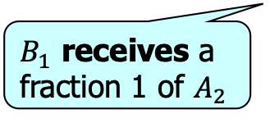
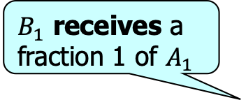
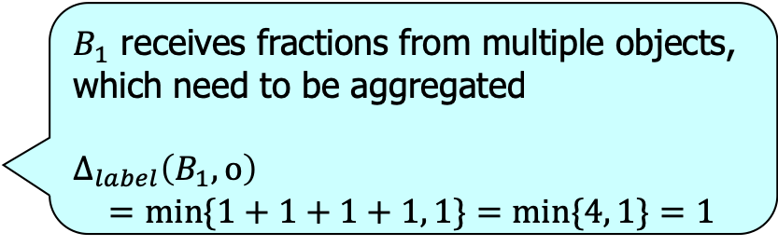
Fraction-Score – Example
$B_{1}$ receives a fraction 1 of $A_{1}$
...
$B_{1}$ receives fractions from multiple objects, which need to be aggregated
$∆_{label}\left(B_{1},o\right)$
$$=\min{\{1+1+1+1, 1\}}=\min{\{4, 1\}}=1$$
Aggregate the fractions from those objects with the same label using a sum function
Bound the aggregated fraction for a label by one unit
...
$B_{1}$ receives a fraction 1 of $A_{2}$

Slide 17
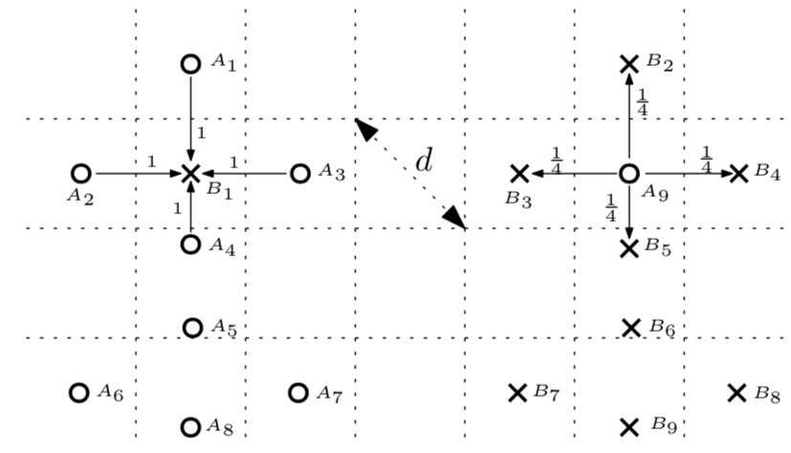
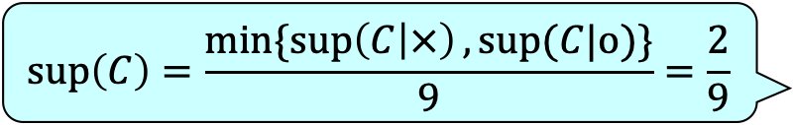
Fraction-Score – Example
Depending on different choice of label for grouping the row instances, we may have different supports
  Choose the label given which the support is the smallest to capture the worst-case prevalence
  Normalize to [0,1] by dividing maximum number of objects that have a specific label
$$\sup\left(C\right)=\frac{\min{\{\sup\left(C | ×\right), sup⁡(C|o})\}}{9}=\frac{2}{9}$$

Slide 18
Outline
Introduction
Fraction-Score
Algorithm
Experimental Results
Conclusion

Slide 19
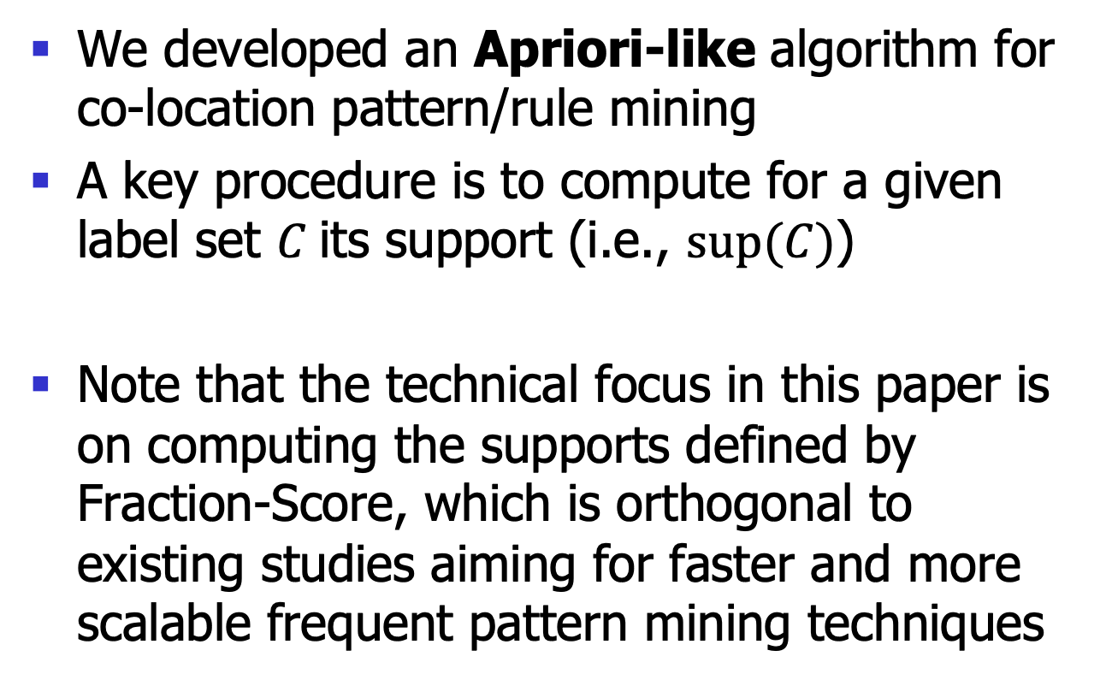
Algorithm
We developed an Apriori-like algorithm for co-location pattern/rule mining
A key procedure is to compute for a given label set $C$its support (i.e., $sup⁡(C)$)
Note that the technical focus in this paper is on computing the supports defined by Fraction-Score, which is orthogonal to existing studies aiming for faster and more scalable frequent pattern mining techniques

Slide 20
Algorithm
Algorithm (SupportComputation):
Input: a label set C and an object set O
Output: the support of C, i.e., sup(C)
  1. For each label t in C
  //Compute sup(C|t)
  2. sup(C|t) = 0
    3. For each object o with label t
    //Add up the fractions received by the object
    4. If there is a row instance of C which involves o
    5. sup(C|t) += FractionAggregation(O,C,o)
  6. Return the smallest sup(C|t)
RI
A procedure that returns the fraction o receives w.r.t. the label set C (detail omitted here)

Slide 21
Algorithm
RI: to decide whether there is a row instance of a given label set C which involves an object o
We proved that the RI problem is NP-hard
A naive method:
  Enumerate all row instances of C and check whether there exists one involving o
An efficient method:
  A Filtering-and-Verification approach

Slide 22
A Filtering-and-Verification Approach for RI
A filtering phase: solve RI for easy cases
A verification phase:
  Dia-CoSKQ-Adapt
  Combinatorial-Search
  Optimization-Search
Dia-CoSKQ problem is closely related to RI as shown in the NP-hardness proof
Enumerate the objects indexed by inverted lists
Each of the 3 methods can solve RI. We compared their performance in the experiment of the paper.
A variant of Combinatorial-Search by replacing an enumeration step with an optimization step
Notes:
Thus, these three methods are not three isolated ones, but each would help to provide some insights into solving the problem. We believe it would help to present a systematic treatment of the problem if we introduce all these methods.

Slide 23
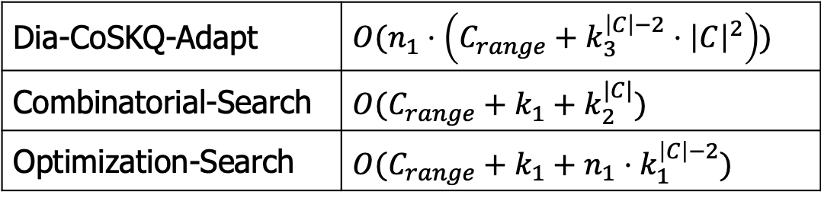
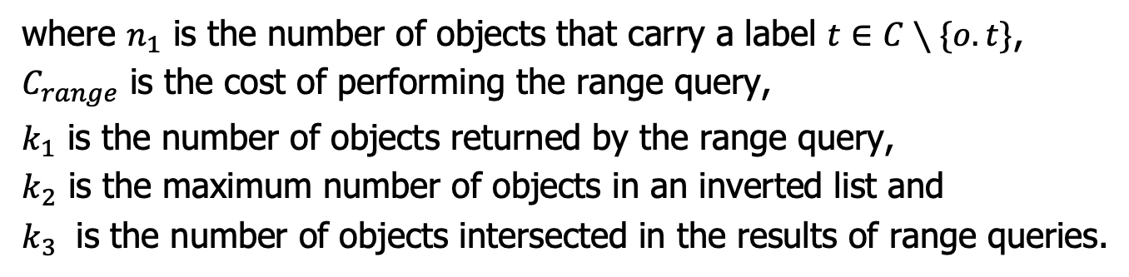
A Filtering-and-Verification Approach for RI
Verification phase dominates the time cost of the approach
Time Complexity
Dia-CoSKQ-Adapt | $O(n_{1}⋅\left(C_{range}+k_{3}^{\left|C\right|−2}⋅{\left|C\right|}^{2}\right))$
Combinatorial-Search | $O(C_{range}+k_{1}+k_{2}^{|C|})$
Optimization-Search | $O(C_{range}+k_{1}+n_{1}⋅k_{1}^{\left|C\right|−2})$
where $n_{1}$ is the number of objects that carry a label $t∈C∖\{o.t\}$,
$C_{range}$ is the cost of performing the range query,
$k_{1}$ is the number of objects returned by the range query,
$k_{2}$ is the maximum number of objects in an inverted list and
$k_{3}$ is the number of objects intersected in the results of range queries.

Slide 24
Outline
Introduction
Fraction-Score
Algorithm
Experimental Results
Conclusion

Slide 25
Experiment Settings
Dataset
  Real dataset: POIs of UK (182,334 objects with 36 labels)
  Synthetic datasets: following existing studies
  [SSTD 2001, TKDE 2004, TKDE 2006]
Adaption
  Join-less [TKDE 2006]: The state-of-the-art algorithm which was originally designed for participation-based measure
Algorithms implemented in C++, Linux Machine with 2.66GHz CPU and 32GB RAM

Slide 26
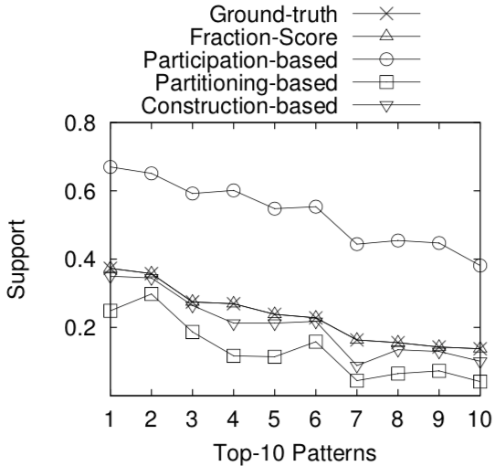
Experimental Results
Effectiveness Results on synthetic datasets
Ground-truth: maximum number of disjoint row instances of the pattern
The supports by participation-based approach are at least 20% larger
The supports by Fraction-Score are very close to the ground-truths
The supports by partitioning-based and construction-based approaches are smaller than ground-truths

Slide 27
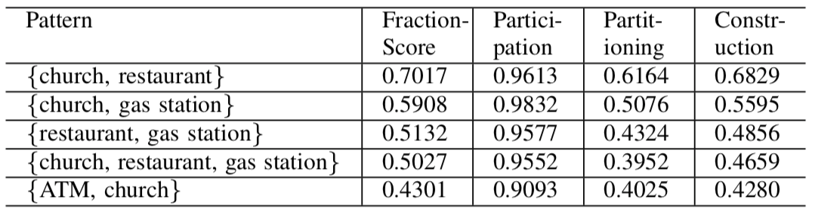
Experimental Results
Effectiveness Results on real datasets
(d=1000m)
Very close to 1 because participation-based measure has a normalization step of dividing by the number of occurrences of the label
Slightly smaller than those by Fraction-Score because both measures miss some row instances

Slide 28
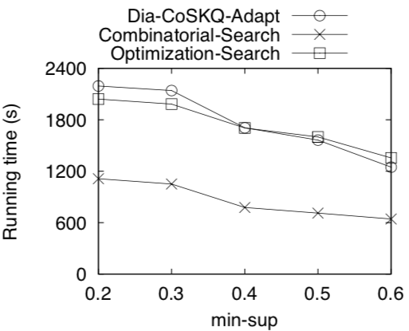
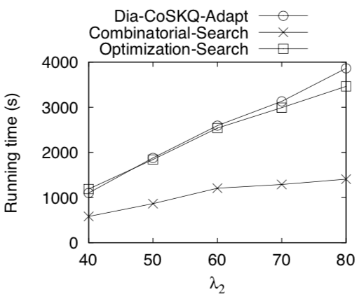
Experimental Results
Methods in verification phase
Combinatorial-Search runs fastest consistently under all settings
Dia-CoSKQ-Adapt and Optimization-Search involve extra steps/techniques for finding the optimal solution and thus they take more time

Slide 29
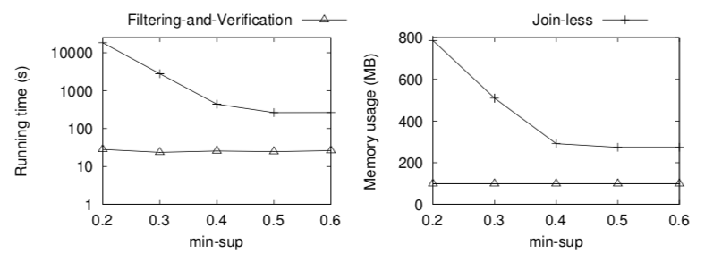
Experimental Results
Filtering-and-Verification (Real dataset)
Our Filtering-and-Verification approach runs much faster and consumes less memory than the Join-less method

Slide 30
Outline
Introduction
Fraction-Score
Algorithm
Experimental Results
Conclusion

Slide 31
Conclusion
We proposed a new support measure Fraction-Score for the co-location pattern mining problem. It quantifies the prevalence of patterns probably.
For a fundamental operation involved in mining the co-location patterns and rules, we provide hardness results and design an efficient algorithm which is significantly faster than a baseline adapted from the state-of-the-art.
We conducted experiments on both real and synthetic datasets which verified the advantages of our Fraction-Score measures and the performance of our algorithm.

Slide 32
Back Up Slides

Slide 33
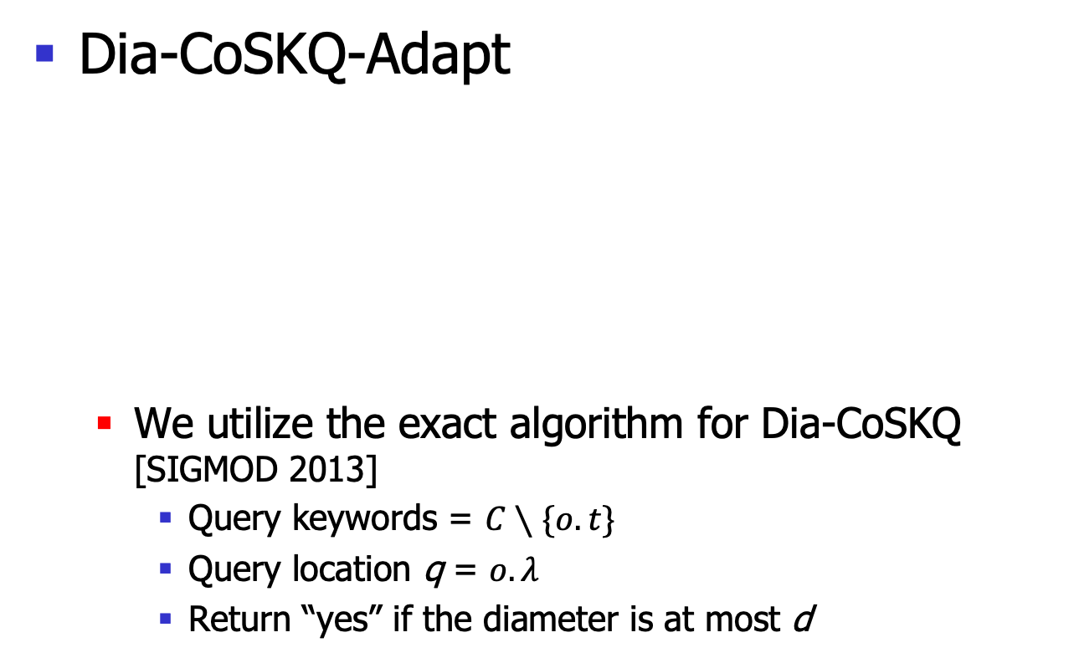
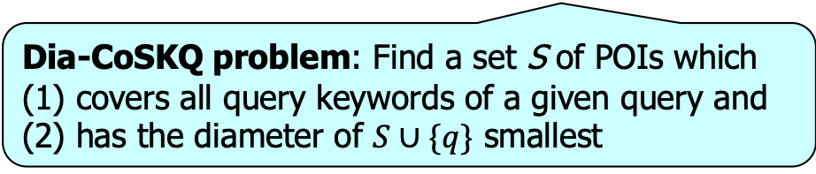
A Filtering-and-Verification Approach for RI
RI: to decide whether there is a row instance of a given label set C which involves an object o
Dia-CoSKQ-Adapt
  We utilize the exact algorithm for Dia-CoSKQ [SIGMOD 2013]
    Query keywords = $C∖\{o.t\}$
    Query location q = $o.λ$
    Return “yes” if the diameter is at most d
A RI
problem instance
A Dia-CoSKQ
problem instance
➔
Dia-CoSKQ problem: Find a set S of POIs which (1) covers all query keywords of a given query and (2) has the diameter of $S∪\{q\}$ smallest

Slide 34
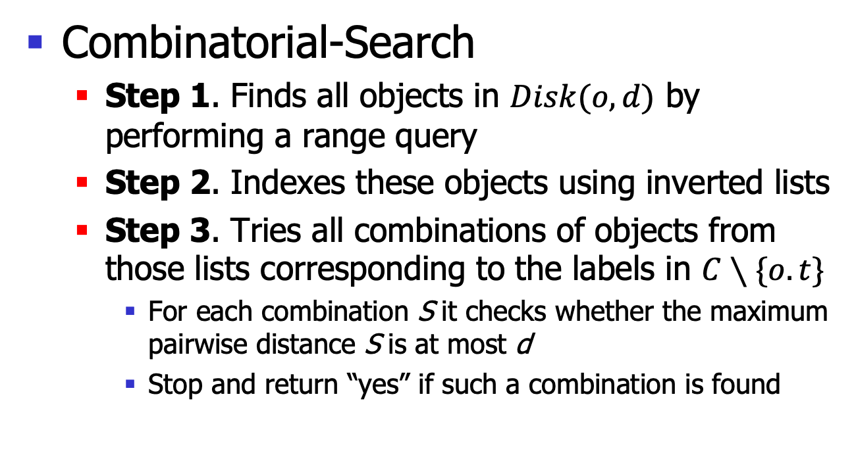
A Filtering-and-Verification Approach for RI
RI: to decide whether there is a row instance of a given label set C which involves an object o
Combinatorial-Search
  Step 1. Finds all objects in $Disk(o,d)$ by performing a range query
  Step 2. Indexes these objects using inverted lists
  Step 3. Tries all combinations of objects from those lists corresponding to the labels in $C∖\{o.t\}$
    For each combination S it checks whether the maximum pairwise distance S is at most d
    Stop and return “yes” if such a combination is found

Slide 35
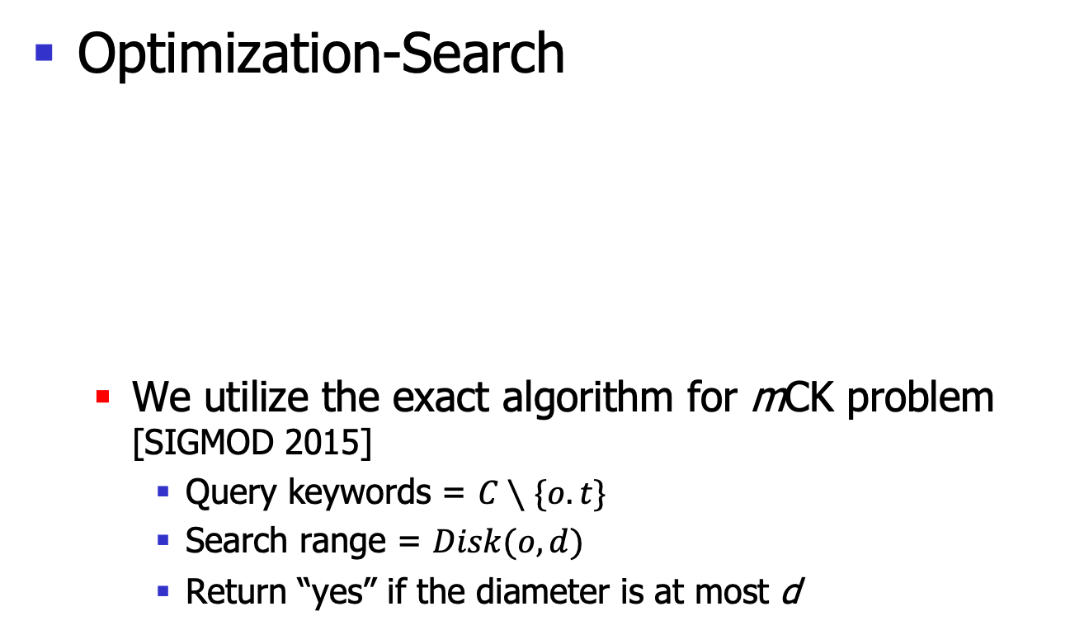
A Filtering-and-Verification Approach for RI
RI: to decide whether there is a row instance of a given label set C which involves an object o
Optimization-Search
  We utilize the exact algorithm for mCK problem
  [SIGMOD 2015]
    Query keywords = $C∖\{o.t\}$
    Search range = $Disk(o,d)$
    Return “yes” if the diameter is at most d
A RI
problem instance
A mCK
problem instance
➔
mCK problem: Find a set of objects which
(1) covers a given set of keywords and
(2) has the smallest diameter

Slide 36
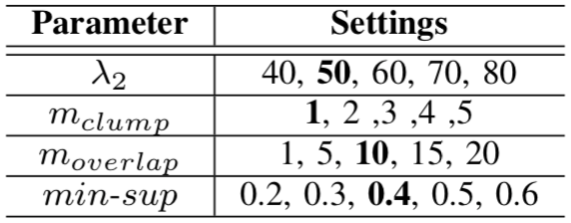
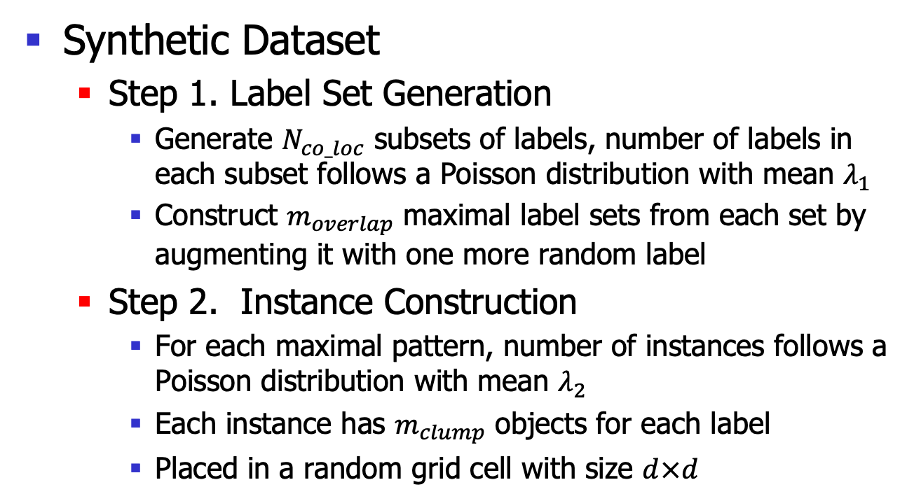
Experiment
Synthetic Dataset
  Step 1. Label Set Generation
    Generate $N_{co_loc}$ subsets of labels, number of labels in each subset follows a Poisson distribution with mean $λ_{1}$
    Construct $m_{overlap}$ maximal label sets from each set by augmenting it with one more random label
  Step 2. Instance Construction
    For each maximal pattern, number of instances follows a Poisson distribution with mean $λ_{2}$
    Each instance has $m_{clump}$ objects for each label
    Placed in a random grid cell with size $d×d$

Slide 37
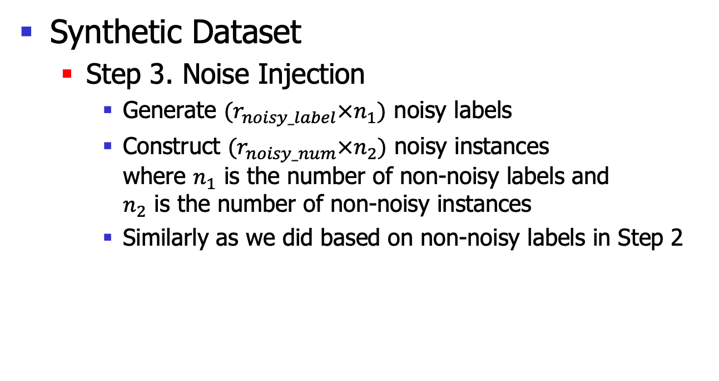
Experiment
Synthetic Dataset
  Step 3. Noise Injection
    Generate $(r_{noisy_label}×n_{1})$ noisy labels
    Construct $(r_{noisy_num}×n_{2})$ noisy instances
    where $n_{1}$ is the number of non-noisy labels and
    $n_{2}$ is the number of non-noisy instances
    Similarly as we did based on non-noisy labels in Step 2

Slide 38
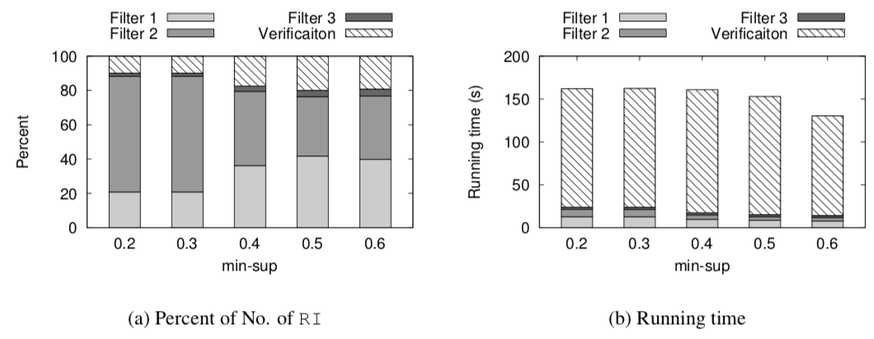
Experiment
Filtering power of filtering phase
>80% of RI instances could be solved in the filtering phase

Slide 39
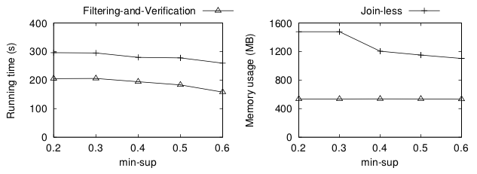
Experimental Results
Filtering-and-Verification (Synthetic datasets)
Our Filtering-and-Verification approach runs much faster and consumes less memory than the Join-less method
Notes:
Also in synthetic datasets

Slide 40
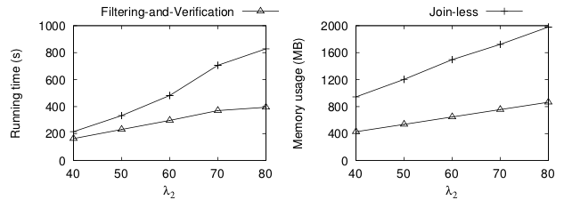
Experiment
Filtering-and-Verification (Synthetic datasets)

Slide 41
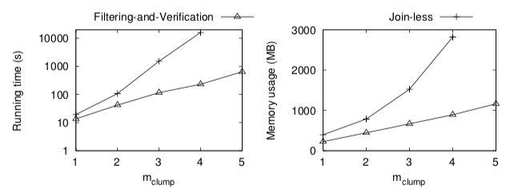
Experiment
Filtering-and-Verification (Synthetic datasets)

Slide 42
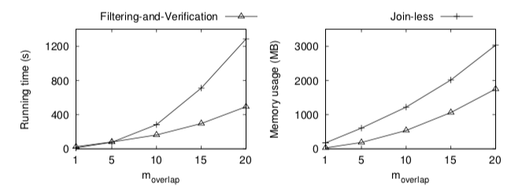
Experiment
Filtering-and-Verification (Synthetic datasets)

Slide 43
Existing Support Measures
Partitioning-based [SSTD 2001]
  It uses a grid to partition the spaces into cells
  Constructs for each cell a transaction
An example that no transaction is constructed
Only those instances within individual cells are considered, while those across adjacent cells are missed.

Slide 44
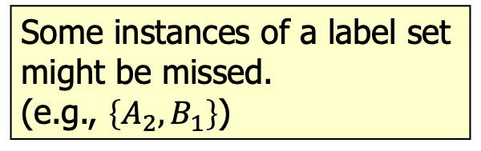
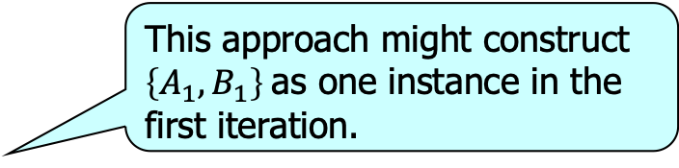
Existing Support Measures
Construction-based [KDD 2001]
  Heuristically constructs instances of a given label set and counts the number of constructed instances as the support
This approach might construct $\left\{A_{1}, B_{1}\right\}$ as one instance in the first iteration.
Followed by dropping these two objects from the database.
Some instances of a label set might be missed.
(e.g., $\left\{A_{2}, B_{1}\right\}$)

Slide 45



Existing Support Measures
Enumeration-based
[SSTD 2001, SAC 2003, TKDE 2004]
  Counts the number of row instances
Row instances of $C=\{o, ×\}$:
$\left\{A_{1}, B_{1}\right\}$, $\left\{A_{2}, B_{1}\right\}$, $\left\{A_{3}, B_{1}\right\}$, $\left\{A_{4}, B_{1}\right\}$
➔ $\sup\left(C\right)=4$
Row instance of $C′=\{×\}$:
$\left\{B_{1}\right\}$
➔ $\sup\left(C′\right)=1$
Not anti-monotonic and counterintuitive
Anti-monotonicity: $\sup\left(C^{′}\right)≥sup⁡(C)$

Slide 46

A Filtering-and-Verification Approach for RI
Filter 1. Check if there exists a row instance S of C, which was found previously when answering another RI instance for a difference object $o′$ and label set C, such that o is involved in S.
  If so, return “yes”
  Implemented by keeping track of all those objects that are involved in row instances that have been found

Slide 47

A Filtering-and-Verification Approach for RI
Filter 2. Check if all objects in $Disk(o,d)$ together carry all labels in C
  If no, we know that any subsets of objects in $Disk(o,d)$ cannot carry all labels in C
  return “no”
Filter 3. Check if all objects in $Disk(o,d/2)$ together carry all labels in C
  If so, we know that there exists a set of objects in $Disk(o,d/2)$ including o that corresponds to a row instance of C
  return “yes”

Slide 48






Fraction-Score
The amount of fraction of an object $o′$that $o$ receives
The aggregated fraction
of objects sharing a label
$t^{′}∈C∖\{t\}$ that o receives
The aggregated fraction o receives w.r.t. C
The support given the label $t$ for grouping row instances
The support of C

