Slide 1




Being Happy with the Least:
Achieving α-happiness with Minimum Number of Tuples
XIE Min, Shenzhen Institute of Computing Sciences
Raymond Chi-Wing Wong, The Hong Kong Univ. of Sci. and Tech.
Peng Peng, inspir.ai
Vassilis J. Tsotras, UC Riverside

Slide 2
Outline
Motivation
Problem Definition
Methodology
Experiments
Conclusions

Slide 3
Outline
Motivation
Problem Definition
Methodology
Experiments
Conclusions

Slide 4
Which apartment should Alice buy?
Suppose that Alice wants to buy an apartment
If the value is larger, then it is better to a user.
One example is the apartment size.
D
Apartment | X₁ | X₂
p₁ | 0 | 1
p₂ | 0.2 | 1
p₃ | 0.6 | 0.9
p₄ | 0.9 | 0.6
p₅ | 1 | 0.2
p₆ | 1 | 0
… | … | …

Slide 5
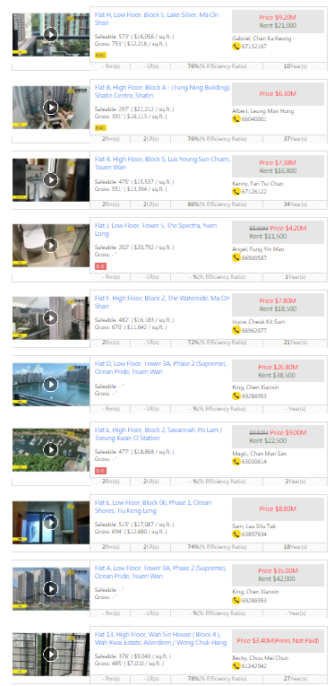
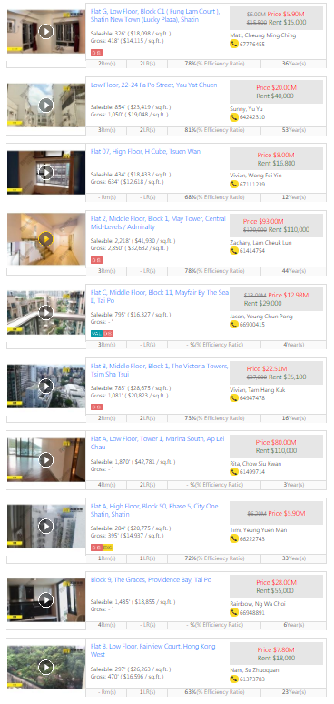
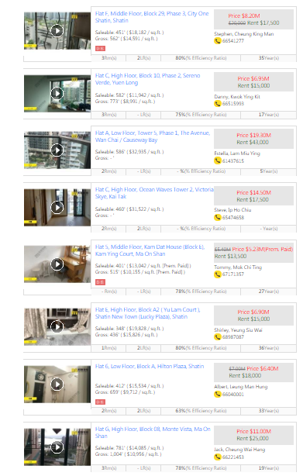
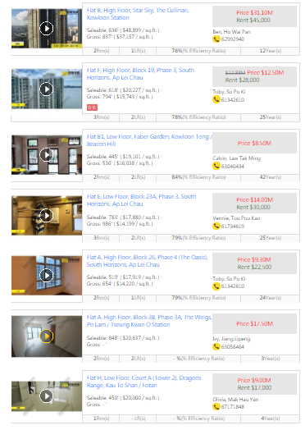
There are many candidate apartments in the market
How can we help Alice to find the apartment she is interested in?

Slide 6



Similar problems appear in car buying and hotel booking

Slide 7
Outline
Motivation
Problem Definition
Methodology
Experiments
Conclusions

Slide 8
Which apartment should Alice buy?
Suppose that Alice wants to buy an apartment
If the value is larger, then it is better to a user.
One example is the apartment size.
There are some popular queries for this problem (e.g., top-k and skyline).
D
Apartment | X₁ | X₂
p₁ | 0 | 1
p₂ | 0.2 | 1
p₃ | 0.6 | 0.9
p₄ | 0.9 | 0.6
p₅ | 1 | 0.2
p₆ | 1 | 0
… | … | …
In this talk, we will talk about a recent type of queries.
Regret minimization queries

Slide 9
A larger weight means that the corresponding dimension is more important in Alice’s mind
Regret minimization queries
Suppose that Alice wants to buy an apartment
Assume that Alice has a utility function in her mind
Utility function f
f(p) = 0.3 X₁ + 0.7 X₂
Utility
D
Utility
Apartment | X₁ | X₂
p₁ | 0 | 1
p₂ | 0.2 | 1
p₃ | 0.6 | 0.9
p₄ | 0.9 | 0.6
p₅ | 1 | 0.2
p₆ | 1 | 0
… | … | …
Utility vector u = (0.3, 0.7)
0.7
But, we do not know this utility function.
0.76
0.81
Suppose that the whole dataset D is seen by user Alice.
0.69
0.44
  We could find her favorite apartment p₃
  (Alice’s maximum utility apartment).
0.3
0.81
…

Slide 10

Regret minimization queries
Suppose that Alice wants to buy an apartment
If Alice’s maximum utility in S is equal to Alice’s maximum utility in D,
then Alice’s happiness ratio is equal to 1
Thus, we would like to have a larger value for Alice’s happiness ratio.
There is a difference between these 2 utility values
Suppose that the whole dataset D is seen by user Alice.
D
Utility
Apartment | X₁ | X₂
p₁ | 0 | 1
p₂ | 0.2 | 1
p₃ | 0.6 | 0.9
p₄ | 0.9 | 0.6
p₅ | 1 | 0.2
p₆ | 1 | 0
… | … | …
0.7
  We could find her favorite apartment p₃
  (Alice’s maximum utility apartment).
Alice’s Happiness Ratio
= $\frac{0.76}{0.81}$
= 0.938
0.76
0.81
Alice’s maximum utility in S
Consider a set S = {p₂, p₄}
Suppose that Alice has not seen the full dataset D but instead only S (D is too big)
0.81
0.69
0.44
  We could find her favorite apartment p₂
  (Alice’s maximum utility apartment based on seeing S).
0.3
Alice’s maximum utility in D
…
0.76

Slide 11

Regret minimization queries
Suppose that Alice wants to buy an apartment
Consider that Alice has a utility function with the utility vector (0.3, 0.7).
But, we do not know this utility function.
There is a difference between these 2 utility values
  Alice’s Happiness Ratio = 0.938
D
There are many other users (e.g.,
Mary and Peter).
Apartment | X₁ | X₂
p₁ | 0 | 1
p₂ | 0.2 | 1
p₃ | 0.6 | 0.9
p₄ | 0.9 | 0.6
p₅ | 1 | 0.2
p₆ | 1 | 0
… | … | …
Utility
0.7
Each of them has different utility functions.
Alice’s Happiness Ratio
= $\frac{0.76}{0.81}$
= 0.938
0.76
Alice’s maximum utility in S
0.81
E.g., Mary’s Happiness Ratio = 0.872
E.g., Peter’s Happiness Ratio = 1
0.69
Each user’s preference is represented in the form of a utility vector (w₁, w₂)
minHap is the worst-case happiness ratio by considering all possible vectors
Minimum Happiness Ratio (minHap) =
the minimum of all happiness ratios (among all users) (e.g., 0.872)
0.44
0.3
Alice’s maximum utility in D
…

Slide 12
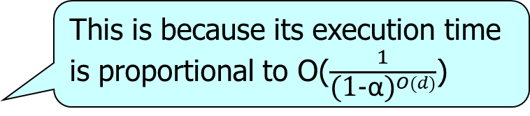
Regret minimization queries
Suppose that Alice wants to buy an apartment
We call it The α-Happiness Query in this talk
Problem:
Given a set D and a happiness threshold α, we want to find a set S of apartments such that the minHap of S is at least α and the size of S is minimized
NP Hardness: The α-happiness query is NP-hard
The best-known previous method for the α-happiness query is CoresetHS [ALENEX’18]
This is because its execution time is proportional to O($\frac{1}{{\text{(1−}\text{α}\text{)}}^{O(d)}}$)
Unfortunately, when we experimentally evaluated it for large α, it experienced a long query time.
Become prohibitive when users require a large α

Slide 13
Regret minimization queries
Suppose that Alice wants to buy an apartment
We call it The α-Happiness Query in this talk
Problem:
Given a set D and a happiness threshold α, we want to find a set S of apartments such that the minHap of S is at least α and the size of S is minimized
NP Hardness: The α-happiness query is NP-hard
Contributions
  We provide a geometric interpretation of the α-happiness query
  We propose a novel algorithm, called Cone-Greedy, to answer the α-happiness query with a bounded output size and is not sensitive to large α

Slide 14
Outline
Motivation
Problem Definition
Methodology
Experiments
Conclusions

Slide 15
Geometric Preliminary
Convex hull: Conv(D)
D
X₂
Apartment | X₁ | X₂
p₁ | 0 | 1
p₂ | 0.2 | 1
p₃ | 0.6 | 0.9
p₄ | 0.9 | 0.6
p₅ | 1 | 0.2
p₆ | 1 | 0
… | … | …
p₁
p₂
p₃
p₄
p₅
p₆
O
X₁

Slide 16
Geometric Preliminary
S = {p₃, p₄}
Convex hull: Conv(S)
D
X₂
Apartment | X₁ | X₂
p₁ | 0 | 1
p₂ | 0.2 | 1
p₃ | 0.6 | 0.9
p₄ | 0.9 | 0.6
p₅ | 1 | 0.2
p₆ | 1 | 0
… | … | …
p₁
p₂
p₃
p₄
p₅
p₆
O
X₁
16

Slide 17
The α-shrunk Set
X₂
p₁'
p₂'
p₃'
p₄'
p₅'
Assume α = 0.9
p₆'
O
X₁
Convex hull: Conv(D’)
D
D’
Apartment | X₁ | X₂
p₁ | 0 | 1
p₂ | 0.2 | 1
p₃ | 0.6 | 0.9
p₄ | 0.9 | 0.6
p₅ | 1 | 0.2
p₆ | 1 | 0
… | … | …
Apartment | X₁ | X₂
p₁' | 0 | 0.9
p₂' | 0.18 | 0.9
p₃' | 0.54 | 0.81
p₄' | 0.81 | 0.54
p₅' | 0.9 | 0.18
p₆' | 0.9 | 0
… | … | …
The α-shrunk set of D
p’ = α · p

Slide 18
Spatial Coverage Problem
Theorem: S is a solution of the α-happiness query if and only if S is a solution of the spatial coverage problem
Problem (Spatial Coverage Problem):
Given a set D and a threshold α, we want to find a set S of apartments such that Conv(D’) is totally contained inside Conv(S) and the size of S is minimized where D’ is the α-shrunk set of D.
X₂
Conv(S)
X₂
p₁
p₂
p₃
p₁'
p₂'
p₃'
p₄
Conv(D')
p₄'
p₅
p₅'
p₆
p₆'
O
X₁
O
X₁

Slide 19
Algorithm Cone-Greedy
Idea
  Define the “coverage” of each p in D
  Use a greedy approach to add apartments

Slide 20
Algorithm Cone-Greedy
Idea
  Define the “coverage” of each p in D
  Use a greedy approach to add apartments

Slide 21
Coverage based on Visibility
The visible range from p₃ to Conv(D’)
X₂
v₁
w₂
Extreme vector
p₁'
p₂'
p₃
v₂
p₃'
p₄'
p₅'
w₁
p₆'
Utility Space (Recall that each user’s preference is represented in the form of a utility vector (w₁, w₂))
O
Conv(D')
X₁

Slide 22
Coverage based on Visibility
The visible range from p₃ to Conv(D’)
X₂
v₁
w₂
Extreme vector
p₁'
p₂'
p₃
v₂
p₃'
p₄'
p₅'
w₁
p₆'
Utility Space (Recall that each user’s preference is represented in the form of a utility vector (w₁, w₂))
O
Conv(D')
X₁

Slide 23
Coverage based on Visibility
The visible range from p₃ to Conv(D’)
Lemma: If p₃ is in S and Alice’s utility vector is in this region, Alice’s happiness ratio is at least α
X₂
v₁
w₂
Extreme vector
The volume of this region is the coverage of p₃
p₁'
p₂'
v₁
p₃
v₂
p₃'
v₂
p₄'
p₅'
w₁
p₆'
Utility Space (Recall that each user’s preference is represented in the form of a utility vector (w₁, w₂))
O
Conv(D')
X₁

Slide 24
Algorithm Cone-Greedy
Idea
  Define the “coverage” of each p in D
  Use a greedy approach to add apartments

Slide 25
w₂
w₂
The volume of this region is the coverage of p₃
The volume of this region is the coverage of p₄
w₁
w₁
Strategy: Construct the solution set S by adding apartments greedily until the entire utility space is covered
Lemma: If the coverage of apartments in S covers the entire utility space, Conv(D’) is totally contained inside Conv(S)
We want to improve the efficiency. Thus, we approximate the coverage of each apartment by Sampling

Slide 26
Performance Guarantee
Output size guarantee
Theorem:
  Cone-Greedy returns a set S of apartments such that
    (1) S has a log-factor bound on the output size
    (2) For each user, the probability that each user’s happiness ratio w.r.t. S is at least α is high
Happiness guarantee

Slide 27
Outline
Motivation
Problem Definition
Methodology
Experiments
Conclusion

Slide 28
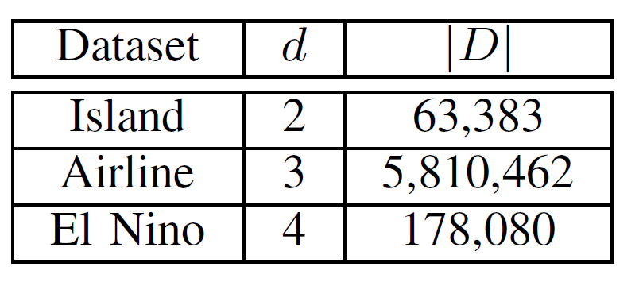
Experimental Setting
Real Datasets:
  Island, Airline, El Nino
Algorithms:
  Cone-Greedy, LP-Greedy, CoresetHS, Coreset
Factors:
  The minimum happiness ratio α
Measurements
  Execution time and output size

Slide 29
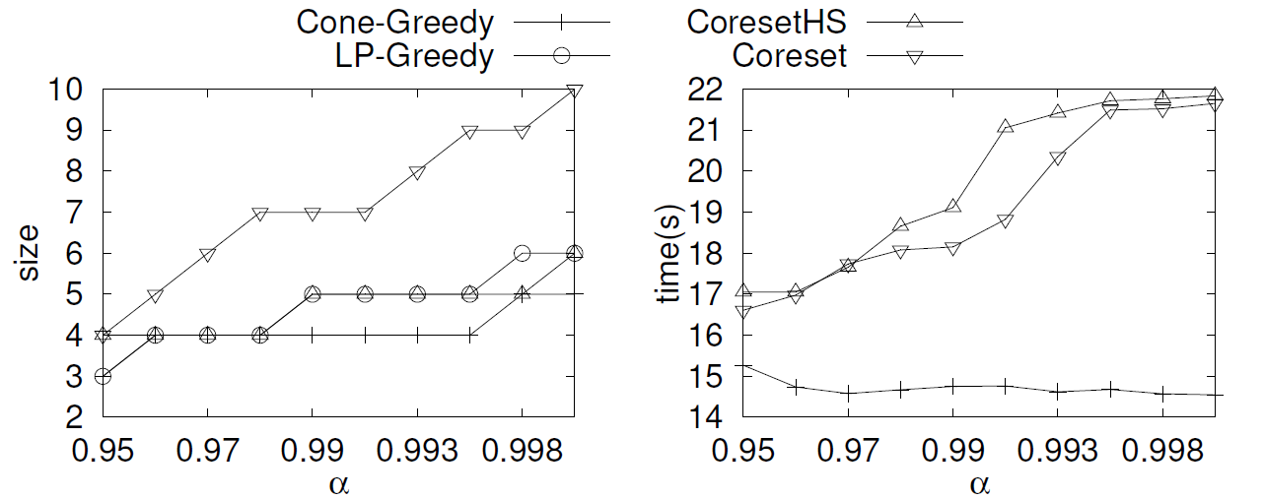
Experimental Results
Dataset: Airline (d = 3, n = 5,810,462)
Factor: The target minimum happiness ratio α
Competitors degrade when α is large
Our approach
1/3 faster
Cone-Greedy returns a set with the smallest output size
The execution time of Cone-Greedy is the smallest and not sensitive to α

Slide 30
Outline
Introduction
Problem Definition
Methodology
Experiments
Conclusions

Slide 31
Conclusions
We study the α-happiness query
We interpret the α-happiness query from a novel geometric perspective
We give an efficient solution called Cone-Greedy, which is less sensitive to α, with novel theoretical guarantees and superior empirical performance

Slide 32
Q & A

