Slide 1


Fair Top-k Query on Alpha-Fairness
Hao Liu, The Hong Kong University of Science and Technology
Zheng Zhang, Individual
Raymond Chi-Wing Wong, The Hong Kong University of Science and Technology
Min Xie, Shenzhen Institute of Computing Sciences
Bo Tang, Southern University of Science and Technology

Slide 2
Outline
Introduction
Fairness Model
Algorithms
Experiment
Conclusion

Slide 3
Outline
Introduction
Fairness Model
Algorithms
Experiment
Conclusion

Slide 4
Introduction: Background
Top-k query, where users specify a utility function (i.e., a ranking scheme) and a positive integer k, returns the k tuples in a dataset with the highest utility.
It is widely used in many applications, e.g., hiring and admission.
However, a poorly designed ranking scheme could cause discrimination to minority groups, e.g., females and ethnic minorities, which could violate the law and regulations.
  Groups that are often discriminated against are denoted as “protected groups” (e.g., females and African-American)
  Attributes that defines protected groups are denoted as “protected attributes” (e.g., gender and race)
Notes:
…
This type of query is widely used in many applications where a user want to select a small number of candidates from a large dataset based on some ranking scheme.

Slide 5
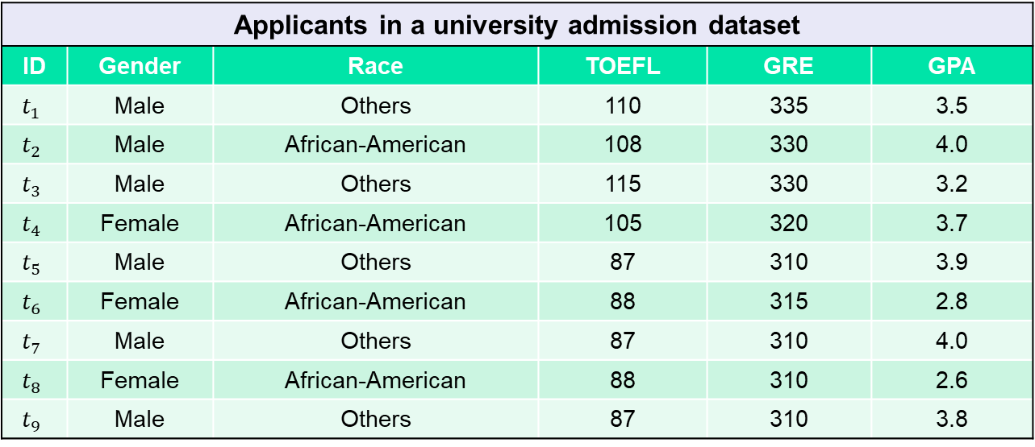
Introduction: Motivating Example
We use an example to show how a ranking scheme could cause discrimination to certain groups.
The university wants to give offer to top-7 applicants
Applicants in a university admission dataset
ID | Gender | Race | TOEFL | GRE | GPA
$$t_{1}$$ | Male | Others | 110 | 335 | 3.5
$$t_{2}$$ | Male | African-American | 108 | 330 | 4.0
$$t_{3}$$ | Male | Others | 115 | 330 | 3.2
$$t_{4}$$ | Female | African-American | 105 | 320 | 3.7
$$t_{5}$$ | Male | Others | 87 | 310 | 3.9
$$t_{6}$$ | Female | African-American | 88 | 315 | 2.8
$$t_{7}$$ | Male | Others | 87 | 310 | 4.0
$$t_{8}$$ | Female | African-American | 88 | 310 | 2.6
$$t_{9}$$ | Male | Others | 87 | 310 | 3.8
Protected attributes
Protected groups

Slide 6
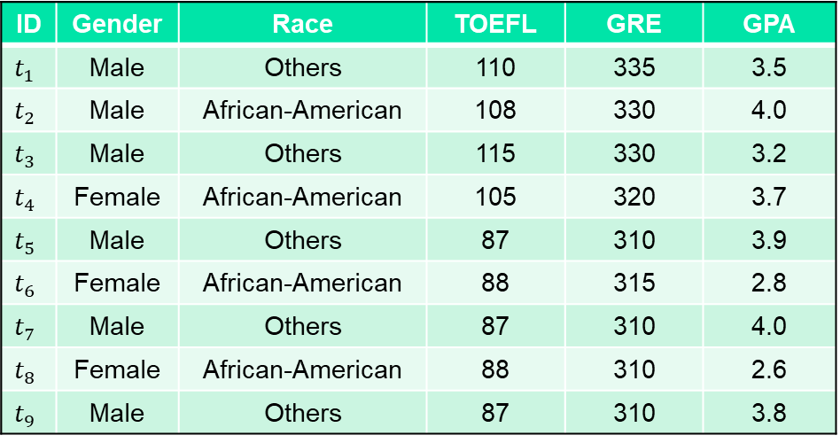
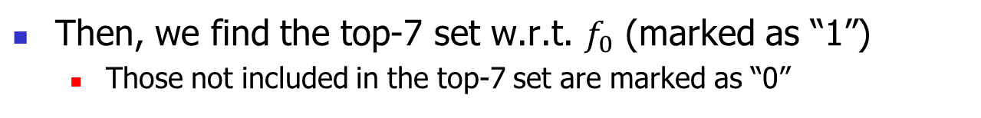
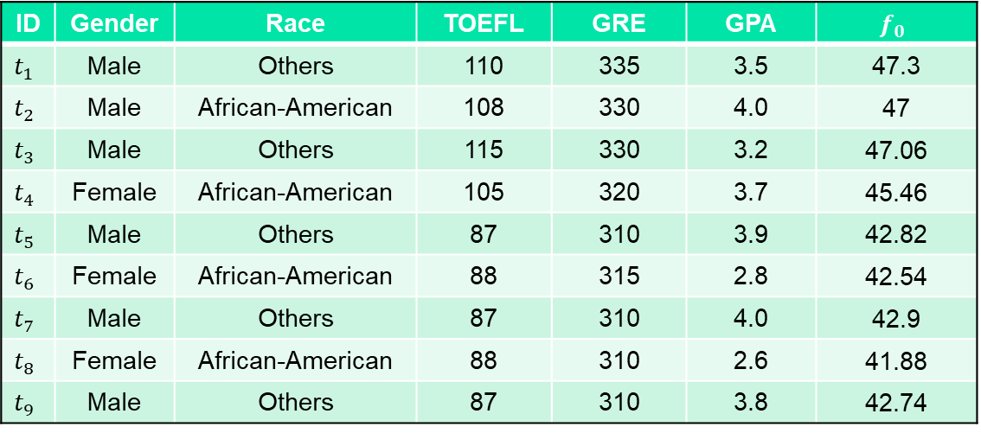
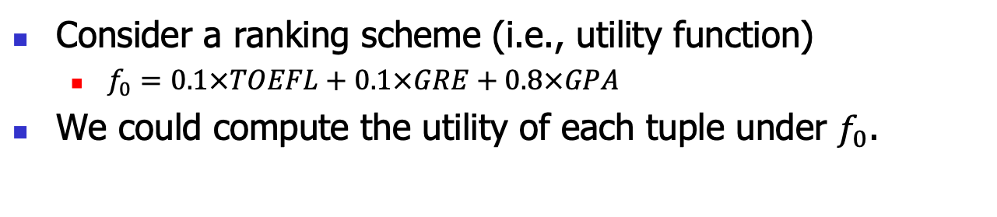
ID | Gender | Race | TOEFL | GRE | GPA | $$f_{0}$$
$$t_{1}$$ | Male | Others | 110 | 335 | 3.5 | 47.3
$$t_{2}$$ | Male | African-American | 108 | 330 | 4.0 | 47
$$t_{3}$$ | Male | Others | 115 | 330 | 3.2 | 47.06
$$t_{4}$$ | Female | African-American | 105 | 320 | 3.7 | 45.46
$$t_{5}$$ | Male | Others | 87 | 310 | 3.9 | 42.82
$$t_{6}$$ | Female | African-American | 88 | 315 | 2.8 | 42.54
$$t_{7}$$ | Male | Others | 87 | 310 | 4.0 | 42.9
$$t_{8}$$ | Female | African-American | 88 | 310 | 2.6 | 41.88
$$t_{9}$$ | Male | Others | 87 | 310 | 3.8 | 42.74
ID | Gender | Race | TOEFL | GRE | GPA
$$t_{1}$$ | Male | Others | 110 | 335 | 3.5
$$t_{2}$$ | Male | African-American | 108 | 330 | 4.0
$$t_{3}$$ | Male | Others | 115 | 330 | 3.2
$$t_{4}$$ | Female | African-American | 105 | 320 | 3.7
$$t_{5}$$ | Male | Others | 87 | 310 | 3.9
$$t_{6}$$ | Female | African-American | 88 | 315 | 2.8
$$t_{7}$$ | Male | Others | 87 | 310 | 4.0
$$t_{8}$$ | Female | African-American | 88 | 310 | 2.6
$$t_{9}$$ | Male | Others | 87 | 310 | 3.8
1
1
1
1
1
0
1
0
1
Consider a ranking scheme (i.e., utility function)
  $f_{0}=0.1×TOEFL+0.1×GRE+0.8×GPA$
We could compute the utility of each tuple under $f_{0}$.
Then, we find the top-7 set w.r.t. $f_{0}$ (marked as “1”)
  Those not included in the top-7 set are marked as “0”

Slide 7
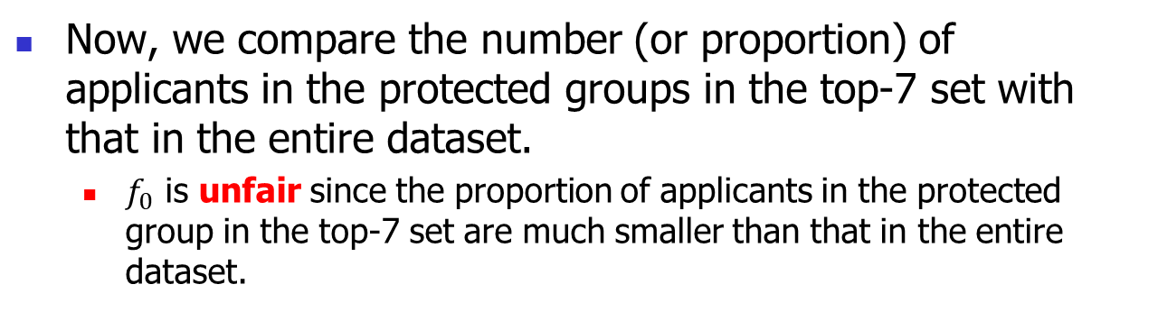

ID | Gender | Race | TOEFL | GRE | GPA | $$f_{0}$$
$$t_{1}$$ | Male | Others | 110 | 335 | 3.5 | 47.3
$$t_{2}$$ | Male | African-American | 108 | 330 | 4.0 | 47
$$t_{3}$$ | Male | Others | 115 | 330 | 3.2 | 47.06
$$t_{4}$$ | Female | African-American | 105 | 320 | 3.7 | 45.46
$$t_{5}$$ | Male | Others | 87 | 310 | 3.9 | 42.82
$$t_{6}$$ | Female | African-American | 88 | 315 | 2.8 | 42.54
$$t_{7}$$ | Male | Others | 87 | 310 | 4.0 | 42.9
$$t_{8}$$ | Female | African-American | 88 | 310 | 2.6 | 41.88
$$t_{9}$$ | Male | Others | 87 | 310 | 3.8 | 42.74
1
1
1
1
1
0
1
0
1
Entire dataset
Females: 3 out of 9 (33.3%)
African-American: 4 out of 9 (44.4%)
Top-7 set under $f_{0}$
Females: 1 out of 7 (14.3%)
African-American: 2 out of 7 (28.6%)
Now, we compare the number (or proportion) of applicants in the protected groups in the top-7 set with that in the entire dataset.
  $f_{0}$ is unfair since the proportion of applicants in the protected group in the top-7 set are much smaller than that in the entire dataset.

Slide 8

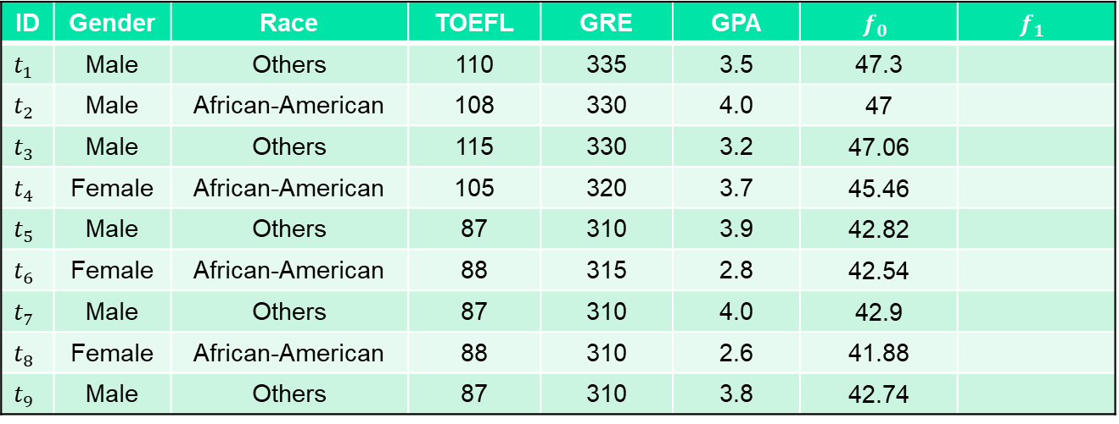
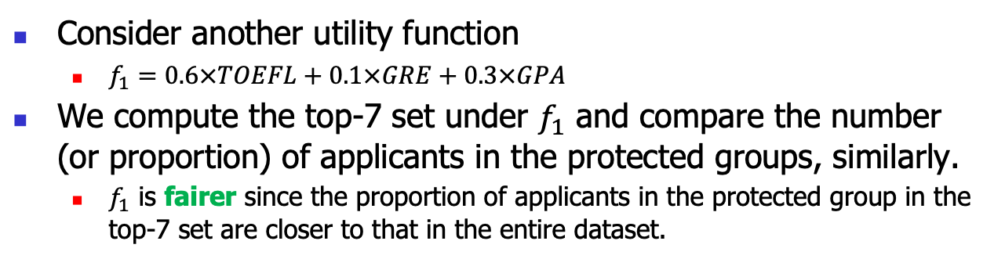
ID | Gender | Race | TOEFL | GRE | GPA | $$f_{0}$$ | $$f_{1}$$
$$t_{1}$$ | Male | Others | 110 | 335 | 3.5 | 47.3
$$t_{2}$$ | Male | African-American | 108 | 330 | 4.0 | 47
$$t_{3}$$ | Male | Others | 115 | 330 | 3.2 | 47.06
$$t_{4}$$ | Female | African-American | 105 | 320 | 3.7 | 45.46
$$t_{5}$$ | Male | Others | 87 | 310 | 3.9 | 42.82
$$t_{6}$$ | Female | African-American | 88 | 315 | 2.8 | 42.54
$$t_{7}$$ | Male | Others | 87 | 310 | 4.0 | 42.9
$$t_{8}$$ | Female | African-American | 88 | 310 | 2.6 | 41.88
$$t_{9}$$ | Male | Others | 87 | 310 | 3.8 | 42.74
ID | Gender | Race | TOEFL | GRE | GPA | $$f_{0}$$
$$t_{1}$$ | Male | Others | 110 | 335 | 3.5 | 47.3
$$t_{2}$$ | Male | African-American | 108 | 330 | 4.0 | 47
$$t_{3}$$ | Male | Others | 115 | 330 | 3.2 | 47.06
$$t_{4}$$ | Female | African-American | 105 | 320 | 3.7 | 45.46
$$t_{5}$$ | Male | Others | 87 | 310 | 3.9 | 42.82
$$t_{6}$$ | Female | African-American | 88 | 315 | 2.8 | 42.54
$$t_{7}$$ | Male | Others | 87 | 310 | 4.0 | 42.9
$$t_{8}$$ | Female | African-American | 88 | 310 | 2.6 | 41.88
$$t_{9}$$ | Male | Others | 87 | 310 | 3.8 | 42.74
1
1
1
1
1
1
1
1
1
1
1
1
1
0
1
0
1
0
1
1
1
0
1
0
1
0
1
Entire dataset
Females: 3 out of 9 (33.3%)
African-American: 4 out of 9 (44.4%)
Top-7 set under $f_{1}$
Females: 3 out of 7 (42.9%)
African-American: 4 out of 7 (57.1%)
Consider another utility function
  $f_{1}=0.6×TOEFL+0.1×GRE+0.3×GPA$
We compute the top-7 set under $f_{1}$ and compare the number (or proportion) of applicants in the protected groups, similarly.
  $f_{1}$ is fairer since the proportion of applicants in the protected group in the top-7 set are closer to that in the entire dataset.

Slide 9
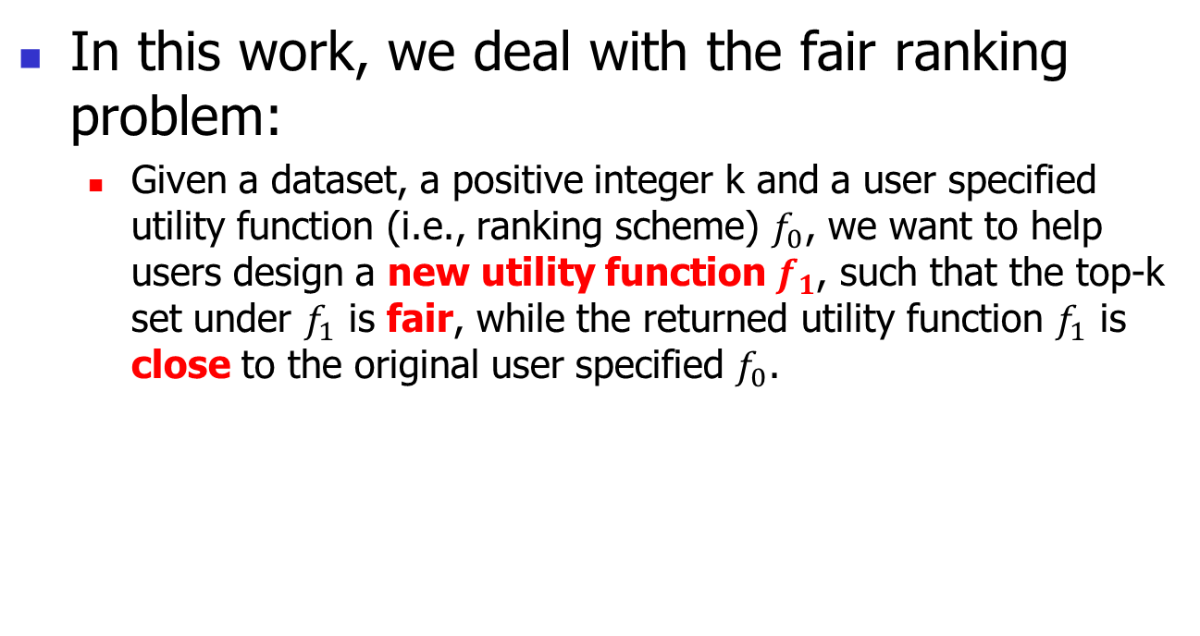
Introduction: Problem Definition
In this work, we deal with the fair ranking problem:
  Given a dataset, a positive integer k and a user specified utility function (i.e., ranking scheme) $f_{0}$, we want to help users design a new utility function $f_{1}$, such that the top-k set under $f_{1}$ is fair, while the returned utility function $f_{1}$ is close to the original user specified $f_{0}$.

Slide 10
Introduction: Existing Approaches
Related studies on fair top-k queries (or ranking) can be classified into two branches
  Intervention with the ranking result: assuming that the utilities of all tuples have been computed by a pre-existing ranking scheme.
    FA*IR [CIKM17]
    Ranking with Fairness Constraints [ICALP18]
These methods may select some tuples with lower utilities to ensure fairness. It causes ranking violation, where a tuple t ranks higher than t’ but t is dominated by t’ (i.e., t’ is better than t on every attribute). In this case, no utility function can give such a top-k set. In comparison, our method always returns the top-k tuples under a utility function to avoid that.

Slide 11
Introduction: Existing Approaches
  Intervention with the ranking scheme: focusing on finding a ranking scheme that is fair and close to the user-input ranking scheme.
    [SIGMOD19]: returning a feasible utility function (satisfying some fairness constraints) with a time-consuming approach of geometrically processing each pair of tuples in the dataset.
We follow this branch.
In comparison:
1. We focus on finding the fairest top-k set (which could be more interesting than a feasible one), while in [SIGMOD19] if the constraint is set too hard, leading to no feasible utility function, the user needs to repeatedly try some looser constraints to obtain the result.
2. We use a more efficient approach to achieve 10x-100x improvement on response time than [SIGMOD19].

Slide 12

Introduction: Our Contributions
We design a fairness model called $α$-fairness to measure the fairness of top-k sets.
We propose two algorithms FairTQ-Exact and FairTQ-Exact-BnB to find the exact solution efficiently.
Extensive experiments on real and synthetic datasets demonstrate our effectiveness and efficiency.

Slide 13
Outline
Introduction
Fairness Model
Algorithms
Experiment
Conclusion

Slide 14
Fairness Model: Intuition
In this work, we focus on group fairness (i.e., treating each group equally when selected as top-k).
Specifically, we adapt the “proportional” model to form our fairness model.
  We measure the group fairness of a top-k set by comparing the proportions of all groups in the dataset (i.e., the “populational proportions”) with the proportions of all groups in the top-k set (i.e., the “representational proportions”).

Slide 15
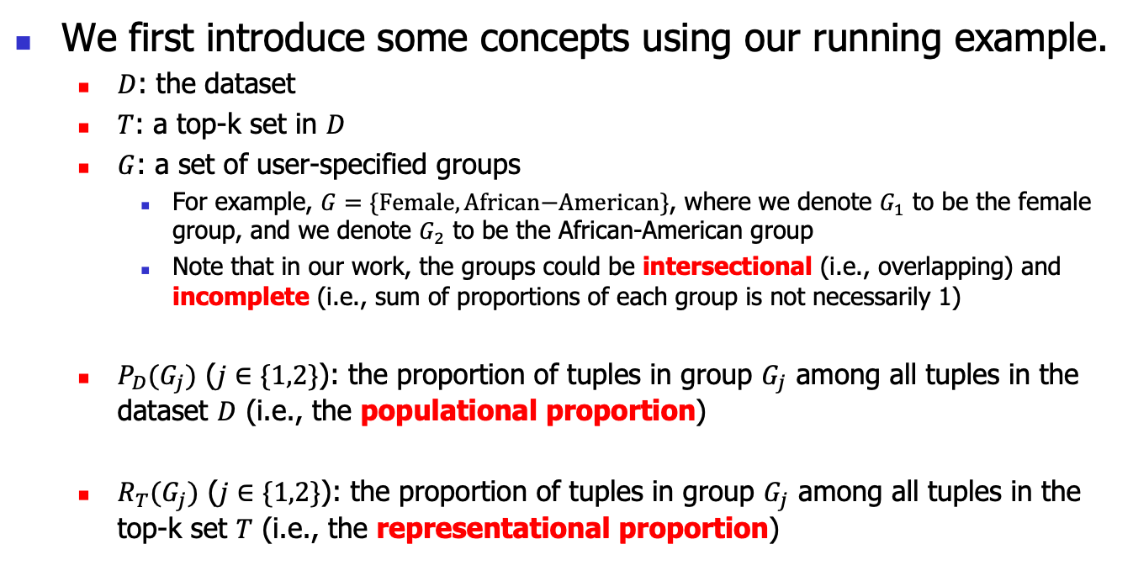
Fairness Model: Concepts
We first introduce some concepts using our running example.
  $D$: the dataset
  $T$: a top-k set in $D$
  $G$: a set of user-specified groups
    For example, $G=\{\text{Female},\text{African}\text{−}\text{American}\}$, where we denote $G_{1}$ to be the female group, and we denote $G_{2}$ to be the African-American group
    Note that in our work, the groups could be intersectional (i.e., overlapping) and incomplete (i.e., sum of proportions of each group is not necessarily 1)
  $P_{D}(G_{j})$ ($j∈\{1,2\}$): the proportion of tuples in group $G_{j}$ among all tuples in the dataset $D$ (i.e., the populational proportion)
  $R_{T}(G_{j})$ ($j∈\{1,2\}$): the proportion of tuples in group $G_{j}$ among all tuples in the top-k set $T$ (i.e., the representational proportion)
Notes:
For better illustration, we directly show the concepts in our running example.

Slide 16

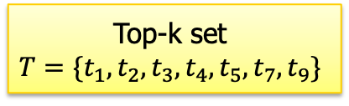



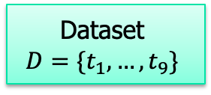

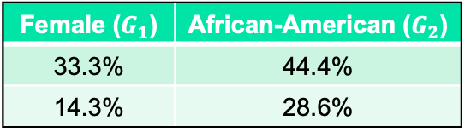

Fairness Model: Example
A set of 2 user-specified arbitrary groups $G$
Populational Proportions
Dataset
$$D=\{t_{1},…,t_{9}\}$$
Female ($G_{1}$) | African-American ($G_{2}$)
33.3% | 44.4%
14.3% | 28.6%
$$P_{D}(G_{1})$$
$$P_{D}(G_{2})$$
Utility function $f_{0}$
$$R_{T}(G_{1})$$
$$R_{T}(G_{2})$$
Representational Proportion
Top-k set
$$T=\{t_{1},t_{2},t_{3},t_{4},t_{5},t_{7},t_{9}\}$$
Notes:
We have our dataset D, and a top-k set of the dataset T. For example, the top-k set here is resulted from the utility function f0.
We also have a set of user-specified groups G, e.g., Female group G1 and African-American group G2.
// Here, I want to specially mention the set G in our fairness model could be arbitrary, i.e., they could be overlapping and incomplete (which means the sum of proportions of all groups is not necessarily 1).
Next, as we just mentioned, we define the populational proportion to be the proportion of each group among the entire dataset D.
And similarly, we define the representational proportion to be the proportion of each group among the top-k set T.
// Above those, we also define the overall population to be a vector of all populational proportions, and the overall representation to be a vector of all representational proportions.

Slide 17

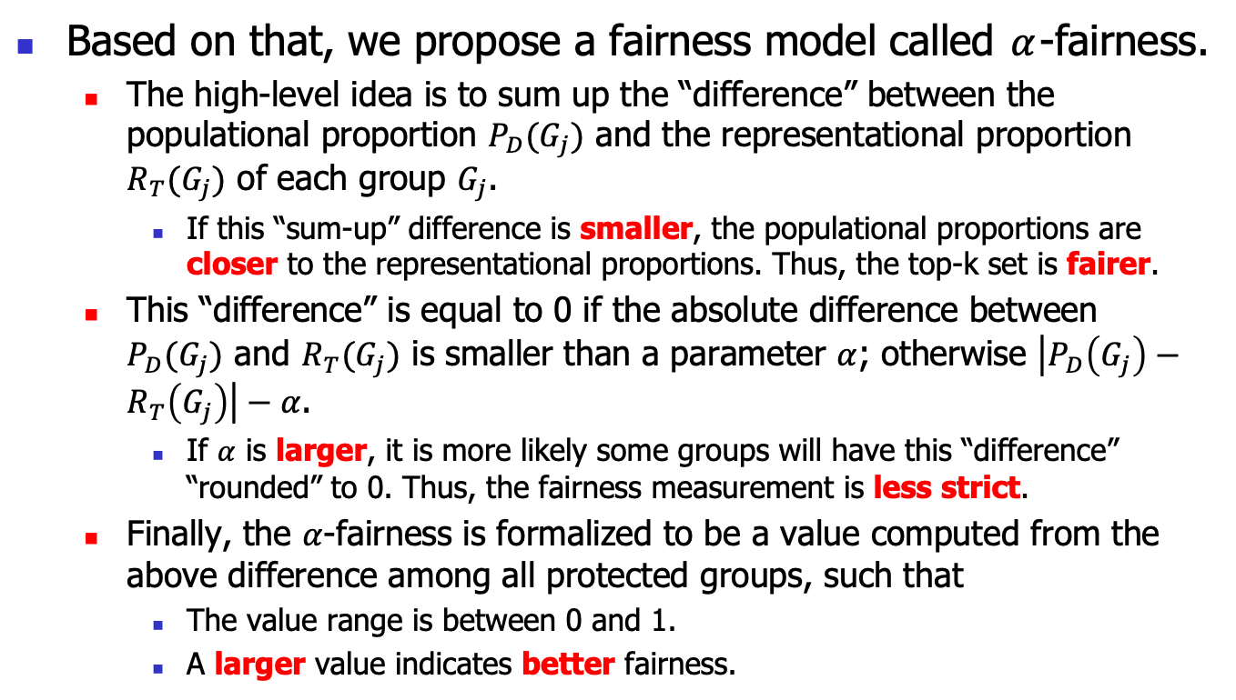
Fairness Model: $α$-fairness
Based on that, we propose a fairness model called $α$-fairness.
  The high-level idea is to sum up the “difference” between the populational proportion $P_{D}(G_{j})$ and the representational proportion $R_{T}(G_{j})$ of each group $G_{j}$.
    If this “sum-up” difference is smaller, the populational proportions are closer to the representational proportions. Thus, the top-k set is fairer.
  This “difference” is equal to 0 if the absolute difference between $P_{D}(G_{j})$ and $R_{T}(G_{j})$ is smaller than a parameter $α$; otherwise $\left|P_{D}\left(G_{j}\right)−R_{T}\left(G_{j}\right)\right|−α$.
    If $α$ is larger, it is more likely some groups will have this “difference” “rounded” to 0. Thus, the fairness measurement is less strict.
  Finally, the $α$-fairness is formalized to be a value computed from the above difference among all protected groups, such that
    The value range is between 0 and 1.
    A larger value indicates better fairness.
Notes:
Due to time limit, we will not go through the theoretical discussions.
I will directly show how our alpha fairness is formalized using our running example.
// [
…
However, we don’t want this difference to be a simple absolute difference.
Instead, this “difference” is equal to 0 …
...
In this way, we could use the parameter alpha to control the strictness of this fairness model or rather to say, a fairness measurement.
]//

Slide 18

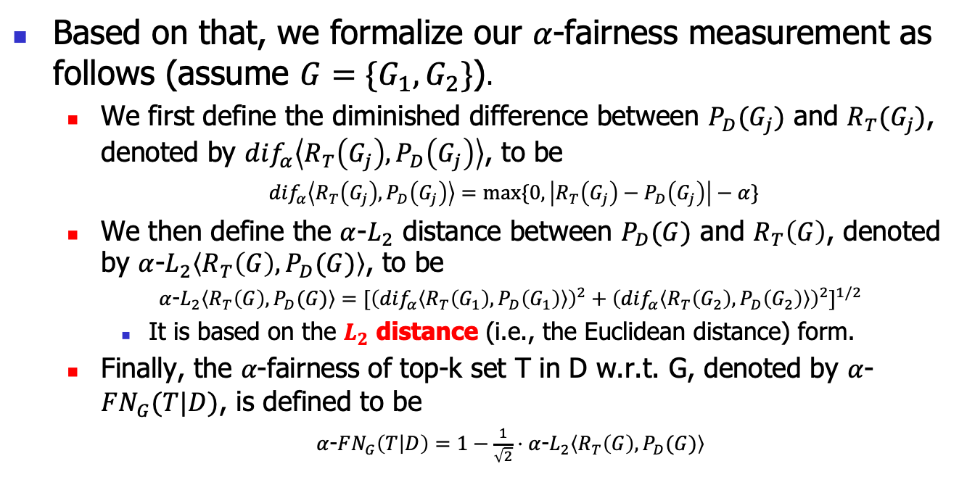
Fairness Model: $α$-fairness Formalization
Based on that, we formalize our 𝛼-fairness measurement as follows (assume $G=\{G_{1},G_{2}\}$).
  We first define the diminished difference between $P_{D}(G_{j})$ and $R_{T}(G_{j})$, denoted by $dif_{α}\left\langle R_{T}\left(G_{j}\right),P_{D}\left(G_{j}\right)\right\rangle$, to be
  $dif_{α}\left\langle R_{T}\left(G_{j}\right),P_{D}\left(G_{j}\right)\right\rangle =max⁡\{0,\left|R_{T}\left(G_{j}\right)−P_{D}\left(G_{j}\right)\right|−α\}$
  We then define the $α$-$L_{2}$ distance between $P_{D}(G)$ and $R_{T}\left(G\right)$, denoted by $α$-$L_{2}\left\langle R_{T}\left(G\right),P_{D}(G)\right\rangle$, to be
  $α$-$L_{2}\left\langle R_{T}\left(G\right),P_{D}(G)\right\rangle ={[{\left(dif_{α}\left\langle R_{T}\left(G_{1}\right),P_{D}\left(G_{1}\right)\right\rangle \right)}^{2}+{\left(dif_{α}\left\langle R_{T}\left(G_{2}\right),P_{D}\left(G_{2}\right)\right\rangle \right)}^{2}]}^{1/2}$
    It is based on the $L_{2}$ distance (i.e., the Euclidean distance) form.
  Finally, the 𝛼-fairness of top-k set T in D w.r.t. G, denoted by $α$-$FN_{G}(T|D)$, is defined to be
  $α$-$FN_{G}\left(T | D\right)=1−\frac{1}{\sqrt{2}}⋅α$-$L_{2}\left\langle R_{T}\left(G\right),P_{D}(G)\right\rangle$
The previously mentioned “difference” controlled by 𝛼
The previously mentioned “sum-up” difference
Notes:
Based on that, we could formalize our alpha-fairness measurement.
So we first define the d-i-f function for the previously mentioned “difference” controlled by alpha.
Then we define the alpha-L2 distance between the two proportions, to implement the previously mentioned “sum-up” difference.
This format is based on L2 distance or Euclidean distance.
Finally, we formalize our alpha-fairness to be some form of normalized alpha-L2 distance.

Slide 19


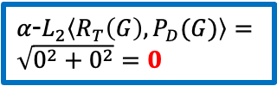
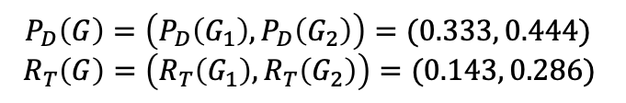
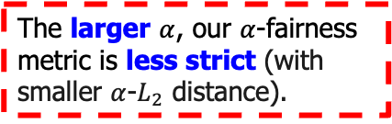
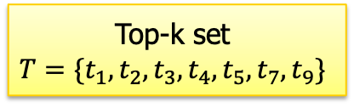

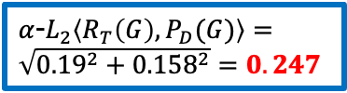




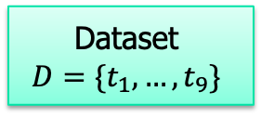



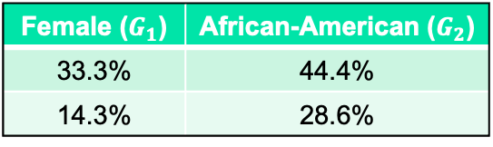



Fairness Model: Example
A set of 2 user-specified arbitrary groups $G$
Dataset
$$D=\{t_{1},…,t_{9}\}$$
Female ($G_{1}$) | African-American ($G_{2}$)
33.3% | 44.4%
14.3% | 28.6%
$$P_{D}(G_{1})$$
$$P_{D}(G_{2})$$
Utility function $f_{0}$
$$R_{T}(G_{1})$$
$$R_{T}(G_{2})$$
$$P_{D}\left(G\right)=\left(P_{D}\left(G_{1}\right),P_{D}\left(G_{2}\right)\right)=(0.333, 0.444)$$
$$R_{T}\left(G\right)=\left(R_{T}\left(G_{1}\right),R_{T}\left(G_{2}\right)\right)=(0.143, 0.286)$$
Top-k set
$$T=\{t_{1},t_{2},t_{3},t_{4},t_{5},t_{7},t_{9}\}$$
$$α=0$$
$$α=0.2$$
$$dif_{α}\left\langle R_{T}\left(G_{1}\right),P_{D}(G_{1})\right\rangle =0.19$$
$$dif_{α}\left\langle R_{T}\left(G_{2}\right),P_{D}(G_{2})\right\rangle =0.158$$
$$dif_{α}\left\langle R_{T}\left(G_{1}\right),P_{D}(G_{1})\right\rangle =0$$
$$dif_{α}\left\langle R_{T}\left(G_{2}\right),P_{D}(G_{2})\right\rangle =0$$
$α$-$FN_{G}\left(T | D\right)=1−\frac{1}{\sqrt{2}}⋅0.247=0.825$
$α$-$L_{2}\left\langle R_{T}\left(G\right),P_{D}(G)\right\rangle =\sqrt{{0.19}^{2}+{0.158}^{2}}=0.247$
$α$-$L_{2}\left\langle R_{T}\left(G\right),P_{D}(G)\right\rangle =\sqrt{0^{2}+0^{2}}=0$
The larger $α$, our $α$-fairness metric is less strict (with smaller $α$-$L_{2}$ distance).
$$p=2$$
$$p=2$$
Notes:
We already obtained the populational proportions and the representational proportions in this example.
The basic idea is to obtain the difference between the two proportions for each group.
Then, we sum up the differences for all groups using the L-2 distance (or we say the Euclidean distance).
Intuitively, if this “sum-up” difference is smaller, the populational proportions are closer to the representational proportions. Thus, the top-k set is fairer.
We could notice that we have a parameter alpha here, which is equal to 0 in this default case.
When alpha is set to 0.2, the results of the dif functions are rounded to 0 based on our definition.
So, this “sum-up” difference is also rounded to 0.
In our fairness model, larger alpha results in the alpha-fairness metric to be less strict.
Finally, the alpha-fairness value of the top-k set is formulated with some normalization such that the larger value indicates better fairness.
// [
Let’s continue our example.
We already obtained the populational proportions and the representational proportions in this example.
We first consider alpha=0, which is actually the default case of the d-i-f function, where the differences are just the absolution difference of the two proportions.
We can compute the alpha-L2 distance for that.
In another case of alpha=0.2, since both the absolute differences are smaller than this value, the results are rounded 0.
The alpha-L2 distance is rounded to 0, which actually means the metric becomes less strict when alpha changes from 0 to 0.2.
Finally, the alpha-fairness of top-k set T is computed.

Slide 20
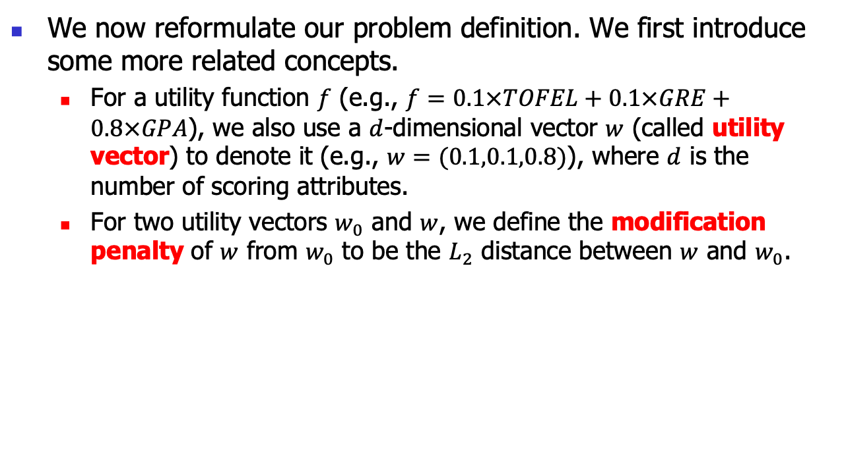
Reformulated Problem Definition
We now reformulate our problem definition. We first introduce some more related concepts.
  For a utility function $f$ (e.g., $f=0.1×TOFEL+0.1×GRE+0.8×GPA$), we also use a $d$-dimensional vector $w$ (called utility vector) to denote it (e.g., $w=(0.1,0.1,0.8)$), where $d$ is the number of scoring attributes.
  For two utility vectors $w_{0}$ and $w$, we define the modification penalty of $w$ from $w_{0}$ to be the $L_{2}$ distance between $w$ and $w_{0}$.
Notes:
Firstly, we represent a utility function by its weights only, using a vector called utility vector.
We also use the L-2 distance to formalize modification penalty between two utility vectors.
Now, our problem is, we want to find a utility function w* such that…

Slide 21

Reformulated Problem Definition
The fair ranking problem:
  Given a dataset $D$, a real number $α$, a positive integer k, a list $G$ of group memberships, a utility function $w_{0}$, our goal is to find a utility function $w^{∗}$ such that the $α$-fairness of the top-k set (resulting from $w^{∗}$) in $D$ w.r.t. $G$ is maximized, while under the maximized $α$-fairness, the modification penalty of $w^{∗}$ from $w_{0}$ is minimized.
Notes:
Firstly, we represent a utility function by its weights only, using a vector called utility vector.
We also use the L-2 distance to formalize modification penalty between two utility vectors.
Now, our problem is, we want to find a utility function w* such that…

Slide 22
Outline
Introduction
Fairness Model
Algorithms
Experiment
Conclusion

Slide 23
Algorithms: Overview
We design an efficient exact framework and its basic implementation called FairTQ-Exact to find the fairest utility function with the minimum modification penalty.
We propose another fast exact algorithm FairTQ-Exact-BnB based on branch-and-bound to improve the basic one.

Slide 24
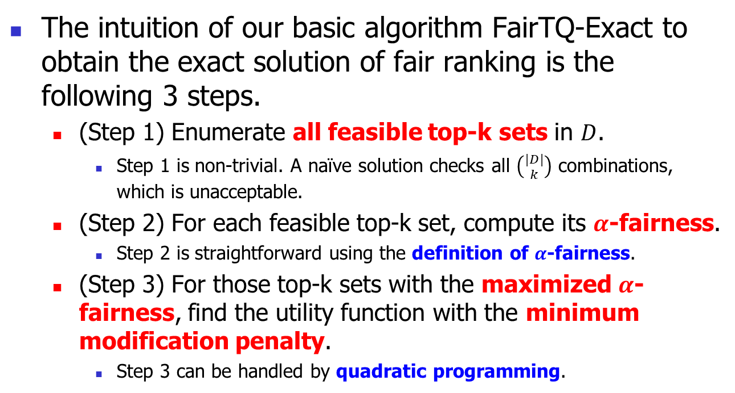
FairTQ-Exact: Intuition
The intuition of our basic algorithm FairTQ-Exact to obtain the exact solution of fair ranking is the following 3 steps.
  (Step 1) Enumerate all feasible top-k sets in $D$.
    Step 1 is non-trivial. A naïve solution checks all $\left({|D| \atop k}\right)$ combinations, which is unacceptable.
  (Step 2) For each feasible top-k set, compute its $α$-fairness.
    Step 2 is straightforward using the definition of $α$-fairness.
  (Step 3) For those top-k sets with the maximized $α$-fairness, find the utility function with the minimum modification penalty.
    Step 3 can be handled by quadratic programming.
We adapt an efficient hyperplane-based approach to handle Step 1

Slide 25
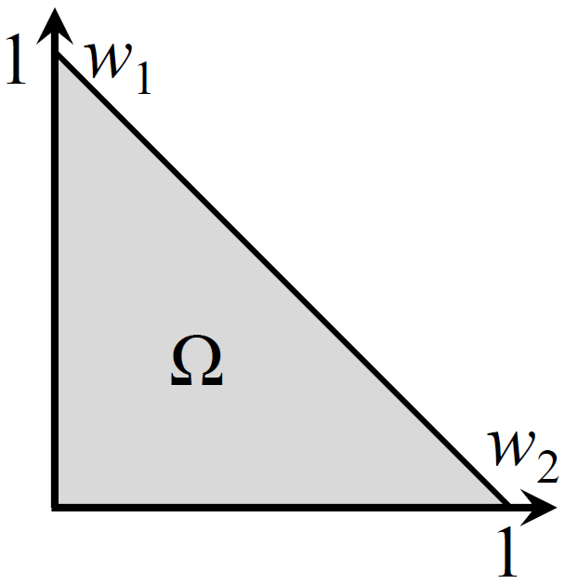
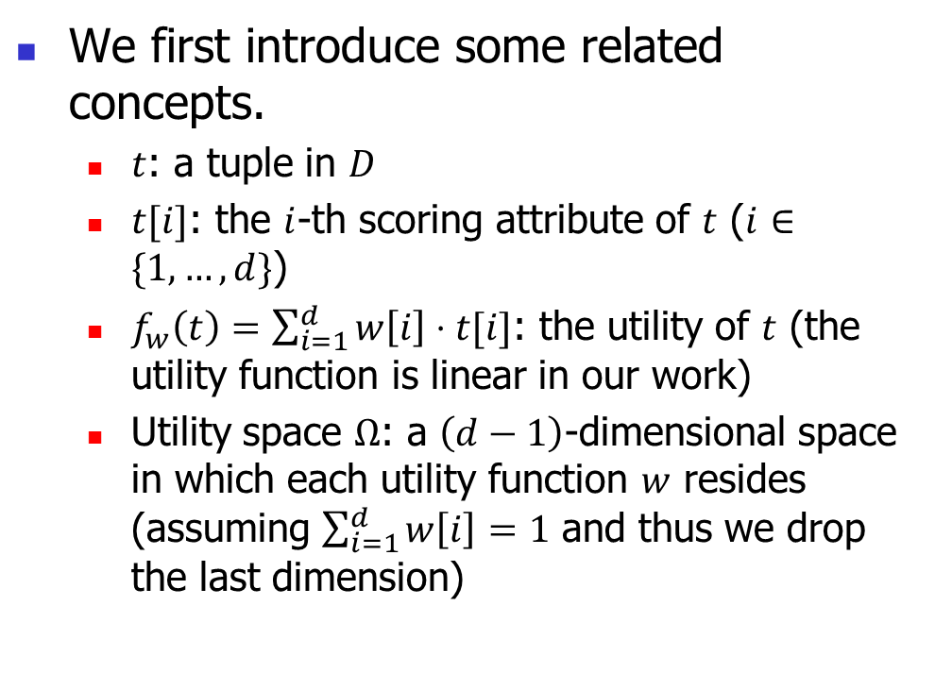
FairTQ-Exact: Related Concepts
We first introduce some related concepts.
  $t$: a tuple in $D$
  $t[i]$: the $i$-th scoring attribute of $t$ ($i∈\{1,…,d\}$)
  $f_{w}\left(t\right)=\sum_{i=1}^{d}{w\left[i\right]⋅t[i]}$: the utility of $t$ (the utility function is linear in our work)
  Utility space $Ω$: a $\left(d−1\right)$-dimensional space in which each utility function $w$ resides (assuming $\sum_{i=1}^{d}{w\left[i\right]}=1$ and thus we drop the last dimension)
Utility space for d = 3, which is a 2-dimensional polygon
Notes:
One of the most important is the utility space, which is a space or region that contains all possible utility functions.
Very obviously, it is also not possible to list all the utility functions in this continuous space.

Slide 26
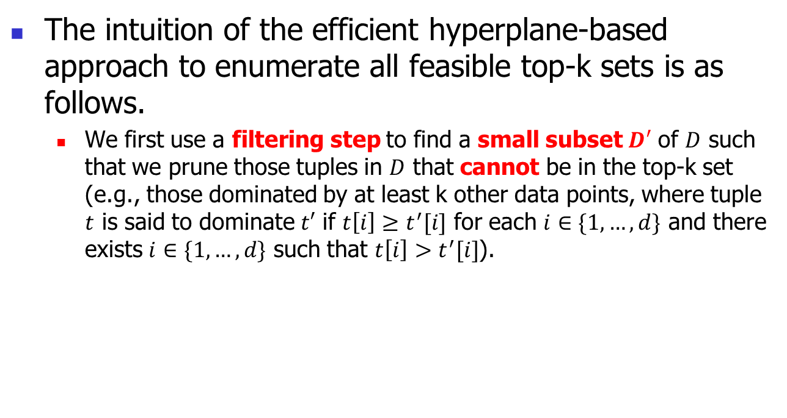
FairTQ-Exact: Hyperplane-based Approach to Enumerate all Top-k Sets
The intuition of the efficient hyperplane-based approach to enumerate all feasible top-k sets is as follows.
  We first use a filtering step to find a small subset $D′$ of $D$ such that we prune those tuples in $D$ that cannot be in the top-k set (e.g., those dominated by at least k other data points, where tuple $t$ is said to dominate $t′$ if $t\left[i\right]≥t^{′}[i]$ for each $i∈\{1,…,d\}$ and there exists $i∈\{1,…,d\}$ such that $t\left[i\right]>t^{′}[i]$).
Notes:
Our intuition is to first prune many tuples that cannot appear in any top-k set,

Slide 27
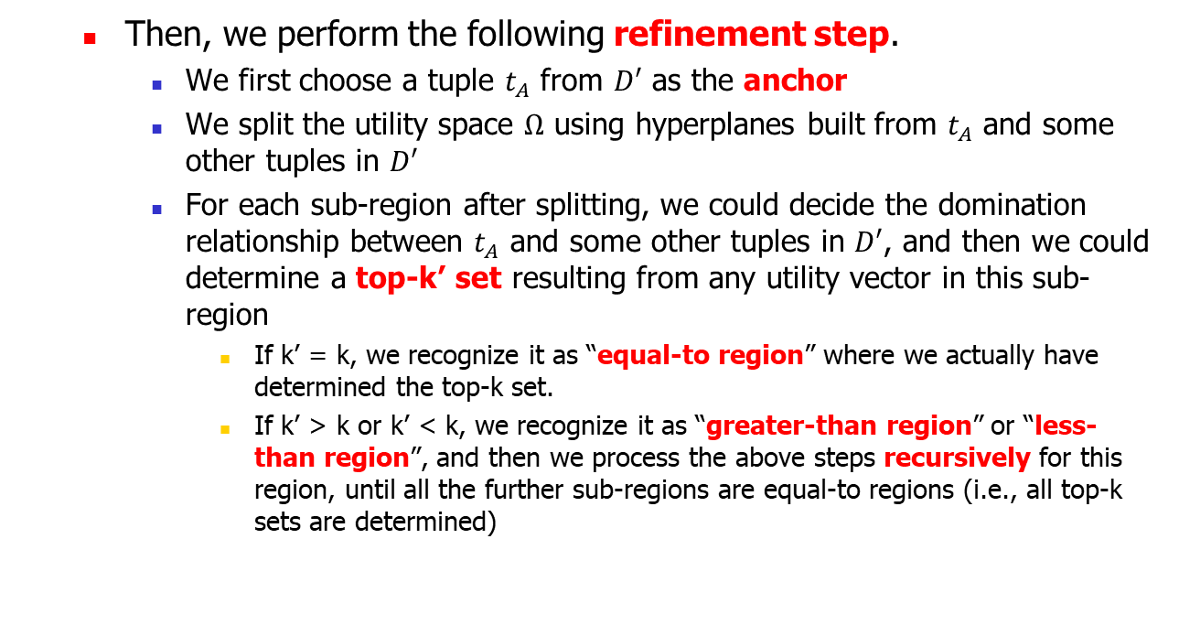
FairTQ-Exact: Hyperplane-based Approach to Enumerate all Top-k Sets
  Then, we perform the following refinement step.
    We first choose a tuple $t_{A}$ from $D′$ as the anchor
    We split the utility space $Ω$ using hyperplanes built from $t_{A}$ and some other tuples in $D′$
    For each sub-region after splitting, we could decide the domination relationship between $t_{A}$ and some other tuples in $D′$, and then we could determine a top-k’ set resulting from any utility vector in this sub-region
      If k’ = k, we recognize it as “equal-to region” where we actually have determined the top-k set.
      If k’ > k or k’ < k, we recognize it as “greater-than region” or “less-than region”, and then we process the above steps recursively for this region, until all the further sub-regions are equal-to regions (i.e., all top-k sets are determined)
Notes:
and then use a partition-based recursive approach to find all top-k sets.

Slide 28





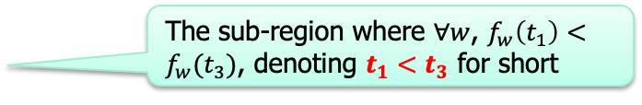
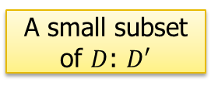


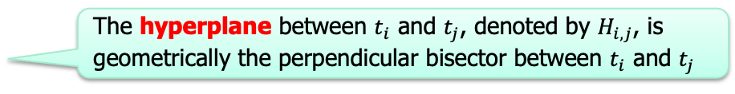
FairTQ-Exact: Example of Hyperplane-based Approach
$$k=3$$
Dataset $D$
$$\{t_{1},…,t_{9}\}$$
Others are pruned since each of them are dominated by at least 3 data points
Filtering Step
A small subset of $D$: $D′$
$$\{t_{1},t_{2},t_{3},t_{6},t_{7}\}$$
Anchor: $t_{1}$
The sub-region where $∀w$, $f_{w}\left(t_{1}\right)>f_{w}(t_{3})$, denoting $t_{1}>t_{3}$ for short (indicated by a black arrow)
The hyperplane between $t_{i}$ and $t_{j}$, denoted by $H_{i,j}$, is geometrically the perpendicular bisector between $t_{i}$ and $t_{j}$
$$H_{1,3}$$
The sub-region where $∀w$, $f_{w}\left(t_{1}\right)<f_{w}(t_{3})$, denoting $t_{1}<t_{3}$ for short
Refinement Step
28
Notes:
Let’s continue our running example to show it.
For our dataset D, when k = 3, we find a small subset D’ using a filtering step.
Then, we perform the recursive partitioning in our refinement step.
The idea is to first choose a tuple as the anchor, e.g., t1.
We can create a hyperplane for the anchor t1 and one of the other tuples, let’s say t3.
This hyperplane splits the utility space into 2 parts.
One part has the property that for any utility vector, the utility of t1 is always larger than the utility of t3.
And, vice versa for the other part.

Slide 29














FairTQ-Exact: Example of Hyperplane-based Approach
$$k=3$$
Dataset $D$
$$\{t_{1},…,t_{9}\}$$
Filtering Step
A small subset of $D$: $D′$
$$\{t_{1},t_{2},t_{3},t_{6},t_{7}\}$$
We insert a hyperplane between $t_{1}$ and each $t_{j}$ from $D′$ (which is not dominated by $t_{i}$ or does not dominate $t_{i}$)
Anchor: $t_{1}$
$$t_{1}>t_{2},t_{3},t_{6},t_{7}$$
Top-k’: $\{t_{1}\}$
Less-than regions, top-k set not determined, need further processing
$$H_{1,6}$$
$$t_{6}>t_{1}>t_{2},t_{3},t_{7}$$
Top-k’: $\{t_{6},t_{1}\}$
$$H_{1,2}$$
Equal-to region, top-k set determined
$$t_{2},t_{6}>t_{1}>t_{3},t_{7}$$
Top-k’: $\{t_{2},t_{6},t_{1}\}$
$$H_{1,3}$$
$$t_{2},t_{3},t_{6}>t_{1}>t_{7}$$
Top-k’: $\{t_{2},t_{3},t_{6},t_{1}\}$
Greater-than regions, top-k set not determined, need further processing
$$H_{1,7}$$
$$t_{2},t_{3},t_{6},t_{7}>t_{1}$$
Top-k’: $\{t_{2},t_{3},t_{6},t_{7},t_{1}\}$
Refinement Step
29
Notes:
Now, we continue the processing for other tuples in D’.
That is, we insert a hyperplanes between t1 and each other tuple.
For efficiency, we skip some tuples that are not needed.
We can see that the whole utility space are split into several sub-regions.
In each sub-region, we can determine the relationship between t1 and other tuples.
Based on that, we can determine a top-k’ set for each sub-region, which is related to the final top-k set mapped to this region.
According to the number k’, we could have different cases: less-than, equal-to and greater-than.
For an equal-to region, k’ is actually equal to k, we actually have determined the top-k set mapped to this regions.
For other cases, the top-k set is not determined, so we need to further process this region recursively using a similar partition approach, until all top-k sets are determined.

Slide 30
Outline
Introduction
Fairness Model
Algorithms
Experiment
Conclusion

Slide 31
Experiment: Datasets and Baselines
Datasets
  Real datasets: XING, COMPAS and DOT
  Synthetic datasets: Independent and Anti-correlated
Baselines
  SR-Adapt [SIGMOD19]: returns an exact solution with an inefficient approach.
  Greedy [ICALP18]: iteratively selects a tuple from D not dominated by any remaining tuples and belonging to the group that contributes the least in the top-k set.
  Prop (a simple algorithm): selects the top tuples from each group to match the populational proportions
  FA*IR [CIKM17]: iteratively selects tuples into the top-k set satisfying some fairness constraint and the “in-group” utility monotonicity

Slide 32
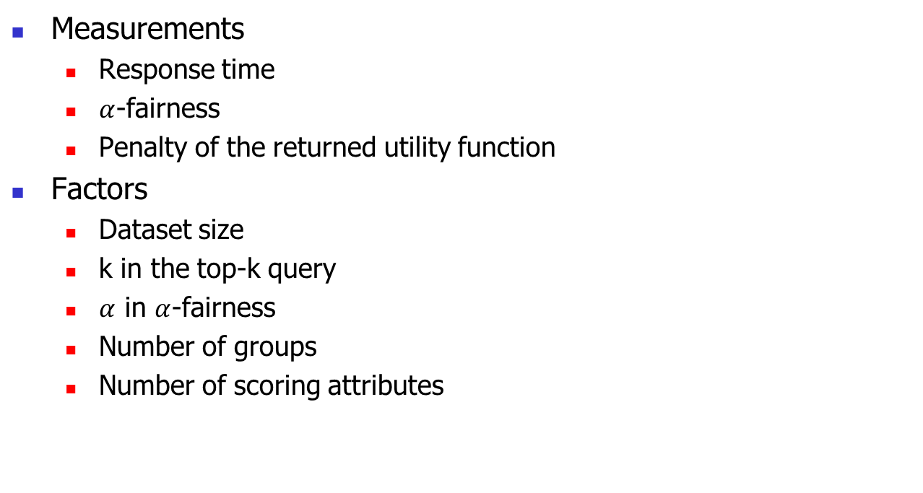
Experiment: Measurements and Factors
Measurements
  Response time
  $α$-fairness
  Penalty of the returned utility function
Factors
  Dataset size
  k in the top-k query
  $α$ in $α$-fairness
  Number of groups
  Number of scoring attributes

Slide 33
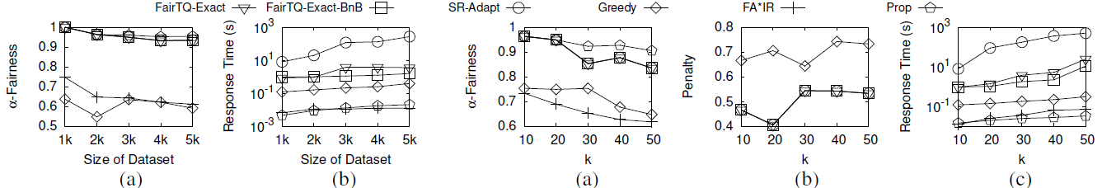
Experiment: Effect of dataset size on dataset COMPAS
Our algorithms return fair results with good efficiency when scaling dataset size.
Although Greedy and FA*IR is fast, they yield poor fairness.
Although Prop is fast, it cannot return a utility function in most cases due to ranking violation.
Notes:
Baselines that do not focus on returning a utility function.

Slide 34
Experiment: Effect of k on dataset COMPAS
Our algorithms return fair results with good efficiency and small penalty when scaling k.

Slide 35
Outline
Introduction
Preliminaries
Methodology
Evaluation
Conclusion

Slide 36
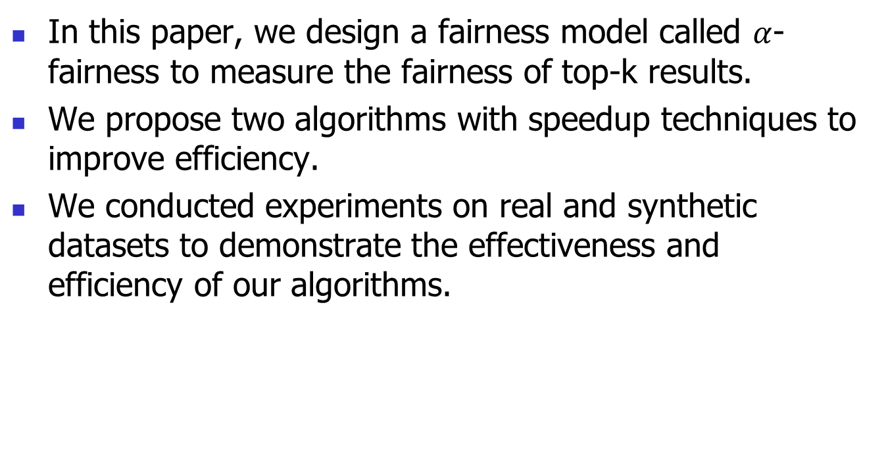
Conclusion
In this paper, we design a fairness model called $α$-fairness to measure the fairness of top-k results.
We propose two algorithms with speedup techniques to improve efficiency.
We conducted experiments on real and synthetic datasets to demonstrate the effectiveness and efficiency of our algorithms.

Slide 37
Q & A
Thank you for listening!

Slide 38


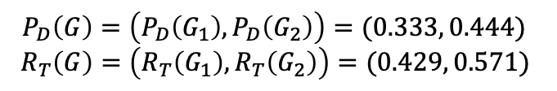
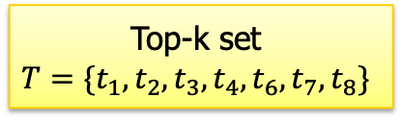

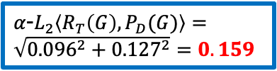
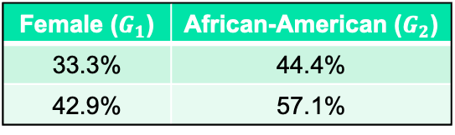
Fairness Model: Example
A set of 2 user-specified arbitrary groups $G$
Dataset
$$D=\{t_{1},…,t_{9}\}$$
Female ($G_{1}$) | African-American ($G_{2}$)
33.3% | 44.4%
42.9% | 57.1%
$$P_{D}(G_{1})$$
$$P_{D}(G_{2})$$
Utility function $f_{1}$
$$R_{T}(G_{1})$$
$$R_{T}(G_{2})$$
$$P_{D}\left(G\right)=\left(P_{D}\left(G_{1}\right),P_{D}\left(G_{2}\right)\right)=(0.333, 0.444)$$
$$R_{T}\left(G\right)=\left(R_{T}\left(G_{1}\right),R_{T}\left(G_{2}\right)\right)=(0.429, 0.571)$$
Top-k set
$$T=\{t_{1},t_{2},t_{3},t_{4},t_{6},t_{7},t_{8}\}$$
$$α=0$$
$$dif_{α}\left\langle R_{T}\left(G_{1}\right),P_{D}(G_{1})\right\rangle =0.096$$
$$dif_{α}\left\langle R_{T}\left(G_{2}\right),P_{D}(G_{2})\right\rangle =0.127$$
$α$-$FN_{G}\left(T | D\right)=1−\frac{1}{\sqrt{2}}⋅0.159=0.888$
$α$-$L_{2}\left\langle R_{T}\left(G\right),P_{D}(G)\right\rangle =\sqrt{{0.096}^{2}+{0.127}^{2}}=0.159$
The larger $α$-fairness value, the smaller $α$-$L_{2}\left\langle R_{T}\left(G\right),P_{D}(G)\right\rangle$. The populational proportions of $T$ are closer to the representational proportions. Then, the top-k set $T$ is fairer.
Notes:
Now we consider another utility function f1, which is shown previous to give a top-k set T that is fairer.
The alpha-fairness of the top-k set T can be computed similarly, which is a larger value.
From this example, we can see that…
// [
We consider the case where alpha=0 only
We can similarly compute the d-i-f function values, the corresponding alpha-L2 distance and the final alpha fairness.
We can find that the alpha fairness is larger than the previous example.
From this example, we can see that …

Slide 39

Fairness Model: Example
Consider another utility function $f_{1}$.

Slide 40
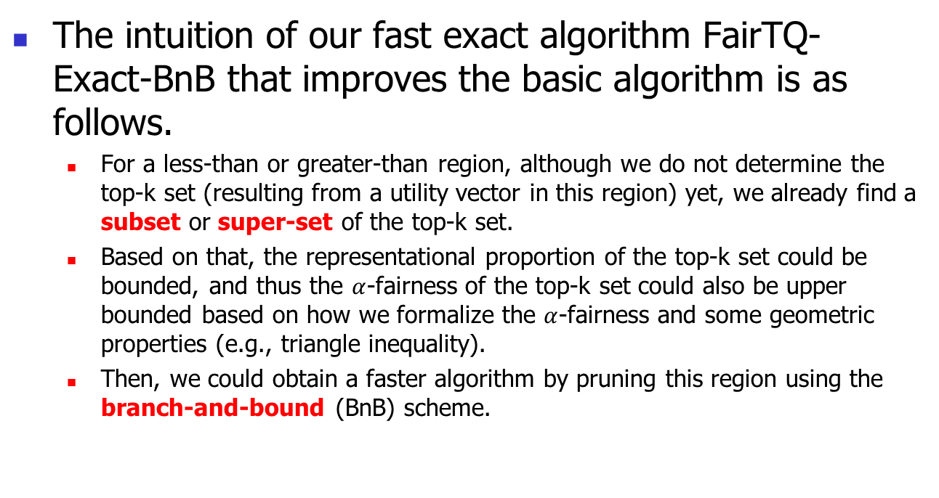
FairTQ-Exact-BnB: Intuition
The intuition of our fast exact algorithm FairTQ-Exact-BnB that improves the basic algorithm is as follows.
  For a less-than or greater-than region, although we do not determine the top-k set (resulting from a utility vector in this region) yet, we already find a subset or super-set of the top-k set.
  Based on that, the representational proportion of the top-k set could be bounded, and thus the $α$-fairness of the top-k set could also be upper bounded based on how we formalize the $α$-fairness and some geometric properties (e.g., triangle inequality).
  Then, we could obtain a faster algorithm by pruning this region using the branch-and-bound (BnB) scheme.

Slide 41
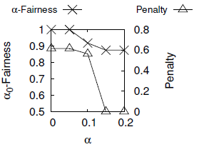
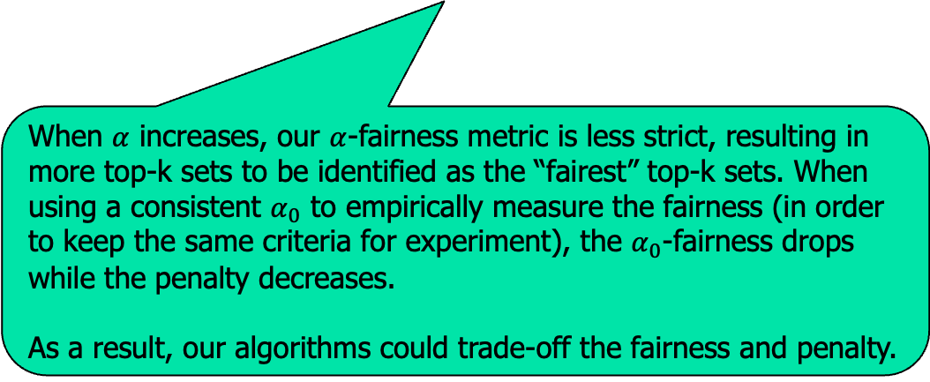

Experiment: Effect of $α$ on dataset XING
When $α$ increases, our $α$-fairness metric is less strict, resulting in more top-k sets to be identified as the “fairest” top-k sets. When using a consistent $α_{0}$ to empirically measure the fairness (in order to keep the same criteria for experiment), the $α_{0}$-fairness drops while the penalty decreases.
As a result, our algorithms could trade-off the fairness and penalty.

