Slide 1


Session-based Recommendation with Local Invariance
Tianwen Chen, Raymond Chi-Wing Wong

Slide 2











What is Session-based Recommendation (SBR)?
Applications
In many online services, users’ actions are sequential and grouped into sessions.
Session: a sequence of actions that occur in a certain timeframe.
Objective: to recommend the next action given previous actions in the current session.
E-commerce
Video streaming
News feeding
A user’s actions, e.g., purchased items, watched videos.
Time
Session $s_{i−1}$
Session $s_{i}$
Session $s_{i}$
$$s_{i,1}$$
$$s_{i,2}$$
$$s_{i,3}$$
$$s_{i,4}$$
$$s_{i,5}$$

Slide 3













Problem of Previous Methods
Most of the previous methods predict the next action by following a strict order
Detailed ordering
in some sub-session
Detailed ordering in some sub-sessions may not matter. (We call this property local invariance.)
$$s_{i,1}$$
$$s_{i,2}$$
$$s_{i,3}$$
$$s_{i,4}$$
$$s_{i,5}$$
$$s_{i,6}$$
$$s_{i,7}$$
High-level ordering
in the complete session
High-level ordering in the complete session is still important.
A good session-based recommender system (SBRS) should pay different attention to the ordering information in different levels of granularity.
Songs
Artists
Notes:
This is a real life example. A user may want to first listen to songs of one artist and then to those of another. So the detailed ordering, i.e., the order among the songs of the same artist, does not matter. But the high-level ordering, the order among the songs of different artists is important.

Slide 4
Contributions
We are the first to introduce the local invariance property in SBR.
We propose a model to explicitly consider the local invariance property.
Experiments on two public benchmark datasets demonstrate the superiority of the proposed method over state-of-the-art methods.

Slide 5



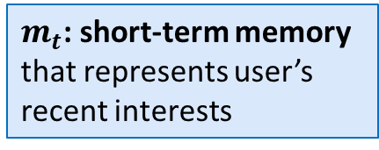


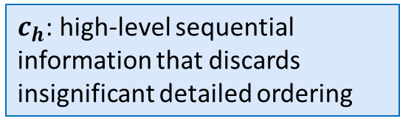




Proposed Method
$$P(x_{t+1}|s)$$
Probability distribution of the next item
Predictor
$c_{h}$: high-level sequential information that discards insignificant detailed ordering
$$c=(c_{h},m_{t})$$
$$m_{t}$$
$$c_{h}$$
$m_{t}$: short-term memory that represents user’s recent interests
Global Encoder
Extracts the high-level sequential information
Local Encoder
Extracts local context information that is invariant to subtle position changes in sub-sessions
Item embeddings
$$x_{1}$$
$$x_{2}$$
$$x_{3}$$
$$x_{t}$$
Embedding Layer
Session $s$

Slide 6
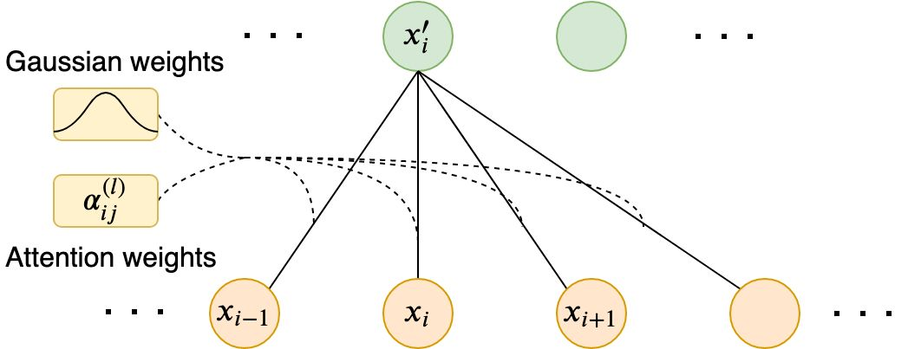
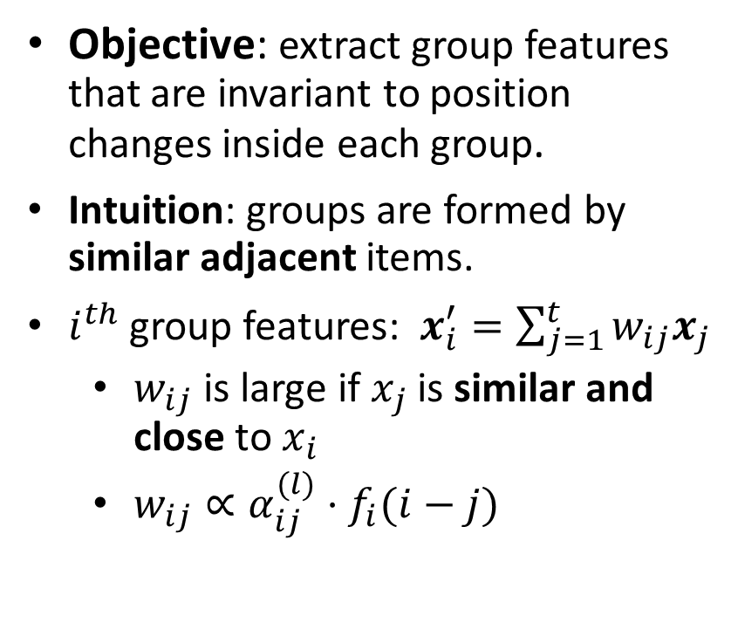
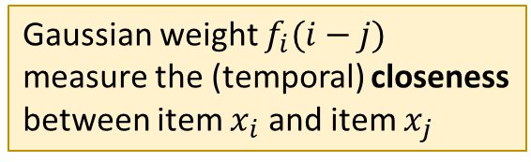
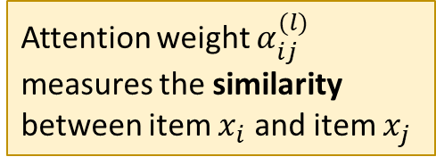
Local Encoder
Gaussian weight $f_{i}(i−j)$ measure the (temporal) closeness between item $x_{i}$ and item $x_{j}$
Objective: extract group features that are invariant to position changes inside each group.
Intuition: groups are formed by similar adjacent items.
$i^{th}$ group features: $x_{i}^{′}=\sum_{j=1}^{t}{w_{ij}x_{j}}$
  $w_{ij}$ is large if $x_{j}$ is similar and close to $x_{i}$
  $w_{ij}∝α_{ij}^{(l)}⋅f_{i}(i−j)$
Attention weight $α_{ij}^{(l)}$ measures the similarity between item $x_{i}$ and item $x_{j}$
Attention weight
Gaussian weight

Slide 7
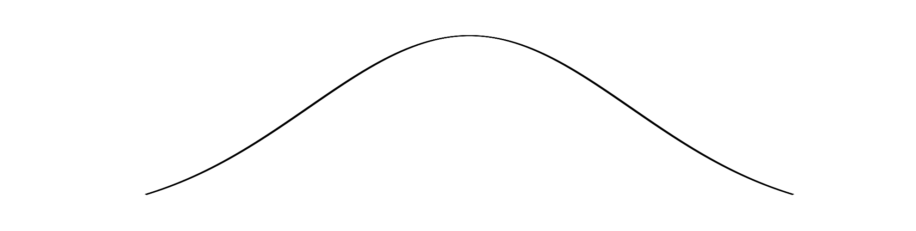
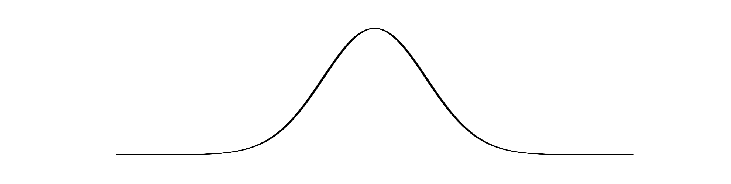

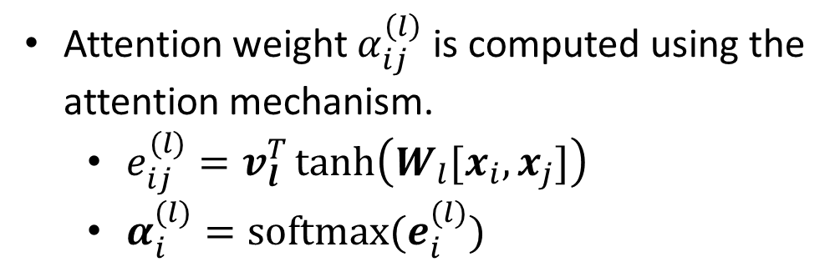

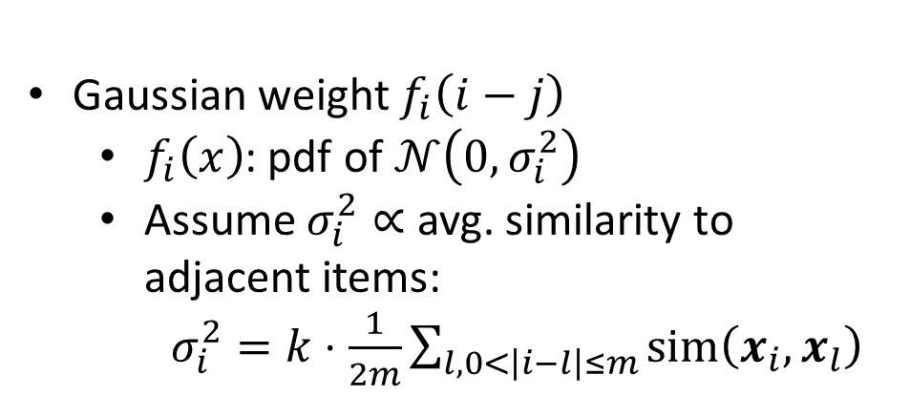


Local Encoder
Attention weight $α_{ij}^{\left(l\right)}$ is computed using the attention mechanism.
  $e_{ij}^{(l)}=v_{l}^{T}\tanh\left(W_{l}[x_{i},x_{j}]\right)$
  $α_{i}^{(l)}=softmax(e_{i}^{(l)})$
$$x_{i−1}^{′}$$
$$x_{i}^{′}$$
$$x_{i+1}^{′}$$
Gaussian weight $f_{i}\left(i−j\right)$
  $f_{i}\left(x\right)$: pdf of $𝒩\left(0, σ_{i}^{2}\right)$
  Assume $σ_{i}^{2}∝$ avg. similarity to adjacent items:
  $σ_{i}^{2}=k⋅\frac{1}{2m}\sum_{l,0<\left|i−l\right|≤m}{sim\left(x_{i},x_{l}\right)}$
Adjacent items more similar, larger group, larger variance
$$f_{i}\left(i−j\right)$$
Adjacent items less similar, smaller group, smaller variance

Slide 8
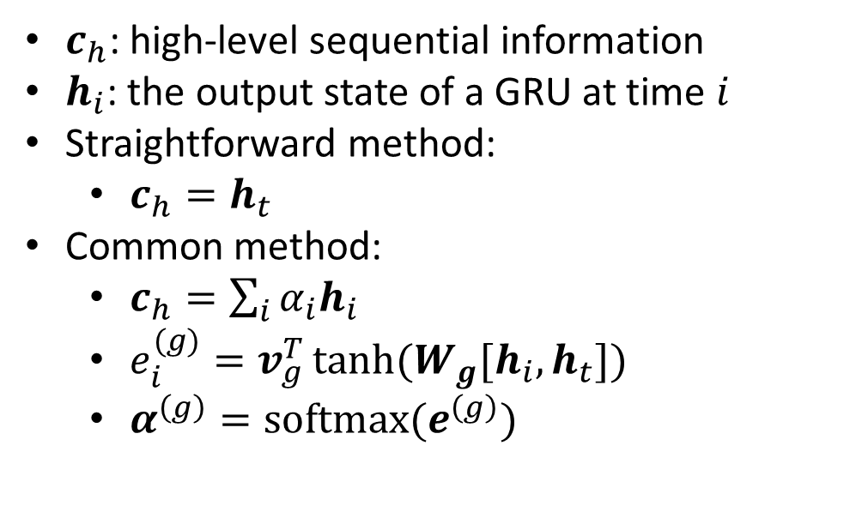
Global Encoder
Objective: extract high-level sequential information from the group features.
$c_{h}$: high-level sequential information
$h_{i}$: the output state of a GRU at time $i$
Straightforward method:
  $c_{h}=h_{t}$
Common method:
  $c_{h}=\sum_{i}{α_{i}h_{i}}$
  $e_{i}^{(g)}=v_{g}^{T}\tanh{(W_{g}[h_{i},h_{t}])}$
  $α^{\left(g\right)}=softmax(e^{\left(g\right)})$

Slide 9

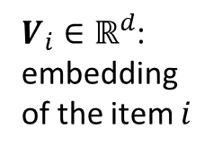

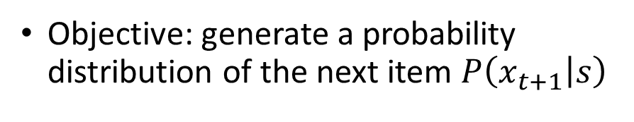

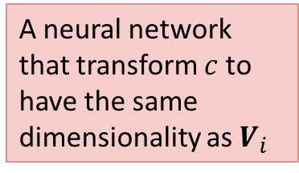
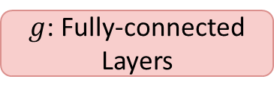
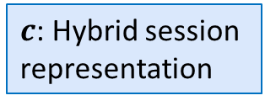


Predictor
Probability distribution of the next item
$$P\left(x_{t+1} | s\right)=softmax(Vg\left(c\right))$$
Objective: generate a probability distribution of the next item $P\left(x_{t+1} | s\right)$
$$g\left(c\right)∈ℝ^{d}$$
$$V∈ℝ^{N×d}$$
A neural network that transform $c$ to have the same dimensionality as $V_{i}$
$g$: Fully-connected Layers
$V_{i}∈ℝ^{d}$: embedding of the item $i$
$$c=\left(c_{h},m_{t}\right)∈ℝ^{2d}$$
Embedding Layer
$c$: Hybrid session representation
$m_{t}$: User’s recent interests

Slide 10
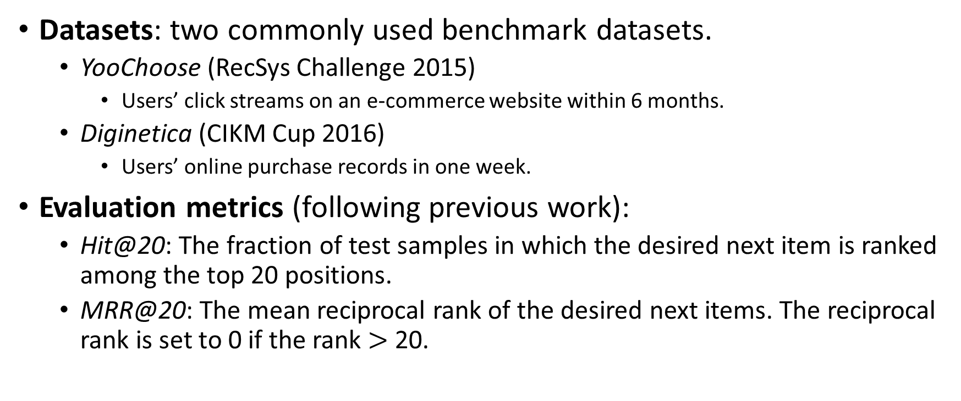
Experiments
Datasets: two commonly used benchmark datasets.
  YooChoose (RecSys Challenge 2015)
    Users’ click streams on an e-commerce website within 6 months.
  Diginetica (CIKM Cup 2016)
    Users’ online purchase records in one week.
Evaluation metrics (following previous work):
  Hit@20: The fraction of test samples in which the desired next item is ranked among the top 20 positions.
  MRR@20: The mean reciprocal rank of the desired next items. The reciprocal rank is set to 0 if the rank $>$ 20.

Slide 11
Compared Methods
 | Methods | Consider All Previous Items? | Is the Ordering of Previous Items Considered? | Is the Local Invariance Property Considered?
Conventional methods | Item-KNN (WWW’01) | No | No | No
 | BPR-MF (UAI’09) | Yes | No | No
 | FPMC (WWW’10) | No | Some (Only Several Previous Items) | No
Neural network-based methods | GRU4Rec (ICLR’16) | Yes | Yes | No
 | NARM (CIKM’17) | Yes | Yes | No
 | STAMP (KDD’18) | Yes | No | No
 | RepeatNet (AAAI’19) | Yes | Yes | No
 | SR-GNN (AAAI’19) | Yes | Yes (Not Exact Ordering) | No
 |  | Yes | Yes | Yes

Slide 12
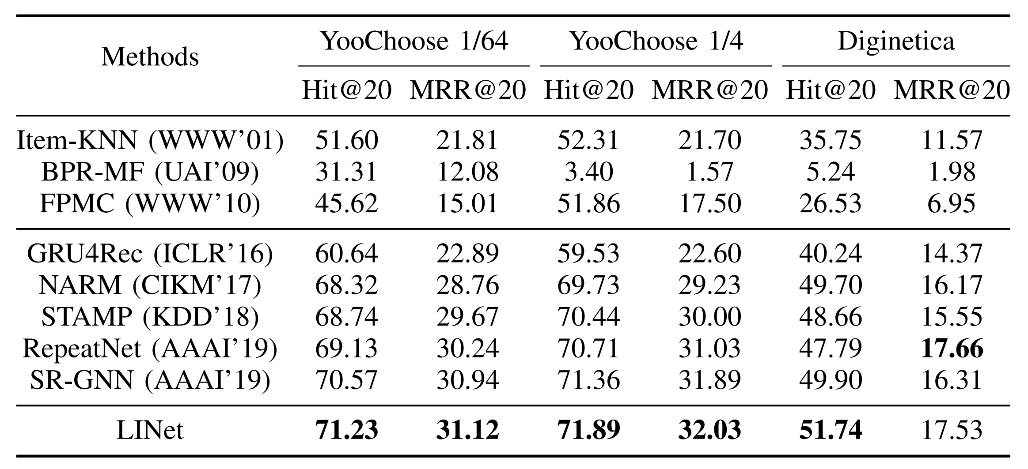
Results
Conventional methods
Neural network-based methods
Proposed method
Neural network-based methods performs much better than conventional methods.
STAMP and SR-GNN do not encode the sequential information strictly but still have competitive performance.
The proposed method LINet outperforms or matches the state-of-the-art methods.

Slide 13
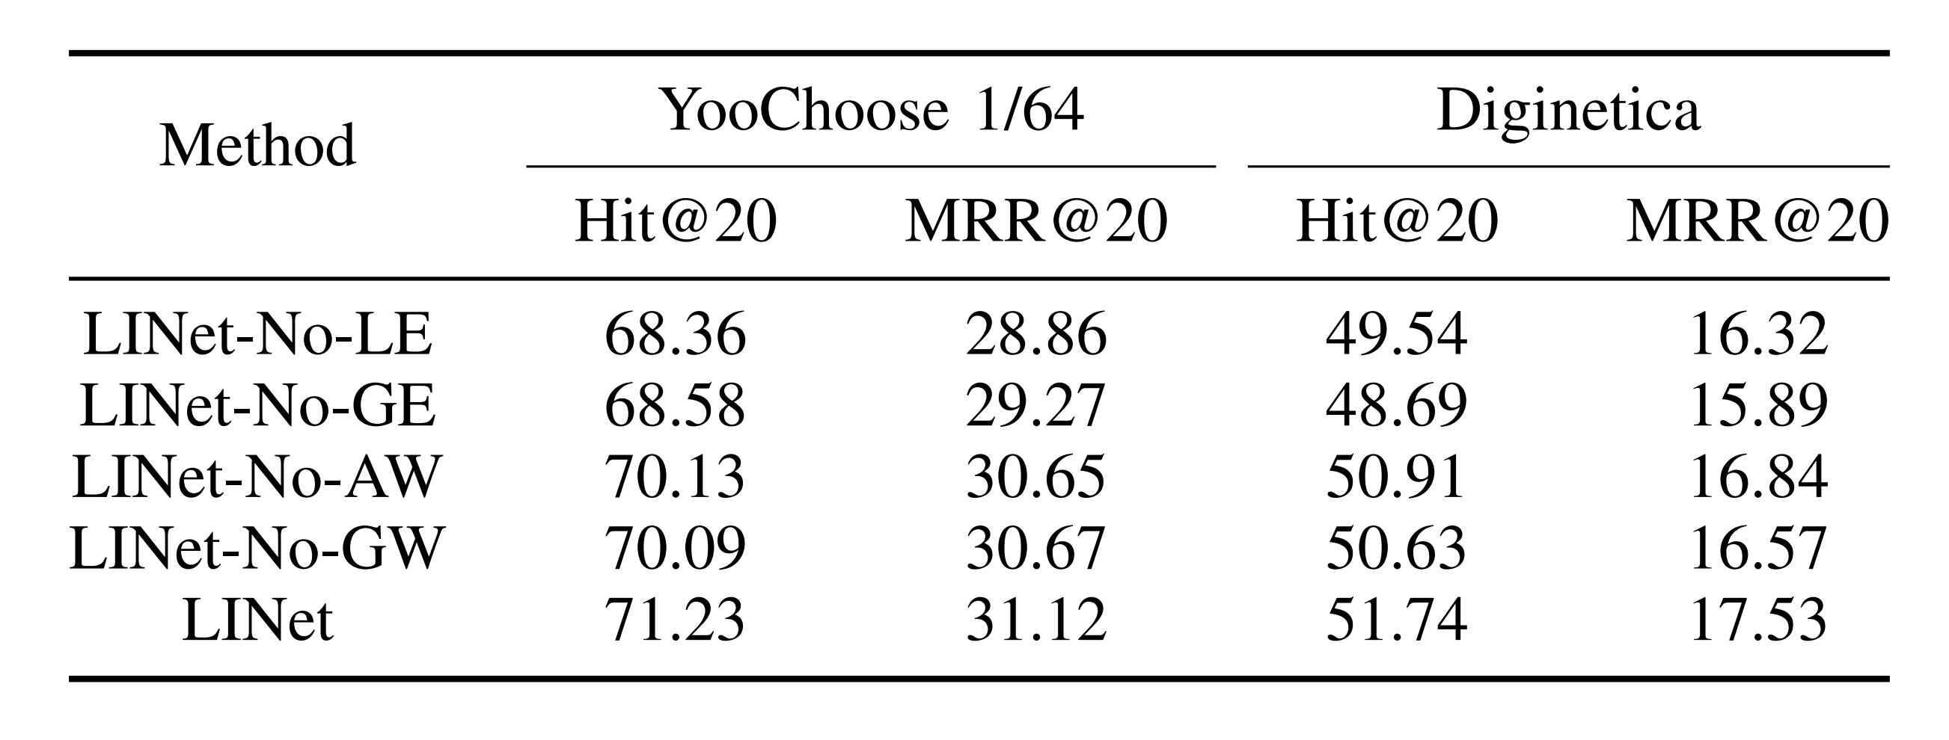
Ablation Experiments
To study the effects of the local encoder (LE), global encoder (GE), attention weights (AW), and Gaussian weights (GW).

Slide 14
















Capability of Considering Local Invariance
Approach: by comparing the performance on similar pairs of sessions.
A pair of sessions are similar if:
  They have the same multiset of
  They have the same last item.
  There are some local ordering differences.
Consider the last item as the next item of all previous items.
Local ordering differences do not affect the occurrence of the next item.
The pair of similar sessions have the local invariance property.
Last Item
items.
(similar)
$$s_{p}$$
$$s_{p,1}$$
$$s_{p,2}$$
$$s_{p,3}$$
$$s_{p,4}$$
$$s_{p,5}$$
$$s_{p,6}$$
$$v$$
$$s_{q}$$
$$s_{q,1}$$
$$s_{q,2}$$
$$s_{q,3}$$
$$s_{q,4}$$
$$s_{q,5}$$
$$s_{q,6}$$
$$v$$
The matched items are exactly the same
Generalization: The matched items are highly similar.
Notes:
The additional experiment evaluates the performance on similar pairs of sessions.
We say two sessions $s_{i}$ and $s_{j}$ are similar if three conditions are satisfied.
First, the two sessions have the same length. Second, they have the same last item.
Third, there exists a perfect matching between the first l-1 items of both sessions. The matching needs to satisfy two properties. First, the similarity between the matched items is at least $θ$. Second, the difference between the indices of the matched items is at most $δ$.
The similarity between two items is defined by this equation.
$n_d^(ij))$ is …
We penalize long distance using a factor $\log\left(d+1\right)$
So two items are similar if they close to each other in the sessions that they co-occur.
The similarity can be viewed as the probability that the two items can be swapped.
The table shows the number of similar pairs for different thresholds.
The number of pairs for the Diginetica dataset is much smaller because the number of items in Diginetica is much larger.
Thus it is less likely to have similar pairs.

Slide 15
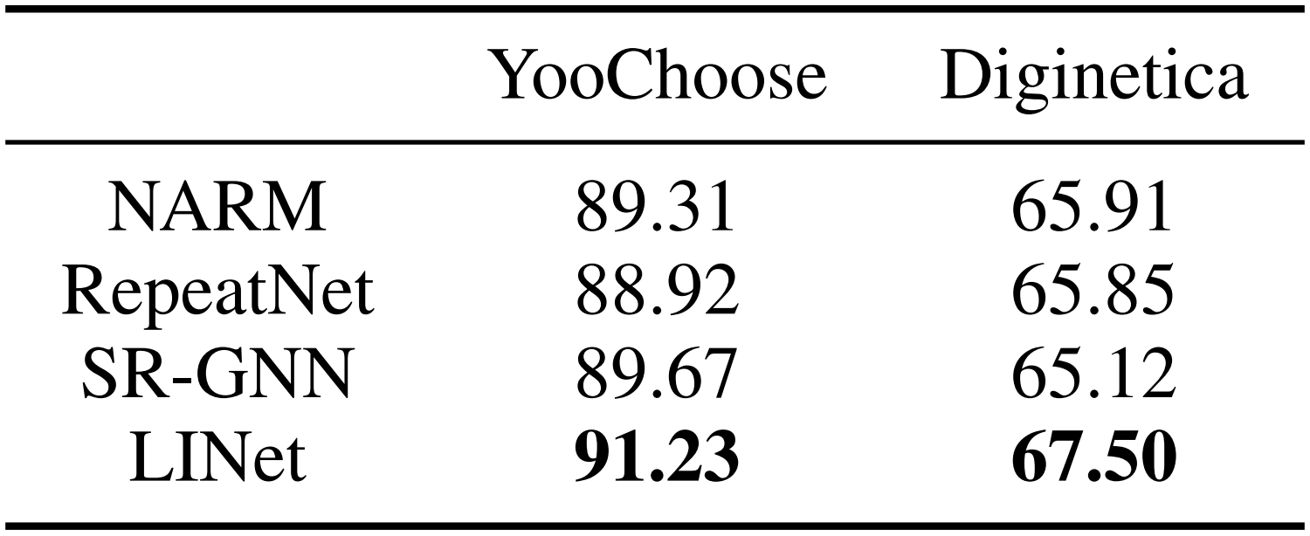
Capability of Considering Local Invariance
The percentage of similar pairs predicted accurately* by each model
(*: a pair is considered as “predicted accurately” if both sessions in the pair is predicted accurately.)
The proposed model outperforms all other methods in similar pairs
$→$ The proposed model has a higher capability of considering local invariance.
Notes:
Given a pair, if a model only predict accurately in one session, then the model does not consider the local invariance property in this pair.

Slide 16
Conclusion
We introduce the local invariance property in SBR.
We propose a model to explicitly consider the local invariance property.
  With the combination of the local and global encoders, our model captures high-level sequential information and automatically discards insignificant local ordering information.
Experiments on two public benchmark datasets demonstrate the superiority of the proposed method over state-of-the-art methods.

Slide 17

Q & A

Slide 18



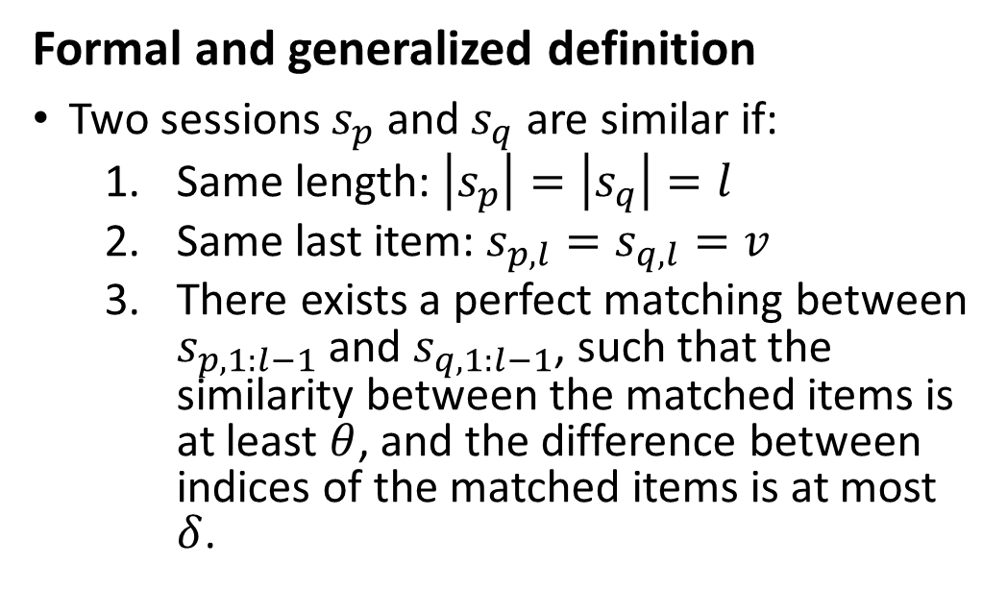





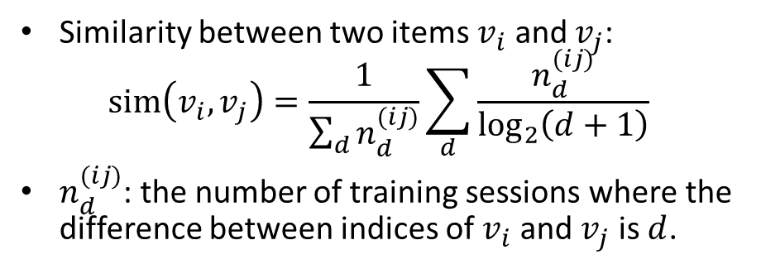

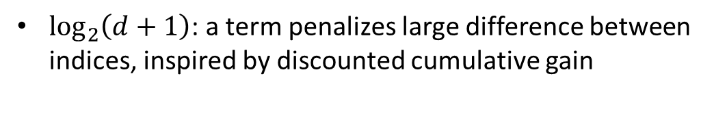





Capability of Considering Local Invariance
Formal and generalized definition
Two sessions $s_{p}$ and $s_{q}$ are similar if:
  Same length: $\left|s_{p}\right|=\left|s_{q}\right|=l$
  Same last item: $s_{p,l}=s_{q,l}=v$
  There exists a perfect matching between $s_{p,1:l−1}$ and $s_{q,1:l−1}$, such that the similarity between the matched items is at least $θ$, and the difference between indices of the matched items is at most $δ$.
Matching
Last Item
$$s_{p}$$
$$s_{p,1}$$
$$s_{p,2}$$
$$s_{p,3}$$
$$s_{p,4}$$
$$s_{p,5}$$
$$v$$
$$s_{q}$$
$$s_{q,1}$$
$$s_{q,2}$$
$$s_{q,3}$$
$$s_{q,4}$$
$$s_{q,5}$$
$$v$$
Similarity | 0.86 | 0.74 | 0.93 | 0.78 | 0.81
Index | 1 | 2 | 3 | 4 | 5
Index Diff. | 2 | 1 | 2 | 2 | 1
Similarity between two items $v_{i}$ and $v_{j}$:
$$sim\left(v_{i},v_{j}\right)=\frac{1}{\sum_{d}{n_{d}^{(ij)}}}\sum_{d}{\frac{n_{d}^{(ij)}}{\log_{2}\left(d+1\right)}}$$
$n_{d}^{(ij)}$: the number of training sessions where the difference between indices of $v_{i}$ and $v_{j}$ is $d$.
$\log_{2}\left(d+1\right)$: a term penalizes large difference between indices, inspired by discounted cumulative gain
Notes:
This slide shows the formal and generalized definition of similar sessions.
Instead of requiring the two sessions have the same multiset of items.
We relax the constraint by allowing similar items.
We say two sessions $s_{i}$ and $s_{j}$ are similar if three conditions are satisfied.
First, the two sessions have the same length. Second, they have the same last item.
Third, there exists a perfect matching between the first l-1 items of both sessions. The matching needs to satisfy two properties. First, the similarity between the matched items is at least $θ$. Second, the difference between the indices of the matched items is at most $δ$.
The similarity between two items is defined by this equation.
$n_d^(ij))$ is …
We penalize long distance using a factor $\log\left(d+1\right)$
So two items are similar if they close to each other in the sessions that they co-occur.
The similarity can be viewed as the probability that the two items can be swapped.
The table shows the number of similar pairs for different thresholds.
The number of pairs for the Diginetica dataset is much smaller because the number of items in Diginetica is much larger.
Thus it is less likely to have similar pairs.

Slide 19



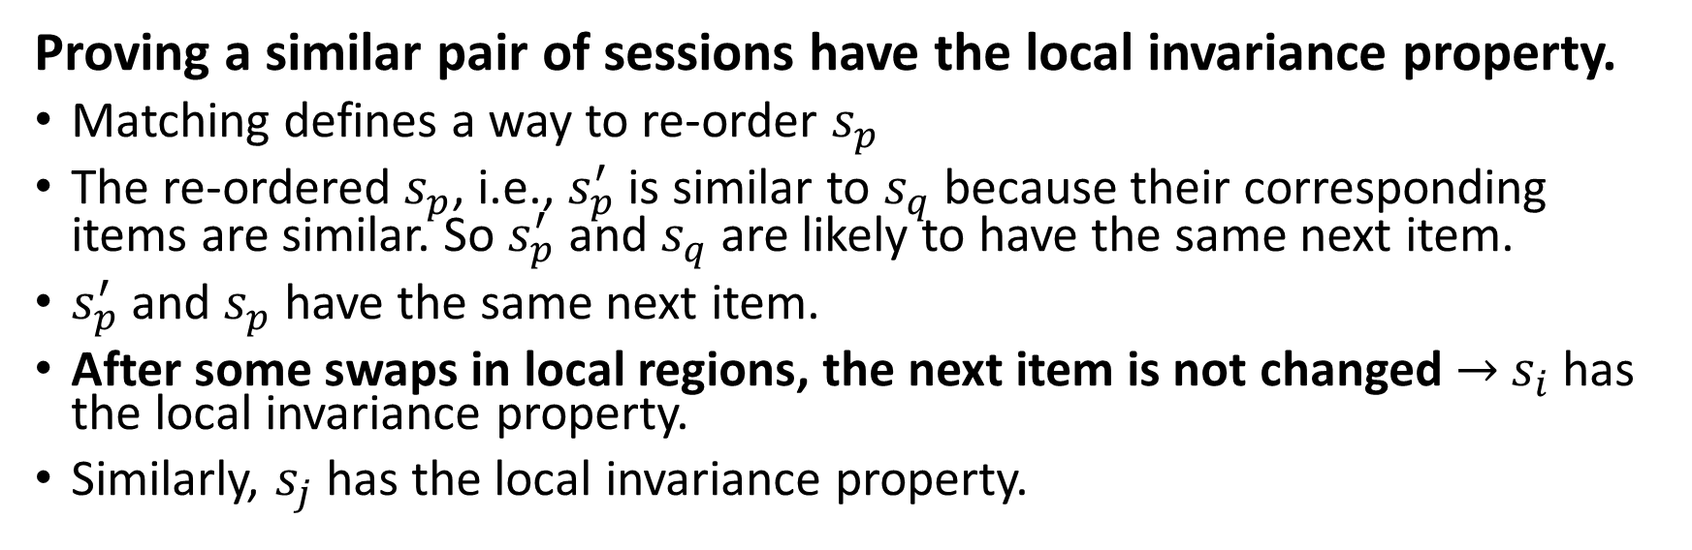


















Matching
Last Item
$$s_{p}$$
$$s_{p,1}$$
$$s_{p,2}$$
$$s_{p,3}$$
$$s_{p,4}$$
$$s_{p,5}$$
$$v$$
$$s_{q}$$
$$s_{q,1}$$
$$s_{q,2}$$
$$s_{q,3}$$
$$s_{q,4}$$
$$s_{q,5}$$
$$v$$
$$s_{p}^{′}$$
$$s_{p,3}$$
$$s_{p,1}$$
$$s_{p,5}$$
$$s_{p,2}$$
$$s_{p,4}$$
$$v$$
Proving a similar pair of sessions have the local invariance property.
Matching defines a way to re-order $s_{p}$
The re-ordered $s_{p}$, i.e., $s_{p}^{′}$ is similar to $s_{q}$ because their corresponding items are similar. So $s_{p}^{′}$ and $s_{q}$ are likely to have the same next item.
$s_{p}^{′}$ and $s_{p}$ have the same next item.
After some swaps in local regions, the next item is not changed $→$ $s_{i}$ has the local invariance property.
Similarly, $s_{j}$ has the local invariance property.

