Slide 1
Analyzing Student Performance with Personalized Study Path and Learning Trouble Ratio
James Yip
Raymond Wong
The Hong Kong University of Science and Technology

Slide 2
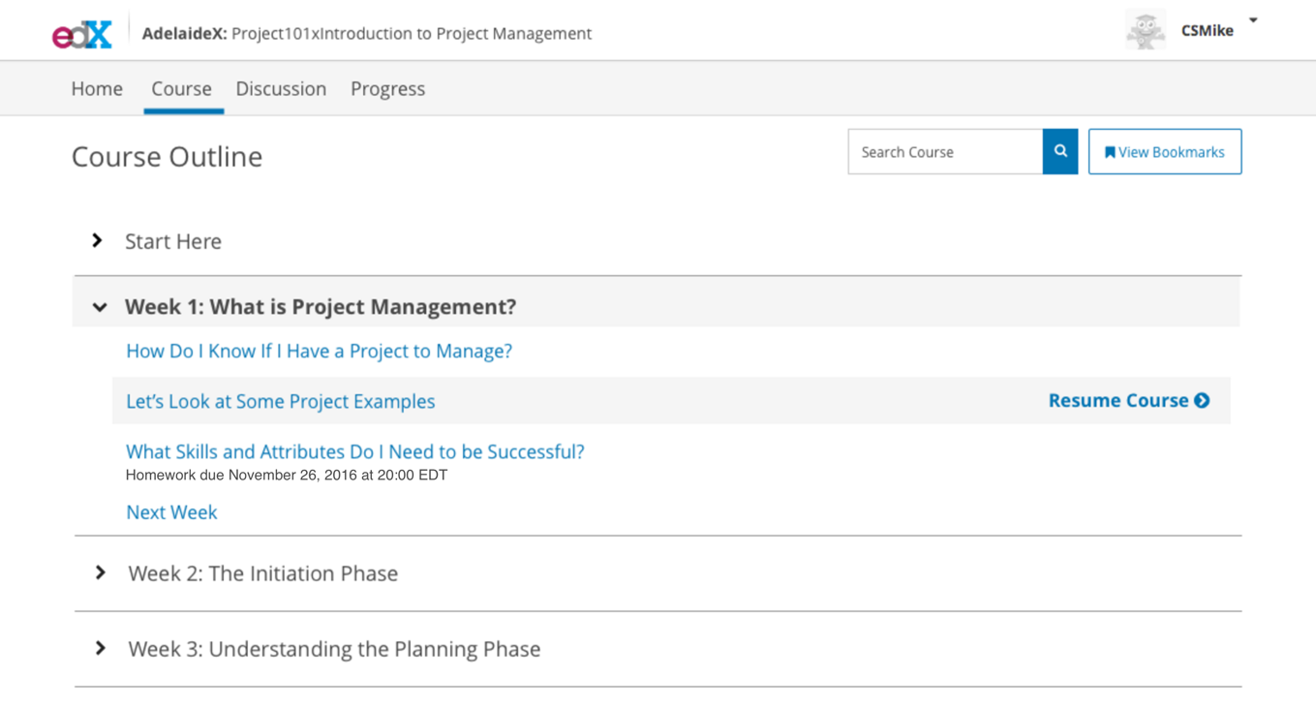
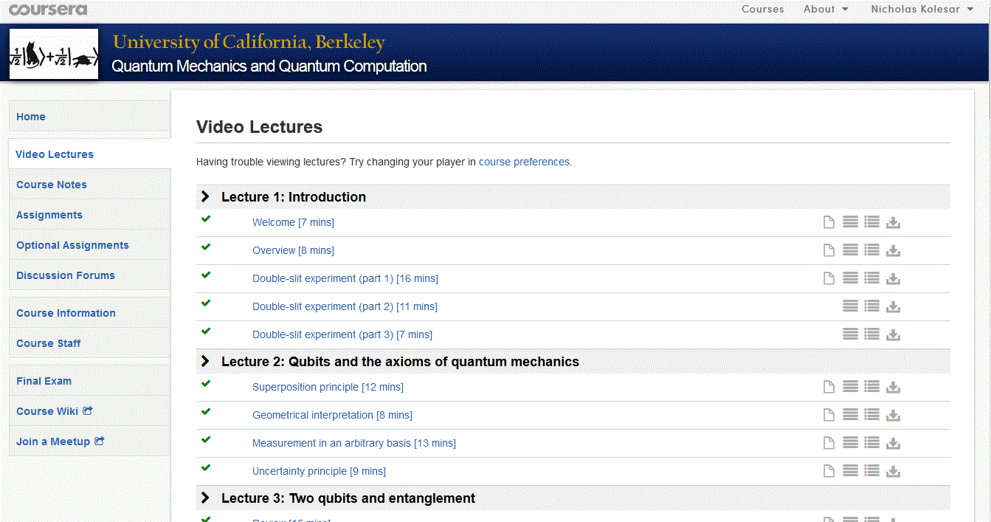
Design in MOOCs

Slide 3

First principles thinking

Slide 4
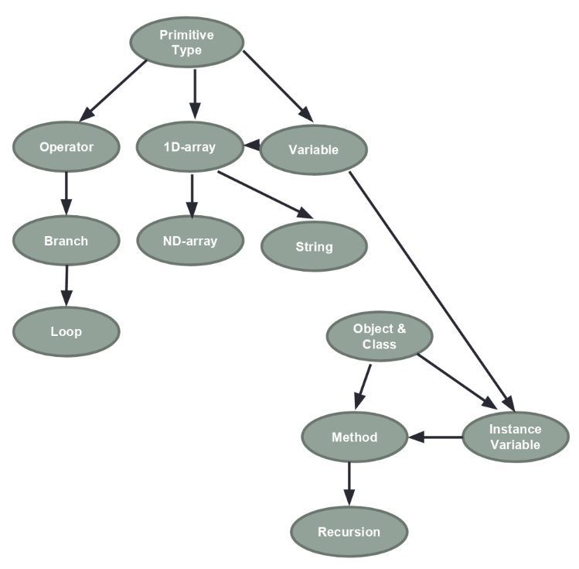
Objectives
We are given a directed graph called a knowledge graph for a course.
Based on the graph, we would like to evaluate the student performance so that students could revise the course materials and to help the instructor design the curriculum of the course better.

Slide 5
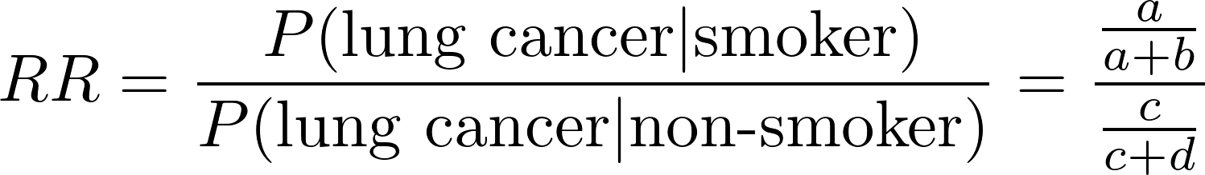
Relative risk / risk ratio
E.g.
a = 20 , b = 80, c = 1, and d = 99.
RR = 20.
Smokers would be 20 times as likely as non-smokers to develop lung cancer.
 | Disease status
 | Present | Absent
Smoker | a | b
non-smoker | c | d

Slide 6
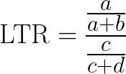
Learning trouble ratio
prev
next
E.g.
a = 20 , b = 80, c = 1, and d = 99.
RR = 20.
If students perform badly in the prerequisite, it would be 20 times as likely as they also perform badly for the subsequent concept.
 | Next
Prev | Bad | Good
Bad | a | b
Good | c | d

Slide 7
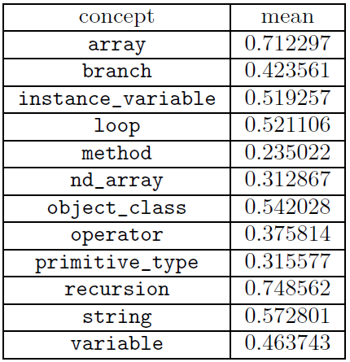
Data
Open Edx course: COMP102X Introduction of Java Programming
Number of weeks: 14
Lecturer: Professor T.C. PONG
Number of students: 10564
12 concepts with 91 questions

Slide 8
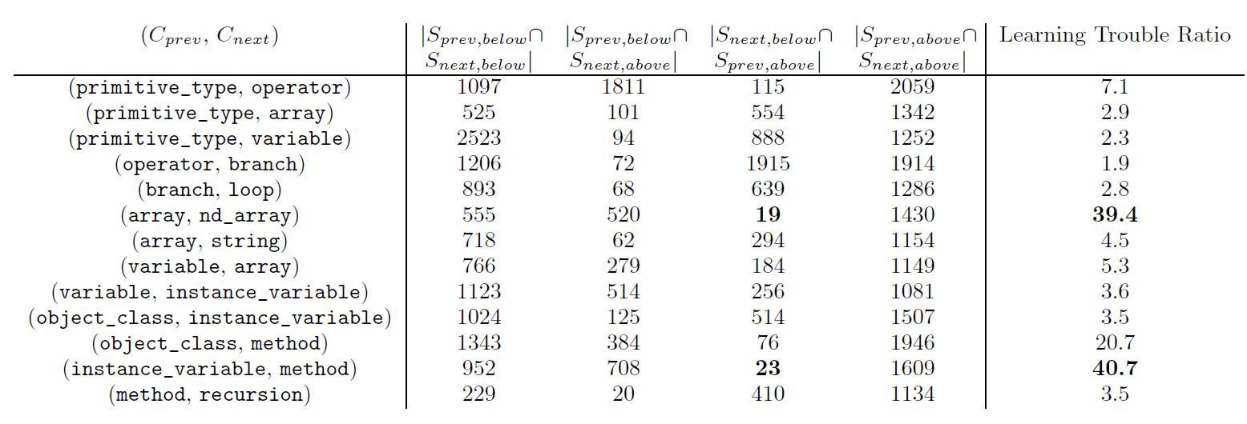
a b c d
Unexpected group

Slide 9

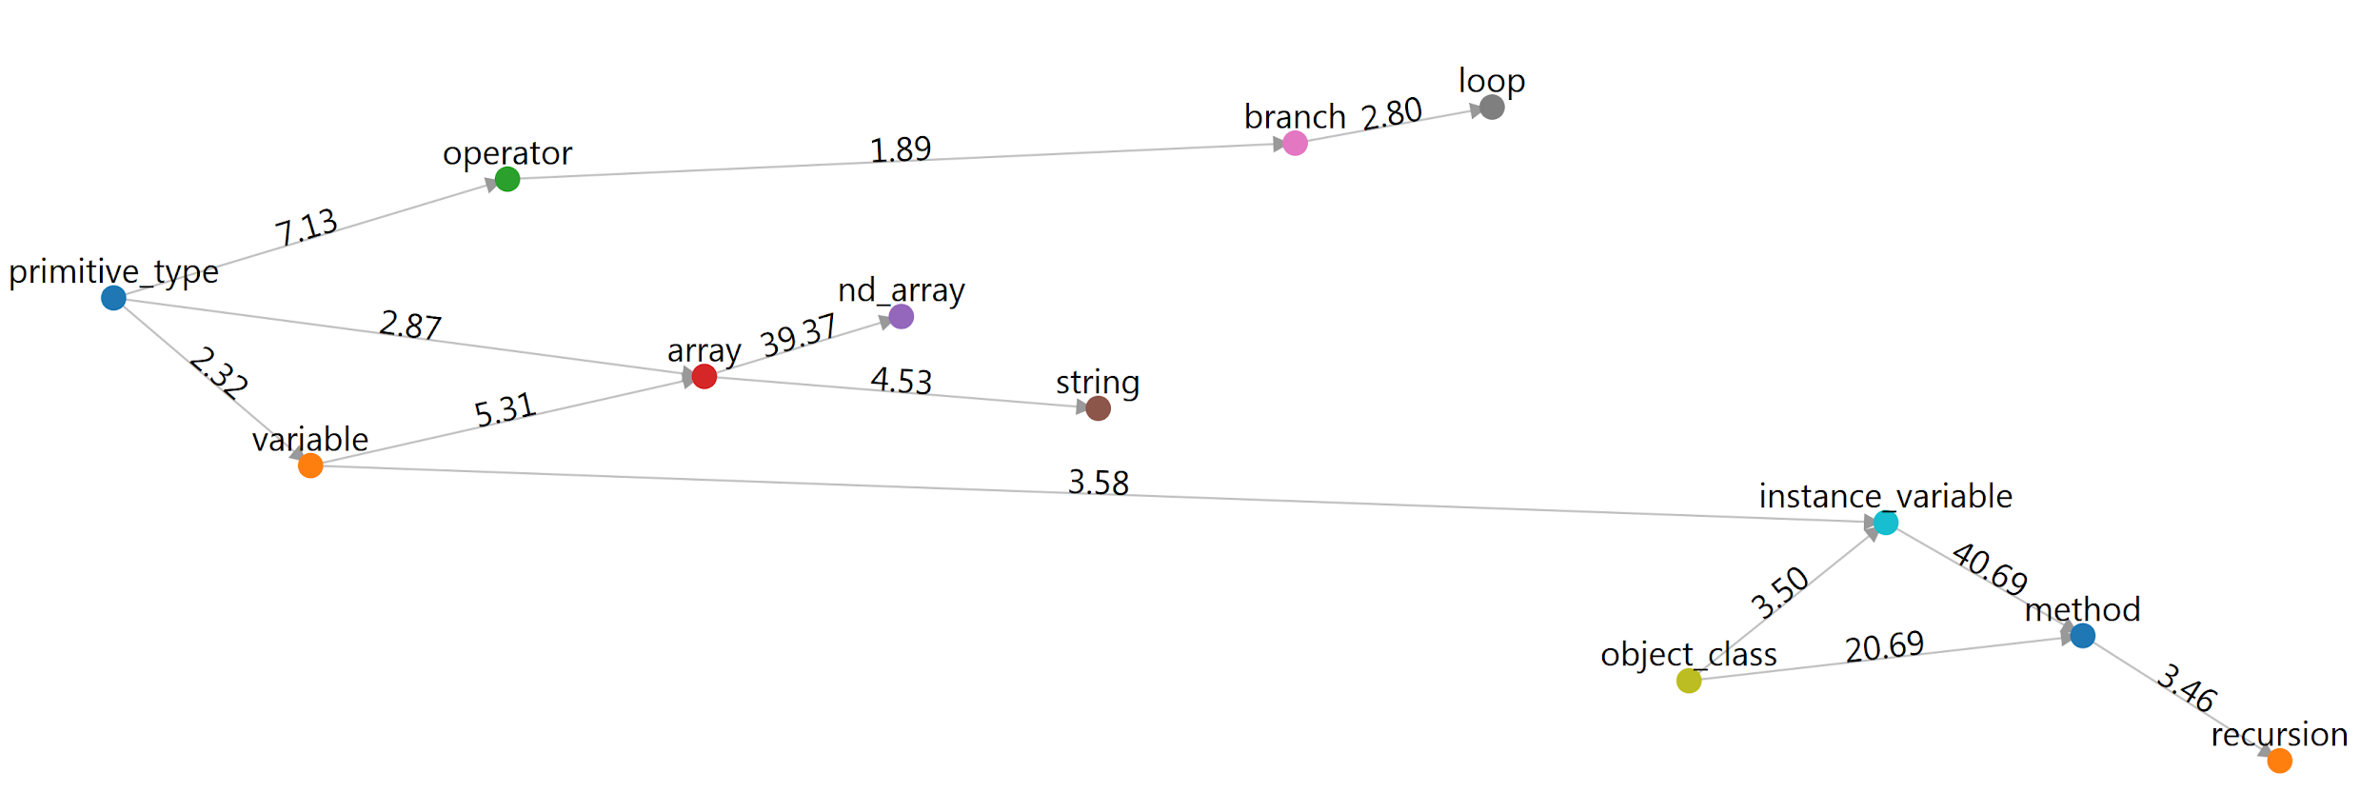
Learning dependency graph

Slide 10
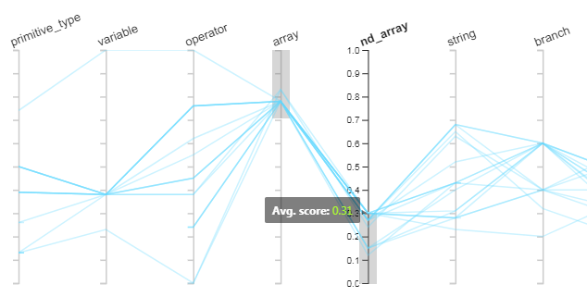
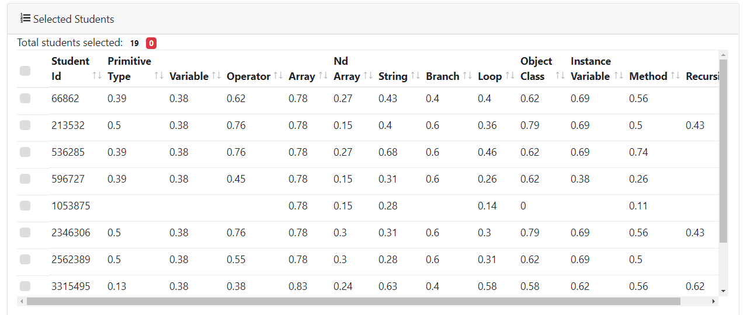
Filtering

Slide 11
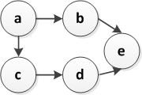
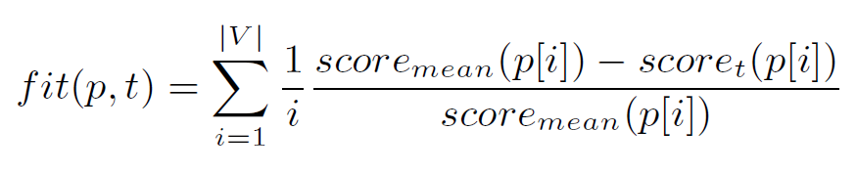
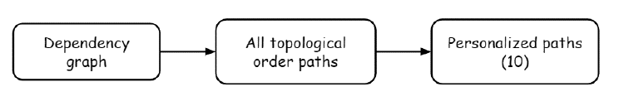
Personalized Study Path
Possible paths:
a b c d e
a c b d e
a c d b e
Fitness function:
Ranking factor
Relevance

Slide 12
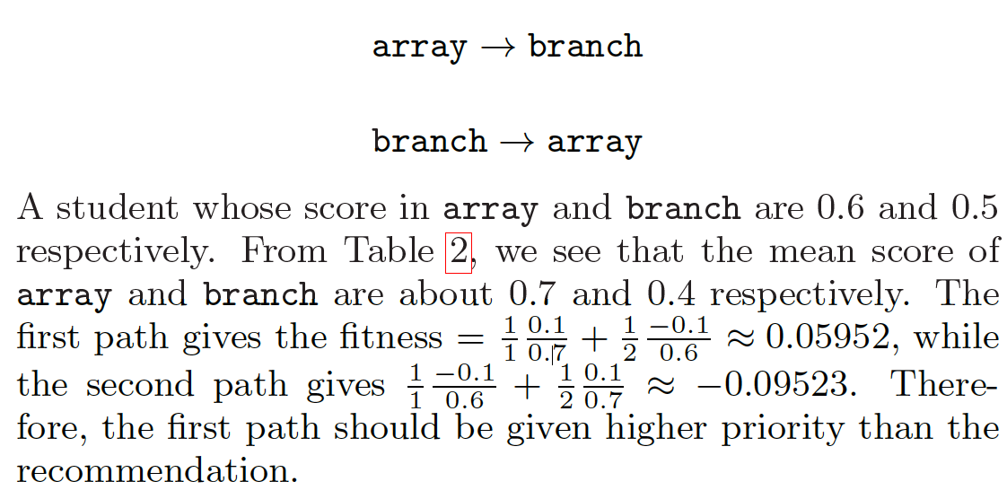

Example

Slide 13
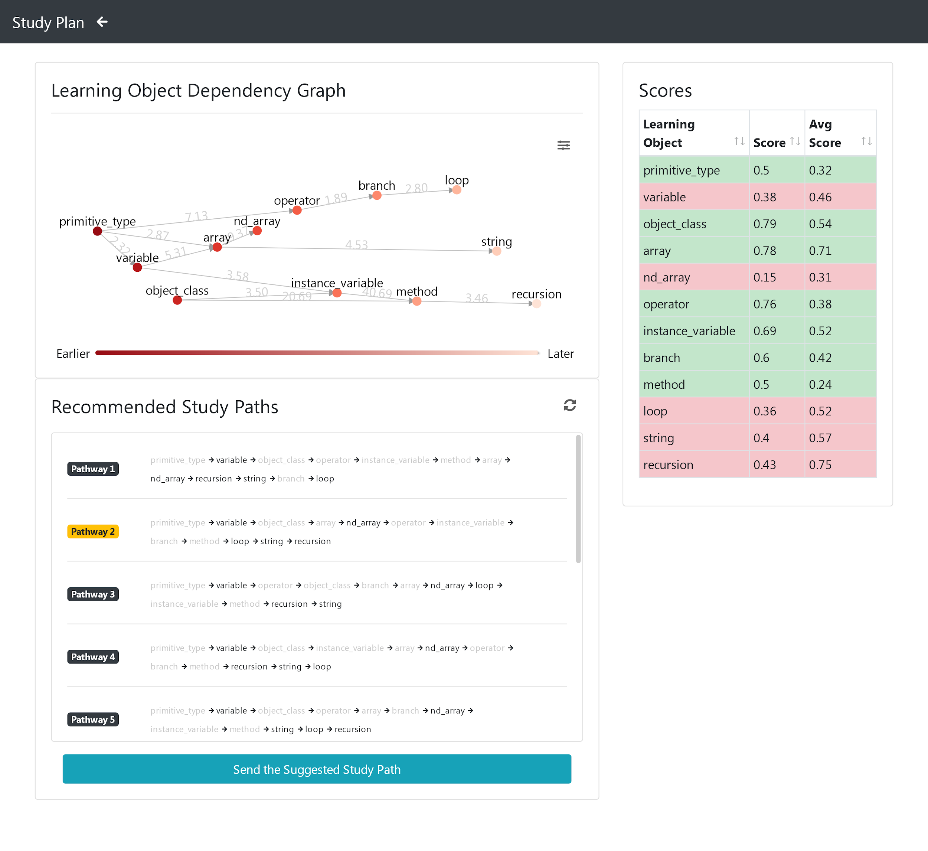

Slide 14


Slide 15
Q&A

