Slide 1
Minimizing Seed Set for Viral Marketing
Cheng Long & Raymond Chi-Wing Wong
Presented by: Cheng Long
20-August-2011

Slide 2
Outline
1. Background
2. Problem
3. Solutions
4. Experimental results
5. Conclusion

Slide 3




Viral Marketing
Traditional advertising:
  Cover massive individuals.
  Trust level: medium/low.
Viral marketing:
  Target a limited number of users.
  Utilizes the relationships in social networks, e.g., friends, families, etc.
  Trust level: relatively high.

Slide 4
Viral Marketing
Process of Viral Marketing.
  Step 1: select initial users (seeds).
  Step 2: propagation process.
    Influenced users.
Two popular propagation models.
  Independent Cascade model (IC model)
  Linear Threshold model (LT model)

Slide 5
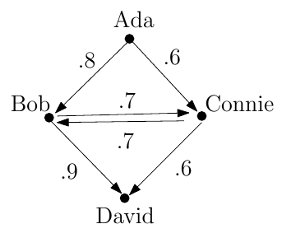
Viral Marketing (Cont.)
An example:
  Family
  Edge, weight
Process
  Step 1: select seeds.
  Step 2: propagation process.
Influenced users:
  We say the influenced nodes are incurred by a seed set.
  E.g., Ada, Bob, David are the influenced users incurred by {Ada}.
seed
Ada
Bob, David

Slide 6
Outline
1. Background
2. Problem
3. Solutions
4. Experimental results
5. Conclusion

Slide 7
Problem definition
σ(S): the expected number of influenced users incurred by seed set S.
J-MIN-Seed:
  Given a social network and an integer J, we want to find a seed set S such that σ(S) ≥ J and |S| is minimized.
J-MIN-Seed is NP-hard. (maximum cover problem)

Slide 8
Applications
Most scenarios of viral marketing.
  Seeds.
  Influenced users.
E.g., in some cases, for a company,
  the goal of targeting a certain amount of users (revenue) has been set up while
  the cost paid to seeds should be minimized.

Slide 9
Related Work
Propagation Models
  E.g., IC model and LT model
Influence Maximization problem
  Mainly focus on maximizing σ(S) given |S|.
  Different goals & different constraints.
  Thus, they cannot be adapted to our problem.
Extensions of Influence Maximization problem.
  E.g., multiple products, competitive products etc..

Slide 10
Outline
1. Background
2. Problem
3. Solutions
4. Experimental results
5. Conclusion

Slide 11
Solution (an approximate one)
Greedy algorithm:
  S: seed set.
  Set S to be empty.
  Iteratively add the user that incurs the largest influence gain into S.
  Stop when the incurred influence achieve the goal of J.

Slide 12
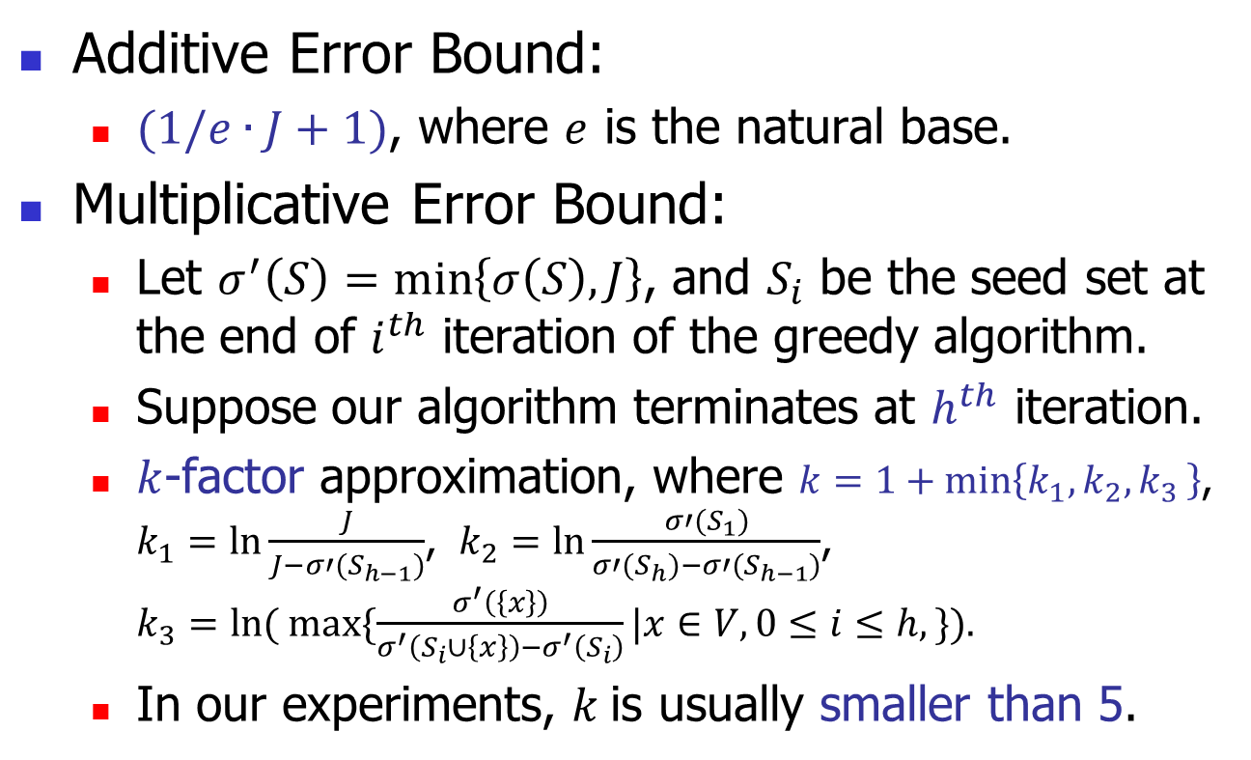
Analysis
Additive Error Bound:
  $(1/e∙J+1)$, where $e$ is the natural base.
Multiplicative Error Bound:
  Let $σ^{′}\left(S\right)=\min\left\{σ\left(S\right), J\right\}$, and $S_{i}$ be the seed set at the end of $i^{th}$ iteration of the greedy algorithm.
  Suppose our algorithm terminates at $h^{th}$ iteration.
  $k$-factor approximation, where $k=1+\min\left\{k_{1},k_{2}{, k}_{3}\right\}$, $k_{1}=ln⁡\frac{J}{J−σ′(S_{h−1})}$, $k_{2}=ln⁡\frac{σ′(S_{1})}{σ′(S_{h})−σ′(S_{h−1})}$, $k_{3}=ln( max⁡\{\frac{σ^{′}\left(\left\{x\right\}\right)}{σ^{′}\left(S_{i}∪\left\{x\right\}\right)−σ^{′}\left(S_{i}\right)}|x∈V, 0≤i≤h,\}).$
  In our experiments, $k$is usually smaller than 5.

Slide 13
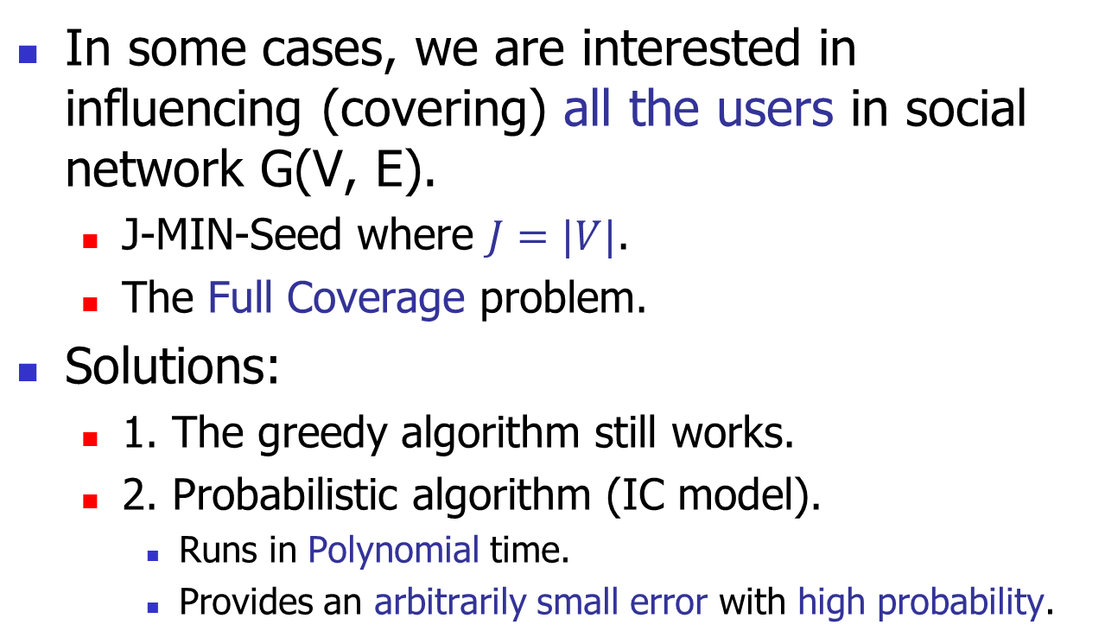
Full Coverage
In some cases, we are interested in influencing (covering) all the users in social network G(V, E).
  J-MIN-Seed where $J=|V|$.
  The Full Coverage problem.
Solutions:
  1. The greedy algorithm still works.
  2. Probabilistic algorithm (IC model).
    Runs in Polynomial time.
    Provides an arbitrarily small error with high probability.

Slide 14
Outline
1. Background
2. Problem
3. Solutions
4. Experimental results
5. Conclusion

Slide 15
Experiment set-up
Real datasets:
  HEP-T, Epinions, Amazon, DBLP
Algorithms:
  Random
  Degree-heuristic
  Centrality-heuristic
  Greedy (Greedy1 and Greedy2)
Measures:
  No. of seeds, Running time and memory

Slide 16
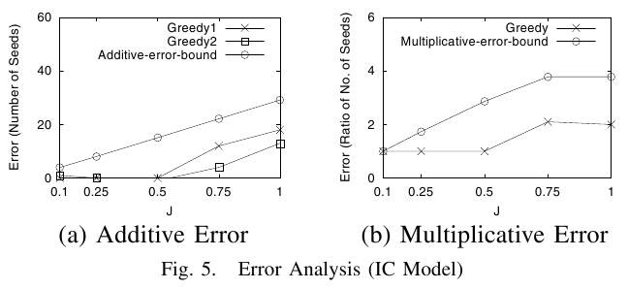
Experimental results (IC Model)
Additive Error (Fig. 5 (a)):
  The errors are much smaller than the theoretical ones.
Multiplicative Error (Fig. 5 (b)):
  The empirical multiplicative error bound is usually smaller than 2.

Slide 17
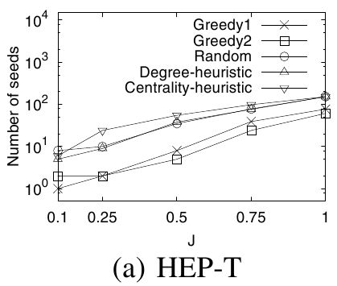
Experimental results (IC Model)
No. of seeds:
  Our greedy algorithm returns the smallest number of seeds.

Slide 18
Outline
1. Background
2. Problem
3. Solutions
4. Experimental results
5. Conclusion

Slide 19
Conclusion
We propose the J-MIN-Seed problem.
We design a greedy algorithm which can provide error guarantees.
Under the setting of J=|V|, we develop another probabilistic algorithm which can provide an arbitrarily small error with high probability.
We conducted extensive experiments which verified our algorithms.

Slide 20
Q & A
Thank you. ☺

Slide 21
Motivation
A seed set incurs some influenced users.
  S: seed set.
  σ(S): influenced users incurred by S.
To a company:
  A seed: cost.
  An influenced user: revenue.
  It wants to earn at least a certain amount of revenue (influenced users) while minimizing the cost (seed).

Slide 22
Motivation (Cont.)
How to select the seed set such that
  at least a certain number of individuals are influenced;
  the number of seeds is minimized?

Slide 23
Intractability & properties
σ(S) is submodular for independent cascade model (IC-model) and liner threshold model (LT-model).
  Error guarantee.
α(I) is not submodular for IC-model or LT-model.

Slide 24
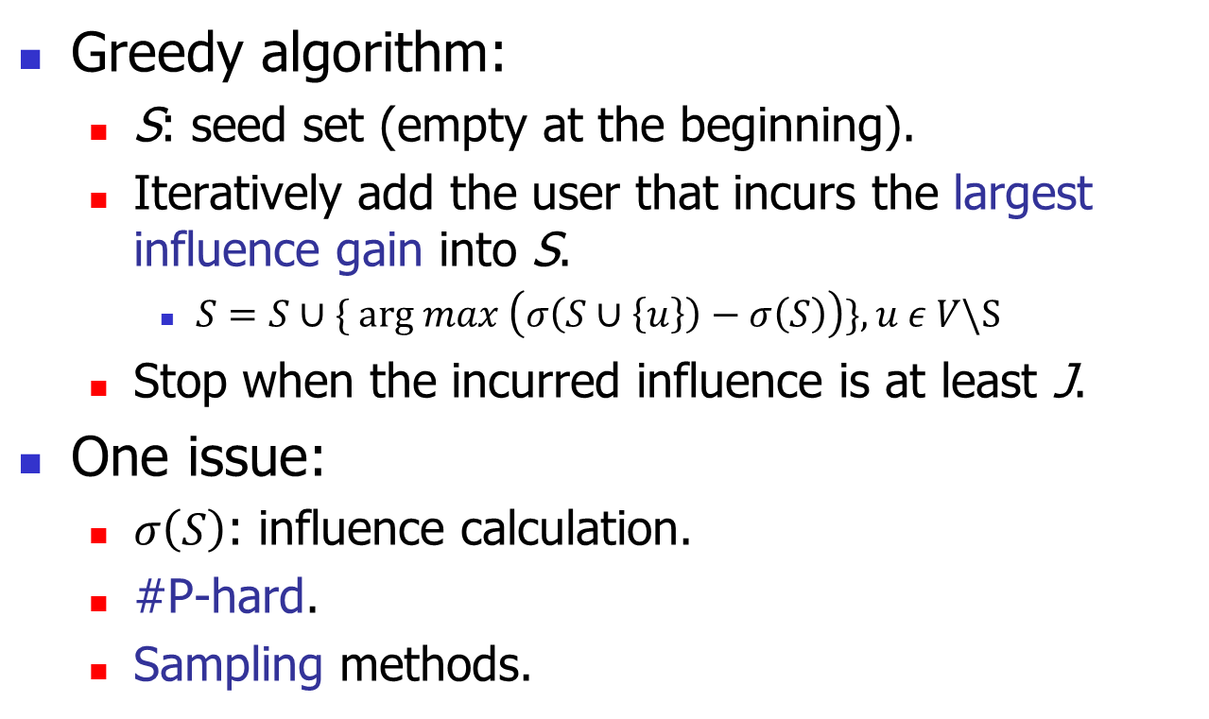
Approximate solution
Greedy algorithm:
  S: seed set (empty at the beginning).
  Iteratively add the user that incurs the largest influence gain into S.
    $S=S∪\{ arg max \left(σ\left(S∪\left\{u\right\}\right)−σ\left(S\right)\right)\}, u ε V\backslash S$
  Stop when the incurred influence is at least J.
One issue:
  $σ\left(S\right)$: influence calculation.
  #P-hard.
  Sampling methods.

Slide 25
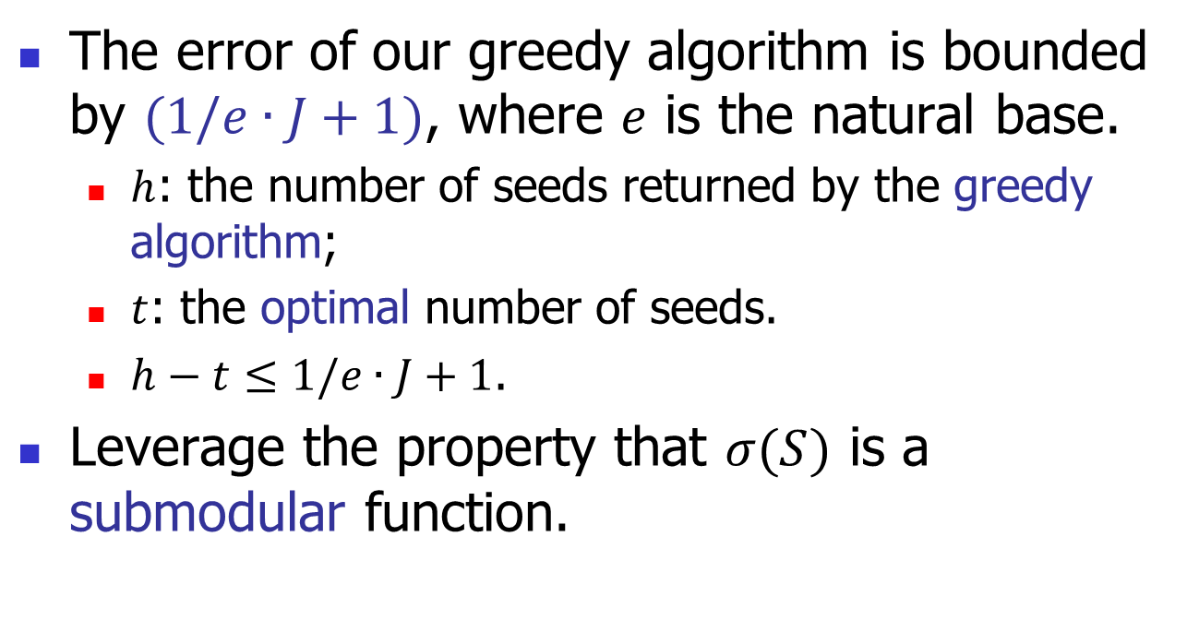
Analysis
The error of our greedy algorithm is bounded by $(1/e∙J+1)$, where $e$ is the natural base.
  $h$: the number of seeds returned by the greedy algorithm;
  $t$: the optimal number of seeds.
  $h−t≤1/e∙J+1$.
Leverage the property that $σ(S)$ is a submodular function.

Slide 26
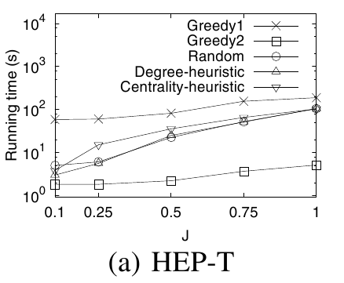
Experimental results (IC Model)
Running time:
  The greedy algorithm runs slower than others.

Slide 27
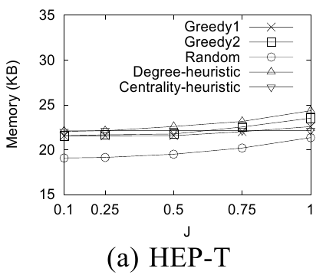
Experimental results (IC Model)
Memory:
  All methods are memory-efficient (less than 2MB).

