Slide 1


Adversarial Learning of Group and Individual Fair Representations
Hao Liu, Department of CSE, HKUST
Raymond Chi-Wing Wong, Department of CSE, HKUST

Slide 2
Outline
Introduction
Preliminaries
Methodology
Evaluation
Conclusion

Slide 3
Outline
Introduction
Preliminaries
Methodology
Evaluation
Conclusion

Slide 4
Introduction: Motivation
Fairness is increasingly becoming an important issue in machine learning (ML).
Using unfair datasets to train ML models could lead to discrimination of some groups of people (i.e., the protected groups).
  Protected groups: groups that are often discriminated against (e.g., females and African-Americans)
  Protected attributes: the corresponding attributes that define the protected groups (e.g., gender and race)
We want to propose a fair classification model to help alleviate discrimination in decision-making systems
Notes:
For example, the model trained on some biased dataset could have larger chance to classify female loan applicants as bad credit than male applicants.

Slide 5
Introduction: Background
Existing fairness notions are mainly categorized into:
  Group fairness: treating different groups defined by protected attributes equally
  Individual fairness: similar individuals should be treated similarly by classifiers.
However, most existing studies focus on group fairness, which may harm individual fairness.

Slide 6
Introduction: Problem Statement
In this work, we deal with the fair representation learning problem:
  Given a dataset, we want to learn a representation of the dataset such that for any classifier on the representation, the three targets, accuracy, group fairness and individual fairness, can be well reconciled.
Notes:
Representation learning has become a common approach in fair classification.
So, in this work, we follow this approach, and we deal with the fair representation learning problem…

Slide 7
Introduction: Our Contributions
We design a novel structure of adversarial representation learning (called GIFair) with two adversaries for group fairness and individual fairness, respectively.
We design a training algorithm that can well reconcile the two adversaries in our structure.
The experiments conducted on 3 real datasets show that GIFair can reconcile good fairness with high accuracy.

Slide 8
Outline
Introduction
Preliminaries
Methodology
Evaluation
Conclusion

Slide 9
Preliminaries: Example of Dataset Formation
Protected attribute A
Outcome attribute Y
A list of attributes X
 | No. days between screening & arrest | … | Severity of Offense | Race | Recidivate or not?
x₁ | 30 | … | 3 | African-American (1) | Yes (1)
... | … | … | …
… | 45 | … | 1 | African-American (1) | No (0)
… | 16 | … | 3 | Other-races (0) | No (0)
… | … | … | … | … | …
x_{N} | 35 | … | 2 | Other-races (0) | No (0)
All data points in protected group
Protected group
D₁
D₀
An example of COMPAS Dataset D
All data points in unprotected group
Notes:
We first introduce our dataset formation using an example of the COMPAS dataset D.
In this dataset, we have the information of N criminals, and each of them has a list of attributes X and an outcome attribute Y.
We want to predict, for each person in this dataset, the outcome is 1 or 0, which means this person will commit crime again or not.
We also have a protected attribute A, which is race.
The protected group for race is African-American represented as 1, who are often discriminated against in such tasks.
The entire dataset is separated into two parts: D1 and D0.
D1 contains all data points in the protected group, and D0 contains all data points in the other group.

Slide 10
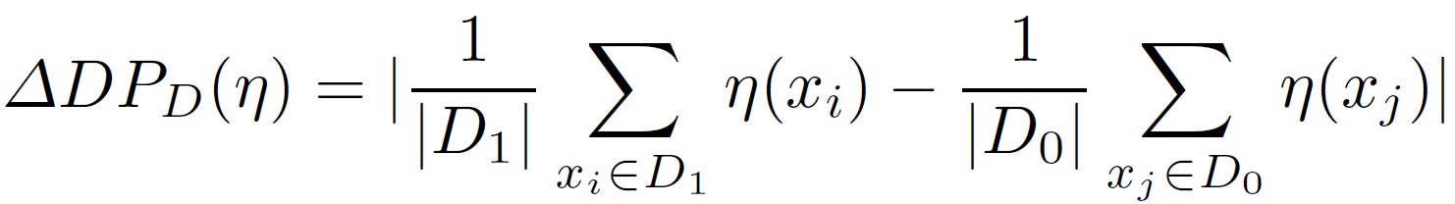
Preliminaries: Group Fairness Metrics
We mainly use demographic parity gap as the group fairness metric.
  Given a classifier η and dataset D, the demographic parity gap of η for D, denoted by ΔDP_{D}(η), is defined to be the absolute difference between the positive rate of D₀ and the positive rate of D₁. Namely,
  Large ΔDP_{D}(η) indicates worse group fairness.
We also use equalized odd distance as the group fairness metric, which is not shown in detail.

Slide 11
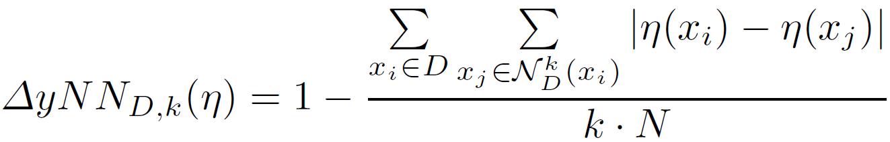
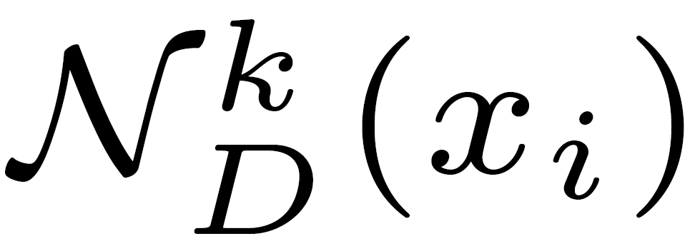
Preliminaries: Individual Fairness Metric
For individual fairness, we use a commonly applied metric called yNN, which measures the consistency of the prediction results among similar data points.
  Given a classifier η, a positive integer k and dataset D, the yNN of η for D and k, denoted by ΔyNN_{D,k}(η), is defined to be
    It captures the average difference between the predicted outcome of a data point x_{i} and that of a nearest neighbor (NN) x_{j} of x_{i} ( denotes the set of k-NN of x_{i}). This difference is 0 if x_{i} and x_{j} have the same predicted outcome and 1 otherwise.
  Larger ΔyNN_{D,k}(η) indicates better individual fairness.

Slide 12
Preliminaries: Related Work
Most related studies focus on either group fairness or individual fairness only:
  LAFTR [ICML18]: It uses the adversarial learning framework to ensure accuracy and group fairness.
  iFair [ICDE19]: It aims at learning representations considering both accuracy and individual fairness.
We address both group and individual fairness by well trading-off them.

Slide 13
Preliminaries: Related Work
A handful of studies target both group and individual fairness
  LFR [ICML13]: It only preserves the spatial closeness in the learnt representation (while achieving group fairness). That is, if the two data points are close in the original dataset, their representations are also close. However, if the original dataset is not individually fair, the representation has bad individual fairness, too.
  DualFair [WWW23]: It only grants individual fairness for “counterfactual” samples. That is, it does not consider the individual fairness between two data points that are similar and are in the same group.
We ensure individual fairness directly by optimizing the consistency of the prediction results among similar data points in the representation.
We consider the individual fairness of similar data points no matter whether they are in the same group or in different groups.
Notes:
The first one only considers preserving the spatial closeness in the learnt representation, which addresses individual fairness indirectly.
It turns out that if the original dataset is not individually fair, the representation is also not individually fair.
In comparison, we ...
The second one ...

Slide 14
Outline
Introduction
Preliminaries
Methodology
Evaluation
Conclusion

Slide 15
Basic Scheme of Adversarial Learning
Original Dataset
P_{data}
From P_{data} or G(z)?
Discriminator
C
Generator
G
Synthetic Data
G(z)
It has two components, namely a generator G and a discriminator C. G aims at deceiving C by constructing synthetic data G(z) that could match the real data distribution P_{data}. C aims at distinguishing whether the data comes from P_{data} or G(z).
After a number of training epochs, C is well capable of making distinction, while having the well performed C, G also improves its ability to generate synthetic data that follows the real data distribution (which is the goal of adversarial learning).

Slide 16
Methodology: Existing Framework
X
Encoder
f
Z
Group Adversary
h
A
Existing framework of adversarial representation learning for fair classification:
  It uses an encoder f as the generator to generate the representation Z from X.
    It aims to obfuscate the group membership and thus ensure group fairness.
  It uses an adversary h as the discriminator to identify the group of the generated representation Z defined by the protected attribute A.
  Finally, a (group) fair representation Z is obtained that can obfuscate the group information by adversarial learning.
It only addresses group fairness, but not individual fairness

Slide 17
Methodology:
Our Proposed Model: GIFair
Group Adversary
h₁
A
X
Encoder
f
Z
Classifier
g
Y
Individual Adversary
h₂
Encode f: It generates the representation Z from X.
Classifier g: It predicts the outcome Y from representation Z, which seeks to preserve the prediction accuracy by minimizing a classification loss function L_{c} (i.e., cross-entropy).
Group adversary h₁: It aims to identify the group of the generated representation Z by maximizing a group (fairness) loss function L_{g} (to be formalized later).
Individual adversary h₂: It aims to distinguish the predicted outcome of each representation in Z with its neighbors by maximizing an individual (fairness) loss function L_{i} (to be formalized later).
Notes:
This is the structure of our proposed model GIFair.

Slide 18
Methodology:
Our Proposed Model: GIFair
By adversarial learning:
  The group adversary is more capable of identifying the group of the representation
  The individual adversary is more capable of distinguishing the predicted outcome of each representation with its neighbors
  Given the well performed group and individual adversaries, the generated representation is also good at obfuscating the group information (i.e., achieving group fairness) and making the same predicted outcome between a representation and its neighbors (i.e., achieving individual fairness).

Slide 19
Methodology: Total Loss and Training Goal
The total loss function L(f, g, h₁, h₂) is formalized to be the weighted sum of the classification loss function L_{c}, group loss function L_{g} and individual loss function L_{i} based on three coefficients α, β and δ, respectively.
Following adversarial learning, we train our model with a min-max optimization:
  It first maximizes the total loss so that the two adversaries h₁ and h₂ are optimized to identify the group labels and to distinguish each individual with its neighbors.
  Then, we minimize the total loss so that the generated representation (by encoder f) are optimized to obfuscate the group labels and to ensure each individual is indistinguishable with its neighbors (thus ensuring group and individual fairness), while the accuracy is also guaranteed by optimizing g.
Now we introduce the details of the two adversaries h₁ and h₂
Notes:
… so that we achieve both types of fairness and also good accuracy.

Slide 20
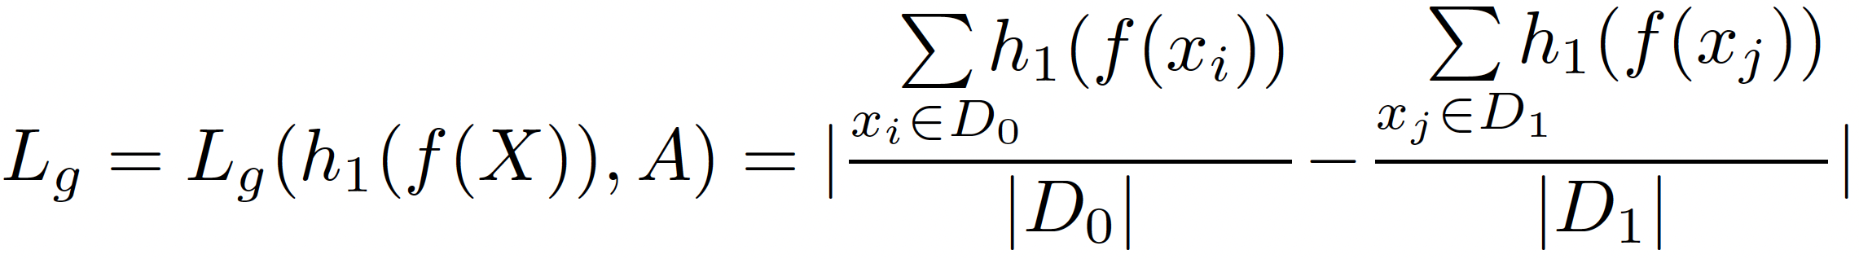
Methodology: Group Adversary h₁
Given a representation z_{i} = f(x_{i}) ∈ Z, the group adversary h₁ generates a value h₁(z_{i}) ∈ {0, 1}, which is the predicted group of z_{i}.
  The objective of h₁ is to differentiate representations in different groups.
  Thus, h₁ is only interested in giving different group labels to two representations in different groups.
  To achieve this goal, we form the group (fairness) loss function L_{g} as follows.
  We aim to maximize this group loss L_{g} for the group adversary
Notes:
For group adversary h1, we formalize the group loss function such that h1 could well differentiate the representations in different groups.
Basically, it is computed to be the absolute difference between the ratio of data points predicted to be group label 1 among D0 and the ratio of data points predicted to be group 1 among D1.
We use an example to illustrate that better.

Slide 21
Methodology: Example of Group Adversary h₁
For example, let |D₁| and |D₀| be 300 and 700, respectively.
  Case 1:
    h₁ predicts the group label to be 1 for 285 out of 300 data points in D₁
    h₁ predicts the group label to be 1 for 35 out of 700 data points in D₀
    In this case, L_{g} = |285/300 – 35/700| = 0.9
  Case 2:
    h₁ predicts the group label to be 1 for 24 out of 300 data points in D₁
    h₁ predicts the group label to be 1 for 658 out of 700 data points in D₀
    In this case, L_{g} = |24/300 – 658/700| = 0.86
  Case 3:
    h₁ predicts the group label to be 1 for 180 out of 300 data points in D₁
    h₁ predicts the group label to be 1 for 434 out of 700 data points in D₀
    In this case, L_{g} = |180/300 – 434/700| = 0.02
  Both case 1 and 2 mean h₁ can well differentiate the group, while case 3 indicates h₁ cannot well differentiate the group
  Adversary h₁ aims to maximize L_{g} for better differentiating the group label
Correct group labels for most data points
Wrong group labels for most data points
Some correct some wrong group labels
Notes:
In this example, the number of data points in the protected group D1, unprotected group D0 are 300 and 700, respectively.
In case 1, most data points are given correct group labels. The loss function is the difference of the two ratios just mentioned, which is a large value 0.9.
In case 2, it is interesting to see that most data points are given wrong group labels. The loss function value is still large, which means h1 can also well differentiate the group.
Only in case 3, where some are given correct but some are given wrong group labels, the loss function value is small, indicating that h1 cannot well differentiate the group.
Therefore, the adversary h1 is aimed to maximize the group loss function.

Slide 22
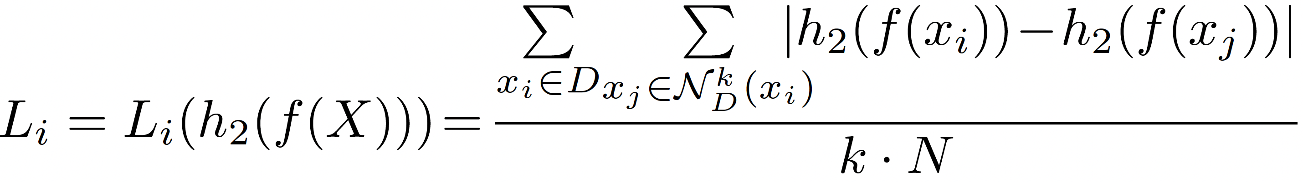
Methodology: Individual Adversary h₂
For each representation z_{i} = f(x_{i}) ∈ Z, h₂ predicts an outcome h₂(z_{i}) ∈ {0, 1} (of attribute Y).
  The objective is that, for another representation z_{j} = f(x_{j}), if x_{i} and x_{j} are similar (e.g., x_{j} is a nearest neighbor of x_{i}), the predicted outcome of z_{j} should be distinguishable with the predicted outcome of z_{i}, i.e., h₂(z_{j}) ≠ h₂(z_{i}).
  To achieve this goal, we form the individual (fairness) loss function L_{i} as follows.
  We aim to maximize this individual loss L_{i} for the individual adversary
Notes:
For individual adversary h2, we formalize the individual loss function such that a data point has different outcome from its neighbors.
We directly use a similar formation of yNN metric to formalize our individual loss function.

Slide 23
Methodology: Example of Individual Adversary h₂
For example:
  For data point x₁ with predicted outcome 1 by h₂, among the 10 nearest neighbors (NNs) of x₁, h₂ aims to distinguish x₁ with its NNs, by giving more 0 predictions for its NNs
  Suppose h₂ predicts most NNs (i.e., 9) of x₁ to be 0 (while the other 1 NN to be 1), then for x₁, its contribution to individual loss L_{i} is 9/10 = 0.9 (i.e., a large value)
  Adversary h₂ aims to maximize L_{i} for better distinguishing the predicted label of a data point with that of its NNs

Slide 24
Outline
Introduction
Preliminaries
Methodology
Evaluation
Conclusion

Slide 25
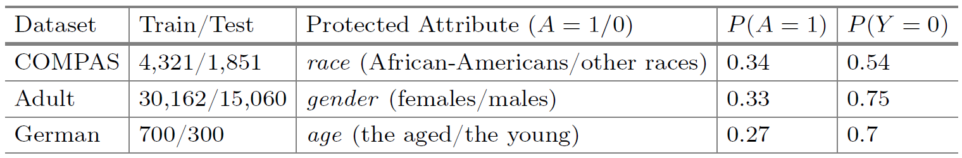
Evaluation: Datasets
We used 3 public datasets: COMPAS, Adult and German

Slide 26
Evaluation: Baselines and Algorithms
Baselines
  UNFAIR: a normal classification algorithm that does not consider fairness.
  LAFTR [ICML18]: includes three variants, which target demographic parity, equalized odds, and equal opportunity.
  iFair [ICDE19]: aims at learning representations considering both accuracy and individual fairness.
  LFR [ICML13]: aims at generating a representation that achieves both group fairness, and individual fairness with a non-adversarial learning approach.
  DualFair [WWW23]: learns representations satisfying both group fairness and counterfactual fairness.
Our algorithm is denoted as GIFair on the original loss function, while GIFair-focal denotes our algorithm on the focal loss function (a balanced loss function we propose).

Slide 27
Evaluation: Measurements
Accuracy
  Accuracy (denoting ACC)
    Defined to be 1 minus the average difference between the outcome and the predicted outcome of all data points
    Indicating the percentage of correctly predicted data points of a classifier
  F-1 Score (denoting F1)
    Defined to be the harmonic mean of the precision and the recall of a classifier
Group fairness
  Demographic parity gap (denoting ΔDP) and equalized odd distance (ΔEO) (as defined previously)
Individual fairness
  yNN (denoting ΔyNN) (as defined previously)
Smaller ΔDP or smaller ΔEO indicates better group fairness
Larger ΔyNN indicates better individual fairness

Slide 28
Evaluation: Trade-off Studies
We studied the trade-off between any two terms from accuracy, group fairness and individual fairness. We compared with the baselines that also study the trade-off. To show which algorithm performs better under multi-metrics, we plotted the Pareto front curves. For each figure, the top-right points are preferable.
Our algorithms GIFair and GIFair-focal achieve superior trade-off between any two targets.
Trade-off Curves on Dataset German

Slide 29
Outline
Introduction
Preliminaries
Methodology
Evaluation
Conclusion

Slide 30
Conclusion
In this paper, we propose an adversarial learning structure, GIFair, with two adversaries for group fairness and individual fairness, respectively.
With a designed training algorithm, GIFair can reconcile accuracy with group and individual fairness during generating a representation on the original dataset.
In our experiments on 3 real datasets, GIFair outperforms baselines with better fairness and higher accuracy.

Slide 31
Q & A
Thank you for listening!

Slide 32
Preliminaries: Fair Classification Problem
The basic goal of the fair classification problem is to obtain a classifier η that can predict an outcome η(x_{i}) ∈ {0, 1} of data point x_{i} for i ∈ [1, N] in the dataset D such that some fairness criteria are satisfied.

Slide 33
Preliminaries: Example of Group Fairness Metrics
For example, let |D₁| and |D₀| be 300 and 700, respectively (i.e., 300 out of 1000 are in the protected group (i.e., African-American), and the other 700 are in the unprotected group).
  Case 1:
    210 out of 300 data points in the protected group are predicted as 1
    497 out of 700 data points in the unprotected group are predicted as 1
    ΔDP_{D}(η) = |210 / 300 – 497 / 700| = 0.01
  Case 2:
    250 out of 300 data points in the protected group are predicted as 1
    280 out of 700 data points in the unprotected group are predicted as 1
    ΔDP_{D}(η) = |250 / 300 – 280 / 700| = 0.43
  Case 2 has larger ΔDP, which indicates worse fairness. More specifically, a much larger positive (i.e., a person will recidivate) rate is observed for the protected group, which means this classifier creates discrimination to the protected group.
Notes:
TODO: concrete example

Slide 34
Preliminaries: Example of Individual Fairness Metric
For example:
  For data point x₁ with predicted outcome 1, if there are 8 out of the 10 nearest neighbors of x₁ has the same prediction 1, x₁ will “contribute” (1 – |8 – 10|/10) = 0.8 for the yNN
  For data point x₂ with predicted outcome 1, if there are 3 out of the 10 nearest neighbors of x₂ has the same prediction 1, x₂ will “contribute” (1 – |3 – 10|/10) = 0.3 for the yNN
  Clearly, the smaller value 0.3 means more individual discrimination to x₂
  The yNN metric is computed to be the mean “contribution” of all data points
Notes:
TODO: concrete example

Slide 35
Methodology: Training Algorithm
Input: Dataset D, Batch size m, Number of epochs e
Output: Encoder f, Classifier g, Group adversary h₁, Individual adversary h₂
  For epoch from 1 to e do
    Randomly sample a mini-batch D’ from D of size m
    // Step 1: (Train h₁)
    Freeze h₂, f, g; unfreeze h₁; optimize h₁ by ascending along gradient on D’
    // Step 2: (Train h₂)
    Freeze h₁, f, g; unfreeze h₂; optimize h₂ by ascending along gradient on D’
    // Step 3: (Train f and g)
    Freeze h₁, h₂; Unfreeze f, g; optimize f and g by ascending along gradient on D’
  Return f, g, h₁, h₂

Slide 36
Methodology: Optimization with Focal Loss
We notice that the ranges of the three losses have large differences (i.e., the loss with a smaller value tends to receive less attention).
To solve this, we utilize the focal loss function to balance the 3 losses.
  For a variable p, the focal loss function uses (1 – p)^{γ} as a weight term where γ ≥ 0 is a focusing parameter.
  It give a larger (smaller) weight to a smaller (larger) p value.
  Based on that, we redesign our loss function as follows.

Slide 37
Evaluation: Parameter Settings
We varied β and δ in GIFair from 0.1 to 20, while α is fixed to 1.
For baselines, we also changed their coefficients from 0.1 to 20.
For GIFair-focal, we varied γ from 0.05 to 5.
By default, we set k to 10 when computing the k-nearest neighbors for yNN.

Slide 38
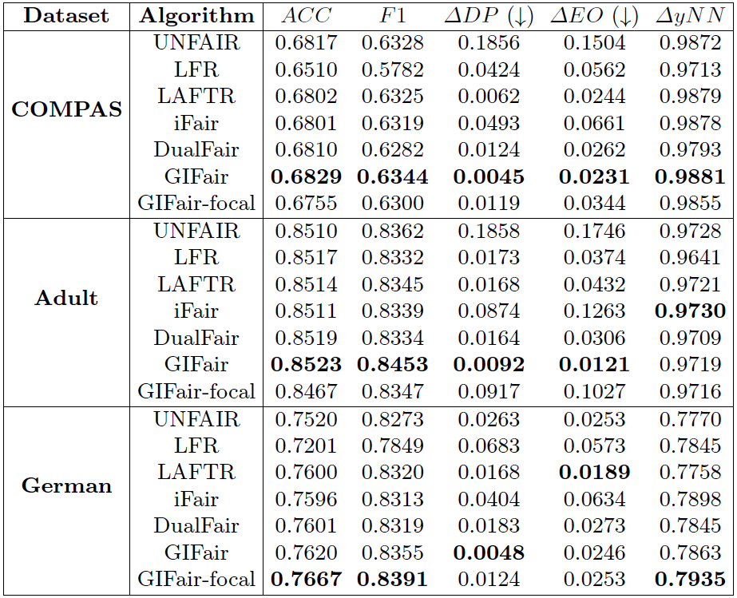
Evaluation: Comparison of GIFair and Baseline Algorithms
Our algorithms GIFair and GIFair-focal outperform all the baselines on most metrics.

Slide 39
Evaluation: Ablation Studies
Ablation Studies of GIFair on Dataset German
Without group adversary h1, GIFair-w/o-h₁ has much larger ΔDP (i.e., worse group fairness) than the original GIFair. This verifies the effectiveness of improving group fairness using the group adversary.
Similarly, GIFair has larger yNN than GIFair-w/o-h₂, indicating that the individual adversary h₂ could effectively improve individual fairness.
Without both adversaries, GIFair-w/o-h₁-h₂ obtains bad performance for both group and individual fairness.

Slide 40
Evaluation: Case Studies
When only group fairness is optimized for dataset COMPAS, we observe a representative result where 47% of the African-American group will recidivate, while this proportion for the other races is only 29%. When both group and individual fairness are optimized, the recidivation proportions among African-Americans and other races are predicted to be 40% and 38%, respectively, which is much fairer.
Moreover, there exist some pairs of similar defendants who only have 1 day difference on “the number of days between screening and arrest” and have the same value for all other attributes. When only individual fairness is optimized, we found that the number of such pairs of similar defendants that obtain different prediction results is 14. This number improves to only 1 when both group and individual fairness are optimized.

