Slide 1
On Good and Fair Paper-Reviewer Assignment
Cheng LONG, Raymond Chi-Wing Wong, Yu Peng, Liangliang Ye
The Hong Kong University of Science and Technology
10 Dec., 2013

Slide 2
Paper Reviewer Assignment
Peer review
  Assign papers to reviewers (PCs)
  756 submissions and 234 PCs [ICDM’12]
Automatic paper-reviewer assignment

Slide 3
Existing solution (1)
Un-balanced
Sensitive to the processing order
Simply heuristic-based
_{Example next …}
Retrieval-based method
  Retrieve expertise for each paper
Matching-based method
  Phase 1: Bipartite graph construction
  Phase 2: Matching computation

Slide 4
Existing solution (2)
The paper being presented:
topic 1: Assignment
topic 2: COI
topic 3: Submodularity
Me as a reviewer:
topic 1: social network
topic 2: assignment
topic 3: algorithmic design
task: Assign 2 reviewers to p₁
t₁
r₁
r₁
r₁
t₂
r₂
3
3
3
r₂
3
r₂
p₁
t₃
Phase 1
p₁
2
Phase 2
p₁
2
t₄
r₃
r₃
r₃
2
2
t₅
r₄
r₄
r₄
In the returned assignment, only 3 topics of p₁ are covered (t₁, t₂, t₃)
A better solution: {(p₁, r₁), (p₁, r₄)} 5 topics of p₁ are covered.

Slide 5
A New Problem: MaxTC-PRA
Maximum Topic Coverage Paper Reviewer Assignment (MaxTC-PRA)
  Three constraints:
    Paper Demand Constraint
    Reviewer Workload Constraint
    Conflict-of-interest Constraint (COI Constraint)
  One Objective:
    The total number of distinct topics of papers that are covered is maximized.

Slide 6
Solution
MaxTC-PRA cannot be fit in the framework of matching-based method
  Weights are dependent!
NP-hard!
Greedy algorithm
  1/3-factor approximation
  Sub-modularity
  P-system

Slide 7
COI study (1)
Issue 1
Issue 2
Issue 3
Issue 1: What types of author-reviewer relationship should be considered as COI?
  Co-author relationship
  Colleague relationship
  Advisor-advisee relationship
  Competitor relationship
The reviewer would be biased for the paper submitted by the author
The reviewer would be biased against the paper submitted by the author
r₁
t₁
r₁
a₁
p₂
t₂
r₂
Competitor relationship: r₁ vs. a_{2.}
a₂
p₁
t₃
t₄
r₃
t₅
r₄

Slide 8
Empirical Study (1)
Datasets
  Paper set: 496 papers published in KDD’06-10
  Reviewer set: 550 PCs of ICDM’10 and those of KDD’10
  Topic set: 49 subject areas of KDD’11
Algorithms
  Greedy and ILP

Slide 9
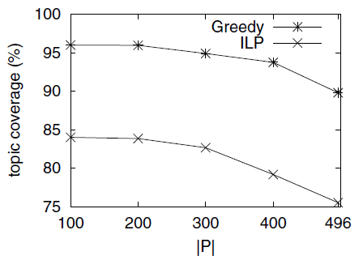
Empirical Study (2)
Greedy improves the topic coverage usually by 10% - 15%.

Slide 10
Conclusion
A new problem: MaxTC-PRA
NP-hardness of MaxTC-PRA and a 1/3-factor approximation
COI study: three issues
Empirical study

Slide 11
Q & A

Slide 12
Solution (2): A Greedy Algorithm
Greedy Process
  Start with an assignment with no matches
  Repeatedly augment the assignment with the match which has the greatest marginal gain in terms of our objective and satisfies each of the three constraints
  Stop when no matches could be included

Slide 13
COI study (2)
Issue 1
Issue 2
Issue 3
Issue 2: Is it reliable to use the COI information specified by the authors and/or the reviewers only?
  Specifying COI manually is tedious (due to large program committees)
  Some COIs would be left un-specified
  Collect COIs automatically?

Slide 14
COI study (3)
Issue 1
Issue 2
Issue 3
Issue 3: Is it always good to use as many COIs as possible?
  Fairer!
  But, side-effect on goodness
  Fairness vs. goodness

Slide 15
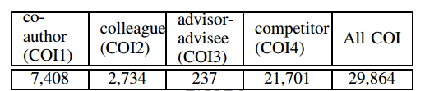
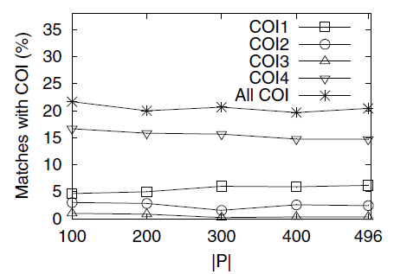
Empirical Study (2)
COIs study: Effects on fairness
Competitor > Co-author > Colleague > Advisor-advisee

Slide 16
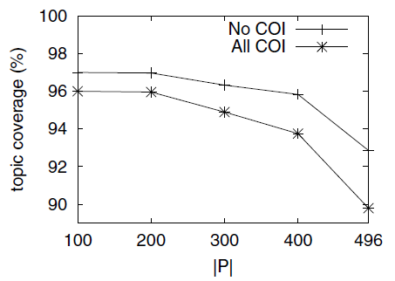
Empirical Study (2)
COIs study: Effects on goodness
COIs have no significant effects on the goodness of the paper-reviewer assignment.

