Slide 1
K-Hit Query: Top-k Query Processing with Probabilistic Utility Function
SIGMOD2015
Peng Peng, Raymond C.-W. Wong
CSE, HKUST
Notes:
Hi, everyone. I am Peng Peng from the Hong Kong University of Science and Technology.
Another author of the paper is my supervisor Raymond Wong.

Slide 2
Outline
1. Introduction
2. Contributions
3. Problem Definition
4. Algorithm k-Hit_Alg
  - Geometry Property
5. Experiment
6. Conclusion
Notes:
Here is the outline consisting of 6 parts and I will follow this order to give my presentation.
(8 seconds)

Slide 3

1. Introduction
An online car selling service place a car showroom in a prominent place of its webpage, where a very limited number of cars are shown.
How can we determine which
cars to be shown to the users?
Notes:
Consider an example of car selling.
An online car selling service will display some cars on a prominent place of its webpage.
However, only a very limit number of cars are shown.
So, as the owner of the webpage, how to determine which cars to be shown to the potential buyers?
(20 seconds)

Slide 4
1. Introduction
We expect to show “good” cars to the users.
Here, a "good" car means a car that a user would be interested in.
In the literature, we are given a utility function for the user. With this utility function, existing studies could find the best car that this user is interested in.
In this paper, we are given a distribution of users' utility functions (called probabilistic utility functions).
Notes:
Our goal is to present users with good cars, which they are interested in.
In the literature, each user is associated with a utility function which could help him or her make a decision.
In this paper, we are given a distribution of users’ utility functions which are called probabilistic utility functions.

Slide 5
1. Introduction
How to obtain the distribution?
  User log information
  Statistics from the users
The distribution has been used by existing systems/models
  User’s recommendation systems
  Bayesian Learning models
  User’s preference elicitations
The distribution on utility functions can be applied over not only a group of users but also a single user. This can help companies a lot for decision-making such as an effective promotion to a particular group of users.
Notes:
So how to obtain the distribution?
A general way is to obtain it from the user log information and also the statistics from the users.
Here, we list some existing problems considering the distribution of utility functions.
Other than a single user, the distribution can be also applied to describe the preference over a group of users.
(25s)

Slide 6
1. Introduction
Existing Approaches
  Top-k query
  Skyline query
Notes:
Traditionally, car selling problem we mentioned above is called “multi-criteria decision analysis”
In which we make a decision w.r.t. multiple conflicting criteria.
There exist two traditional queries for solving this problem.
They are the top-k query and the skyline query.

Slide 7
1. Introduction
Top-k queries and skyline queries have their own limitations.
  Top-k queries assume that the utility function of a single user is known. But, it is possible that the utility function of a single user is not known in some cases.
  Skyline queries may return too many outputs.
Notes:
However, both of them have defects.
For top-k queries, the utility function is assumed to be known, but in many cases the utility function is not accessible.
For skyline queries, even though no utility function is required as an input, the output size may be a huge number,
Which is useless for decision-making.
(25 seconds)

Slide 8
1. Introduction
Top-k queries
  Top-k queries on certain databases with certain utility functions (ICDE12, TKDE07)
  Top-k queries on uncertain databases with certain utility functions (ICDE07, SIGMOD08)
  Top-k queries on certain databases with uncertain utility functions (our work)
Other queries
  Skyline queries (ICDE01,SIGMOD06)
  K-Regret queries (VLDB10,SIGMOD12,ICDE14)
  Order-based skyline queries (SIGMOD10)
Notes:
Let me state some interesting queries in the literature.
Existing studies on Top-k queries can be divided into three big categories.
Our work belongs to the last category.
There are also other queries for solving the problem of multicriteria decision analysis.
However, the first tow did not consider the underlying distribution of the utility functions.
The third one is the most closely related work to our paper.
(30seconds)

Slide 9
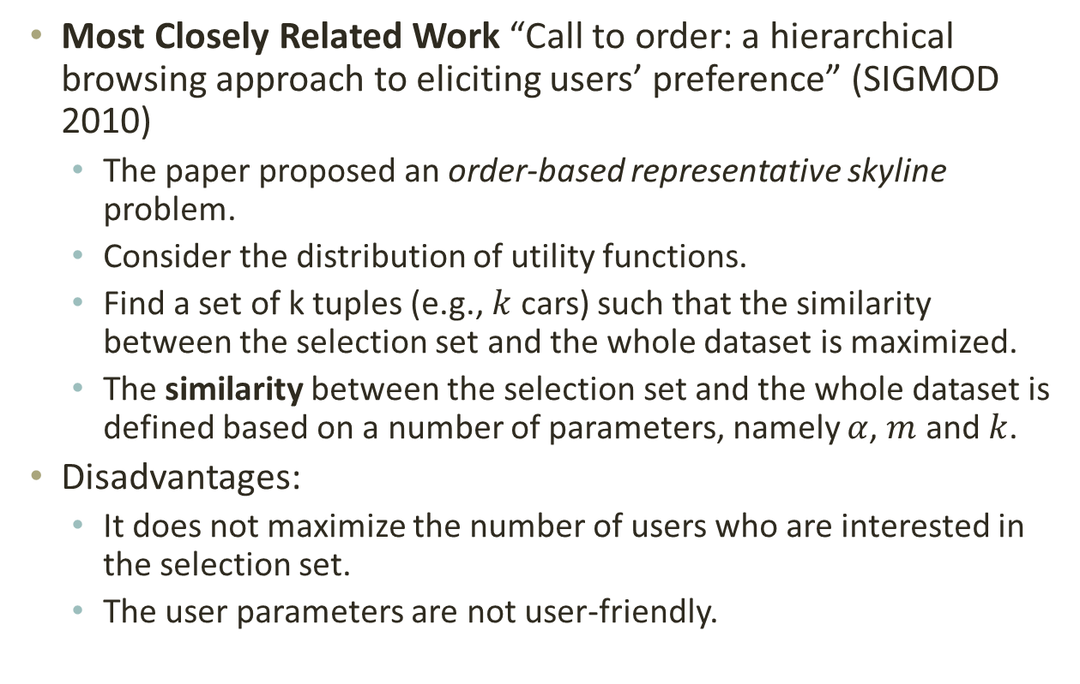
1. Introduction
Most Closely Related Work “Call to order: a hierarchical browsing approach to eliciting users’ preference” (SIGMOD 2010)
  The paper proposed an order-based representative skyline problem.
  Consider the distribution of utility functions.
  Find a set of k tuples (e.g., $k$ cars) such that the similarity between the selection set and the whole dataset is maximized.
  The similarity between the selection set and the whole dataset is defined based on a number of parameters, namely $α$, $m$ and $k$.
Disadvantages:
  It does not maximize the number of users who are interested in the selection set.
  The user parameters are not user-friendly.
Notes:
This paper proposed an order-based representative skyline problem.
However, it has two disadvantages. First, its definition is not straightforward. Second, the parameters are set without any guideline.

Slide 10
2. Contributions
We propose a novel k-hit query in the presence of the distribution of utility functions to maximize the number of users who are interested in the selection set.
We propose algorithms using geometry properties for answering the k-hit query.
Notes:
Here, we list the major contributions of our paper.
We propose a new k-hit query, incorporating user’s partial information as the query input.
We also explore the geometry properties of the k-hit query and propose algorithms using the geometry properties
To answer the k-hit query.
(25 seconds)

Slide 11
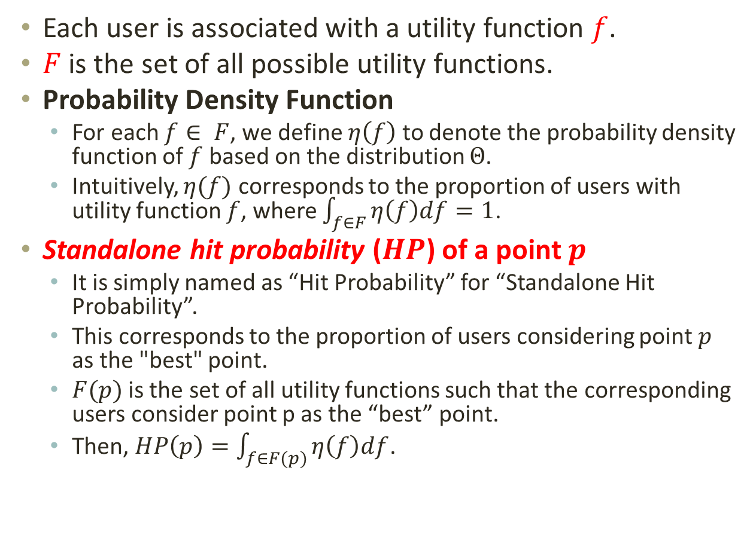
3. Problem Definition
Each user is associated with a utility function $f$.
$F$ is the set of all possible utility functions.
Probability Density Function
  For each $f∈ F$, we define $η\left(f\right)$to denote the probability density function of $f$ based on the distribution $Θ$.
  Intuitively, $η(f)$ corresponds to the proportion of users with utility function $f$, where $\int_{f∈F}{η\left(f\right)df}=1$.
Standalone hit probability ($HP$) of a point $p$
  It is simply named as “Hit Probability” for “Standalone Hit Probability”.
  This corresponds to the proportion of users considering point $p$ as the "best" point.
  $F(p)$is the set of all utility functions such that the corresponding users consider point p as the “best” point.
  Then, $HP\left(p\right)=\int_{f∈F(p)}{η\left(f\right)df}$.
Notes:
We know that each user is associated with a utility function f chosen from the utility function space capital F.
Here, we simply review the definition of a probability density function.
The density function denoted by eta f corresponds to the proportion of users with f.
We also know that the integration of eta f is 1 over the whole function space.
We define the probability that point p achieves the highest utility as the hitting probability, abbreviated as HP, of a point p.
It is equal to the integral of the density function eta on f which is selected from the set F(p).
Here, capital F p is the set of all utility functions such that the corresponding users considered p as the best point.
(70 seconds)

Slide 12
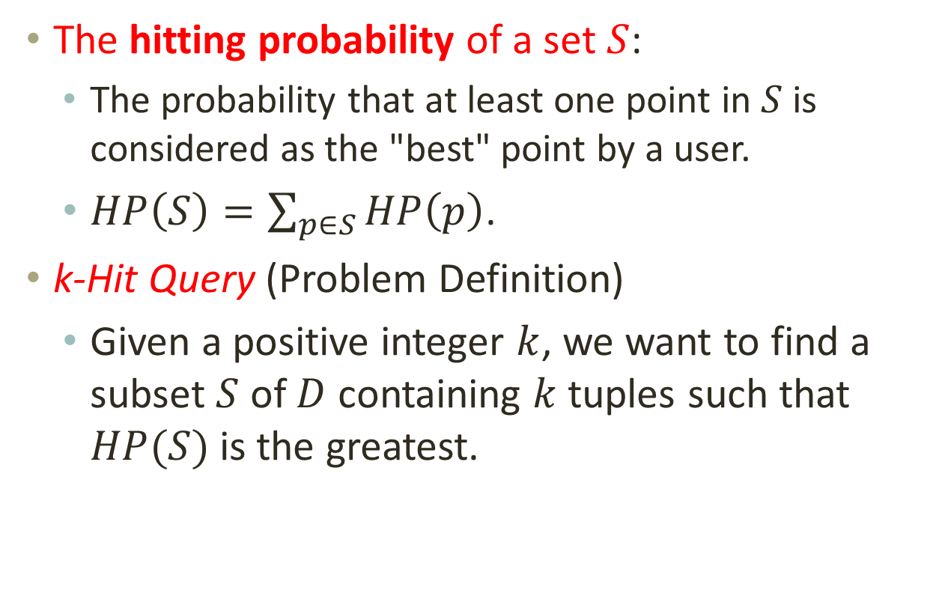
3. Problem Definition
The hitting probability of a set $S$:
  The probability that at least one point in $S$ is considered as the "best" point by a user.
  $HP\left(S\right)=\sum_{p∈S}{HP\left(p\right)}$.
k-Hit Query (Problem Definition)
  Given a positive integer $k$, we want to find a subset $S$ of $D$ containing $k$ tuples such that $HP(S)$is the greatest.
Notes:
Similarly, we define the hitting probability of a set S, which is simply the summation of the hitting probability of p
where p is selected from the set S.
Now, we give a formal definition of the k-hit query.
That is, given a positive integer k, we want to find a subset S of D containing k tuples such that
The hitting probability of the set S is the greatest.
(25 seconds)

Slide 13
3. Problem Definition
Different Settings:
  The form of a utility function
    Linear case
    Non-linear case
  The distribution of utility functions
    Uniform distribution
    Non-uniform distribution
f = 2x[1] + 3x[2] + x[3]
    (with geometry properties)
Notes:
There are various settings for our problem.
We can study the problem based on either the linear or the non-linear case.
Also, the distribution of utility functions can be either uniform or non-uniform.
In the presentation, we focus on the linear case, which introduced the geometry properties.
(25 seconds)

Slide 14










4. Algorithm k-Hit_Alg - Geometry Property
  Let $Conv(D)$be the convex hull constructed by the tuples in $D$ and their projections on the axis.
  Let $surf(Conv\left(D\right))$ be the set of tuples on the surface of $Conv(D)$.
$$p_{5}$$
$$BP_{1}$$
$$p_{1}$$
$$p_{4}$$
$$p_{2}$$
$$p_{3}$$
$$p_{6}$$
$$O$$
$$BP_{2}$$
Notes:
We use this notation to denote the set of points on the surface of the convex hull of D.
Here, we introduce a lemma which shows that
If the selection set S contains all the points on the surface of the convex hull of D,
The hitting probability of S is equal to 1.
(25 seconds)

Slide 15
4. Algorithm k-Hit_Alg - Geometry Property
We use the concept of “solid angle” used in the computational geometry to compute the hitting probability of a point.
Solid angle is a measure of how large the object appears to an observer looking from that point.
Notes:
We use the concept of “solid angle” to compute the hitting probability of a point.
The physical meaning of solid angle is a measure of how large the object appears to an observer looking from that point.
(20 seconds)

Slide 16







An Example in 2-d
Convex Cone:
  An unbounded convex cone in a 2-dimensional space $Cone(\{v_{1},v_{2}\})$.
  $B_{2}$ denotes a 2-dimensional hypersphere
$$v_{1}$$
$$v_{2}$$
$$Cone(\{v_{1},v_{2}\})$$
$B_{2}$: 2-dimensional hypersphere
$$O$$
$$r=1$$
Notes:
In the 2-D example shown below, the shadow area corresponds to the convex cone
Supported by two vectors v1 and v2.
(10 seconds)

Slide 17


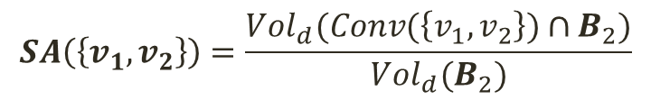




An Example in 2-d
Solid Angle:
  Solid angle of a convex cone $C$ (denoted by $SA(C)$) is defined to be the volume of the convex cone $C$ (i.e., the red shadow area where $C=Cone(\left\{v_{1},v_{2}\right\})$).
$$Cone(\{v_{1},v_{2}\})$$
$$v_{1}$$
$$v_{2}$$
$$B_{2}$$
$$O$$
$$r=1$$
$$SA\left(\left\{v_{1},v_{2}\right\}\right)=\frac{Vol_{d}(Conv(\left\{v_{1},v_{2}\right\})∩B_{2})}{Vol_{d}(B_{2})}$$
Notes:
In the 2-D example shown in this page,
The solid angle of the convex cone with the vectors v_1 and v_2 is the red shadow area.
(13 seconds)
Quadrant I, octant I, orthant I.

Slide 18
4. Algorithm k-Hit_Alg - Geometry Property
We have just given a formal definition of the solid angle.
Next, we will present our new concept called “hitting solid angle”, one component of our problem.
After that, we will give the relationship between the solid angle and the hitting solid angle.
Notes:
Let me straighten out the clues in my later presentation.
We have just given the definition of solid angle.
Next, we introduce the concept called hitting solid angle.
Afterwards, we show the relationship between the solid angle and the hitting solid angle.
(20 seconds)

Slide 19











4. Algorithm k-Hit_Alg - Geometry Property
Drawing a perpendicular vector, namely a hitting vector, from the origin $O$ to each facet of $Conv(D)$.
There are 4 points on the surface of the convex hull in the example. The whole data space is divided into $4$ partitions, each of which is the cone of a point on the surface of the convex hull.
$$p_{5}$$
$${cone of p}_{5}$$
$$p_{1}$$
$${cone of p}_{1}$$
$${cone of p}_{2}$$
$$p_{2}$$
$${cone of p}_{6}$$
$$p_{6}$$
$$O$$
$$O$$
Notes:
Now, let us draw perpendicular vectors, namely hitting vectors, from the origin to the facets.
Let R be the number of points on the surface of the convex hull.
A crucial observation is the whole data space is divided into R partitions,
Each of which is the cone of a tuple, which is one at the surface of the convex cone.
(30 seconds)

Slide 20












4. Algorithm k-Hit_Alg - Geometry Property
Hitting solid angle
  In the example, $HitVector\left(p_{5}\right)=\{v_{1},v_{2}\}$.
  We define “the cone of $p_{5}$” to be $Cone(\left\{v_{1},v_{2}\right\})$.
  Given a tuple $p∈Surf\left(Conv\left(D\right)\right)$, the hitting solid angle for $p$ is defined to be the solid angle of the cone $C_{p}$ of $p$(i.e., $SA(C_{p})$).
$$p_{5}$$
$${cone of p}_{5}$$
$$v_{1}$$
$$p_{1}$$
$${cone of p}_{1}$$
$$v_{2}$$
$${cone of p}_{2}$$
$$p_{2}$$
$${cone of p}_{6}$$
$$p_{6}$$
$$O$$
$$O$$
Notes:
Let $HitVector(p)$ be the hitting vectors who are perpendicular to the facets incident to $p$.
We define the cone of $p$ to be $Conv(HitVector(p))$.
Given a tuple $p∈Surf\left(Conv\left(D\right)\right)$, the hitting solid angle for p is defined to be $SA(HitVector(p))$.
(35 seconds)
"when we compute the hitting solid angle for p in our algorithm to be described next, we will first find the cone of p and then will compute the solid angle of this cone

Slide 21
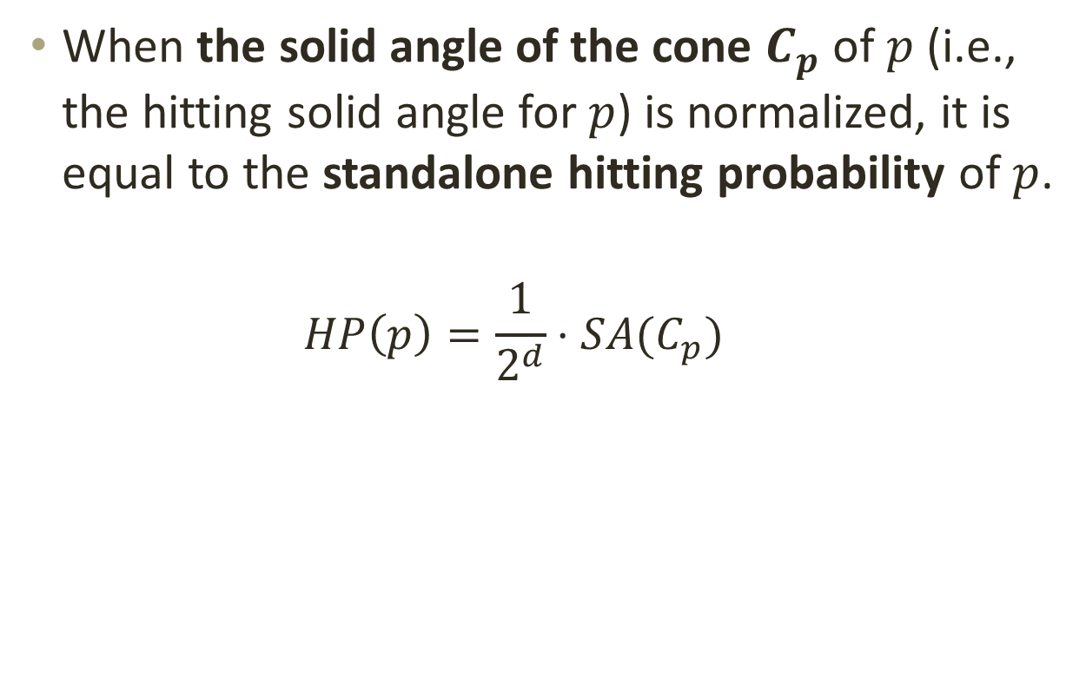
4. Algorithm k-Hit_Alg - Geometry Property
When the solid angle of the cone $C_{p}$ of $p$ (i.e., the hitting solid angle for $p$) is normalized, it is equal to the standalone hitting probability of $p$.
  $$HP\left(p\right)=\frac{1}{2^{d}}⋅SA(C_{p})$$
Notes:
Therefore, we conclude that when the solid angle for p is normalized, it is equal to the standalone hitting probability of p.
(15s)

Slide 22
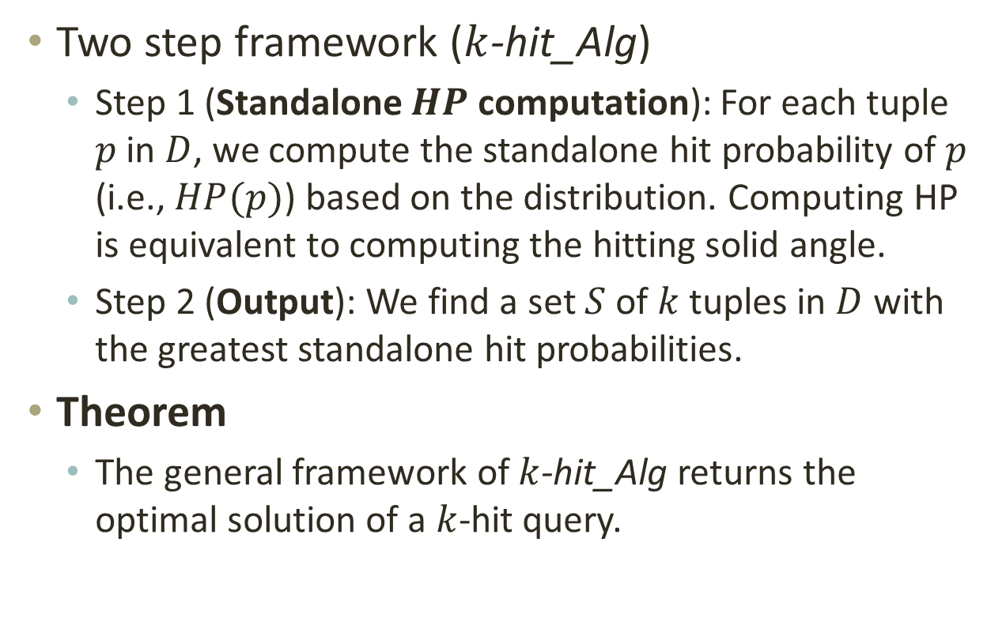

4. Algorithm k-Hit_Alg - Geometry Property
Two step framework ($k$-hit_Alg)
  Step 1 (Standalone $HP$ computation): For each tuple $p$ in $D$, we compute the standalone hit probability of $p$ (i.e., $HP(p)$) based on the distribution. Computing HP is equivalent to computing the hitting solid angle.
  Step 2 (Output): We find a set $S$ of $k$ tuples in $D$ with the greatest standalone hit probabilities.
Theorem
  The general framework of $k$-hit_Alg returns the optimal solution of a $k$-hit query.
Standalone $HP$ computation
Notes:
Our algorithm is simply a two-step framework, where the first step is for the standalone HP computation,
And the second step is to return the output based on the results computed in the first step.
Theorem 1 states that the general framework of our algorithm returns the optimal solution of a k-hit query.
(20s)

Slide 23
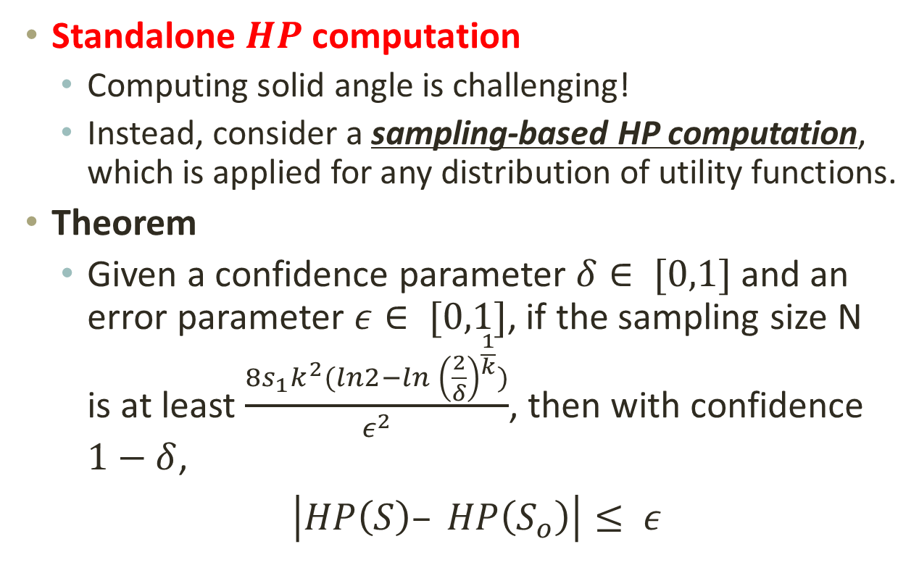
4. Algorithm k-Hit_Alg - Geometry Property
Standalone $HP$ computation
  Computing solid angle is challenging!
  Instead, consider a sampling-based HP computation, which is applied for any distribution of utility functions.
Theorem
  Given a confidence parameter $δ∈ [0,1]$ and an error parameter $ε∈ [0,1]$, if the sampling size N is at least $\frac{8s_{1}k^{2}(ln2−ln {\left(\frac{2}{δ}\right)}^{\frac{1}{k}})}{ε^{2}}$, then with confidence $1−δ$,
  $\left|HP\left(S\right)– HP\left(S_{o}\right)\right|≤ ε$
Notes:
Let us focus on the HP computation in the following.
Since computing solid angle is inefficient when the corresponding convex cone is irregular,
We instead consider a sampling-based HP computation, which could be applied for any distribution of utility functions.
The theorem shown below states the accuracy guarantee on the difference between the hitting probability of the set based on the sampling strategy and the hitting probability of the optimal set.
Here, s1 is the maximum hitting probability of a single point in D.

Slide 24
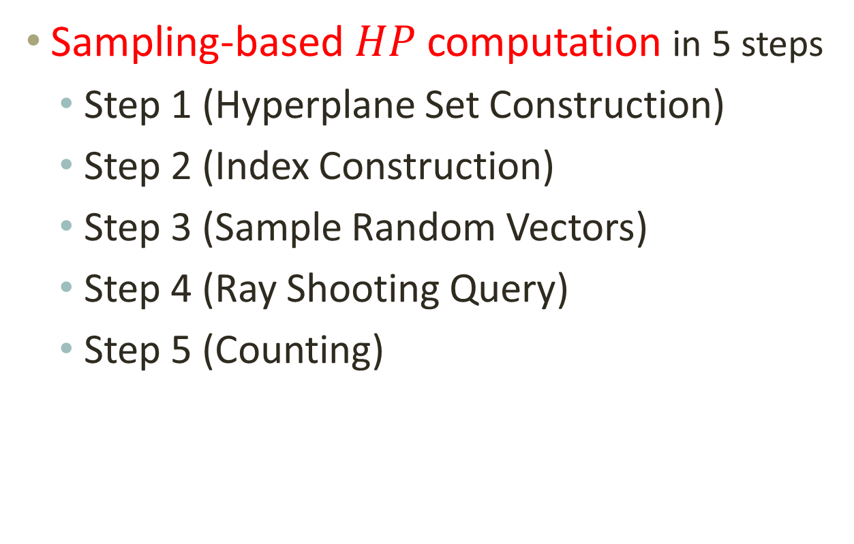
4. Algorithm k-Hit_Alg - Geometry Property
Sampling-based $HP$ computation in 5 steps
  Step 1 (Hyperplane Set Construction)
  Step 2 (Index Construction)
  Step 3 (Sample Random Vectors)
  Step 4 (Ray Shooting Query)
  Step 5 (Counting)
Notes:
Because the limit of time, we simply give an overview of the sampling-based HP computation, which comprises three steps.
In the first step, we construct the set of hyperplanes on the data set.
In the second step, we build an indexing structure on the set of hyperplanes.
Lastly, we leveraged the ray shooting query to compute the solid angles and
Then return k points whose corresponding solid angles have the k largest volumes.
(35 seconds)

Slide 25
5. Experiment
Datasets
    Household dataset (6d): n = 903077, d = 6
    Household dataset (10d): n = 1103241, d = 10
    NBA dataset: n = 21962, d = 5
    Color dataset: n = 68040, d = 9
    Stocks dataset: n = 122574, d = 5
Notes:
In the experimental part, we conducted experiments on five real datasets.
Here are the statistics of the datasets.
In the following, we simple show the results on the NBA dataset as an example.
(15 seconds)

Slide 26
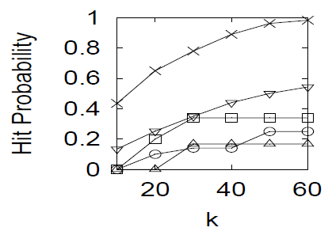
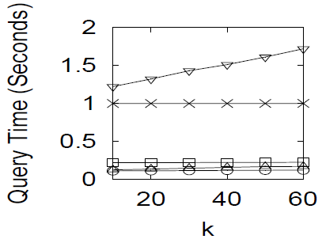
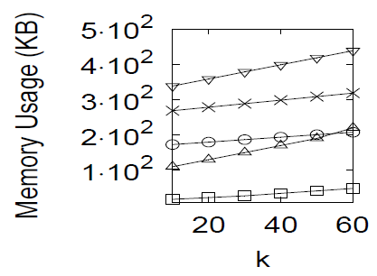

Experiments on “NBA” dataset
Effect of $k$ on Hit Probability/Query Time/Memory Usage
For the NBA dataset, k-hit_Alg gives the greatest hitting probability with a reasonable query time (within 1 second), using memory of a reasonable size (within 400 KB).
Notes:
Here, we show the effect of k on three evaluations, i.e., the hit probability, the query time and the memory usage.
The results showed that our proposed algorithm
gives the greatest hitting probability with a reasonable query time, using memory of a reasonable size.
(25 seconds)

Slide 27
6. Conclusion
We proposed a k-hit query, which returns a set of k tuples such that the probability that one of the k tuples is considered as the “best” tuple by a user is maximized.
We proposed an algorithm called k-hit_Alg for answering the k-hit query.
Notes:
Finally, let me conclude this paper.
In the paper, we proposed a k-hit query, which returns a set of k tuples such that the probability
That one of the k tuples is considered as the “best” tuple by a user is maximized.
We also proposed algorithms for solving this problem.
(20 seconds)

Slide 28
THANK YOU!
ANY QUESTIONS?
Notes:
So, that is all for my presentation. Thank you very much.
(10 seconds)

