Slide 1
Exact Top-k Nearest Keyword Search in Large Networks
Minhao Jiang†, Ada Wai-Chee Fu‡, Raymond Chi-Wing Wong†
† The Hong Kong University of Science and Technology, ‡ The Chinese University of Hong Kong
Prepared by Minhao Jiang
Presented by Minhao Jiang

Slide 2

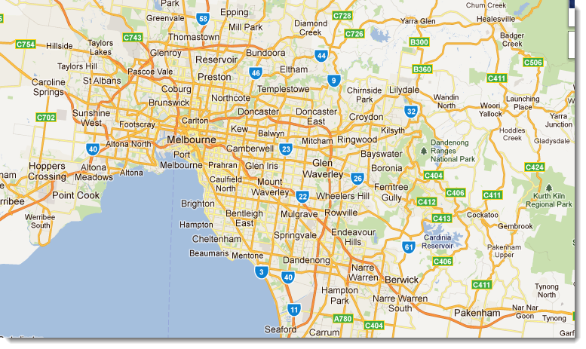
Motivation
Social network :
In DBLP, who are the researchers that study “database” and are closely related to my supervisor?
Road network:
In Melbourne, where are the nearest cinemas from my hotel showing “3D” movies?

Slide 3
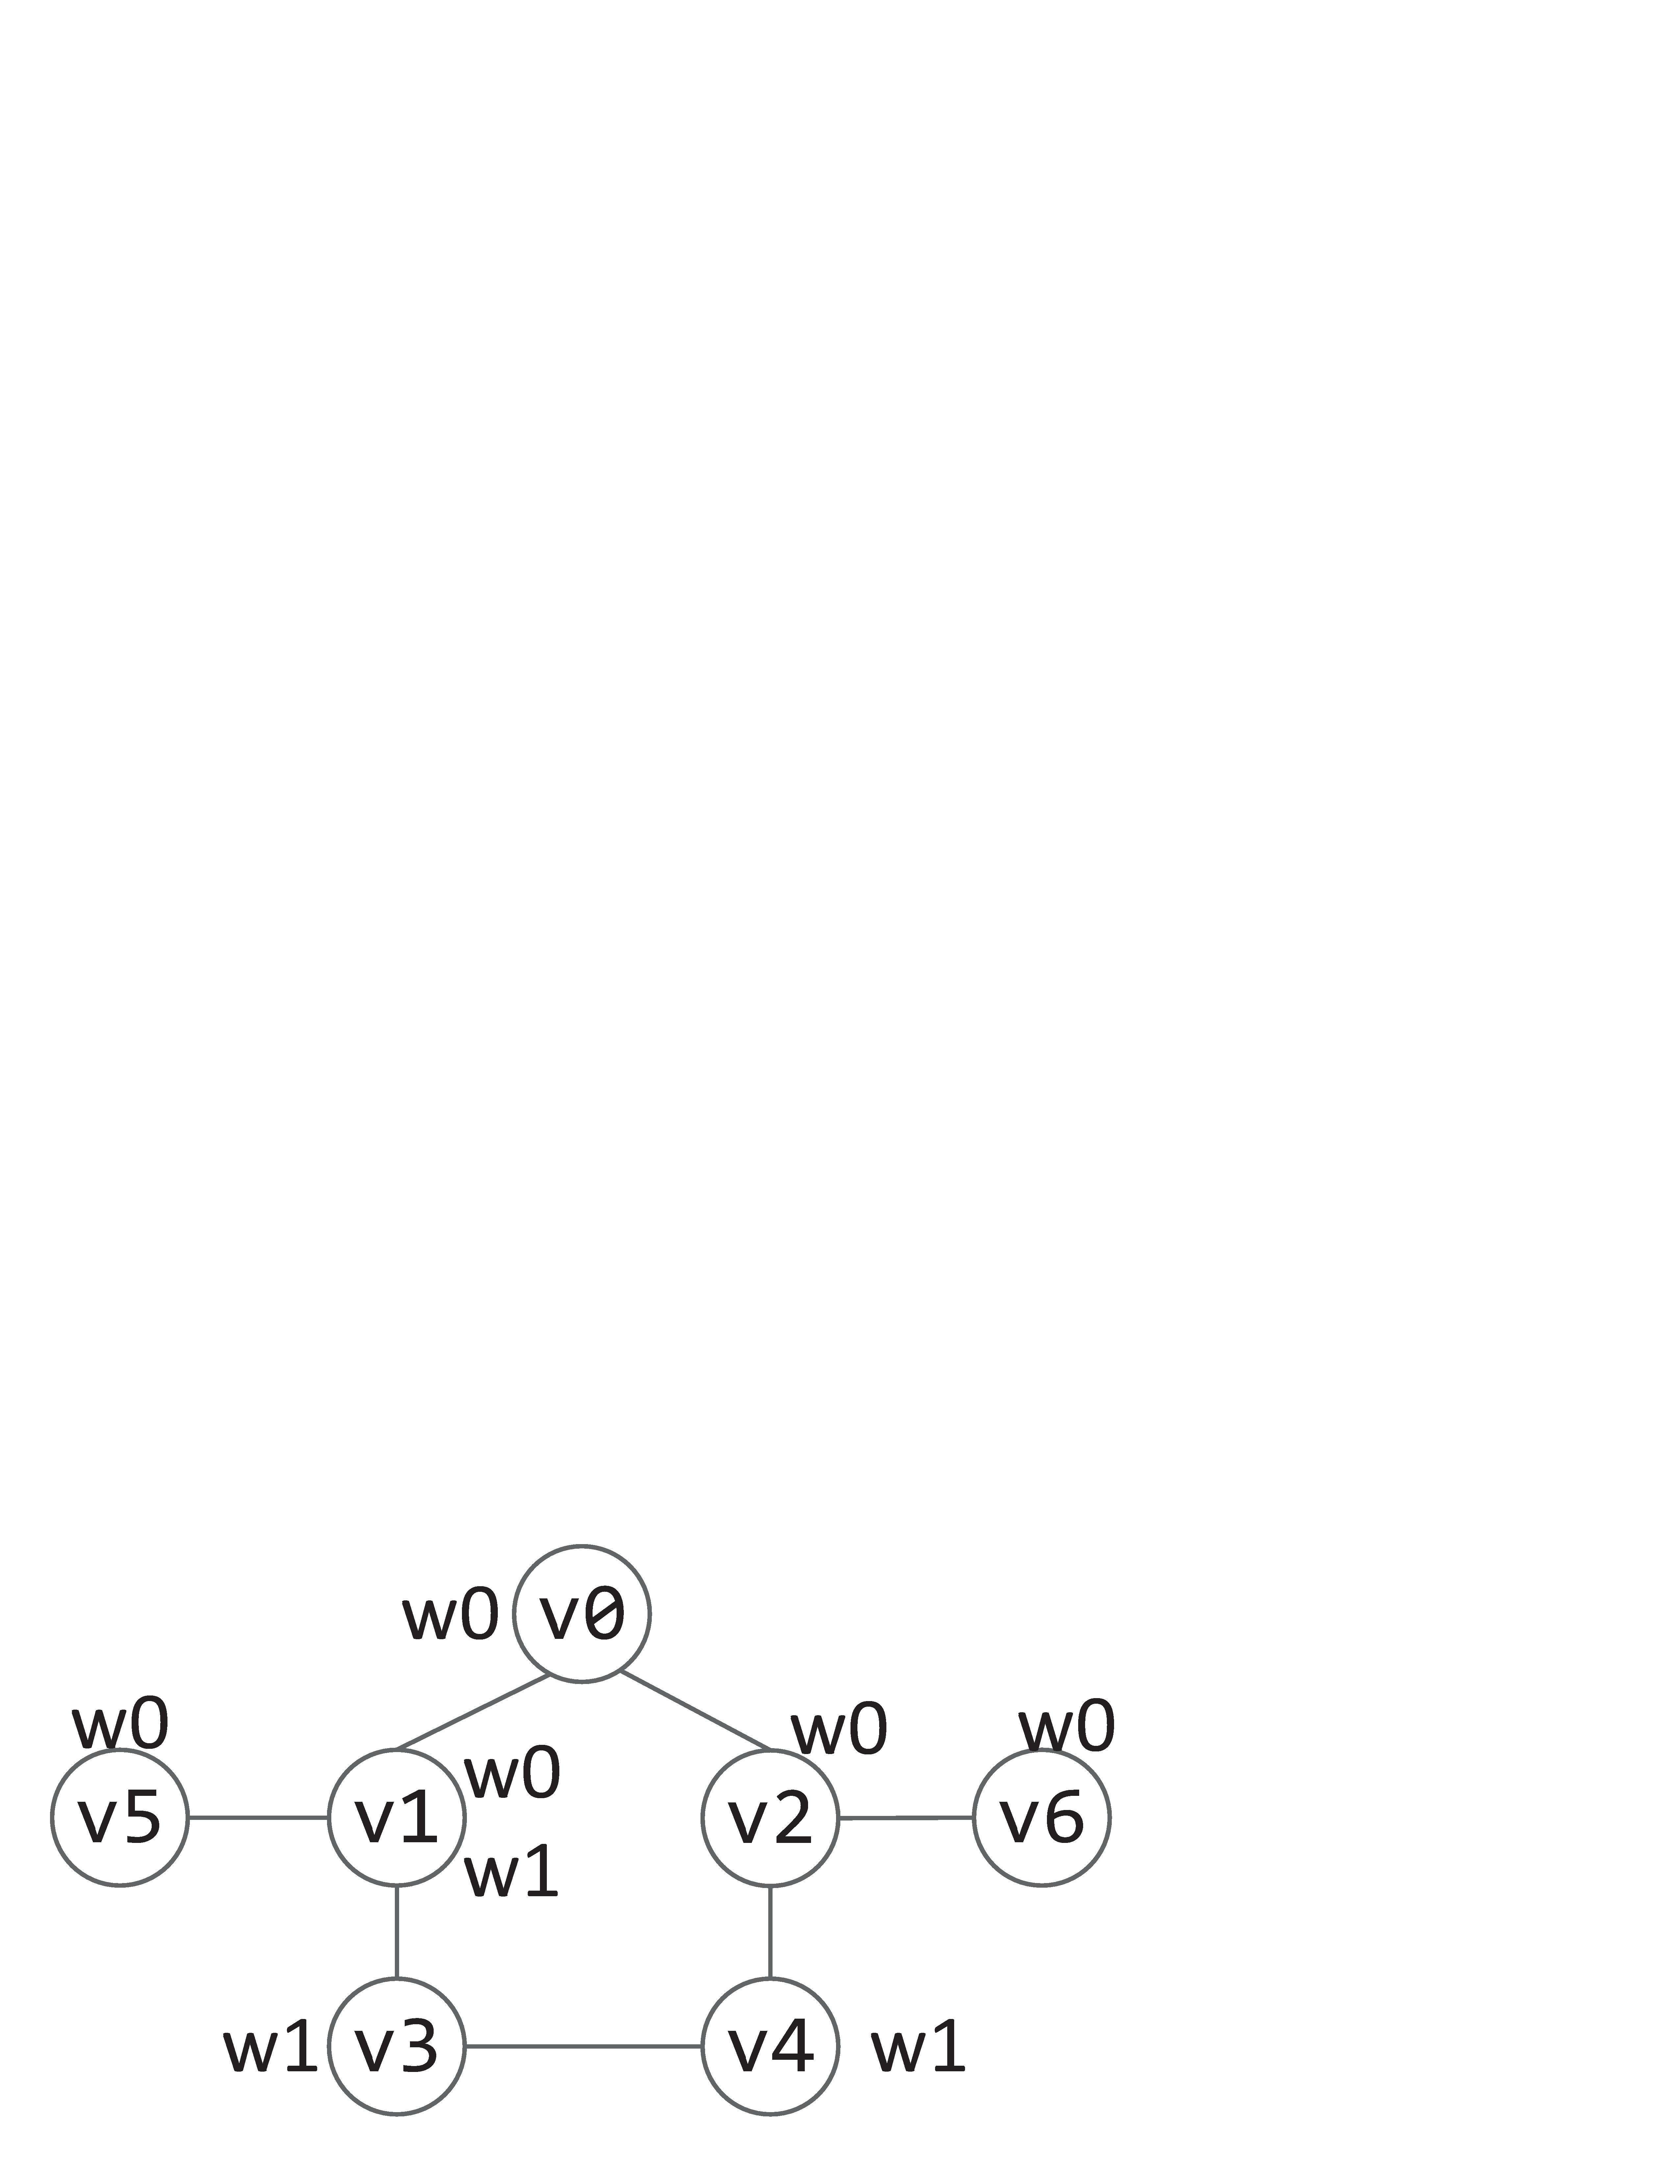
Problem
Given a weighted undirected graph G(V, E), where each vertex contains a set of keywords,
k-Nearest Keyword Search:
k-NK(q,w,k) -- what are the k nearest vertices from vertex q that contain keyword w?
e.g.
k-NK(v2, w0, 3) = {v2, v0, v6}
an undirected graph with unit weighted edges

Slide 4
Outline
1. Existing Algorithms
2. Our Algorithm
3. Experiments
4. Conclusion

Slide 5
1.1 Naive Algorithm
Dijkstra-like search : too slow
k-NK(v2, w0, 3) = {v2, v0, v6}
Optimal Solution

Slide 6
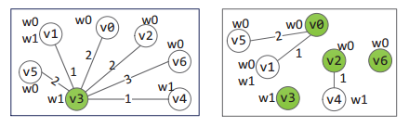
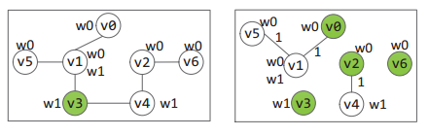
1.2 Existing Index-based Algorithms
All existing index-based algorithms : efficient, but cannot return the optimal solution.
1. PMI algorithm (WWW’ 12) creates the following index.
k-NK_{PMI}(v2, w0, 3)={v2, v1, v0}, which is not correct.
2. pivot algorithm (VLDB’ 13) creates the following index.
k-NK(v2, w0, 3) = {v2, v0, v6}
Optimal Solution
k-NK_{pivot}(v2, w0, 3)={v2, v6, v1}, which is not correct.

Slide 7
2. Our Algorithm
the first index-based exact algorithm which is also efficient
two-hop labeling index
(state-of-the-art distance querying technique [SODA 02, VLDB 13,14, SIGMOD 12,13])
+
keyword-aware index
(proposed in this paper)

Slide 8
2.1 Background Knowledge:
Two-hop Labeling Index
1. a label set L(v) : {(v→x1, d1), (v→x2, d2), (v→x3, d3)… }
2. any dist(u,v) = min (d1 + d2), where (v→x, d1) ∈ L(v) and (u→x, d2) ∈ L(u)
e.g.
L(v1) = {(v1→v0, 1), (v1→v1, 0)},
L(v6) = {(v6→v0, 2), (v6→v2, 1), (v6→v6, 0)}
dist(v1,v6) = 1 + 2
(by a linear scan on each of L(v1) and L(v6))

Slide 9
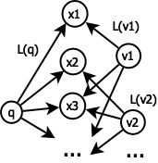
2.2 Forward Search(FS) Component
Step 1: For each vertex vi containing the query keyword w, we find dist(q, vi)
Step 2: Maintain k nearest vi to q
Efficient when w is infrequent

Slide 10
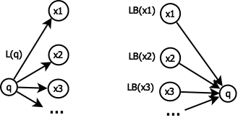
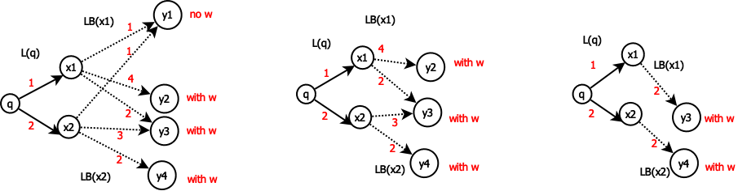
2.3 Forward Backward Search(FBS) Component
(q→xi, di) ∈ L(q) ➔ (xi→q, di) ∈ LB(xi)
Step 1: scan (q→xi, di) in L(q)
Step 2: for each xi
(a). scan (xi→yij, dij) in LB(xi)
(b). find k shortest (xi → yij, dij) such that yij contains w
(c). maintain the best-known answers
Efficient when w is frequent
➔
➔
by KT index
priority queue

Slide 11
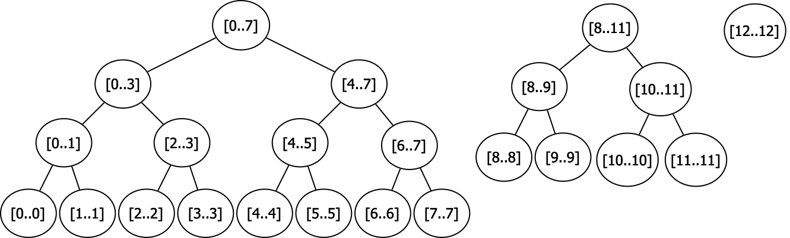
2.3 KT index
Step 2(b): for each xi, find k shortest
(xi → yij, dij) in LB(xi) such that yij contains w.
Naive method: O(|LB(xi)|) : a linear scan
KT index: O( klog(|LB(xi)|/k) ) :
(1). sort (xi → yij, dij) by dij, and build a binary tree forest
(2). index the keywords of all yij components in all entries in LB(xi) by the hash value (stored in each tree node)
e.g. when LB(xi) = {(xi→y0, d0), …, (xi→y12, d12)}
by KT index

Slide 12
2.4 FS-FBS Algorithm
Combine FS and FBS:
1. If the query keyword is frequent,
- use the FBS method.
2. If the query keyword is not frequent,
- use the FS method.

Slide 13
2.5 Extension
Disk-based setting
Multiple keyword query
Dynamic update

Slide 14
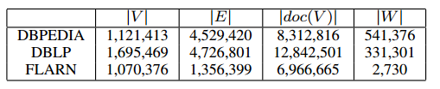
3. Experiments
Datasets: millions of vertices

Slide 15
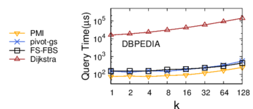
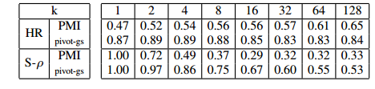
3.1 Querying Efficiency
PMI: WWW’12 index-based algorithm
pivot-gs: VLDB’13 index-based algorithm
FS-FBS: our exact algorithm
Dijkstra: naive exact algorithm
HR(hit rate): % of reported vertices that are
in the optimal solution.
S-ρ(spearman’s rho): correlation between the
reported ranking and the optimal ranking.
Existing index-based algorithms are inaccurate
Our exact algorithm is as efficient as existing index-based algorithms
value = 1.00 → Output is the optimal solution

Slide 16
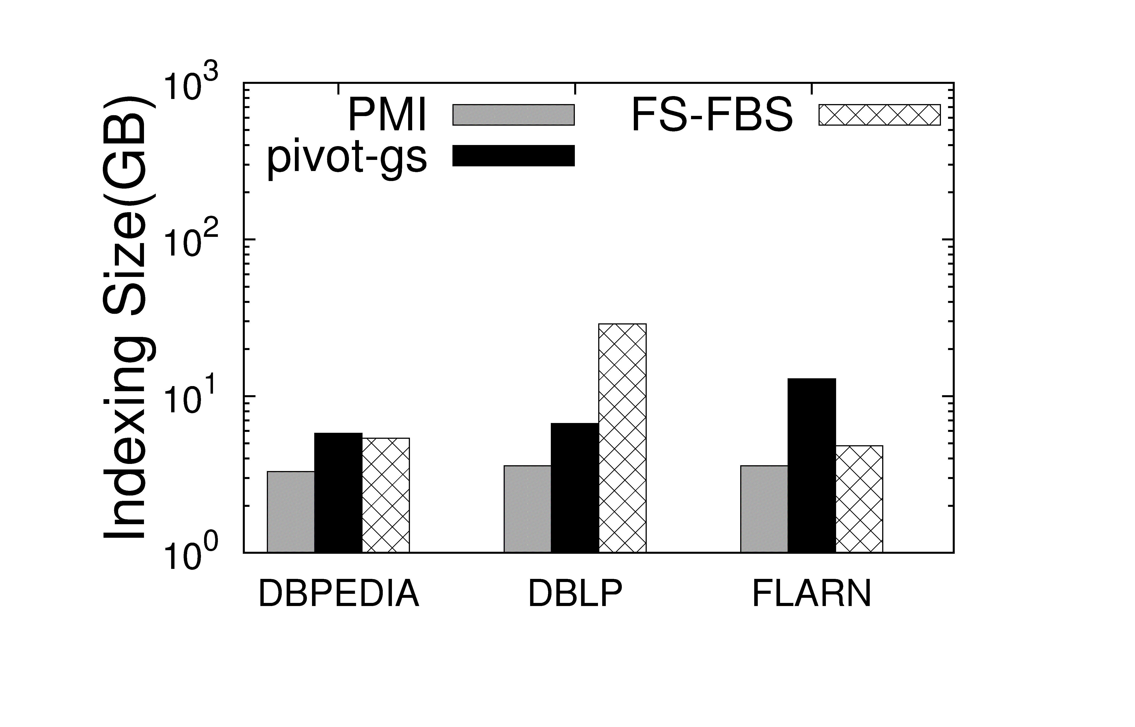
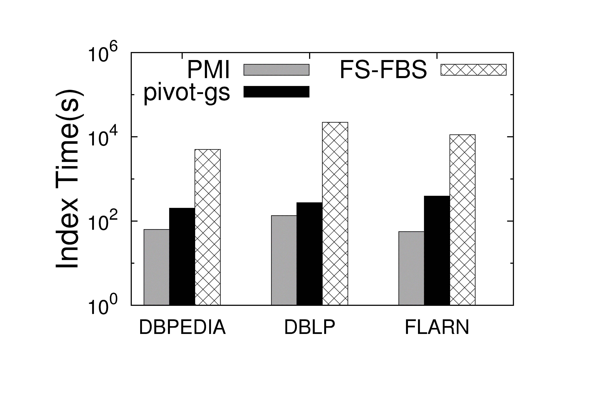
3.2 Indexing Cost
Index Size: comparable with existing index-based algorithms
Indexing Time: acceptable

Slide 17
4. Conclusion
Our method can handle k-NK queries in large networks.
We propose the first index-based algorithm returning the optimal solution.
Our method is as efficient as the best-known index-based algorithms (returning non-optimal answers).

Slide 18
END

Slide 19
2.3 Forward Backward Search(FBS) Algorithm
How to obtain k shortest (xi → yij, dij) in LB(xi) such that yij contains w ?
Sort (xi → yij, dij) by non-ascending dij in each LB(xi)
k shortest (xi → yij, dij) with yij containing w are at the end of LB(x)
2. Hierarchy:
e.g. when LB(x) = {(x→y0, d0), …, (x→y12, d12)}
Project keyword to hash value :
e.g. h(w) = 00010000
h[8..11] = h(w1) bitwiseOR h(w2) bitwiseOR h(w3)…… where wi is in y8, y9, y10 or y11,
if h[8..11] bitwiseAND h(w) = 0, w is not contained in y8, y9, y10 and y1, we check h[0..7], otherwise, we check h[10..11]

Slide 20
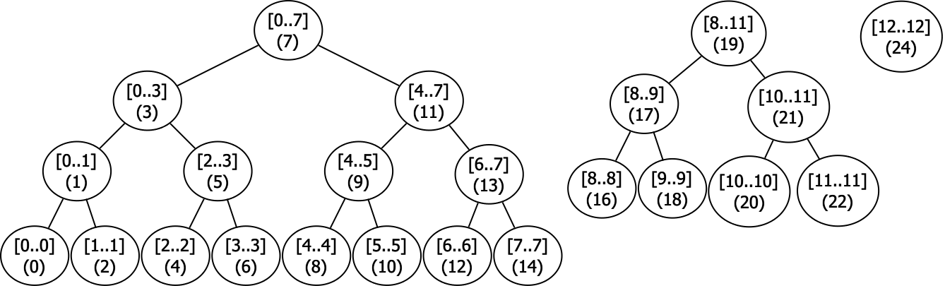
2.3 Forward Backward Search(FBS) Algorithm
How to obtain k shortest (xi → yij, dij) in LB(xi) such that yij contains w ?
Sort (xi → yij, dij) by non-ascending dij
Hierarchy
Store hierarchy in array:
e.g. [8..11] is in a[19] → compact storage without loss of efficiency in searching
One FBS time complexity :
where |L| is the size of the 2-hop index, |doc(V)| is the total number of keywords in the graph

Slide 21
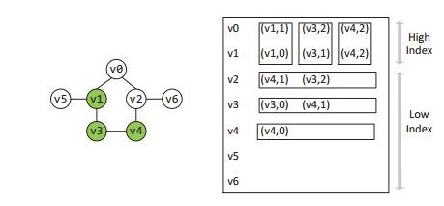
2.5 Adapt to Disk-based Setting
Keyword w related backward index for each w : LB → Lw
Partition each Lw into high index and low index
e.g. when w is contained in v1, v3 and v4

Slide 22
2.5 Adapt to Multiple Keywords Query
Trivial in FS
Same hierarchy in FBS
3. Modify recursive search by
Disjunctive/OR: if h[8..11] bitwiseAND (h(w1) bitwiseOR h(w2) …) = 0, w is not contained in y8, y9, y10 and y1, we check h[0..7], otherwise, we check h[10..11]
Conjunctive/AND: if h[8..11] bitwiseAND (h(w1) bitwiseOR h(w2) …) < h[8..11], w is not contained in y8, y9, y10 and y1, we check h[0..7], otherwise, we check h[10..11]

Slide 23
2.5 Adapt to Dynamic Update
Keyword Update Trivial in FS
Keyword Update hierarchy in FBS:
When keyword w is inserted into / removed from vertex v, each LB(u) that contains (u→v, d) should update its hierarchy by reconstructing the hash value from root to v
Structure Update:
3.1 Update 2-hop by existing algorithms
3.2 Update keyword-related information accordingly

