Slide 1

Efficient k-Regret Query Algorithm with Restriction-free Bound for any Dimensionality
XIE Min, The Hong Kong Univ. of Sci. and Tech.
Raymond Chi-Wing Wong, The Hong Kong Univ. of Sci. and Tech
Jian Li, Tsinghua University
Cheng Long, Queen’s University Belfast
Ashwin Lall, Denison University

Slide 2
Outline
Introduction
Problem Definition
Algorithm
Experiment
Conclusion

Slide 3
Outline
Introduction
Problem Definition
Algorithm
Experiment
Conclusion

Slide 4
Motivating Example
Background:
  A database system usually contains millions of tuples nowadays and an end user may be interested in only some of them
  It is convenient if the database system can provide some operators for an end user to obtain the tuples he is interested in
  Multi-criteria Decision Making
Scenario:
  Assume that a car is characterized by two attributes, namely horse power (HP) and miles per gallon (MPG)
  Alice visits a large car database and wants to buy a car with high HP and high MPG

Slide 5
A Possible Solution
A possible solution: Some representative cars are selected based on some criteria (e.g., cars favored by Alice) and are shown to Alice
In order to decide which car to show, we assume
  Alice has a preference function, called a utility function, in her mind
  Based on this utility function, each car in the database has a utility
  A high utility means that this car is favored by Alice

Slide 6
Goals in Multi-criteria Decision Making
Two goals in multi-criteria decision making:
  Low User Efforts: we do not require a user to specific his utility, which might be unknown in advance
  Controllable output size: it is meaningless if the user is overwhelmed by millions of tuples
Traditional queries:
  The top-k query
  The skyline query

Slide 7
Traditional Queries
The top-k query:
  Assume that the utility function is given
  The k tuples with the highest utilities are returned
The skyline query:
  Does not ask a user for any utility function
  Dominance: p dominates q if and only if p is not worse than q on each attribute and p is better than q on at least one attribute
  Tuples which are not dominated by any other tuples in the database are returned

Slide 8
The k-Regret Query
 | Low User Effort | Controllable Output Size
The top-k query | ✗ | ✓
The skyline query | ✓ | ✗
The k-regret query | ✓ (Do not require utility functions) | ✓ (Only k tuples are returned)
Consider a particular user. It is very likely the there is a difference between the highest utility over all tuples in the database and the highest utility over the selected k tuples
Consider all users. The greatest regret ratio (over all users) is called the Maximum Regret Ratio
A k-regret query is to select a set of k tuples such that the maximum regret ratio of the set is minimized
Regret Ratio

Slide 9
The k-Regret Query (Intuition)
It quantifies how regretful a user is if s/he gets the best tuple among the selected k tuples but not the best tuple among all tuples in the database
Consider our car database application
  Different users have different preferences in their minds
  A k-regret query on the car database returns a set of k cars, minimizing the “regret” level for all users
  No matter what preference the user has, there is a car in the selected set which is favored by the user in a great extent

Slide 10
Outline
Introduction
Problem Definition
Algorithm
Experiment
Conclusion

Slide 11
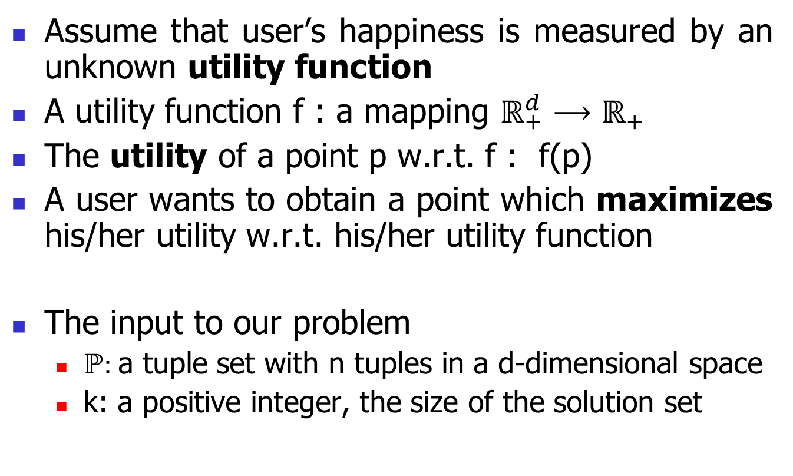
Preliminary
Assume that user’s happiness is measured by an unknown utility function
A utility function f : a mapping $ℝ_{+}^{d}⟶ℝ_{+}$
The utility of a point p w.r.t. f : f(p)
A user wants to obtain a point which maximizes his/her utility w.r.t. his/her utility function
The input to our problem
  ℙ: a tuple set with n tuples in a d-dimensional space
  k: a positive integer, the size of the solution set

Slide 12
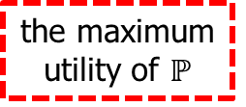
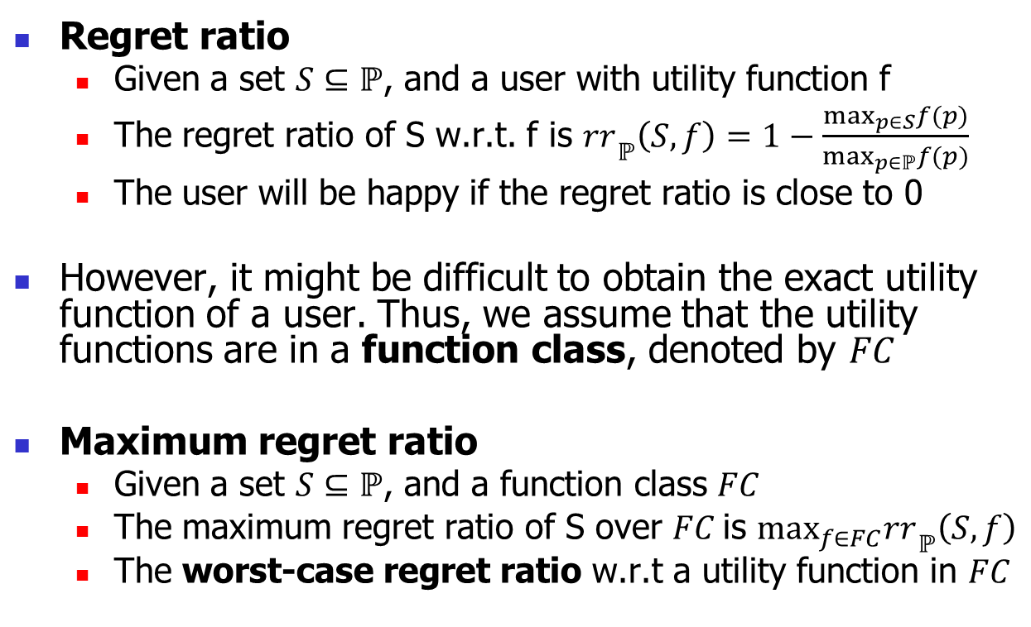
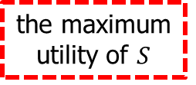
Preliminary (cont.)
Regret ratio
  Given a set $S⊆ℙ$, and a user with utility function f
  The regret ratio of S w.r.t. f is $r{r_{ }}_{ℙ}\left(S, f\right)=1−\frac{\max_{p∈S}f(p)}{\max_{p∈ℙ}f(p)}$
  The user will be happy if the regret ratio is close to 0
However, it might be difficult to obtain the exact utility function of a user. Thus, we assume that the utility functions are in a function class, denoted by $FC$
Maximum regret ratio
  Given a set $S⊆ℙ$, and a function class $FC$
  The maximum regret ratio of S over $FC$is $\max_{f∈FC}r{r_{ }}_{ℙ}\left(S, f\right)$
  The worst-case regret ratio w.r.t a utility function in $FC$
the maximum utility of $S$
the maximum utility of $ℙ$

Slide 13
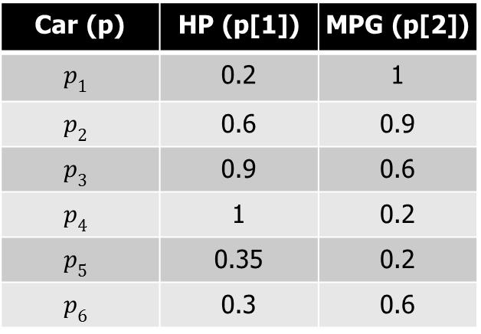
Running Example
The car database ℙ consists of 6 tuples.
MPG
Car (p) | HP (p[1]) | MPG (p[2])
$$p_{1}$$ | 0.2 | 1
$$p_{2}$$ | 0.6 | 0.9
$$p_{3}$$ | 0.9 | 0.6
$$p_{4}$$ | 1 | 0.2
$$p_{5}$$ | 0.35 | 0.2
$$p_{6}$$ | 0.3 | 0.6
p₁
p₂
p₃
p₆
p₄
p₅
O
HP

Slide 14
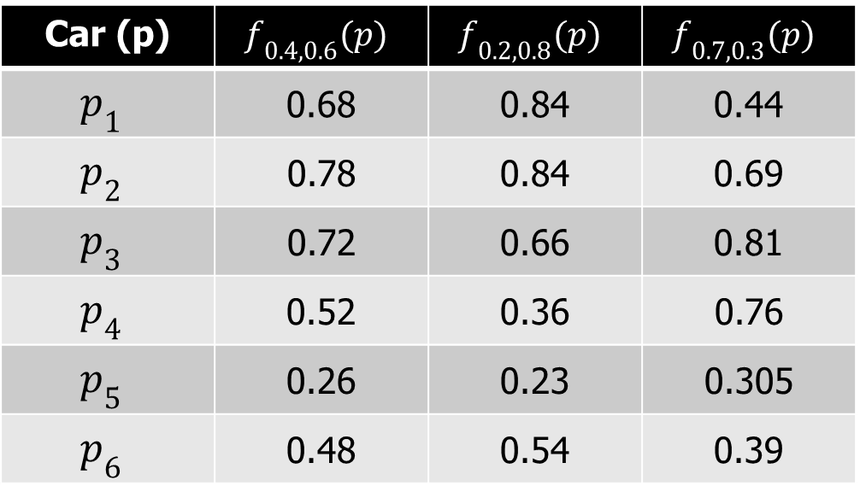

Running Example (cont.)
Assume that $FC=\left\{f_{0.4,0.6},f_{0.2,0.8},f_{0.7,0.3}\right\}$ where $f_{a,b}\left(p\right)=a×p\left[1\right]+b×p\left[2\right]$
Car (p) | $$f_{0.4,0.6}(p)$$ | $$f_{0.2,0.8}(p)$$ | $$f_{0.7,0.3}(p)$$
$$p_{1}$$ | 0.68 | 0.84 | 0.44
$$p_{2}$$ | 0.78 | 0.84 | 0.69
$$p_{3}$$ | 0.72 | 0.66 | 0.81
$$p_{4}$$ | 0.52 | 0.36 | 0.76
$$p_{5}$$ | 0.26 | 0.23 | 0.305
$$p_{6}$$ | 0.48 | 0.54 | 0.39

Slide 15
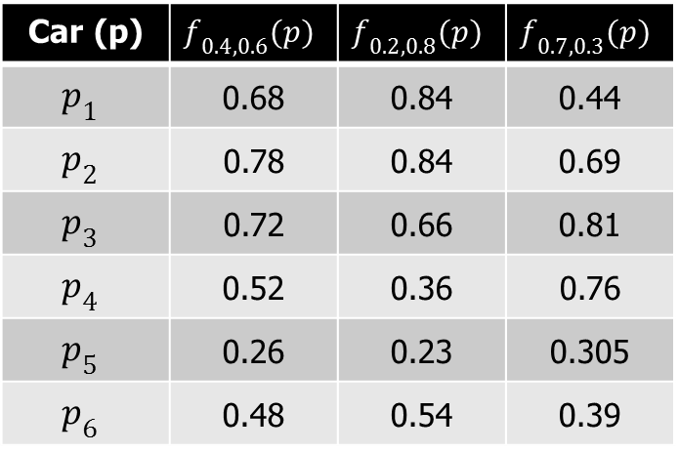
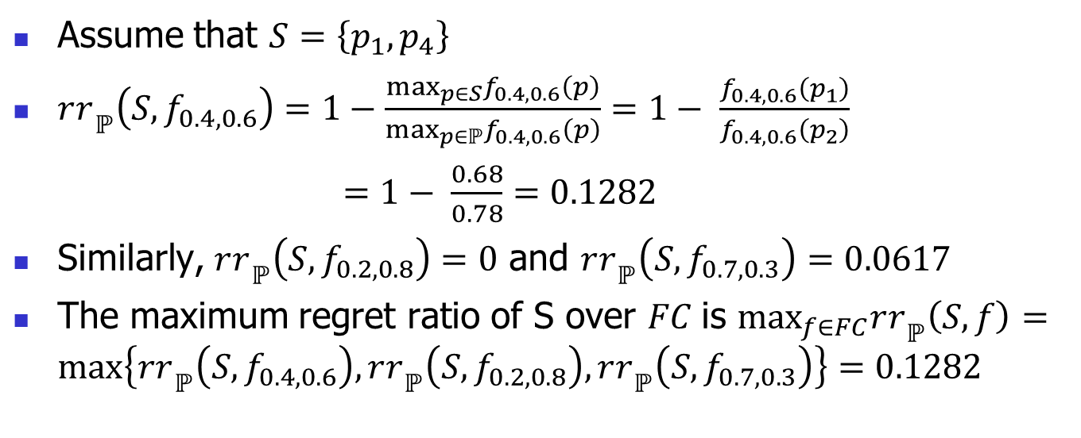


Car (p) | $$f_{0.4,0.6}(p)$$ | $$f_{0.2,0.8}(p)$$ | $$f_{0.7,0.3}(p)$$
$$p_{1}$$ | 0.68 | 0.84 | 0.44
$$p_{2}$$ | 0.78 | 0.84 | 0.69
$$p_{3}$$ | 0.72 | 0.66 | 0.81
$$p_{4}$$ | 0.52 | 0.36 | 0.76
$$p_{5}$$ | 0.26 | 0.23 | 0.305
$$p_{6}$$ | 0.48 | 0.54 | 0.39
$$\max_{p∈S}f_{0.4,0.6}(p)$$
$$\max_{p∈ℙ}f_{0.4,0.6}(p)$$
Assume that $S=\left\{p_{1}, p_{4}\right\}$
$r{r_{ }}_{ℙ}\left(S,f_{0.4,0.6}\right)=1−\frac{\max_{p∈S}f_{0.4,0.6}\left(p\right)}{\max_{p∈ℙ}f_{0.4,0.6}\left(p\right)}=1− \frac{f_{0.4,0.6}\left(p_{1}\right)}{f_{0.4,0.6}\left(p_{2}\right)}$
$=1− \frac{0.68}{0.78}=0.1282$
Similarly, $r{r_{ }}_{ℙ}\left(S,f_{0.2,0.8}\right)=0$ and $r{r_{ }}_{ℙ}\left(S,f_{0.7,0.3}\right)=0.0617$
The maximum regret ratio of S over $FC$is $\max_{f∈FC}r{r_{ }}_{ℙ}\left(S, f\right)=\max\left\{r{r_{ }}_{ℙ}\left(S,f_{0.4,0.6}\right),r{r_{ }}_{ℙ}\left(S,f_{0.2,0.8}\right),r{r_{ }}_{ℙ}\left(S,f_{0.7,0.3}\right)\right\}=0.1282$

Slide 16
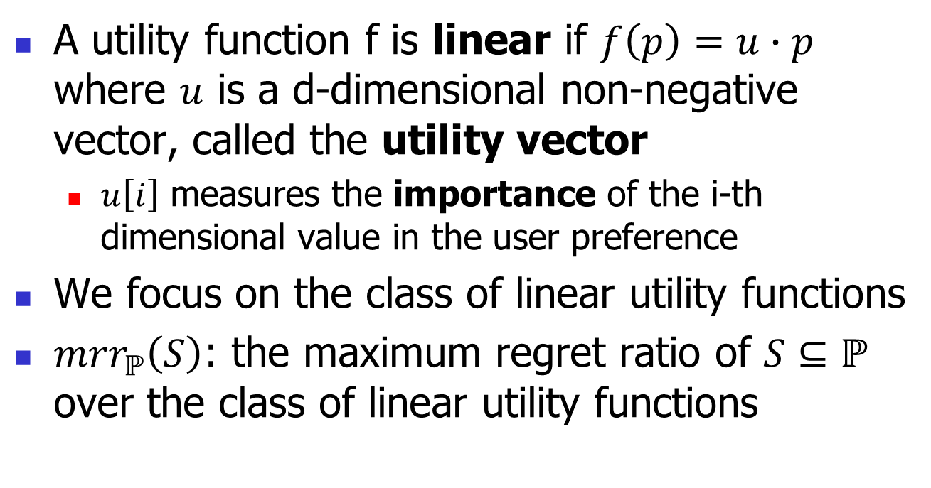
Linear Utility Functions
A utility function f is linear if $f\left(p\right)=u∙p$ where $u$ is a d-dimensional non-negative vector, called the utility vector
  $u\left[i\right]$ measures the importance of the i-th dimensional value in the user preference
We focus on the class of linear utility functions
${mrr}_{ℙ}\left(S\right)$: the maximum regret ratio of $S⊆ℙ$ over the class of linear utility functions

Slide 17
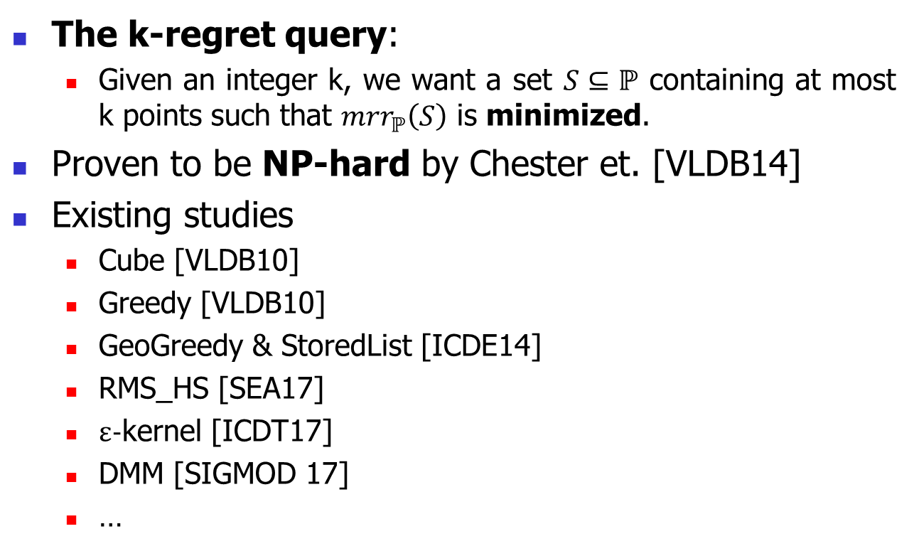
Problem Definition
The k-regret query:
  Given an integer k, we want a set $S⊆ℙ$ containing at most k points such that ${mrr}_{ℙ}\left(S\right)$ is minimized.
Proven to be NP-hard by Chester et. [VLDB14]
Existing studies
  Cube [VLDB10]
  Greedy [VLDB10]
  GeoGreedy & StoredList [ICDE14]
  RMS_HS [SEA17]
  ε-kernel [ICDT17]
  DMM [SIGMOD 17]
  …

Slide 18
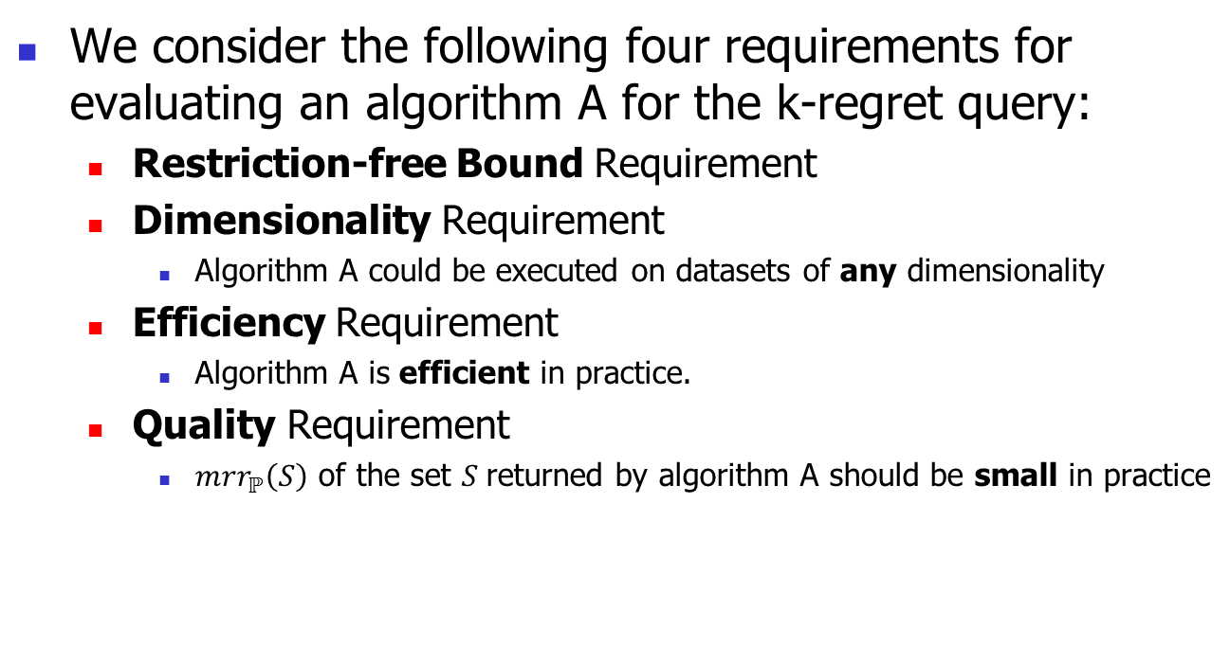
Requirements for the k-Regret Query
We consider the following four requirements for evaluating an algorithm A for the k-regret query:
  Restriction-free Bound Requirement
  Dimensionality Requirement
    Algorithm A could be executed on datasets of any dimensionality
  Efficiency Requirement
    Algorithm A is efficient in practice.
  Quality Requirement
    ${mrr}_{ℙ}\left(S\right)$ of the set $S$returned by algorithm A should be small in practice

Slide 19
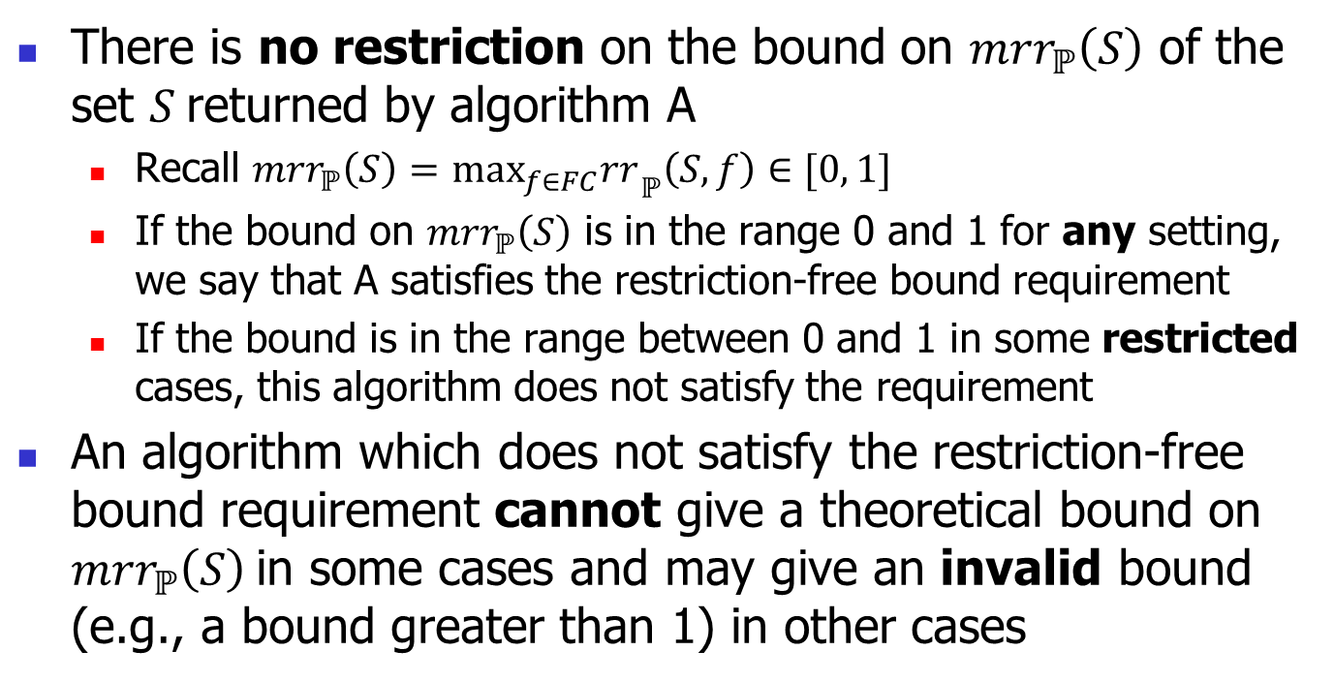
Restriction-free Bound Requirement
There is no restriction on the bound on ${mrr}_{ℙ}\left(S\right)$ of the set $S$returned by algorithm A
  Recall ${mrr}_{ℙ}\left(S\right)=$ $\max_{f∈FC}r{r_{ }}_{ℙ}\left(S, f\right)∈[0, 1]$
  If the bound on ${mrr}_{ℙ}\left(S\right)$ is in the range 0 and 1 for any setting, we say that A satisfies the restriction-free bound requirement
  If the bound is in the range between 0 and 1 in some restricted cases, this algorithm does not satisfy the requirement
An algorithm which does not satisfy the restriction-free bound requirement cannot give a theoretical bound on ${mrr}_{ℙ}\left(S\right)$in some cases and may give an invalid bound (e.g., a bound greater than 1) in other cases

Slide 20
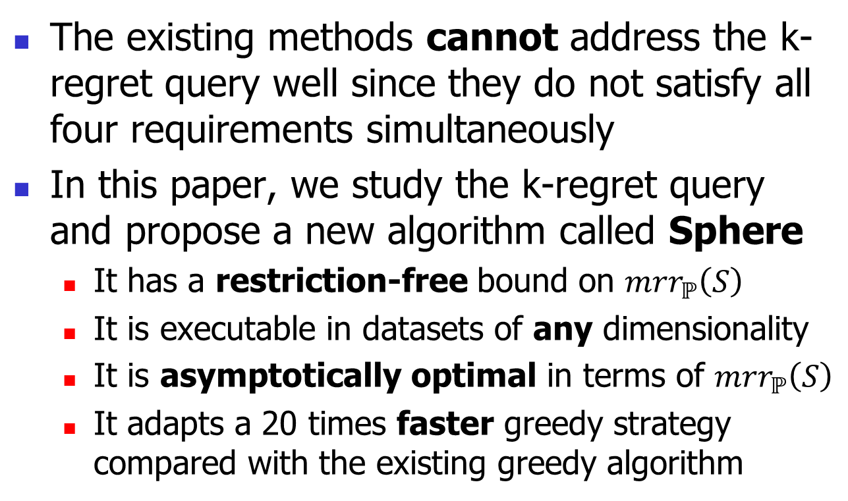
Our Contributions
The existing methods cannot address the k-regret query well since they do not satisfy all four requirements simultaneously
In this paper, we study the k-regret query and propose a new algorithm called Sphere
  It has a restriction-free bound on ${mrr}_{ℙ}\left(S\right)$
  It is executable in datasets of any dimensionality
  It is asymptotically optimal in terms of ${mrr}_{ℙ}\left(S\right)$
  It adapts a 20 times faster greedy strategy compared with the existing greedy algorithm

Slide 21
Outline
Introduction
Problem Definition
Algorithm
Experiment
Conclusion

Slide 22


Sphere – High Level Idea
Given a utility function $f$, we want to guarantee
  $\max_{p∈S}f(p)$is high and is close to $\max_{p∈ℙ}f(p)$
  So that the regret ratio $r{r_{ }}_{ℙ}\left(S, f\right)$ is bounded
Step 1 (Initialization):
  A baseline guarantee on $\max_{p∈S}f(p)$
Step 2 (Constructing a set $I_{R}^{+}$):
  Construct some “representative” utility functions
Step 3 (Finding $ℙ$-basis):
  Find points with high utilities w.r.t. the representative utility functions
Step 4 (Inserting additional points):
  A greedy procedure with efficient pruning strategies
$$r{r_{ }}_{ℙ}\left(S, f\right)=1−\frac{\max_{p∈S}f(p)}{\max_{p∈ℙ}f(p)}$$

Slide 23

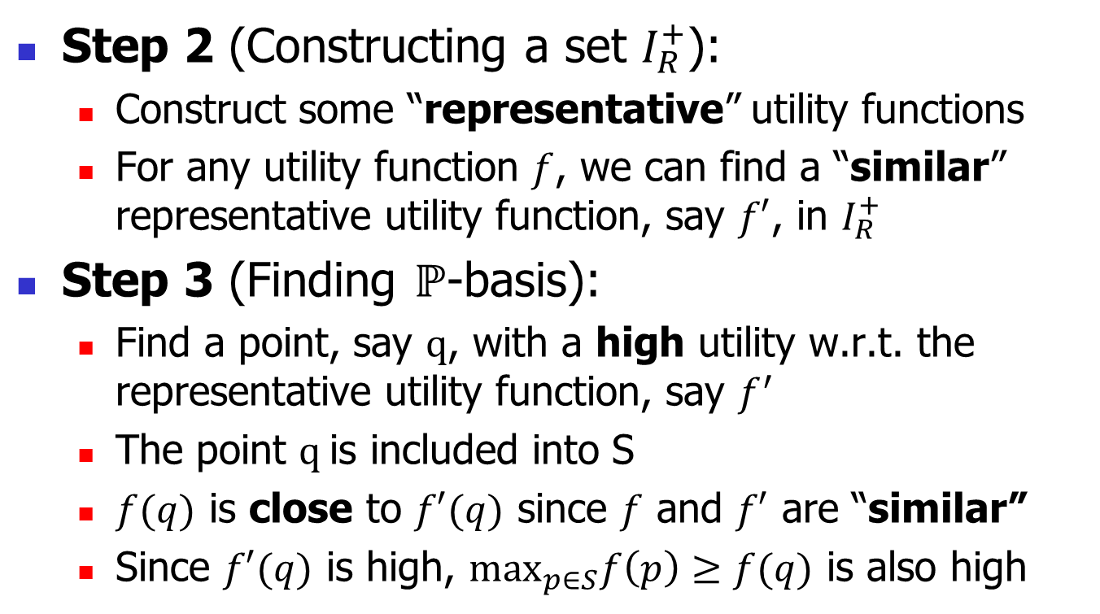
More Intuitions
Step 2 (Constructing a set $I_{R}^{+}$):
  Construct some “representative” utility functions
  For any utility function $f$, we can find a “similar” representative utility function, say $f′$, in $I_{R}^{+}$
Step 3 (Finding $ℙ$-basis):
  Find a point, say $q$, with a high utility w.r.t. the representative utility function, say $f^{′}$
  The point $q$is included into S
  $f(q)$ is close to $f′(q)$ since $f$ and $f′$ are “similar”
  Since $f′(q)$ is high, $\max_{p∈S}f\left(p\right)≥f(q)$ is also high
This is how we define $f′$

Slide 24
More Intuitions
Step 2 (Constructing a set $I_{R}^{+}$):
  Construct some “representative” utility functions
  For any utility function $f$, we can find a “similar” representative utility function, say $f′$, in $I_{R}^{+}$
Step 3 (Finding $ℙ$-basis):
  Find a point, say $q$, with a high utility w.r.t. the representative utility function, say $f^{′}$
  The point $q$is included into S
  $f(q)$ is close to $f′(q)$ since $f$ and $f′$ are “similar”
  Since $f′(q)$ is high, $\max_{p∈S}f\left(p\right)≥f(q)$ is also high
This is how we choose q

Slide 25

More Intuitions
Step 2 (Constructing a set $I_{R}^{+}$):
  Construct some “representative” utility functions
  For any utility function $f$, we can find a “similar” representative utility function, say $f′$, in $I_{R}^{+}$
Step 3 (Finding $ℙ$-basis):
  Find a point, say $q$, with a high utility w.r.t. the representative utility function, say $f′$
  The point $q$is included into S
  $f(q)$ is close to $f′(q)$ since $f$ and $f′$ are “similar”
  Since $f′(q)$ is high, $\max_{p∈S}f\left(p\right)≥f(q)$ is also high
This is how we define S

Slide 26
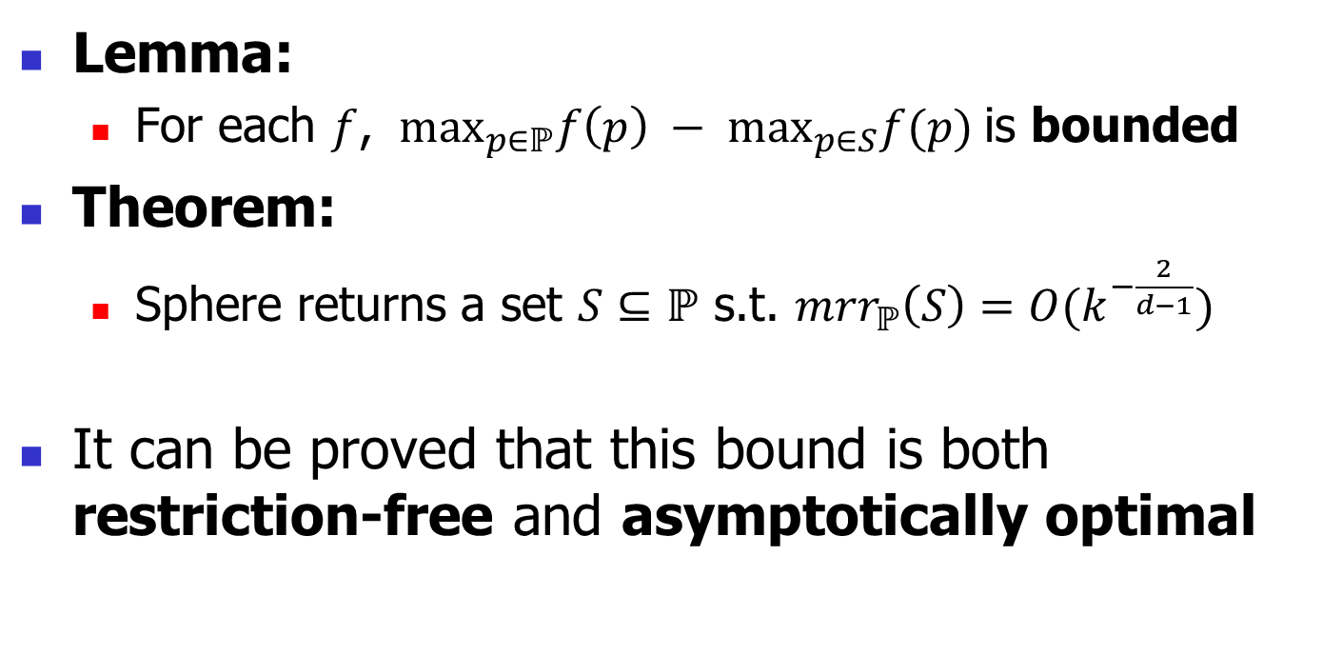
Theoretical Guarantee
Lemma:
  For each $f$, $\max_{p∈ℙ}f\left(p\right) − \max_{p∈S}f(p)$is bounded
Theorem:
  Sphere returns a set $S⊆ℙ$ s.t. ${mrr}_{ℙ}\left(S\right)=O(k^{−\frac{2}{d−1}})$
It can be proved that this bound is both restriction-free and asymptotically optimal

Slide 27
Outline
Introduction
Problem Definition
Algorithm
Experiment
Conclusion

Slide 28
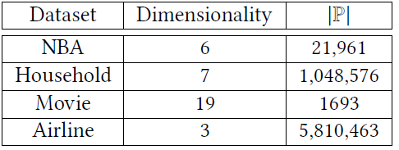
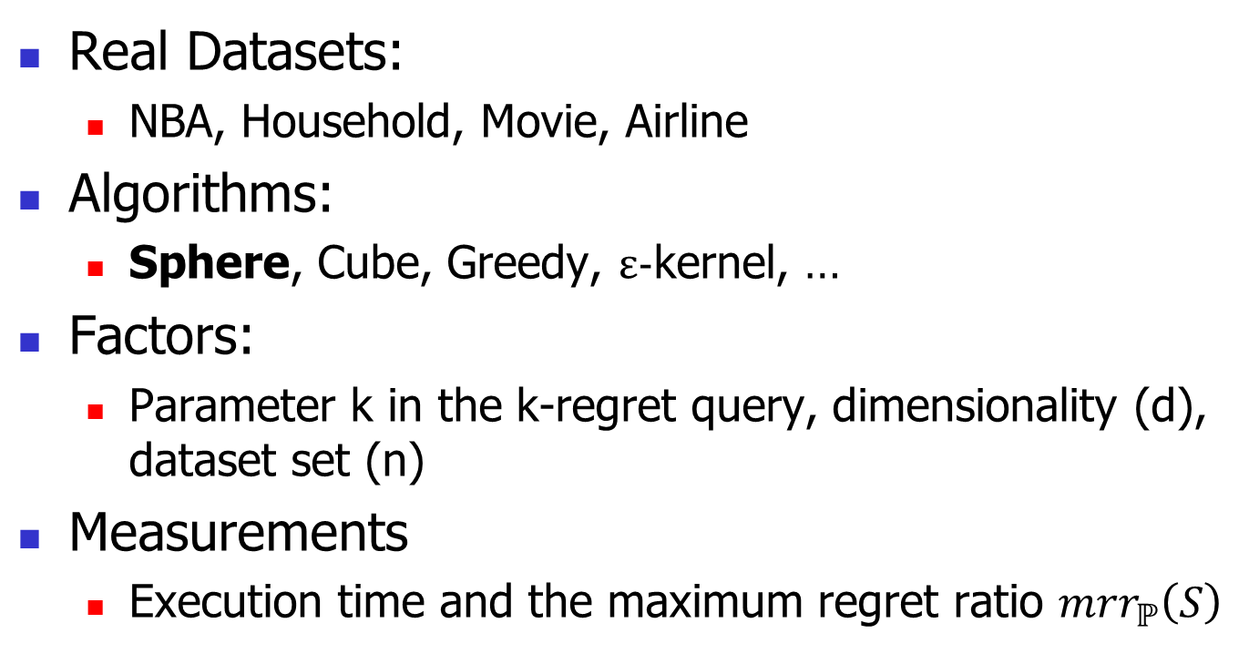
Experiment Setting
Real Datasets:
  NBA, Household, Movie, Airline
Algorithms:
  Sphere, Cube, Greedy, ε-kernel, …
Factors:
  Parameter k in the k-regret query, dimensionality (d), dataset set (n)
Measurements
  Execution time and the maximum regret ratio ${mrr}_{ℙ}\left(S\right)$

Slide 29
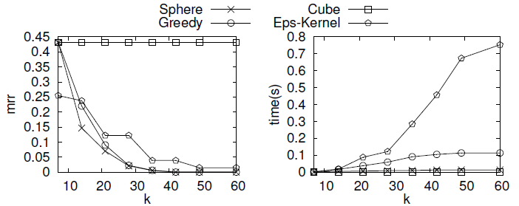
Experimental Results
Dataset: Household (d = 7, n = 1,048,578)
Factor: parameter k in the k-regret query

Slide 30
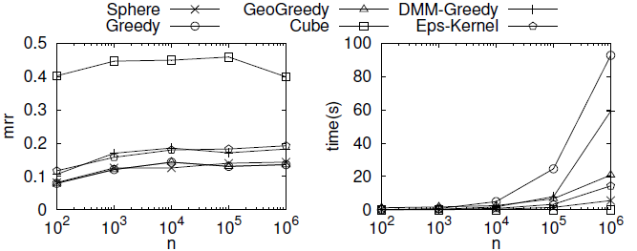
Experimental Results (cont.)
Scalability on n (d = 6, k = 30)

Slide 31
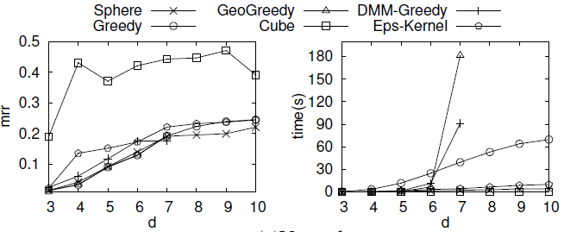
Experimental Results (cont.)
Scalability on d (n = 100,000, k = 30)

Slide 32
Outline
Introduction
Problem Definition
Algorithm
Experiment
Conclusion

Slide 33
Conclusion
We study the k-regret query in this paper
We propose an efficient algorithm called Sphere whose upper bound on the maximum regret ratio is restriction-free and asymptotically optimal for any dimensionality
We concocted extensive experiments to demonstrate the superiority of Sphere

Slide 34
Q & A

Slide 35
Back Up Slides

Slide 36
Other Applications
Information Retrieval (IR)
Recommendation Systems (RS)
  Job recommendation system
Other commercial companies
  Amazon, Taobao, …

Slide 37
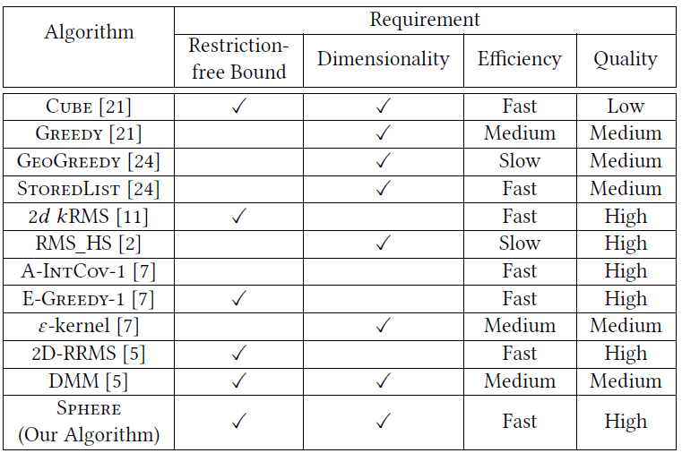
Comparison between Algorithms

Slide 38
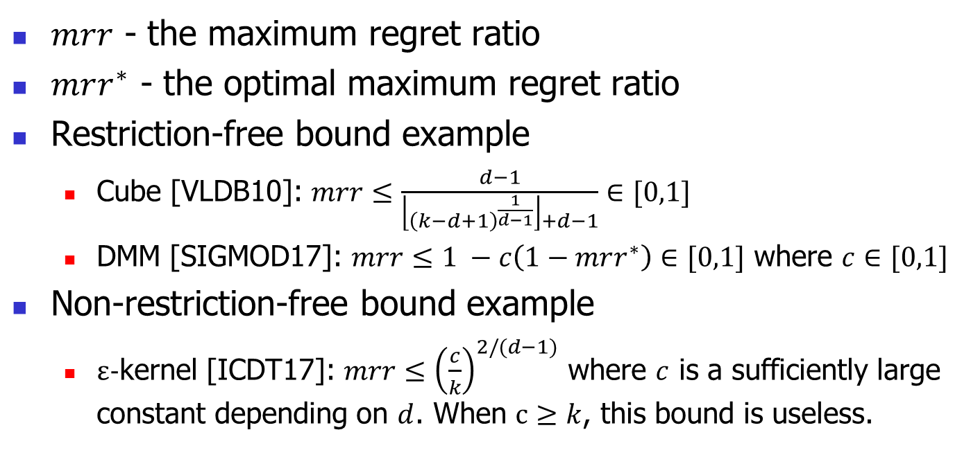
Restriction-free Bound Example
$mrr$ - the maximum regret ratio
$mrr^{∗}$ - the optimal maximum regret ratio
Restriction-free bound example
  Cube [VLDB10]: $mrr≤\frac{d−1}{\left\lfloor {\left(k−d+1\right)}^{\frac{1}{d−1}}\right\rfloor +d−1}∈[0,1]$
  DMM [SIGMOD17]: $mrr≤1 −c\left(1−mrr^{∗}\right)∈[0,1]$ where $c∈[0,1]$
Non-restriction-free bound example
  ε-kernel [ICDT17]: $mrr≤{\left(\frac{c}{k}\right)}^{2/(d−1)}$ where $c$ is a sufficiently large constant depending on $d$. When $c≥k$, this bound is useless.

Slide 39






Terminologies
MPG
$$dist\left(P,s\right)$$
$$s$$
p₁
p₂
$$𝕊_{R}^{+}$$
p₆
p₃
p₅
$$𝒞ℋ\left(ℙ\right)$$
p₄
Let $𝕊_{R}^{+}=\left\{s∈ℝ_{+}^{d}\right| \left\|s\right\|=R\}$
Given $P⊆ℙ$ and $s{∈𝕊}_{R}^{+}$,
we define the distance between $P$ and $s$ to be
$dist\left(P,s\right)=\max_{\left\{p∈𝒞ℋ\left(P\right)\right\}}{dist(p,s)}$
  $𝒞ℋ\left(P\right)$is the convex hull of P
  $dist(p,s)$ denotes the Euclidean distance between p and s
E.g., P = $ℙ$={p₁, p₂, p₃, p₄, p₅, p₆}, $R=2\sqrt{2}$ and $s{∈𝕊}_{R}^{+}$
O
HP
$$R$$

Slide 40

Terminologies
MPG
$$dist\left(P,s\right)$$
$$s$$
p₁
p₂
$$𝕊_{R}^{+}$$
p₆
p₃
p₅
$$𝒞ℋ\left(ℙ\right)$$
p₄
Given $P⊆ℙ$ and $s{∈𝕊}_{R}^{+}$,
a set $B⊆P$ is a P-basis of $s$ if
  (1) $∀B^{′}⊂B, dist\left(B,s\right)<dist(B^{′}, s)$
  (2) $dist\left(B,s\right)=dist(P, s)$
A P-basis of s is a minimal subset of P whose distance to s is equal to the distance between P and s
E.g., B={p₂, p₃} is a $ℙ$-basis of s
  (1) $dist\left(\left\{p_{2},p_{3}\right\},s\right)<dist(\{p_{2}\}, s)$ and $dist\left(\left\{p_{2},p_{3}\right\},s\right)<dist(\{p_{3}\}, s)$
  (2) $dist\left(\left\{p_{2},p_{3}\right\},s\right)$ = $dist\left(ℙ,s\right)$
O
HP
$$R$$
The distance between s and a point on the line segment connected by p₂ and p₃

Slide 41
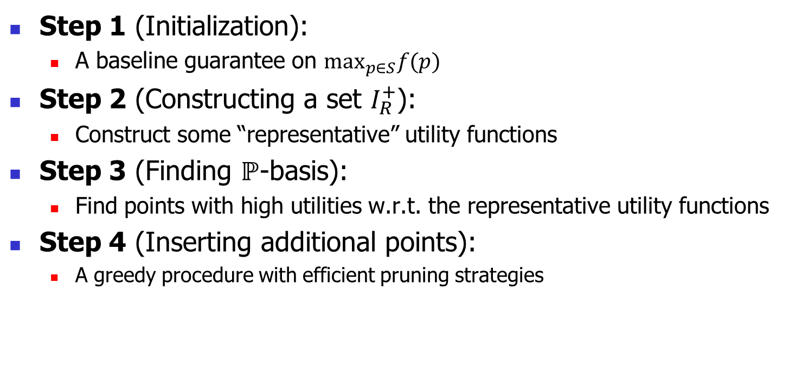
Sphere
Step 1 (Initialization):
  A baseline guarantee on $\max_{p∈S}f(p)$
Step 2 (Constructing a set $I_{R}^{+}$):
  Construct some “representative” utility functions
Step 3 (Finding $ℙ$-basis):
  Find points with high utilities w.r.t. the representative utility functions
Step 4 (Inserting additional points):
  A greedy procedure with efficient pruning strategies

Slide 42

Step 1 (Initialization)
S is initialized to be {b₁, b₂, …, b_{d}}
  b_{i} has the highest i-th dimensional value
Lemma: $\max_{p∈S}f\left(p\right)≥ \frac{1}{\sqrt{d}}$
MPG
S ={p₁, p₄}
p₁
p₂
$$𝕊_{R}^{+}$$
p₆
p₃
p₅
p₄
O
HP

Slide 43
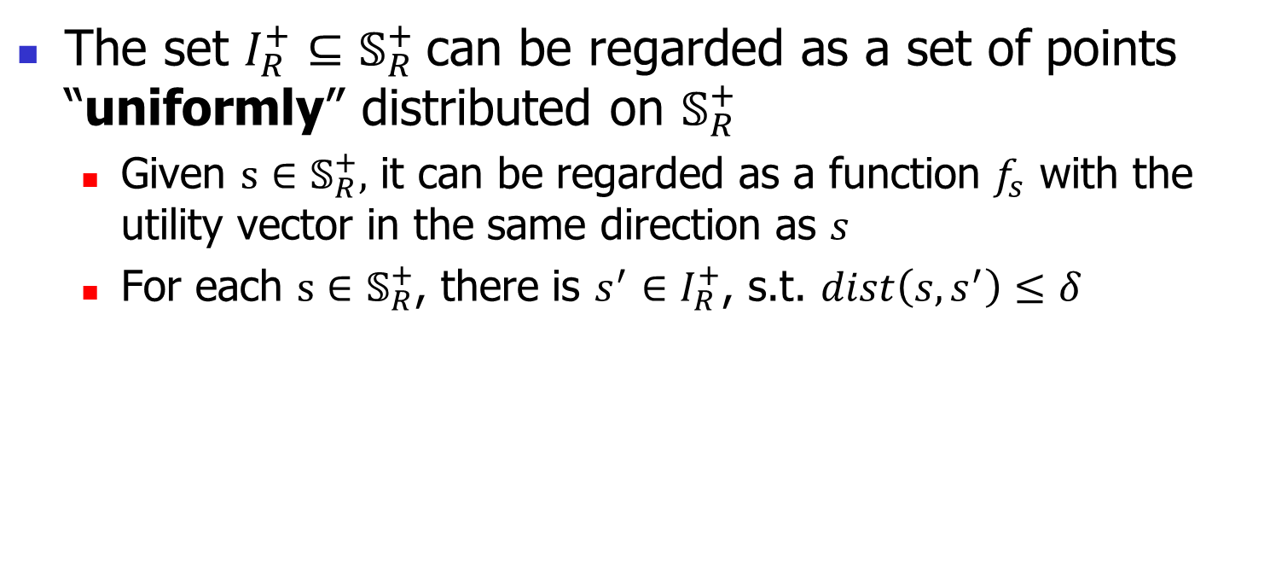
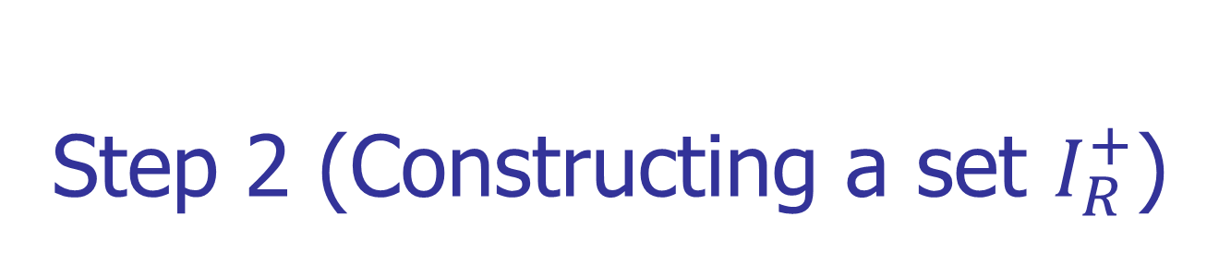

Step 2 (Constructing a set $I_{R}^{+}$)
The set $I_{R}^{+}⊆𝕊_{R}^{+}$can be regarded as a set of points “uniformly” distributed on $𝕊_{R}^{+}$
  Given $s∈𝕊_{R}^{+},$ it can be regarded as a function $f_{s}$ with the utility vector in the same direction as $s$
  For each $s∈𝕊_{R}^{+}$, there is ${s^{′}∈I}_{R}^{+}$, s.t. $dist\left(s, s^{′}\right)≤δ$
MPG
$$s$$
$$I_{R}^{+}=\{s\}$$
p₁
p₂
$$𝕊_{R}^{+}$$
p₆
p₃
p₅
p₄
O
HP

Slide 44


Step 3 (Finding $ℙ$-basis)
For each ${s^{′}∈I}_{R}^{+}$, we include its $ℙ$-basis into S
MPG
$$dist\left(P,s\right)$$
$$s$$
S ={p₁, p₂, p₃, p₄}
p₁
p₂
$$𝕊_{R}^{+}$$
p₆
p₃
p₅
$$𝒞ℋ\left(ℙ\right)$$
p₄
O
HP

Slide 45
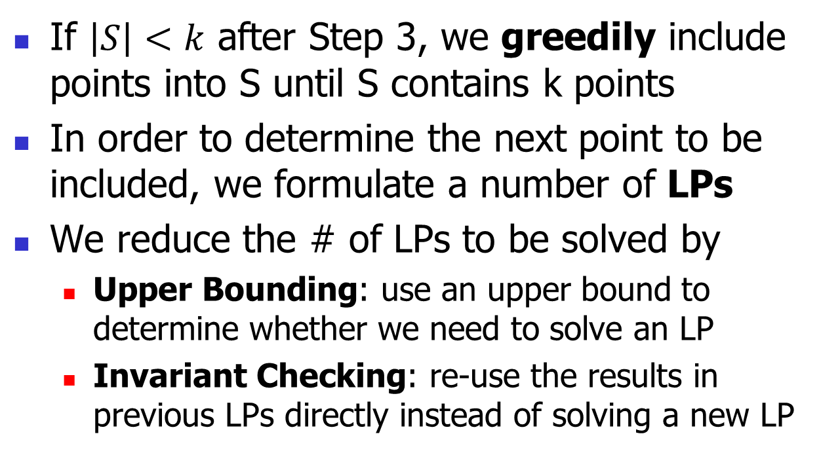
Step 4 (Inserting additional points)
If $\left|S\right|<k$ after Step 3, we greedily include points into S until S contains k points
In order to determine the next point to be included, we formulate a number of LPs
We reduce the # of LPs to be solved by
  Upper Bounding: use an upper bound to determine whether we need to solve an LP
  Invariant Checking: re-use the results in previous LPs directly instead of solving a new LP

Slide 46
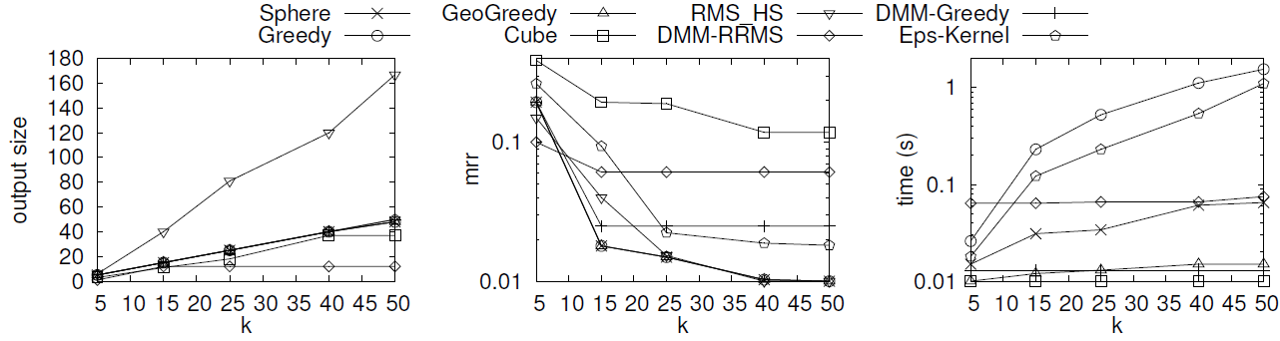
Experimental Results
Dataset: 2d anti-correlated dataset (n = 100,000)
Factor: parameter k in the k-regret query

Slide 47
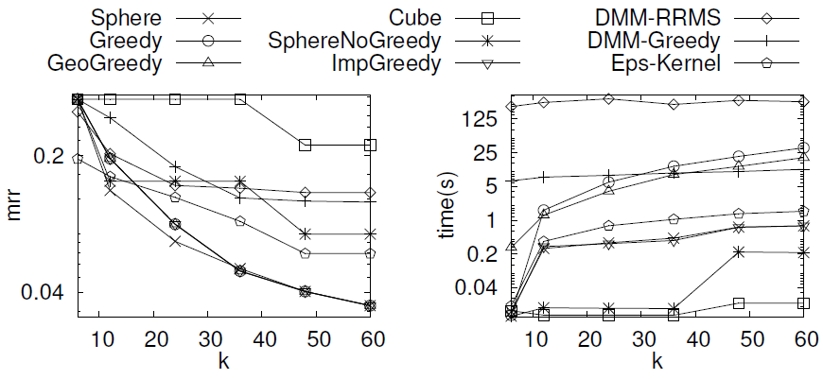
Experimental Results
Dataset: 6d anti-correlated dataset (n = 100,000)
Factor: parameter k in the k-regret query

Slide 48
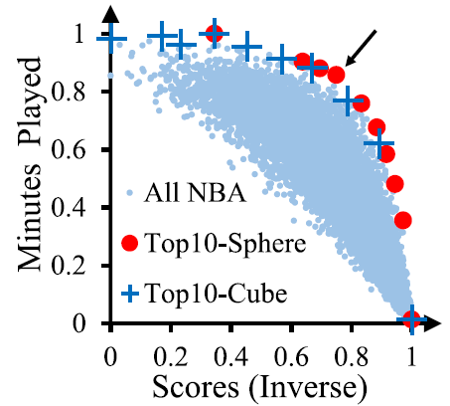
Subjective Evaluation
Dataset: NBA
Attributes: scores (inverse), minutes played
We are interested in the players who obtained low scores in a long play time. It is useful to improve the performance
We are less interested in the players who play for a long time and obtain high scores

