Slide 1

Strongly Truthful Interactive Regret Minimization
XIE Min, The Hong Kong Univ. of Sci. and Tech.
Raymond Chi-Wing Wong, The Hong Kong Univ. of Sci. and Tech.
Ashwin Lall, Denison University

Slide 2
Outline
Introduction
Problem Definition
Algorithm
Experiment
Demo System
Conclusion

Slide 3
Outline
Introduction
Problem Definition
Algorithm
Experiment
Demo System
Conclusion

Slide 4
Which apartment should Alice buy?
Suppose that user Alice wants to buy an apartment
If the value is larger, then it is better to a user.
One example is the apartment size.
There are some popular queries for this problem (e.g., top-k and skyline).
D
Apartment | X₁ | X₂
p₁ | 0 | 1
p₂ | 0.2 | 1
p₃ | 0.6 | 0.9
p₄ | 0.9 | 0.6
p₅ | 1 | 0.2
p₆ | 1 | 0
… | … | …
In this talk, we will talk about a recent type of queries.
Regret minimization queries

Slide 5
A larger weight means that the corresponding dimension is more important in Alice’s mind
Regret minimization queries
Suppose that user Alice wants to buy an apartment
Assume that Alice has a utility function in her mind
Utility function f
f(p) = 0.3 X₁ + 0.7 X₂
Utility
D
Utility
Apartment | X₁ | X₂
p₁ | 0 | 1
p₂ | 0.2 | 1
p₃ | 0.6 | 0.9
p₄ | 0.9 | 0.6
p₅ | 1 | 0.2
p₆ | 1 | 0
… | … | …
Utility vector u = (0.3, 0.7)
0.7
But, we do not know this utility function.
0.76
0.81
Suppose that the whole dataset is seen
by user Alice.
0.69
0.44
  We could find her favorite apartment p₃
  (Alice’s maximum utility point).
0.3
0.81
…

Slide 6

Regret minimization queries
Suppose that user Alice wants to buy an apartment
If Alice’s maximum utility in S is equal to Alice’s maximum utility in D,
then Alice’s regret ratio is equal to 0
Thus, we would like to have a smaller value for Alice’s regret ratio.
There is a difference between these 2 utility values
D
Suppose that the whole dataset is seen
by user Alice.
Utility
Apartment | X₁ | X₂
p₁ | 0 | 1
p₂ | 0.2 | 1
p₃ | 0.6 | 0.9
p₄ | 0.9 | 0.6
p₅ | 1 | 0.2
p₆ | 1 | 0
… | … | …
0.7
  We could find her favorite apartment p₃
  (Alice’s maximum utility point).
Alice’s Regret Ratio
= 1 - $\frac{0.76}{0.81}$
= 0.06173
0.76
0.81
Alice’s maximum utility in S
Consider a set S = {p₂, p₄}
(which could be an output of this query).
Suppose that set S is seen by user
Alice.
0.81
0.69
0.44
0.3
Alice’s maximum utility in D
  We could find her favorite apartment p₂
  (Alice’s maximum utility point).
…
0.76

Slide 7
Outline
Introduction
Problem Definition
Algorithm
Experiment
Demo System
Conclusion

Slide 8
Regret minimization queries queries
Suppose that user Alice wants to buy an apartment
Consider that Alice has a utility function with the utility vector (0.3, 0.7).
But, we do not know this utility function.
D
Apartment | X₁ | X₂
p₁ | 0 | 1
p₂ | 0.2 | 1
p₃ | 0.6 | 0.9
p₄ | 0.9 | 0.6
p₅ | 1 | 0.2
p₆ | 1 | 0
… | … | …
Which one is better?
p₂
p₃
p₃
Alice
After this round,
we understand Alice’s preference better.

Slide 9
Regret minimization queries queries
Suppose that user Alice wants to buy an apartment
Consider that Alice has a utility function with the utility vector (0.3, 0.7).
But, we do not know this utility function.
D
Apartment | X₁ | X₂
p₁ | 0 | 1
p₂ | 0.2 | 1
p₃ | 0.6 | 0.9
p₄ | 0.9 | 0.6
p₅ | 1 | 0.2
p₆ | 1 | 0
… | … | …
Which one is better?
p₄
p₅
p₄
With more rounds/questions, we could know Alice’s preference more.
Alice
After this round,
we understand Alice’s preference much better.

Slide 10
Problem 1 (Interactive Regret Minimization): Given a set D, we want to ask a number of questions to Alice and return an apartment such that Alice’s regret ratio is at most ε.
Regret minimization queries queries
Problem 2 (Maximum Utility Point Determination): Given a set D, we want to ask a number of questions to Alice and return an apartment such that this apartment is Alice’s maximum utility point in D.
Suppose that user Alice wants to buy an apartment
Consider that Alice has a utility function with the utility vector (0.3, 0.7).
But, we do not know this utility function.
D
Apartment | X₁ | X₂
p₁ | 0 | 1
p₂ | 0.2 | 1
p₃ | 0.6 | 0.9
p₄ | 0.9 | 0.6
p₅ | 1 | 0.2
p₆ | 1 | 0
… | … | …
Which one is better?
p₄
p₅
p₄
With more rounds/questions, we could know Alice’s preference more.
Alice
After this round,
we understand Alice’s preference much better.

Slide 11
Problem 1 (Interactive Regret Minimization): Given a set D, we want to ask a number of questions to Alice and return an apartment such that Alice’s regret ratio is at most ε.
Problem 2 (Maximum Utility Point Determination): Given a set D, we want to ask a number of questions to Alice and return an apartment such that this apartment is Alice’s maximum utility point in D.
Contributions
  Problem Complexity
    We show the lower bound of the number of questions required for problem “Maximum Utility Point Determination”
Theorem: The total number of questions required is Ω(log n) where n is the total number of points.
  Algorithm
    When there are 2 attributes, we propose 2 algorithms called Median and Hull which are asymptotically optimal in terms of the number of questions asked
    When there are d attributes where d ≥ 2, we propose an algorithm called UH (Utility Hyperplane) with provable guarantee

Slide 12
Outline
Introduction
Problem Definition
Algorithm
Experiment
Demo System
Conclusion

Slide 13
Algorithm
When there are 2 dimensions
  Median
  Hull
When there are d dimensions where d ≥ 2,
  UH (Utility Hyperplane)

Slide 14
Algorithm Median
Idea
  Use a binary search approach to find the maximum utility point

Slide 15
Algorithm Median
“Peak” Lemma: Consider a utility function f
(e.g., Alice’s utility function). Let p_{i} be the maximum utility point.
f(p₁) ≤ f(p₂) ≤ … ≤ f(p_{i-1}) ≤ f(p_{i}) ≥ f(p_{i+1}) ≥… ≥f(p₆)
Step 1
f(p₁) ≤ f(p₂) ≤ f(p₃) ≥ f(p₄) ≥ f(p₅) ≥f(p₆)
Sort all apartments in a clockwise direction.
p₁, p₂, p₃, p₄, p₅, p₆
D
Utility
Apartment | X₁ | X₂
p₁ | 0 | 1
p₂ | 0.2 | 1
p₃ | 0.6 | 0.9
p₄ | 0.9 | 0.6
p₅ | 1 | 0.2
p₆ | 1 | 0
… | … | …
X₂
0.7
p₁
p₂
p₃
0.76
0.81
p₄
0.69
0.44
p₅
0.3
p₆
…
X₁

Slide 16
Algorithm Median
“Peak” Lemma: Consider a utility function f
(e.g., Alice’s utility function). Let p_{i} be the maximum utility point.
f(p₁) ≤ f(p₂) ≤ … ≤ f(p_{i-1}) ≤ f(p_{i}) ≥ f(p_{i+1}) ≥… ≥f(p₆)
Step 1
f(p₁) ≤ f(p₂) ≤ f(p₃) ≥ f(p₄) ≥ f(p₅) ≥f(p₆)
Sort all apartments in a clockwise direction.
p₁, p₂, p₃, p₄, p₅, p₆
Step 2
Create a candidate list L = <p₁, p₂, p₃, p₄, p₅, p₆>
Find the 2 apartments in the “middle” of the list.
D
Apartment | X₁ | X₂
p₁ | 0 | 1
p₂ | 0.2 | 1
p₃ | 0.6 | 0.9
p₄ | 0.9 | 0.6
p₅ | 1 | 0.2
p₆ | 1 | 0
… | … | …
X₂
Show these 2 apartments to Alice
p₁
p₂
Step 3
Continue until there is one point in L
p₃
Suppose that Alice chooses p₃ as a better apartment.
This is because
(1) p₃ has a higher utility than p₄.
(2) The maximum utility point must be p₁, p₂ or p₃ based on the “peak” lemma.
p₄
p₅
We set the candidate
list L as
<p₁, p₂, p₃>
p₆
X₁

Slide 17
Algorithm Median
Let n be the total number of points.
Theorem: Algorithm Median determines the maximum utility point in O(log n) rounds.
Algorithm Median is asymptotically optimal in terms of the total number of questions asked.

Slide 18
Algorithm
When there are 2 dimensions
  Median
  Hull
When there are d dimensions where d ≥ 2,
  UH (Utility Hyperplane)

Slide 19
Algorithm UH
Which one is better?
p₄
p₅
Step 1 (Point Selection)
p₄
Step 2 (Information Maintenance)
Alice
After this round,
we understand Alice’s preference better.

Slide 20
Algorithm UH
Idea
  We repeat the following 2 steps until a stopping condition is satisfied.
    Step 1 (Point Selection)
    Step 2 (Information Maintenance)

Slide 21
Algorithm UH
We maintain two components
  A convex region R
  A candidate set C
All possible utility functions of Alice based on her answers on all questions shown to her
All possible points in D which could be the maximum utility point
Whenever there is an answer of a question from Alice,
we could reduce the size of region R
and shrink the candidate set C

Slide 22
Algorithm UH
The utility function is represented by a utility vector (w₁, w₂) (e.g., (0.3, 0.7))
D
Apartment | X₁ | X₂
p₁ | 0 | 1
p₂ | 0.2 | 1
p₃ | 0.6 | 0.9
p₄ | 0.9 | 0.6
p₅ | 1 | 0.2
p₆ | 1 | 0
… | … | …
w₂
1
Region R
1
w₁

Slide 23
Algorithm UH
Consider 3 attributes instead of 2 attributes
The utility function is represented by a utility vector (w₁, w₂, w₃) (e.g., (0.3, 0.6, 0.1))
w₃
D
Apartment | X₁ | X₂
p₁ | 0 | 1
p₂ | 0.2 | 1
p₃ | 0.6 | 0.9
p₄ | 0.9 | 0.6
p₅ | 1 | 0.2
p₆ | 1 | 0
… | … | …
X₃
0.2
0.7
0.8
1
0
0.6
…
Region R
w₂
w₁

Slide 24
Algorithm UH
Whenever there is an answer of a question from Alice,
we could reduce the size of region R
and shrink the candidate set C
When p₂ and p₄ are shown to Alice,
Alice chooses p₂
w₃
p₂ – p₄
Utility hyperplane
When we ask more questions,
we will have more utility hyperplanes
The shaded region becomes smaller
and smaller.
w₂
w₁
Region R
Lemma: If Alice prefers p₂ to p₄, Alice’s utility function is in this shaded region.

Slide 25
Algorithm UH
We maintain two components
  A convex region R
  A candidate set C
All possible utility functions of Alice based on her answers on all questions shown to her
All possible points in D which could be the maximum utility point
Whenever there is an answer of a question from Alice,
we could reduce the size of region R
and shrink the candidate set C

Slide 26
Algorithm UH
C = {p₁, p₂, p₃, p₅, p₆}
Consider two points p₂ and p₃
w₃
p₃ – p₂
p₂ – p₄
Lemma: If this region does not overlap with region R, then p₃ is NOT the maximum utility point.
w₂
We could prune p₃
w₁
Region R

Slide 27
Algorithm UH
Idea
  We repeat the following 2 steps until a stopping condition is satisfied.
    Step 1 (Point Selection)
    Step 2 (Information Maintenance)

Slide 28
Algorithm UH
Point Selection
  UH-Random
  UH-Simplex
We select 2 points randomly.
We select 2 points based on vertices of the convex hull in the candidate set C

Slide 29
Outline
Introduction
Problem Definition
Algorithm
Experiment
Demo System
Conclusion

Slide 30
Experiments
Datasets
  Synthetic Datasets
    Anti-Correlated Dataset
    (d = 4, n = 100k)
  Real Datasets
Dataset | d | n
Island | 2 | 63,383
NBA | 4 | 21,961
Household | 7 | 1,048,578

Slide 31
Problem 1 (Interactive Regret Minimization): Given a set D, we want to ask a number of questions to Alice and return an apartment such that Alice’s regret ratio is at most ε.
Algorithms
  Our Algorithms
    UH-Random
    UH-Simplex
  Existing Algorithms
    UtilityApprox (SIGMOD 2012)
    CoresetHS (ALENEX 2018)
Measurement
  No. of questions asked (or no. of points shown)

Slide 32
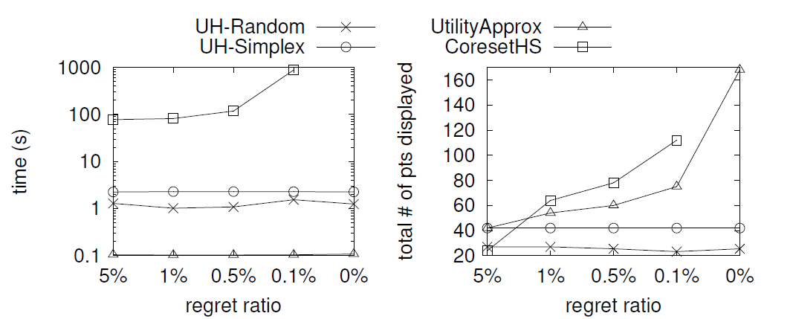

Slide 33
Problem 2 (Maximum Utility Point Determination): Given a set D, we want to ask a number of questions to Alice and return an apartment such that this apartment is Alice’s maximum utility point in D.
Algorithms
  Our Algorithms
    UH-Random
    UH-Simplex
  Existing Algorithms
    Adaptive (VLDB 2015)
    ActiveRanking (NIPS 2011)
Measurement
  No. of questions asked (or no. of points shown)

Slide 34
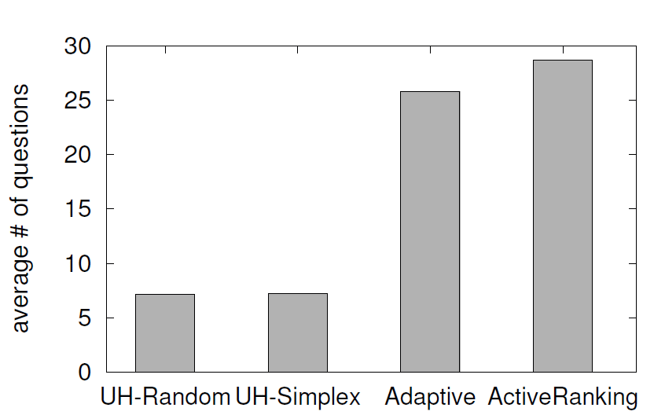

Slide 35
Outline
Introduction
Problem Definition
Algorithm
Experiment
Demo System
Conclusion

Slide 36
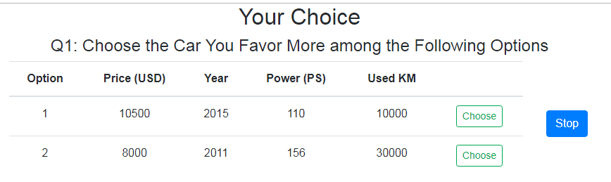
Demo System
We developed a demo system on a car database
Alice chooses this option.
Then, she is asked for several questions and keeps choosing options.

Slide 37
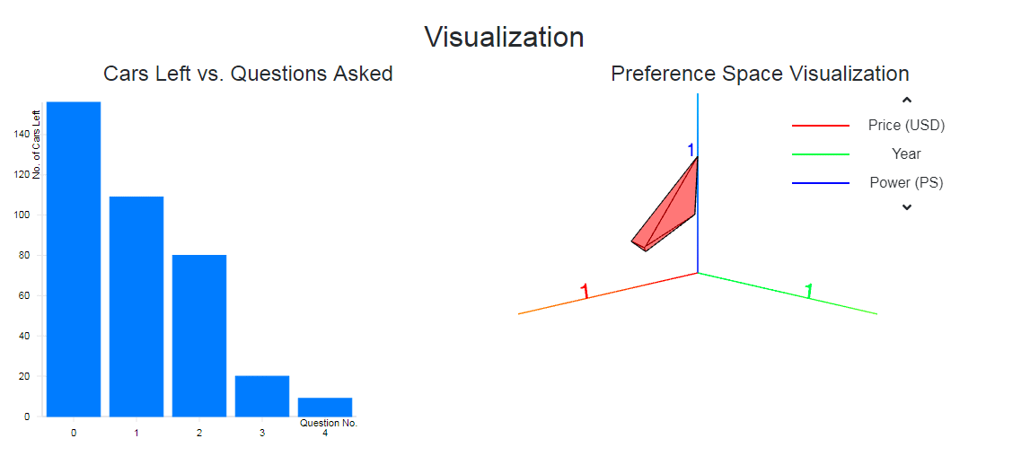
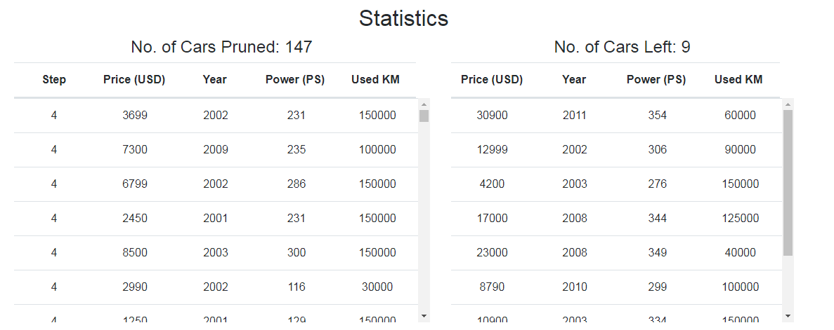

Slide 38
Outline
Introduction
Problem Definition
Algorithm
Experiment
Demo System
Conclusion

Slide 39
Conclusion
We studied interactive regret minimization
We proposed algorithms
We conducted experiments to show that our algorithms are better than the best-known algorithms
We also developed a demo system for this project.

Slide 40


Q & A
Play with it!
Demo System
Demo Video

Slide 41
Algorithm
When there are 2 dimensions
  Median
  Hull
When there are d dimensions where d ≥ 2,
  UH (Utility Hyperplane)

Slide 42
Algorithm Hull
Idea
  Use a “equal” partitioning approach to find the maximum utility point
These three partitions are formed by {p₂, p₄}
L = <p₁, p₂, p₃, p₄, p₅, p₆>
Partition 1
Partition 2
Partition 3
  Show {p₂, p₄} to Alice
  Based on the “peak” lemma, determine the partitions which contain the maximum utility point

Slide 43
Algorithm UH
Step 3 (Stopping Condition)
Idea
  We repeat the following 2 steps until a stopping condition is satisfied.
    Step 1 (Point Selection)
    Step 2 (Information Maintenance)

Slide 44
Algorithm UH
Problem 1 (Interactive Regret Minimization): Given a set D, we want to ask a number of questions to Alice and return an apartment such that Alice’s regret ratio is at most ε.
Stopping Conditions: we can stop the interaction if either of the following condition is true
  (1) There is only one tuple in C
  (2) The convex region R is very small
Lemma: Alice’s regret ratio is bounded proportionally to the “diameter” of R

Slide 45
Consider two-dimensional dataset
  We have 2 algorithms
    Median
    Hull

Slide 46
