Slide 1
Distance Oracle On Terrain Surface
Victor Junqiu Wei (The Hong Kong University of Science and Technology)
Raymond Chi-Wing Wong (The Hong Kong University of Science and Technology)
Cheng Long (Queen’s University Belfast)
David M. Mount (University of Maryland)
Presented by Victor Junqiu Wei
Prepared by Victor Junqiu Wei

Slide 2
Outline
Introduction
  Related Work
Proposed Oracle
  Preprocessing Phase
  Query Phase
Experiment
Conclusion

Slide 3
1. Introduction
Terrain Surface and Geodesic Distance
  Terrain Surface: vertices, edges, faces
  Geodesic Distance Between s and t

Slide 4
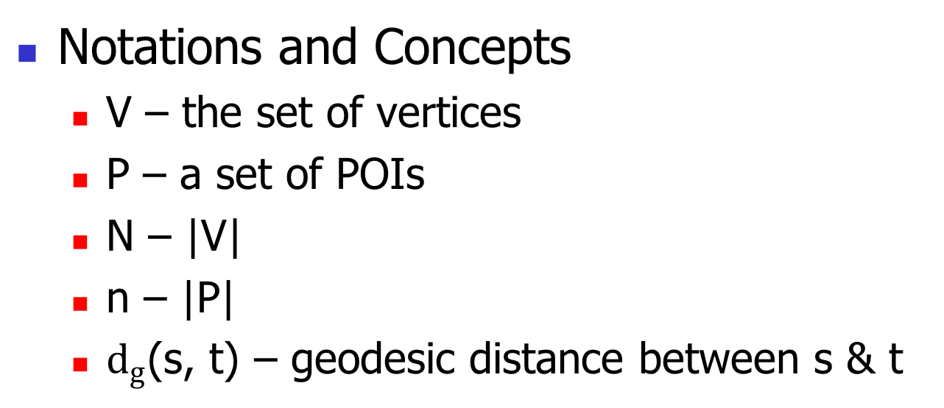
1. Introduction
Notations and Concepts
  V – the set of vertices
  P – a set of POIs
  N – |V|
  n – |P|
  $d_{g}$(s, t) – geodesic distance between s & t

Slide 5
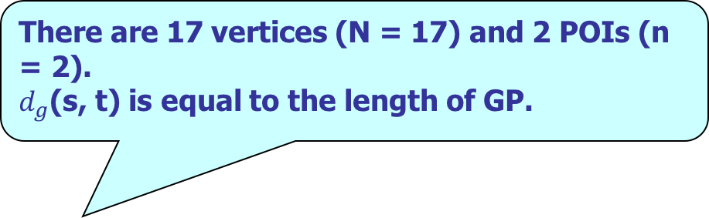

2. Proposed Oracle
Notations and Concepts
  V – the set of vertices
  P – a set of POIs
  N – |V|
  n – |P|
  $d_{g}$(s, t) – geodesic distance between s & t
There are 17 vertices (N = 17) and 2 POIs (n = 2).
$d_{g}$(s, t) is equal to the length of GP.

Slide 6
1. Introduction
Terrain Surface and Geodesic Distance
  Application 1 – Geographical Information System (GIS)
  Application 2 – Computer Graphics and Vision
  Application 3 – Scientific Data 3D Modeling
  Application 4 – 3D Virtual Game
  Application 5 – Spatial Data Mining

Slide 7
1. Introduction
Terrain Surface and Geodesic Distance
  Application 1 – Geographical Information System (GIS)
POIs: landmarks and residential sites of animals.
Geodesic distances between POIs: measure travel time/cost and study the migration patterns of animals.

Slide 8
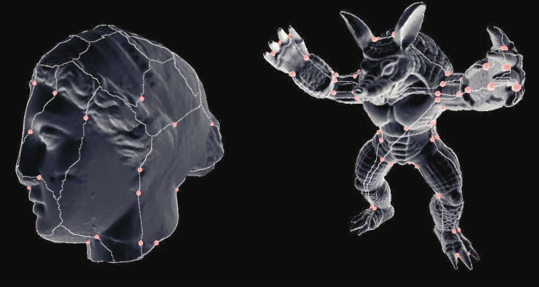
1. Introduction
Terrain Surface and Geodesic Distance
  Application 2 – Computer Graphics and Vision
POIs: reference points in the 3D model
Geodesic distances between the reference points: capture the features of a model.
The geodesic distance-based feature is used to measure similarity.

Slide 9
1. Introduction
Terrain Surface and Geodesic Distance
  Application 3 – Scientific Data 3D Modeling
  Scientists model their studied objects such as organs with 3D models.
  POIs: reference points which corresponds to the functional units.
  Geodesic distances between the reference points: make analysis together with the MRI images.

Slide 10
1. Introduction
Terrain Surface and Geodesic Distance
  Application 4 – 3D Location-Based Virtual Game
  Application 5 – Spatial Data Mining
    Inner-/Inter- Cluster Distance
    In the mountainous area, the geodesic distance is a good metric.
  E.g., INGRESS.
  POIs: portals
  Geodesic distances:
  measure travel cost.

Slide 11
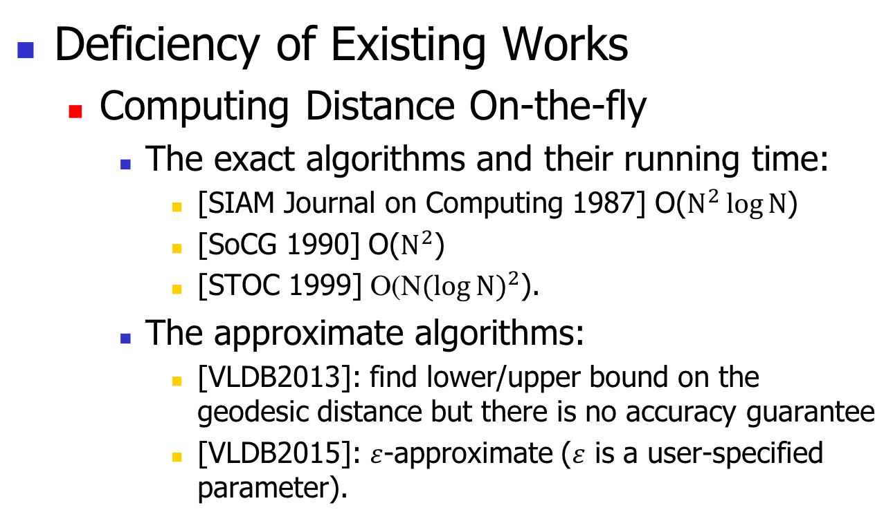
1. Introduction
Deficiency of Existing Works
  Computing Distance On-the-fly
    The exact algorithms and their running time:
      [SIAM Journal on Computing 1987] O($N^{2}\log{N}$)
      [SoCG 1990] O($N^{2}$)
      [STOC 1999] O(N${(\log{N})}^{2}$).
    The approximate algorithms:
      [VLDB2013]: find lower/upper bound on the geodesic distance but there is no accuracy guarantee
      [VLDB2015]: $ε$-approximate ($ε$ is a user-specified parameter).
  N is the number of vertices on the terrain surface.
  Both of them have an O(N log N) running time.

Slide 12
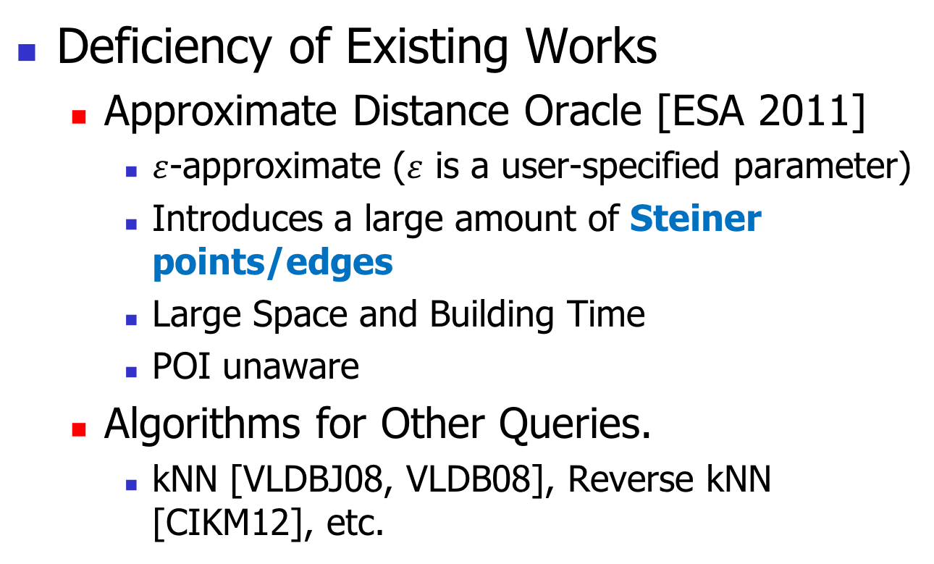
1. Introduction
  SP-Oracle
Deficiency of Existing Works
  Approximate Distance Oracle [ESA 2011]
    $ε$-approximate ($ε$ is a user-specified parameter)
    Introduces a large amount of Steiner points/edges
    Large Space and Building Time
    POI unaware
  Algorithms for Other Queries.
    kNN [VLDBJ08, VLDB08], Reverse kNN [CIKM12], etc.

Slide 13
1. Introduction
Contributions
  We studied three types of geodesic distance queries
    POI-to-POI (P2P): POIs are known a priori.
    Vertex-to-Vertex (V2V): each POI is located at a vertex
    Arbitrary point-to-arbitrary point (A2A): POIs are not known a priori.
  In this presentation, we focus on P2P only.

Slide 14
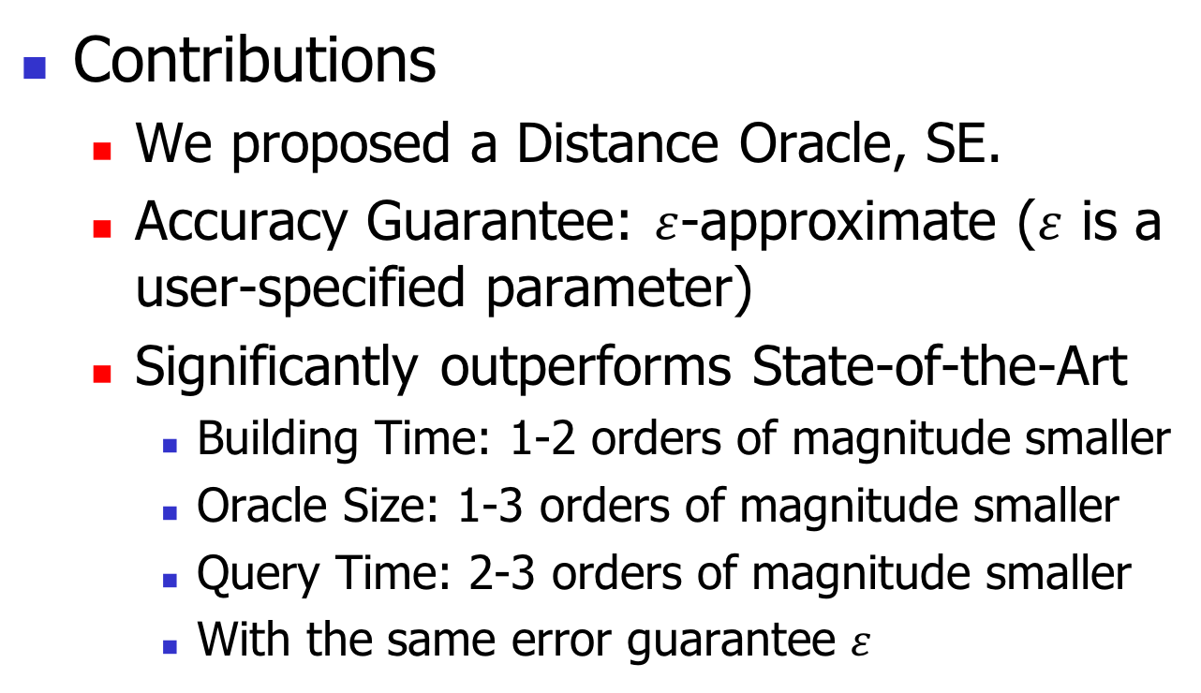
1. Introduction
Contributions
  We proposed a Distance Oracle, SE.
  Accuracy Guarantee: $ε$-approximate ($ε$ is a user-specified parameter)
  Significantly outperforms State-of-the-Art
    Building Time: 1-2 orders of magnitude smaller
    Oracle Size: 1-3 orders of magnitude smaller
    Query Time: 2-3 orders of magnitude smaller
    With the same error guarantee $ε$
Major Idea: SE indexes the approximate pairwise distances between POIs directly and this avoids the introduction of a large amount of Sterner points/edges.

Slide 15
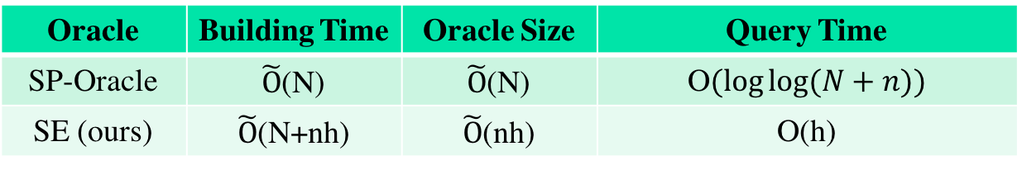
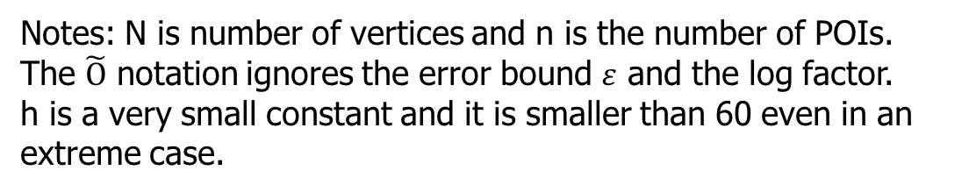
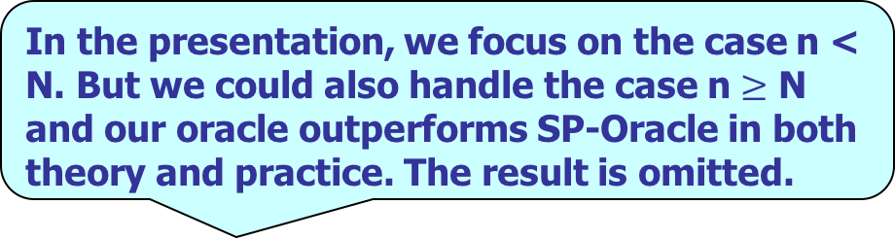
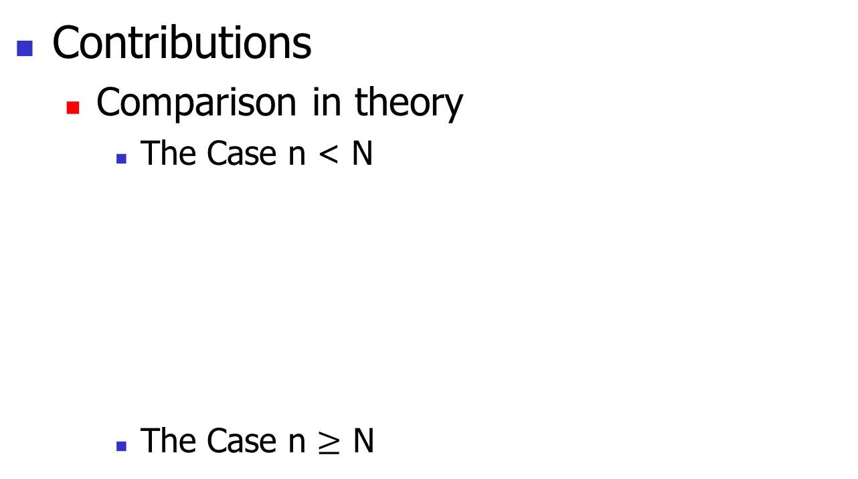
1. Introduction
n is typically smaller than N in practice. E.g., EaglePeak dataset (n = 4k and N=1.5M), BearHead (n=4k and N=1.4M) two benchmarks used in the literature.
Contributions
  Comparison in theory
    The Case n < N
    The Case n $≥$ N
Oracle | Building Time | Oracle Size | Query Time
SP-Oracle | $\tilde{O}$(N) | $\tilde{O}$(N) | O$(\log{\log{(N+n)})}$
SE (ours) | $\tilde{O}$(N+nh) | $\tilde{O}$(nh) | O(h)
In the presentation, we focus on the case n < N. But we could also handle the case n $≥$ N and our oracle outperforms SP-Oracle in both theory and practice. The result is omitted.
Notes: N is number of vertices and n is the number of POIs.
The $\tilde{O}$ notation ignores the error bound $ε$ and the log factor.
h is a very small constant and it is smaller than 60 even in an extreme case.

Slide 16
Outline
Introduction
  Related Work
Proposed Oracle
  Preprocessing Phase
  Query Phase
Experiment
Conclusion

Slide 17
2. Proposed Oracle
Overview – two components
  Component 1 – Compressed Partition Tree
    Indexes All POIs.
    Each node corresponds to a disk.
  Component 2 – Node Pair Set
    Contains a set of node pairs.
    Each node is a node in compressed partition tree.
    Each node pair is associated with a distance.

Slide 18
Outline
Introduction
  Related Work
Proposed Oracle
  Preprocessing Phase
  Query Phase
Experiment
Conclusion

Slide 19
2. Proposed Oracle
Component 1 – Compressed Partition Tree
  To construct Compressed Partition Tree, we build a structure called Partition Tree first.

Slide 20
2. Proposed Oracle
Component 1 – Compressed Partition Tree

Slide 21
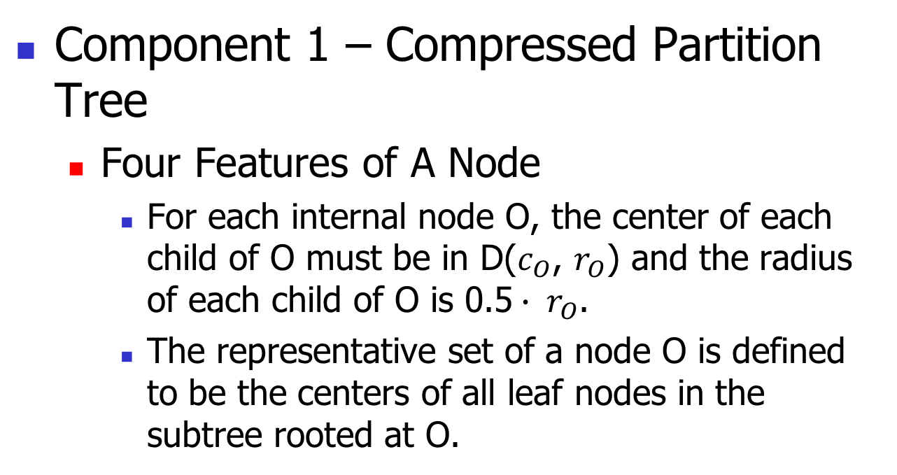
2. Proposed Oracle
Component 1 – Compressed Partition Tree
  Four Features of A Node
    For each internal node O, the center of each child of O must be in D($c_{O}$, $r_{O}$) and the radius of each child of O is 0.5$∙ r_{O}$.
    The representative set of a node O is defined to be the centers of all leaf nodes in the subtree rooted at O.
Partition Tree

Slide 22
2. Proposed Oracle
Component 1 – Compressed Partition Tree
  Construction Algorithm of Partition Tree
    Layer By Layer
    In a Top-Down Order
    Details Omitted

Slide 23
2. Proposed Oracle
Component 1 – Compressed Partition Tree
Partition Tree
Compressed Partition Tree

Slide 24
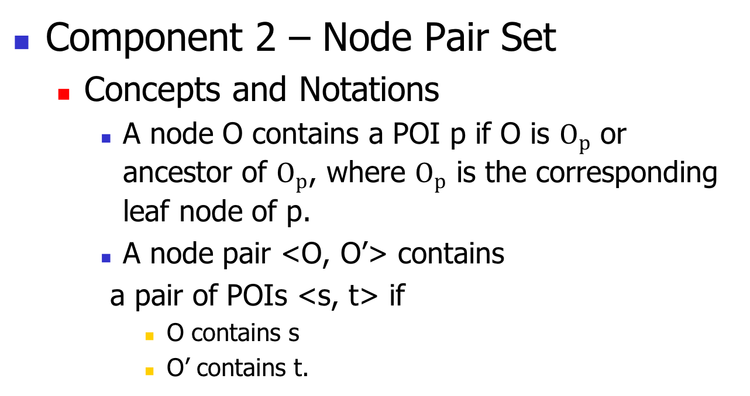
2. Proposed Oracle
Component 2 – Node Pair Set
  Concepts and Notations
    A node O contains a POI p if O is $O_{p}$ or ancestor of $O_{p}$, where $O_{p}$ is the corresponding leaf node of p.
    A node pair <O, O’> contains
    a pair of POIs <s, t> if
      O contains s
      O’ contains t.

Slide 25
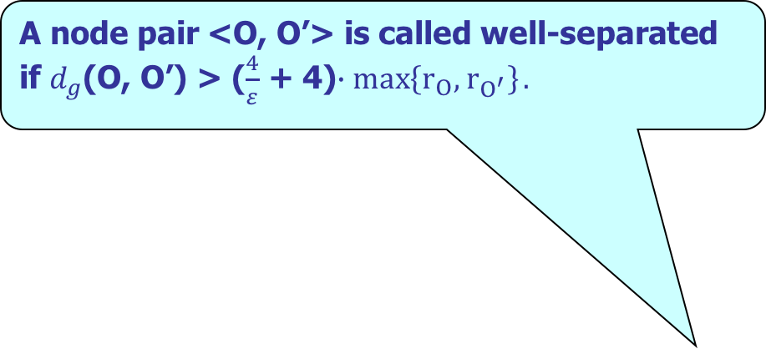

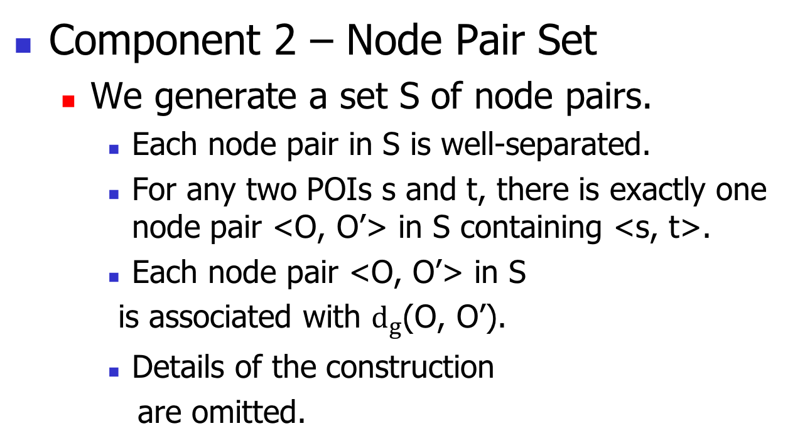
2. Proposed Oracle
  A node pair <O, O’> is called well-separated if $d_{g}$(O, O’) > ($\frac{4}{ε}$ + 4)$∙\max\left\{r_{O}, { r}_{O^{′}}\right\}.$
$d_{g}$(O, O’) = $d_{g}$($c_{O}$, $c_{O′}$).
Component 2 – Node Pair Set
  We generate a set S of node pairs.
    Each node pair in S is well-separated.
    For any two POIs s and t, there is exactly one node pair <O, O’> in S containing <s, t>.
    Each node pair <O, O’> in S
    is associated with $d_{g}$(O, O’).
    Details of the construction
    are omitted.

Slide 26
Outline
Introduction
  Related Work
Proposed Oracle
  Preprocessing Phase
  Query Phase
Experiment
Conclusion

Slide 27
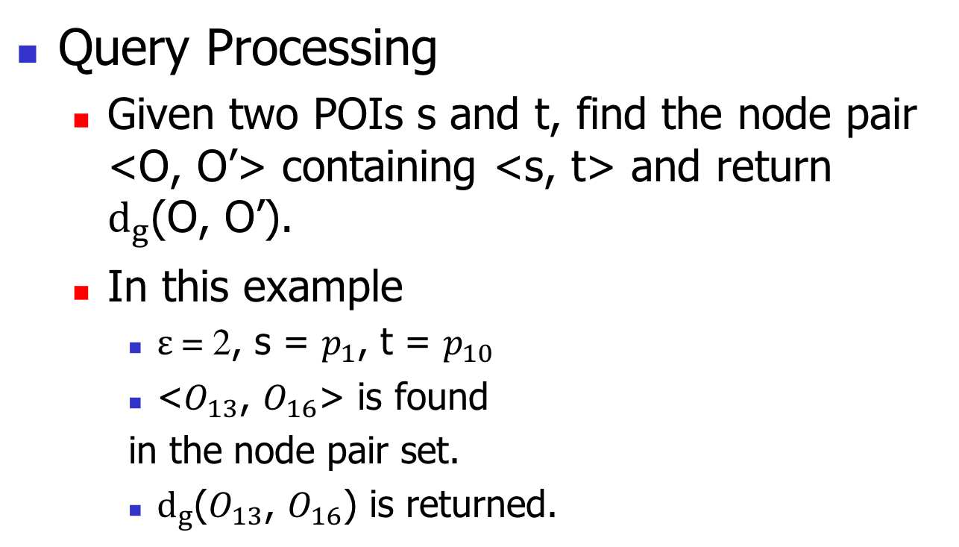
2. Proposed Oracle
Query Processing
  Given two POIs s and t, find the node pair <O, O’> containing <s, t> and return $d_{g}$(O, O’).
  In this example
    $ε$ = 2, s = $p_{1}$, t = $p_{10}$
    <$O_{13}$, $O_{16}$> is found
    in the node pair set.
    $d_{g}$($O_{13}$, $O_{16}$) is returned.

Slide 28

2. Proposed Oracle
Query Processing
  Given two POIs s and t, find the node pair <O, O’> containing <s, t> and return $d_{g}$(O, O’).
  In this example
    $ε$ = 2, s = $p_{1}$, t = $p_{10}$
    <$O_{13}$, $O_{16}$> is found
    in the node pair set.
    $d_{g}$($O_{13}$, $O_{16}$) is returned.
  i.e., $d_{g}$($p_{2}$, $p_{10}$)

Slide 29
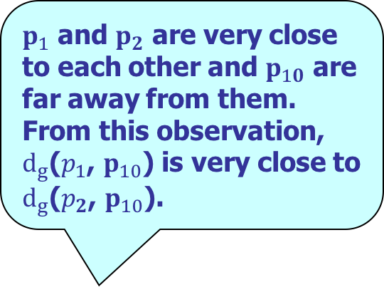
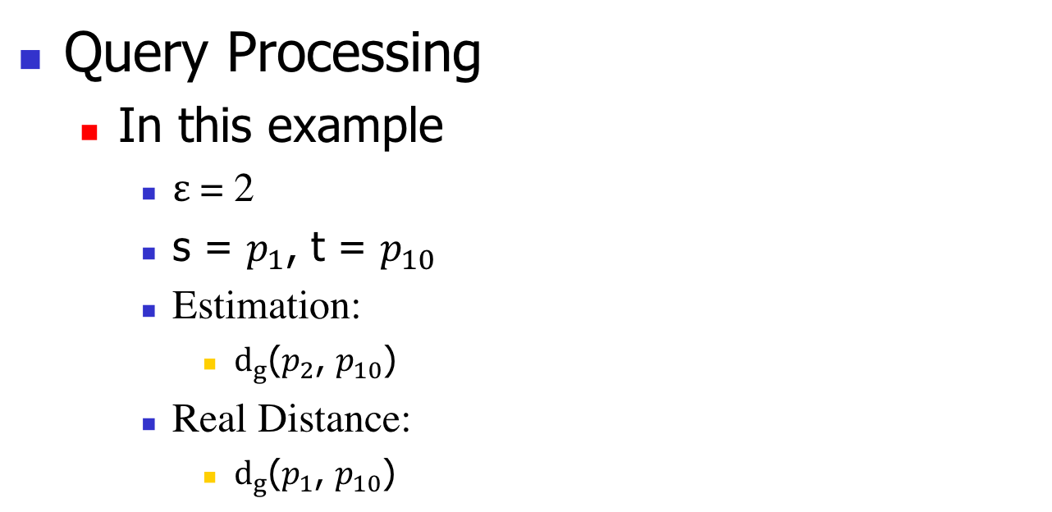
2. Proposed Oracle
  $p_{1}$ and $p_{2}$ are very close to each other and $p_{10}$ are far away from them. From this observation, $d_{g}$($p_{1}$, $p_{10}$) is very close to $d_{g}$($p_{2}$, $p_{10}$).
Query Processing
  In this example
    $ε$ = 2
    s = $p_{1}$, t = $p_{10}$
    Estimation:
      $d_{g}$($p_{2}$, $p_{10}$)
    Real Distance:
      $d_{g}$($p_{1}$, $p_{10}$)
  = 10
  = 9.6
  Multiplicative Error = (10 – 9.6)/9.6 = 0.042

Slide 30
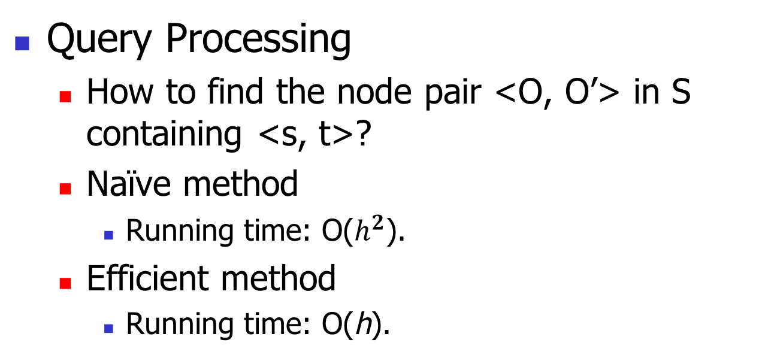
2. Proposed Oracle
Query Processing
  How to find the node pair <O, O’> in S containing <s, t>?
  Naïve method
    Running time: O($h^{2}$).
  Efficient method
    Running time: O(h).
  h is the height of the compressed partition tree.

Slide 31
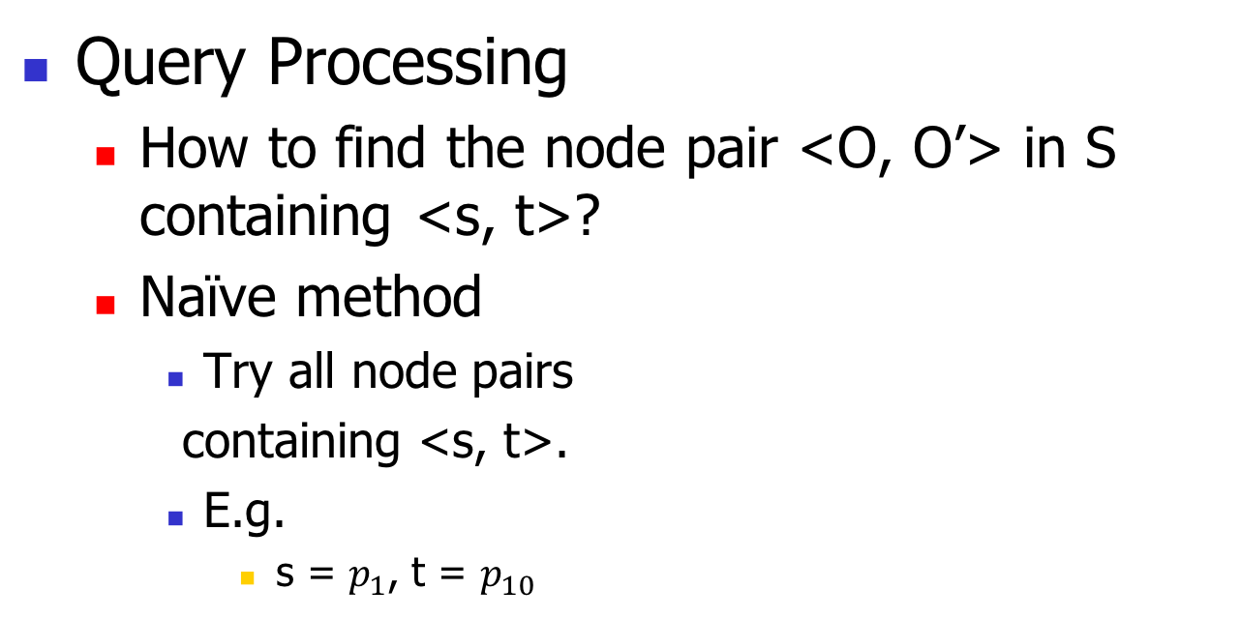
2. Proposed Oracle
Query Processing
  How to find the node pair <O, O’> in S containing <s, t>?
  Naïve method
    Try all node pairs
    containing <s, t>.
    E.g.
      s = $p_{1}$, t = $p_{10}$

Slide 32
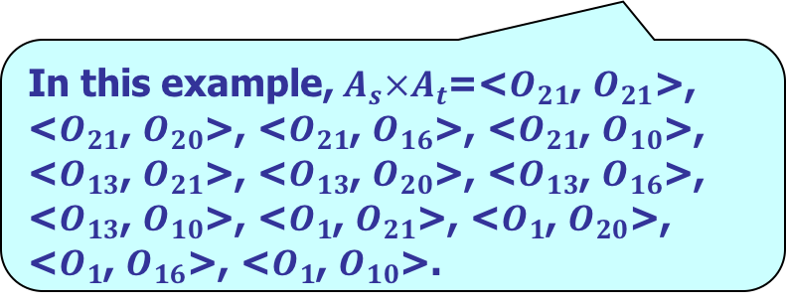
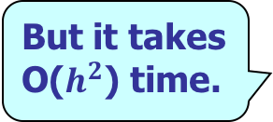
2. Proposed Oracle
Query Processing
  How to find the node pair <O, O’> in S containing <s, t>?
  Naïve method
    Try all node pairs
    containing <s, t>.
  But it takes O($h^{2}$) time.
  In this example, $A_{s}×A_{t}$=<$O_{21}$, $O_{21}$>, <$O_{21}$, $O_{20}$>, <$O_{21}$, $O_{16}$>, <$O_{21}$, $O_{10}$>, <$O_{13}$, $O_{21}$>, <$O_{13}$, $O_{20}$>, <$O_{13}$, $O_{16}$>, <$O_{13}$, $O_{10}$>, <$O_{1}$, $O_{21}$>, <$O_{1}$, $O_{20}$>, <$O_{1}$, $O_{16}$>, <$O_{1}$, $O_{10}$>.
12 pairs in total.

Slide 33
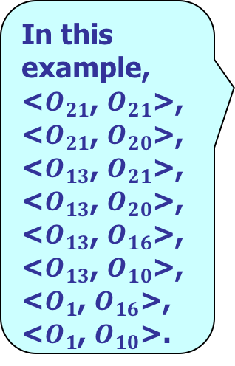
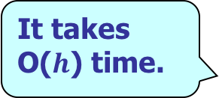
2. Proposed Oracle
Query Processing
  How to find the node pair <O, O’>in S containing <s, t>?
  Efficient method
    Try every possible
    node pair such that
      it contains <s, t>.
      it satisfies Layer
      Property.
Each node pair <O, O’> in S satisfies a property called Layer Property.
  It takes O($h$) time.
  In this example, <$O_{21}$, $O_{21}$>, <$O_{21}$, $O_{20}$>, <$O_{13}$, $O_{21}$>, <$O_{13}$, $O_{20}$>, <$O_{13}$, $O_{16}$>, <$O_{13}$, $O_{10}$>, <$O_{1}$, $O_{16}$>, <$O_{1}$, $O_{10}$>.
8 pairs in total.

Slide 34
Outline
Introduction
  Related Work
Proposed Oracle
  Preprocessing Phase
  Query Phase
Experiment
Conclusion

Slide 35
3. Experiment
Settings
  Dataset
  C++, Linux Machine with 2.67Hz CPU and 48GB memory.
Dataset | # of Vertices | Resolution | Region Covered | # of POIs
BH | 1.4M | 10 meters | 14km * 10km | 4k
EP | 1.5M | 10 meters | 10.7km * 14km | 4k
SF | 170k | 30 meters | 14km * 11.1km | 51k

Slide 36

3. Experiment
Settings
  Baselines
    SP-Oracle [ESA 2010]: Best Existing Distance Oracle
    K-Algo [VLDB 2015]: Fastest On-the-fly Algorithm
  Measurements
    Oracle Building Time
    Oracle Size
    Query Time
  They both provide $ε$-approximate distance.

Slide 37

3. Experiment
  The building time (resp. space) of SE is smaller than that of SP-Oracle by 1-2 (1-3) orders of magnitude.
Results
SF Dataset, Varying $ε$
  The query time of SE is smaller than that of SP-Oracle (resp. K-Algo) by 2-3 (resp. 5-7) orders of magnitude.

Slide 38
Outline
Introduction
  Related Work
Proposed Oracle
  Preprocessing Phase
  Query Phase
Experiment
Conclusion

Slide 39
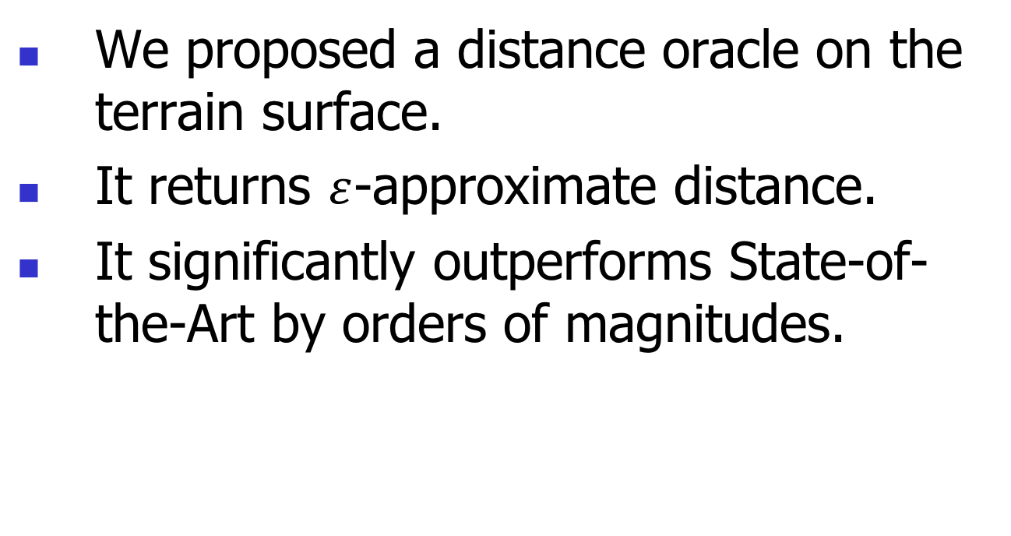
4. Conclusion
We proposed a distance oracle on the terrain surface.
It returns $ε$-approximate distance.
It significantly outperforms State-of-the-Art by orders of magnitudes.

Slide 40
Q&A

Slide 41
V2V and A2A Query Processing
V2V Query
  V2V Query is a special case of P2P Query where all vertices are treated as POIs.
A2A Query
  Preprocessing:
    We first introduce the Steiner points as SP-Oracle.
    We treats the Steiner points as POIs and build SE.

Slide 42
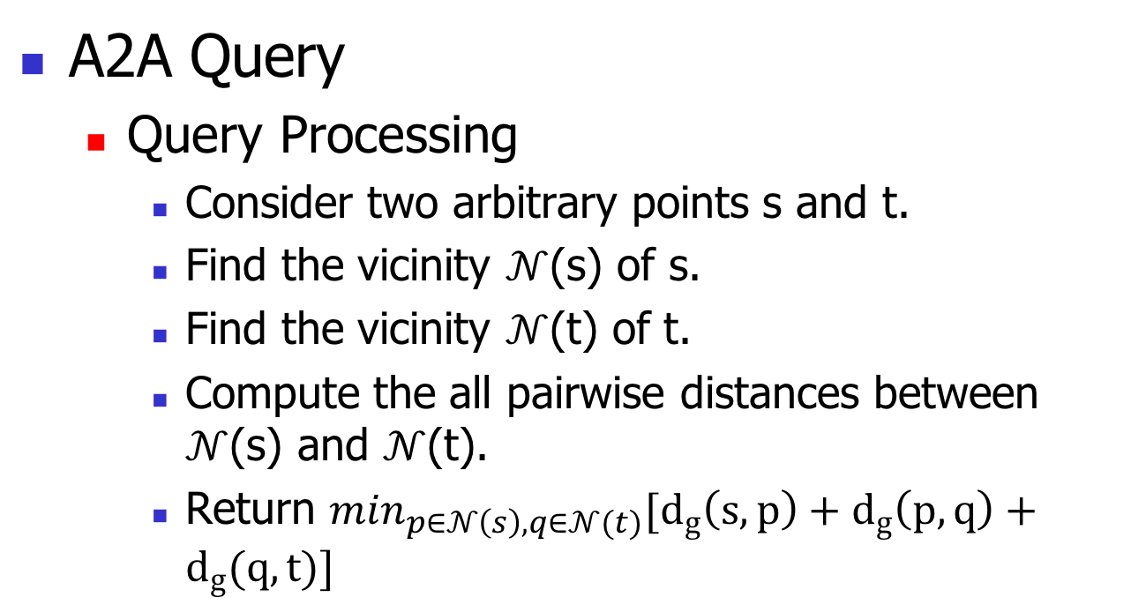
V2V and A2A Query Processing
  The vicinity of a point is the set of Steiner points on the face of the point and its adjacent faces.
A2A Query
  Query Processing
    Consider two arbitrary points s and t.
    Find the vicinity $𝒩$(s) of s.
    Find the vicinity $𝒩$(t) of t.
    Compute the all pairwise distances between $𝒩$(s) and $𝒩$(t).
    Return $\min_{p∈𝒩\left(s\right), q∈𝒩(t)}[d_{g}\left(s, p\right)+d_{g}\left(p,q\right)+d_{g}(q, t)]$

Slide 43

Additional Experimental Results
P2P Query
BH Dataset, Varying $ε$

Slide 44

Additional Experimental Results
P2P Query
EP Dataset, Varying $ε$

Slide 45

Additional Experimental Results
  The generated POIs follows a Normal distribution which has the same mean and variance as the original POIs.
P2P Query
SF Dataset, Varying $n$

Slide 46

Additional Experimental Results
  The generated terrain is simplified from the higher resolution SF dataset
P2P Query
SF Dataset, Varying $N$

Slide 47
Additional Experimental Results
V2V Query
BH Dataset (Low Resolution, 145k vertices), Varying $ε$

Slide 48
Additional Experimental Results
A2A Query
BH Dataset (Low Resolution, 145k vertices), Varying $ε$

Slide 49
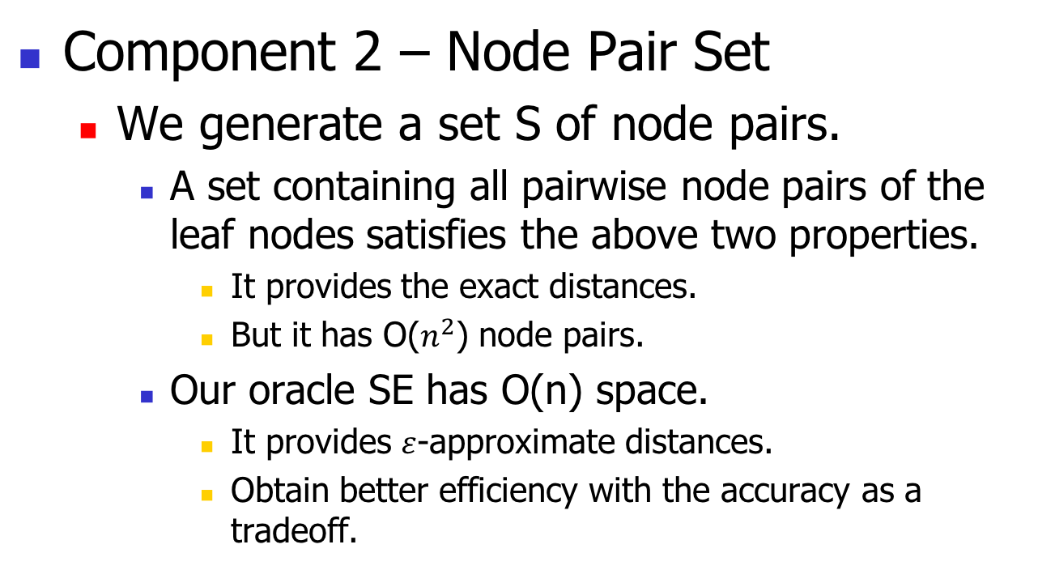
2. Proposed Oracle
  In other words, it is to materialize all pairwise distances of P.
Component 2 – Node Pair Set
  We generate a set S of node pairs.
    A set containing all pairwise node pairs of the leaf nodes satisfies the above two properties.
      It provides the exact distances.
      But it has O($n^{2}$) node pairs.
    Our oracle SE has O(n) space.
      It provides $ε$-approximate distances.
      Obtain better efficiency with the accuracy as a tradeoff.

Slide 50
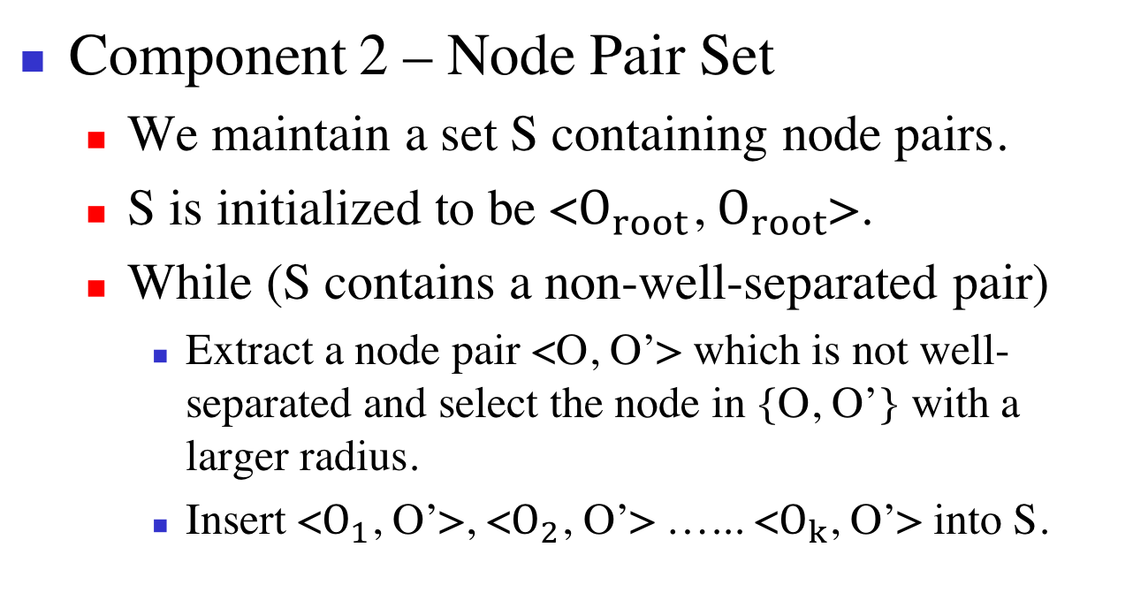
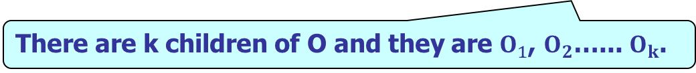
2. Proposed Oracle
  If they have the same radius, pick the one with smaller node ID. If they have the same radius and the same node ID, pick the second one in the pair.
Component 2 – Node Pair Set
  We maintain a set S containing node pairs.
  S is initialized to be <$O_{root}$, $O_{root}$>.
  While (S contains a non-well-separated pair)
    Extract a node pair <O, O’> which is not well-separated and select the node in {O, O’} with a larger radius.
    Insert <$O_{1}$, O’>, <$O_{2}$, O’> …... <$O_{k}$, O’> into S.
  Without loss of generality, we assume that O is picked.
  There are k children of O and they are $O_{1}$, $O_{2}$…... $O_{k}$.

Slide 51
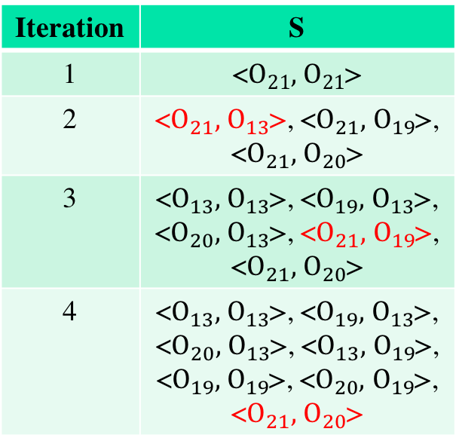
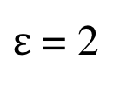
2. Proposed Oracle
Component 2 – Node Pair Set
$ε$ = 2
Iteration | S
1 | <$O_{21},$ $O_{21}$>
2 | <$O_{21},$ $O_{13}$>, <$O_{21},$ $O_{19}$>, <$O_{21},$ $O_{20}$>
3 | <$O_{13},$ $O_{13}$>, <$O_{19},$ $O_{13}$>, <$O_{20},$ $O_{13}$>, <$O_{21},$ $O_{19}$>, <$O_{21},$ $O_{20}$>
4 | <$O_{13},$ $O_{13}$>, <$O_{19},$ $O_{13}$>, <$O_{20},$ $O_{13}$>, <$O_{13},$ $O_{19}$>, <$O_{19},$ $O_{19}$>, <$O_{20},$ $O_{19}$>, <$O_{21},$ $O_{20}$>

Slide 52
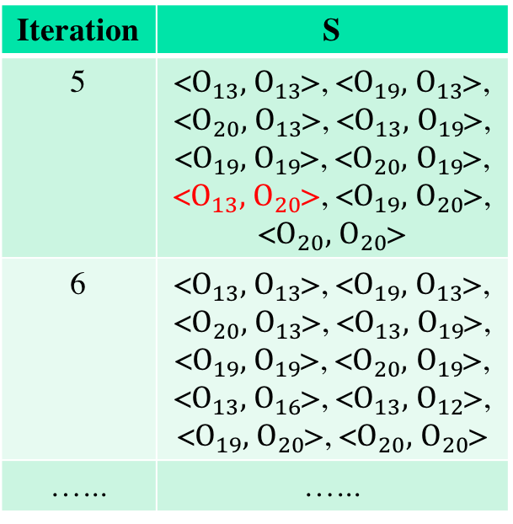
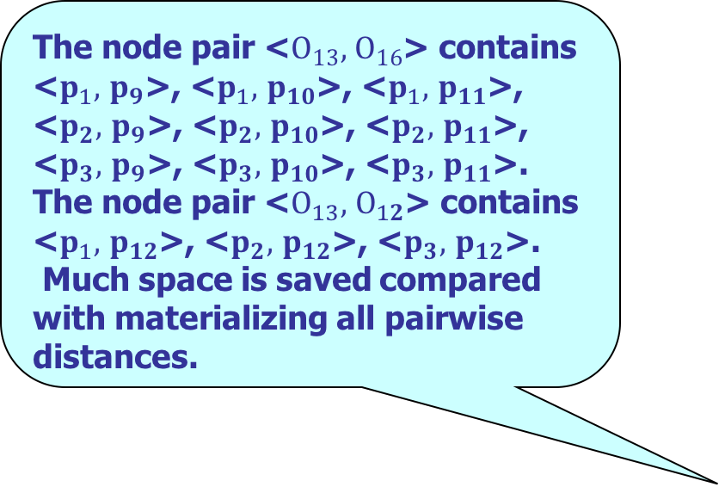
2. Proposed Oracle
  The node pair <$O_{13},$ $O_{16}$> contains <$p_{1},$ $p_{9}$>, <$p_{1},$ $p_{10}$>, <$p_{1},$ $p_{11}$>, <$p_{2},$ $p_{9}$>, <$p_{2},$ $p_{10}$>, <$p_{2},$ $p_{11}$>, <$p_{3},$ $p_{9}$>, <$p_{3},$ $p_{10}$>, <$p_{3},$ $p_{11}$>.
  The node pair <$O_{13},$ $O_{12}$> contains <$p_{1},$ $p_{12}$>, <$p_{2},$ $p_{12}$>, <$p_{3},$ $p_{12}$>.
  Much space is saved compared with materializing all pairwise distances.
Component 2 – Node Pair Set
$ε$ = 2
Iteration | S
5 | <$O_{13},$ $O_{13}$>, <$O_{19},$ $O_{13}$>, <$O_{20},$ $O_{13}$>, <$O_{13},$ $O_{19}$>, <$O_{19},$ $O_{19}$>, <$O_{20},$ $O_{19}$>, <$O_{13},$ $O_{20}$>, <$O_{19},$ $O_{20}$>, <$O_{20},$ $O_{20}$>
6 | <$O_{13},$ $O_{13}$>, <$O_{19},$ $O_{13}$>, <$O_{20},$ $O_{13}$>, <$O_{13},$ $O_{19}$>, <$O_{19},$ $O_{19}$>, <$O_{20},$ $O_{19}$>, <$O_{13},$ $O_{16}$>, <$O_{13},$ $O_{12}$>, <$O_{19},$ $O_{20}$>, <$O_{20},$ $O_{20}$>
…... | …...
  They are well-separated and will not be extracted anymore.

Slide 53
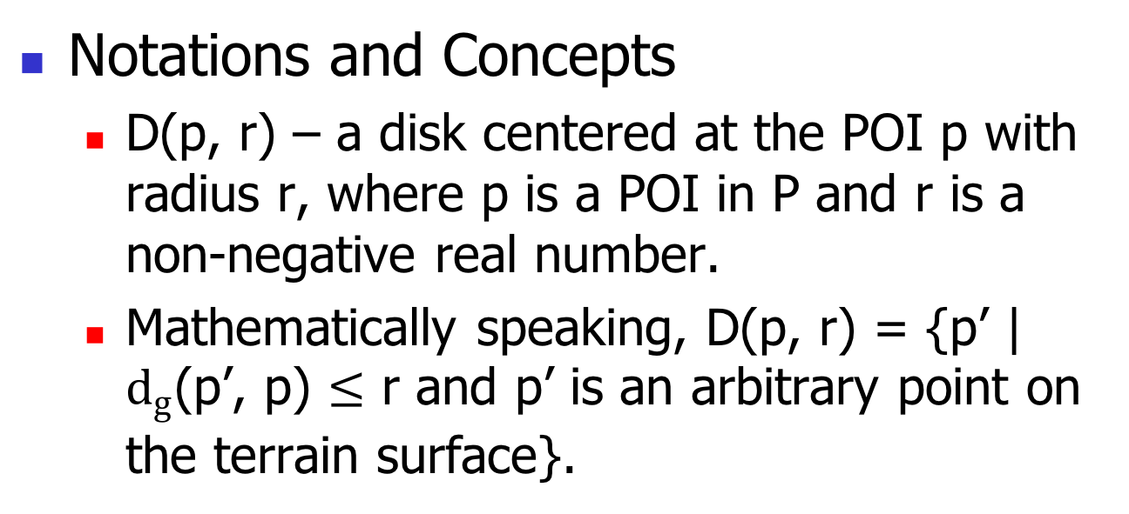
2. Proposed Oracle
Notations and Concepts
  D(p, r) – a disk centered at the POI p with radius r, where p is a POI in P and r is a non-negative real number.
  Mathematically speaking, D(p, r) = {p’ | $d_{g}$(p’, p) $≤$ r and p’ is an arbitrary point on the terrain surface}.

Slide 54
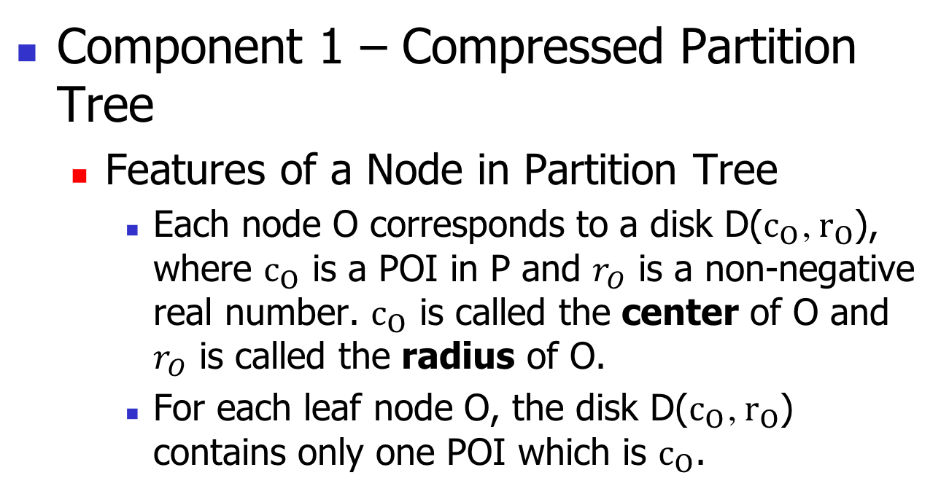
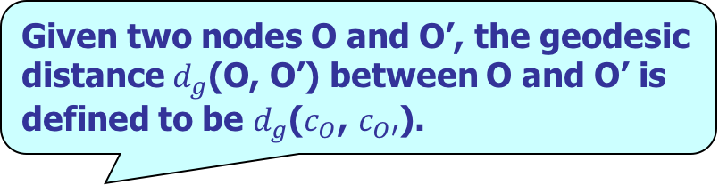
2. Proposed Oracle
Component 1 – Compressed Partition Tree
  Features of a Node in Partition Tree
    Each node O corresponds to a disk D($c_{O}$, $r_{O}$), where $c_{O}$ is a POI in P and $r_{O}$ is a non-negative real number. $c_{O}$ is called the center of O and $r_{O}$ is called the radius of O.
    For each leaf node O, the disk D($c_{O}$, $r_{O}$) contains only one POI which is $c_{O}$.
Given two nodes O and O’, the geodesic distance $d_{g}$(O, O’) between O and O’ is defined to be $d_{g}$($c_{O}$, $c_{O′}$).

Slide 55
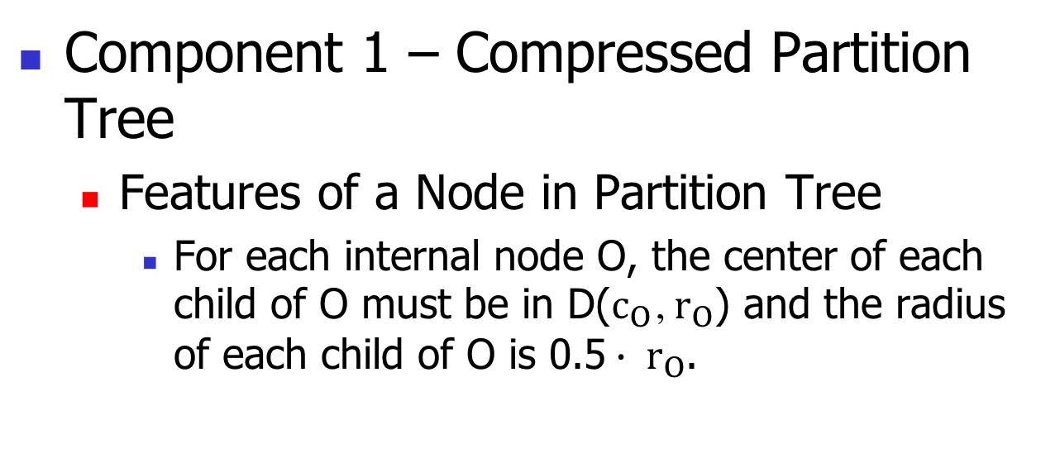
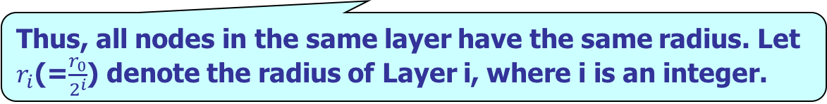
2. Proposed Oracle
Component 1 – Compressed Partition Tree
  Features of a Node in Partition Tree
    For each internal node O, the center of each child of O must be in D($c_{O}$, $r_{O}$) and the radius of each child of O is 0.5$∙ r_{O}$.
Thus, all nodes in the same layer have the same radius. Let $r_{i}$(=$\frac{r_{0}}{2^{i}}$) denote the radius of Layer i, where i is an integer.

Slide 56
2. Proposed Oracle
Component 1 – Compressed Partition Tree
  Four Features of A Node
    For each internal node O, the center of each child of O must be in D($c_{O}$, $r_{O}$) and the radius of each child of O is 0.5$∙ r_{O}$.
    The representative set of a node O is defined to be the centers of all leaf nodes in the subtree rooted at O.

Slide 57
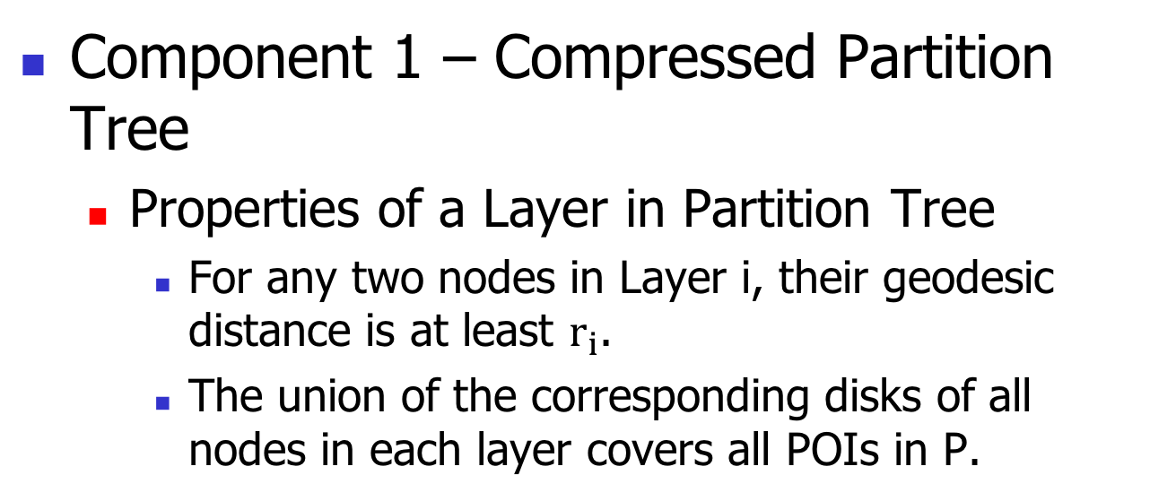
2. Proposed Oracle
Component 1 – Compressed Partition Tree
  Properties of a Layer in Partition Tree
    For any two nodes in Layer i, their geodesic distance is at least $r_{i}$.
    The union of the corresponding disks of all nodes in each layer covers all POIs in P.

Slide 58
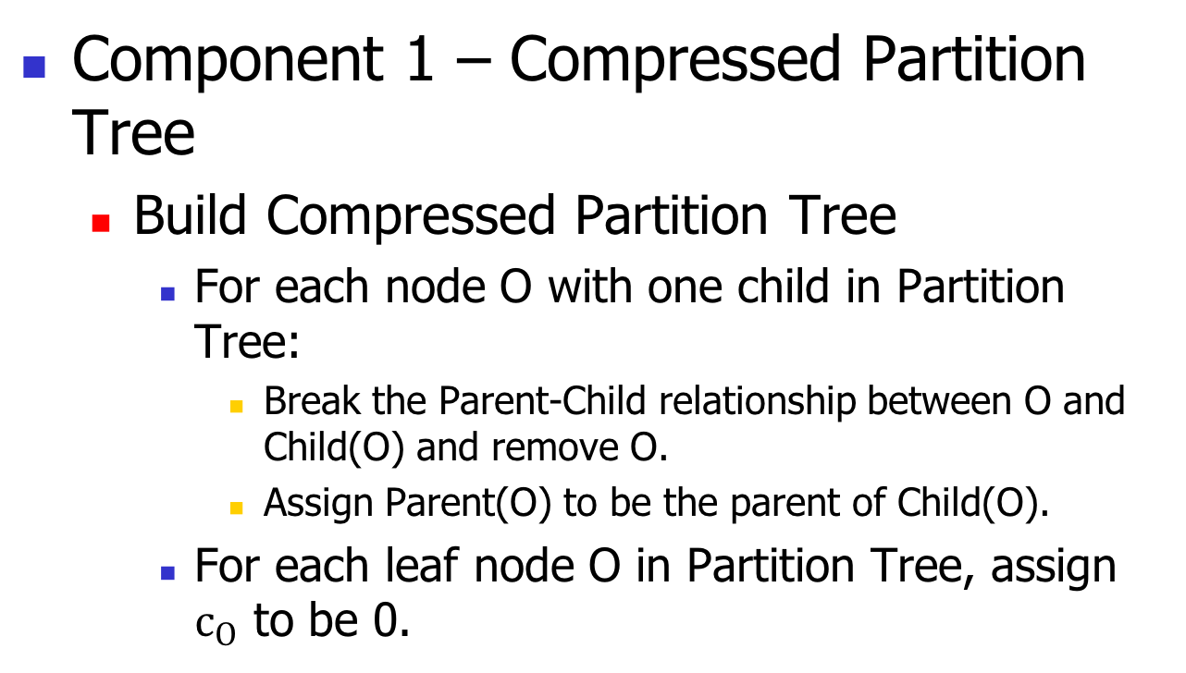
2. Proposed Oracle
Component 1 – Compressed Partition Tree
  Build Compressed Partition Tree
    For each node O with one child in Partition Tree:
      Break the Parent-Child relationship between O and Child(O) and remove O.
      Assign Parent(O) to be the parent of Child(O).
    For each leaf node O in Partition Tree, assign $c_{O}$ to be 0.
Let Parent(O) denote its parent and Child(O) denote its child.

Slide 59
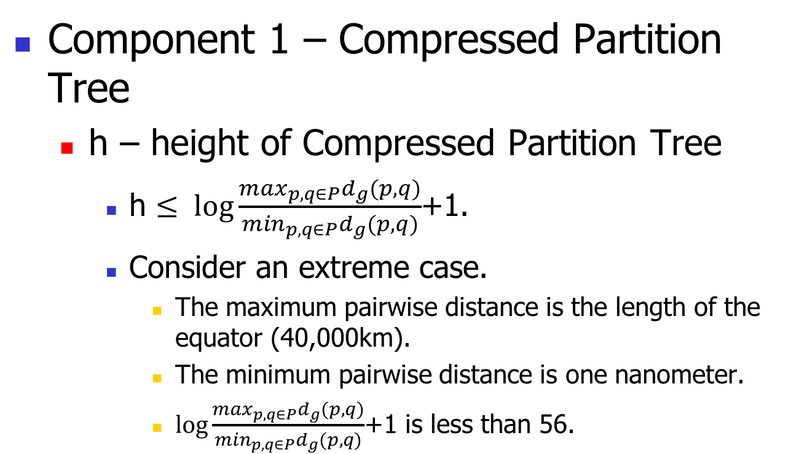
2. Proposed Oracle
Component 1 – Compressed Partition Tree
  h – height of Compressed Partition Tree
    h $≤ \log{\frac{\max_{p,q∈P}d_{g}(p,q)}{\min_{p,q∈P}d_{g}(p,q)}}$+1.
    Consider an extreme case.
      The maximum pairwise distance is the length of the equator (40,000km).
      The minimum pairwise distance is one nanometer.
      $\log{\frac{\max_{p,q∈P}d_{g}(p,q)}{\min_{p,q∈P}d_{g}(p,q)}}$+1 is less than 56.
  Proof is omitted.
  In our experiment, h is at most 30.
  i.e., planet-scale distance
  i.e., cell-scale distance

Slide 60
2. Proposed Oracle
Each node pair <O, O’> in S falls in one of the 3 cases.
Case 1. O and O’ are in the same layer.
Case 2. O is in a higher layer than O’ and the parent of O’ is in a higher layer than O or in the same layer as O.
Case 3. O’ is in a higher layer than O and the parent of O is in a higher layer than O’ or in the same layer as O’.
Layer Property
  Related to the node pair generation algorithm. Details omitted.
Query Processing
  How to find the node pair <O, O’>in S containing <s, t>?
  Efficient method
    Try every possible
    node pair such that
      it contains <s, t>.
      it satisfies Layer
      Property.
  It takes O($h$) time.
  In this example, <$O_{21}$, $O_{21}$>, <$O_{21}$, $O_{20}$>, <$O_{13}$, $O_{21}$>, <$O_{13}$, $O_{20}$>, <$O_{13}$, $O_{16}$>, <$O_{13}$, $O_{10}$>, <$O_{1}$, $O_{16}$>, <$O_{1}$, $O_{10}$>.
8 pairs in total.

