Slide 1


QHL: A Fast Algorithm for Exact Constrained Shortest Path Search on Road Networks
Libin Wang, Department of CSE, HKUST
Raymond Chi-Wing Wong, Department of CSE, HKUST

Slide 2
Outline
Motivation
Preliminaries
Methodology
Experiments
Conclusion

Slide 3
Outline
Motivation
Preliminaries
Methodology
Experiments
Conclusion

Slide 4



Motivation: route planning
Route planning plays a critical role in many spatial applications

Slide 5
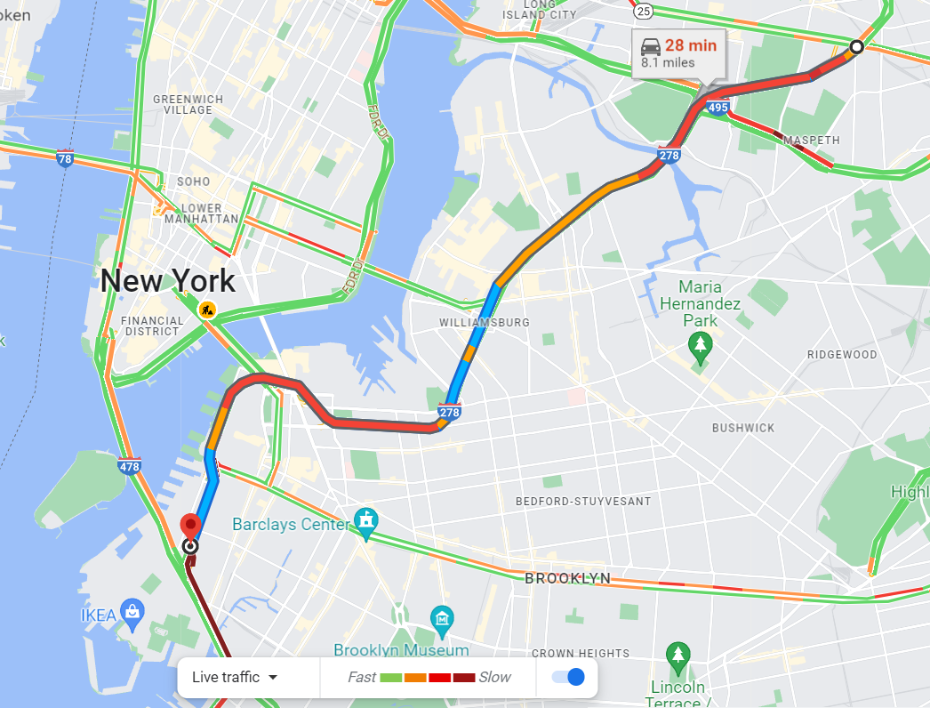
Motivation: one single objective
The recommended route only minimizes the travel time

Slide 6
Motivation: objective under a constraint
Traffic jam
  One may accept slightly long detours to experience less crowded roads
Long-distance trip
  One may not choose highways and bridges with high toll charges under limited budget
Constrained Shortest Path problem (CSP)
NP-hard!

Slide 7




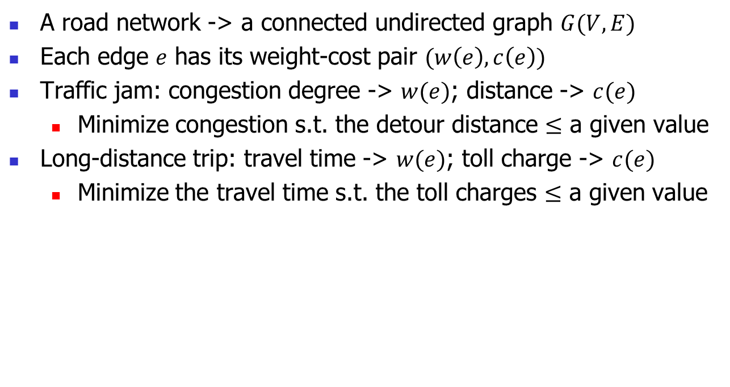


























Motivation: Constrained Shortest Path (CSP) problem
A road network -> a connected undirected graph $G(V,E)$
Each edge $e$ has its weight-cost pair $(w\left(e\right),c\left(e\right))$
Traffic jam: congestion degree -> $w(e)$; distance -> $c(e)$
  Minimize congestion s.t. the detour distance $≤$ a given value
Long-distance trip: travel time -> $w(e)$; toll charge -> $c(e)$
  Minimize the travel time s.t. the toll charges $≤$ a given value
$$v_{1}$$
$$(8,9)$$
$$v_{13}$$
$$(7,6)$$
$$v_{12}$$
$$(3,2)$$
$$(2,5)$$
$$(1,1)$$
$$v_{6}$$
$$(2,3)$$
$$(1,2)$$
$$v_{8}$$
$$(2,4)$$
$$v_{3}$$
$$v_{11}$$
$$v_{4}$$
$$(2,1)$$
$$(6,2)$$
$$(6,3)$$
$$(2,2)$$
$$v_{7}$$
$$(4,2)$$
$$(1,6)$$
$$(1,1)$$
$$(3,4)$$
$$(5,2)$$
$$v_{2}$$
$$v_{9}$$
$$v_{10}$$
$$v_{5}$$

Slide 8
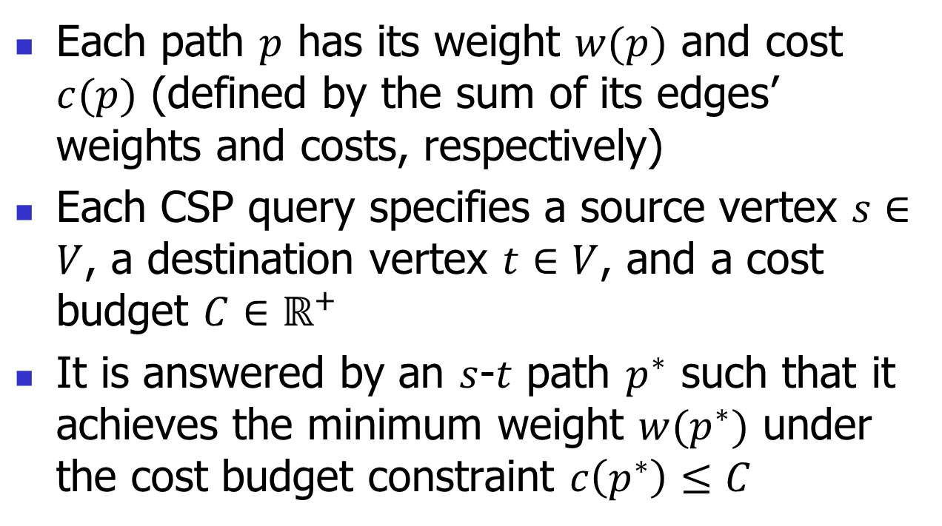
Motivation: Constrained Shortest Path (CSP) query
Each path $p$ has its weight $w(p)$ and cost $c(p)$ (defined by the sum of its edges’ weights and costs, respectively)
Each CSP query specifies a source vertex $s∈V$, a destination vertex $t∈V$, and a cost budget $C∈ℝ^{+}$
It is answered by an $s$-$t$ path $p^{∗}$ such that it achieves the minimum weight $w(p^{∗})$ under the cost budget constraint $c\left(p^{∗}\right)≤C$

Slide 9

Definition: CSP query example
CSP query: $s=v_{8},t=v_{4},C=13$
Without the cost budget constraint, the path with the minimum weight is $p=(v_{8},v_{2},v_{9},v_{10},v_{11},v_{6},v_{12},v_{4})$ with $w\left(p\right)=16$, but its cost $c\left(p\right)=18$ violates the cost budget of 13
$$v_{1}$$
$$(8,9)$$
$$v_{13}$$
$$(7,6)$$
$$v_{12}$$
$$(3,2)$$
$$(2,5)$$
$$(1,1)$$
$$v_{6}$$
$$(2,3)$$
$$(1,2)$$
$$v_{8}$$
$$(2,4)$$
$$v_{3}$$
$$v_{11}$$
$$v_{4}$$
$$(2,1)$$
$$(6,2)$$
$$(6,3)$$
$$(2,2)$$
$$v_{7}$$
$$(4,2)$$
$$(1,6)$$
$$(1,1)$$
$$(3,4)$$
$$(5,2)$$
$$v_{2}$$
$$v_{9}$$
$$v_{10}$$
$$v_{5}$$

Slide 10

Definition: CSP query example
CSP query: $s=v_{8},t=v_{4},C=13$
Under the cost budget constraint, the CSP answer $p^{∗}=(v_{8},v_{2},v_{9},v_{10},v_{5},v_{4})$ with its minimum weight $w\left(p^{∗}\right)=17$ and $c\left(p^{∗}\right)=13≤C=13$
$$v_{1}$$
$$(8,9)$$
$$v_{13}$$
$$(7,6)$$
$$v_{12}$$
$$(3,2)$$
$$(2,5)$$
$$(1,1)$$
$$v_{6}$$
$$(2,3)$$
$$(1,2)$$
$$v_{8}$$
$$(2,4)$$
$$v_{3}$$
$$v_{11}$$
$$v_{4}$$
$$(2,1)$$
$$(6,2)$$
$$(6,3)$$
$$(2,2)$$
$$v_{7}$$
$$(4,2)$$
$$(1,6)$$
$$(1,1)$$
$$(3,4)$$
$$(5,2)$$
$$v_{2}$$
$$v_{9}$$
$$v_{10}$$
$$v_{5}$$

Slide 11
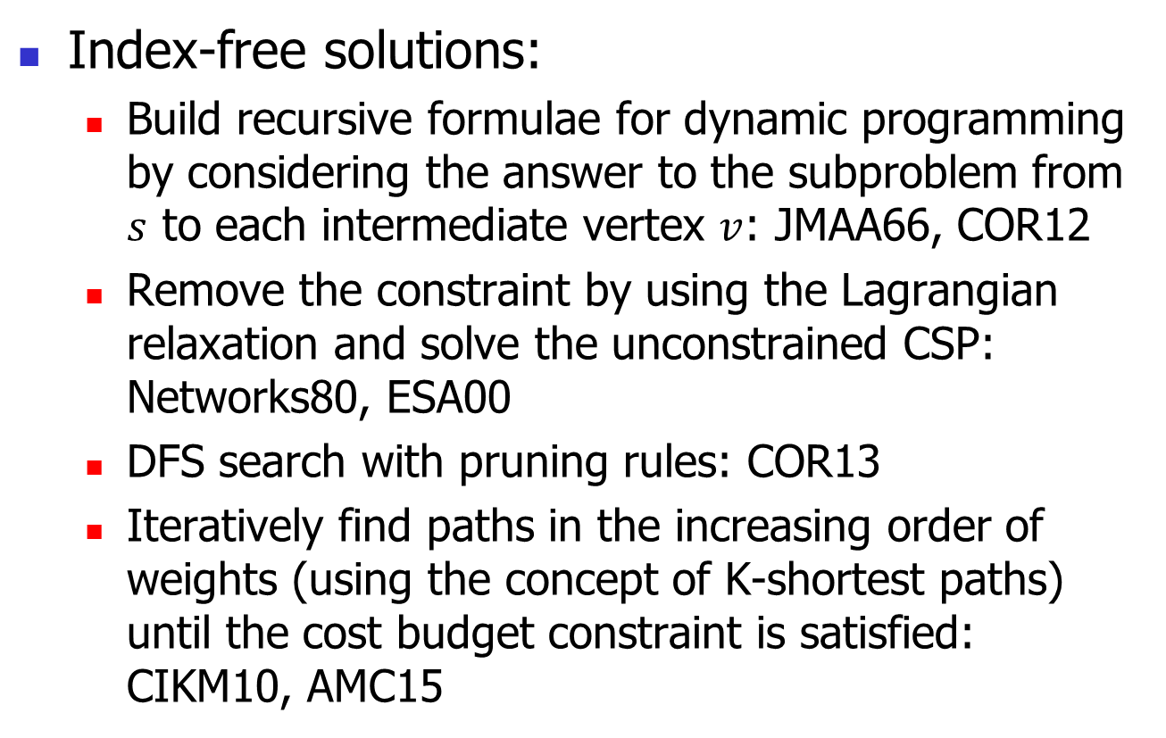
Motivation: related work
Index-free solutions:
  Build recursive formulae for dynamic programming by considering the answer to the subproblem from $s$ to each intermediate vertex $v$: JMAA66, COR12
  Remove the constraint by using the Lagrangian relaxation and solve the unconstrained CSP: Networks80, ESA00
  DFS search with pruning rules: COR13
  Iteratively find paths in the increasing order of weights (using the concept of K-shortest paths) until the cost budget constraint is satisfied: CIKM10, AMC15

Slide 12
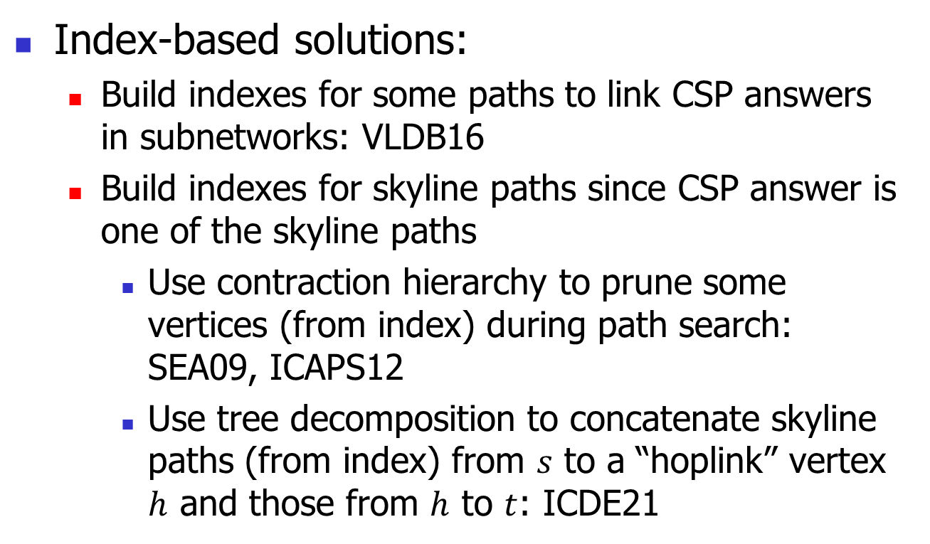
Motivation: related work
But, CSP-2Hop essentially finds skyline paths, which overlooks CSP query information that can be used to prune computations. For example, not all skyline paths satisfy the cost budget constraint
Index-based solutions:
  Build indexes for some paths to link CSP answers in subnetworks: VLDB16
  Build indexes for skyline paths since CSP answer is one of the skyline paths
    Use contraction hierarchy to prune some vertices (from index) during path search: SEA09, ICAPS12
    Use tree decomposition to concatenate skyline paths (from index) from $s$ to a “hoplink” vertex $h$ and those from $h$ to $t$: ICDE21
Proposed CSP-2Hop with its query time orders of magnitude faster than all the other solutions

Slide 13
Contributions
We propose an index-based exact solution, called Query-aware Hop Labeling (QHL), which is specific to CSP queries
We design several useful pruning strategies by fully utilizing CSP query information
QHL runs faster than the state-of-the-art CSP-2Hop by up to two orders of magnitude, and its time complexity has one fewer multiplier than CSP-2Hop’s complexity

Slide 14
Outline
Motivation
Preliminaries
Methodology
Experiments
Conclusion

Slide 15
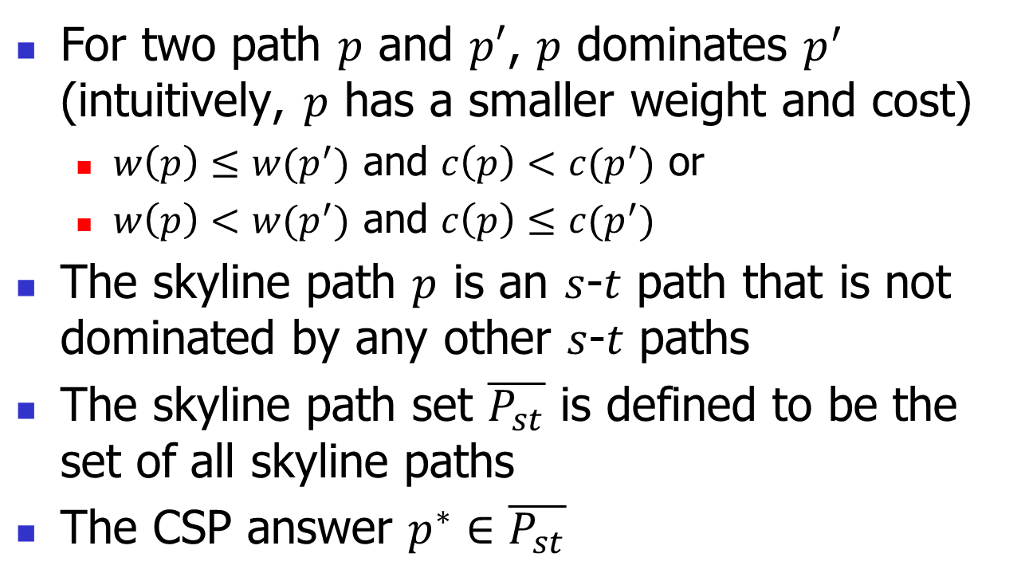
Preliminaries: skyline paths
For two path $p$ and $p′$, $p$ dominates $p^{′}$ (intuitively, $p$ has a smaller weight and cost)
  $w\left(p\right)≤w(p^{′})$ and $c\left(p\right)<c(p^{′})$ or
  $w\left(p\right)<w(p^{′})$ and $c\left(p\right)≤c(p^{′})$
The skyline path $p$ is an $s$-$t$ path that is not dominated by any other $s$-$t$ paths
The skyline path set $\overline{P_{st}}$ is defined to be the set of all skyline paths
The CSP answer $p^{∗}∈\overline{P_{st}}$

Slide 16







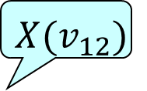
























Preliminaries: tree decomposition
A tree decomposition maps the network to a tree
  For each vertex $v∈V$, there is a tree node $X(v)$
In each tree node, there is a vertex set (also denoted by $X(v)$)
  $X\left(v_{12}\right)=\{v_{12},v_{13}\}$
$$X(v_{12})$$
$${ v}_{13}$$
$$v_{1}$$
$$(8,9)$$
$$v_{13}$$
$$(7,6)$$
$$v_{12}$$
$${ v}_{12},v_{13}$$
$$(3,2)$$
$$(2,5)$$
$$(1,1)$$
$$v_{6}$$
$$(2,3)$$
$${ v}_{11},v_{12}, v_{13}$$
$$(1,2)$$
$$v_{8}$$
$$(2,4)$$
$$v_{3}$$
$$v_{11}$$
$$v_{4}$$
$${ v}_{10},v_{11}, v_{12}, v_{13}$$
$${ v}_{6},v_{11}, v_{12}$$
$$(2,1)$$
$$(6,2)$$
$$(6,3)$$
$$(2,2)$$
$$v_{7}$$
$$(4,2)$$
$${ v}_{9},v_{10}, v_{13}$$
$${ v}_{5},v_{10}, v_{12}$$
$${ v}_{7},v_{10}, v_{11}$$
$$(1,6)$$
$$(1,1)$$
$$(3,4)$$
$$(5,2)$$
$${ v}_{8},v_{9}, v_{13}$$
$${ v}_{4},v_{5}, v_{12}$$
$$v_{2}$$
$$v_{9}$$
$$v_{10}$$
$$v_{5}$$
$${ v}_{1},v_{8}, v_{13}$$
$${ v}_{2},v_{8}, v_{9}$$
$${ v}_{3},v_{8}, v_{9}$$

Slide 17


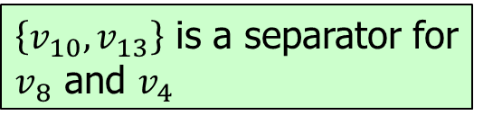








Preliminaries: separator
The separator for $s$ and $t$ is a vertex set such that any $s$-$t$ path must visit at least one vertex in it
$$v_{1}$$
$$(8,9)$$
$$v_{13}$$
$$(7,6)$$
$$v_{12}$$
$$(3,2)$$
$\left\{v_{10},v_{13}\right\}$ is a separator for $v_{8}$ and $v_{4}$
$$(2,5)$$
$$(1,1)$$
$$v_{6}$$
$$(2,3)$$
$$(1,2)$$
$$v_{8}$$
$$(2,4)$$
$$v_{3}$$
$$v_{11}$$
$$v_{4}$$
$$(2,1)$$
$$(6,2)$$
$$(6,3)$$
$$(2,2)$$
$$v_{7}$$
$$(4,2)$$
$$(1,6)$$
$$(1,1)$$
$$(3,4)$$
$$(5,2)$$
$$v_{2}$$
$$v_{9}$$
$$v_{10}$$
$$v_{5}$$

Slide 18

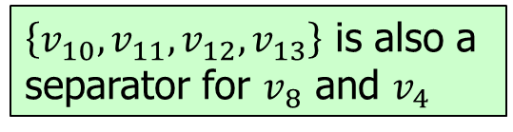
Preliminaries: separator in LCA
The separator for $s$ and $t$ is a vertex set such that any $s$-$t$ path must visit at least one vertex in it
Property: The vertex set $X(l)$ of the least common ancestor (LCA) node of $X(s)$ and $X(t)$ is a separator for $s$ and $t$
$$v_{1}$$
$$(8,9)$$
$$v_{13}$$
$$(7,6)$$
$$v_{12}$$
$$(3,2)$$
$\left\{v_{10},v_{13}\right\}$ is a separator for $v_{8}$ and $v_{4}$
$$(2,5)$$
$$(1,1)$$
$$v_{6}$$
$$(2,3)$$
$$(1,2)$$
$$v_{8}$$
$$(2,4)$$
$$v_{3}$$
$$v_{11}$$
$$v_{4}$$
$\left\{v_{10},v_{11},v_{12},v_{13}\right\}$ is also a separator for $v_{8}$ and $v_{4}$
$$(2,1)$$
$$(6,2)$$
$$(6,3)$$
$$(2,2)$$
$$v_{7}$$
$$(4,2)$$
$$(1,6)$$
$$(1,1)$$
$$(3,4)$$
$$(5,2)$$
$$v_{2}$$
$$v_{9}$$
$$v_{10}$$
$$v_{5}$$

Slide 19




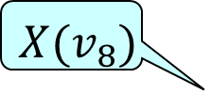














Preliminaries: separator in LCA
Property: The LCA $X(l)$ of $X(s)$ and $X(t)$ is a separator
For $s=v_{8}$ and $t=v_{4}$, its LCA $X\left(v_{10}\right)=\{v_{10},v_{11},v_{12},v_{13}\}$ is a separator for $v_{8}$ and $v_{4}$
$${ v}_{13}$$
$$v_{1}$$
$$(8,9)$$
$$v_{13}$$
$$(7,6)$$
$$v_{12}$$
$${ v}_{12},v_{13}$$
$$(3,2)$$
LCA node
$$(2,5)$$
$$(1,1)$$
$$v_{6}$$
$$(2,3)$$
$${ v}_{11},v_{12}, v_{13}$$
$$(1,2)$$
$$v_{8}$$
$$(2,4)$$
$$v_{3}$$
$$v_{11}$$
$$v_{4}$$
$${ v}_{10},v_{11}, v_{12}, v_{13}$$
$${ v}_{6},v_{11}, v_{12}$$
$$(2,1)$$
$$(6,2)$$
$$(6,3)$$
$$(2,2)$$
$$v_{7}$$
$$X(v_{8})$$
$${ v}_{9},v_{10}, v_{13}$$
$${ v}_{5},v_{10}, v_{12}$$
$${ v}_{7},v_{10}, v_{11}$$
$$(4,2)$$
$$(1,6)$$
$$(1,1)$$
$$(3,4)$$
$$(5,2)$$
$$v_{2}$$
$$v_{9}$$
$$v_{10}$$
$$v_{5}$$
$${ v}_{8},v_{9}, v_{13}$$
$${ v}_{4},v_{5}, v_{12}$$
$$X(v_{4})$$
$${ v}_{1},v_{8}, v_{13}$$
$${ v}_{2},v_{8}, v_{9}$$
$${ v}_{3},v_{8}, v_{9}$$

Slide 20





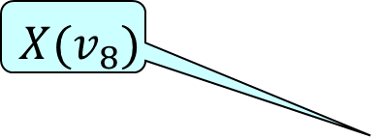

Preliminaries: CSP-2Hop Index
Index: for each tree node $X(v)$, generate the label $L(v)$ that is a set of pairs in the form of $(u,\overline{P_{vu}})$ (skyline path sets) for each ancestor $X(u)$ of $X(v)$
  For $X(v_{8})$, generate $L\left(v_{8}\right)=\{(v_{9},\overline{P_{v_{8}v_{9}}})$, $(v_{10},\overline{P_{v_{8}v_{10}}})$, $(v_{11},\overline{P_{v_{8}v_{11}}})$, $(v_{12},\overline{P_{v_{8}v_{12}}})\text{, }(v_{13},\overline{P_{v_{8}v_{13}}})\}$
$${ v}_{13}$$
$${ v}_{12},v_{13}$$
$${ v}_{11},v_{12}, v_{13}$$
$$X(v_{8})$$
$${ v}_{10},v_{11}, v_{12}, v_{13}$$
$${ v}_{6},v_{11}, v_{12}$$
$${ v}_{9},v_{10}, v_{13}$$
$${ v}_{5},v_{10}, v_{12}$$
$${ v}_{7},v_{10}, v_{11}$$
$${ v}_{8},v_{9}, v_{13}$$
$${ v}_{4},v_{5}, v_{12}$$
$${ v}_{1},v_{8}, v_{13}$$
$${ v}_{2},v_{8}, v_{9}$$
$${ v}_{3},v_{8}, v_{9}$$
Notes:
The two ideas corresponds two algorithms. The first one is spatiotemporal oblivious routing, called SOR. It uses.. The second one is SRH.

Slide 21
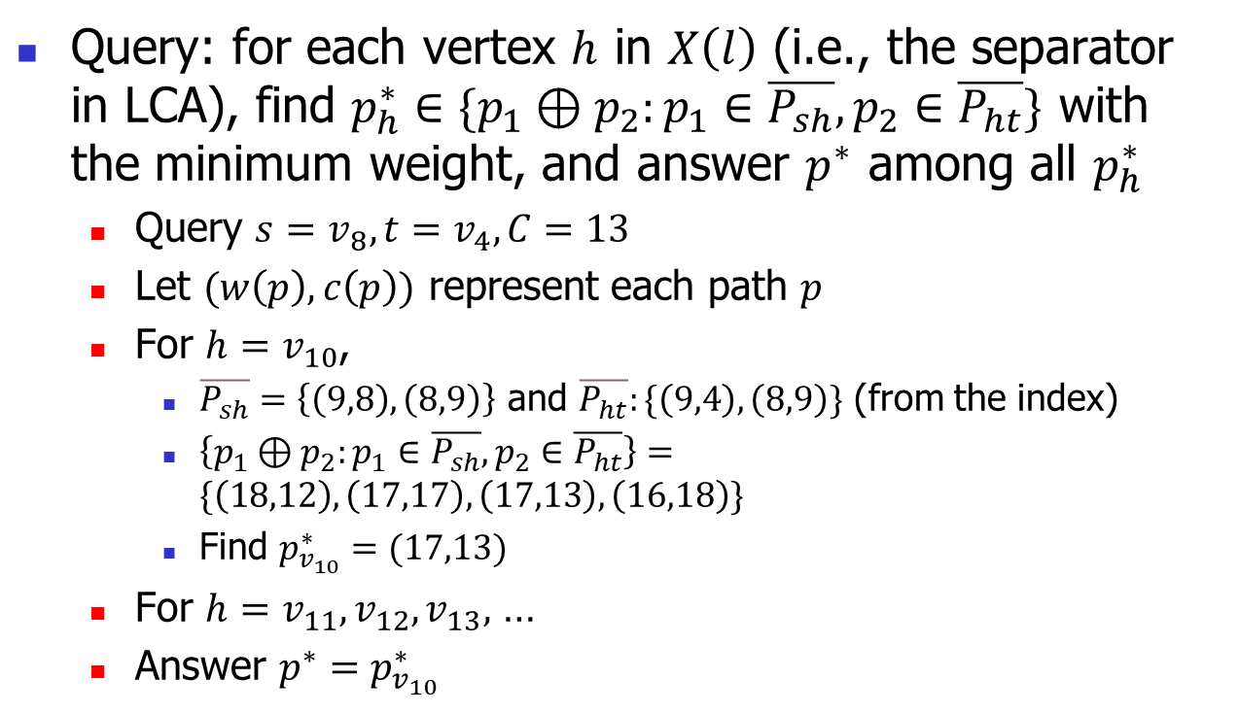
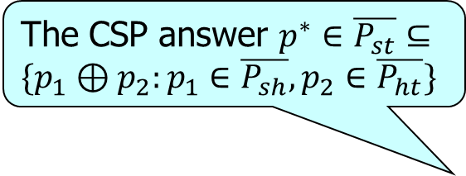
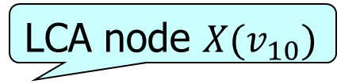

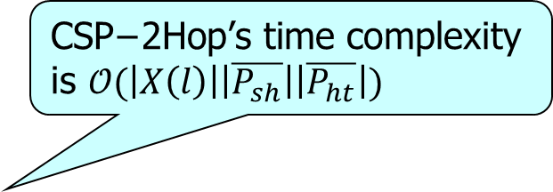


Preliminaries: CSP-2Hop query processing
The CSP answer $p^{∗}∈\overline{P_{st}}⊆\{p_{1}⊕p_{2}:p_{1}∈\overline{P_{sh}}, p_{2}∈\overline{P_{ht}}\}$
$$\text{CSP}\text{−2}\text{Hop}\text{’}\text{s} \text{time} \text{complexity} \text{is} 𝒪(\left|X\left(l\right)\right|\left|\overline{P_{sh}}\right|\left|\overline{P_{ht}}\right|)$$
Query: for each vertex $h$ in $X\left(l\right)$ (i.e., the separator in LCA), find $p_{h}^{∗}∈\{p_{1}⊕p_{2}:p_{1}∈\overline{P_{sh}}, p_{2}∈\overline{P_{ht}}\}$ with the minimum weight, and answer $p^{∗}$ among all $p_{h}^{∗}$
  Query $s=v_{8},t=v_{4}, C=13$
  Let $(w\left(p\right),c\left(p\right))$ represent each path $p$
  For $h=v_{10}$,
    $\overline{P_{sh}}=\left\{\left(9,8\right), \left(8,9\right)\right\}$ and $\overline{P_{ht}}:\{\left(9,4\right), \left(8,9\right)\}$ (from the index)
    $\left\{p_{1}⊕p_{2}:p_{1}∈\overline{P_{sh}}, p_{2}∈\overline{P_{ht}}\right\}=\{\left(18,12\right),\left(17,17\right),\left(17,13\right),\left(16,18\right)\}$
    Find $p_{v_{10}}^{∗}=(17,13)$
  For $h=v_{11},v_{12},v_{13},$ …
  Answer $p^{∗}=p_{v_{10}}^{∗}$
LCA node $X(v_{10})$
$$v_{10}$$
$$v_{11}$$
$$v_{12}$$
$$v_{13}$$
$${X(v}_{8})$$
$${X(v}_{4})$$

Slide 22
Outline
Motivation
Preliminaries
Methodology
Experiments
Conclusion
Notes:
We next introduce our methodology

Slide 23
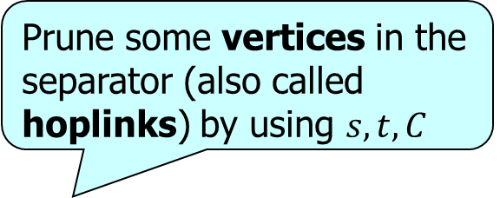





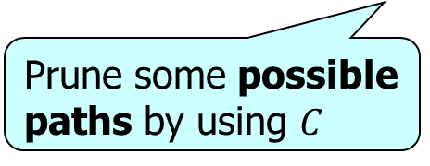






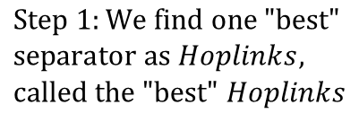

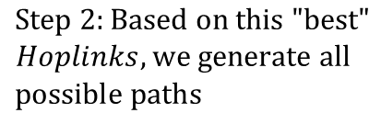














QHL: framework
Prune some vertices in the separator (also called hoplinks) by using $s,t,C$
$$v_{8}:$$
$$8$$
$$14$$
$$0$$
$$0$$
$$Separator H_{1}:$$
$$v_{6}:$$
$$1$$
$$∞$$
$$0$$
$$0$$
$$X(l)$$
$$⋯$$
$$H(s)$$
$$H(t)$$
$$v_{4}:$$
$$0$$
$$3$$
$$0$$
$$X(t)$$
$$Separator H_{2}:$$
$$v_{7}:$$
$$0$$
$$4$$
$$0$$
$$Index:$$
$$X(s)$$
$$Tree decomposition$$
$$⋯$$
$$⋯$$
$$\& Skyline path sets$$
$$Pruning Conditions$$
$$Query$$
$$Processing:$$
$$Step 1:We find one "\text{best}\text{"}$$
$$separator as Hoplinks,$$
$$called the "best" Hoplinks$$
$$Step 2:Based on this \text{"}\text{best}\text{"}$$
$$Hoplinks, we generate all$$
$$possible paths$$
Prune some possible paths by using $C$

Slide 24
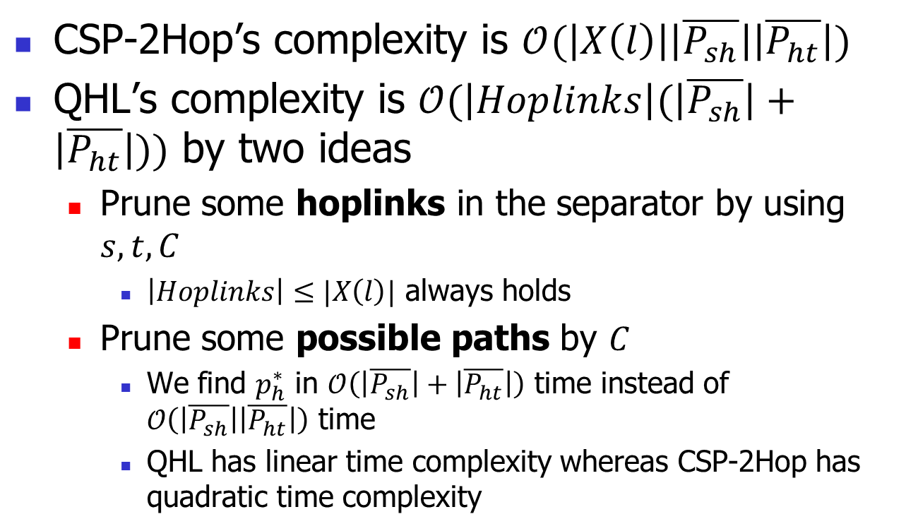
QHL: time complexity
CSP-2Hop’s complexity is $𝒪(\left|X\left(l\right)\right|\left|\overline{P_{sh}}\right|\left|\overline{P_{ht}}\right|)$
QHL’s complexity is $𝒪(\left|Hoplinks\right|(\left|\overline{P_{sh}}\right|+\left|\overline{P_{ht}}\right|))$ by two ideas
  Prune some hoplinks in the separator by using $s,t,C$
    $\left|Hoplinks\right|≤|X\left(l\right)|$ always holds
  Prune some possible paths by $C$
    We find $p_{h}^{∗}$ in $𝒪\left(\left|\overline{P_{sh}}\right|+\left|\overline{P_{ht}}\right|\right)$ time instead of $𝒪\left(\left|\overline{P_{sh}}\right|\left|\overline{P_{ht}}\right|\right)$ time
    QHL has linear time complexity whereas CSP-2Hop has quadratic time complexity

Slide 25
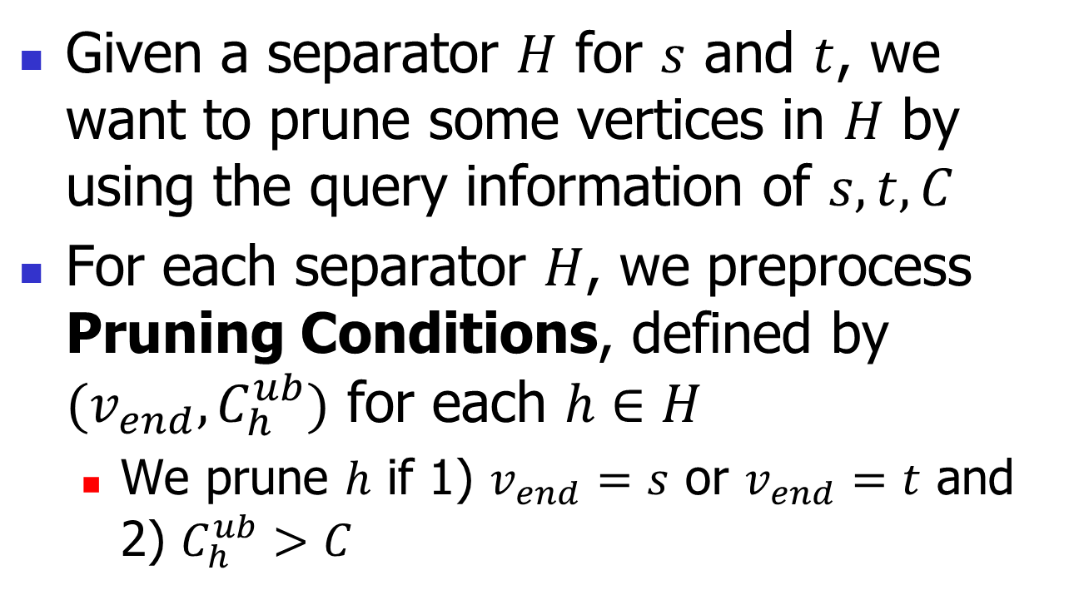
QHL: prune hoplinks
Given a separator $H$ for $s$ and $t$, we want to prune some vertices in $H$ by using the query information of $s,t,C$
For each separator $H$, we preprocess Pruning Conditions, defined by $(v_{end},C_{h}^{ub})$ for each $h∈H$
  We prune $h$ if 1) $v_{end}=s$ or $v_{end}=t$ and 2) $C_{h}^{ub}>C$

Slide 26
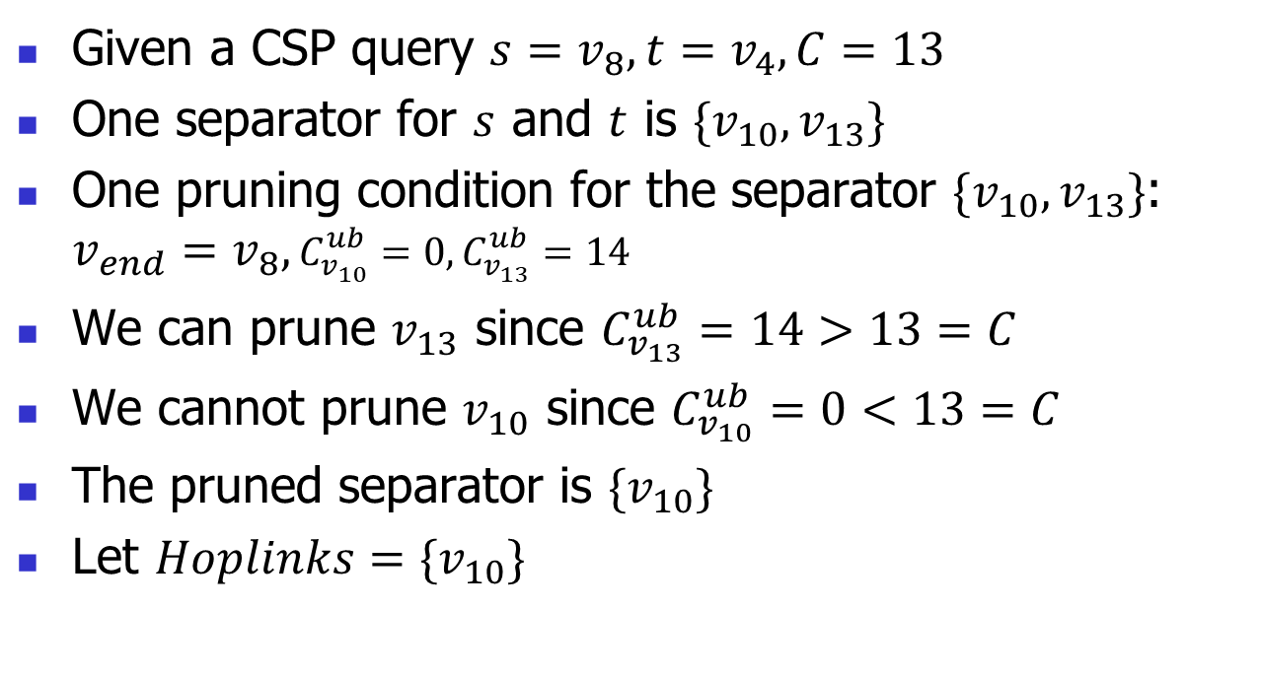
Prune hoplinks: example
Given a CSP query $s=v_{8},t=v_{4},C=13$
One separator for $s$ and $t$ is $\{v_{10},v_{13}\}$
One pruning condition for the separator $\{v_{10},v_{13}\}$: $v_{end}=v_{8},C_{v_{10}}^{ub}=0,C_{v_{13}}^{ub}=14$
We can prune $v_{13}$ since $C_{v_{13}}^{ub}=14>13=C$
We cannot prune $v_{10}$ since $C_{v_{10}}^{ub}=0<13=C$
The pruned separator is $\{v_{10}\}$
Let $Hoplinks=\{v_{10}\}$

Slide 27

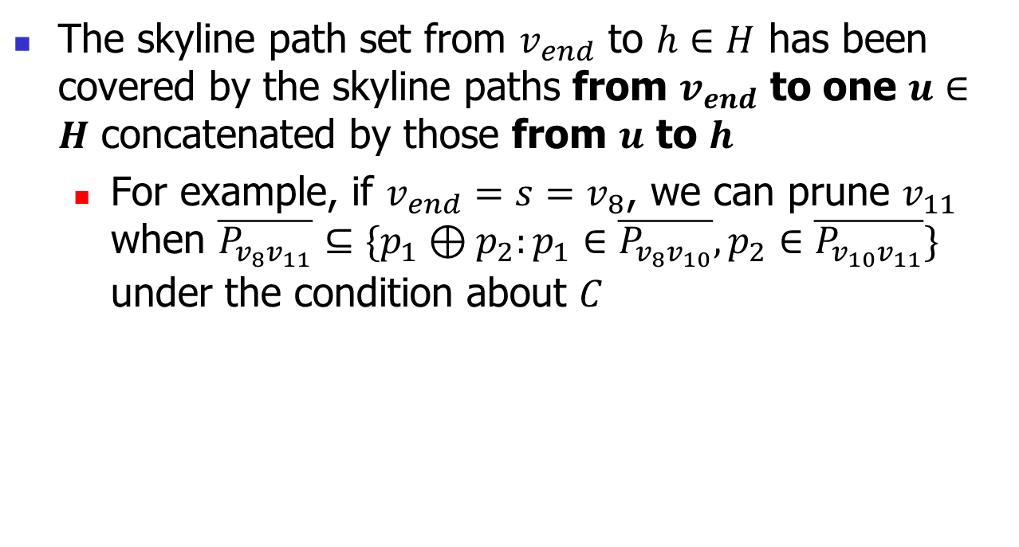


Prune hoplinks: intuition
The skyline path set from $v_{end}$ to $h∈H$ has been covered by the skyline paths from $v_{end}$ to one $u∈H$ concatenated by those from $u$ to $h$
  For example, if $v_{end}=s=v_{8}$, we can prune $v_{11}$ when $\overline{P_{v_{8}v_{11}}}⊆\{p_{1}⊕p_{2}:p_{1}∈\overline{P_{v_{8}v_{10}}}, p_{2}∈\overline{P_{v_{10}v_{11}}}\}$ under the condition about $C$
$$v_{10}$$
$$v_{11}$$
$$v_{12}$$
$$v_{13}$$
$${X(v}_{8})$$

Slide 28
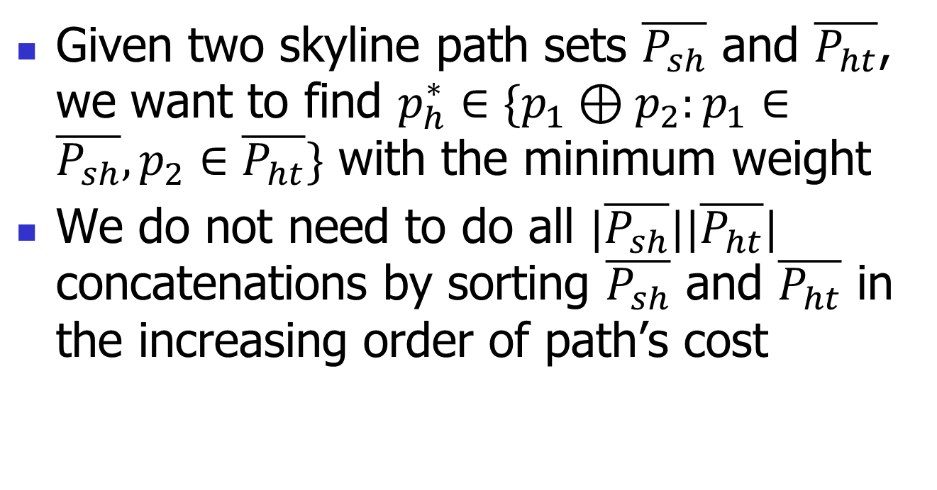
QHL: prune possible paths
Given two skyline path sets $\overline{P_{sh}}$ and $\overline{P_{ht}}$, we want to find $p_{h}^{∗}∈\{p_{1}⊕p_{2}:p_{1}∈\overline{P_{sh}}, p_{2}∈\overline{P_{ht}}\}$ with the minimum weight
We do not need to do all $|\overline{P_{sh}}\text{||}\overline{P_{ht}}|$ concatenations by sorting $\overline{P_{sh}}$ and $\overline{P_{ht}}$ in the increasing order of path’s cost

Slide 29
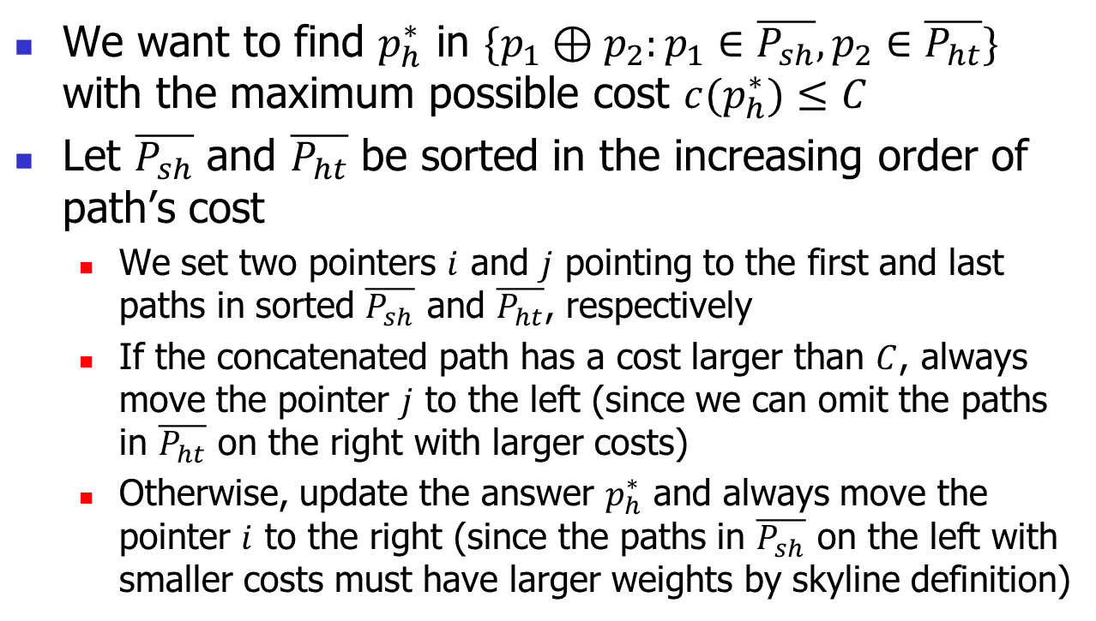
Prune possible paths: intuition
We want to find $p_{h}^{∗}$ in $\{p_{1}⊕p_{2}:p_{1}∈\overline{P_{sh}}, p_{2}∈\overline{P_{ht}}\}$ with the maximum possible cost $c(p_{h}^{∗})≤C$
Let $\overline{P_{sh}}$ and $\overline{P_{ht}}$ be sorted in the increasing order of path’s cost
  We set two pointers $i$ and $j$ pointing to the first and last paths in sorted $\overline{P_{sh}}$ and $\overline{P_{ht}}$, respectively
  If the concatenated path has a cost larger than $C$, always move the pointer $j$ to the left (since we can omit the paths in $\overline{P_{ht}}$ on the right with larger costs)
  Otherwise, update the answer $p_{h}^{∗}$ and always move the pointer $i$ to the right (since the paths in $\overline{P_{sh}}$ on the left with smaller costs must have larger weights by skyline definition)

Slide 30

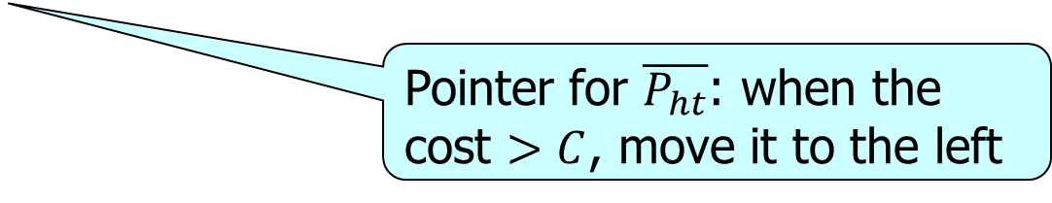




Prune possible paths: example
Given a CSP query $s=v_{8},t=v_{4},C=13$
The pruned separator is $\{v_{10}\}$ and $h=v_{10}$
$\left(9,8\right)⊕\left(8,9\right)$: Its cost of $17>C=13$. Move $\overline{P_{ht}}$’s pointer to the left
$$h_{3},h_{4}$$
$$\overline{P_{sh}}:\{\left(9,8\right), \left(8,9\right)\}$$
$$C=13$$
$$\overline{P_{ht}}:\{\left(9,4\right), \left(8,9\right)\}$$
Pointer for $\overline{P_{ht}}$: when the cost $>C$, move it to the left

Slide 31
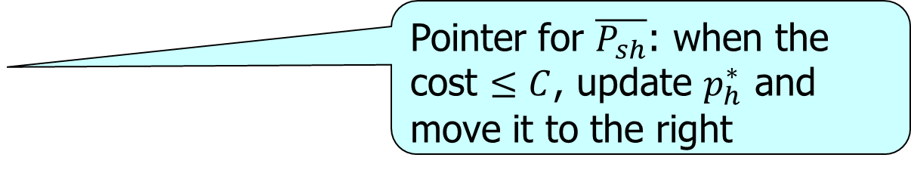

Prune possible paths: example
$\left(9,8\right)⊕\left(9,4\right)$: Its cost of $12≤C=13$. Update $p_{h}^{∗}=(18,12)$. Move $\overline{P_{sh}}$’s pointer to the right
Pointer for $\overline{P_{sh}}$: when the cost $≤C$, update $p_{h}^{∗}$ and move it to the right
$$h_{3},h_{4}$$
$$\overline{P_{sh}}:\{\left(9,8\right), \left(8,9\right)\}$$
$$C=13$$
$$\overline{P_{ht}}:\{\left(9,4\right), \left(8,9\right)\}$$

Slide 32
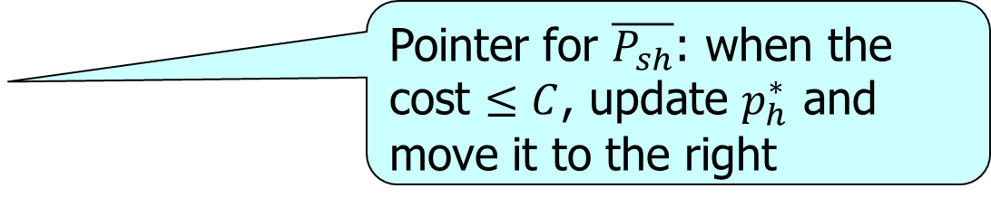

Prune possible paths: example
$\left(8,9\right)⊕\left(9,4\right)$: Its cost of $13≤C=13$. Update $p_{h}^{∗}=\left(17,13\right)$ since its weight is smaller than $(18,12)$. Move $\overline{P_{sh}}$’s pointer to the right
Pointer for $\overline{P_{sh}}$: when the cost $≤C$, update $p_{h}^{∗}$ and move it to the right
$$h_{3},h_{4}$$
$$\overline{P_{sh}}:\{\left(9,8\right), \left(8,9\right)\}$$
$$C=13$$
$$\overline{P_{ht}}:\{\left(9,4\right), \left(8,9\right)\}$$

Slide 33
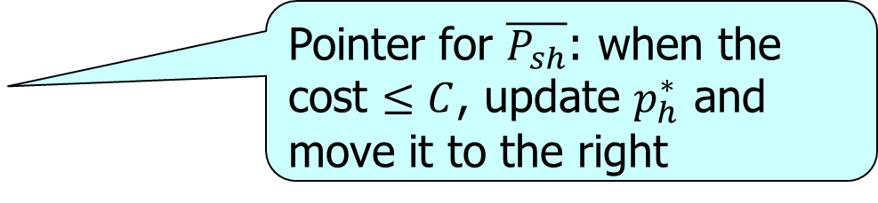

Prune possible paths: example
Return the answer $p_{h}^{∗}=\left(17,13\right)$ since the pointer for $\overline{P_{sh}}$ has reached the end
Pointer for $\overline{P_{sh}}$: when the cost $≤C$, update $p_{h}^{∗}$ and move it to the right
$$h_{3},h_{4}$$
$$\overline{P_{sh}}:\{\left(9,8\right), \left(8,9\right)\}$$
$$C=13$$
$$\overline{P_{ht}}:\{\left(9,4\right), \left(8,9\right)\}$$

Slide 34
Outline
Motivation
Preliminaries
Methodology
Experiments
Conclusion
Notes:
Here is the outline. I will talk about the motivation, definition, methodology, experiments, and finally the conclusion.

Slide 35
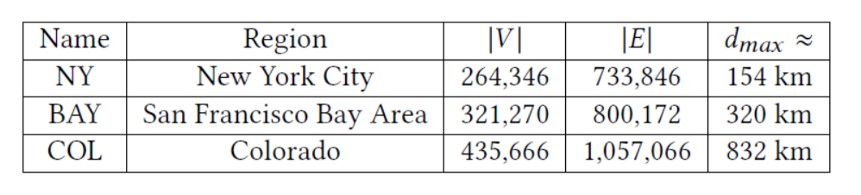
Experimental setting
Real road networks: NY, BAY, COL
Algorithms:
  Index-based solutions: QHL, CSP-2Hop [ICDE21], COLA [VLDB16]

Slide 36
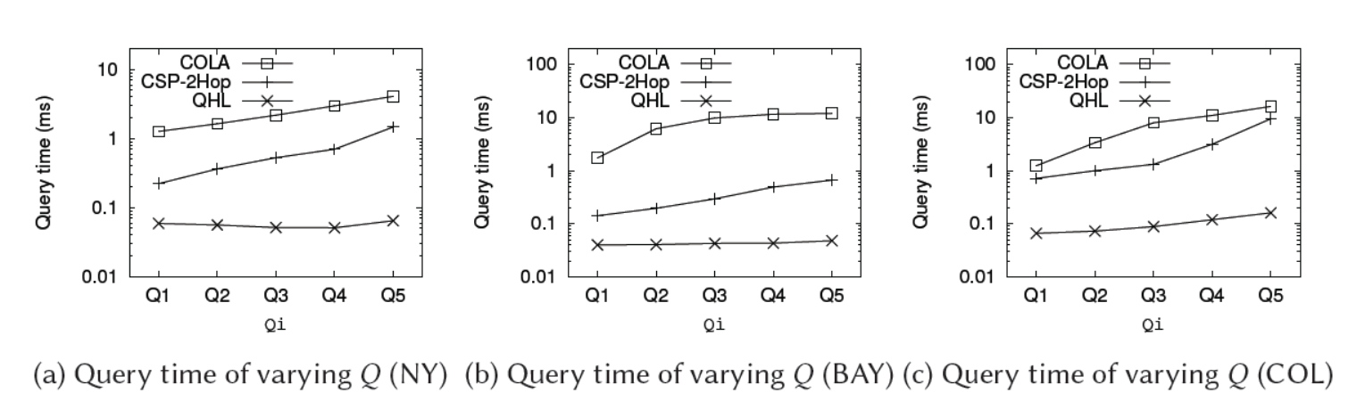
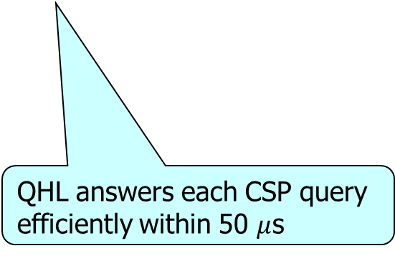
Experimental results
Query processing time on different road networks
QHL answers each CSP query efficiently within 50 $μ$s
QHL outperforms the other two by up to two orders of magnitude

Slide 37
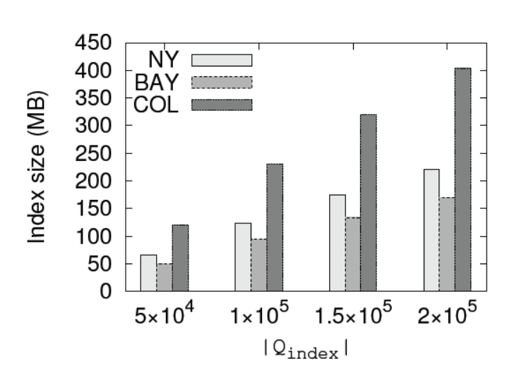
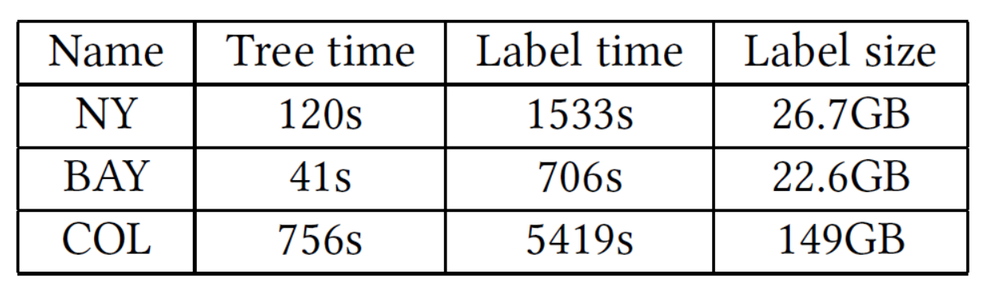
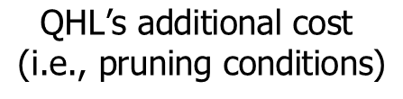

Index cost
$$\text{QHL}\text{’}\text{s} \text{additional} \text{cost}$$
$$\text{(}\text{i}\text{.}\text{e}\text{., }\text{pruning} \text{conditions}\text{)}$$
$$\text{CSP}\text{−2}\text{Hop}\text{’}\text{s} \text{index} \text{cost}$$
QHL consumes around 1% additional space cost compared with CSP-2Hop

Slide 38
Outline
Motivation
Preliminaries
Methodology
Experiments
Conclusion

Slide 39
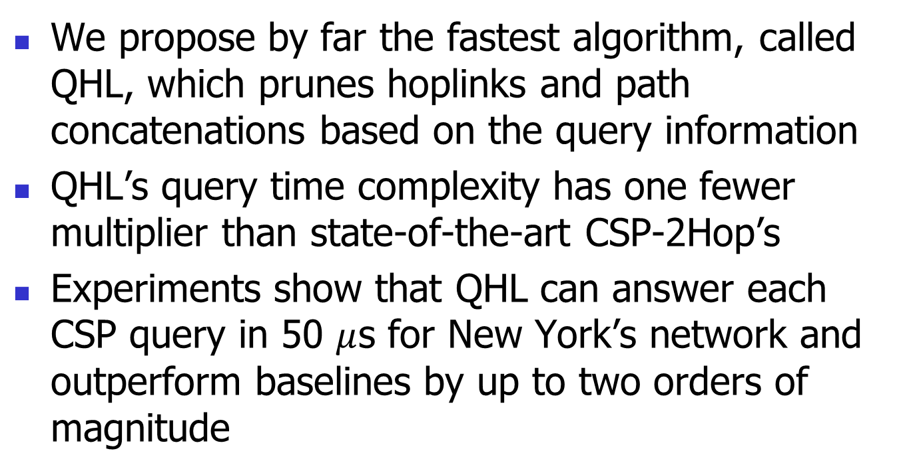
Conclusion
We propose by far the fastest algorithm, called QHL, which prunes hoplinks and path concatenations based on the query information
QHL’s query time complexity has one fewer multiplier than state-of-the-art CSP-2Hop’s
Experiments show that QHL can answer each CSP query in 50 $μ$s for New York’s network and outperform baselines by up to two orders of magnitude

Slide 40
Q & A
Thank you for listening!

