Slide 1
Trajectory Simplification: On Minimizing the Direction-based Error
Cheng Long, Hong Kong University of Science and Technology
Raymond Chi-Wing Wong, Hong Kong University of Science and Technology
H. V. Jagadish, University of Michigan

Slide 2
Sample A Movement
Consider the case where
  we have a moving object o
  we want to sample the positions of o every one minute
Position
(8:03AM)
10 positions
p₃
p₁₀
p₈
Position (8:01AM)
p₇
p₉
p₄
Position
(8:10AM)
p₁
p₂
p₅
p₆
Position (8:02AM)
Position
(8:09AM)

Slide 3
Trajectory
Segment
Segment
p₃
p₁₀
10 positions
p₈
p₇
9 segments
p₉
p₄
Segment
p₁
p₂
p₅
p₆
Segment
Segment

Slide 4
Trajectory
Trajectory
p₃
p₁₀
10 positions
p₈
p₇
9 segments
p₉
p₄
p₁
p₂
p₅
p₆

Slide 5
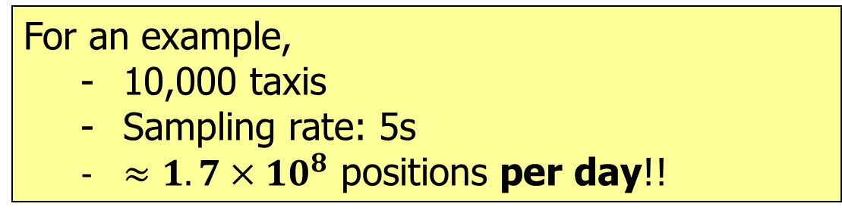
Trajectory
Raw trajectory data is usually very large
For an example,
  10,000 taxis
  Sampling rate: 5s
  $≈1.7×{10}^{8}$ positions per day!!
Trajectory Simplification
Drop some positions
Issue 1: Storing all sampled positions incurs a very high space cost
As a result, only a portion of the positions is kept
Issue 2: Query processing big trajectory data incurs high time cost

Slide 6
Trajectory Simplification
Trajectory Simplification:
  Drop some positions
Trajectory
p₃
p₁₀
p₈
p₇
Suppose p₂, p₄, p₅, p₇, p₈, p₉ are dropped
p₉
p₄
p₁
p₂
p₅
p₆
Trajectory
6 positions to be dropped

Slide 7
Trajectory Simplification
Trajectory Simplification:
  Drop some positions
p₃
p₁₀
p₁
p₆
Simplified trajectory

Slide 8
Trajectory Simplification
Trajectory Simplification:
  Drop some positions
Trajectory
p₃
p₁₀
p₈
p₇
Suppose p₂, p₃, p₅, p₆, p₇, p₉ are dropped
p₉
p₄
p₁
p₂
p₅
p₆
Trajectory
6 positions to be dropped

Slide 9
Trajectory Simplification
Trajectory Simplification:
  Drop some positions
p₁₀
p₈
p₄
p₁
Another Simplified trajectory

Slide 10
Trajectory Simplification
Trajectory Simplification:
  Drop some positions
Which positions should be dropped?
Depending which positions to be dropped, it returns different simplified trajectories
Our Idea:
  Drop the positions such that the “direction information” of the original trajectory is preserved
Direction-Preserving Trajectory Simplification (DPTS)

Slide 11
Direction-Preserving Trajectory Simplification (DPTS)
Direction-Preserving Trajectory Simplification (DPTS)
What is “direction information”?
Why to preserve “direction information”?
How to preserve “direction information”?

Slide 12
What Is “Direction Information”?
p₃
p₁₀
p₈
Trajectory
p₇
p₉
p₄
p₁
p₂
p₅
p₆

Slide 13
What Is “Direction Information”?
Direction information

Slide 14
Direction-Preserving Trajectory Simplification (DPTS)
Direction-Preserving Trajectory Simplification (DPTS)
What is “direction information”?
Why to preserve “direction information”?
How to preserve “direction information”?

Slide 15
Why To Preserve “Direction Information”?
Applications That Use “Direction Information”
Map Matching
Trajectory Mining
Trajectory Query Processing
Trajectory Clustering
Trajectory Classification
Trajectory Outlier Detection
Brakatsoulas et al. VLDB’05
Brakatsoulas et al. IDEAS’ 04, Pelekis et al. TIME’07
Lee et al. SIGMOD’07, Hung et al. VLDBJ’11
Lee et al. VLDB’08
Lee et al. ICDE’08

Slide 16
Trajectory Clustering
Trajectory Clustering:
  Partition a set of trajectories into several clusters such that
    trajectories in the same cluster are similar
    trajectories in different clusters are dissimilar
Cluster 1
Cluster 2
T₁
T₂
T₃
T₄
T₁ and T₂ are similar
T₃ and T₄ are similar

Slide 17
Trajectory Clustering
Trajectory Clustering
Lee et al. SIGMOD’07, Hung et al. VLDBJ’11
Cluster 1
Cluster 2
T₁
T₂
T₃
T₄
T₁ and T₂ have similar “direction information”
T₃ and T₄ have similar “direction information”

Slide 18
Why To Preserve “Direction Information”?
Applications That Use “Direction Information”
Map Matching
Trajectory Mining
Trajectory Query Processing
Trajectory Clustering
Trajectory Classification
Trajectory Outlier Detection
Brakatsoulas et al. VLDB’05
Brakatsoulas et al. IDEAS’ 04, Pelekis et al. TIME’07
Lee et al. SIGMOD’07, Hung et al. VLDBJ’11
Lee et al. VLDB’08
Lee et al. ICDE’08
Existing trajectory simplification methods:
  Pay NO attention on preserving the “direction information”
  Preserve the “position information” in most cases

Slide 19
Direction-Preserving Trajectory Simplification (DPTS)
Direction-Preserving Trajectory Simplification (DPTS)
What is “direction information”?
Why to preserve “direction information”?
How to preserve “direction information”?

Slide 20
How To Preserve “Direction Information”?
Direction-based Error Measurement
p₃
p₁₀
p₈
p₇
p₉
p₄
p₁
p₂
p₅
p₆
Original trajectory: T
Simplified trajectory: T’

Slide 21










How To Preserve “Direction Information”?
Direction-based Error Measurement
Error of T’ = the max of its segments’ errors
p₃
p₃
p₁₀
p₈
p₇
p₉
p₄
p₁
p₂
p₅
p₆
p₆
Error of segment p₁-p₃
$$π/2$$
Error of segment p₃-p₆
$$π/2$$
Error of segment p₆-p₁₀
$$π/2$$
$$π$$
$$π$$
$$π$$
$$0$$
$$0$$
$$0$$
$$3π/2$$
$$3π/2$$
$$3π/2$$

Slide 22
How To Preserve “Direction Information”?
VLDB 2013
Problem (Min-Size):
  Given:
    A trajectory T;
    An error tolerance \eps;
  Goal: A simplified trajectory T’ s.t.
    T’ has its error at most \eps;
    T’ has the fewest positions
Problem (Min-Error):
  Given:
    A trajectory T;
    A budget W;
  Goal: A simplified trajectory T’ s.t.
    T’ has at most W positions;
    T’ has the smallest error
Suitable when the knowledge of \eps is available
Suitable when the knowledge of \eps is NOT available, but a budget is

Slide 23
How To Preserve “Direction Information”?
Exact Algorithms
Approximate Algorithm
Algorithms For Min-Error
DP
Error-Search
Span-Search

Slide 24
DP: A Sub-Problem Optimality Property
Problem Instance 1:
  Trajectory: p₁-p₂-…-p₁₀
  Budget: 4
p₁-p₃-p₆-p₁₀ is the optimal solution for Problem Instance 1
p₃
p₁₀
p₈
p₇
p₉
p₄
p₁
p₂
p₅
p₆
Problem Instance 2:

Slide 25
DP: A Sub-Problem Optimality Property
Problem Instance 1:
  Trajectory: p₁-p₂-…-p₁₀
  Budget: 4
p₁-p₃-p₆-p₁₀ is the optimal solution for Problem Instance 1
p₃
p₁₀
p₈
Sub-problem of Problem Instance 1
Could be verified by contradiction
p₇
p₉
p₄
p₁
p₂
p₅
p₆
Problem Instance 2:
  Trajectory: p₁-p₂-…-p₆
  Budget: 3
p₁-p₃-p₆ is the optimal solution for Problem Instance 2

Slide 26
How To Preserve “Direction Information”?
Exact Algorithms
Approximate Algorithm
Algorithms For Min-Error
DP
Error-Search
Span-Search
Time: O(W n³)
Space: O(n²)

Slide 27
Error-Search: A Rough Idea
Problem (Min-Error):
  Given:
    A trajectory T;
    A budget W;
  Goal: A simplified trajectory T’ s.t.
    T’ has at most W positions;
    T’ has the smallest error
  Goal:
    A feasible simplification with the smallest error
Feasible simplification:
  A simplified trajectory with at most W positions
All possible “feasible simplifications”:
  p₁-p₄-p₇-p₁₀
p₃
p₁₀
p₈
p₇
p₉
p₄
p₁
p₂
p₅
p₆
W = 4

Slide 28
Error-Search: A Rough Idea
Problem (Min-Error):
  Given:
    A trajectory T;
    A budget W;
  Goal: A simplified trajectory T’ s.t.
    T’ has at most W positions;
    T’ has the smallest error
  Goal:
    A feasible simplification with the smallest error
Feasible simplification:
  A simplified trajectory with at most W positions
All possible “feasible simplifications”:
  p₁-p₄-p₇-p₁₀
  P₁-p₄-p₆-p₁₀
p₃
p₁₀
p₈
p₇
p₉
p₄
p₁
p₂
p₅
p₆
W = 4

Slide 29
Error-Search: A Rough Idea
Problem (Min-Error):
  Given:
    A trajectory T;
    A budget W;
  Goal: A simplified trajectory T’ s.t.
    T’ has at most W positions;
    T’ has the smallest error
  Goal:
    A feasible simplification with the smallest error
Feasible simplification:
  A simplified trajectory with at most W positions
All possible “feasible simplifications”:
  p₁-p₄-p₇-p₁₀
  P₁-p₄-p₆-p₁₀
  p₁-p₃-p₆-p₁₀
p₃
p₁₀
p₈
p₇
p₉
p₄
p₁
p₂
p₅
p₆
W = 4

Slide 30
Error-Search: A Rough Idea
Problem (Min-Error):
  Given:
    A trajectory T;
    A budget W;
  Goal: A simplified trajectory T’ s.t.
    T’ has at most W positions;
    T’ has the smallest error
  Goal:
    A feasible simplification with the smallest error
Feasible simplification:
  A simplified trajectory with at most W positions
All possible “feasible simplifications”:
  p₁-p₄-p₇-p₁₀
  P₁-p₄-p₆-p₁₀
  p₁-p₃-p₆-p₁₀
  …
Corresponding errors (in radians):
  1.305
  1.305
  0.785
  …
p₃
p₁₀
p₈
p₇
p₉
p₄
p₁
p₂
p₅
p₆
Optimal solution
The smallest error
W = 4

Slide 31
Error-Search: A Rough Idea
Problem (Min-Error):
  Given:
    A trajectory T;
    A budget W;
  Goal: A simplified trajectory T’ s.t.
    T’ has at most W positions;
    T’ has the smallest error
  Goal:
    A feasible simplification with the smallest error
Feasible simplification:
  A simplified trajectory with at most W positions
Multiple simplifications share the same error
All possible “feasible simplifications”:
  p₁-p₄-p₇-p₁₀
  P₁-p₄-p₆-p₁₀
  p₁-p₃-p₆-p₁₀
  …
Corresponding errors (in radians):
  1.305
  1.305
  0.785
  …
O(n²) possible segments in a simplified trajectory
p₃
p₁₀
p₈
p₇
p₉
p₄
p₁
p₂
p₅
p₆
Size: O( n^{W})
Size: bounded by O( n²)
W = 4

Slide 32
How To Preserve “Direction Information”?
Exact Algorithms
Approximate Algorithm
2-factor approximation
Algorithms For Min-Error
DP
Error-Search
Span-Search
Time: O(W n³)
Space: O(n²)
Time: O(C n² log n)
Space: O(n²)
Time: O(n log² n)
Space: O(n)

Slide 33
Span-Search: The Main Idea
The “span” of a simplified trajectory
p₃
p₁₀
p₈
p₇
p₉
p₄
p₁
p₂
p₅
p₆
Original trajectory: T
Simplified trajectory: T’

Slide 34
Span-Search: The Main Idea
The “span” of a simplified trajectory
Span of T’ = the max of its sub-trajectories’ spans
p₃
p₃
p₁₀
p₈
p₇
p₉
p₄
p₁
p₂
p₅
p₆
p₆
Span of
p₁-p₂-p₃
$$π/2$$
Span of
p₃-p₄-p₅-p₆
$$π/2$$
Span of
p₆-p₇-p₈-p₉-p₁₀
$$π/2$$
$$π$$
$$π$$
$$π$$
$$0$$
$$0$$
$$0$$
$$3π/2$$
$$3π/2$$
$$3π/2$$

Slide 35
Span-Search: The Main Idea
A Property: A simplified trajectory has its error
  at most its span and
  at least half its span
Error of segment p₁-p₃
$$π/2$$
Error of segment p₃-p₆
$$π/2$$
Error of segment p₆-p₁₀
$$π/2$$
$$π$$
$$π$$
$$π$$
$$0$$
$$0$$
$$0$$
$$3π/2$$
$$3π/2$$
$$3π/2$$
Span of
p₁-p₂-p₃
$$π/2$$
Span of
p₃-p₄-p₅-p₆
$$π/2$$
Span of
p₆-p₇-p₈-p₉-p₁₀
$$π/2$$
$$π$$
$$π$$
$$π$$
$$0$$
$$0$$
$$0$$
$$3π/2$$
$$3π/2$$
$$3π/2$$

Slide 36
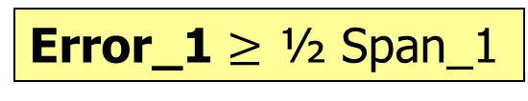
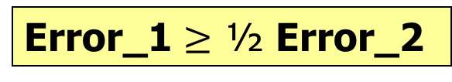
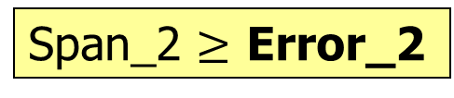
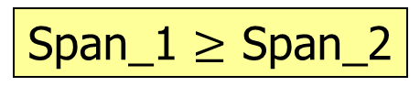
Span-Search: The Main Idea
Problem (Min-Error):
  Given:
    A trajectory T;
    A budget W;
  Goal: A simplified trajectory T’ s.t.
    T’ has at most W positions;
    T’ has the smallest error
Feasible simplification
Time: O(W n³) or O(C n² log n)
Space: O(n²)
2-factor approximation
A trajectory
Time: O(n log² n)
Space: O(n)
DP
Error-Search
Span-Search
The feasible simplification with the smallest error
The feasible simplification with the smallest span
Error_1
Span_1
Error_2
Span_2
Error_1 $≥$ ½ Span_1
Span_1 $≥$ Span_2
Span_2 $≥$ Error_2
Error_1 $≥$ ½ Error_2

Slide 37
Experiments: Settings
 | # of trajectories | Total # of positions | Average # of positions / trajectory
Geolife | 18K | 25M | 1K
T-Drive | 10K | 18M | 2K
Datasets:
  Geolife and T-Drive
Algorithms
  Exact: DP and Error-Search
  Approximate: Span-Search and Douglas-Peucker
Experiments
  DPTS vs. Wavelet Transformation
  Performance Studies
Most well-known trajectory simplification algorithm

Slide 38
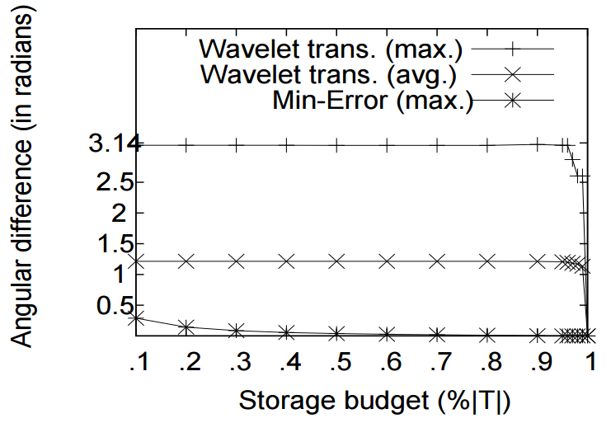
Experiments: Min-Error vs. Wavelet Transformation
Error
Budget W (in terms of %)

Slide 39
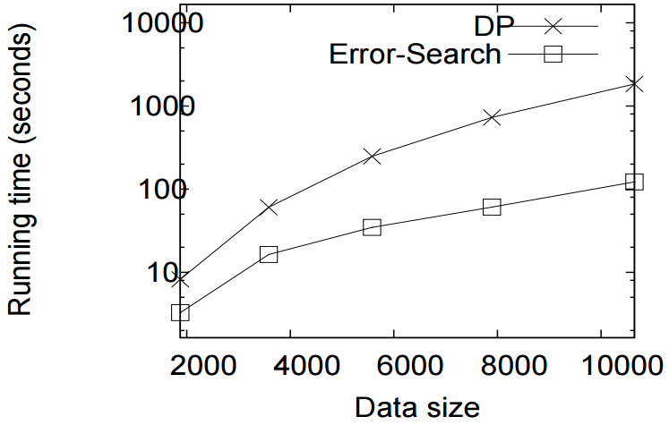
Experiments: Performance Studies on Exact Algorithms (1)
Running time
# of positions in the trajectory

Slide 40
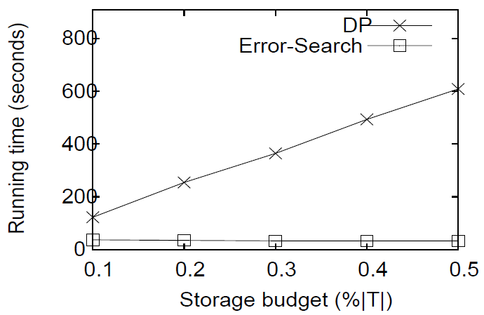
Experiments: Performance Studies on Exact Algorithms (2)
Running time
Budget W (in terms of %)

Slide 41
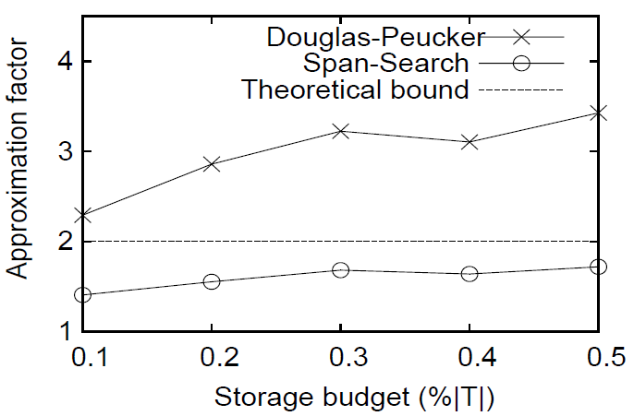
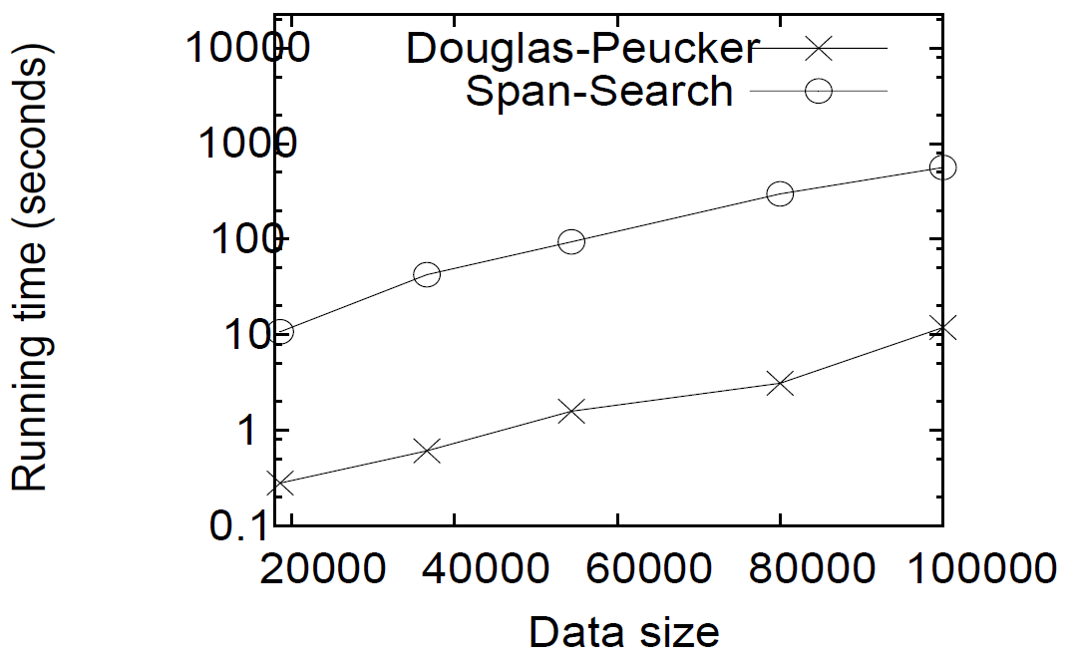
Experiments: Performance Studies on Approximate Algorithms
Appro. factor
Run. time
Budget W (in terms of %)
Budget W (in terms of %)

Slide 42
Conclusion
A New Problem: Min-Error
Two Exact Algorithms: DP and Error-Search
One 2-factor Approximate Algorithm: Span-Search
Experiments

Slide 43
Q & A

