Slide 1
New Lower and Upper Bounds for Shortest Distance Queries on Terrains
Manohar Kaul (IIT-H)
mkaul@iith.ac.in

Slide 2
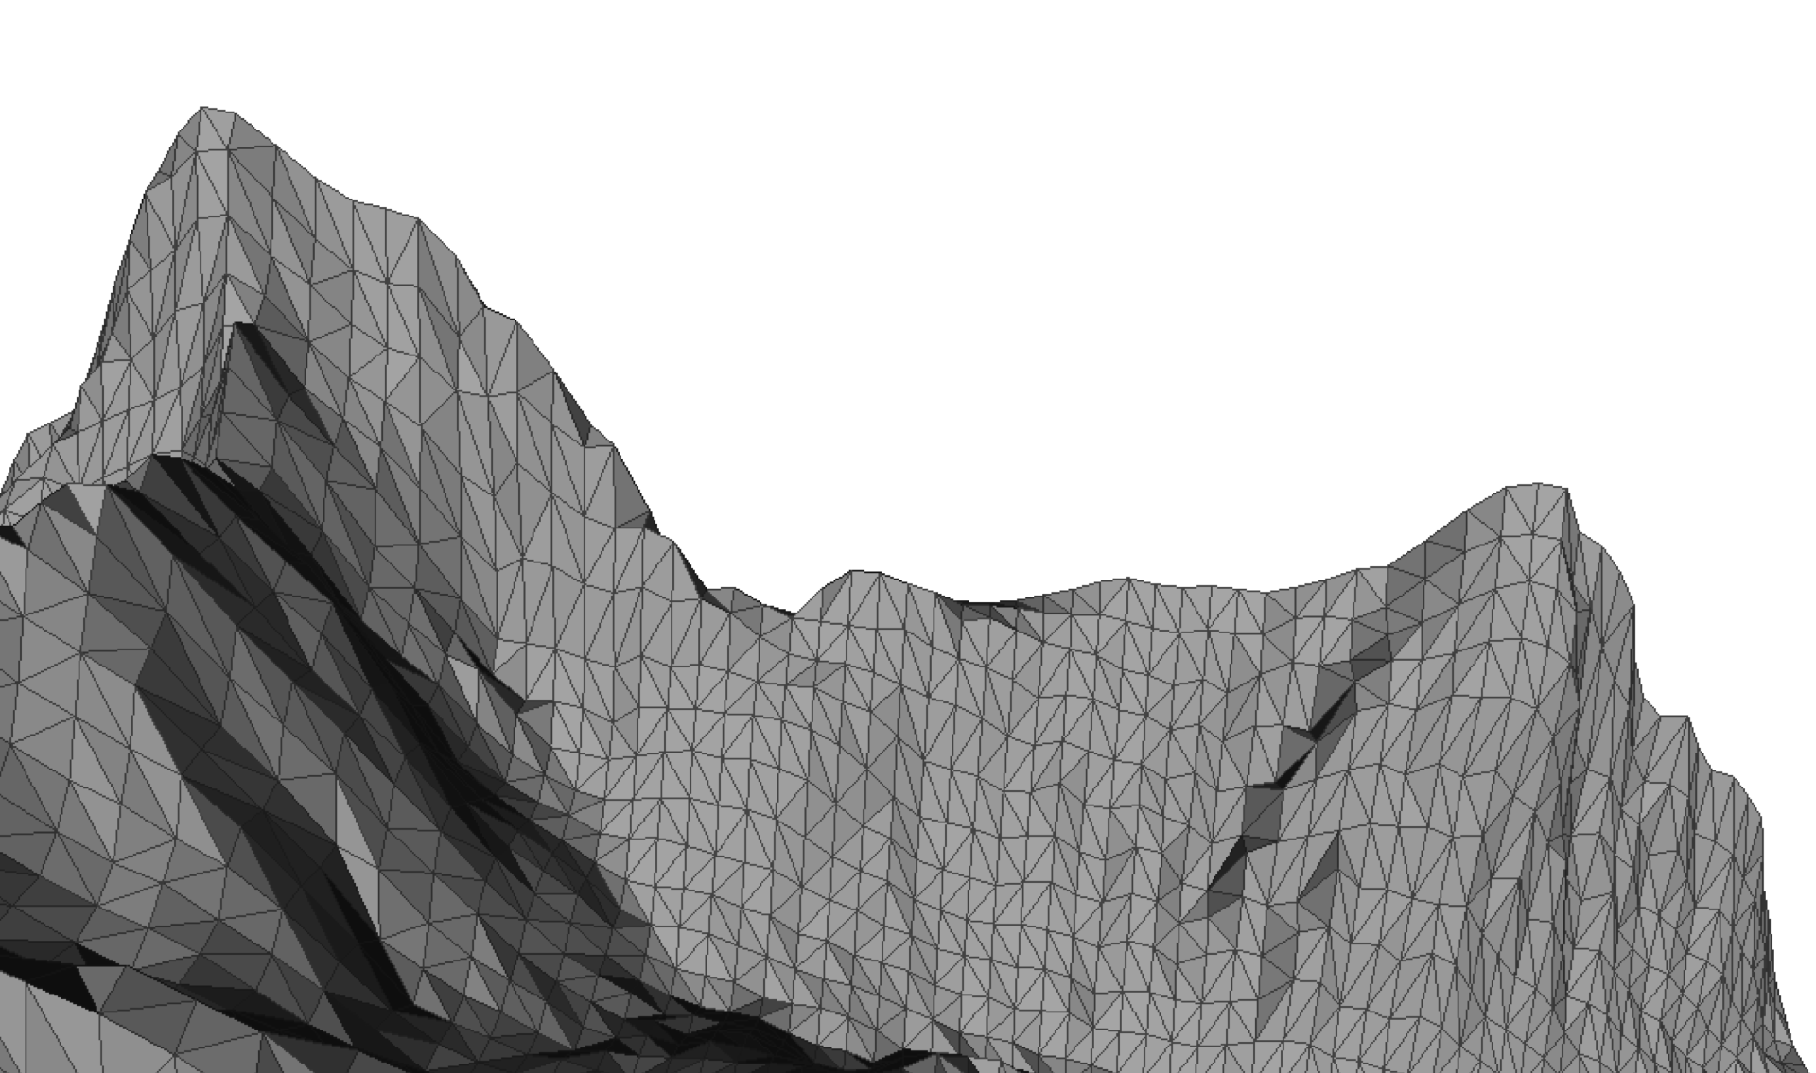
What does a Terrain look like?
Note: A triangulation can also be seen as a “Geometric Graph” G=(V,E,V_{w},E_{w}) with (x,y,z) coordinates as vertex weights and the 3D Euclidean distance between vertices as edge weights.

Slide 3
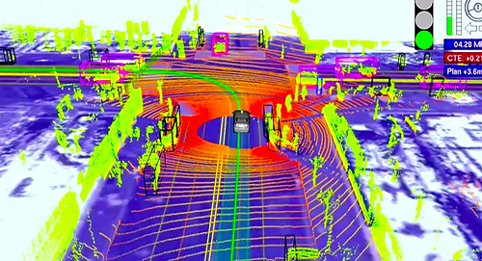
Google’s Driverless Cars
Google’s driverless vehicles using 3D terrain data for positioning on the roads

Slide 4
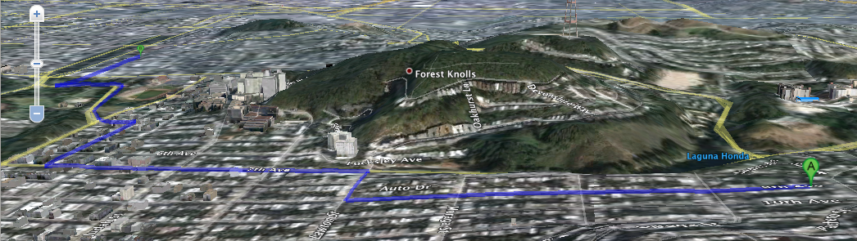
Google Maps (Terrain View)
Google Bicycle Paths Avoiding Steep Slopes

Slide 5
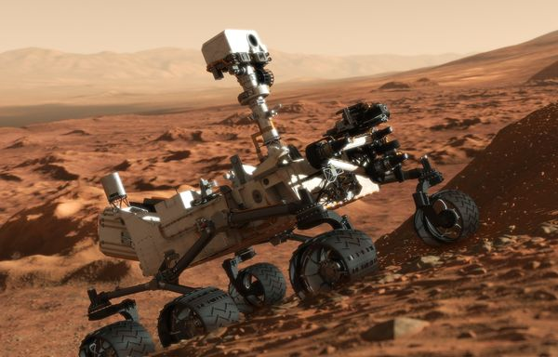
Robot Path Planning
Military Planning, Robot Path Planning and Geo-Realistic Computer games.

Slide 6
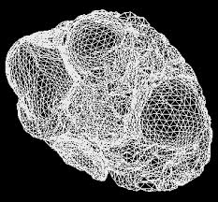
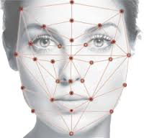
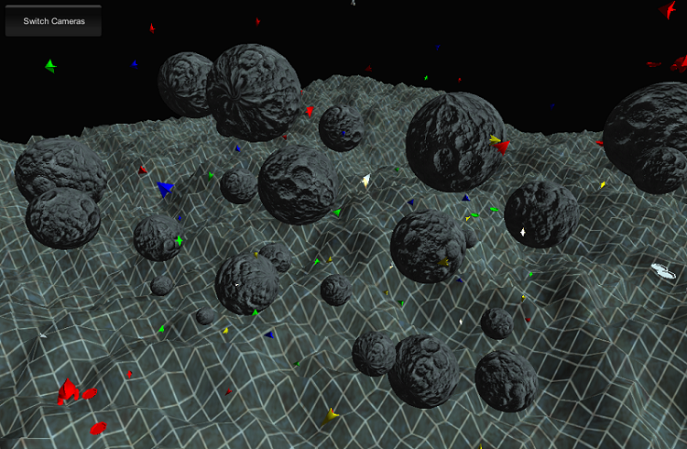
Many More Interesting Applications Exist...
Human Brain
(Tumour Detection)
Facial Recognition
3D Kinodynamics
(Collision Avoidance)

Slide 7
Finding Shortest Surface Paths for Spatial Queries
Finding Shortest Paths on Terrains
  Surface k Nearest Neighbor Queries ( VLDBJ 08, VLDB 08, VLDB 09 )
  Surface Range Queries
  Surface Reverse Nearest Neighbor Queries ( CIKM 12 )
  Shortest “Gentle” Paths ( SIGMOD 11)
All above queries rely on efficient computation of shortest surface paths
Computing the EXACT shortest surface path is expensive!
State of art algorithm by Chen & Han has time complexity of O(n²) ; where n is the number of faces in the terrain.
So find cheaper bounds...

Slide 8
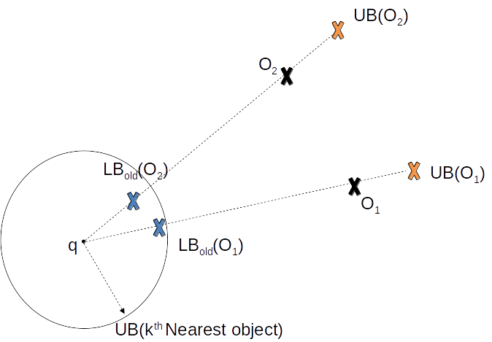
Effect of Bounds on Well-Known Spatial Queries
Spatial Queries on a surface (E.g. sk-NN and s-Range) are composed of numerous shortest surface path queries.

Slide 9
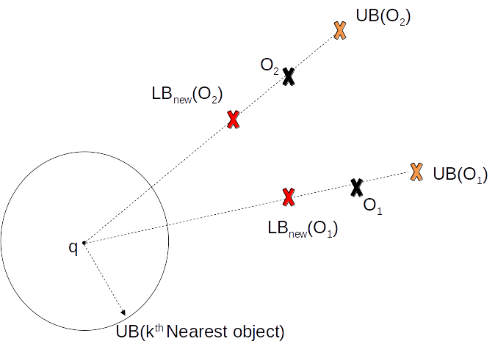
Effect of Bounds on Well-Known Spatial Queries
Spatial Queries on a surface (E.g. sk-NN and s-Range) are composed of numerous shortest surface path queries.

Slide 10
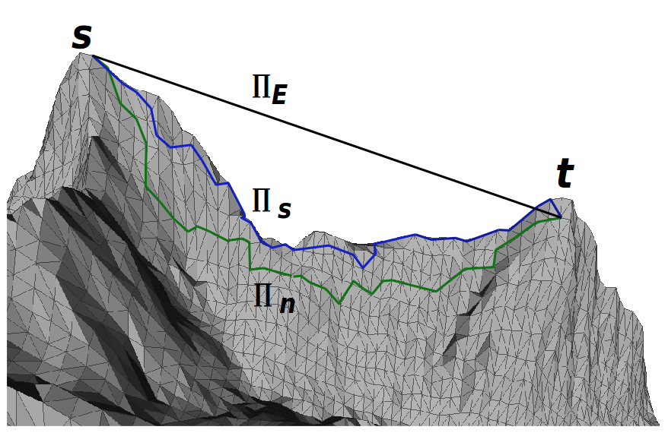
Paths on a Triangulated Terrain

Slide 11
Paths on a Triangulated Terrain
𝛱_{n} is constrained to traverse across edges of triangles, while 𝛱_{s} can cut across triangle faces!

Slide 12
Rationale behind our previous work...
Finding a tighter lower bound that
  uses the information of the underlying terrain
  base this on the network shortest path?
  is fast to compute!

Slide 13
Previous Contribution: Finding a Tighter Lower Bound
Let 𝛱_{s}(s,t) and 𝛱_{n}(s,t) be the shortest surface path and the shortest network path between source s and destination t on terrain Ρ, respectively. Then,
𝛌|𝛱_{n}(s,t)| ≤ |𝛱_{s}(s,t)| ≤ |𝛱_{n}(s,t)|
where 𝛌 = min { sin θ_{m} / 2 , sin θ_{m} cos θ_{m} } and θ_{m} is the minimum interior angle of a triangle that 𝛱_{n}(s,t) crosses over.
Lower Bound
Upper Bound

Slide 14
Contribution 1: Finding a Tighter Lower Bound
Let 𝛱_{s}(s,t) and 𝛱_{n}(s,t) be the shortest surface path and the shortest network path between source s and destination t on terrain Ρ, respectively. Then,
𝛌|𝛱_{n}(s,t)| ≤ |𝛱_{s}(s,t)| ≤ |𝛱_{n}(s,t)|
where 𝛌 = min { sin θ_{m} / 2 , sin θ_{m} cos θ_{m} } and θ_{m} is the minimum interior angle of a triangle that 𝛱_{n}(s,t) crosses over.
Lower Bound
Upper Bound
If θ_{m} is lower => 𝛌 is lower!
“Realistic Terrains” maximize θ_{m}
Hence, θ_{m} >= 45 deg and 𝛌 >= 0.35

Slide 15
The Remaining Challenge!
Our lower bound was 𝛌|𝛱_{n}(s,t)|, where 𝛌 = min { sin θ_{m} / 2 , sin θ_{m} cos θ_{m} } and θ_{m} is the minimum interior angle of a triangle that 𝛱_{n}(s,t) crosses over

Slide 16
The Remaining Challenge!
Our lower bound was 𝛌|𝛱_{n}(s,t)|, where 𝛌 = min { sin θ_{m} / 2 , sin θ_{m} cos θ_{m} } and θ_{m} is the minimum interior angle of a triangle that 𝛱_{n}(s,t) crosses over.
The quality of the lower bound depends on θ_{m}

Slide 17
The Remaining Challenge!
Our lower bound was 𝛌|𝛱_{n}(s,t)|, where 𝛌 = min { sin θ_{m} / 2 , sin θ_{m} cos θ_{m} } and θ_{m} is the minimum interior angle of a triangle that 𝛱_{n}(s,t) crosses over.
The quality of the lower bound depends on θ_{m}
s
B
A
t
Degenerate Triangles: AsB and AtB

Slide 18
The Remaining Challenge!
Our lower bound was 𝛌|𝛱_{n}(s,t)|, where 𝛌 = min { sin θ_{m} / 2 , sin θ_{m} cos θ_{m} } and θ_{m} is the minimum interior angle of a triangle that 𝛱_{n}(s,t) crosses over.
The quality of the lower bound depends on θ_{m}
𝛱_{s}(s,t) = < s,t >
s
B
A
t
Degenerate Triangles: AsB and AtB

Slide 19
The Remaining Challenge!
Our lower bound was 𝛌|𝛱_{n}(s,t)|, where 𝛌 = min { sin θ_{m} / 2 , sin θ_{m} cos θ_{m} } and θ_{m} is the minimum interior angle of a triangle that 𝛱_{n}(s,t) crosses over.
The quality of the lower bound depends on θ_{m}
𝛱_{s}(s,t) = < s,t >
𝛱_{n}(s,t) = < s,B,t >
s
B
A
t
Degenerate Triangles: AsB and AtB

Slide 20
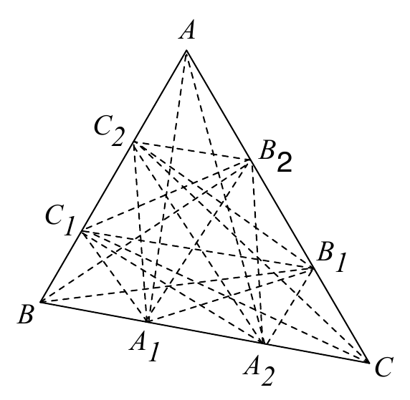
Our Solution
Introduce additional vertices (cut-vertices) and edges (cut-edges) along each edge of the triangulation.
The shortest face-crossing path denoted by 𝛱_{FC}(s,t) was now a tighter approximation to shortest surface path 𝛱_{s}(s,t).

Slide 21
Our Solution
Introduce additional vertices (cut-vertices) and edges (cut-edges) along each edge of the triangulation.
The shortest face-crossing path denoted by 𝛱_{FC}(s,t) was now a tighter approximation to shortest surface path 𝛱_{s}(s,t).
Setting the number of cut-vertices per edge to infinity makes 𝛱_{FC}(s,t) tend to 𝛱_{s}(s,t).
Setting the number of cut-vertices per edge to zero makes 𝛱_{FC}(s,t) tend to 𝛱_{n}(s,t).

Slide 22
Contribution 1: Tighter Constant-Ratio Bounds
Let 𝛱_{fc}(s,t), 𝛱_{s}(s,t), and 𝛱_{n}(s,t) be the shortest surface face-crossing path, shortest surface path and the shortest network path between source s and destination t on terrain Ρ, respectively. Then,
𝛌|𝛱_{fc}(s,t)| ≤ |𝛱_{s}(s,t)| ≤ |𝛱_{fc}(s,t)|
where 𝛌 = (1 - 1 / K) and K >= 10 (Real-Valued Constant).
Lower Bound
Upper Bound

Slide 23

Contribution 1: Tighter Constant-Ratio Bounds
Let 𝛱_{fc}(s,t), 𝛱_{s}(s,t), and 𝛱_{n}(s,t) be the shortest surface face-crossing path, shortest surface path and the shortest network path between source s and destination t on terrain Ρ, respectively. Then,
𝛌|𝛱_{fc}(s,t)| ≤ |𝛱_{s}(s,t)| ≤ |𝛱_{fc}(s,t)|
where 𝛌 = (1 - 1 / K) and K >= 10 (Real-Valued Constant).
Note: 𝝙I is at most
Lower Bound
Upper Bound
θ_{min} :Minimum interior angle of single face, l_{min}:Length of smallest edge in P, 𝝙I :Gap between cut-vertices on an edge

Slide 24
Contribution 1: Tighter Constant-Ratio Bounds
Let 𝛱_{fc}(s,t), 𝛱_{s}(s,t), and 𝛱_{n}(s,t) be the shortest surface face-crossing path, shortest surface path and the shortest network path between source s and destination t on terrain Ρ, respectively. Then,
𝛌|𝛱_{fc}(s,t)| ≤ |𝛱_{s}(s,t)| ≤ |𝛱_{fc}(s,t)|
where 𝛌 = (1 - 1 / K) and K >= 10 (Real-Valued Constant).
Note: 𝝙I is at most
Lower Bound
Upper Bound
For lower θ_{min}, we have 𝝙I also getting lowered => On skinny triangles we automatically introduce more cut-vertices!
θ_{min} :Minimum interior angle of single face, l_{min}:Length of smallest edge in P, 𝝙I :Gap between cut-vertices on an edge

Slide 25
Contribution 2: Proving their Tightness.
The lower bound proposed ℒ_{old} in the state-of-the-art [prev-work] based on 𝛱_{n}(s,t) is always smaller than ℒ_{new} (our new constant-ratio lower bound) for any value of θ_{m}
The upper bound proposed U_{old} in the state-of-the-art [prev-work] based on 𝛱_{n}(s,t) is always larger than U_{new} = 𝛱_{fc}(s,t)

Slide 26
Algorithm Overview
Dijkstra-like: Propagate outwards like a wavefront from the edges of the adjacent faces that are opposite to vertex s.
Place cut-vertices and cut-edges on-the-fly on the propagation barrier
Cut-vertices are only placed on edges whose Euclidean distance to the target t is shorter than Euclidean distance between s and t.

Slide 27
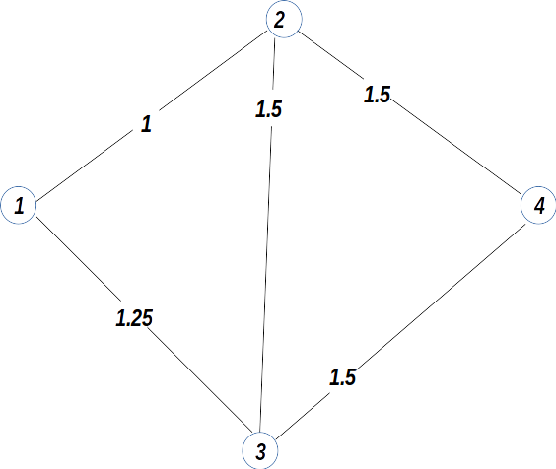
Running Example

Slide 28
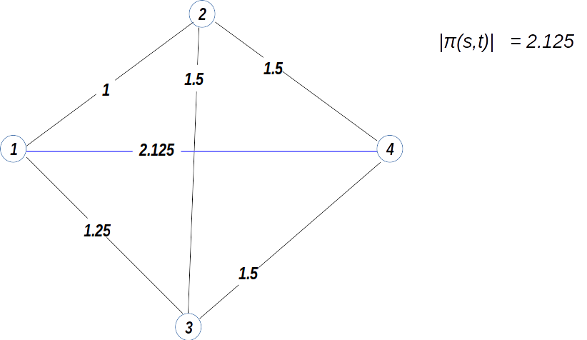
Running Example

Slide 29
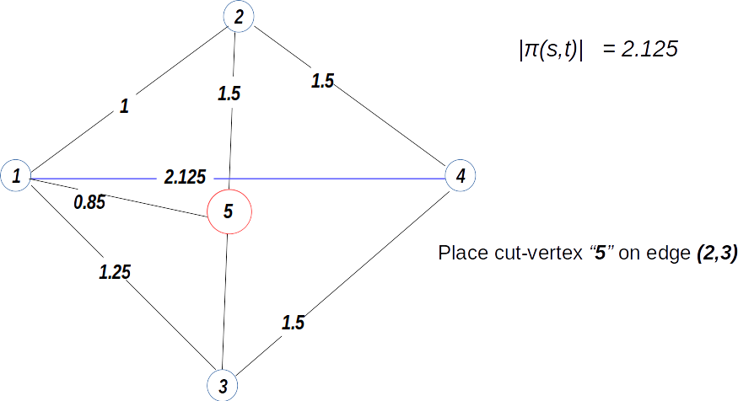
Running Example

Slide 30
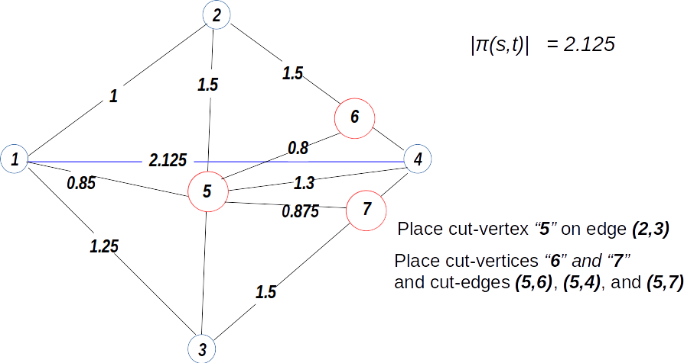
Running Example

Slide 31
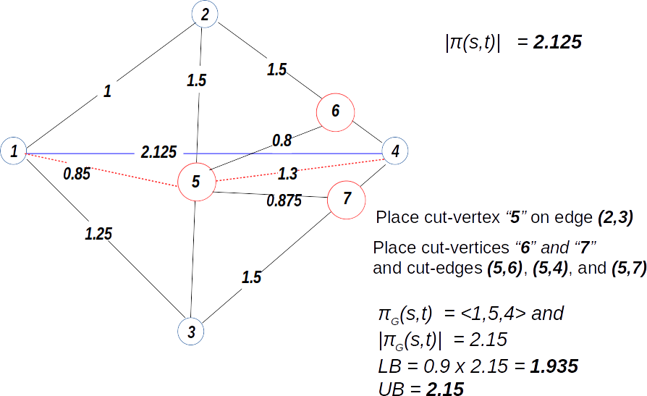
Running Example

Slide 32
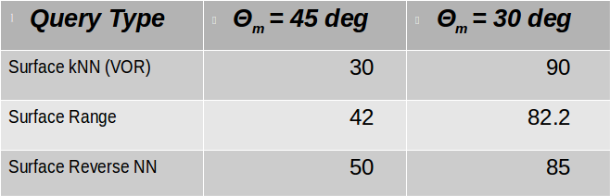
Experimental Summary
Our lower bound is up to 3.1 times larger (or better) than the our previously proposed lower bound.
Our upper bound is up to 1.13 times smaller (or better) than the our previously proposed upper bound.
Speedups Achieved

Slide 33
Thank You!

