Slide 1
Finding Shortest Paths on Terrains by Killing Two Birds with One Stone
Manohar Kaul (Aarhus University)
Raymond Chi-Wing Wong (Hong Kong University of Science and Technology)
Bin Yang (Aarhus University)
Christian S. Jensen (Aarhus University)
Presented by Raymond Chi-Wing Wong
Prepared by Raymond Chi-Wing Wong

Slide 2
Outline
Introduction
  Related Work
Problem 1: Finding Lower Bound
Problem 2: Surface Simplification
Empirical Study
Conclusion

Slide 3
1. Introduction
Finding Shortest Paths on Terrains
Terrain
Triangulated Irregular Network (TIN) model

Slide 4
1. Introduction
Finding Shortest Paths on Terrains

Slide 5
1. Introduction
Finding Shortest Paths on Terrains
We want to find the shortest surface path from s to t
s
t
There is a state-of-the-art algorithm called the Chen-and-Han algorithm [SCG90].
The time complexity is O(N²) where N is the total number of vertices in the model.

Slide 6
1. Introduction
Finding Shortest Paths on Terrains
  Surface k-Nearest Neighbor Queries
    VLDBJ08, VLDB08, VLDB09
  Surface Range Queries
  Surface Reverse Nearest Neighbor Queries
    CIKM12
  Finding Shortest Path
    SIGMOD11
These algorithms have a component of finding shortest paths.
Since computing shortest paths is costly, most of these algorithms find a “lower bound” and an “upper bound” of the shortest distance/path, whose computation cost is cheaper.

Slide 7
1. Introduction
Contribution 1: “Killing Two Birds with One Stone”
We know that we have to compute the shortest network distance
for the upper bound.
Problem 1: “Finding Lower Bound”
We want to find a lower bound of the shortest surface distance which is equal to the shortest network distance multiplied by a constant derived from the terrain.
Our new lower bound is just equal to this distance multiplied by
a constant derived from the terrain.
No additional computation cost is introduced.
Finding Shortest Paths on Terrains
Weakness: The existing lower bound is too loose. It does not use any information about the terrain.
We want to find the shortest surface path from s to t
s
t
Lower bound
The direct Euclidean distance
Very Low Computation Cost
Upper bound
These lower and upper bounds are commonly adopted in the literature for pruning.
The shortest network distance (i.e., the shortest distance on the graph)
Dijkstra’s algorithm
Low Computation Cost

Slide 8
1. Introduction
Lower bound
Contribution 1: “Killing Two Birds with One Stone”
We know that we have to compute the shortest network distance
for the upper bound.
L: lower bound computed on G
L: lower bound computed on G’
L ≤ L
Problem 1: “Finding Lower Bound”
We want to find a lower bound of the shortest surface distance which is equal to the shortest network distance multiplied by a constant derived from the terrain.
Our new lower bound is just equal to this distance multiplied by
a constant derived from the terrain.
We introduce a user parameter ω (which is a real number at least 1) denoting how much we can simplify.
If ω is 1, then G’ gives the same lower/upper bounds as G.
If ω is a larger value, then the tightness of the bounds is sacrificed.
1
. L ≤
Although computing the shortest network distance on a large graph G is fast, it can be attractive to compute lower and upper bounds even more quickly.
ω
No additional computation cost is introduced.
Upper bound
Finding Shortest Paths on Terrains
U: upper bound computed on G
U: upper bound computed on G’
U ≤ U
We want to find the shortest surface path from s to t
≤ ω . U
Contribution 2: “Surface Simplification”
We want to simplify the surface of the terrain so that the number of triangles is smaller and thus the graph is smaller.
Problem 2: “Surface Simplification”
Given a graph G, we want to generate a simplified graph G’ such that for any source vertex s and any destination vertex t,
Based on this smaller graph G’, computing the shortest network distance is faster.
1
. L ≤ L ≤ L
and
U ≤ U ≤ ω . U
ω
At the same time, the lower/upper bound computed based on the smaller graph G’ is “close” to the lower/upper bound computed based on the original graph G

Slide 9
Outline
Introduction
  Related Work
Problem 1: Finding Lower Bound
Problem 2: Surface Simplification
Empirical Study
Conclusion

Slide 10
2. Finding Lower Bound
Problem 1: “Finding Lower Bound”
We want to find a lower bound of the shortest surface distance which is equal to the shortest network distance multiplied by a constant derived from the terrain.
If θ_{m} is smaller, then λ is smaller.
Thus, our lower bound is looser.
In Computational Geometry, there is a concept called “realistic terrain” which maximizes θ_{m}.
The existing lower bound
In our experimental results,
θ_{m} is at least 45º.
s
t
Π_{G}(s, t)
λ is at least 0.35
Shortest network path
In some of our results, our lower bound is 2.8 times larger than the existing lower bound (which means that our lower bound is tighter).
Π(s, t)
Shortest surface path
An interior angle of a triangle
Let θ_{m} be the minimum interior angle of a triangle in the terrain.
Lemma
Existing upper bound
λ . |Π_{G}(s, t)| ≤
|Π(s, t)| ≤ |Π_{G}(s, t)|
where λ = min{ , sin θ_{m} cos θ_{m}}
λ is a constant derived from the terrain.
sin θ_{m}
Our lower bound
2

Slide 11
2. Finding Lower Bound
Since our lower bound is tighter compared with existing lower bounds, existing algorithms using the lower bound for pruning can be speeded up.

Slide 12
Outline
Introduction
  Related Work
Problem 1: Finding Lower Bound
Problem 2: Surface Simplification
Empirical Study
Conclusion

Slide 13
Problem 2: “Surface Simplification”
Given a graph G, we want to generate a simplified graph G’ such that for any source vertex s and any destination vertex t,
1
. L ≤ L ≤ L
and
U ≤ U ≤ ω . U
ω
Algorithm for Generating G’
We iteratively remove a vertex from G and check whether the simplified graph satisfies the above conditions.
We stops when there does not exist a vertex in G such that the resulting graph G’ after the removal of this vertex satisfies the above conditions.
Output: G’

Slide 14
Outline
Introduction
  Related Work
Problem 1: Finding Lower Bound
Problem 2: Surface Simplification
Empirical Study
Conclusion

Slide 15
4. Empirical Studies
Dataset
  Eagle Peak (EP) (in Wyoming, USA)
  1.3 million data points

Slide 16
4. Empirical Studies
Query
  Surface k-Nearest Neighbor Query
Algorithm
  SF (Straightforward)
  MR3 (VLDBJ08)
  VOR (VLDB08)
Since they use upper/lower bounds in their methods, our proposed approaches can be embedded in their methods.

Slide 17
4. Empirical Studies
Parameter
  k = 2
  (in Surface k-Nearest Neighbor Query)
  ω = 1.2
Measurement
  Query time

Slide 18
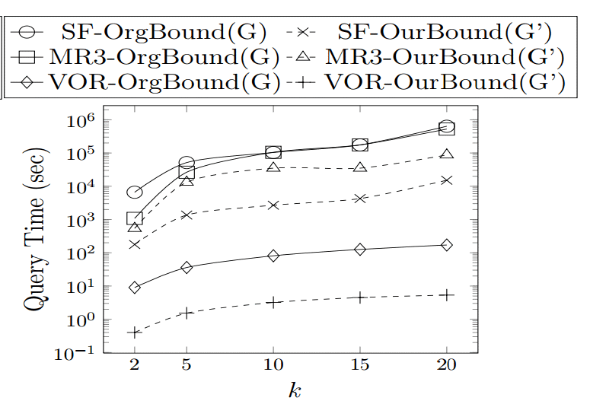
4. Empirical Studies

Slide 19
Outline
Introduction
  Related Work
Problem 1: Finding Lower Bound
Problem 2: Surface Simplification
Empirical Study
Conclusion

Slide 20
5. Conclusion
We propose a tighter lower bound of the shortest surface distance, a fundamental operator in many spatial queries on terrains.
We propose how to simplify the surface so that the lower/upper bounds computed on this simplified surface are near to those computed on the original surface.
Our methods can speed up existing algorithms up to 43 times for well-known spatial queries.

Slide 21
Q&A

Slide 22
2. Finding Lower Bound
Since our lower bound is tighter compared with existing lower bounds, existing algorithms using the lower bound for pruning can be speeded up.
Surface k-NN Queries
  Multi-Resolution Range Ranking (MR3) (VLDBJ08)
  Voronoi Diagram Based Method (VLDB08)
Reverse Nearest Neighbor Queries
  MSRNN Algorithm (CIKM12)

Slide 23
3. Surface Simplification
L: lower bound computed on G
L: lower bound computed on G’
Problem 2: “Surface Simplification”
Given a graph G, we want to generate a simplified graph G’ such that for any source vertex s and any destination vertex t,
U: lower bound computed on G
U: lower bound computed on G’
1
. L ≤ L ≤ L
and
U ≤ U ≤ ω . U
ω
Two Challenges:
Given a simplified graph G’, we say that G’ satisfies the network distance property
if and only if for any source vertex s and any destination vertex t,
Challenge 1: We have to process
a lot of source vertices and a lot
of destination vertices for each
iteration.
1
. L ≤ L ≤ L
and
U ≤ U ≤ ω . U
Challenge 2: We have to define
L and U.
ω
Algorithm for Generating G’
We iteratively remove a vertex from G and check whether the resulting graph G’ satisfies the network distance property.
We stops when there does not exist a vertex in G such that the resulting graph G’ after the removal of this vertex satisfies the network distance property.
Output: G’
How can we execute this checking step for each
iteration?

Slide 24
3. Surface Simplification
Two Challenges:
Given a simplified graph G’, we say that G’ satisfies the network distance property
if and only if for any source vertex s and any destination vertex t,
Challenge 1: We have to process
a lot of source vertices and a lot
of destination vertices for each
iteration.
1
. L ≤ L ≤ L
and
U ≤ U ≤ ω . U
Challenge 2: We have to define
L and U.
ω
Algorithm for Generating G’
We iteratively remove a vertex from G and check whether the resulting graph G’ satisfies the network distance property.
We stops when there does not exist a vertex in G such that the resulting graph G’ after the removal of this vertex satisfies the network distance property.
Output: G’

Slide 25
3. Surface Simplification
Lemma
Two Challenges:
If G’ satisfies the estimated distance property,
then G’ satisfies the network distance property.
Challenge 1: We have to process
a lot of source vertices and a lot
of destination vertices for each
iteration.
Challenge 2: We have to define
L and U.
Given a simplified graph G’, we say that G’ satisfies the network distance property
if and only if for any source vertex s and any destination vertex t,
estimated distance property
d_{G} (s, t)
1
and
|Π_{G}(s, t)|≤ d_{G} (s, t) ≤ ω . |Π_{G}(s, t)|
ω
. L ≤ L ≤ L
U ≤ U ≤ ω . U
The estimated distance between a source vertex s and a destination vertex t on G’
Algorithm for Generating G’
We iteratively remove a vertex from G and check whether the resulting graph G’ satisfies the network distance property.
We stops when there does not exist a vertex in G such that the resulting graph G’ after the removal of this vertex satisfies the network distance property.
Output: G’
estimated distance property
λ
L =
ω
d_{G} (s, t)
.
U =
d_{G} (s, t)

Slide 26
3. Surface Simplification
Two Challenges:
Challenge 1: We have to process
a lot of source vertices and a lot
of destination vertices for each
iteration.
Challenge 2: We have to define
L and U.
Given a simplified graph G’, we say that G’ satisfies the network distance property
if and only if for any source vertex s and any destination vertex t,
estimated distance property
1
and
|Π_{G}(s, t)|≤ d_{G} (s, t) ≤ ω . |Π_{G}(s, t)|
ω
. L ≤ L ≤ L
U ≤ U ≤ ω . U

Slide 27
3. Surface Simplification
v₁
v₃
v₄
v₅
Two Challenges:
v₂
v₆
Challenge 1: We have to process
a lot of source vertices and a lot
of destination vertices for each
iteration.
v₁₀
v₇
v₈
v₉
v₁₁
Challenge 2: We have to define
L and U.
Given a simplified graph G’, we say that G’ satisfies the network distance property
if and only if for any source vertex s and any destination vertex t,
estimated distance property
For each iteration,
we remove a vertex v.
1
and
|Π_{G}(s, t)|≤ d_{G} (s, t) ≤ ω . |Π_{G}(s, t)|
ω
. L ≤ L ≤ L
U ≤ U ≤ ω . U
Let N(v) be the set of vertices
in the neighborhood of v in G’
N(v₆) = {v₁, v₂, v₇}
Suppose that a graph satisfies
the estimated distance property
wrt any s and any t in the set V of all vertices.
Now, we remove vertex v₆.

Slide 28
3. Surface Simplification
v₁
v₃
v₄
v₅
Two Challenges:
v₂
Challenge 1: We have to process
a lot of source vertices and a lot
of destination vertices for each
iteration.
v₁₀
v₇
v₈
v₉
v₁₁
Challenge 2: We have to define
L and U.
Given a simplified graph G’, we say that G’ satisfies the network distance property
if and only if for any source vertex s and any destination vertex t,
estimated distance property
For each iteration,
we remove a vertex v.
in N(v) where v is a vertex to be removed.
1
and
|Π_{G}(s, t)|≤ d_{G} (s, t) ≤ ω . |Π_{G}(s, t)|
ω
. L ≤ L ≤ L
U ≤ U ≤ ω . U
Let N(v) be the set of vertices
in the neighborhood of v in G’
Lemma
N(v₆) = {v₁, v₂, v₇}
Checking whether G’ satisfies the estimated distance property wrt any s and any t in V
is equivalent to
checking whether G’ satisfies the estimated distance property wrt any s and any t in N(v₆)
Suppose that a graph satisfies
the estimated distance property
wrt any s and any t in the set V of all vertices.
Now, we remove vertex v₆.
We have a smaller graph G’

Slide 29
3. Surface Simplification
v₁
v₃
v₄
v₅
Two Challenges:
v₂
v₆
Challenge 1: We have to process
a lot of source vertices and a lot
of destination vertices for each
iteration.
v₁₀
v₇
v₈
v₉
v₁₁
Challenge 2: We have to define
L and U.
We have addressed
  Challenge 1
  Challenge 2
The remaining issue is how to compute
d_{G} (s, t)
At each iteration, we have to remove a vertex. There are two types of vertices:
(1) A vertex not in G’ and
(2) A vertex in G’
Each vertex v not in G’ is associated with H(v).
Each vertex v in G’ is associated with
G(v)
GL(v)
Host set of v
Guest set of v
Guest information set of v

Slide 30
3. Surface Simplification
v₁
v₃
v₄
v₅
Two Challenges:
v₂
v₆
Challenge 1: We have to process
a lot of source vertices and a lot
of destination vertices for each
iteration.
v₁₀
v₇
v₈
v₉
v₁₁
Challenge 2: We have to define
L and U.
d_{G} (s, t)
Case 1: s is in G’ and t is in G’
Case 2: s is not in G’ and t is in G’
Case 3: s is in G’ and t is not in G’
Case 4: s is not in G’ and t is not in G’
At each iteration, we have to remove a vertex. There are two types of vertices:
(1) A vertex not in G’ and
(2) A vertex in G’
Each vertex v not in G’ is associated with H(v).
Each vertex v in G’ is associated with
G(v)
GL(v)
Host set of v
Guest set of v
Guest information set of v

Slide 31
3. Surface Simplification
v₁
v₃
v₄
v₅
Two Challenges:
v₂
v₆
Challenge 1: We have to process
a lot of source vertices and a lot
of destination vertices for each
iteration.
v₁₀
v₇
v₈
v₉
v₁₁
Challenge 2: We have to define
L and U.
d_{G} (s, t)
Case 1: s is in G’ and t is in G’
Find the shortest network distance between s and t in the graph G’
containing s and t
At each iteration, we have to remove a vertex. There are two types of vertices:
(1) A vertex not in G’ and
(2) A vertex in G’
Each vertex v not in G’ is associated with H(v).
Each vertex v in G’ is associated with
G(v)
GL(v)
Host set of v
Guest set of v
Guest information set of v

Slide 32
3. Surface Simplification
v₁
v₃
v₄
v₅
Two Challenges:
v₂
v₆
Challenge 1: We have to process
a lot of source vertices and a lot
of destination vertices for each
iteration.
v₁₀
v₇
v₈
v₉
v₁₁
Challenge 2: We have to define
L and U.
d_{G} (s, t)
Case 2: s is not in G’ and t is in G’
For each vertex (called host) u in H(v),
find the shortest network distance between u and t in the graph G’
containing u and t
compute the “estimated” distance of the path (s → u → t)
Choose the smallest sum calculated above as the final value of
d_{G} (s, t)
At each iteration, we have to remove a vertex. There are two types of vertices:
(1) A vertex not in G’ and
(2) A vertex in G’
Each vertex v not in G’ is associated with H(v).
Each vertex v in G’ is associated with
G(v)
GL(v)
Host set of v
Guest set of v
Guest information set of v

Slide 33
3. Surface Simplification
v₁
v₃
2.5
v₄
2.7
v₅
Two Challenges:
3.5
v₂
2.1
1.5
1.7
Challenge 1: We have to process
a lot of source vertices and a lot
of destination vertices for each
iteration.
2.6
v₆
2.4
v₁₀
Find the shortest network distance between v₆ and v₁₀
2.2
2.2
2.0
3.0
3.8
3.5
2.2
3.8
2.0
3.5
v₇
4.2
v₈
2.2
v₉
3.0
v₁₁
Challenge 2: We have to define
L and U.
v₆ and v₁₀ are in G’
Case 1
v | G(v) | GL(v) | v | G(v) | GL(v)
v₁ |  |  | v₇
v₂ |  |  | v₈
v₃ |  |  | v₉
v₄ |  |  | v₁₀
v₅ |  |  | v₁₁
v₆
d_{G} (v₆, v₁₀)
{}
{}
{}
{}
= 2.4 + 2.1 +2.5+1.5
{}
{}
{}
{}
= 8.5
{}
{}
{}
{}
{}
{}
{}
{}
v | H(v)
{}
{}
{}
{}
{}
{}
Each vertex v not in G’ is associated with H(v).
Each vertex v in G’ is associated with
G(v)
GL(v)
Host set of v
Guest set of v
Guest information set of v

Slide 34
3. Surface Simplification
v₁
v₃
2.5
v₄
2.7
v₅
Two Challenges:
3.5
v₂
2.1
1.5
1.7
Challenge 1: We have to process
a lot of source vertices and a lot
of destination vertices for each
iteration.
2.6
v₆
2.4
v₁₀
2.2
2.2
2.0
3.0
3.8
3.5
2.2
3.8
2.0
3.5
v₇
4.2
v₈
2.2
v₉
3.0
v₁₁
Challenge 2: We have to define
L and U.
We remove vertex v₆.
v | G(v) | GL(v) | v | G(v) | GL(v)
v₁ |  |  | v₇
v₂ |  |  | v₈
v₃ |  |  | v₉
v₄ |  |  | v₁₀
v₅ |  |  | v₁₁
v₆
{(v₆, 2.6)}
{}
{}
{v₆}
{(v₆, 2.2)}
{}
{}
{v₆}
{}
{}
{}
{v₆}
{(v₆, 2.4)}
{}
{}
{}
{}
{}
{}
{}
{}
{}
v | H(v)
{}
{}
{}
v₆
{v₁, v₂, v₇}
{}
{}
{}
Each vertex v not in G’ is associated with H(v).
Each vertex v in G’ is associated with
G(v)
GL(v)
Host set of v
Guest set of v
Guest information set of v

Slide 35
3. Surface Simplification
v₁
v₃
2.5
v₄
2.7
v₅
Two Challenges:
3.5
v₂
2.1
1.5
1.7
Challenge 1: We have to process
a lot of source vertices and a lot
of destination vertices for each
iteration.
v₁₀
2.2
2.2
2.0
3.0
3.8
3.5
3.8
2.0
3.5
v₁₀ is in G’.
Case 2
v₇
4.2
v₈
2.2
v₉
3.0
v₁₁
Challenge 2: We have to define
L and U.
v₆ is not in G’.
We remove vertex v₆.
v | G(v) | GL(v) | v | G(v) | GL(v)
v₁ |  |  | v₇
v₂ |  |  | v₈
v₃ |  |  | v₉
v₄ |  |  | v₁₀
v₅ |  |  | v₁₁
v₆
d_{G} (v₆, v₁₀)
{(v₆, 2.6)}
{}
{}
{v₆}
{(v₆, 2.2)}
{}
{}
{v₆}
{}
{}
{}
{v₆}
{(v₆, 2.4)}
{}
{}
{}
{}
{}
{}
{}
{}
{}
v | H(v)
{}
{}
{}
v₆
{v₁, v₂, v₇}
{}
{}
{}
Find the shortest network distance between v₁ and v₁₀
Each vertex v not in G’ is associated with H(v).
Each vertex v in G’ is associated with
G(v)
GL(v)
The estimated distance of the path
(v₆ → v₁ → v₁₀)
Host set of v
2.6
9.6
Guest set of v
= 3.5+2.1+2.5+1.5
Sum = 12.2
= 9.6
Guest information set of v

Slide 36
3. Surface Simplification
v₁
v₃
2.5
v₄
2.7
v₅
Two Challenges:
3.5
v₂
2.1
1.5
1.7
Challenge 1: We have to process
a lot of source vertices and a lot
of destination vertices for each
iteration.
v₁₀
2.2
2.2
2.0
3.0
3.8
3.5
3.8
2.0
3.5
v₁₀ is in G’.
Case 2
v₇
4.2
v₈
2.2
v₉
3.0
v₁₁
Challenge 2: We have to define
L and U.
v₆ is not in G’.
We remove vertex v₆.
v | G(v) | GL(v) | v | G(v) | GL(v)
v₁ |  |  | v₇
v₂ |  |  | v₈
v₃ |  |  | v₉
v₄ |  |  | v₁₀
v₅ |  |  | v₁₁
v₆
d_{G} (v₆, v₁₀)
{(v₆, 2.6)}
{}
{}
{v₆}
{(v₆, 2.2)}
{}
{}
{v₆}
{}
{}
{}
{v₆}
{(v₆, 2.4)}
{}
{}
{}
{}
{}
{}
{}
{}
{}
v | H(v)
{}
{}
{}
v₆
{v₁, v₂, v₇}
{}
{}
{}
Find the shortest network distance between v₁ and v₁₀
Find the shortest network distance between v₂ and v₁₀
The estimated distance of the path
(v₆ → v₂ → v₁₀)
Each vertex v not in G’ is associated with H(v).
Each vertex v in G’ is associated with
G(v)
GL(v)
The estimated distance of the path
(v₆ → v₁ → v₁₀)
2.4
6.1
Host set of v
Guest set of v
= 3.5+2.1+2.5+1.5
= 2.1+2.5+1.5
2.6
9.6
Sum = 8.5
Sum = 12.2
= 9.6
= 6.1
Guest information set of v

Slide 37
3. Surface Simplification
v₁
v₃
2.5
v₄
2.7
v₅
Two Challenges:
3.5
v₂
2.1
1.5
1.7
Challenge 1: We have to process
a lot of source vertices and a lot
of destination vertices for each
iteration.
v₁₀
2.2
2.2
2.0
3.0
3.8
3.5
3.8
2.0
3.5
v₁₀ is in G’.
Case 2
v₇
4.2
v₈
2.2
v₉
3.0
v₁₁
Challenge 2: We have to define
L and U.
v₆ is not in G’.
We remove vertex v₆.
v | G(v) | GL(v) | v | G(v) | GL(v)
v₁ |  |  | v₇
v₂ |  |  | v₈
v₃ |  |  | v₉
v₄ |  |  | v₁₀
v₅ |  |  | v₁₁
v₆
d_{G} (v₆, v₁₀)
{(v₆, 2.6)}
{}
{}
{v₆}
{(v₆, 2.2)}
{}
{}
{v₆}
{}
{}
{}
{v₆}
{(v₆, 2.4)}
{}
Find the shortest network distance between v₇ and v₁₀
{}
{}
{}
{}
The estimated distance of the path
(v₆ → v₇ → v₁₀)
{}
{}
{}
{}
v | H(v)
2.2
9.9
= 3.8+ 2.1+2.5+1.5
v₆
{v₁, v₂, v₇}
{}
{}
{}
{}
Sum = 12.1
= 9.9
{}
{}
Find the shortest network distance between v₁ and v₁₀
Find the shortest network distance between v₂ and v₁₀
The estimated distance of the path
(v₆ → v₂ → v₁₀)
Each vertex v not in G’ is associated with H(v).
Each vertex v in G’ is associated with
G(v)
GL(v)
The estimated distance of the path
(v₆ → v₁ → v₁₀)
2.4
6.1
Host set of v
Guest set of v
= 3.5+2.1+2.5+1.5
= 2.1+2.5+1.5
2.6
9.6
Sum = 8.5
Sum = 12.2
= 9.6
= 6.1
Guest information set of v

Slide 38
3. Surface Simplification
v₁
v₃
2.5
v₄
2.7
v₅
Two Challenges:
3.5
v₂
2.1
1.5
1.7
Challenge 1: We have to process
a lot of source vertices and a lot
of destination vertices for each
iteration.
v₁₀
2.2
2.2
2.0
3.0
3.8
3.5
3.8
2.0
3.5
v₁₀ is in G’.
Case 2
v₇
4.2
v₈
2.2
v₉
3.0
v₁₁
Challenge 2: We have to define
L and U.
v₆ is not in G’.
We remove vertex v₆.
v | G(v) | GL(v) | v | G(v) | GL(v)
v₁ |  |  | v₇
v₂ |  |  | v₈
v₃ |  |  | v₉
v₄ |  |  | v₁₀
v₅ |  |  | v₁₁
v₆
d_{G} (v₆, v₁₀)
{(v₆, 2.6)}
{}
{}
{v₆}
{(v₆, 2.2)}
{}
{}
{v₆}
= min{12.2, 8.5, 12.1}
{}
{}
{}
{v₆}
{(v₆, 2.4)}
{}
= 8.5
Find the shortest network distance between v₇ and v₁₀
{}
{}
{}
{}
The estimated distance of the path
(v₆ → v₇ → v₁₀)
{}
{}
{}
{}
v | H(v)
2.2
9.9
= 3.8+ 2.1+2.5+1.5
v₆
{v₁, v₂, v₇}
{}
{}
{}
{}
Sum = 12.1
= 9.9
{}
{}
Find the shortest network distance between v₁ and v₁₀
Find the shortest network distance between v₂ and v₁₀
The estimated distance of the path
(v₆ → v₂ → v₁₀)
Each vertex v not in G’ is associated with H(v).
Each vertex v in G’ is associated with
G(v)
GL(v)
The estimated distance of the path
(v₆ → v₁ → v₁₀)
2.4
6.1
Host set of v
Guest set of v
= 3.5+2.1+2.5+1.5
= 2.1+2.5+1.5
2.6
9.6
Sum = 8.5
Sum = 12.2
= 9.6
= 6.1
Guest information set of v

Slide 39
4. Empirical Studies
Original Algorithm (using the original bounds on the original graph G)
  SF
  MR3
  VOR
-OrgBound(G)
-OrgBound(G)
-OrgBound(G)
Updated Algorithm (using our new bounds on the original graph G)
  SF
  MR3
  VOR
-OurBound(G)
Experiment 1: Contribution 1 (Lower Bound)
-OurBound(G)
-OurBound(G)
Updated Algorithm (using the original bounds on the simplified graph G’)
  SF
  MR3
  VOR
-OrgBound(G’)
-OrgBound(G’)
Experiment 2: Contribution 2 (Simplified Graph G’)
-OrgBound(G’)
Updated Algorithm (using our new bounds on the simplified graph G’)
  SF
  MR3
  VOR
-OurBound(G’)
Experiment 3: Contribution 1 (Lower Bound)
and Contribution 2 (Simplified Graph G’)
together
-OurBound(G’)
-OurBound(G’)

Slide 40
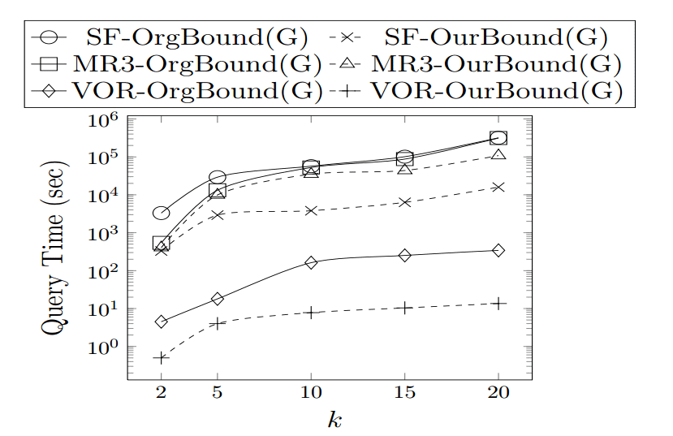
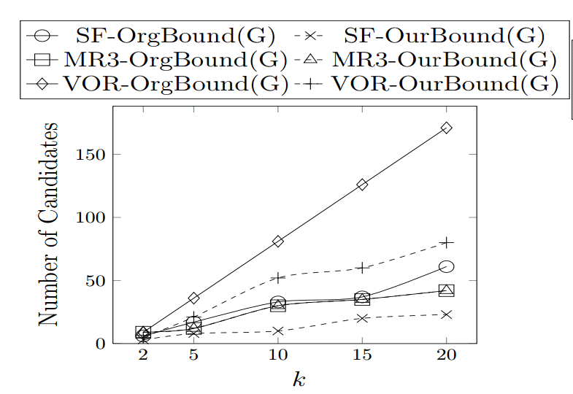
4. Empirical Studies
Experiment 1: Contribution 1 (Lower Bound)

Slide 41
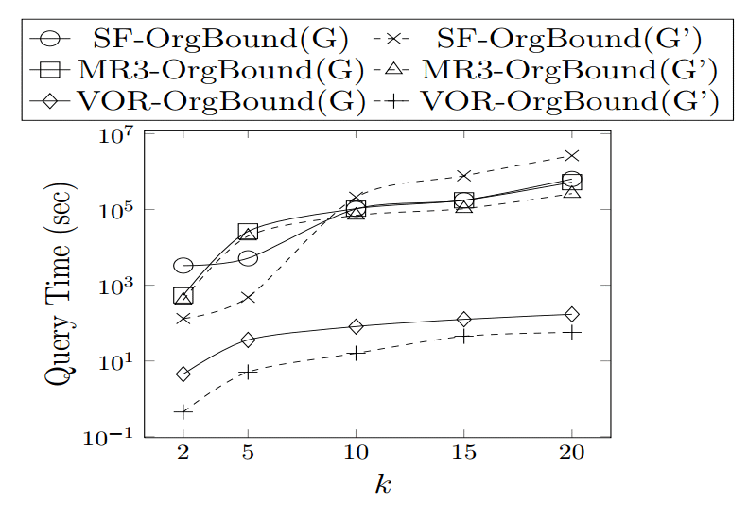
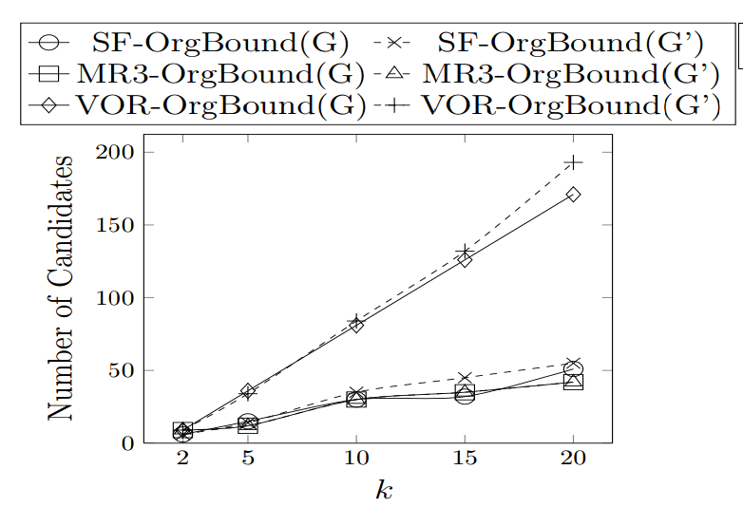
4. Empirical Studies
Experiment 2: Contribution 2 (Simplified Graph G’)

Slide 42
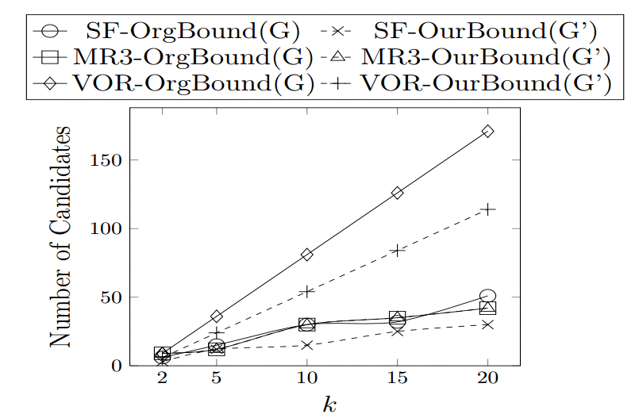
4. Empirical Studies
Experiment 3: Contribution 1 (Lower Bound)
and Contribution 2 (Simplified Graph G’)
together

Slide 43
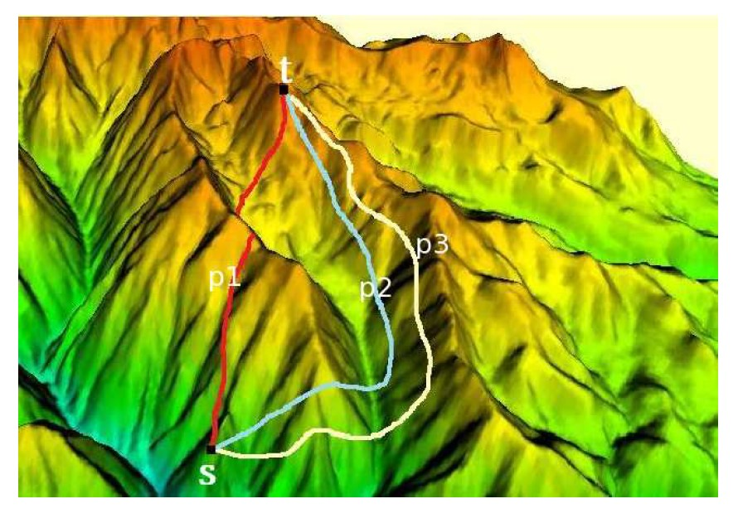
1. Introduction
Finding Shortest Paths on Terrains
Terrain

Slide 44
1. Introduction
Applications
  Defense Industry
    Simulate battlefield landscapes to allow tactical path planning
  Robot Path Planning
    Unmanned vehicles on terrains
  Georealistic Computer Games
  Evacuations in a natural disaster (like earthquake and fires)

Slide 45
1. Introduction
Existing spatial queries on terrains relies on computing efficient lower/upper bounds of the shortest distance for pruning.
This paper improves the quality of the lower bound for more effective pruning
This paper also speeds up the computation of lower/upper bounds for efficient computation.

