Slide 1
Hop Doubling Label Indexing for
Point-to-Point Distance Querying on Scale-Free Networks
Minhao Jiang¹, Ada Wai-Chee Fu², Raymond Chi-Wing Wong¹, Yanyan Xu²
The Hong Kong University of Science and Technology ¹
The Chinese University of Hong Kong ²
Prepared by Minhao Jiang
Presented by Minhao Jiang

Slide 2
Outline
1. Background
2. Our Method
3. Experiment
4. Conclusion
5. Future Work

Slide 3
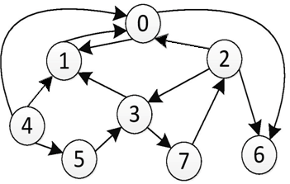
Background
1. Point-to-Point Distance Query:
Given an unweighted directed graph G = (V, E)
the shortest distance dist_{G}(u,v) from u to v in a graph G
Example: dist_{G}(5,6) = 4

Slide 4
Background
Point-to-Point Distance Query:
Applications:
(1). Routing in communication network
(2). Social network analysis
(3). Web search
(4). Operation research
Two Approaches:
(1). Answer queries on the fly : Dijkstra's algorithm
(2). Index the graph in preprocessing and answer the query based on the index, e.g. 2-hop index.

Slide 5
Background
2-Hop Index:
Each vertex u : 2 labels L_{out} (u) and L_{in}(u)
Each label: a set of label entries (u→v, d)
L_{out} (u) | L_{in}(u)
(u→v0, d0)
 | (v1→u, d1)
(u→v2, d2) | (v2→u, d3)
 | (v3→u, d4)
…… | ……
vertex | Out label | In label
v0 | L_{out} (v0) | L_{in}(v0)
v1 | L_{out} (v1) | L_{in}(v1)
… | … | …
u | L_{out} (u) | L_{in}(u)
… | … | …
each vertex u:
L_{out} (u) | L_{in}(v)
(u→v0, d0) | (v0→v, d5)
(u→v2, d2)
 | (v6→v, d6)
…… | ……
querying dist_{G}(u,v) by L_{out} (u) and L_{in}(v)

Slide 6
Background
2. 2-Hop Index:
Example:
L_{out} (5) | L_{in}(6)
(5→0, 3) | (0→6, 1)
(5→1, 2)
(5→2, 3) | (2→6, 1)
(5→3, 1)
(5→5, 0)
 | (6→6, 0)

Slide 7
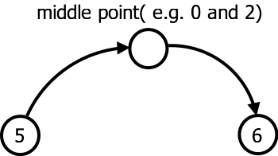
Background
2. 2-Hop Index:
querying dist_{G}(5,6) by L_{out} (5) and L_{in}(6)
Example:
L_{out} (5) | L_{in}(6) | dist_{G} (5,6)
(5→0, 3) | (0→6, 1)
(5→1, 2)
(5→2, 3) | (2→6, 1)
(5→3, 1)
(5→5, 0)
 | (6→6, 0)
3+1 = 4
3+1 = 4
Solid line : graph edge
label entry in the index
Dotted line : created label entry

Slide 8
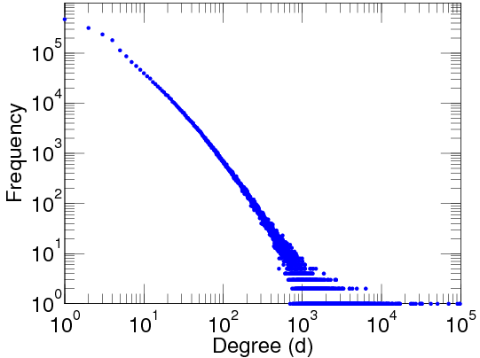
Background
Scale-Free Network:
Degree Distribution:
Real Life Graphs
Social Network
e.g. Google plus
Communication Network
e.g. European email network
Many real graphs
can be modeled as
[Science 99, SIGCOMM 99, Combinatorica 04 ,….. ]
Note that some graphs are not scale-free.
Scale-Free
Network
Web
e.g. flickr.com
RDF Graph
e.g. Wikipedia

Slide 9
Background
4. Related Works:
4.1 Greedy 2-hop cover [SODA 02]
log(n)-approximation 2-hop labeling algorithm
Build 2-hop by iteratively choosing densest subgraph
Weakness: high complexity, large index size in practice (We perform well on various datasets.)
4.2 Independent-set based labeling [VLDB 13]
Build 2-hop by iteratively removing independent-set vertices
Weakness: cannot build complete 2-hop for large graphs, and querying on partial index is slow (We can build complete index and answer queries efficiently.)
4.3 Pruning landmark labeling [SIGMOD 13]
Build 2-hop by pruning labels on BFS trees
Weakness: need large memory, otherwise external BFS is inefficient for handling large disk-resident graphs (We use disk-based method to handle large disk-resident graphs efficiently.)

Slide 10
Background
5. Our Contribution:
Make use of the properties of scale-free graph for a distance query
Propose a novel IO-efficient method for distance query on a large disk-resident graph
Verify the performance on various large real graphs

Slide 11
Our Method
1. Framework:
Scale-Free
Networks
disk-based
each iteration:
Label Generation
2. Pruning
read
Partial
write
Partial
Graph
Complete
Graph
+ Index
+ Index
iteratively
。
。
。
disk
memory
Goal 1. handle large graph → disk-based IO-efficient method

Slide 12
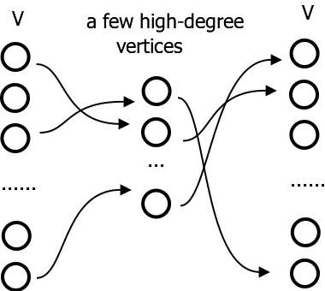
Our Method
Hop-Doubling Label Generation:
2.1 Properties of a Scale-Free Network
Observation 1:
(as black arrow)
Hit most shortest paths
by high-degree vertices
Create labels with
high-degree vertices
Scale-Free Properties
a few high-degrees vertices can hit most long-length shortest paths

Slide 13
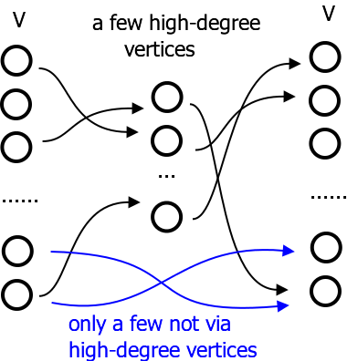
Our Method
Hop-Doubling Label Generation:
2.1 Properties of a Scale-Free Network
Observation 2:
(as blue arrow)
Hit a few shortest paths
by other vertices
The number of short-length shortest paths through any vertex not hit by high-degrees vertices is small
Scale-Free Properties

Slide 14
Our Method
Hop-Doubling Label Generation:
2.1 Properties of a Scale-Free Network
Scale-Free Properties
There exists a 2-hop index with small size.

Slide 15
Our Method
Hop-Doubling Label Generation:
2.2 Iterative Labeling Algorithm
Rank the vertices,
e.g. in descending order of deg(v)
Example: r(0) > r(1) > r(2) ….

Slide 16
Our Method
Hop-Doubling Label Generation:
2.2 Iterative Labeling Algorithm
Initialize labels with the edges
Generate labels iteratively until it can answer any query correctly

Slide 17
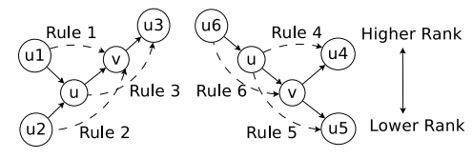
Our Method
Hop-Doubling Label Generation:
2.2 Iterative Labeling Algorithm
Generate labels based on 6 rules for each iteration

Slide 18
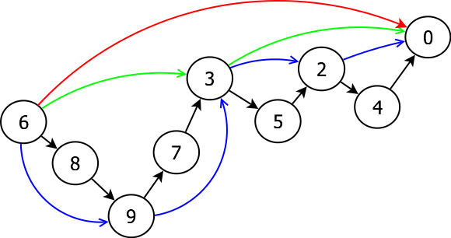
Our Method
Hop-Doubling Label Generation:
2.2 Iterative Labeling Algorithm
Generate labels based on 6 rules for each iteration
Doubling effect:
A length D path can be generated in iterations
Example: generating (6→0) of length 8:
Black: initialization
Blue: 1st iteration
Green: 2nd iteration
Red: 3rd iteration

Slide 19
Our Method
Hop-Stepping Enhancement
3.1 Hop-Length i+1 from i and 1
Hop-Doubling:
Weakness: fast growth → many labels generated
Hop-Stepping Enhancement:
Strength: slower growth → fewer labels generated

Slide 20
Our Method
Hop-Stepping Enhancement
3.2 Hop-Doubling + Hop-Stepping
 | advantage | disadvantage | usage
Hop-Stepping | slower growth (length+1) | more iterations (D iterations) | in the first few iterations
Hop-Doubling | less iterations (2logD iterations) | faster growth (length*2) | in later iterations

Slide 21
Experiment
Setup:
1.1 Machine
3.3 GHz CPU, 4GB RAM, 7200 RPM disk
1.2 Main Competitors
Baseline: bidirectional Dijkstra search
Disk-based: IS-Label [VLDB, 13]
Memory-based: PLL [SIGMOD, 13]
1.3 Datasets
Real datasets: from SNAP and KONECT
Synthetic datasets: generated by GLP model[infocom, 02]

Slide 22
Experiment
Performance Comparison:
IS-Label: Disk-based algorithm [VLDB, 13]
PLL: Memory-based algorithm [SIGMOD, 13]
HopDb: Disk-based algorithm [this paper]
type | graph | |V| | |E| | Index size(MB) |  |  | Indexing time(sec)
 |  |  |  | IS-Label | PLL | HopDb | IS-Label | PLL | HopDb
Large graphs | Delicious | 5.3M | 602M | --- | --- | 12748 | --- | --- | 31999
 | BTC | 168M | 361M | --- | --- | 13971 | --- | --- | 11401
 | Skitter | 1.7M | 22M | --- | --- | 3732 | --- | --- | 4888
Small graphs | Cat | 150K | 5M | 171 | 141 | 61 | 628 | 7 | 102
 | Flickr | 106K | 2M | --- | 226 | 238 | --- | 42 | 269
 | Enron | 37K | 368K | 138 | 33 | 10 | 37 | 0.5 | 3

Slide 23
Experiment
Performance Comparison:
BIDIJ: Memory-based bidirectional Dijkstra search
IS-Label: Disk-based algorithm [VLDB, 13]
PLL: Memory-based algorithm [SIGMOD, 13]
HopDb: Disk-based algorithm [this paper]
type | graph | Memory query time(µs) |  |  |  | Disk query time(ms)
 |  | BIDIJ | IS-Label | PLL | HopDb | IS-Label | HopDb
Large graphs | Delicious | --- | --- | --- | --- | --- | 30.1
 | BTC | --- | --- | --- | --- | --- | 28.4
 | Skitter | 5011 | --- | --- | 3.06 | --- | 24.6
Small graphs | Cat | 1880 | 2.3 | 0.31 | 0.22 | 15.7 | 7.3
 | Flickr | 1497 | --- | 2.06 | 2.06 | --- | 12.6
 | Enron | 108 | 4.8 | 0.14 | 0.08 | 6.9 | 0.6

Slide 24
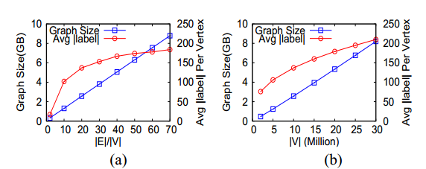
Experiment
Scalability:
Generate synthetic graphs by GLP model
(a). Fix |V| = 10M, varying density |E|/|V|
(b). Fix density |E|/|V|=20, varying |V|

Slide 25
Conclusion
HopDb can handle large graphs with limited main memory
Index building is fast
Index size is small
Very fast query time

Slide 26
Future Work
Handling large dynamic graph
Extending to distributed environment

Slide 27
END
Q & A

Slide 28
Background
4. Our Goal:
Source vertex u
Destination vertex v
Scale-Free
Networks
Index Bulding
2-hop index
Querying
dist_{G}(u,v)
handle large graph
→ disk-based IO-efficient method
2. fast indexing
→ scale-free property for speeding up
3. small index size
→ 2-hop index based on scale-free property
4. short query time
→ small 2-hop index for querying

Slide 29
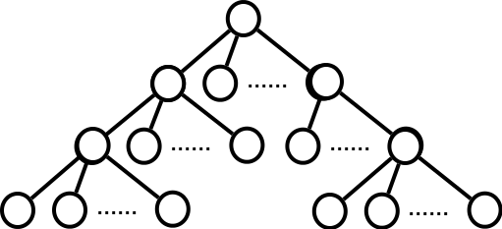
Background
3. Scale-Free Network:
Degree distribution:
Small Diameter:
Expansion factor:
Consider a BFS tree from a random vertex
D: the expected height
R: the expected # of branches
D
R

Slide 30
Background
3. Scale-Free Network:
Degree distribution:
Small Diameter:
Expansion factor:
Degree deg(v), rank r(v):
Example: |V|=1M,
D ≈ 4.6,
R ≈ 20,
Degree of highest-degree vertex ≈ 63K

Slide 31
Examples
Assumption 1:
a few high-degrees vertices(e.g. v0 in the example) can hit most long-length shortest paths (e.g. all paths of length at least 4)
Example: |V|=1M,
v0 : the highest-degree vertex
v0 is expected to reach all vertices in 2 hops,
v0 is expected to hit all shortest paths ≥ 4 hops.
v0

Slide 32
Examples
Assumption 2:
The number of short-length shortest paths (e.g. paths of length < 4 hops in the example) not hit by high-degrees vertices is small (e.g. 0.8%)
Example: |V|=1M,
v0 : the highest-degree vertex
v : a random vertex
without v0,
v can only reach less than 0.8% vertices in < 4 hops.
Shortest paths of length < 4 hops not via v0 is only 0.8%.

Slide 33
Examples
Assumption 3:
There exists a 2-hop cover with small size.
(1) long-length shortest path :
very likely hit by high-degree vertices (assumption 1)
(2) short-length shortest path around high-degree vertices:
hit by high-degree vertices
(3) short-length shortest path outside high-degree vertices:
very few (assumption 2)

Slide 34
Our Method
Hop-doubling label generation:
2.2 Iterative Labeling Algorithm
Generate labels by 6 rules iteratively
correctness:
w : the highest ranked vertex in a shortest path (u→v)
(u→w) and (w→v) must be generated
e.g. in shortest path (5→6) = (5→3→1→0→6),
(5→0) and (0→6) are indexed

Slide 35
Our Method
Hop-doubling label generation:
2.2 Iterative Labeling Algorithm
Generate labels by 6 rules iteratively
e.g. in shortest path (5→6) = (5→3→1→0→6),
Initialization : all edges, including (5→3) and (0→6)
After the 1st iteration: (5→1)
After the 2nd iteration: (5→0)
so (5→0) and (0→6) are generated

Slide 36
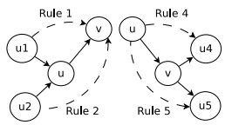
Our Method
Hop-Doubling Label Generation:
2.2 Iterative Labeling Algorithm
Simplify the 6 rules to 4 rules
(1)more efficient label generation
(2)still answer a distance query via the 2-hop index generated based on 4 rules

Slide 37
Our Method
Hop-doubling label generation:
2.2 Iterative Labeling Algorithm
Generate labels by 6 rules iteratively
In the i-th iteration,
(u→v) : generated in the (i-1)-th iteration
(u1→u), (u2→u), (v→u3): generated before the i-th iteration
Doubling effect:
The label length can be doubled in every 2 iterations in the worst case.
A length D path can be generated in iterations,
i.e.
(1) Start from length 1 labels, i.e. graph edges.
(2) Double label lengths every 2 iterations in the worst case.
(3) IO-efficient

Slide 38
Our Method
Hop-doubling label generation:
2.2 Iterative Labeling Algorithm
Rank vertices by degree
Generate labels by 6 rules iteratively
rationale:
In most cases, the highest-degree vertex in one of the shortest path from a vertex to another vertex is a globally high-degree vertex(assumption 1,2,3)

Slide 39
Our Method
Hop-doubling label generation:
2.2 Iterative Labeling Algorithm
Rank vertices by degree
Generate labels by 6 rules iteratively
rationale:

Slide 40
Our Method
Triangle inequality pruning
Example:
consider (2→1) generated by (2→3) and (3→1), note that (2→1) cannot be generated by (2→0) and (0→1),
length(2→1) = length(2→3→1) = length(2→0→1) = 2,
Using (2→1), one shortest path (7→1) is
(7→2)+(2→1) = (7→2→3→1).
Not using (2→1), one shortest path (7→1) is
(7→0)+(0→1) = (7→2→0→1),
i.e. (2→1)=(2→3→1) can be replaced by (2→0) and (0→1)

Slide 41
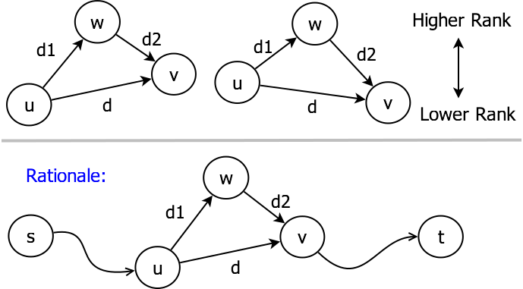
Our Method
Triangle inequality pruning
3.1 Iterative pruning after label generation
(u→v, d) is pruned by (u→w, d1) and (w→v, d2)
if r(w)>r(u), r(w)>r(v) and d≥d1+d2
any length(s→u→v→t) ≥ length(s→u→w→v→t)

Slide 42
Our Method
Triangle-Inequality Based Pruning
IO-efficient Techniques
Details are skipped

Slide 43
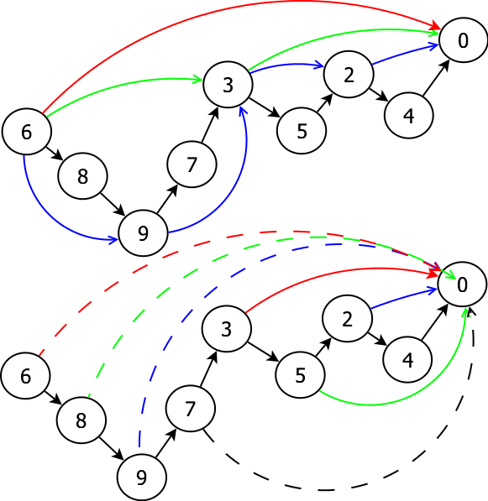
Our Method
Hop-Stepping Enhancement
3.1 Hop-Doubling VS Hop-Stepping
Example:
Generating (6→0) of length 8:
3 iterations VS 7 iterations
New label entries generated:
multiple VS one (in 1 iteration)
Black: initialization
Blue: 1st iteration
Green: 2nd iteration
Red: 3rd iteration
Dotted Black: 4th iteration
Dotted Blue: 5th iteration
Dotted Green: 6th iteration
Dotted Red: 7th iteration

Slide 44
Our Method
Hop-Stepping enhancement
4.1 Hop-length i+1 from i and 1
Hop-doubling:
hop-length i : (u→v), (u1→u), (u2→u), (v→u4), (v→u5)
Hop-stepping:
hop-length i : (u→v)
hop-length 1 : (u1→u), (u2→u), (v→u4), (v→u5)
Correctness still holds
more iterations

Slide 45
Our Method
IO-efficient implementation
5.1 IO-efficient label generation
Take rule 1 & 2 as an example:
Block nested loop by rule 1 & 2 simultaneously:
Load the labels in the following order for IO-efficient
(1). Outer loop (u→*) and (*→u):
(u→v), (u→v’), (u→v’’), ... (u1→u), (u1’→u), (u1’’→u), ...
(2). Inner loop (u2→*):
(u2→u), (u2→u’), (u2→u’’), ...

Slide 46
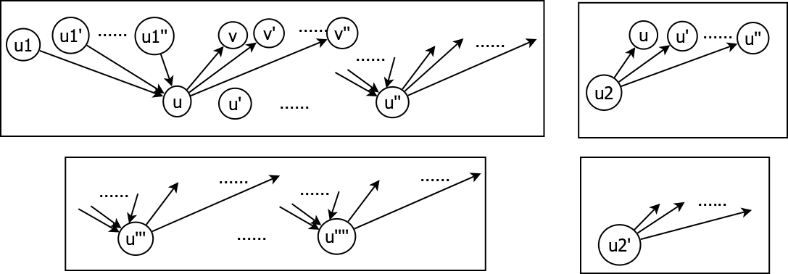
Our Method
IO-efficient implementation
5.1 IO-efficient label generation
Block nested loop:
Current outer block
Current inner block
Next outer block
Next inner block

Slide 47
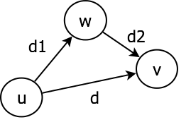
Our Method
IO-efficient implementation
5.2 IO-efficient pruning
Take when r(w)>r(v)>r(u) as an example
Block nested loop:
Load the labels in the following order for IO-efficient
(1). Outer loop (u→*):
(u→w), (u→w’), (u→w’’), … (u→v), (u→v’), (u→v’’), …
(2). Inner loop (*→v):
(w→v), (w’→v), (w’’→v), …

